Slide 1
Vaccination against monkeypox using the MVA-BN vaccine
Training for healthcare practitioners
20 October 2022
Notes:
The content of these slides was correct at the time of publishing. Practitioners should always ensure they are accessing the most up to date information and guidance.
This resource is designed to train healthcare practitioners involved in delivering vaccination against monkeypox. Trainers should select the slides they need depending on audience background, role in the programme, length of training session and so on.
This resource does not cover vaccine administration technique. If staff require practical training for this, they should refer to their line manager for additional training.

Slide 2
Suggested pre-requisites prior to vaccine administration
Before administering MVA-BN vaccine, it is recommended that vaccinators should:​
ensure they follow local educational and clinical governance arrangements in relation to knowledge and proficiency to undertake vaccination
discuss their learning needs (including clinical skills and mandatory training) with their employer
undertake statutory and mandatory training as required by their employer for example infection prevention and control, child protection, safeguarding​, management of anaphylaxis and Basic Life Support and any additional training relevant to the age of people being vaccinated
Suggested pre-requisites include:
core immunisation training
practical training in vaccine preparation and administration​ by the recommended routes
completion and sign off of a vaccinator competency assessment (for example Immunisation Knowledge and Skills Competence Assessment Tool)
ensuring an appropriate legal framework to supply and administer the vaccine is in place for example patient specific prescription, Patient Specific Direction (PSD), Patient Group Direction (PGD)
access to relevant guidance for example Green Book Smallpox and monkeypox chapter, UKHSA monkeypox guidance

Slide 3
Aim and learning outcomes
Aim:
  To help equip vaccinators with the knowledge they require to safely and effectively administer the MVA-BN vaccine
Learning outcomes:
By the end of this session, vaccinators should be able to:​
describe the aetiology and current epidemiology of monkeypox
explain the recommendations for the use of the MVA-BN vaccine ​and know where to access current guidance
recognise the legal aspects of vaccine administration
describe the storage, handling and safe administration of the MVA-BN vaccine

Slide 4
Key messages
a large number of cases of monkeypox have been reported across the UK and several other countries across the world
in July 2022, the WHO determined that the multi-country outbreak of monkeypox constituted a Public Health Emergency of International Concern
monkeypox is a rare disease caused by infection with monkeypox virus, a DNA virus of the orthopoxvirus genus
since the eradication of smallpox in 1980 and subsequent cessation of smallpox vaccination, it has emerged as the most important orthopoxvirus
community transmission has been occurring, with a high proportion of cases currently (though not exclusively) affecting gay, bisexual and men who have sex with men (GBMSM)
thus far, the majority of cases in the UK have been in men age 20 to 50 and illness appears to be generally mild and not life-threatening

Slide 5
Key messages (continued)
as monkeypox virus is closely related to the virus that causes smallpox, vaccines designed for smallpox are being used to protect people from getting monkeypox
the MVA-BN vaccine is approved by the MHRA and EMA (brand name: Imvanex) and the FDA in the USA (where it is named Jynneos) for the prevention of smallpox and monkeypox in adults
a single dose of MVA-BN vaccine is being advised following a confirmed or suspected exposure to monkeypox
although vaccination is thought to provide the greatest protection when given as soon as possible following contact, the vaccine may still be offered up to 14 days after the date of exposure
JCVI have recommended that vaccination should be offered to GBMSM at highest risk
MVA-BN vaccine does not contain smallpox virus and cannot cause or spread smallpox
ordinarily MVA-BN is administered subcutaneously or off-label intramuscularly; fractional dosing via the intradermal administration route is permitted only during periods of vaccine supply constraints

Slide 6
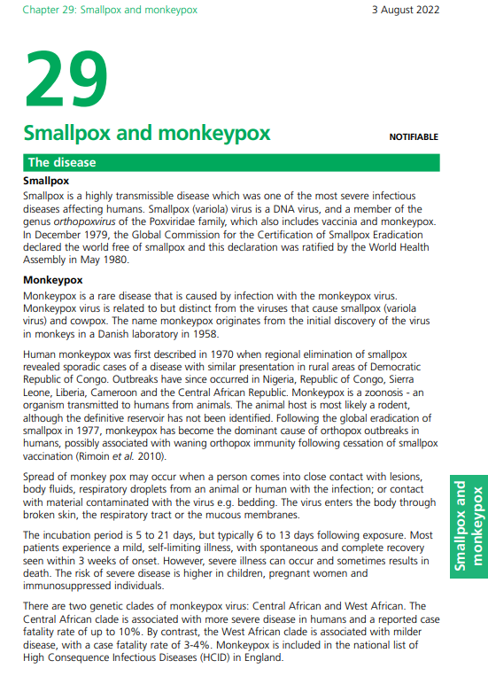
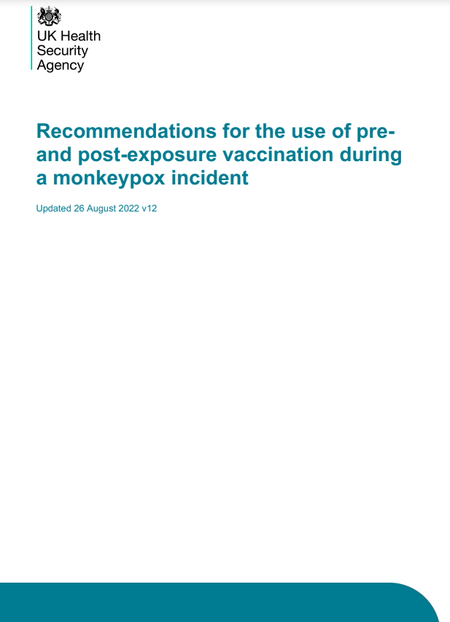
Key reading
It is strongly recommended that healthcare practitioners involved in delivering the MVA-BN vaccine read the latest versions of:
Immunisation against infectious disease Chapter 29 Smallpox and monkeypox
Recommendations for the use of pre and post exposure vaccination during a monkeypox incident
on GOV.UK

Slide 7
Monkeypox
monkeypox is a rare disease caused by infection with the monkeypox virus
monkeypox virus is related to, but distinct from, the viruses that cause smallpox (variola virus) and cowpox
the name monkeypox originates from the initial discovery of the virus in monkeys in a Danish laboratory in 1958
human monkeypox was first described in 1970 when regional elimination of smallpox revealed sporadic cases of a disease with similar presentation in rural areas of the Democratic Republic of Congo
outbreaks have since occurred in Nigeria, Republic of Congo, Sierra Leone, Liberia, Cameroon and the Central African Republic
monkeypox is a zoonosis – an organism transmitted to humans from animals
the animal host is most likely a rodent, although the definitive reservoir has not been identified
following the global eradication of smallpox in 1977, monkeypox has become the dominant cause of orthopox outbreaks in humans, possibly associated with waning orthopox immunity following cessation of smallpox vaccination

Slide 8
Symptoms of monkeypox
the symptoms of monkeypox are usually mild and self-limiting for most people, particularly for infections with the West African strain
however, severe illness can occur and symptoms can progress to multi-organ involvement, with bronchopneumonia, encephalitis and sepsis
the risk of severe disease is higher in children, pregnant women and immunosuppressed individuals
the illness begins with:
    fever
    headache
    muscle aches
    backache
within 1 to 5 days after the appearance of fever, a rash develops, often beginning on the face, then spreading to other parts of the body
    swollen lymph nodes
    chills
    exhaustion

Slide 9
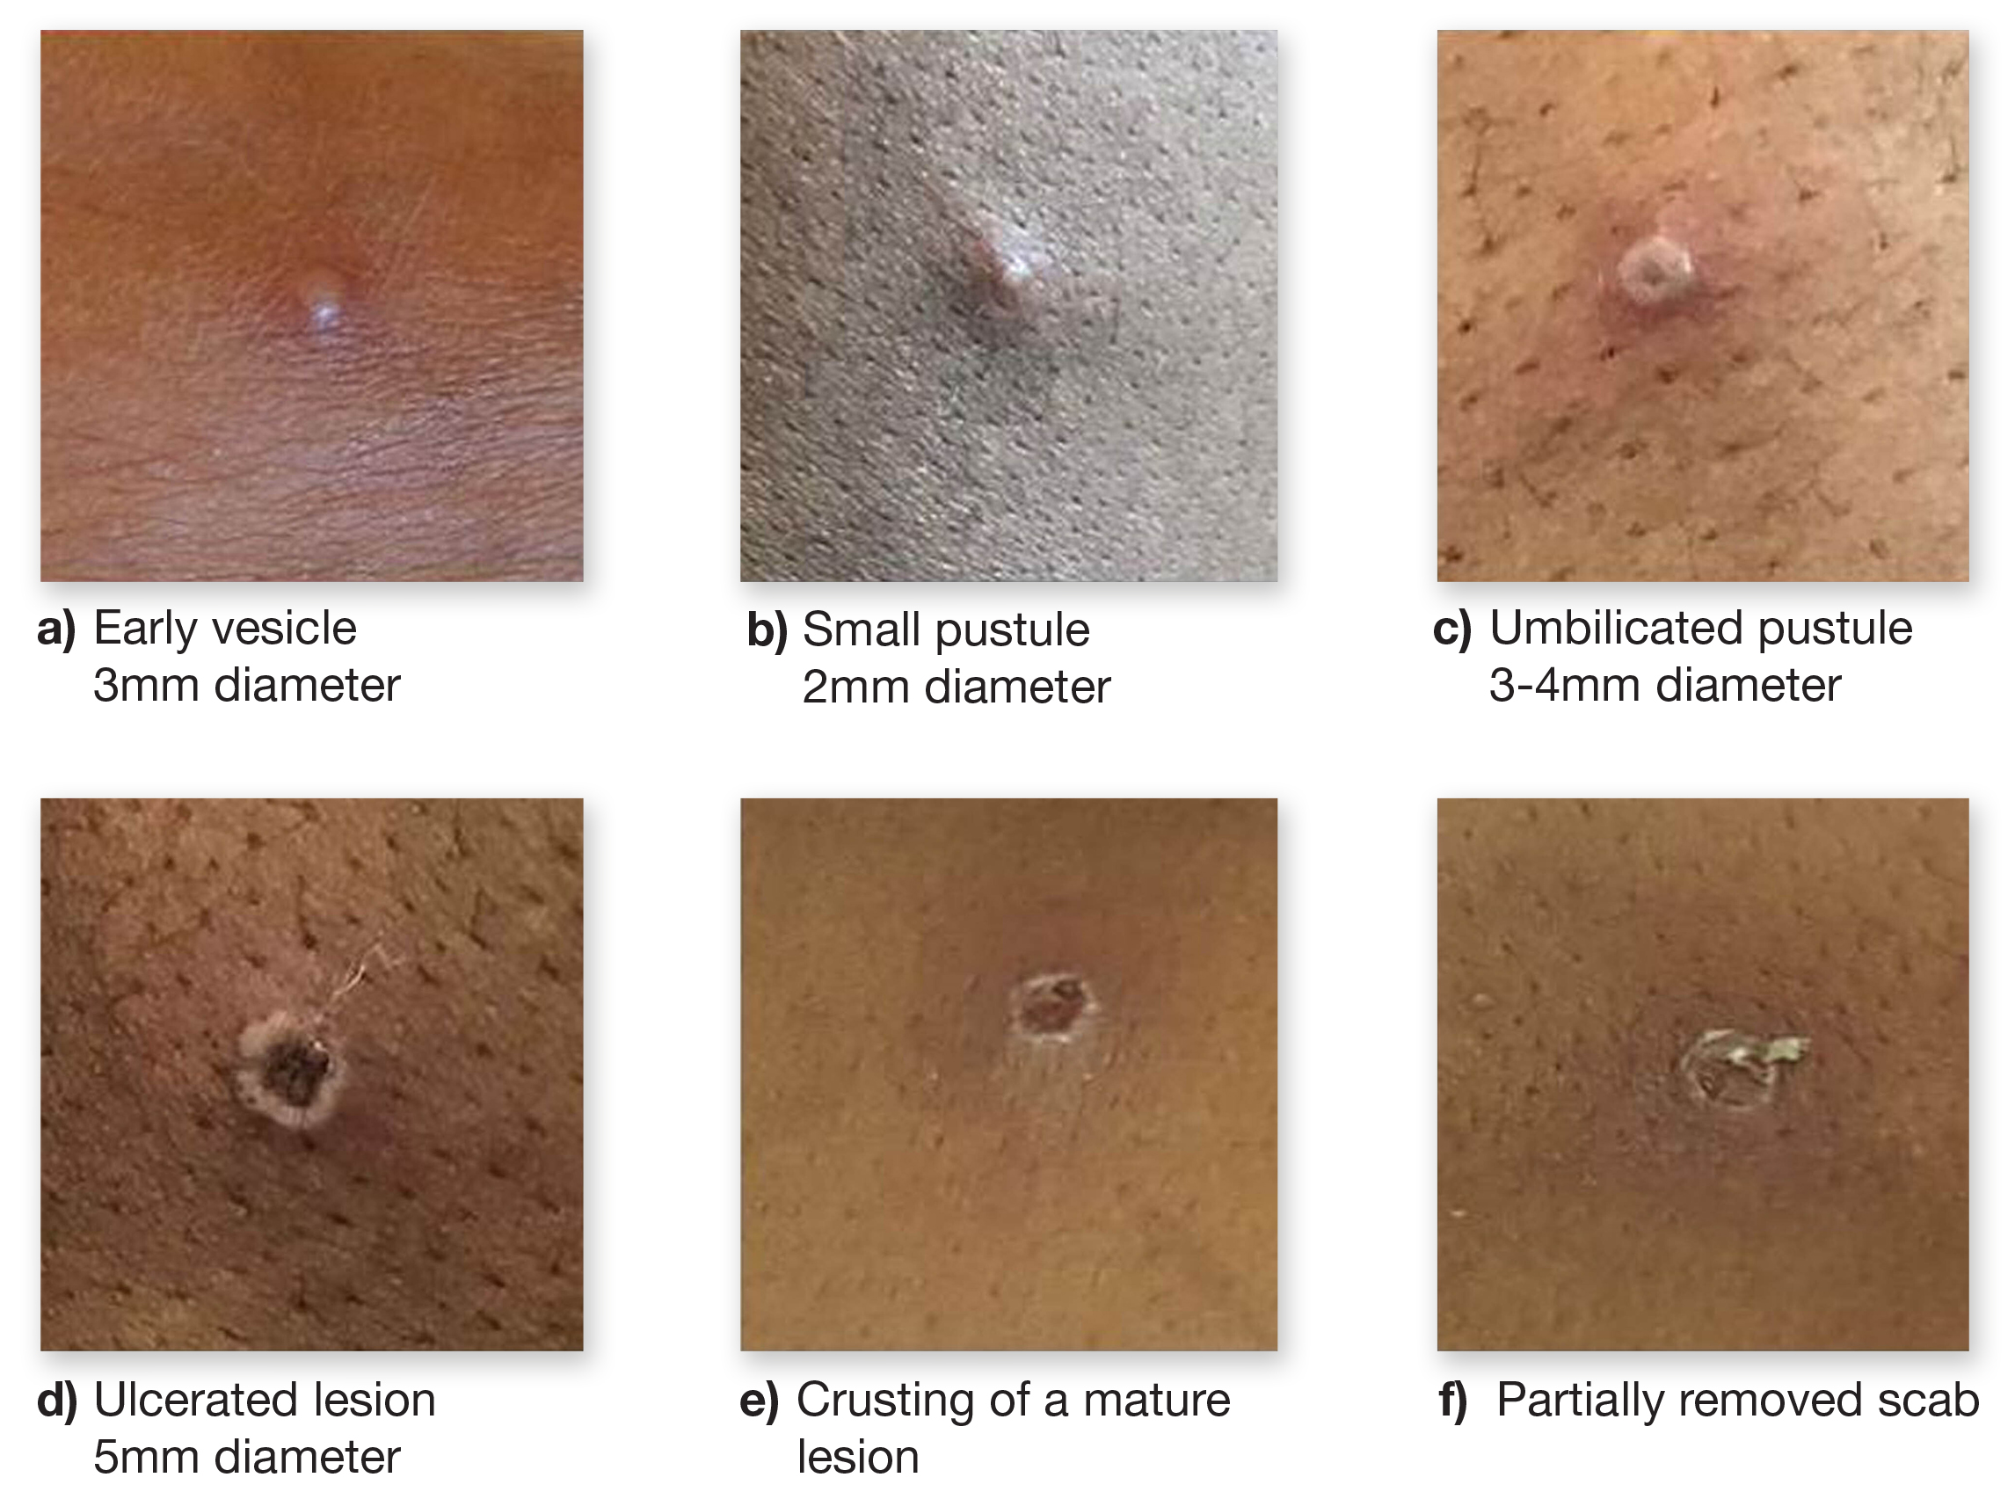
Monkeypox rash
the lesions go through several different stages
unlike chickenpox, the lesions are usually all at the same phase of development
they heal by crusting over and scabbing
the skin lesions resolve within 2 to 4 weeks
an individual is contagious until all the scabs have fallen off and there is intact skin underneath
the scabs may also contain infectious virus material

Slide 10
Transmission
monkeypox does not spread easily between people
spread of monkeypox may occur when a person comes into close contact with
  lesions, body fluids or respiratory droplets from an animal or infected human
  or materials contaminated with the virus, for example bedding
the virus enters the body through broken skin (even if breaks are not visible), the respiratory tract, or the mucous membranes (eyes, nose, or mouth)
person-to-person spread is very uncommon, but may occur through:
  contact with clothing or linens (such as bedding or towels) used by an infected person
  direct contact with monkeypox skin lesions or scabs
  close exposure to the coughs or sneezes of an individual with a monkeypox rash
the incubation period for monkeypox is between 5 and 21 days (typically 6 to 13 days) following exposure

Slide 11
Monkeypox in the UK
in 2018 there were 3 cases of monkeypox in the UK. 2 occurred in people who had recently travelled from Nigeria. The third case was in a healthcare worker involved in the care of 1 of the cases and was infected following contact with contaminated bed linen
in 2019 1 case of monkeypox occurred in the UK following travel to Nigeria
in 2021 3 monkeypox cases were reported from within the same family; the index case had recent travel history to Nigeria
on 7 May 2022, a case of monkeypox was reported in a person who had recently travelled to Nigeria
on 14 May, 2 further cases, with no known links to the case announced on 7 May, were reported in individuals from the same household
on 16 May, 4 additional monkeypox cases were reported in England. These cases had no known connections with the cases reported on 7 and 14 May
by 26 June, 1076 cases of monkeypox had been laboratory confirmed in the UK

Slide 12
Monkeypox in the UK (continued)
As of 18 October 2022:
3,537 laboratory-confirmed cases of monkeypox in the UK (3,363 in England)
median age of cases in the UK was 36 years old
a high proportion of cases known to be London residents (69% overall)
98.6% cases in UK were in men
monkeypox continues to be transmitted through close or sexual contact, primarily in interconnected sexual networks of gay, bisexual, or other men who have sex with men (GBMSM)
no reported deaths in the UK but there is significant morbidity in the majority of people who are admitted to hospital for clinical care reasons, including severe pain and complications due to secondary bacterial infection
Notes:
Monkeypox outbreak: epidemiological overview - GOV.UK (www.gov.uk)
Monkeypox outbreak: technical briefings - GOV.UK (www.gov.uk)

Slide 13
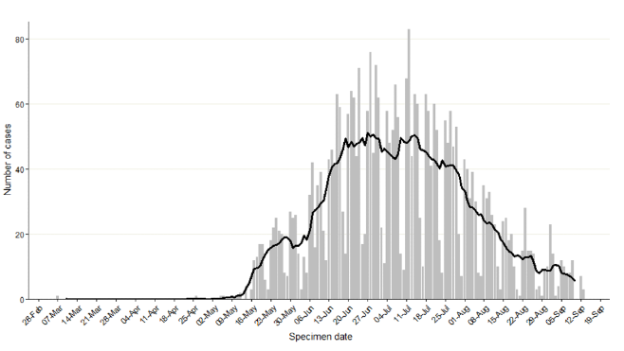
Monkeypox in the UK (continued)
the graph shows the specimen dates of monkeypox cases over time in England
there is a clear peak in mid-July, with more than 60 cases per day, followed by a decline to less than 15 cases per day during the beginning of September
it is likely that multiple factors, including vaccination and behavioural modification, are contributing to the decline in transmission
Confirmed and highly probable monkeypox cases by specimen date* in England as of 16 September 2022

Slide 14
Diagnosis and treatment
clinical diagnosis of monkeypox can be difficult as it is often confused with other infections such as chickenpox
a definite diagnosis of monkeypox requires assessment by a health professional and specific testing in a specialist laboratory
in the UK, the Rare and Imported Pathogens Laboratory (RIPL) at UKHSA Porton Down is the designated diagnostic laboratory
suspected cases should be discussed with the Imported Fever Service prior to submitting samples for laboratory testing
treatment for monkeypox is mainly supportive, the illness is usually mild and most of those infected will recover within a few weeks without treatment
smallpox vaccine, cidofovir, and tecovirimat can be used to control outbreaks of monkeypox
people vaccinated against smallpox in childhood may experience a milder disease

Slide 15
Smallpox vaccines
historically, first and second generation live smallpox vaccines have been used for population-level and targeted occupational health-related immunisation programmes in the UK
these vaccines are reactogenic and associated with risks of other serious adverse events and are no longer available in the UK
the newer third generation smallpox vaccines have a much-improved side effect profile compared with first and second generation smallpox vaccines
the modified vaccinia Ankara (MVA-BN) vaccine, a third generation smallpox vaccine was licensed in Europe (as Imvanex) for the prevention of smallpox in 2013
in September 2019, the US Food and Drug Administration (FDA) approved the MVA-BN vaccine (known in US as Jynneos) for the prevention of monkeypox as well as smallpox; in September 2022, MVA-BN was approved by the Medicines and Healthcare products Regulatory Agency (MHRA) for immunisation against monkeypox
MVA-BN vaccine has been used in the UK in response to previous monkeypox incidents

Slide 16
MVA-BN
MVA-BN is a third generation live modified vaccinia Ankara (MVA) vaccine, manufactured by Bavarian Nordic (BN)
the virus used in the vaccine is attenuated (weakened) through multiple passages in chicken embryo fibroblast cells
this leads to a substantial loss of its genome (genetic information) and many of the known immune evasion and virulence factors are not encoded
in human and animal studies, it demonstrates very limited replication capability and low neuropathogenicity, while retaining immunogenic properties, including protective immune responses against a variety of orthopoxviruses
as MVA-BN cannot replicate in mammalian cells, it does not produce a lesion at the site of vaccination
the vaccine virus has been modified so that it does not replicate in humans and it should be considered as an inactivated vaccine

Slide 17
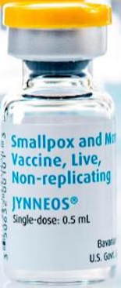
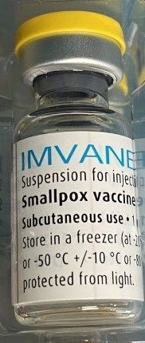
MVA-BN vaccine
the MVA-BN vaccine is called Imvanex (in Europe), Jynneos (in USA) and Imvamune (in Canada)
these are all the same MVA vaccine manufactured by Bavarian Nordic; only the brand names and licensing status varies
in the UK during the current Monkeypox outbreak, both Imvanex and Jynneos are being supplied for use depending on availability

Slide 18
Efficacy of MVA-BN vaccine
whilst the aim of MVA-BN efficacy studies have been to look at protective efficacy against smallpox, many of the licensing studies have been conducted using challenge with monkeypox virus
animal studies using MVA-BN vaccine have shown:
  high efficacy against monkeypox, from 6 days after a single dose of vaccine
  similar levels of neutralising antibody to first and second generation smallpox vaccines
human trials of MVA-BN suggested 2 doses of vaccine are immunogenic, generating antibody levels considered protective against smallpox, and by extrapolation, monkeypox as well
there is very limited evidence on whether the vaccine can prevent or modify disease when given post-exposure
although the full course comprises 2 doses, some immunological response to the first dose can be detected within the first 2 weeks
  rapid vaccination may therefore prevent infection and/or modify disease severity for cases with longer incubation period

Slide 19
Efficacy when administered intradermally
A clinical study of immunocompetent individuals showed that a lower dose (0.1ml) of MVA-BN administered intradermally was immunologically non-inferior to the standard (0.5ml) dose given by subcutaneous administration.
Intradermal vaccination of a fractional dose is recommended for some eligible individuals during periods of vaccine supply constraints (as advised by UKHSA).
Notes:
Frey SE, Wald A, Edupuganti S, et al. Comparison of lyophilized versus liquid modified vaccinia Ankara (MVA) formulations and subcutaneous versus intradermal routes of administration in healthy vaccinia-naïve subjects. Vaccine 2015;33:5225-5234.
Brooks JT, Marks P et al. Intradermal Vaccination for Monkeypox — Benefits for Individual and Public Health. The New England Journal of Medicine 2022; DOI: 10.1056/NEJMp2211311, www.nejm.org/doi/full/10.1056/NEJMp2211311

Slide 20
Experience of use of MVA-BN vaccine in previous incidents in the UK
In 2018 and 2019, several cases of imported monkey pox were reported in the UK and MVA-BN vaccine was offered as part of the incident response, including to children:
in 2018, 3 cases of monkey pox were diagnosed in the UK, and MVA-BN vaccine was offered as post exposure vaccination to 17 community contacts (5 people chose to be vaccinated). No onward transmission was identified from the first case
a total of 147 individuals at occupational risk (including healthcare workers and decontamination staff) were offered MVA-BN. One hundred and twenty-six chose to be vaccinated. One case was identified in a healthcare worker who had received post exposure vaccine 6 to 7 days after initial exposure
in 2019, following another imported case, 17 of 18 contacts accepted post exposure vaccination. In these incidents, young children, including infants, received post exposure vaccine with no known adverse events

Slide 21
Pre-exposure vaccine recommendations for MVA-BN vaccine (Occupational)
Pre-exposure vaccination is recommended for workers at high risk of exposure to monkeypox or other orthopox viruses
Those eligible for occupational vaccination following risk assessment include:
staff expected to provide care to monkeypox cases in high-consequence infectious disease (HCID) units
designated staff in additional hospital units being stood up to provide close/prolonged care for monkeypox patients
staff in sexual health clinics identified to assess suspected cases
workers in specialist laboratories where pox viruses (such as monkeypox or genetically modified vaccinia) are handled, and others who work in specialist and reference laboratories with an identifiable risk of exposure as per Advisory Committee on Dangerous Pathogens (ACDP) guidance
staff regularly undertaking environmental decontamination around cases of monkeypox
Notes:
Other healthcare staff should be able to avoid inadvertent exposure by ensuring suspected monkeypox cases are assessed by designated staff, or by wearing appropriate personal protective equipment.

Slide 22
Pre-exposure vaccine recommendations for MVA-BN vaccine (GBMSM)
Pre-exposure vaccination is recommended for GBMSM at highest risk of exposure identified via sexual health services using markers of high-risk behaviour similar to those used to assess eligibility for HIV pre-exposure prophylaxis (PrEP), but applied regardless of HIV status.
These risk criteria would include:
a recent history of multiple partners
participating in group sex
attending sex-on-premises venues
a proxy marker such as a bacterial sexually transmitted infection (STI) within the last year

Slide 23
Pre-exposure vaccine recommendations for MVA-BN vaccine (GBMSM and contacts)
UKHSA have advised that others who have frequent close and intimate contact with the high risk GBMSM community may be vaccinated irrespective of their identified gender.
This would include staff who work in sex on premises venues, such as saunas, if they are regularly exposed to items (e.g. linens) or surfaces likely to be contaminated with body fluids or skin cells.
This offer could be combined with supplementary approaches to provide outreach vaccination to high risk GBMSM who may not be in contact with sexual health services.

Slide 24
Pre-exposure vaccine recommendations
the licensed pre-exposure primary course of MVA-BN comprises 2 doses, given at least 28 days apart
for individuals with a history of receiving a single dose of a live smallpox vaccine, a single dose of MVA-BN is recommended
live vaccine was only used up to the 1970s, so apart from the healthcare workers vaccinated in 2003/4, vaccinated individuals will be older, and should have a distinctive scar (which normally looks like a circular 5p size dent in the left upper arm)

Slide 25
Completing the pre-exposure primary vaccine course
(occupational)
completion of the primary course with a second dose at least 28 days later should be considered on assessment of ongoing risk of exposure
if there is a foreseeable risk of subsequent occupational exposure to monkeypox, HCWs, lab workers, and individuals undertaking environmental decontamination who have received 1 dose of MVA-BN either as pre or post-exposure prophylaxis, should be offered a second dose at least 28 days after the first to complete the manufacturer-recommended schedule
staff at occupational risk who have received a single dose of MVA-BN or a different smallpox vaccine at any time in the past, require only 1 further dose of MVA-BN to complete the recommended schedule, with a minimum interval of 28 days between doses. There is no requirement to restart the 2-dose schedule
in the event of an incident, it is highly unlikely there will be sufficient time to offer 2 doses for those at risk of occupational exposure; in this scenario a single dose of vaccine should be offered immediately

Slide 26
Completing the pre-exposure primary vaccine course (GBMSM)
in June 2022, the JCVI advised that the initial priority was to deliver first doses to as many GBMSM in the highest risk group as possible
in September 2022, based on the doses already delivered, the declining incidence and the current vaccine supply, JCVI agreed that the next priority is to offer a second dose to GBMSM at highest risk from around 2 to 3 months after their first dose
offering second doses to the high-risk eligible group to complete their primary course should provide them with longer lasting protection (direct protection), and indirectly protect others by preventing transmission of infection
this will aim to protect the community against subsequent introduction from countries where the virus is still circulating at higher levels

Slide 27
Post-exposure vaccine recommendations
individuals should be risk assessed according to the Recommendations for the use of pre and post exposure vaccination during a monkeypox incident and offered post-exposure vaccination with a single dose of MVA-BN
vaccination should be administered as soon as possible (ideally within 4 days) after an identified exposure to prevent or attenuate infection but can be administered up to 14 days post-exposure to reduce symptoms and to protect those at high risk of ongoing exposure
if exposure has been intermittent or continuous, post-exposure vaccination should be ideally given within 4 days of the last exposure
as the vaccine may only attenuate rather than prevent disease in some cases, contacts who have been vaccinated require equivalent follow up to those contacts who remain unvaccinated
immunocompetent individuals who have previously received a 2 dose course of MVA-BN, with the second dose given in the past 2 years, do not need a further dose of vaccine after exposure
immunosuppressed individuals who have previously received a 2 dose course of MVA-BN, with the second dose given in the past 2 years, may have made a lower or less durable immune response so an additional dose can be considered after exposure

Slide 28
Post exposure vaccine recommendations
Offer post-exposure to:
  high risk community or occupational contacts of any age of a case of monkeypox, ideally within 4 days of exposure to prevent onset of the disease
Vaccine may be offered up to 14 days to those at on-going risk (for example during an outbreak) or those who are at higher risk of more severe monkeypox infection (such as children under 5 years of age, pregnant women and individuals with immunosuppression)
Individuals should only be offered post-exposure vaccination in line with current recommendations (see Recommendations for the use of pre and post exposure vaccination during a monkeypox incident on UKHSA website and the Green Book Smallpox and monkeypox chapter)

Slide 29
Completing the primary vaccine course
(post-exposure)
Individuals who received a single dose of vaccine as a result of community exposure do not need to be offered a second dose as they do not have a foreseeable risk of further exposure to monkeypox and will be past the incubation period from the exposure that warranted post exposure vaccination.

Slide 30
MVA-BN: delayed vaccination and administration with, before or after other vaccines
if the MVA-BN course is interrupted or delayed, it should be resumed using the same vaccine but the first dose does not need to be repeated
although no data for co-administration of MVA-BN vaccine with other vaccines exists, it is thought that any interference between this vaccine and other vaccines (live and inactivated) is likely to be limited
based on experience with other vaccines, any potential interference is most likely to result in a slightly attenuated immune response to one of the vaccines
there is no evidence of any safety concerns from giving other vaccines at the same time as the MVA-BN vaccine, although it may make the attribution of any adverse events more difficult
where individuals in an eligible cohort present having recently received one or more inactivated or another live vaccine, MVA-BN vaccination should still be given
the same applies where MVA-BN vaccination has been received first or where a patient presents requiring 2 or more vaccines
it is generally better for vaccination with any required vaccines (including MVA-BN, hepatitis A, hepatitis B and HPV) to proceed to avoid any further delay in protection and to avoid the risk of the individual not returning for a later appointment

Slide 31
Fractional dosing
In August 2022, following the emergency use approval by the US Food and Drug Administration, JCVI endorsed the use of a fractional dose (0.1ml) of MVA-BN given by intradermal injection during periods of supply constraints
this provides a dose-sparing solution to the limited worldwide availability of MVA-BN, allowing the continued roll-out of the vaccination programme which has been implemented to bring the outbreak under control
Fractional doses (0.1ml) are withdrawn from a single-dose (0.5ml) vial and can only be given via the intradermal route:
a 0.1ml dose administered intradermally to those individuals for whom it is recommended appears to be equivalent to a 0.5ml dose given subcutaneously or intramuscularly

Slide 32
Antibody persistence and boosting
there is limited data to determine the appropriate timing of booster doses after a 2 dose primary course of MVA-BN for those at ongoing occupational risk of monkeypox
studies have demonstrated a rapid boosting response following a single booster in individuals who have completed a primary schedule, demonstrating ongoing memory and persistence of antibodies to 24 months
given this, it is likely that adequately primed individuals will make a good response to natural exposure that will protect or reduce the severity of any breakthrough infection
where boosting is considered necessary for those at on-going risk of exposure, a single dose of 0.5 ml should be administered, at least two years after the primary course
if a documented exposure occurs more than two years after the primary course, a single dose of 0.5 ml should be administered within 4 days

Slide 33
Contraindications
MVA-BN vaccine is contraindicated in those who have had a sudden life-threatening allergic reaction to a previous dose of, or to any components of the MVA-BN vaccine
if a confirmed anaphylactic reaction has been experienced after a previous dose of MVA-BN or any of its components, specialist advice should be sought
the vaccine contains trometamol, sodium chloride and water for injections
it may also contain trace amounts of chicken protein, benzonase, gentamicin and ciprofloxacin from the manufacturing process

Slide 34
Precautions
minor illnesses without fever or systemic upset are not valid reasons to postpone immunisation
if an individual is acutely unwell, immunisation may be postponed until they have fully recovered
this is to avoid confusing the differential diagnosis of any acute illness by wrongly attributing any signs or symptoms to the adverse effects of the vaccine
individuals who are unwell should be assessed to determine whether they are displaying symptoms of monkeypox
individuals with atopic dermatitis may need to be risk assessed prior to vaccination
individuals who are pregnant or breastfeeding should discuss the benefits and risks prior to vaccination

Slide 35
Current or previous monkeypox infection
if an individual is acutely unwell with symptoms or signs of possible monkeypox infection, immunisation should be postponed until they have fully recovered
this is to reduce the risks of exposing others and to avoid wrongly attributing any signs or symptoms to the adverse effects of the vaccine
whether prior monkeypox infection protects against future infection is currently unknown but based on analogy from smallpox infection and from live smallpox vaccine, it is thought that re-infection will be unusual, particularly in the short term
although previous monkeypox infection is not a contra-indication to vaccination, when there is limited vaccine supply, it is recommended that vaccination of confirmed cases is deferred
if supply allows, vaccination may be considered for those at on-going risk once fully recovered

Slide 36
Children
the MVA-BN vaccine is not licensed for and has been not been used widely in children
however, vaccines using MVA as a vector have been used in paediatric studies where they have been shown to be effective and have an acceptable safety record
the MVA-BN vaccine has been given safely to children, including infants, in the UK after previous cases
the vaccine should therefore be offered to children considered to be at risk as children, especially young children, appear to have a more severe presentation of monkeypox
administration of MVA-BN in children under 18 years should be through the subcutaneous or intramuscular route as there is no evidence on the use of intradermal fractional doses in children

Slide 37
Pregnancy
MVA-BN is not contraindicated in pregnancy
although it has not formally been evaluated in pregnancy, animal studies identified no vaccine related fetal malformations
use of MVA-BN in pregnant women is limited to fewer than 300 pregnancies but no adverse events on pregnancy were seen
as it is a non-replicating vaccine, there is no theoretical reason for concerns in pregnancy and the adverse events profile would be expected to be similar to that in non-pregnant vaccinees
whilst it is not routinely recommended for use in pregnancy, any theoretical concern needs to be weighed against the maternal risks from monkeypox in late pregnancy (such as risk of more severe disease from viral infections in third trimester) and any consequent fetal risks from maternal infection in early pregnancy

Slide 38
Breastfeeding
MVA-BN is not contraindicated if breast-feeding
it is not known whether MVA-BN is excreted in human milk, but this is unlikely as the vaccine virus does not replicate effectively in humans
women who are breast feeding and have a significant exposure to monkeypox should therefore be offered vaccination, after discussion about the risks of monkeypox to themselves and to the breast-fed child

Slide 39
Individuals with atopic dermatitis
individuals with atopic dermatitis are known to have developed more site-associated reactions and generalised symptoms following MVA-BN vaccination
a clinical trial found that local and general reactions were all reported more frequently in participants with atopic dermatitis than in healthy participants
in vaccinated clinical trial participants with atopic dermatitis, 7% experienced exacerbation of their condition during the course of the trials
individuals in this group therefore need to have an individual risk assessment before being offered vaccination to assess the risk from exposure, the risk of side effects from vaccination and the potential use of alternative preventive interventions
individuals with a history of developing keloid scarring may be offered a 0.5ml SC/IM dose of MVA-BN in preference to a fractional dose intradermally

Slide 40
Individuals with immunosuppression and HIV infection
as MVA-BN is a replication defective virus, it is considered safe in immunosuppressed individuals
however, the immune response to the vaccine could be reduced in severely immunosuppressed individuals
in clinical trials on the use of MVA-BN in immunocompromised individuals, no increase in adverse events in this group was seen
MVA-BN vaccine has been demonstrated to be safe in people with HIV infection
vaccination should proceed in accordance with recommendations as individuals with immunosuppression and HIV are at significant risk of the complications of monkeypox
however specialist advice on other measures may be required
additional doses should be considered for those at ongoing risk of exposure in this group
as there is no data on intradermal administration in this group, vaccination should be given via the SC or IM routes

Slide 41
Fractional dosing: operational considerations and intradermal administration: indications
Fractional dosing by intradermal administration may be considered for administration to eligible individuals aged 18 and above during periods of supply constraints
  appropriate operational considerations and planning are required to maximise safety and minimise vaccination errors and vaccine wastage; staff must have received specific, appropriate training to administer vaccine via this route
  there is stability data only to support use of the contents of the vial within one hour of removal from the fridge; the vial should be kept at room temperature; adhering to these time and temperature limits will also minimise the risk of microbial contamination/proliferation
  it is recommended that you remove the vial from cold storage, recording the time, and then maintain the vial at room temperature using it as quickly as possible and discarding anything that remains after one hour
  therefore, practically, in order to avoid cycling temperature and to adhere to these recommendations, fractional dosing is only useful in high throughput clinics

Slide 42
Fractional dosing and intradermal administration: indications
this option is only suitable for immunocompetent adults
intradermal administration is not recommended for:
  individuals who are less than 18 years of age; there is no evidence on the use of intradermal fractional doses in children
  individuals who are immunosuppressed (as defined in the Green Book chapter 7)
    note: individuals living with HIV who are virally suppressed and have a CD4 count of more than 200 cells/mm³ are not considered immunosuppressed for the purposes of this guidance
  individuals with a history of keloid scarring

Slide 43
Recommendations for pre- and post-exposure use of MVA-BN: summary
 | Individuals previously not vaccinated against smallpox | Individuals previously vaccinated against smallpox
Immunocompetent individuals (including people with atopic dermatitis) | 0.5 ml subcutaneous / intramuscular injection OR 0.1ml intradermal injection (during supply constraints) + 0.5 ml subcutaneous / intramuscular injection any time from 28 days OR 0.1ml intradermal injection at any time from 28 days | 0.5 ml subcutaneous / intramuscular injection OR 0.1ml intradermal injection (during supply constraints)
Children under 18 years, immunosuppressed adults¹ (as defined in Chapter 6 in the Green Book) and those with a history of keloid scarring | 0.5 ml subcutaneous / intramuscular injection + 0.5 ml subcutaneous / intramuscular injection at any time from 28 days | 0.5 ml subcutaneous / intramuscular injection
¹Individuals living with HIV who are virally suppressed and have a CD4 count above 200 cells/mm³ are not considered immunosuppressed for the purposes of this guidance

Slide 44
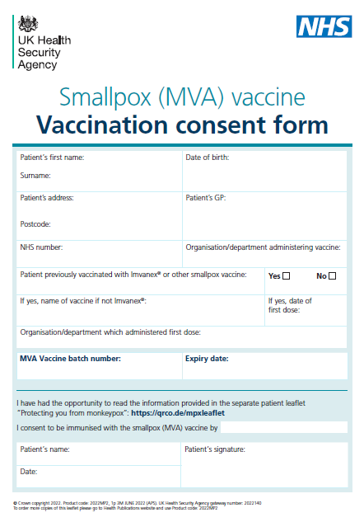
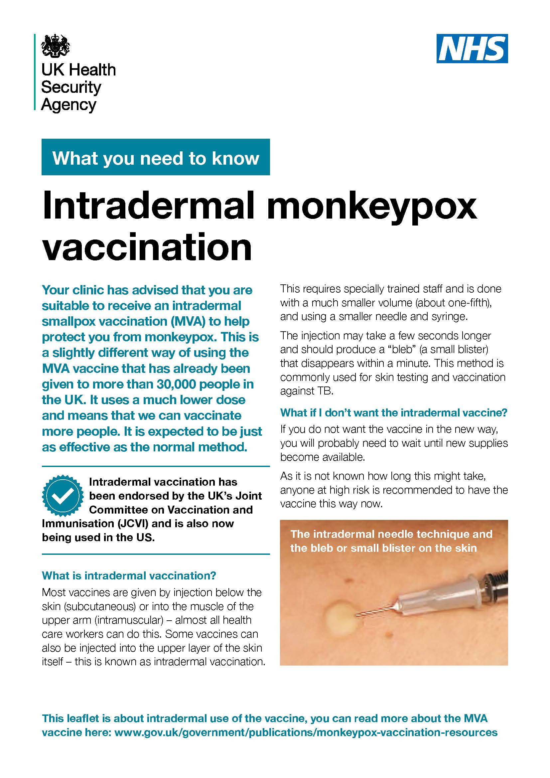
Consent
before giving any vaccine, vaccinators must ensure that they have obtained informed consent from the vaccinee
in order to be able to consent to vaccination, the vaccinee should receive an explanation of the treatment and its benefits and risks, either verbally from a clinician, or in the form of a leaflet or letter
vaccinators should be familiar with the principles of consent for immunisation as described in the Consent chapter in the Green Book
a consent form and healthcare professional pre-vaccination checklist are available on the GOV.UK website
the UKHSA intradermal leaflet should be provided to individuals being offered an intradermal dose
further information on prescriber responsibilities for off-label or unlicensed medicines

Slide 45
Infection control
pre-exposure vaccination should be managed in the same way as routine vaccination using standard infection prevention and control (IPC) precautions
advice to help lower the chance of passing monkeypox infection to others during post-exposure vaccination clinics is available online
this guidance provides advice on the risk assessment process and actions to be taken when individuals are travelling to and attending vaccination clinics
it should be read in conjunction with the national IPC manual

Slide 46
Legal framework for administration
use of MVA-BN for vaccination against Monkeypox may be via a prescription, Patient Specific Direction (PSD) or a Patient Group Direction (PGD) depending on the vaccine being supplied, and the route of administration
at present, there are no stocks of the UK licensed MVA-BN vaccine Imvanex available in the UK
the Medicines and Healthcare products Regulatory Agency (MHRA) have therefore granted batch-specific variation for batches FDP00012 and FDP00072 of the US licensed vaccine Jynneos, in view of the urgency of the need to manage the monkeypox outbreak
this means the MHRA have given approval for use of this US licensed vaccine in the UK and it can be administered under a PGD
UKHSA have produced a PGD specifically for the use of the US licensed Batches FDP00012 and FDP00072 of Jynneos vaccine but the PGD must only be used for these batches
if there are any programme changes, these may not be immediately reflected in the PGD; a prescription or PSD should be used in the interim

Slide 47
Storage and handling of MVA-BN vaccine
MVA-BN vaccine has complex storage requirements and the expiry date depends upon storage temperature
MVA-BN vaccine will be shipped from UKHSA storage sites at -20°C
it should be stored at -20°C upon receipt to keep the expiry date longer
if -20°C storage is not available, frozen vials should be immediately stored at 2°C to 8°C to thaw or may be thawed for approx 15 minutes at room temperature for immediate use
after thawing at +2°C to 8°C, MVA-BN vaccine can be stored at this temperature for up to 8 weeks; add a post-thaw expiry label – follow the NHS Specialist Pharmacy Service SOPs
do not re-freeze a vial once it has been thawed
store in original package in order to protect from light
do not use the vaccine after the expiry date shown on the vial label, or earlier if the post-thaw (8 weeks) expiry date is sooner
vials used to deliver multiple doses through fractional intradermal administration must be used within one hour of removal from fridge

Slide 48
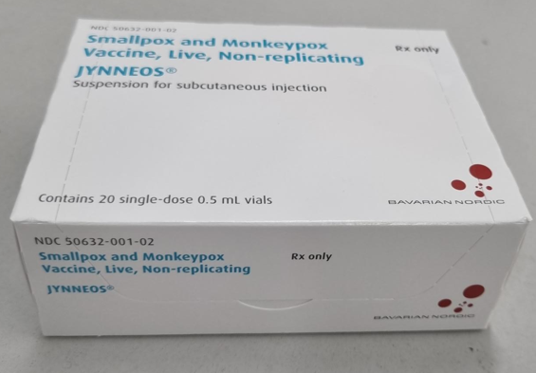
Storage and handling of MVA-BN vaccine
MVA-BN vaccine is supplied in packs containing 20 single dose vials (0.5ml in each)
once the frozen vaccine has been thawed, it is a light yellow to pale white milky suspension for injection
the vaccine should be allowed to reach room temperature before use
swirl vial gently before use for at least 30 seconds
visually inspect the suspension prior to administration
if particles and/or discolouration or abnormal appearance are seen, the vaccine should be discarded
for subcutaneous or intramuscular injection, withdraw a dose of 0.5ml into a sterile syringe
for intradermal injection, withdraw a dose of 0.1ml into a sterile syringe

Slide 49
Additional handling and storage requirements for vials used for fractional dosing
fractional dosing is the administration of smaller volumes of the vaccine taken from a single dose vial. Each single dose vial will yield a maximum of 5 x 0.1ml doses. These smaller doses should only be administered vial the intradermal route
  only complete 0.1ml doses should be administered; early feedback from a pilot has indicated that in some cases only 4 x 0.1ml doses can be extracted from each vial; using a low dead-space volume syringe increases the likelihood of obtaining 5 doses from each vial
  if the vial yields less than 5 full doses then any residual volume of less than 0.1ml should be discarded; pooling of residual volume from several vials is not permitted
vials of vaccine used for fractional dosing are subject to additional preparation and handling requirements
follow the guidance in the Green Book, chapter 4, Immunisation procedures on the use of multi-dose vials
once a vial of thawed vaccine is removed from the fridge, note the time, swirl the contents and withdraw the first 0.1ml dose
the contents of the vial can remain at room temperature for up to one hour whilst the 5 doses are used; each dose should be given immediately once drawn up
appropriate infection control and aseptic techniques should be used at all times; this is particularly important when using multi-dose vials and even more so when a single-dose vial is being used as a multi-dose vial; use a new sterile syringe and needle for each additional dose drawn from the vial
to minimise the risk of coring, as far as is practicable pierce the bung in a different place each time a dose is being drawn up; inspect the contents before every withdrawal and discard the vial if particulates are present (as this may indicate coring of the bung has taken place)
discard vaccine promptly after 1 hour has elapsed to avoid accidental administration of time-expired vaccine

Slide 50
Standard procedures
The following guidance applies irrespective of the route used for administration:
Preparation of the vaccination site:
  if the skin is clean, no further cleaning is necessary. Only visibly dirty skin needs to be cleaned. It is not necessary to disinfect the skin; see Immunisation procedures: the green book, chapter 4 personal protective equipment:
  routine use of gloves for immunisation is not recommended; follow national IPC guidance
Post-vaccination observation:
  no routine requirement for observation
  observe for any immediate reactions whilst vaccinated individual is receiving any verbal post vaccination information and exiting the clinic/ venue
  as fainting can occur following any vaccination, all those vaccinated with MVA-BN should be advised not to drive for 15 minutes after vaccination
  note: facilities the for management of anaphylaxis should be available at all vaccination sites (see Vaccine safety and adverse events following immunisation: the green book, chapter 8

Slide 51
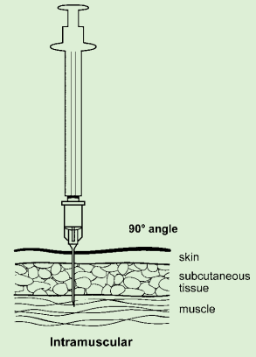
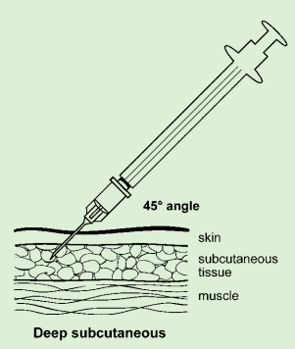
Administration of MVA-BN – intramuscular/subcutaneous
the MVA-BN Summary of Product Characteristics (SmPC) advises that the vaccine should be administered by the deep sub-cutaneous (SC) route
however, there is published evidence suggesting an adequate immunological response and extensive experience of using MVA-containing vaccines given by the intra-muscular (IM) route
from 3 August 2022, UKHSA advised that IM administration is an acceptable alternative so the vaccine can be given IM or SC
for adults, the preferred sites for both IM and SC immunisation is the deltoid area of the upper arm; for small children the anterolateral aspect of the thigh is preferred
IM injections should be given with the needle at a 90 degree angle to the skin and the skin should be stretched, not bunched
deep SC injections should be given with the needle at a 45 degree angle to the skin and the skin should be bunched, not stretched

Slide 52
Recommended sites for intradermal administration
A fractional dose intradermal injection for MVA-BN may be administered:
  over the area of the deltoid muscle (the same site recommended for BCG - see Green Book chapters 32 and 4)
    preferably avoid using the left deltoid if the individual is due to have a BCG vaccination, as this is the usual site for that injection (and note that, as per the Green Book chapter 32, if BCG has been given in the last 3 months a different limb should be used for any other vaccination, including MVA-BN
  or on the volar aspect (palm side) of the forearm around 2 to 4 inches (5 to 10cm) below the ante-cubital fossa (the same site as normally used for Mantoux testing)
Although the initial study in the USA was conducted using the forearm site (Frey and others, 2015), other vaccines (including influenza and rabies) have been tested with fractional intradermal dosing over the area of the deltoid muscle.

Slide 53
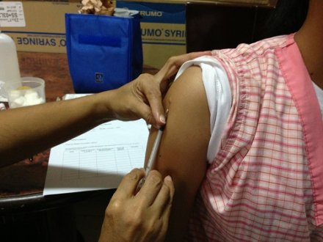
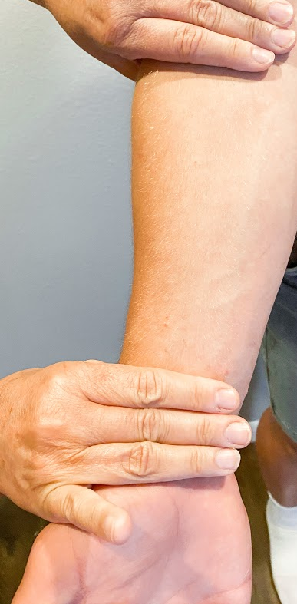
The deltoid and forearm sites for intradermal injection
Volar aspect (palm side) of the forearm, around 2 to 4 inches (5 to 10cm) below the ante-cubital fossa
Intradermal injection – deltoid area

Slide 54

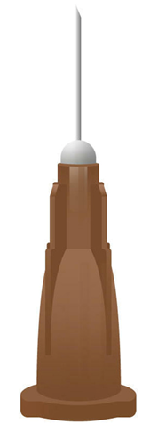
Needle choice for intradermal administration
It is recommended that the following are used to correctly administer the MVA-BN vaccine intradermally:
a 1ml graduated syringe
a 26G or 27G short bevelled needle (for example, a 0.45mm x 10mm brown needle)

Slide 55
Administration of MVA-BN – intradermal
the needle must be attached firmly and the intradermal injection administered with the bevel facing up
the immuniser should stretch the skin between the thumb and forefinger of one hand and with the other slowly insert the needle, with the bevel upwards, about 3mm into the superficial layers of the dermis almost parallel with the surface
  the needle can usually be seen through the epidermis
a correctly given intradermal injection results in a tense, blanched, raised bleb of around 7mm diameter following a 0.1ml intradermal injection
  if little resistance is felt when injecting and a diffuse swelling occurs as opposed to a tense blanched bleb, the needle is too deep
  if this occurs, the needle should be withdrawn and a full dose should be repeated immediately (no minimum interval); the repeated dose should be placed at least 2 inches (5cm) away from the incorrectly given dose

Slide 56
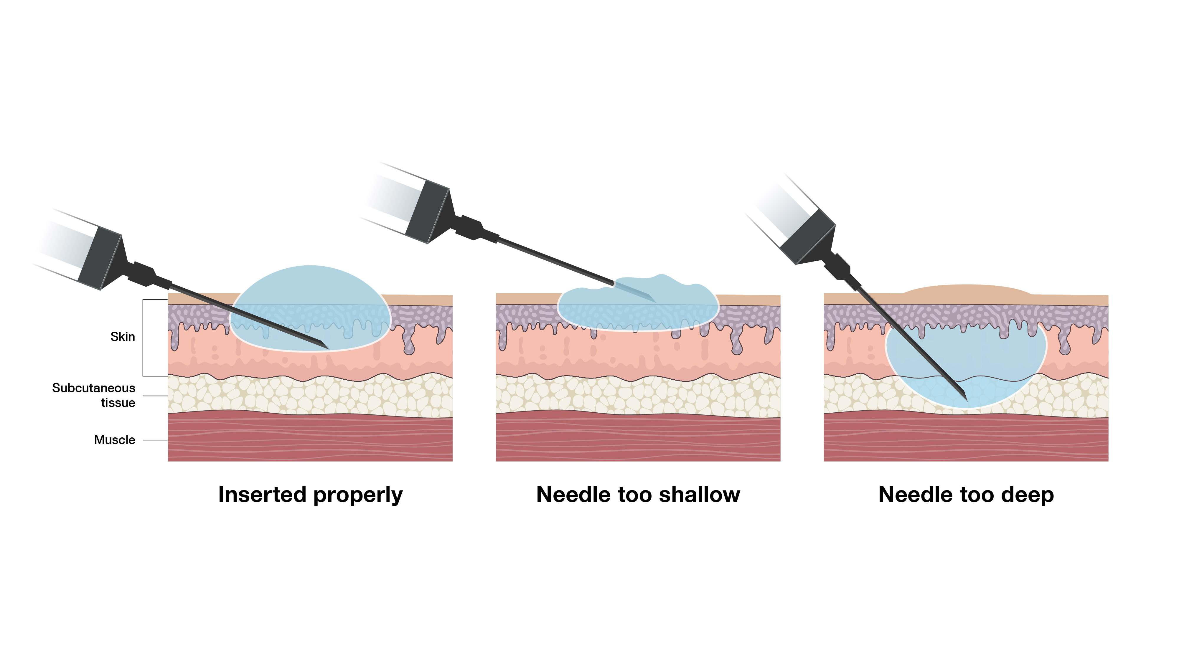
Guide to the correct intradermal technique
The skin is stretched between the thumb and forefinger of one hand, the needle is slowly inserted with the other hand, bevel upwards, about 3mm into the superficial layers of the dermis almost parallel with the surface; the needle can usually be seen through the epidermis
A correctly given intradermal injection results in a tense, blanched, raised bleb of around 7mm diameter following a 0.1ml intradermal injection.
If little resistance is felt when injecting and a diffuse swelling occurs as opposed to a tense blanched bleb, the needle is too deep.

Slide 57
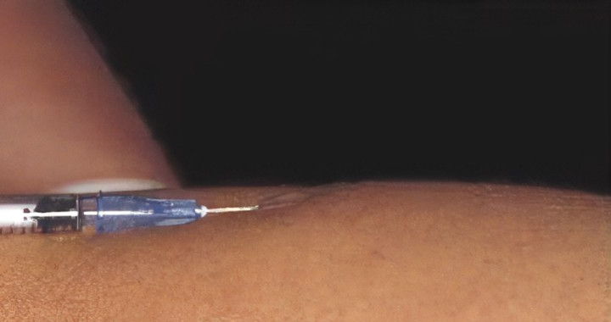
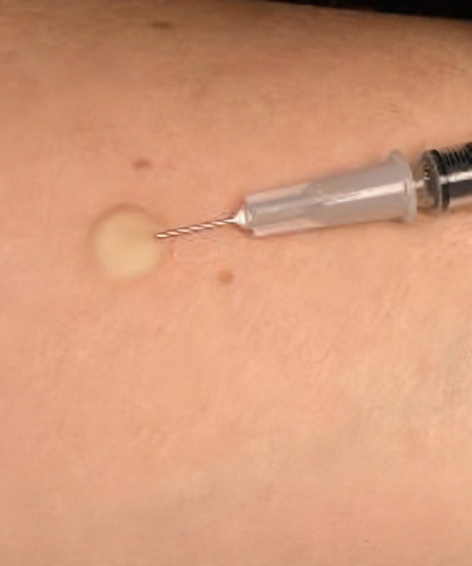
Correct intradermal technique continued
Photograph showing the correct angle of needle insertion
Photograph showing the bleb

Slide 58
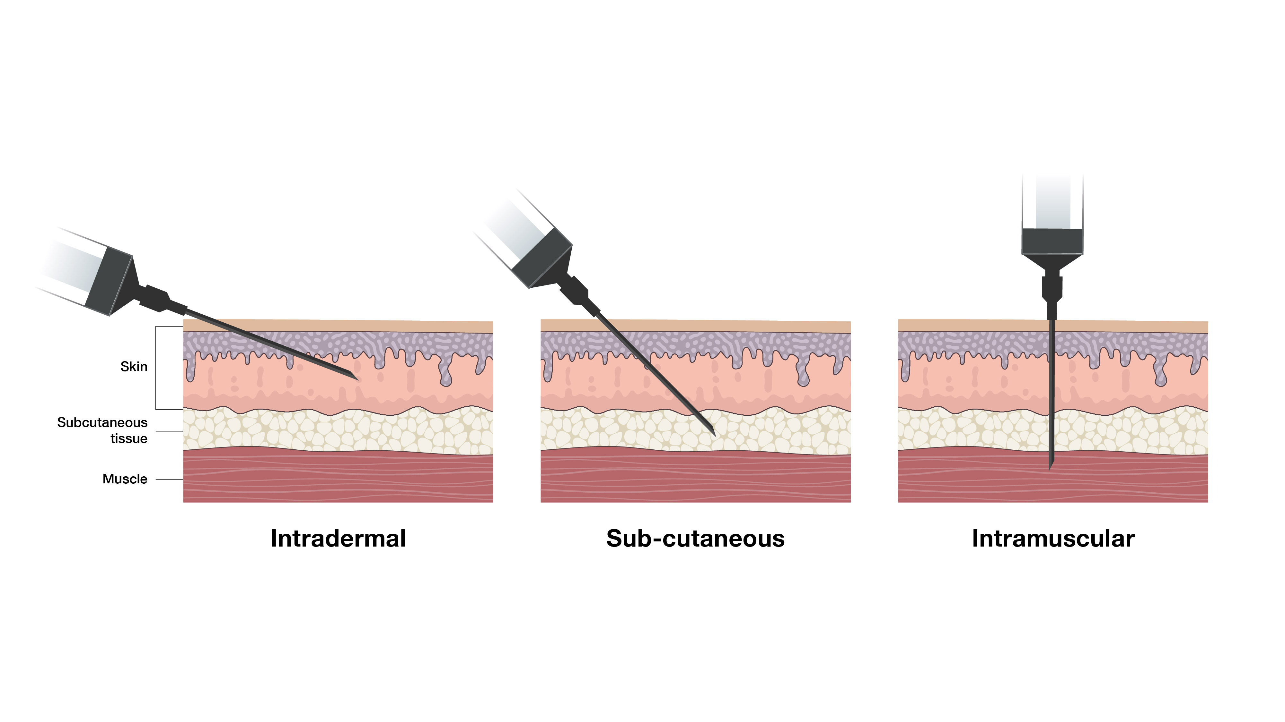
Comparison of intradermal, subcutaneous and intramuscular technique
This diagram shows the required needle insertion angle and depth of tissue penetration for each technique

Slide 59
Disposal
equipment used for vaccination, including used vials, ampoules or syringes, should be disposed of by placing them in a proper, puncture-resistant ‘sharps box’ according to local authority regulations and guidance in Health Technical Memorandum 07-01: Safe management of healthcare waste (Department of Health, 2013)
sharps waste and empty vials should be placed into yellow lidded waste bins and sent for incineration

Slide 60
Recording
the following information should be recorded for each vaccine given:
  vaccine name, product name, batch number and expiry date
  dose administered and route and anatomical site of administration
  date immunisation given
  Route or site used
  name and signature of vaccinator
pre-exposure vaccine given to GBMSM in sexual health clinics should be recorded in established IT systems (GUMCAD)
post-exposure vaccines given to contacts and pre- and post-exposure prophylaxis for staff should be recorded on the online form created by UKHSA to securely and systematically monitor the usage, safety and effectiveness of the MVA-BN vaccine
if the vaccine recipient is pregnant, if possible record this and the gestational age

Slide 61
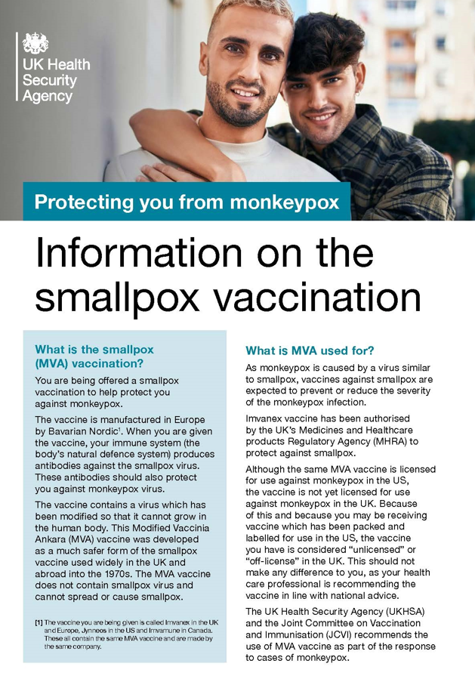
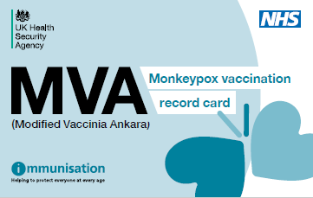
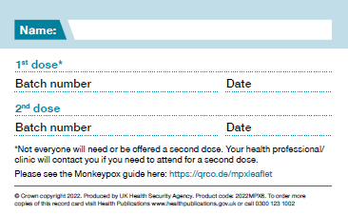
Post vaccination information
as is recommended after any vaccination, any fever following vaccination should be monitored and if individuals are concerned about their health at any time, they should seek advice from their GP or NHS111
following vaccination, vaccine recipients should be given information about possible reactions to the vaccine, how to treat these, and when and from whom to seek further advice if required
Encourage recipients to report adverse reactions to the MHRA Yellow Card Scheme (details are included in the UKHSA patient information leaflet)
a patient information leaflet is available with the MVA-BN vaccine to be given to vaccinees (additional copies can be downloaded)
a UKHSA patient information leaflet and patient vaccination record card must be given to all eligible patients and are also available to order from the Health Publications website or call 0300 123 1002 using the product code 2022MP1EN. Translated, braille and audio versions are available
the UKHSA Intradermal leaflet should be given to patients who have received it this way
information on monkeypox also available from NHS UK
Notes:
Considerations for monkeypox vaccination – SPS - Specialist Pharmacy Service – The first stop for professional medicines advice

Slide 62
Adverse reactions following MVA-BN vaccination
data from multiple clinical trials shows that MVA-BN vaccine causes less adverse events than the first and second generation smallpox vaccines
although adverse events, such as local injection site reactions and influenza-like illness symptoms are common, serious adverse events are rare
the most common side effects seen following MVA-BN vaccination in clinical trials were:
    headache
    nausea
    myalgia (muscle pain)
    tiredness
    injection site reactions (pain, redness, swelling, hardening and itching)
reactions were mild to moderate in intensity and resolved without intervention within 7 days following vaccination
rates of adverse events reported after 1st, 2nd or booster dose were similar, but anecdotally the frequency of adverse events, particularly local site reactions, appears to be higher in those who have received previous live smallpox vaccine
any adverse reaction to a vaccine should be documented in the individual’s record and the individual’s clinician should be informed

Slide 63
Reported reactions to MVA-BN
Very common (may affect more than 1 in 10 people) | Common (may affect up to 1 in 10 people) | Uncommon (may affect up to 1 in 100 people) | Rare (may affect up to 1 in 1000 people)
headache | chills | nose and throat infection, upper respiratory tract infection | sinus infection
aching muscles | fever | swollen lymph nodes underarm swelling, pain in the armpit | influenza-like illness
feeling sick | joint pain, pain in extremities | abnormal sleep | hives (nettle rash)
tiredness | loss of appetite | dizziness, abnormal skin sensations | skin discolouration, bruising, lump
pain, redness, swelling, hardness or itching at the injection site | discolouration, bruising or warmth at the injection site | muscle stiffness | sweating and night sweats
 |  | sore throat, runny nose, cough | muscle cramps, pain and weakness
 |  | diarrhoea, vomiting, abdominal pain, dry mouth | swelling of the ankles, feet, fingers, face, mouth and throat
 |  | rash, itch, skin inflammation, skin discolouration, bruising flushing, feeling unwell chest pain | faster heart beat back, neck, abdominal pain ear and throat ache dry mouth spinning sensation (vertigo) migraine nerve disorder causing weakness, tingling or numbness, drowsiness blisters at injection site weakness, feeling unwell pink eye

Slide 64
Adverse reactions after intradermal vaccination
The clinical study of intradermal administration of 0.1ml of MVA-BN found that, compared to subcutaneous injection:
  it was associated with a higher rate of itchiness and local reactions such as erythema and induration
  pain at the injection site was less common
  some of the local reactions persisted for longer
  some subjects developed small nodules or discoloration at the injection site 6 months after the injection
  systemic reactions were generally similar

Slide 65
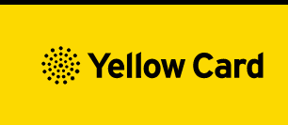
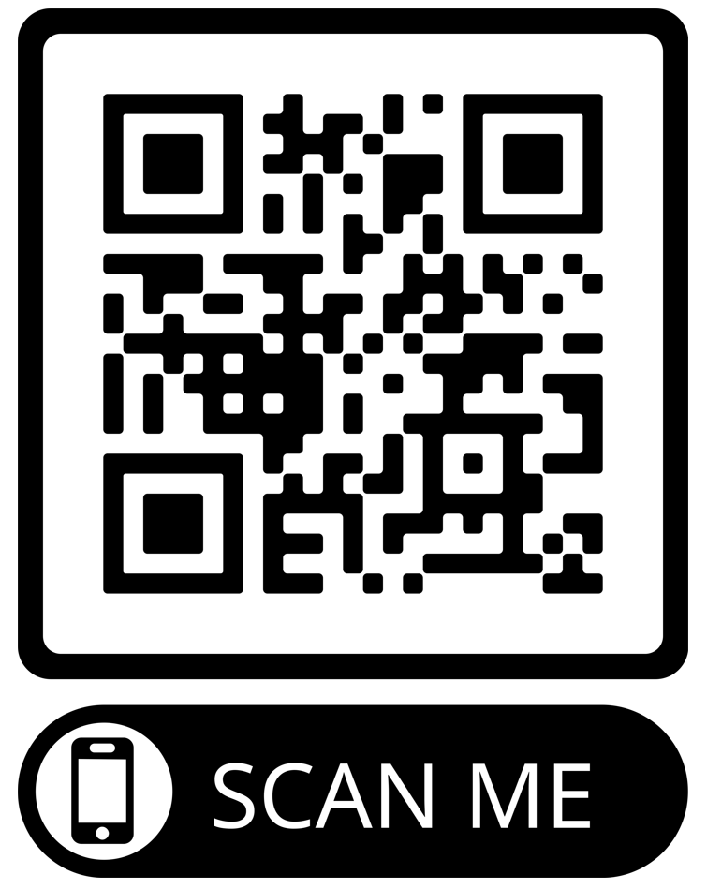
Reporting adverse events
as this vaccine is labelled with a black triangle ( ), all suspected adverse reactions occurring in individuals of any age after MVA-BN vaccination should be reported to the MHRA using the Yellow Card scheme
anyone (patients and HCWs) can make a Yellow Card report, even if they are uncertain as to whether a vaccine caused the condition/side effect
vaccinees should be advised that they can report any adverse reactions to the MHRA using the online Yellow Card scheme, by downloading the Yellow Card app or by calling the Yellow Card scheme on 0800 731 6789 9am to 5pm Monday to Friday
please record and provide vaccinees with details of the vaccine brand and batch if possible so this can be included in the Yellow Card report
The QR code can be used for quick and easy access to the Yellow Card reporting site

Slide 66
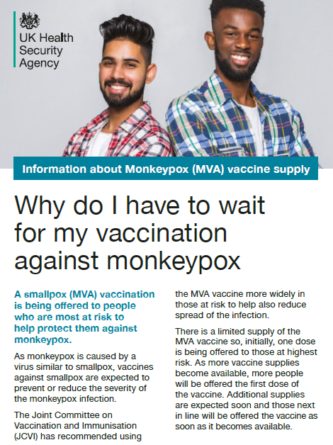
Useful resources
Smallpox and monkeypox: the Green Book Chapter 29
Monkeypox outbreak: vaccination strategy UKHSA's vaccine strategy in response to the UK monkeypox outbreak
Monkeypox: guidance Information and advice for healthcare professionals and the general public including background information, case definitions, contact tracing, testing and other guidance documents
Monkeypox: background information Guidance and information about the epidemiology, transmission, clinical features, diagnosis, treatment, infection prevention and control and management of monkeypox virus infections
Recommendations for the use of pre and post exposure vaccination during a monkeypox incident
Monkeypox cases confirmed in England – latest updates
Imvanex vaccine Summary of Product Characteristics (SPC) and Patient Information Leaflet (PIL)
Jynneos - FDA prescribing information, side effects and uses
Monkeypox vaccination resources Information for patients about the smallpox vaccination
Intradermal leaflet for eligible patients
Health publications website to order stocks of leaflets, record cards etc.

Slide 67
Acknowledgements
With thanks to
colleagues in NHS Education for Scotland and Public Health Scotland for the use of some of these slides
Bavarian Nordic for stability data
pharmacy colleagues in NHS England for input regarding the additional storage, handling and administration requirements when the vaccine is being used for fractional dosing

