Slide 1
School age MenACWY and teenage 3-in-1 booster resources
Vaccine Preventable Disease Programme
Public Health Wales
December 2025
Notes:
Material contained in this document may be reproduced without prior permission provided it is done so accurately and is not used in a misleading context.
Acknowledgement to Public Health Wales NHS Trust to be stated.
© 2025 Public Health Wales NHS Trust.

Slide 2


Leaflets
Separate leaflets for MenACWY and teenage 3-in-1 booster vaccines are available
Bilingual digital versions are available for download on PHW vaccines leaflets page on website:
  English website page (English presents first on the leaflet)
  Welsh website page (Welsh presents first on the leaflet)
Leaflets are also available to order for free on Health Information Resources website

Slide 3
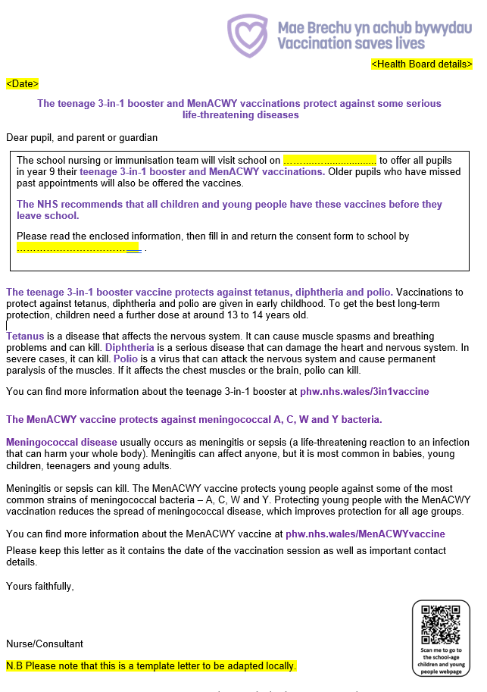
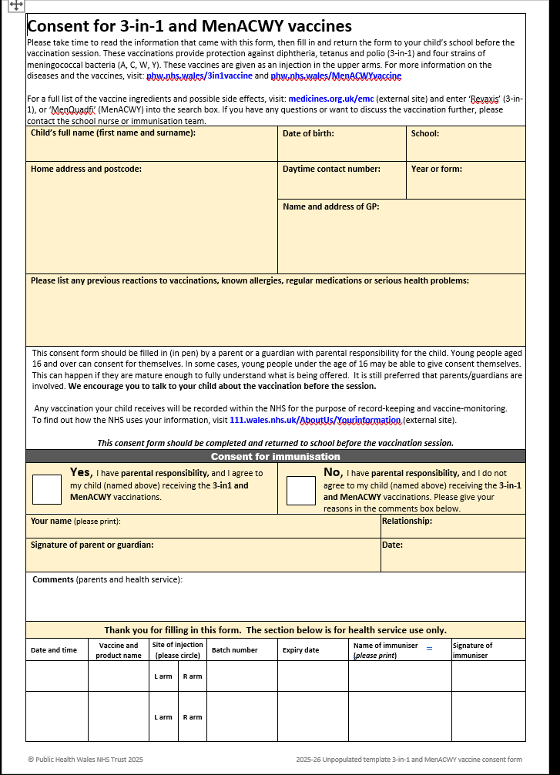
Template consent form and cover letter
Templates for the combined cover letter and consent form both include information about self-consent, with reference to Gillick competence
Bilingual versions of these templates are available here and here.

Slide 4

Briefing document for schools
This bilingual resource is available here:
  English page (English presents first)
  Welsh page (Welsh presents first)
It is a digital bilingual document – can be linked to or printed off in health boards
Provides school staff with information about the MenACWY and teenage 3-in-1 booster vaccines, the vaccination programme, why we vaccinate in schools, process, how schools can help, and consent (including Gillick competence)
Feedback from school nurses suggests many are not aware of the suite of briefing documents. Briefing documents are available for all school-based programmes and are available from School age children and young people - Public Health Wales
Please promote briefing documents as a useful tool for schools

Slide 5

Poster
This bilingual resource highlights key information about the MenACWY vaccine
Stock is available to order for free on the Health Information Resources website here

Slide 6

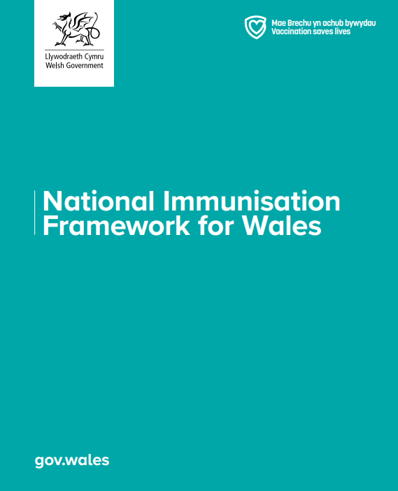
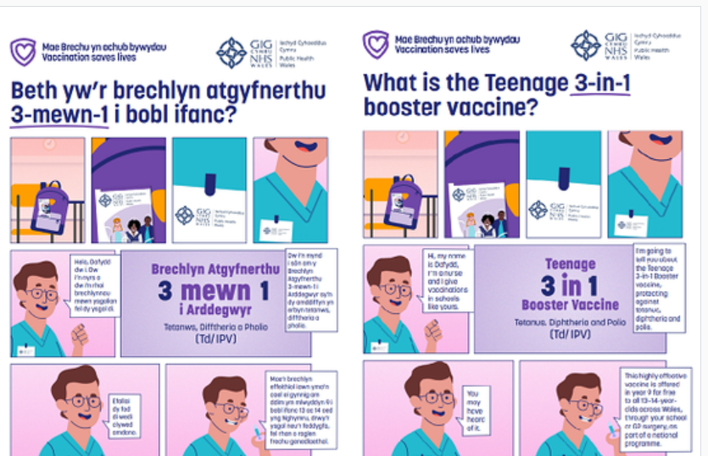
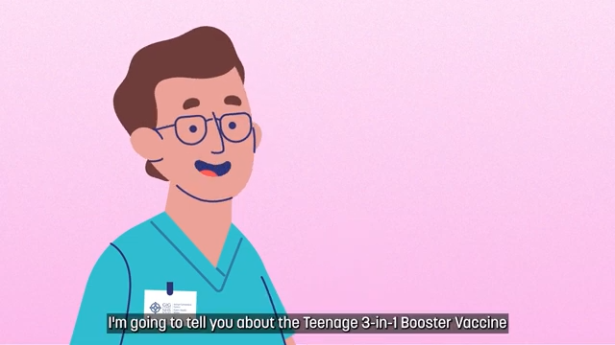
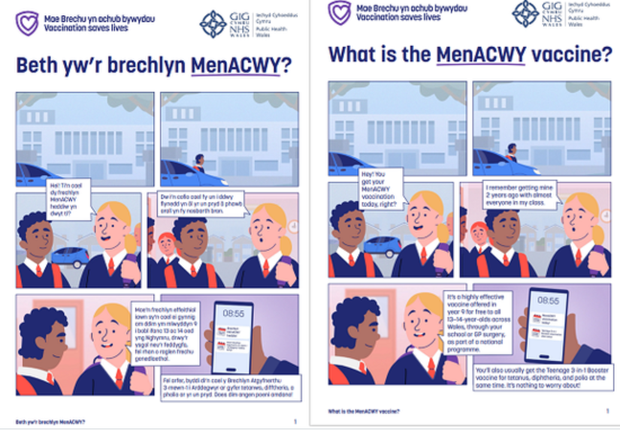
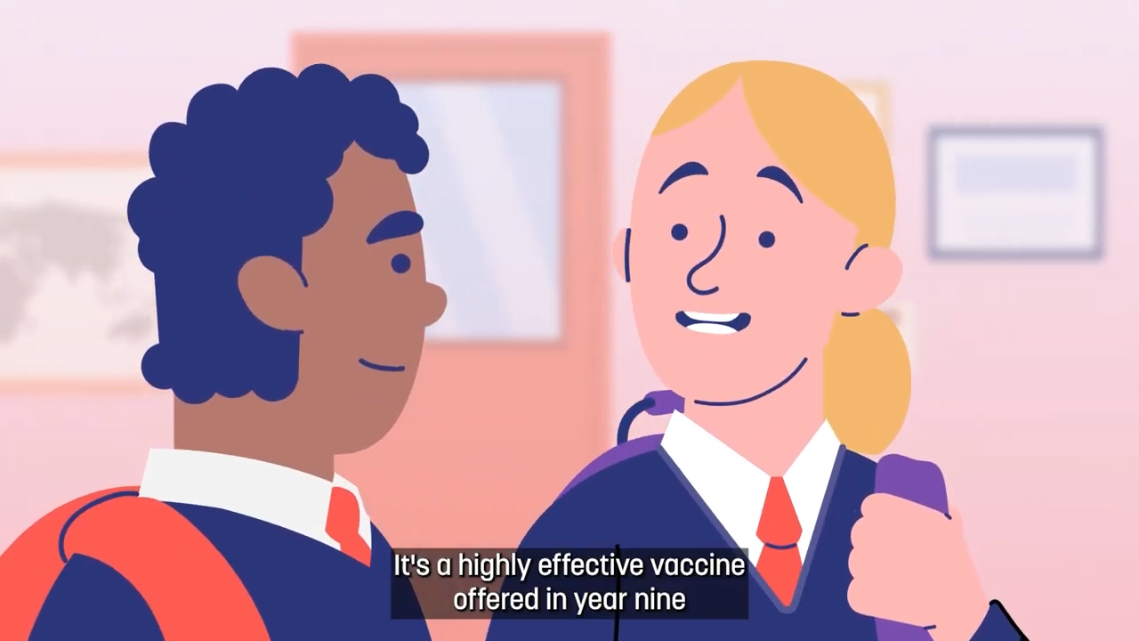
MenACWY & teenage 3-in-1 booster animations and report
Co-produced vaccine animations are now available for all school-age vaccination programmes:
Through a range of insight work, young people continue to identify animation, with some live-action footage as their preferred information format – they helped us tailor the MenACWY and Teenage 3in1 booster information animations to the needs of their age-group. This was then further tested with other young people.
Key findings [from audience testing]:
Young people strongly preferred upbeat, clear voiceovers and visually varied animations.
Terms like “booster” and “teenage” were found to be more relatable and appealing for naming the 3in1 vaccine.
Both focus group and survey participants recommended presenting information for each vaccine separately to reduce confusion or information overload.
Current Status
The short 3 min animations, along with accompanying comic strips, are now complete and live on the Web Shop (PHW Products - Public Health Wales). The full insights report will be available from the engagement team: PHW.VaccinesEngagement@wales.nhs.uk
Notes:
MenACWY and 3-in-1 animations
We’ve been working in partnership with Social Change UK to support the development of new educational resources focused on the MenACWY and Teenage 3-in-1 Booster vaccines.
The aim was to better understand the existing knowledge, attitudes, and experiences of young people aged 13 to 14, and to explore their preferences around how vaccination information is presented. This work helped inform the design and distribution of two new coproduced animations and comics, building on the suite of existing resources.
As part of the insight phase, two focus groups were conducted with a total of 17 Year 9 and 10 pupils from schools within the CTM and Swansea Bay University Health Board areas.
We gathered information regarding the structure of animations, considering aspects such as pacing, language and paralinguistics in order to really maintain attention.
Importantly, the test phase of the MenACWY/3in1 animations indicated that they were easy to understand, and they encouraged vaccination intention suggesting that the core information was effectively delivered.
The reasons students gave, including clarity, safety, and relevance reinforced the value of using animations to support vaccine communication – which is a key finding for us when we look to convey future vaccination information
Specifically referring to language, we found that terms such as ‘booster’ and ‘teenage’ resonated well with the audience and helped them better understand the content. We found that ‘Booster’ sounded positive and safe, while ‘teenage’ also made the vaccine feel more relevant to their age group. Based on this, and in alignment with the language young people found most accessible, we’re now using the term “Teenage 3-in-1 Booster” within PHW’s school-age vaccination programme.
SO in terms of Where are we now?: The animations, along with comic strips, are now complete and live on the Web Shop. The accompanying insights report featuring recommendations is currently being finalised and will be available soon on the Public Engagement insights web page

Slide 7
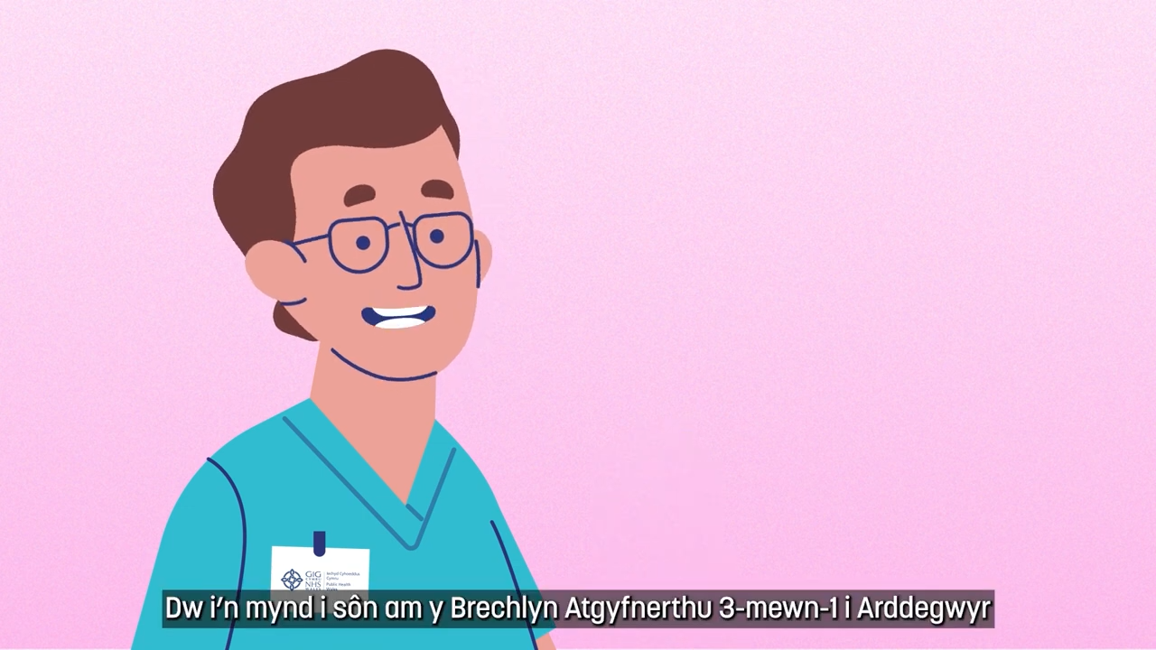
Teenage 3-in-1 booster vaccine video animation
What is the teenage 3-in-1 booster vaccine?
Beth yw’r Brechlyn Atgyfnerthu 3-mewn-1 i Arddegwyr?

Slide 8
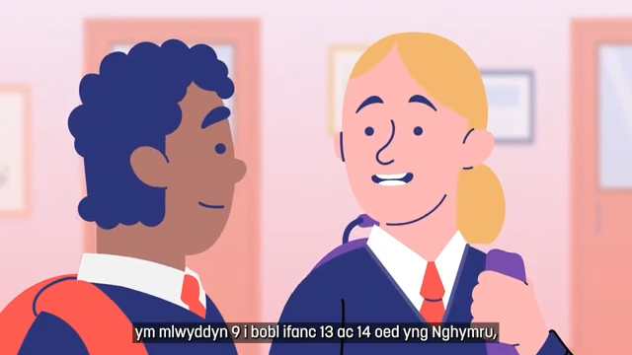
MenACWY vaccine video animation
What is the MenACWY vaccine? - YouTube
Beth yw’r brechlyn MenACWY?

Slide 9
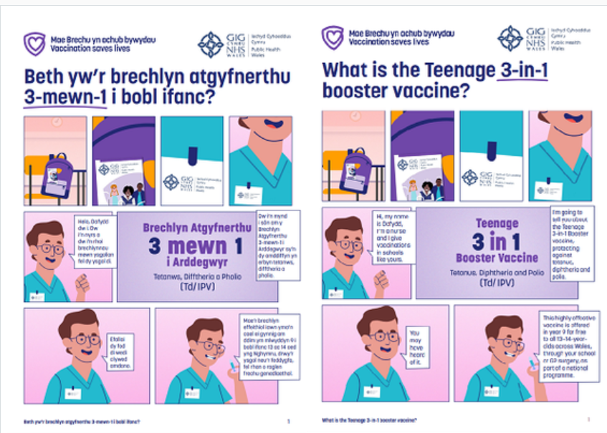
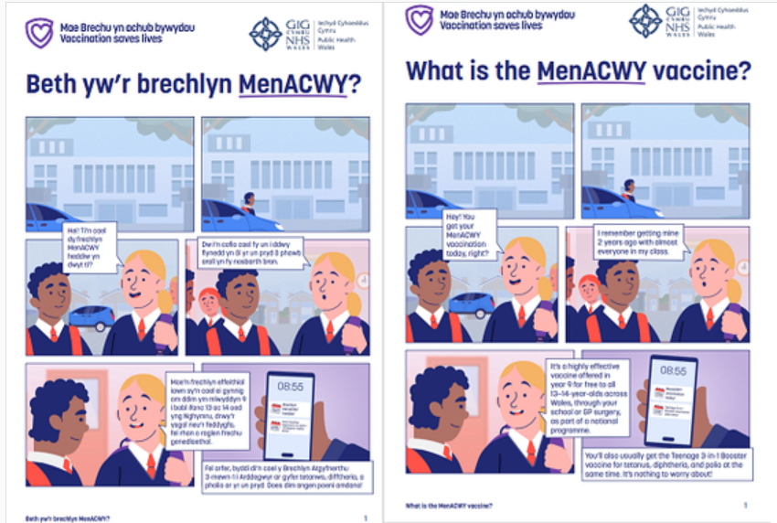
Teenage 3-in-1 booster vaccine comic
Bilingual ‘What is the Teenage 3-in-1 Booster vaccine?’ comic, available here
MenACWY vaccine comic
Bilingual ‘What is the MenACWY vaccine?’ comic, available here

Slide 10


Training resources
MenACWY Immunisation programme for adolescents slide set Training slide set for health care professionals involved in advising on or delivering the adolescent MenACWY vaccination programme.
‘Teenage vaccinations: Helping to protect you from disease’ slide set
A template slide set to assist with the delivery of local teenage vaccine information sessions for young people. Information is included on MenACWY, teenage 3-in-1 booster, HPV, flu and MMR catch-up vaccinations.

Slide 11
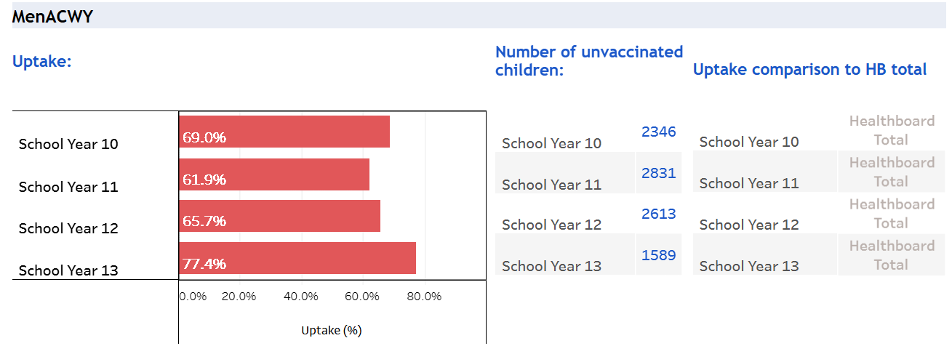
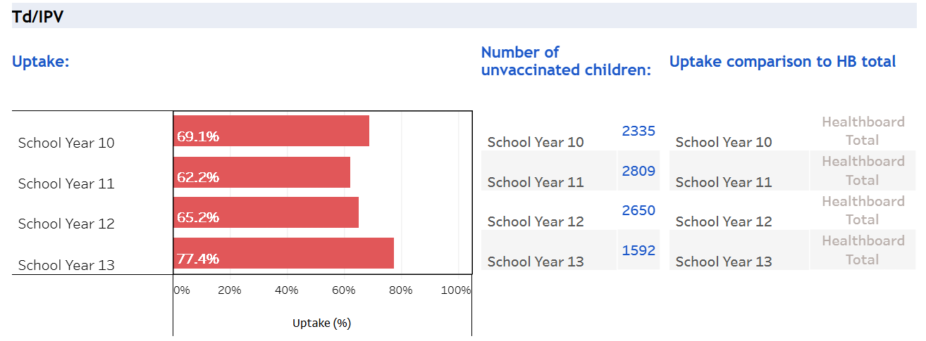
Public Health Wales – School age vaccine data
Dashboard for vaccination data including MenACWY, teenage 3-in-1 booster, HPV and MMR uptake is available as school and health board level data.
The dashboard is called 'Teenage Immunisation School Level Uptake' and there is a separate link for each HB and then drop down for each school (NHS Wales access required) https://nhswales365.sharepoint.com/sites/PHW_VPDPComms/SitePages/Childhood-Immunisation-(COVER).aspx

Slide 12
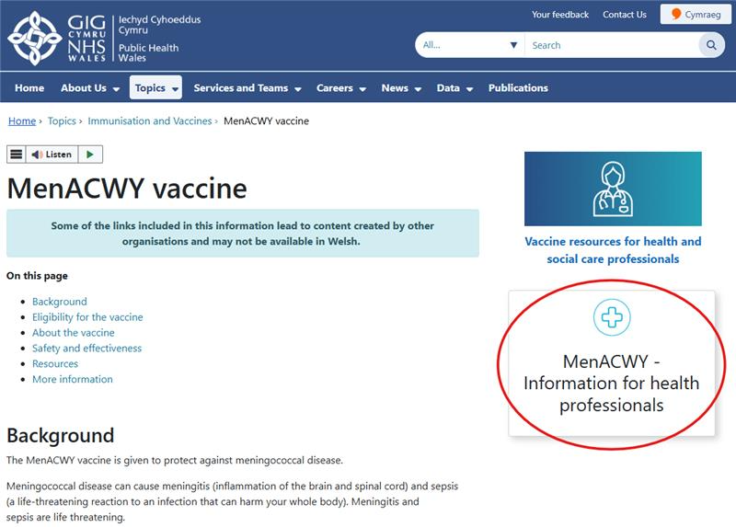
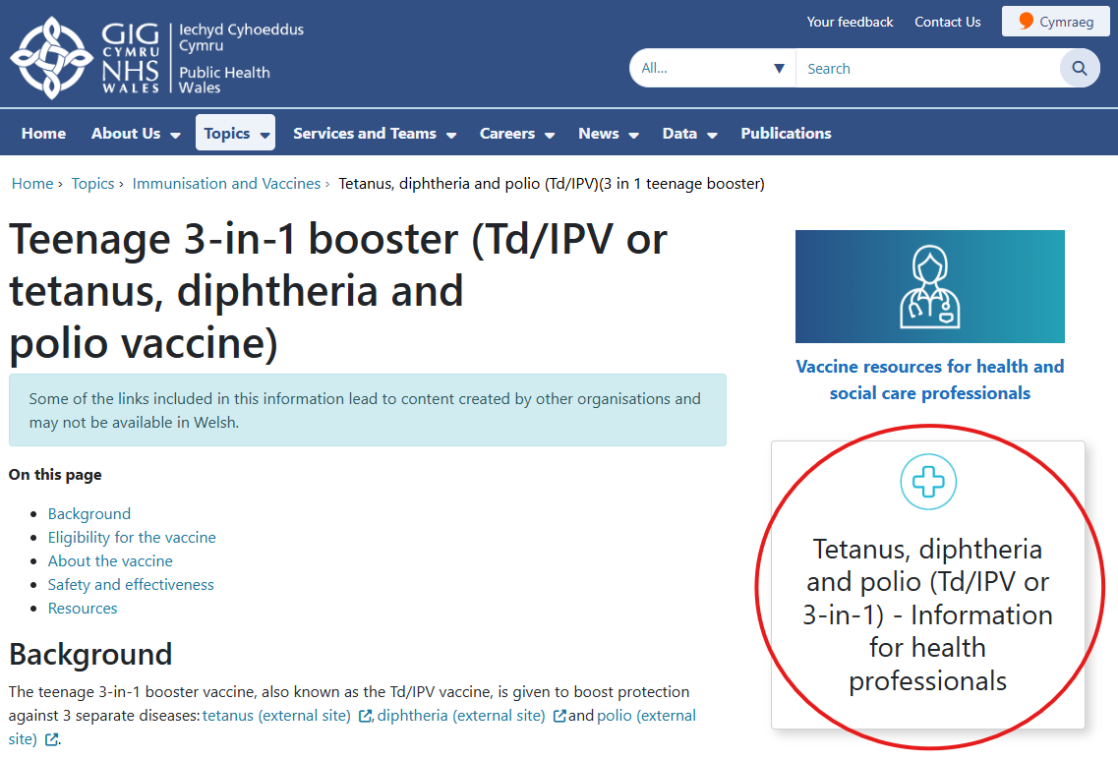
Public Health Wales vaccine webpages
Public Health Wales have separate MenACWY and teenage 3-in-1 booster specific pages for the public, and for health care professionals delivering the vaccination programmes
The public page can be reached by visiting/typing into your web browser
  MenACWY
  phw.nhs.wales/MenACWYvaccine
  icc.gig.cymru/brechlynMenACWY
  Teenage 3-in-1 booster
  phw.nhs.wales/3in1vaccine
  icc.gig.cymru/brechlyn3mewn1
The health care professional pages can also be accessed from the public pages (see image circled right)
Additional resources on vaccination for health care professionals on vaccination and immunisation in Wales are available at:
  phw.nhs.wales/vaccines-professionals and
  Vaccine Preventable Disease Programme (VPDP) - Home (sharepoint.com) (NHS Wales access required)

Slide 13

Call to action – Catch-up vaccination programmes
Insight gathering
VPDP would like to capture some parental and teenage insights around planned catch-up vaccination appointments, to better understand:
Enablers and barriers to attending vaccination appointments
To understand why individuals respond to catch-up offers when they missed or delayed routine appointments
To identify barriers and enablers to attending routine school age catch-up appointments.
VPDP are undertaking some ongoing work to capture parental and teenage insights around
catch-up vaccination, to better understand
The surveys are intended for parents and teenagers attending for any catch-up vaccination. The anonymous surveys can be accessed via QR codes

Slide 14

Catch-up vaccination: Resources
VPDP co-designed and launched:
Poster
Postcards to facilitate sharing of the survey QR codes
Available for ordering and local printing from the PHW web shop: PHW Products - Public Health Wales
Catch-up vaccination: Resources
Suggested use of the resources
Place posters in waiting areas before vaccination (survey can be completed before vaccine is given)
Print postcards to give to parents/ teenager
Display poster in any post immunisation waiting area.
Immunisation teams may facilitate use of digital equipment / tablets to allow those without IT access to complete form at their appointment.
Immunisation teams may wish to support families to complete survey at the appointment by completing the survey with them.

Slide 15
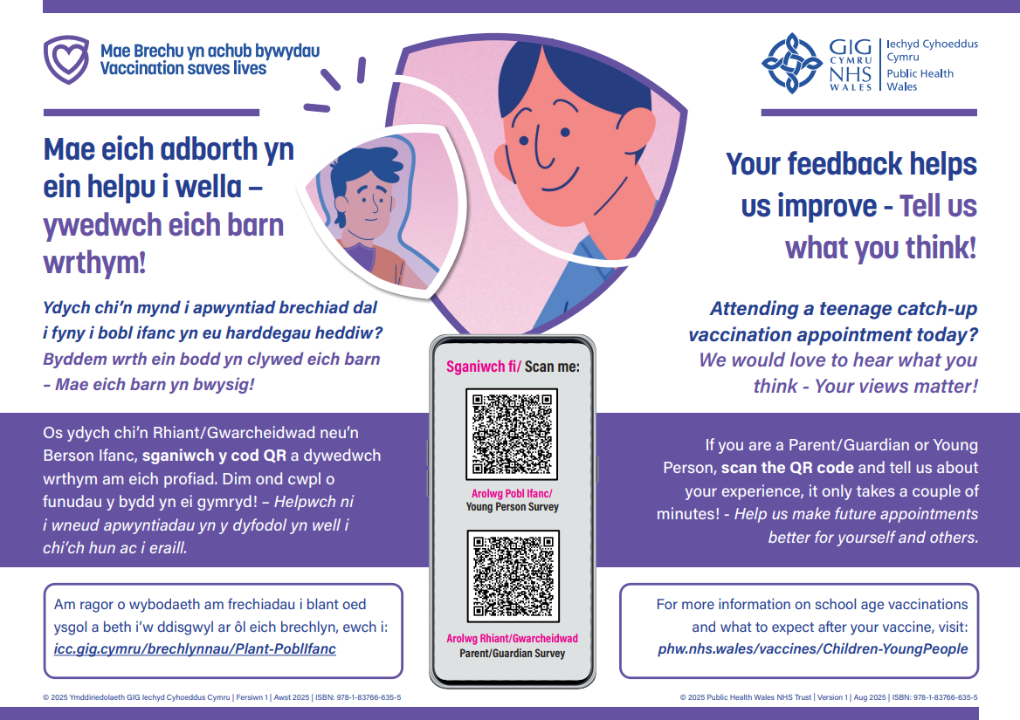
Resource proofs
Poster
Postcard

Slide 16
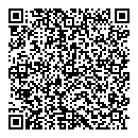
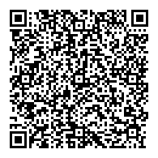
QR codes and links
Clicwch fi i fynd I’r arolwg Pobl Ifanc:
https://ex.civicamysay.co.uk/EjHdC0xRaHP (Seasneg yn unig)
Click me to go to the Young Person survey:
https://ex.civicamysay.co.uk/EjHdC0xRaHP
Sganiwch fi i fynd i'r arolwg Pobl Ifanc
Scan me to go to the Young Person survey
Clicwch fi i fynd I’r arolwg Rhiant/ Gwarcheidwad:
https://ex.civicamysay.co.uk/BCsDz2h0XY (Seasneg yn unig)
Click me to go to the Parent/ Guardian survey:
https://ex.civicamysay.co.uk/BCsDz2h0XY
Sganiwch fi i fynd i'r arolwg Rhiant/Gwarcheidwad
Scan me to go to the Parent/ Guardian survey

Slide 17
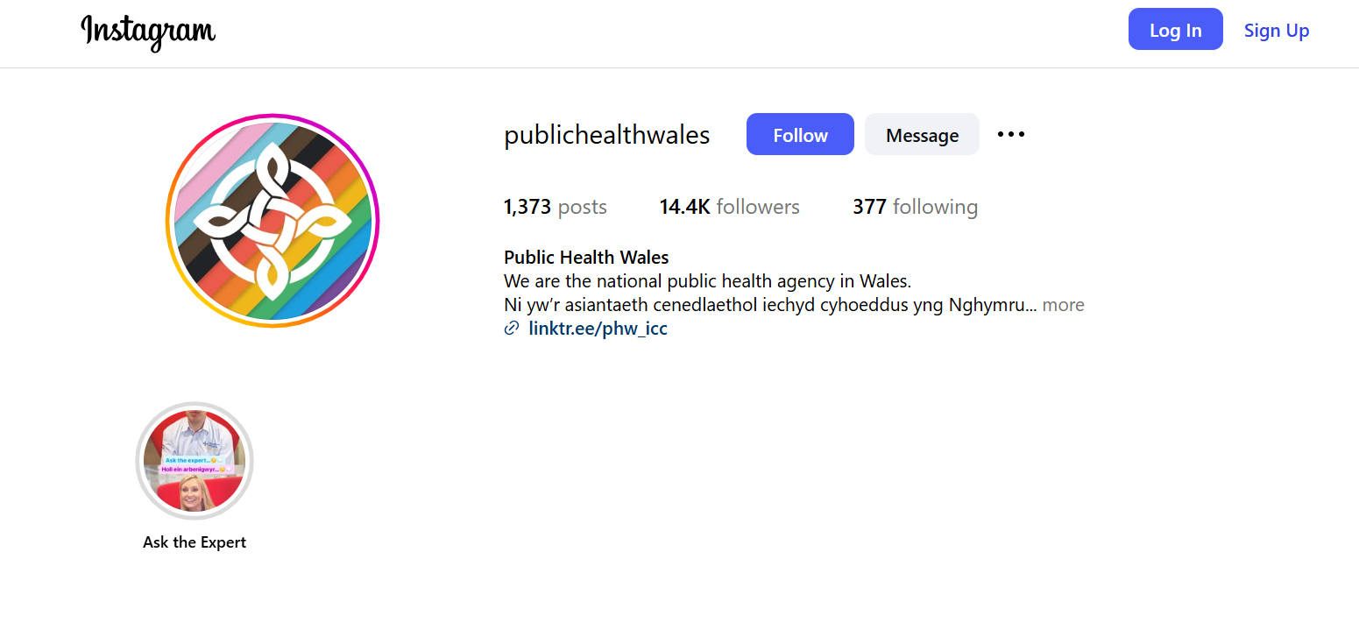
Communications campaign
You can follow Public Health Wales on social media here:
Facebook: Eng | Cym
Instagram: @publichealthwales
LinkedIn: https://www.linkedin.com/company/public-health-wales
TikTok: @publichealthwales

Slide 18
Supportive documentation
School Based Vaccinations - A Guide for Schools: Supporting the administration and management of childhood vaccination programmes delivered in schools (Welsh Government, 2025)
Health Protection in Children and Young (Including Education) (Public Health Wales, 2025)

