Slide 1

Teenage vaccinations
Helping to protect you from disease
These slides are version controlled and subject to revision
December 2025 (Version 3)
Notes:
Material contained in this document may be reproduced without prior permission provided it is done so accurately and is not used in a misleading context.
Acknowledgement to Public Health Wales NHS Trust to be stated.
© 2025 Public Health Wales NHS Trust

Slide 2
Notes to school nurses
This template slide set has been produced to assist with the delivery of local teenage vaccine information sessions for young people.
The content is not exhaustive and should be checked prior to use and amended as appropriate.
Websites and sources of further information are included in the notes sections throughout this presentation.
The notes section within this template is designed to provide nurses with additional information for their own reference and is not necessarily to be delivered to pupils as part of this presentation.
It is important to critically appraise sources of information prior to using them in the session.
Material contained in this document may be reproduced without prior permission provided it is done so accurately and is not used in a misleading context.
Acknowledgement to Public Health Wales Vaccine Preventable Disease Programme to be stated.

Slide 3
Why is vaccination important?
Vaccination (sometimes called immunisation) is a highly effective way of helping to protect you against serious diseases or illnesses such as meningitis, measles, diphtheria, tetanus, polio and some types of cancers.
Once you have been vaccinated, your body is more able to fight these diseases if you come into contact with them.
When enough people are vaccinated, it helps protect those who can't have the vaccine, like newborn babies and people with certain health conditions. This is called herd immunity.
After clean water, immunisation is the most effective way of saving lives.
Vaccinations are estimated to save 3.5-5 million lives across the world every year.
Notes:
https://www.who.int/health-topics/vaccines-and-immunization#tab=tab_1

Slide 4
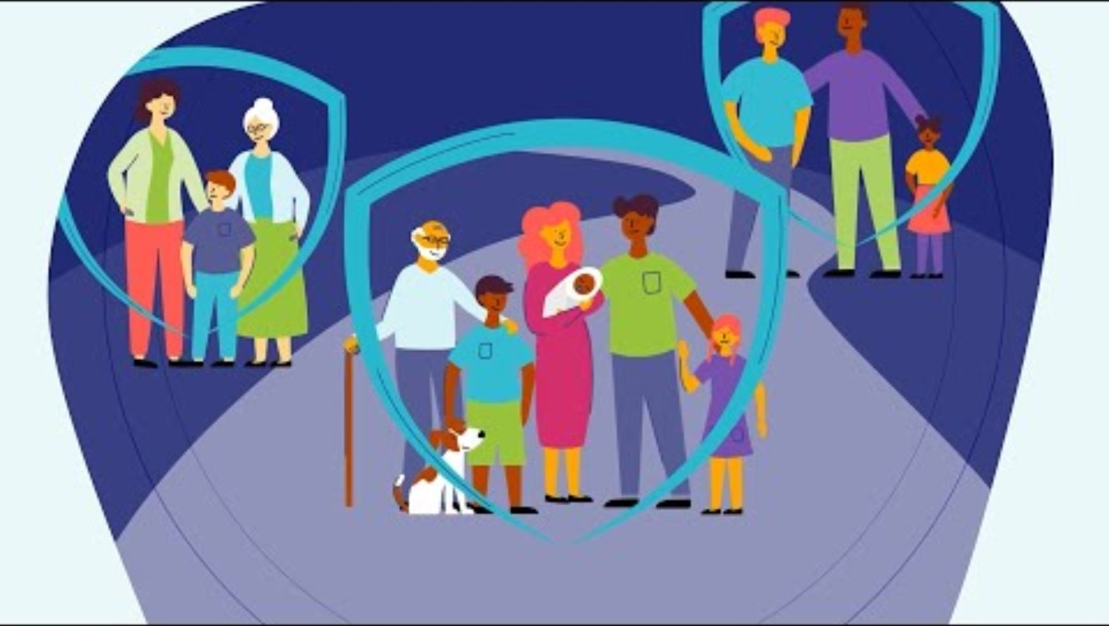
Importance of Vaccines
Public Health Wales animated video (2023)
Importance of Vaccines | Public Health Wales - YouTube
Notes:
Welsh language version: Pwysigrwydd Brechlynnau | Iechyd Cyhoeddus Cymru - YouTube

Slide 5
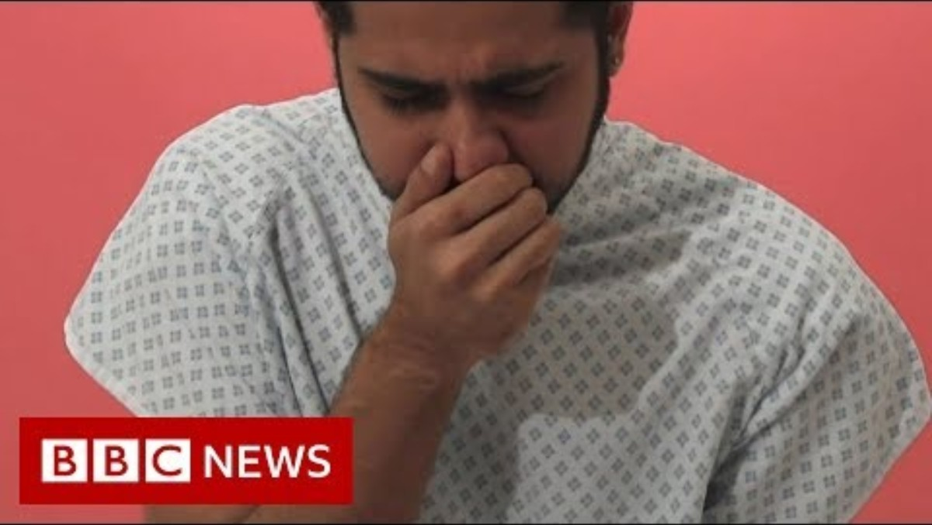
Immunisation: Why we do it
BBC news video (2019)
Immunisation: Why we do it and how 'herd immunity' works - BBC News (youtube.com)

Slide 6
What vaccinations will you be offered?
*Flu vaccination - Years 7 to 11.
*Human papillomavirus vaccination (HPV) - Year 8.
Teenage 3-in-1 booster vaccination (Tetanus, diphtheria and polio (Td/IPV)) - Year 9.
Meningitis ACWY vaccination (MenACWY) - Year 9.
Measles, mumps and rubella vaccination (MMR) - any age if missing 1 or 2 doses.
If you miss a vaccine in school year it is usually offered, you can still have it in later school years.
* In Cardiff and Vale schools - HPV and flu vaccinations are given in school. Others are given by your GP.
Notes:
National immunisation schedule for Wales is available at: https://phw.nhs.wales/topics/immunisation-and-vaccines/routine-immunisation-schedules-for-wales/

Slide 7
What other vaccinations might you need?
Other vaccines may be offered to you:
  Before starting some university or college courses
  For your chosen career
  Before you travel to certain countries in the world
  If you or someone you live with have certain medical conditions or risk factors
  If there is an outbreak of disease

Slide 8
Flu vaccine

Slide 9

Flu vaccine
Anyone can get flu, but children have the highest rate of infection and flu can be very serious for them.
Children and young people can also pass the flu virus on to friends or family members. This can be serious for people who are vulnerable like grandparents, people with health conditions, or people having treatments that affect their immune system (e.g. chemotherapy).
Most children and young people will usually have their flu vaccine in school. Information and a consent form will be sent home (either paper or digitally).
Most children and young people have a quick and painless nasal spray. If the nasal spray is unsuitable due to a medical condition or pork gelatine content, then an injectable vaccine is available.
Flu vaccination is needed each autumn/winter to offer the best protection.
Visit phw.nhs.wales/fluvaccine for more information.
Notes:
More information about flu and the vaccine is available at www.phw.nhs.wales/fluvaccine

Slide 10
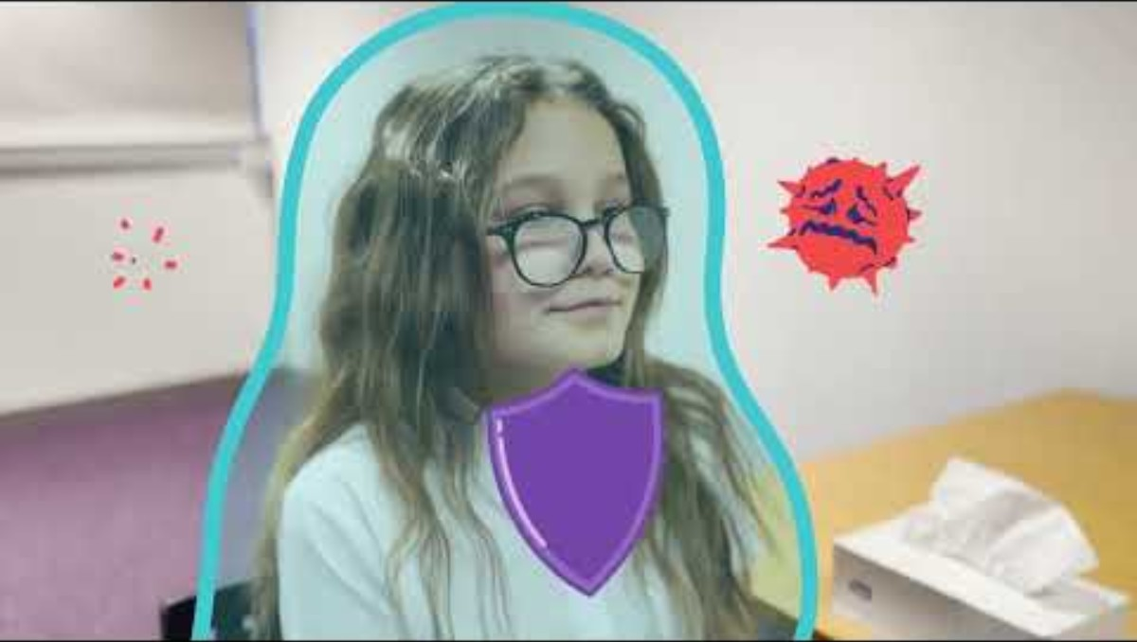
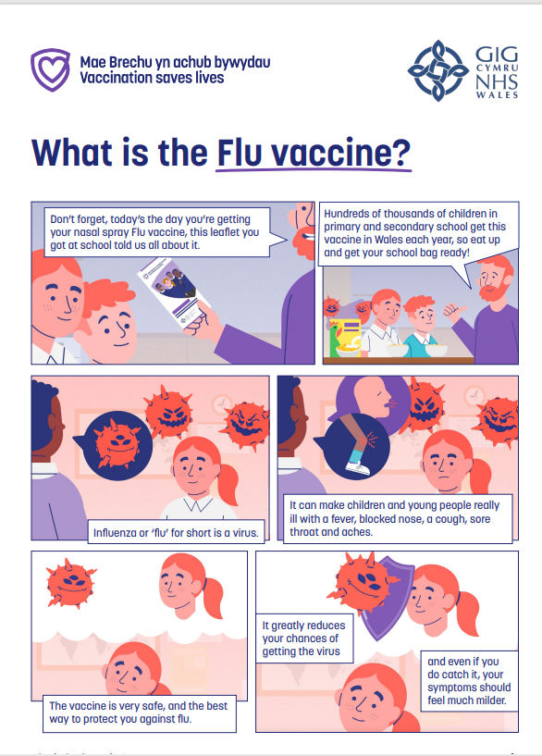
Co-produced video animation and comic: Flu vaccine
Public Health Wales animated video (2023)
'What is the Flu Vaccine' Audiovisual (youtube.com)
Public Health Wales comic (2023)
What is the Flu Vaccine (Comic)
Notes:
Welsh language animation: Beth yw’r Brechlyn ffliw
Welsh language comic: Comig: Beth yw’r Brechlyn ffliw

Slide 11
HPV vaccine

Slide 12

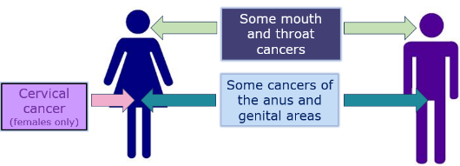
HPV vaccine
HPV (Human papillomavirus) is very common and can be passed on through skin-to-skin contact.
Most people will have contact with the HPV virus at some time in their lives.
The HPV vaccine can help reduce your risk from some cancers caused by the HPV virus, including cervical, and head and neck cancers (most common in males).
In most cases the HPV vaccine is given as 1 dose and is an injection in the upper arm.
More information is available from phw.nhs.wales/HPVvaccine
Notes:
More information about HPV and the vaccine can be found at: www.phw.nhs.wales/HPVvaccine
The previous HPV vaccine used in the UK offered protection against 4 types of HPV infection. Types 16 and 18 (high-risk types) and types 6 and 11 (low-risk types). Gardasil 9 is now the vaccine of choice for the HPV programme. It offers protection against an additional 5 types 31, 33, 45, 52, 58.
Since the HPV programme started in 2008, evidence from the UK shows:
Fewer HPV infections with the main cancer causing HPV types
A fall in the number of cases of genital warts
A big reduction in pre-cancer and cancer of the cervix
Low-risk HPV types 6 and 11 are responsible for causing approximately 90% of genital warts
Genital warts are the most common viral sexually transmitted infection (STI) in the UK
They are small growths or bumps that appear on or around the genital area (private parts)
Genital warts can take months or years to develop after infection and can be passed on even if they are not visible
Human papillomavirus (HPV): the green book, chapter 18a - GOV.UK (www.gov.uk)

Slide 13
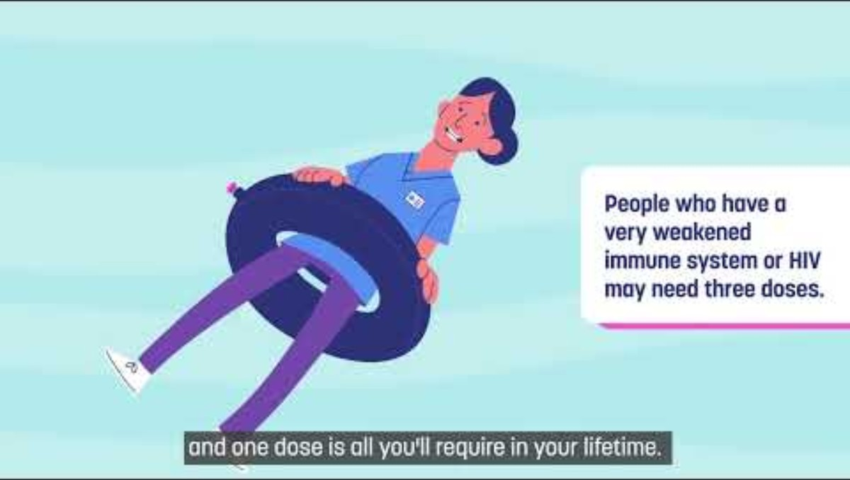
Public Health Wales video
'What is the HPV Vaccine' Audiovisual - YouTube

Slide 14
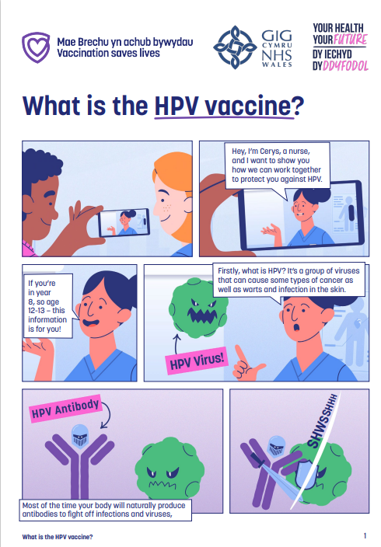
Public Health Wales comic
phw.nhs.wales/topics/immunisation-and-vaccines/hpv/what-is-the-hpv-vaccine-comic-pdf/

Slide 15
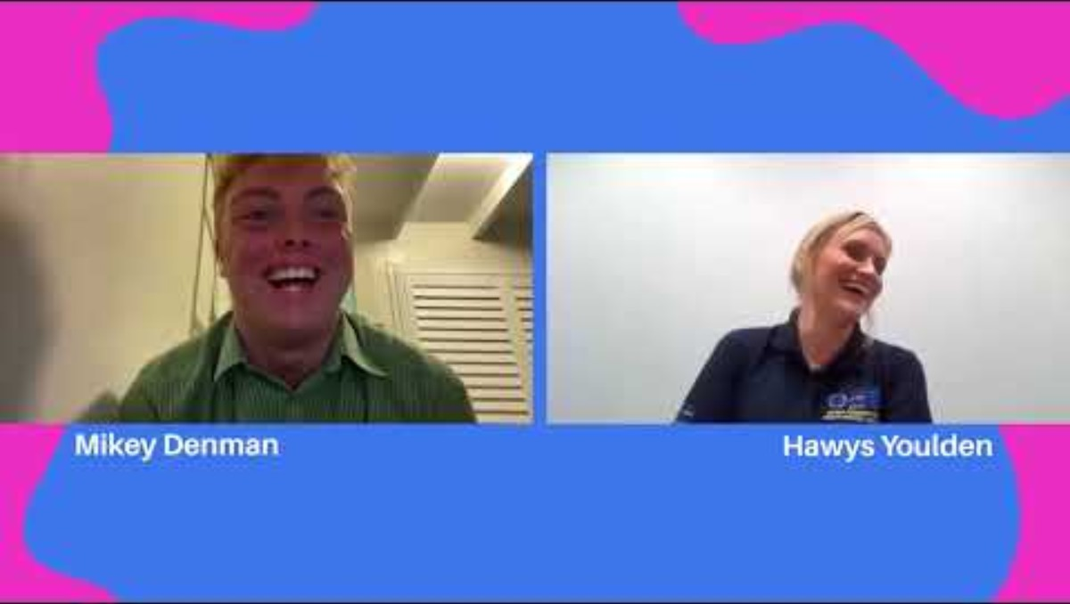
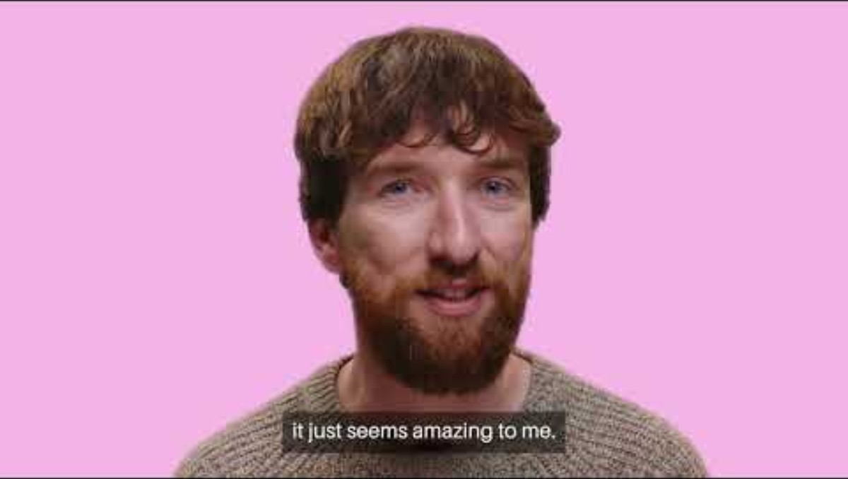
Public Health Wales videos
Influencer X Clinician chat
Public Health Wales video (2023) HPV - Advice to my younger self (youtube.com)
Notes:
Welsh language animation: 'Beth yw'r Brechlyn HPV' (youtube.com)
Welsh language video: HPV - Cyngor fyddwn i'n ei roi i'r fi ifanc (youtube.com)

Slide 16
Teenage 3-in-1 booster

Slide 17
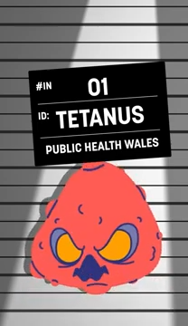
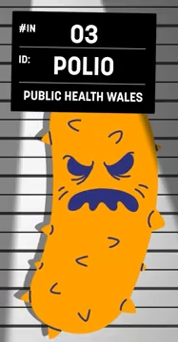
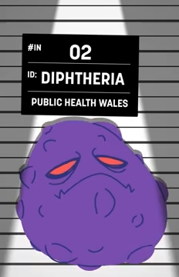
Teenage 3-in-1 booster (Td/IPV)
A combined vaccine that protects against 3 diseases:
  Tetanus – “T”. Bacteria are normally found in soil. Caught through open skin wounds and affects the nerves in your body.
  Diphtheria – “d”. Bacteria spread by coughs and sneezes and can cause serious breathing and heart problems.
  Inactivated Polio Virus “IPV” . The virus is spread from person to person, and can cause severe illness, permanent disability and in some cases death.
Notes:
5 doses are offered for life long protection but further doses may be required for example travel, work and for people with a weakened immune system
More information about tetanus, diphtheria, polio and the 3-in-1 vaccine can be found at: www.phw.nhs.wales/3in1vaccine

Slide 18

Teenage 3-in-1 booster (Td/IPV)
You will have been offered 4 routine doses before you started primary school.
This routine teenage dose works to boost your immunity into adulthood.
The vaccine is given as an injection in the upper arm usually at the same time as the MenACWY vaccine.
More information is available from phw.nhs.wales/3in1vaccine
Notes:
5 doses are offered for life long protection but further doses may be required for example travel, work and for people with a weakened immune system
More information about tetanus, diphtheria, polio and the 3-in-1 vaccine can be found at: www.phw.nhs.wales/3in1vaccine

Slide 19

Teenage 3-in-1 booster animations
What is the Teenage 3-in-1 Booster vaccine?
19
Notes:
MenACWY and 3-in-1 animations
We’ve been working in partnership with Social Change UK to support the development of new educational resources focused on the MenACWY and Teenage 3-in-1 Booster vaccines.
The aim was to better understand the existing knowledge, attitudes, and experiences of young people aged 13 to 14, and to explore their preferences around how vaccination information is presented. This work helped inform the design and distribution of two new coproduced animations and comics, building on the suite of existing resources.
As part of the insight phase, two focus groups were conducted with a total of 17 Year 9 and 10 pupils from schools within the CTM and Swansea Bay University Health Board areas.
We gathered information regarding the structure of animations, considering aspects such as pacing, language and paralinguistics in order to really maintain attention.
Importantly, the test phase of the MenACWY/3in1 animations indicated that they were easy to understand, and they encouraged vaccination intention suggesting that the core information was effectively delivered.
The reasons students gave, including clarity, safety, and relevance reinforced the value of using animations to support vaccine communication – which is a key finding for us when we look to convey future vaccination information
Specifically referring to language, we found that terms such as ‘booster’ and ‘teenage’ resonated well with the audience and helped them better understand the content. We found that ‘Booster’ sounded positive and safe, while ‘teenage’ also made the vaccine feel more relevant to their age group. Based on this, and in alignment with the language young people found most accessible, we’re now using the term “Teenage 3-in-1 Booster” within PHW’s school-age vaccination programme.
Where are we now?: The animations, along with comic strips, are now complete and live on the Web Shop. The accompanying insights report featuring recommendations is currently being finalised and will be available soon on the Public Engagement insights web page

Slide 20
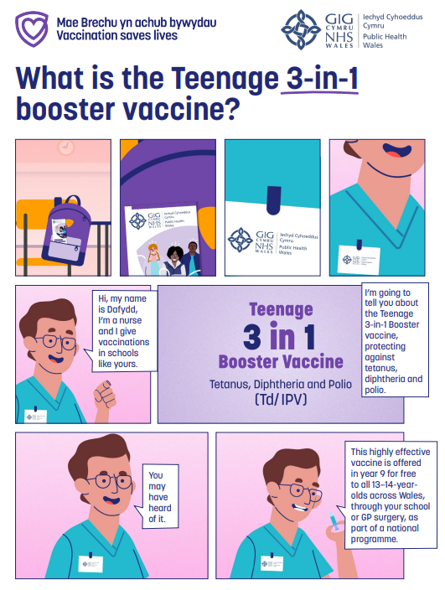
Teenage 3-in-1 booster comic
English:
phw.nhs.wales/topics/immunisation-and-vaccines/tetanus-diphtheria-and-polio/children-and-young-person-comic-what-is-the-teenage-3-in-1-vaccine/
20
Notes:
MenACWY and 3-in-1 animations
We’ve been working in partnership with Social Change UK to support the development of new educational resources focused on the MenACWY and Teenage 3-in-1 Booster vaccines.
The aim was to better understand the existing knowledge, attitudes, and experiences of young people aged 13 to 14, and to explore their preferences around how vaccination information is presented. This work helped inform the design and distribution of two new coproduced animations and comics, building on the suite of existing resources.
As part of the insight phase, two focus groups were conducted with a total of 17 Year 9 and 10 pupils from schools within the CTM and Swansea Bay University Health Board areas.
We gathered information regarding the structure of animations, considering aspects such as pacing, language and paralinguistics in order to really maintain attention.
Importantly, the test phase of the MenACWY/3in1 animations indicated that they were easy to understand, and they encouraged vaccination intention suggesting that the core information was effectively delivered.
The reasons students gave, including clarity, safety, and relevance reinforced the value of using animations to support vaccine communication – which is a key finding for us when we look to convey future vaccination information
Specifically referring to language, we found that terms such as ‘booster’ and ‘teenage’ resonated well with the audience and helped them better understand the content. We found that ‘Booster’ sounded positive and safe, while ‘teenage’ also made the vaccine feel more relevant to their age group. Based on this, and in alignment with the language young people found most accessible, we’re now using the term “Teenage 3-in-1 Booster” within PHW’s school-age vaccination programme.
Where are we now?: The animations, along with comic strips, are now complete and live on the Web Shop. The accompanying insights report featuring recommendations is currently being finalised and will be available soon on the Public Engagement insights web page

Slide 21
MenACWY vaccine

Slide 22
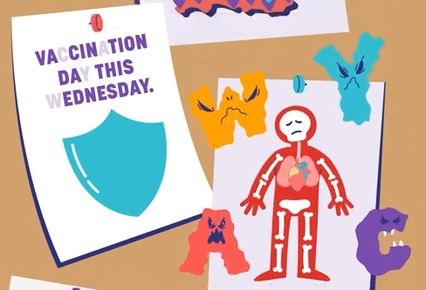
MenACWY vaccine
The MenACWY vaccine protects against some of the most common strains of meningococcal bacteria – A, C, W and Y. It is not complete protection against all types of meningococcal disease.
Meningococcal disease can cause:
  Meningitis - an infection of the lining of the brain;
  Sepsis - a life-threatening reaction to an infection that can harm your whole body.
  Both diseases are very serious, especially if not diagnosed early – they can both kill.
Notes:
1 in 10 people carry the bacteria without experiencing illness, this increases to 1 in 4 older teenagers. So, vaccinating teenagers should also help protect other people, including babies and older people, against meningococcal disease through herd immunity
If a dose of a MenACWY conjugate vaccine has already been given after 10 years of age a further teenage dose is not needed
Vaccination of individuals with uncertain or incomplete immunisation - GOV.UK (www.gov.uk)
If young people have older family members under the age of 25 that have not had their MenACWY vaccine please encourage them to make an appointment with their GP surgery
For more information about the meningococcal disease A, C, W & Y and the MenACWY vaccine, visit: www.phw.nhs.wales/MenACWYvaccine

Slide 23

MenACWY vaccine
Older teenagers are more likely to carry the bacteria and are more at risk of infection.
Meningococcal disease is spread by close contact. Living in close contact with others, such as university accommodation, increases the risk.
Vaccination helps reduce the risk of infection and stop the spread of the disease.
The vaccine is given as an injection in the upper arm, usually at the same time as the teenage 3-in-1 booster vaccine.
More information is available from phw.nhs.wales/MenACWYvaccine
Notes:
1 in 10 people carry the bacteria without experiencing illness, this increases to 1 in 4 older teenagers. So, vaccinating teenagers should also help protect other people, including babies and older people, against meningococcal disease through herd immunity
If a dose of a MenACWY conjugate vaccine has already been given after 10 years of age a further teenage dose is not needed
Vaccination of individuals with uncertain or incomplete immunisation - GOV.UK (www.gov.uk)
If young people have older family members under the age of 25 that have not had their MenACWY vaccine please encourage them to make an appointment with their GP surgery
For more information about the meningococcal disease A, C, W & Y and the MenACWY vaccine, visit: www.phw.nhs.wales/MenACWYvaccine

Slide 24
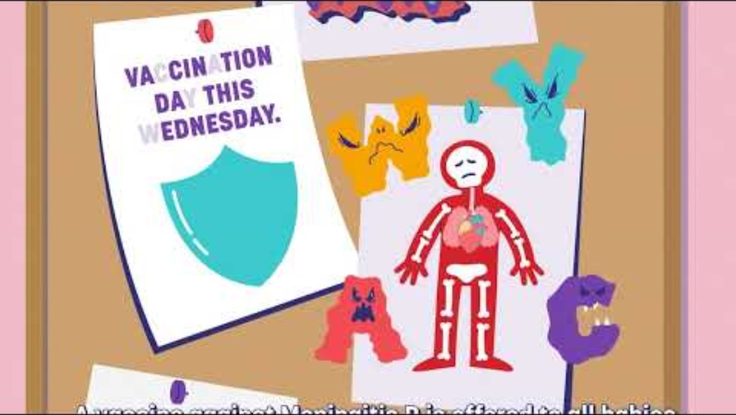
MenACWY animations
What is the MenACWY vaccine? - YouTube
Notes:
MenACWY and 3-in-1 animations
We’ve been working in partnership with Social Change UK to support the development of new educational resources focused on the MenACWY and Teenage 3-in-1 Booster vaccines.
The aim was to better understand the existing knowledge, attitudes, and experiences of young people aged 13 to 14, and to explore their preferences around how vaccination information is presented. This work helped inform the design and distribution of two new coproduced animations and comics, building on the suite of existing resources.
As part of the insight phase, two focus groups were conducted with a total of 17 Year 9 and 10 pupils from schools within the CTM and Swansea Bay University Health Board areas.
We gathered information regarding the structure of animations, considering aspects such as pacing, language and paralinguistics in order to really maintain attention.
Importantly, the test phase of the MenACWY/3in1 animations indicated that they were easy to understand, and they encouraged vaccination intention suggesting that the core information was effectively delivered.
The reasons students gave, including clarity, safety, and relevance reinforced the value of using animations to support vaccine communication – which is a key finding for us when we look to convey future vaccination information
Specifically referring to language, we found that terms such as ‘booster’ and ‘teenage’ resonated well with the audience and helped them better understand the content. We found that ‘Booster’ sounded positive and safe, while ‘teenage’ also made the vaccine feel more relevant to their age group. Based on this, and in alignment with the language young people found most accessible, we’re now using the term “Teenage 3-in-1 Booster” within PHW’s school-age vaccination programme.
Where are we now?: The animations, along with comic strips, are now complete and live on the Web Shop. The accompanying insights report featuring recommendations is currently being finalised and will be available soon on the Public Engagement insights web page

Slide 25
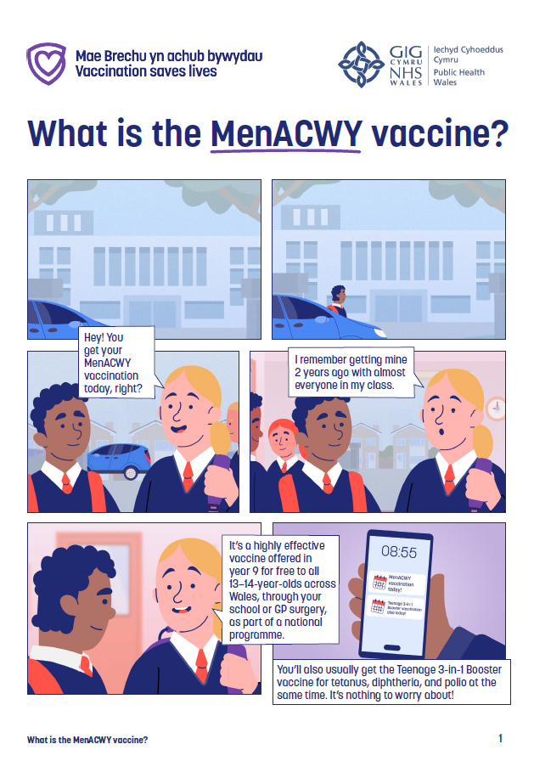
MenACWY comic
‘What is the MenACWY vaccine?’ comic, available here

Slide 26
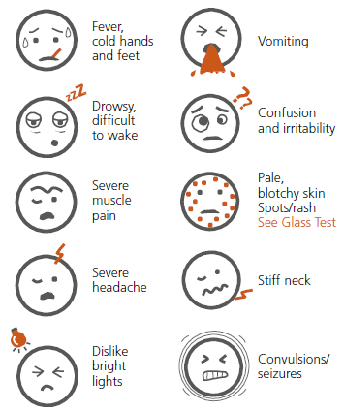
Meningitis and sepsis
MenACWY vaccine protects against some but not all causes of meningitis and sepsis, and no vaccine is 100% effective.
It is very important for you to know the signs of meningitis and sepsis.
You can become ill very quickly, and both meningitis and sepsis can kill.
Symptoms can appear in any order. Some may not appear at all.
Know the signs, look out for each other and trust your instincts.
Source: Meningitis Now
Notes:
https://www.meningitisnow.org/

Slide 27
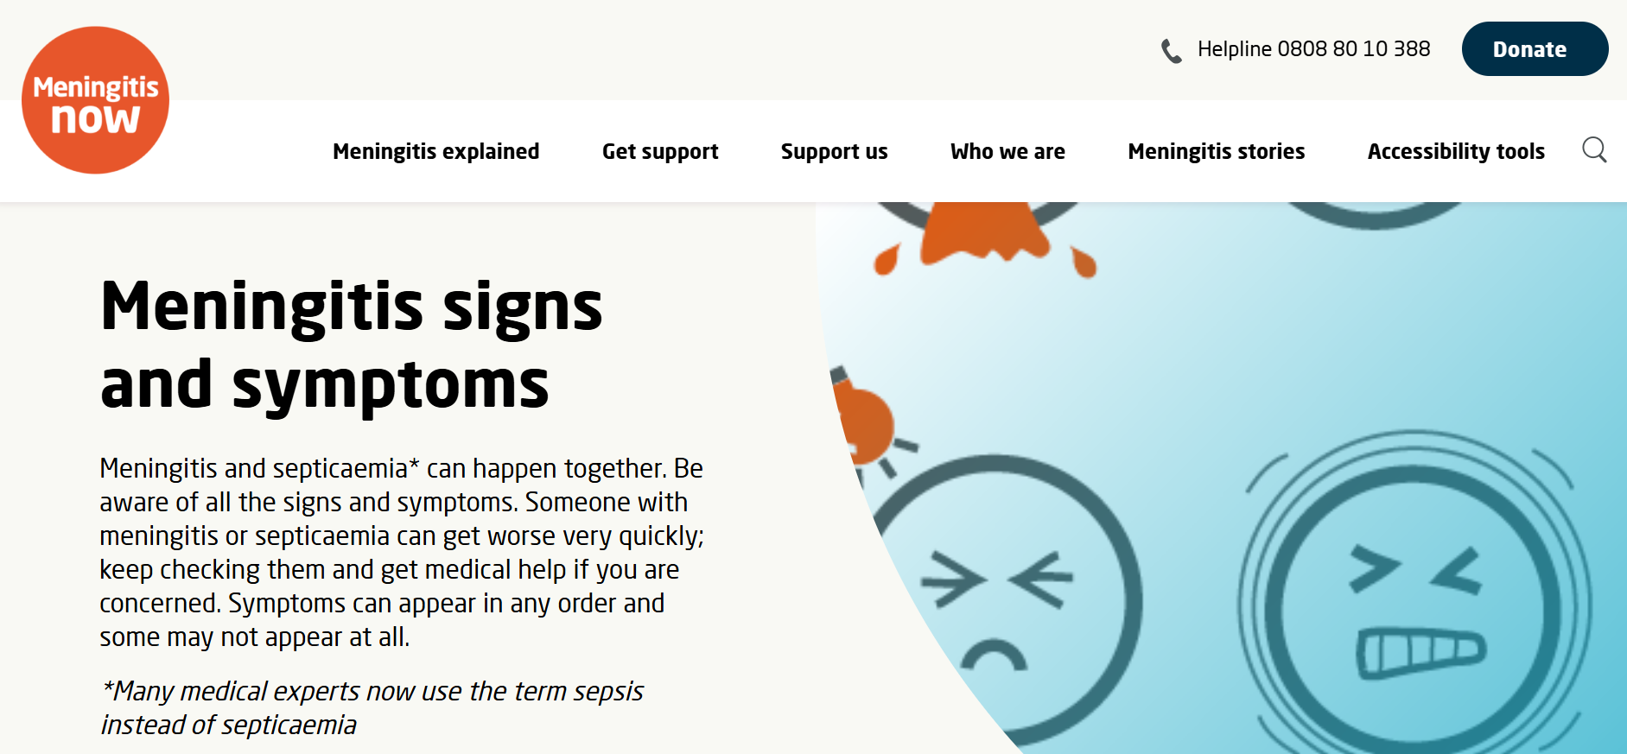
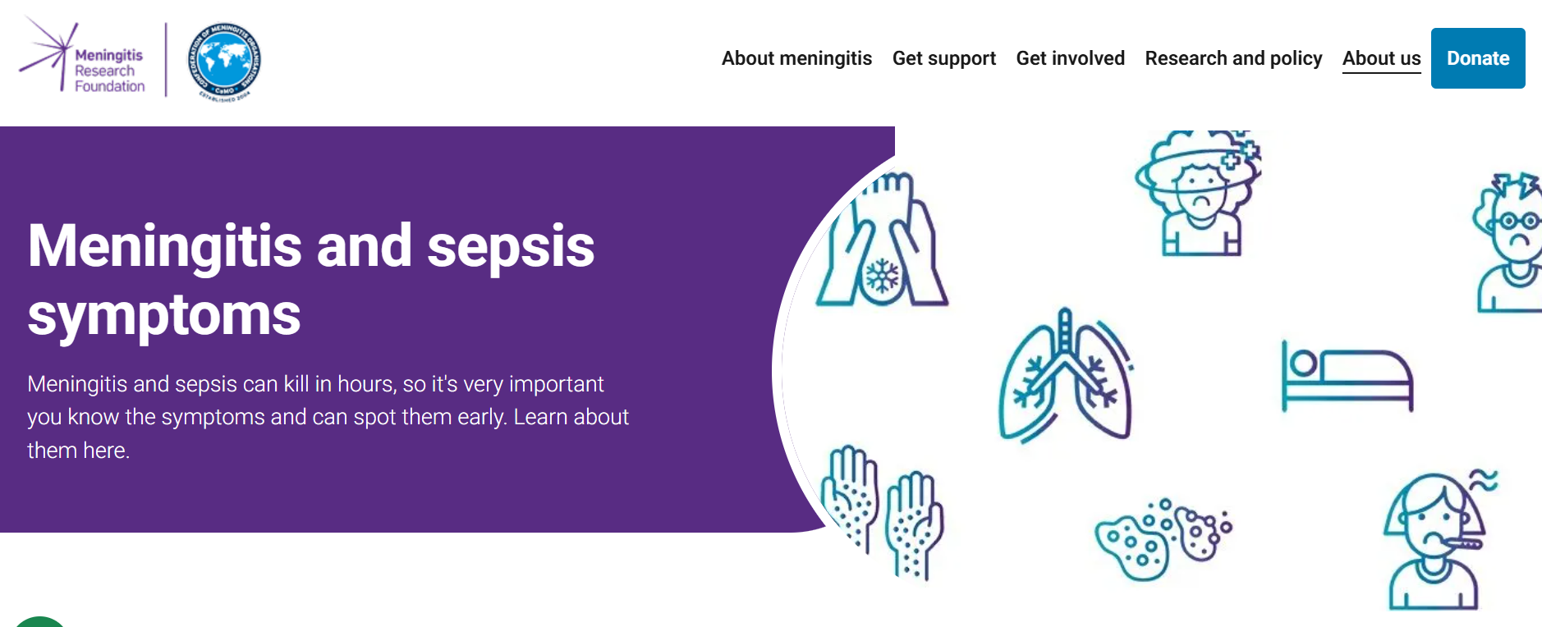
Meningitis and sepsis
If you think you or someone you know has meningitis or sepsis, don’t waste time, get medical help immediately.
More information on signs and symptoms of meningitis and sepsis are available from:
Meningitis now
Meningitis research foundation
Notes:
https://www.meningitisnow.org/

Slide 28
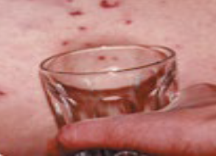
Meningitis and sepsis – the glass test
Someone with sepsis may develop a rash of tiny “pin pricks” which can turn into purple bruising. This rash does not fade under pressure.
Press the side of a clear glass firmly against the skin. Spots/rash may fade at first.
On dark skin the spots/rash can be more difficult to see. Check lighter areas such as the palms of the hands or the soles of the feet.
Keep checking.
Fever with spots/rash that does not fade under pressure is a medical emergency.
Source: Meningitis Now
Do not wait for a rash. If someone is ill and getting worse, get medical help immediately.

Slide 29
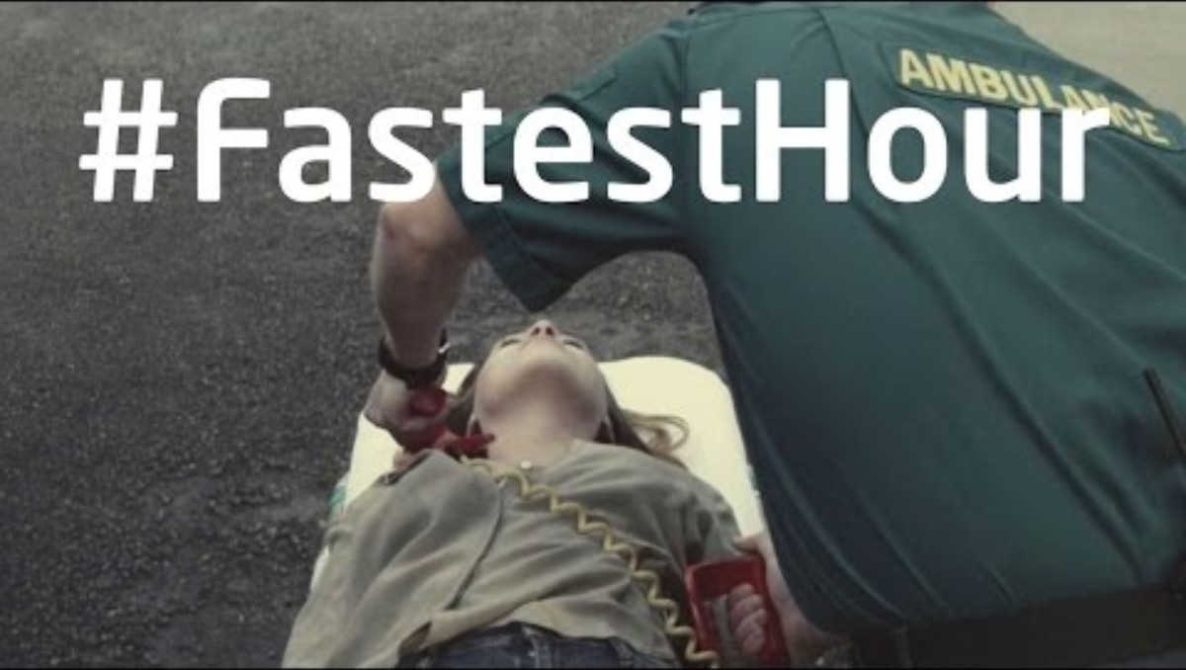
The Fastest Hour
Meningitis Now video (2017)
Meningitis Now: The #FastestHour - Awareness | Meningitis Now (youtube.com)

Slide 30
MMR vaccine

Slide 31

Measles, mumps and rubella (MMR) vaccine
Measles, mumps and rubella are 3 serious infections.
They are caused by viruses spread by coughs and sneezes.
All 3 infections can have serious complications.
Making sure you have had 2 doses of MMR will help protect you and your friends and family.
Children are offered 2 doses of the MMR vaccine before they start primary school. If you’ve missed these, it’s not too late!
Notes:
If one dose has already been given only one further dose is required no matter how long ago it was given. If two doses are required they can be given one month apart.
Anyone born after 1970 who has not had two doses of MMR vaccine can be vaccinated at their GP practice for free

Slide 32
Measles, mumps and rubella (MMR) vaccine
Measles
- Almost everyone infected will get a high fever, a rash and be very unwell.
- Complications of measles include infection of the lungs, brain and sometimes death.
Mumps
- Causes painful, swollen glands in the face, neck, jaw, a high fever and headache. Complications can include infection of the brain and brain covering.
- It can also cause painful swelling of the ovaries in women and the testicles in males.
- Mumps can sometimes cause death.
Rubella (also known as German measles).
- Symptoms are usually mild.
- Catching rubella while pregnant can be very serious for unborn babies. It can cause miscarriage and damage to the baby’s sight, hearing, heart and brain.
Notes:
If one dose has already been given only one further dose is required no matter how long ago it was given. If two doses are required they can be given one month apart.
Anyone born after 1970 who has not had two doses of MMR vaccine can be vaccinated at their GP practice for free

Slide 33
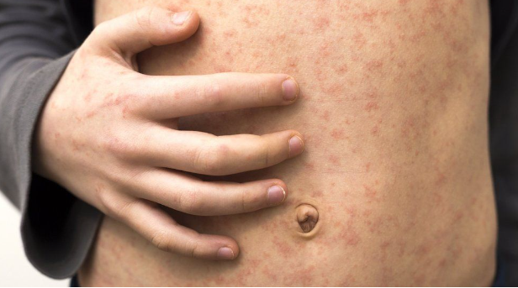
Measles in Wales
Measles is one of the world’s most contagious diseases.
It is spread by coughing and sneezing, close personal contact or direct contact with infected nasal or throat secretions.
It can be a very serious disease and can cause severe and life-threatening complications.
Before measles vaccination started in the UK, around 100 children died in England and Wales every year.
There is no cure for measles.
Source: BBC News
Notes:
For more information about measles, mumps, rubella and the MMR vaccine, visit: www.phw.nhs.wales/MMRvaccine

Slide 34
Measles in Wales
Between November 2012 and July 2013, a large outbreak of measles occurred in Wales. There were 447 cases of measles confirmed from the Mid and West Wales area, 64 cases were admitted to hospital and there was one death.
Since the outbreak in 2012/13, there has been a decrease in the number of cases of measles in Wales.
In Wales, there were 9 confirmed cases of measles in 2023, 8 of which were part of a measles outbreak in Cardiff.
In 2024, there was a significant rise in measles cases across the UK, with the UKHSA reporting 2,918 confirmed cases in England.
In April 2024, an outbreak of measles was declared in South-East Wales, resulting in 17 confirmed cases in total.
Notes:
For more information about measles, mumps, rubella and the MMR vaccine, visit: www.phw.nhs.wales/MMRvaccine

Slide 35
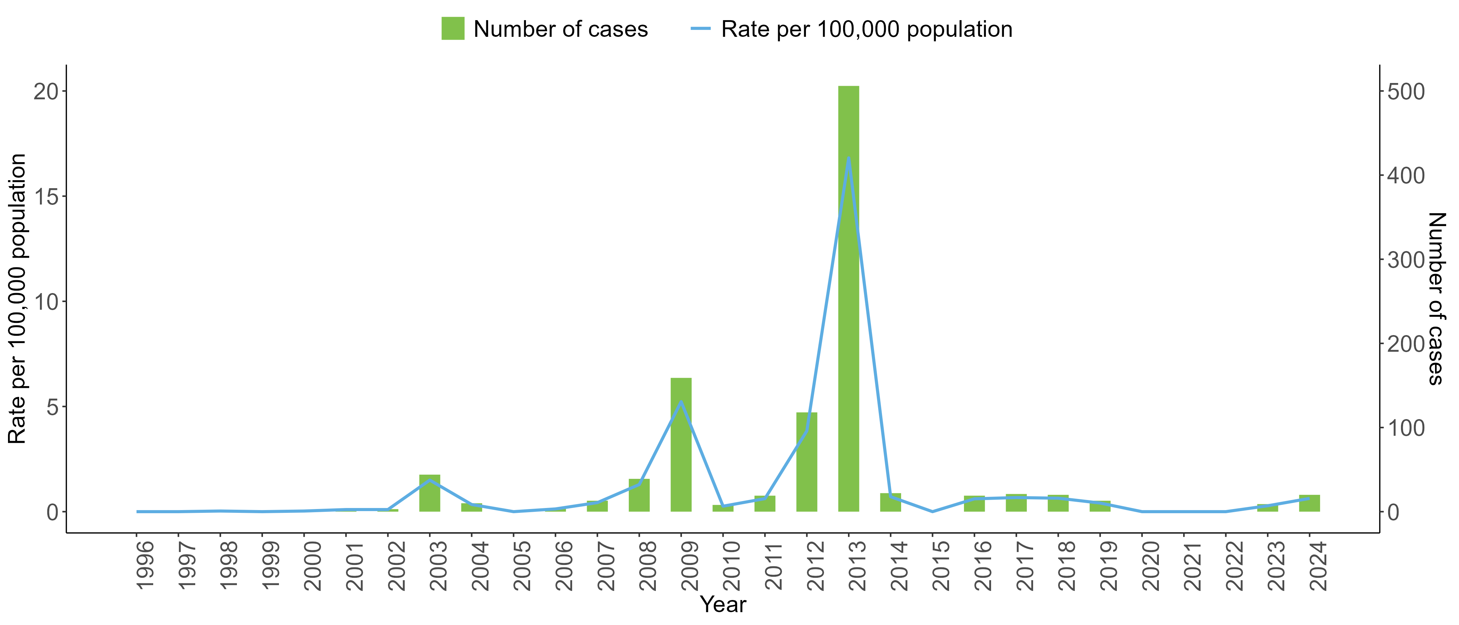
Chart showing the rate per 100,000 population and number of confirmed cases of measles in Wales from 1996-2024
Measles surveillance and epidemiology - Public Health Wales
Notes:
For more information about measles, mumps, rubella and the MMR vaccine, visit: www.phw.nhs.wales/MMRvaccine

Slide 36
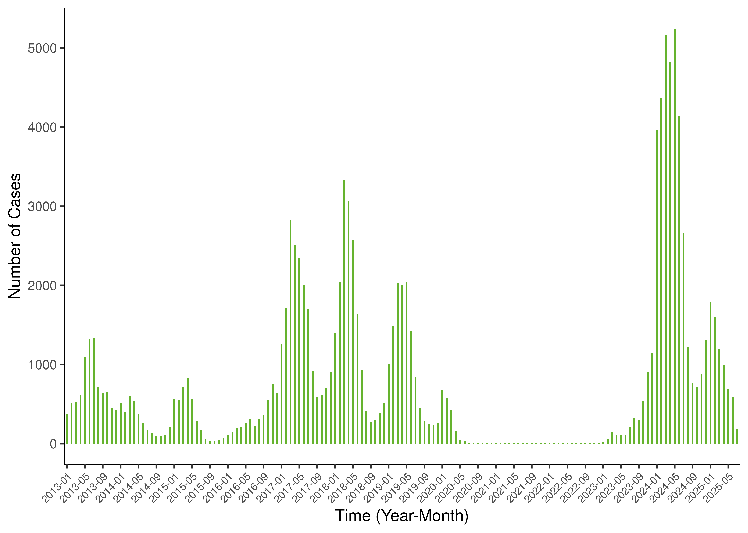
Measles in Europe
There has been a rise in cases of measles across Europe since 2023.
From 1 August 2024 to 31 July 2025, 30 EU/EEA Member States reported a total of 11,943 cases of measles.
Across the world 107,500 people died from measles in 2023, mostly children under the age of five years.
Making sure you have had two doses of the MMR vaccine will protect you and those around you.
Number of measles cases by month and year, EU/EEA, 1 January 2013 to 31 July 2025
https://measles-rubella-monthly.ecdc.europa.eu/
Notes:
https://www.ecdc.europa.eu/en/measles/surveillance-and-disease-data

Slide 37
What do you need to do?
Before the day:
- Familiarise yourself with the information about the vaccine.
- Talk through with your parent or guardian.
- Return the completed consent form as soon as possible. This may be a paper consent form or a digital e-consent form.
On the day:
- Wear suitable clothing (school polo shirt/short sleeve shirt).
- Have breakfast or a snack before the session.
- Know when/where to attend.
- Don’t be afraid to ask questions.
If you are nervous, speak to the nurse beforehand and they will be able to support you!
Notes:
May wish to discuss self consent with this slide
Gillick competence/ age of consent dependent on health board policy-further information on additional slides
Alongside the bullet point about wearing suitable clothing- depending on school uniform policy nurses can discuss wearing school tops with loose sleeves that can be rolled up or short sleeved shirts.

Slide 38
Consent
Consent means giving permission for something to happen.
The person giving you the vaccine will always check whether they have the necessary consent from you or a parent/guardian before giving the vaccination.
Young people aged 16 and over can consent for themselves.
In some cases, young people under the age of 16 may be able to give consent themselves, if they are assessed as mature enough to fully understand what is being offered.
Where young people give their own consent, it is still preferred that parents/guardians are involved in the decision making. If the young person agrees, the parent/guardian will be informed that the vaccination has been given.

Slide 39
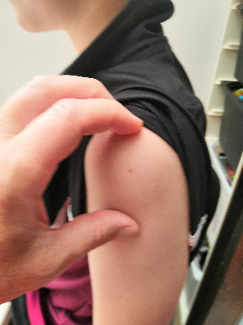
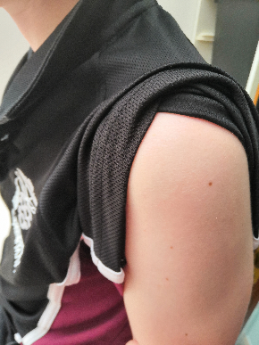
How and when are the vaccines given?
The vaccines will be offered to you in:
  year 8 for HPV;
  year 9 for the teenage 3-in-1 booster and MenACWY, (in some areas, these two are given by your GP surgery).
These vaccines are given as an injection into the muscle in the upper arm.

Slide 40
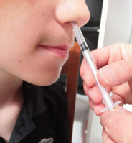
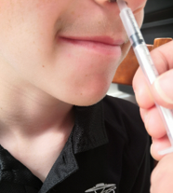
How and when are the vaccines given?
You need the flu vaccination each year and this is normally offered in the autumn school term.
  The flu vaccine is a nasal spray for most young people.
  Flu vaccination can be given as an injection in the upper arm if the nasal spray is unsuitable.

Slide 41
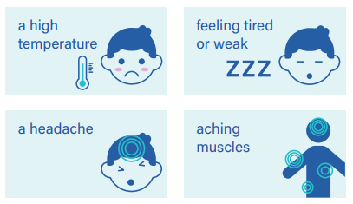
Are there any side effects?
Like all medicines, vaccines can cause side effects, but not everyone gets them.
Most side effects are mild and may last a day or two.
The nurse will advise you on what to expect after you've had your vaccine.
You do not need to miss school after having your vaccination!
Notes:
All vaccines can cause side effects

Slide 42
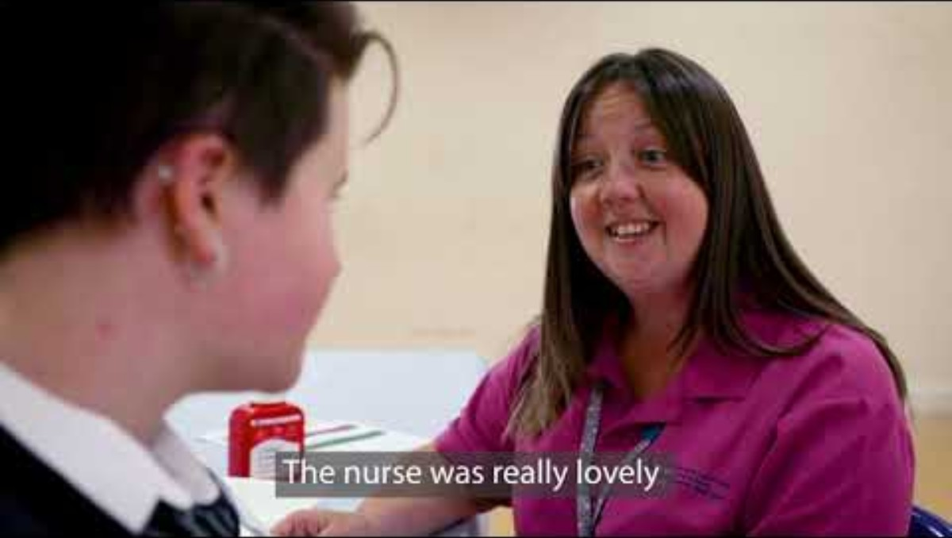
Get Immunised is a school-based vaccination video made by Aneurin Bevan UHB

Slide 43
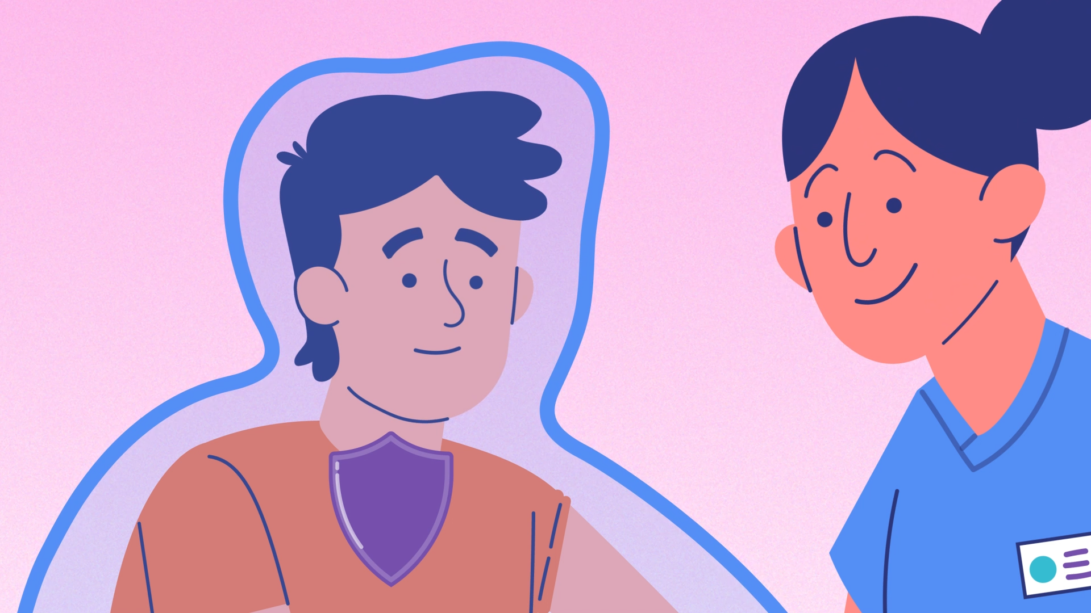
Key points
Vaccination is a way of helping to protect you and other people that can’t have vaccines against serious diseases.
Certain vaccines may be needed before you start university or college, for your chosen career, or before you travel to certain countries in the world.
Vaccines save lives!

Slide 44
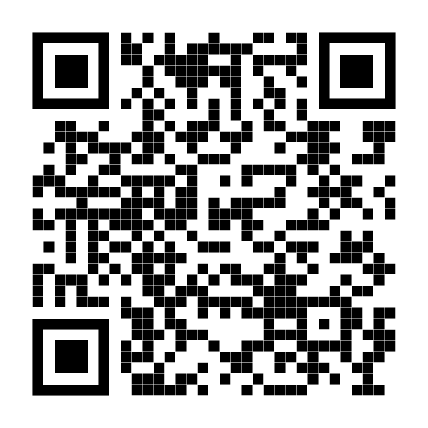
More information
You can find more information about vaccinations from:
  Your school nurse or immunisation team.
  Your GP surgery.
Go online and visit:
  phw.nhs.wales/vaccines
  Or scan the QR code to take you the vaccines page

