Slide 1
Vaccination against shingles (Herpes Zoster)
These slides are version controlled and subject to revision
Vaccine Preventable Disease Programme
Public Health Wales
Version 4 (11 September 2023)
Notes:
Material contained in this document may be reproduced without prior permission provided it is done so accurately and is not used in a misleading context.
Acknowledgement to Public Health Wales NHS Trust to be stated.
© 2023 Public Health Wales NHS Trust.
Version 2
Slide 37 and 56: Updated Green book advice on co-administration - update to the COVID-19: the green book, chapter 14a - GOV.UK (www.gov.uk) indicates that COVID-19 vaccines can be given at the same time as other vaccines, including flu vaccines.
Version 3 (1 September 2023)
Completed slide set update: Updated to align with proposed changes to shingles programme from 01 September 2023
Version 4 (11 September 2023)
Slide 45: Slide content and notes section updated to align with recently updated UKHSA Shingles vaccination: guidance for healthcare professionals: https://www.gov.uk/government/publications/shingles-vaccination-guidance-for-healthcare-professionals
Slide 48: Slide content and notes section updated to align with recently updated UKHSA Shingles vaccination: guidance for healthcare professionals: https://www.gov.uk/government/publications/shingles-vaccination-guidance-for-healthcare-professionals
Slide 49 and 50: Added slide “Immunosuppressed individuals who develop a varicella rash following inadvertent vaccination with Zostavax®” to provide further information to healthcare practitioners. Aligned with Green Book Chapter 28a: Shingles (up to 31/08/2023): Shingles (herpes zoster): the green book, chapter 28a - GOV.UK (www.gov.uk) / https://www.gov.uk/government/publications/shingles-herpes-zoster-the-green-book-chapter-28a and UKHSA Shingles vaccination: guidance for healthcare professionals: https://www.gov.uk/government/publications/shingles-vaccination-guidance-for-healthcare-professionals
Slide 57: Slide content and notes section updated to align with recently updated UKHSA Shingles vaccination: guidance for healthcare professionals https://www.gov.uk/government/publications/shingles-vaccination-guidance-for-healthcare-professionals
Slide 64: Slide content and notes section updated to align with recently updated UKHSA Shingles vaccination: guidance for healthcare professionals https://www.gov.uk/government/publications/shingles-vaccination-guidance-for-healthcare-professionals
Slide 65: Slide content and notes section updated to align with recently updated UKHSA Shingles vaccination: guidance for healthcare professionals: https://www.gov.uk/government/publications/shingles-vaccination-guidance-for-healthcare-professionals
Slide 78: Resource information updated
Slide 79: Image of ‘Visual aid for healthcare professionals’ added to slide

Slide 2
Vaccination against shingles (Herpes Zoster)
The information contained within this slide set is up to date as of 11 September 2023. ​It is important that all immunisers delivering the shingles vaccination programme and or those who are providing immunisation advice familiarise themselves with the most up to date clinical evidence and guidance, this can be found in the following key documents:
Shingles (Herpes Zoster): the green book, chapter 28a: https://www.gov.uk/government/publications/shingles-herpes-zoster-the-green-book-chapter-28a. **Please note there will be two shingles chapters running concurrently until stocks of Zostavax® deplete**
UKHSA Shingles vaccination: guidance for healthcare professionals: https://www.gov.uk/government/publications/shingles-vaccination-guidance-for-healthcare-professionals.
Shingles vaccination programme microsite page is available here: Shingles - Information for health professionals - Public Health Wales (nhs.wales).
****Please note the Green Book Chapter 28a: Shingles provides both policy (for England) and clinical information, in addition the UKHSA Shingles immunisation programme: information for healthcare practitioners offers more detail on some information in the Green Book****
The content of this training slide set is subject to review, this resource will be version controlled. This is version 4 dated 11 September 2023.
Notes:
Background
In 2010, the Joint Committee on Vaccination and Immunisation (JCVI) was asked by the Secretary of State for Health to review the available evidence relevant to the introduction of a universal vaccination programme to protect against shingles (Herpes Zoster).
The JCVI considered a range of issues including disease epidemiology, vaccine efficacy, vaccine safety and the cost effectiveness of introducing a routine shingles vaccination programme in the UK. Based on the findings of the cost-effectiveness analysis, the JCVI recommended a universal routine herpes zoster (shingles) vaccination programme using a single dose of the live Zostavax® shingles vaccine for adults aged 70 with a catch-up programme for those aged 71 to 79 years. Individuals who reached their 80th birthday were not eligible for a shingles vaccination due to the reduced efficacy of Zostavax® vaccine with increased age.
From September 2013, a single dose of Zostavax® shingles vaccine was offered routinely to individuals aged 70 years (born on or after 1 September 1942) with a phased catch up programme based on age as of 1 September that year. From August 2021 Shingrix® vaccine was introduced as an alternative vaccine for immunocompromised individuals.
From September 2023 Shingrix® will be offered to all severely immunosuppressed individuals from 50 years of age and to immunocompetent individuals from 60 years of age over a 10 year phased introduction.
This resource is designed to support healthcare practitioners involved in discussing and delivering the routine vaccination against shingles with the changes to the vaccine programme from 01 September 2023.
It is to support healthcare practitioners involved in discussing routine vaccination against shingles.
This resource does not cover the actual administration techniques involved in vaccinating against shingles. If staff are required to deliver vaccinations they should refer to their line manager for additional training.
Note: shingles is also known as herpes zoster. Shingles is used throughout this slide set.

Slide 3
Immunisation against infectious disease
(the Green Book) Shingles (herpes zoster) chapter 28a
There will be 2 Green Book Shingles chapters in use prior to 1 September 2023:
  the current chapter (dated 23 August 2021) which contains information about Zostavax®. This chapter will be removed once Zostavax® is no longer available to order through ImmForm
  the updated chapter (dated 17 July 2023) which includes information about the shingles vaccine programme from 1 September 2023 onwards

Slide 4
Pre-requisites to administering shingles vaccine
Before administering a shingles vaccine, it is recommended you have:
Undertaken training in the management of anaphylaxis and Basic Life Support as specified by policy for your local area and are familiar with Resuscitation Council UK (RCUK) guidance on Management of Anaphylaxis in the Vaccination Setting.
Undertaken any additional statutory and mandatory training as required by your employer
Received appropriate shingles vaccine training, if you are a new immuniser a competency assessment is recommended - competency assessment tool: Publications | Royal College of Nursing (rcn.org.uk).
An appropriate legal framework to supply and administer shingles vaccine in place e.g. patient specific prescription, Patient Specific Direction (PSD), Patient Group Direction (PGD). Further information will be available here: Patient Group Directions (PGDs) and Protocols Landing Page - Public Health Wales (nhs.wales) and Patient Group Directions (PGD) - Welsh Medicines Advice Service (wales.nhs.uk)
Described the process of consent and how this applies when giving vaccines.
Accessed and familiarised yourself with the following key documents: Shingles, Green Book Chapter 28a, Vaccination against shingles: Information for healthcare practitioners: Vaccination against shingles(publishing.service.gov.uk)
Notes:
Practitioners should always ensure they are accessing the most up to date information and guidance.

Slide 5
Acknowledgements
Public Health Wales, Vaccine Preventable Disease Programme.
UK Health Security Agency (UKHSA) https://www.gov.uk/government/collections/shingles-vaccination-programme.
UKHSA Shingles training slide set (2023)* https://www.gov.uk/government/collections/shingles-vaccination-programme.
Public Health Scotland Screening Tool for Contraindications for Shingles Vaccine - version 16 - Screening Tool for Contraindications for Shingles Vaccine - Publications - Public Health Scotland.
Other references included in slides or footer notes.
Notes:
*including UKHSA Training slides: August 2021 (Text transferred to UK Health Security Agency (UKHSA) template January 2022) (Available on request)

Slide 6
Learning outcomes
After completing this training, immunisers will be able to:
  Describe the aetiology and epidemiology of shingles.
  Describe the relationship between shingles and chickenpox (varicella zoster) and the severity of the disease.
  Discuss the important role of vaccination against shingles.
  Describe the changes to the routine shingles vaccine programme from 1 September 2023.
  Identify sources of additional information.
Notes:
Content
Shingles infection
Epidemiology
Shingles vaccine
National shingles vaccination programme
Resources

Slide 7
Shingles

Slide 8
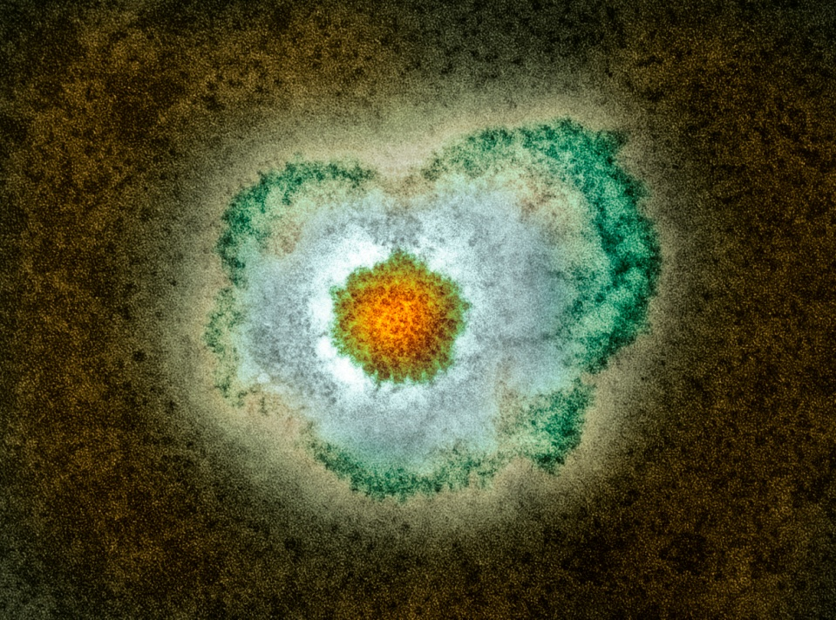
Shingles infection
Shingles is a viral infection of the nerve cells and surrounding skin.
After a person recovers from chickenpox infection (caused by the varicella zoster virus), the virus remains dormant in the nerve cells and can reactivate at a later stage when the immune system is weakened.
Reactivation of the dormant virus leads to the clinical manifestation of shingles.
Reactivation can be associated with older age, malignancy, immunosuppressant therapy or HIV infection.
Notes:
Shingles (herpes zoster) is caused by the reactivation of a latent varicella zoster virus (VZV) infection, generally decades after the primary infection
Following primary VZV infection, the virus enters the sensory nerves and travels along the nerve to the sensory dorsal root ganglia and establishes a permanent latent infection
Increasing incidence of shingles infection among older age groups is thought to be associated with a decline in cell mediated immunity to varicella zoster virus (i)
Although rare, it is possible to have shingles more than once
Shingles is not caused by the same virus that causes genital herpes
(i) Green Book Chapter 1:
Immunity and how vaccines work: the green book, chapter 1 - GOV.UK (www.gov.uk)

Slide 9
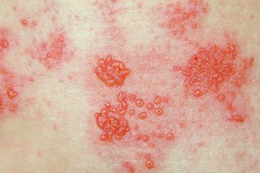
Clinical presentation of shingles (1)
Prodromal phase – the first signs of shingles may include:
  Abnormal skin sensations and pain in the affected area of skin (dermatone).
  Headache
  Feeling generally unwell
  Photophobia
  Malaise
  Fever (although this is less common)
Individuals usually experience a prodromal phase and within days or weeks a unilateral vesicular rash typically appears in a dermatomal distribution.
Image source: www.nhs.uk/conditions/shingles/
Notes:
Diagnosis | Diagnosis | Shingles | CKS | NICE
Shingles (herpes zoster): the green book, chapter 28a - GOV.UK (www.gov.uk)
Images of shingles available NHS site: www.nhs.uk/conditions/shingles/

Slide 10
Clinical presentation of shingles (2)
Acute stage
A rash of fluid filled blisters develops after a few days, commonly on one side of the face or body, usually within the distribution of a dermatome (an area of skin that is supplied by a single nerve).
The rash often causes intense pain, burning, tingling, itching or numbness in the area of the affected nerve.
The rash forms blisters that typically scab over in 7 to 10 days, this eventually clears within 2 to 4 weeks.
In individuals with weakened immune systems, a more disseminated rash covering multiple dermatomes may occur and this may appear similar to the chickenpox rash.
Notes:
Shingles (herpes zoster): the green book, chapter 28a - GOV.UK (www.gov.uk)
Shingles can affect any part of the body, although most commonly affected areas include face (including eyes) chest and abdomen.
Individuals may also experience pain in the arms and legs and may feel exhausted.
A dermatome can be defined as an area of skin that is supplied by a single nerve. Shingles can affect one or more isolated dermatomes.

Slide 11
Possible complications of shingles
Shingles is more likely in adults aged 50 years and over, with the severity of the illness increasing with age.
Most common complications are:
Post herpetic neuralgia (PHN).
Secondary bacterial skin infections.
Less common complications can include:
Ophthalmic zoster (leading to keratitis, corneal ulceration, conjunctivitis, retinitis, optic neuritis and or glaucoma).
Peripheral motor neuropathy.
Rare complications can include:
Systemic dissemination (disseminated into the lungs, liver, gut, and brain, leading to pneumonia, hepatitis, encephalitis, and disseminated intravascular coagulopathy). This is more likely to occur in individuals who are severely immunocompromised with a case fatality rate reported to be between 5 and 15%, and most deaths being attributable to pneumonia .
In severe cases, shingles can lead to hospitalisation and death.
Notes:
Shingles can cause a number of secondary complications and the severity of these can be dependent on how weak the individual’s immune system is.
Most commonly reported complications in the older age groups include secondary bacterial infections at the site of the rash (that may require antibiotic therapy) and post herpetic neuralgia.
Other less common complications can include ophthalmic shingles and peripheral motor neuropathy. Ophthalmic shingles affects the facial nerve (trigeminal) and can cause ulceration and scarring of the eye and uveitis (inflammation of the inner eye). Ophthalmic shingles can also cause loss of vision if untreated and is often associated with long term pain. Estimates show between 10 and 20% of shingles cases result in ophthalmic zoster with approximately 4% of these cases resulting in long term sequelae
Peripheral motor neuropathy is more common in the elderly population and results in temporary nerve damage (peripheral motor nerve) that controls movement (peripheral motor nerve) of limbs such as the arm or leg, causing paralysis in the associated limb. This effect is temporary and individuals can make a good recovery
Shingles (herpes zoster): the green book, chapter 28a - GOV.UK (www.gov.uk)
Complications | Background information | Shingles | CKS | NICE

Slide 12
Post Herpetic Neuralgia (PHN)
Post herpetic neuralgia (PHN) is a common complication of shingles in older adults:
PHN is a pain at the rash site that persists for, or appears more than 90 days after the onset of the shingles rash.
On average PHN lasts from 3 to 6 months, but can persist for longer.
Severity of pain may be constant, intermittent or triggered by stimulation of affected area such as a breeze on the face.
The pain may be a burning, itching, stabbing or aching pain which is extremely sensitive to touch and not generally relieved by common painkillers.
PHN is more likely to develop, and is more severe, in people over the age of 50, with one third of sufferers over the age of 80 experiencing intense pain.
Notes:
PHN is defined as an intense pain that persists for, or develops after 90 days following the onset of the shingles rash and can persist between for 3 and 6 months. This pain can last longer and is dependent on the individual’s immune system.
As the pain can be intense and is not generally relieved by common pain killers, PHN can have a negative impact on the individuals quality of life. PHN can contribute to fatigue, insomnia, depression, anxiety and can impair the basic activities of daily living for the individual.
Green book, Chapter 28a Shingles: Shingles (herpes zoster): the green book, chapter 28a - GOV.UK (www.gov.uk) https://www.gov.uk/government/publications/shingles-herpes-zoster-the-green-book-chapter-28a
Oxman MN and others (2005). A vaccine to prevent herpes zoster and postherpetic neuralgia in older adults New England Journal of Medicine 2005: volume 352 issue 22, pages 2271-84
Diagnosis | Diagnosis | Post-herpetic neuralgia | CKS | NICE
Complications | Background information | Shingles | CKS | NICE

Slide 13
Infectious period
A person with shingles is only infectious when the rash is present and fluid filled vesicles are present.
A person is not infectious before the rash is present or when the rash has crusted.
Shingles is less infectious than chickenpox and covering the rash will greatly reduce the risk of exposure to those non-immune to chickenpox.
Note: The fluid from the rash vesicles can spread chickenpox to those who have not had it. Transmission of VZV can occur following direct contact with herpes zoster lesions, resulting in chickenpox in contacts who are susceptible to VZV.
Therefore, individuals at high risk of severe complications from varicella infection should be assessed for the need for post exposure management with antivirals or varicella zoster immunoglobulin (see Green Book Shingles Chapter 34 (publishing.service.gov.uk) for further details).
Individuals with shingles should try to avoid:
Pregnant women who have not had chickenpox before.
People with a weakened immune system - like someone having chemotherapy.
Babies less than 1 month old.
Notes:
https://assets.publishing.service.gov.uk/government/uploads/system/uploads/attachment_data/file/1012943/Green_book_of_immunisation_28a_Shingles.pdf:
Management of at-risk individuals following significant exposure to chickenpox or herpes zoster: The aim of post-exposure management is to protect individuals at high risk of suffering from severe varicella and those who may transmit infection to those at high risk (e.g. healthcare workers). VZIG prophylaxis is recommended for individuals who fulfil all of the following three criteria: ● significant exposure to chickenpox or herpes zoster ● a clinical condition that increases the risk of severe varicella; this includes immunosuppressed patients, neonates and pregnant women (see below) ● no antibodies to VZ virus Chapter 34 (publishing.service.gov.uk)
https://www.nhs.uk/conditions/shingles/

Slide 14
Transmission
The varicella virus that causes shingles (herpes zoster) is the same virus that causes chickenpox (varicella zoster).
Shingles is not spread through coughing, sneezing or casual contact.
Shingles cannot be transmitted from one person to another.
A person exposed to shingles will not develop shingles.
A person exposed to chickenpox will not develop shingles.
A person who has not had chickenpox may develop chickenpox as a result of exposure to the herpes zoster virus through direct contact with the fluid filled blisters from someone who has shingles.
Notes:
Infection with varicella zoster (chickenpox) is a pre-requisite for the development of shingles
You do not develop shingles from being in contact with chickenpox
Shingles cannot be transmitted from one person to another, although it can cause chickenpox in individuals who have not previously had the disease and who have direct contact with the fluid from the shingles vesicles
https://www.gov.uk/government/publications/shingles-herpes-zoster-the-green-book-chapter-28a

Slide 15
Epidemiology and Surveillance

Slide 16
Incidence of Shingles
Each year, approximately 750 cases of shingles are diagnosed by GPs per 100,000 people aged 65y and over in Wales¹
In Wales approximately 60 cases of PHN are diagnosed by GPs per 100,000 people aged 65y and over each year²
During April 2021 to March 2022 there were 90 people aged 65 and over admitted to hospital with shingles²
1 in 1,000 cases of shingles in people 70 years of age and over are estimated to result in death³.
The risk of shingles is higher in individuals with certain conditions, including lupus, rheumatoid arthritis, diabetes and granulomatosis with polyangiitis (an auto immune disease leading to small vessel vasculitis^{)4.}
Notes:
¹Data taken from Audit+ (2023)
²Data taken from Patient Episode Database Wales (PEDW) (2023)
³UKHSA (2023) Immunisation against infectious disease. Chapter 28a Shingles [online] due to the nature of the population and risk of co-morbidities some deaths recorded as being shingles-related may not be directly attributable to the disease
⁴ UKHSA (2023) Immunisation against infectious disease. Chapter 28a Shingles [online]. The risk of shingles is also increased in individuals with certain conditions, including systemic lupus erythematosus (Nagasawa et al.,1990), rheumatoid arthritis (Smitten et al., 2007), diabetes (Heymann et al 2008) and Wegener’s granulomatosis. (Wung et al., 2005).

Slide 17
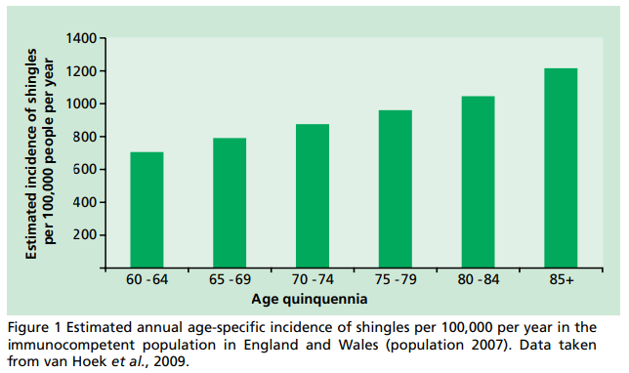
Epidemiology of shingles in
England and Wales
Source: Green Book of immunisation - Chapter 28a Shingles (publishing.service.gov.uk)
Notes:
The above graph shows the estimated annual age-specific incidence of shingles per 100, 000 per year in the immunocompetent population (Y-axis) against the age quinquennia (X-axis).
The graph shows a continued increase in age related shingles, confirming that the incidence of shingles is largely associated with older age who are more at risk of developing the disease.
Age-specific incidence rates of shingles have been estimated using a number of different primary care derived data sources including: the Royal College of General Practitioners (RCGP) Weekly Returns Service; the fourth Morbidity Survey in General Practice (MSGP-4), and the General Practice Research Database
These are estimates (based on available data sources) as shingles is only clinically diagnosed, thus no lab confirmation of this is available. Actual figures may be much higher.

Slide 18
Vaccine coverage
Since the introduction of the Shingles vaccination programme in 2013 there has been a year on year decline in timely vaccine uptake.
Coverage increases over time as people have been eligible for longer but remains suboptimal.
Efforts to identify and vaccinate all eligible individuals are needed to achieve a continuing reduction in the number of cases of this debilitating and painful condition.
All those advising on or administering the shingles vaccine should take every opportunity to offer vaccination to eligible patients as soon as they become eligible to help to protect them from this serious illness.

Slide 19
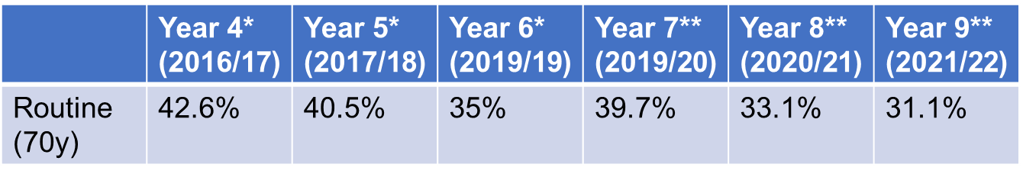
Shingles vaccine coverage data: Wales
Shingles vaccination was successfully introduced in Wales during September 2013.
Since then, there has been a year on year decline in vaccine uptake (coverage) in the newly eligible routine cohort (70-year-old).
(Information in Table above relates to year from April – March)
*Age 70 as at previous September
** Age 70 as at extract date (end March)
NB. Data in 2020 to 2021 has dropped and is most likely due to the coronavirus (COVID-19) pandemic.
Data to monitor shingles immunisation in Wales are provided to Public Health Wales (PHW) by General Practices through Audit+
Notes:
It is important that general practices consider how they can optimise the uptake of shingles vaccine in eligible patients in order to reduce the significant burden of disease associated with shingles among older adults.

Slide 20
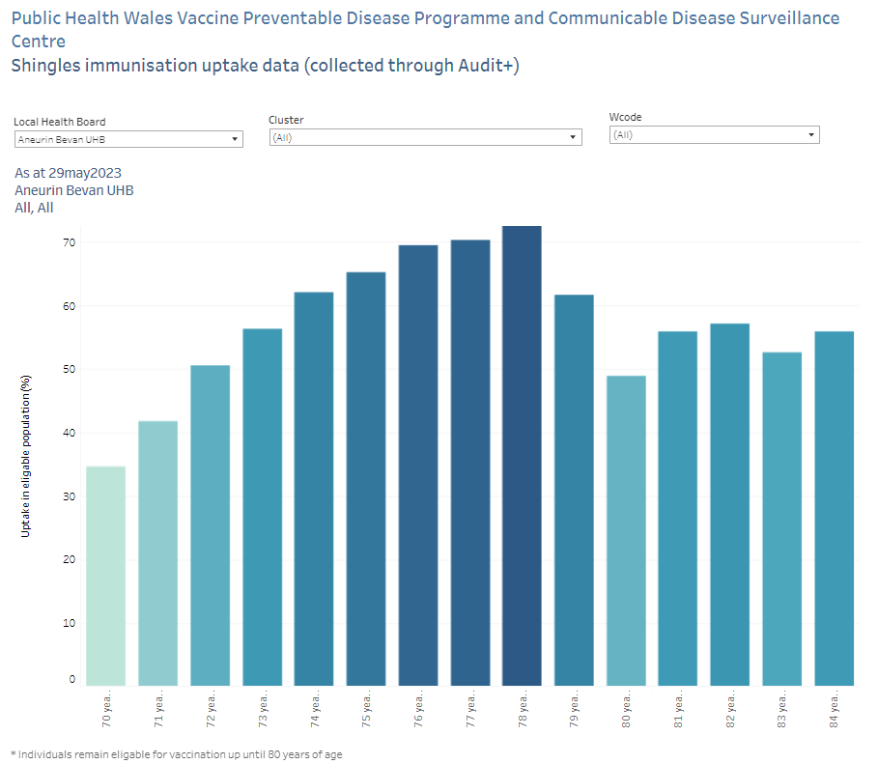
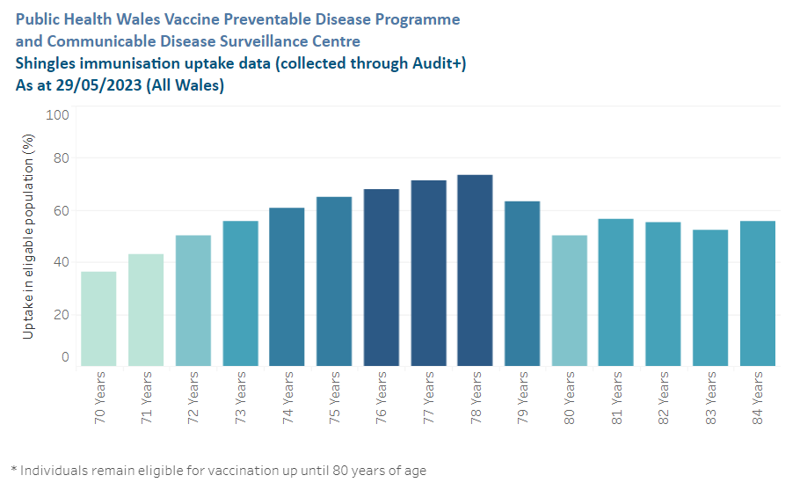
National and HB level Shingles dashboard - ENGLISH | Tableau Public
GP_Shingles: GP Shingles - Tableau Server (cymru.nhs.uk)
Notes:
Shingles vaccine uptake by HB can be viewed here: National and HB level Shingles dashboard - ENGLISH | Tableau Public
Shingle vaccine uptake by GP and cluster is available here: GP_Shingles: GP Shingles - Tableau Server (cymru.nhs.uk)

Slide 21
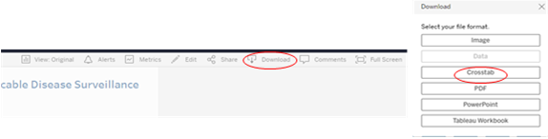
Cluster and GP level data
A GP and cluster level shingles immunisation summary has been developed and can be found on the VPDP SharePoint Surveillance Page.
The interactive dashboard summarises shingles immunisation uptake data for those aged 70-84 years (individuals remain eligible for vaccination until 80 years of age).
The data on which the report is based are submitted from general practices through Audit+ and the dashboard will be updated on a monthly basis.
The dashboard data can be exported to Excel by clicking on the Download button at the top right of the dashboard and selecting Crosstab – see screenshots below:
Notes:
Shingle vaccine uptake by GP and cluster is available here: GP_Shingles: GP Shingles - Tableau Server (cymru.nhs.uk)

Slide 22
Evaluation of the shingles vaccination programme
In 2020 an England population based study¹ estimated that the impact of herpes zoster vaccination in the 5 years after the introduction for 70-79 yr. olds in England in September 2013 was:
40,500 fewer herpes zoster GP consultations.
1,840 fewer herpes zoster hospitalisations (including 540 PHN consultations).
These reductions were consistent with a vaccine effectiveness of:
between 37% (for hospitalised zoster) and 75% (for PHN consultations) in the routine cohorts (vaccinated aged 70)
between 49% (for hospitalised PHN) and 66% (for PHN consultations) in catch up cohorts (vaccinated aged 78 to 79)
Public Health Wales are working on a study which will be shared when available, however the data from England highlights the effectiveness of the shingles vaccine programme.
Notes:
¹https://bmjopen.bmj.com/content/bmjopen/10/7/e037458.full.pdf
Impact of the herpes zoster vaccination programme on hospitalised and general practice consulted herpes zoster in the 5 years after its introduction in England: a population-based study
Andrews N, Stowe J, Kuyumdzhieva G, Sile B, Yonova I, de Lusignan S, Ramsay M, Amirthalingam G
Izurieta H S et al (2021) Recombinant Zoster Vaccine (Shingrix®): Real-World Effectiveness in the First 2 Years Post-Licensure Recombinant Zoster Vaccine (Shingrix): Real-World Effectiveness in the First 2 Years Post-Licensure | Clinical Infectious Diseases | Oxford Academic (oup.com)

Slide 23
Shingles vaccination programme

Slide 24
Changes to the shingles vaccination programme from 1 September 2023
In February 2019, based on impact and cost effectiveness modelling, the JCVI recommended that the national shingles immunisation programme be changed such that Shingrix® is offered to:
  immunocompetent individuals routinely at 60 years of age
  immunocompromised individuals aged 50 years old and over
JCVI also advised a catch-up of 60 to 70 year olds that should be implemented in stages, starting with vaccination of those turning 65 and 70 years old, then moving to vaccination of those turning 60 and 65 years old, following which time vaccination could then be routinely offered to those turning 60 years old
The advice was based on the high efficacy, safety, and immunogenicity of Shingrix® observed in clinical trials
Evidence suggests that Shingrix® provides a substantially longer duration of protection from shingles than Zostavax®
There is now sufficient supply of Shingrix® to implement the JCVI recommendations
The changes to the programme should be implemented from 1 September 2023

Slide 25
Key messages about changes to the shingles programme (1)
Change of vaccine
From 1 September 2023 (in line with JCVI advice and WHC Change of vaccine and cohort expansion for shingles vaccination programme (from September 2023) (WHC/2023/024):
Shingrix® will replace Zostavax® for the shingles programme.
Shingrix® will require a 2-dose schedule for all cohorts but the dosing interval will differ for immunocompromised (severely immunosuppressed) and immunocompetent patients.
Individuals who have received Zostavax® previously as part of the routine programme (between 70 and 79) should not be revaccinated with Shingrix®
Shingrix® should be offered to all people reaching the eligible age on or after 1 September 2023
Shingles vaccination should continue to be offered year-round: patients can be immunised with shingles vaccine at any point in the year as soon as they reach eligible age.
The cohort previously eligible for Zostavax® (aged 70 before 01 September 2023 to under 80), should continue to be offered Zostavax® until central (via Immform) and local stocks deplete, after which they should be offered Shingrix®
Shingrix® can be administered at the same time as, or at any interval from, other vaccines including influenza vaccines and the 23-valent pneumococcal polysaccharide vaccine (PPV23). Refer to the Shingles Green Book chapter 28a for more information.
It is important that healthcare professionals continue to encourage and offer vaccination to all eligible patients.
Notes:
Individuals given Zostavax® before 60 years of age Immunocompetent and mildly immunosuppressed individuals given Zostavax® before 60 years of age should be offered the Shingrix® vaccine once they reach the eligible age for shingles vaccine via the national programme, leaving an interval of 5 years since the last dose of Zostavax® vaccine.
Severely immunosuppressed individuals (definition in the Green Book Shingles chapter 28a) who were given Zostavax®, for example pre immunosuppressive treatment, and before 50 years of age, should be given the Shingrix® vaccine when they reach the eligible age for the vaccine on the national programme. There is no reason to leave any interval after a previous Zostavax® vaccine for this group. Shingles immunisation programme: information for healthcare practitioners - GOV.UK (www.gov.uk)

Slide 26
Key messages about changes to the programme (2) Changes to eligibility (1)
From 1 September 2023 (in line with JCVI advice and WHC Change of vaccine and cohort expansion for shingles vaccination programme (from September 2023) (WHC/2023/024):
Immunocompromised (severely immunosuppressed) cohort
Since September 2021, Shingrix® has been available for immunocompromised individuals aged 70 to 79 years, who are contraindicated to receive Zostavax®.
The forthcoming change from 1 September 2023 will expand the eligibility to all immunocompromised (severely immunosuppressed: eligibility as defined in Green Book Shingles: Chapter 28a) individuals aged 50 years and over (with no upper age limit), including those anticipating immunosuppressive therapy.
Immunocompromised (severely immunosuppressed) individuals who have already received 2 doses of Shingrix® do not need re-vaccination.
Immunocompromised (severely immunosuppressed) individuals represent the highest priority for vaccination given their risk of severe disease, and therefore the programme aims to catch up all immunocompromised (severely immunosuppressed) individuals aged 50 years and over in the first year of the programme implementation.
The second dose should be given 8 weeks to 6 months after the first dose for this cohort.
Notes:
There should be a minimal interval between the 2 doses of Shingrix® vaccine of 8 weeks.

Slide 27
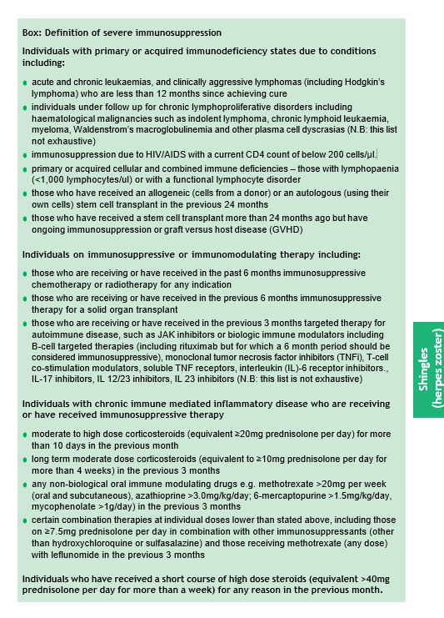
Green Book: Definition of severe immunosuppression
For details about which individuals with severe immunosuppression should be offered Shingrix® vaccine from 50 years of age, vaccinators should refer to the box in the Green Book Shingles Chapter 28a.
If there is any doubt, individual patients should be discussed with their specialist.

Slide 28
Key messages about changes to the programme (2) Changes to eligibility (2)
Immunocompetent cohort
The eligible age for immunocompetent individuals will change from 70 to 60 years of age for the routine cohort, in a phased implementation over a 10 year period in two 5-year phases
The second dose should be given 6 to 12 months* after the first dose for this cohort
                Reference: WHC/2023/024
*Vaccine may be offered from 8 weeks after the first dose. For operational reasons a longer dose interval is being used between 6-12 months in England and Wales
Notes:
*Vaccine may be offered from 8 weeks after the first dose. For operational reasons a longer dose interval is being used between 6-12 months in England and Wales

Slide 29
Key messages about changes to the programme (3) Changes to eligibility (3)
Phase 1 (1 September 2023 to 31 August 2028)
Shingrix® will be offered to those turning 65 and 70 years on or after 1 September 2023
Zostavax® will be offered to individuals aged between 70 to 79 that were eligible for the vaccination programme before 1 September 2023. Once all stocks of Zostavax® are exhausted, these individuals can be offered Shingrix® if they have not previously been given a shingles vaccine
Phase 2 (1 September 2028 to 31 August 2033)
Shingrix® will be offered to those turning 60 and 65 years of age
From 1 September 2033 and thereafter
Shingrix® will be offered routinely at age 60 years*
All immunocompetent individuals remain eligible until their 80th birthday
Where an individual has turned 80 years of age following their first dose of Shingrix®, a second dose should be provided before the individual’s 81st birthday to complete the course
Notes:
*Those that become eligible but do not take up the vaccine offer immediately remain eligible until their 80th birthday.
Individuals who were eligible for Zostavax® should continue to receive Zostavax® until central stocks are depleted, after which time they should receive Shingrix®.
The 80th birthday upper age cut off remains in place for the immunocompetent cohort regardless of vaccine offered.
Recommended scheduling for immunocompetent individuals is to give the second dose 6 to 12 months after the first dose.

Slide 30
Summary of changes to the shingles vaccination programme from 1 September 2023
Implementation phases | Delivery period | Eligible for first dose
Phase 1 (five year duration) | 1 Sept 2023 to 31 Aug 2028 | Those who reach age 65 or 70 years during this period should be called in on/after their 65th or 70th birthday*
Phase 2 (five year duration) | 1 Sept 2028 to 31 Aug 2033 | Those who reach age 60 or 65 years during this period should be called in on/after their 60th or 65th birthday*
Ongoing routine offer | 1 Sept 2033 onwards | Those turning 60 years of age should be called in on/after their 60th birthday*
*Those that became eligible and missed out remain eligible until their 80th birthday.
Notes:
In relation to those who were eligible prior to September 2023 changes (70-79 years) they remain eligible until age 80. Where an individual has turned 80 years of age following their first dose of Shingrix®, a second dose should be provided before the individual’s 81st birthday to complete the course.

Slide 31
Opportunistic vaccination
The ability to provide opportunistic shingles vaccination* has been instrumental in the shingles programme. The WHC/2023/024 encourages this practice to continue:
General practices can accommodate opportunistic vaccination (if operationally possible) in instances where an individual has already attained or passed the age of:
  65 but not yet 80 for phase one and
  60 but not yet 80 in phase two
This opportunistic offer is available to enhance the robust call/recall that should be in place from 1 September 2023.
Notes:
* The WHC/2023/024 allows for opportunistic vaccination of this group as it has been instrumental in the shingles programme to date and maintaining this practice going forwards is encouraged. In instances where an individual has already attained or passed the age of 65 but not yet 80 for phase one, or 60 but
not yet 80 in stage two, then general practices can accommodate opportunistic vaccination if operationally possible. The SFE will be clear on the parameters for this reimbursement route for opportunistic vaccination. This opportunistic offer is available to enhance the robust call/recall that should be in place from 1 September 2023.
The SFE will be clear on the parameters for this reimbursement route for opportunistic vaccination.

Slide 32
Call and recall
In deploying vaccination to all newly eligible groups, an effective call/recall system must be in place (WHC/2023/024) which should continue after the initial stages of the roll-out:
expectation that eligible individuals will receive an invitation to be vaccinated, with reminders for those who do not decline but fail to respond to the initial invitation
requirement to make up to three attempts to contact eligible individuals within 12 weeks of reaching their invitation age
can be calls, emails, text messages or written invitations, however at least one must be a written invitation
The rollout to immunocompromised (severely immunosuppressed) individuals who are aged over 50 years old should take place in the first year from 1 September 2023 and conclude by 1 September 2024.
After this time immunocompromised (severely immunosuppressed) individuals who turn 50 years old should be offered vaccination within 12 weeks of reaching their invitation age.
Newly diagnosed unvaccinated immunocompromised (severely immunosuppressed) individuals already over 50 years old should be vaccinated within 12 weeks of immunocompromised diagnosis.
Notes:
When implementing call/recall, it is a requirement to make up to three attempts to contact eligible individuals within 12 weeks of reaching their invitation age. This is applicable for immunocompetent and immunocompromised individuals at all stages of the programme.
The WHC/2023/024 provides further detail on call/recall.

Slide 33
Vaccination against shingles
(Herpes Zoster)

Slide 34
Shingles vaccines
Two shingles vaccines are currently available in Wales:
Zostavax®
Live attenuated vaccine.
Offered to all immunocompetent individuals from 70 to 79 years of age already eligible for routine immunisation schedule.
One dose.
As Zostavax® is being phased out, stock will only be available until current supply, available to order from ImmForm, is used up
Shingrix®
Recombinant adjuvanted (non-live) subunit vaccine.
Available for:
  Immunocompromised individuals aged 50 years and over
  Newly eligible individuals aged 65 or 70 on/after 01/09/2023 and to those aged 70 (before 01/09/2023) to 79 years of age once Zostavax ® stocks are depleted
2 dose schedule
  Immunocompetent: the second dose should be given 6-12 months after the first dose*.
  Immunocompromised (severely immunosuppressed): the second dose should be given 8 weeks to 6 months after the first dose
Notes:
*For immunocompetent individuals the second dose may be offered from 8 weeks after the first dose. For operational reasons a longer dose interval is being used between 6-12 months in England and Wales
Supplies for the routine programme should be ordered from ImmForm
From September 2023 Zostavax® vaccine will eventually be replaced with Shingrix® for everyone following the agreed implementation plan. Zostavax® should continue to be offered to immunocompetent individuals until stocks from ImmForm are exhausted.

Slide 35
Shingles vaccine supplies
To obtain supplies of Shingrix^{® f}or use outside of the national immunisation programme contact GlaxoSmithKline UK, direct on Tel: 0800 221 441
To obtain supplies of Zostavax® for use outside of the routine programme contact Sanofi Pasteur MSD, direct on Tel: 0800 085 5511
Notes:
Supplies for the routine programme should be ordered from ImmForm
Vaccines for private prescriptions, occupational health or travel are NOT provided free of charge and should be ordered directly from the manufacturer
Locally held stocks of Shingrix® ordered via ImmForm for the previous shingles immunocompromised programme can be used for eligible cohorts in the expanded programme. (WHC/2023/024)

Slide 36
Vaccination of patients outside of the national immunisation programme recommendations
Zostavax®:
Following assessment by a suitably qualified clinician, the shingles vaccine may be offered to those who are not currently eligible for the national programme but who benefit medically, for example those with underlying conditions which increase their risk of shingles.
Vaccine for this purpose cannot be used from central supplies (Immform) and must be sourced separately. A PGD cannot be used.
Refer to WHC (2019) 008 Changes to the shingles immunisation programme from 1 April 2019 , WHC (2021) 021 Introduction of Shingrix® for immunocompromised individuals (from September 2021) and WHC (2023) 024 Change of vaccine and cohort expansion for shingles vaccination programme (from September 2023)
Shingrix® (once Zostavax® supplies depleted):
As above
For administration of shingles to those outside of the national programme an individual clinical assessment is required and a legal framework to administer the vaccination.
Notes:
Text links
WHC (2019) 008 Changes to the shingles immunisation programme from 01 April 2019: https://gov.wales/sites/default/files/publications/2019-05/changes-to-the-shingles-immunisation-programme-from-1-april-2019.pdf
WHC (2021) 021 Introduction of Shingrix® for immunocompromised individuals (from September 2021): https://gov.wales/sites/default/files/publications/2021-09/introduction-of-shingrix-for-immunocompromised-individuals-from-september-2021.pdf
WHC (2023) 024 Change of vaccine and cohort expansion for shingles vaccination programme (from September 2023)

Slide 37
Zostavax® vaccine
Zostavax®
Shingles (herpes zoster) vaccine (Live)
Merck Sharp & Dohme MSD
  Live attenuated (weakened live organism).
  One dose schedule
  Licensed for use from 50 years of age and above.
  Recommended for immunocompetent individuals aged 70 to 79 years of age already eligible for the routine immunisation schedule (unless contraindicated).
  Zostavax ® should continue to be offered to this cohort until supply of national stock has been depleted; once this has happened Shingrix ® will be offered instead.
Notes:
The aim of the national shingles immunisation programme is to lower the incidence and severity of shingles in older people.
From September 2023 Zostavax® vaccine will eventually be replaced with Shingrix® for everyone following the agreed implementation plan. Zostavax® should continue to be offered to immunocompetent individuals until stocks from ImmForm are exhausted.

Slide 38
Vaccine efficacy
Zostavax®:
In clinical trials, a one-dose schedule of Zostavax® was assessed in 17,775 adults aged 70 years and over.
The incidence of shingles was reduced by 38% respectively and provided protection for at least 5 years.
For those vaccinated but who later developed shingles:
  The burden of illness was significantly reduced by 55%
  The incidence of PHN was significantly reduced by 66.8%
  Reference: Green book Chapter 28a Shingles
Notes:
In a clinical trial, one dose of Zostavax® was assessed in 38,546 adults aged 60 years and over of whom 17,775 were aged 70 years or over.
The Zostavax® vaccine reduced the incidence of shingles in those aged 70 years and over by 38%, and the incidence of PHN by 66.8%.

Slide 39
Zostavax® composition
Composition
Varicella-zoster virus, Oka/Merck strain (live, attenuated) not less than 19400 PFU*
Produced in human diploid (MRC-5) cells.
* PFU = Plaque-forming units.
Residual substances
This vaccine may contain traces of neomycin.
Excipients
Powder:
Sucrose.
Hydrolysed gelatin.
Sodium chloride.
Potassium dihydrogen phosphate.
Potassium chloride .
Monosodium L-glutamate monohydrate.
Disodium phosphate.
Sodium hydroxide (to adjust pH).
Urea.
Solvent:
Water for injection.
Notes:
https://www.medicines.org.uk/emc/product/6101

Slide 40
Zostavax® contraindications*
Contraindications to Zostavax®*:
Confirmed anaphylactic reaction to a previous dose of varicella-containing vaccine or any component of the vaccine.
Pregnancy (Zostavax® is not indicated in women of childbearing age and women who are pregnant should not receive Zostavax®).
Immunosuppression due to underlying condition or treatment as defined in the Green Book Shingles chapter 28a.
* This list is not extensive please refer to Green Book Chapter 28a Shingles
Notes:
Green Book Chapter 28a Shingles
https://www.gov.uk/government/publications/shingles-herpes-zoster-the-green-book-chapter-28a
From 1 September 2023 Shingrix® vaccine is available for all severely immunosuppressed individuals from 50 years of age (eligibility as defined in the Green Book Shingles Chapter 28a)

Slide 41
Zostavax® cautions
Individuals who are acutely unwell should postpone immunisation until they have recovered.
Severe Immunosuppression
Individuals aged 50 years and above with severe immunosuppression (see box page 7 Green Book Chapter 28a: Shingles) should be offered Shingrix® vaccination.
Individuals with lower levels of immunosuppression should be offered Shingrix® vaccination if they are within an eligible age cohort for the routine programme.
Notes:
Shingrix® vaccine is available for immunosuppressed individuals (full details available in the Green Book Shingles Chapter 28a)
From 1 September 2023 Shingrix® vaccine is available for all severely immunosuppressed individuals from 50 years of age.
Individuals with milder immunosuppression (not listed in the Box: ‘definition of severe immunosuppression’ in the Green Book shingles Chapter 28a) are not eligible to receive Shingrix® from age 50 and must wait until they reach the routine programme qualifying age or there is a change in their medical status.

Slide 42
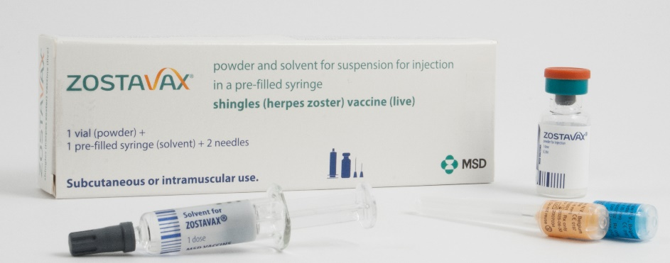
Zostavax® presentation
Zostavax® with solvent for reconstitution supplied in a pre-filled syringe.
The powder in the glass vial is a white to off-white, compact crystalline plug.
The diluent in the pre-filled syringe is a clear colourless liquid
When reconstituted, Zostavax® is a semi-hazy to translucent, off white to pale yellow liquid.
Zostavax® pack contains:
x1 Zostavax® vial.
x1 pre-filled syringe.
x2 separate needles.

Slide 43
Zostavax® reconstitution instructions
Separate needles should be used for the reconstitution and administration of the vaccine.
To reconstitute the vaccine, inject the entire content of the solvent syringe into the vial containing the powder.
Gently agitate to dissolve completely.
The reconstituted vaccine should be inspected visually for any foreign particulate matter and/or abnormal physical appearance prior to administration. In the event of either being observed, discard the vaccine.
Withdraw the entire content of the reconstituted vaccine into the syringe for injection.
Change the needle and push the new needle onto the extremity of the syringe and rotate a quarter of a turn (90⁰) to secure the connection.
Vaccine should be administered immediately after reconstitution.
Reconstituted vaccine should not be used if you notice any particulate matter or if the appearance of the solvent or of the reconstituted vaccine differs from that described in the SmPC (a semi-hazy to translucent, off white to pale yellow liquid).
For reconstitution information/instructions refer to manufacturers SmPC
Notes:
It is recommended that the vaccine be administered immediately after reconstitution to minimise loss of potency. Discard reconstituted vaccine if it is not used within 30 minutes.
Zostavax® is provided with 1 or 2 unattached needles in the pack (as sent from the manufacturer).
Vaccinators would need to supply their own green needle for reconstituting the vaccine and then select the most appropriate needle length for the patient.
For I/M injections the needle needs to be sufficiently long to ensure that the vaccine is injected into muscle, so longer length needles would be recommended for morbidly obese individuals

Slide 44
Administration of Zostavax®
A single dose of 0.65ml should be given by intramuscular injection, preferably in the deltoid region of the upper arm.
Intramuscular injection is the preferred route of administration as injection-site reactions were significantly less frequent in those who received the vaccine via this route.
For individuals with a bleeding disorder* see next slide and see advice in PGD.
If more than one vaccine is given at the same appointment – give at separate sites, preferably in different limbs. If given in the same limb, they should be given at least 2.5cm apart.
Record the site each vaccine has been given in the individual’s records.
NB. Please refer to Green Book: Shingles Chapter 28a and Chapter 11 for further information on co-administration.
Notes:
*Individuals with bleeding disorders may be vaccinated intramuscularly if, in the opinion of a doctor familiar with the individual's bleeding risk, vaccines or similar small volume intramuscular injections can be administered with reasonable safety by this route. If the individual receives medication or treatment to reduce bleeding, for example treatment for haemophilia, intramuscular vaccination can be scheduled shortly after such medication or treatment is administered.
Individuals on stable anticoagulation therapy, including individuals on warfarin who are up to date with their scheduled INR testing and whose latest INR was below the upper threshold of their therapeutic range, can receive intramuscular vaccination. A fine needle (equal to 23 gauge or finer calibre such as 25 gauge) should be used for the vaccination, followed by firm pressure applied to the site (without rubbing) for at least 2 minutes. If in any doubt, consult with the clinician responsible for prescribing or monitoring the individual’s anticoagulant therapy.
UKHSA PGD Templates: www.gov.uk/government/collections/immunisation-patient-group-direction-pgd
Zostavax®: www.gov.uk/government/publications/shingles-vaccine-zostavax-patient-group-direction-pgd-template

Slide 45
Individuals with bleeding disorders: Zostavax®
For individuals with a bleeding disorder, Zostavax® should be given by deep subcutaneous injection to reduce the risk of bleeding.
Zostavax® should NOT be injected intravascularly.
NB. Deep subcutaneous administration is off-label and outside the produce licence but in accordance with national guidance (Green Book Chapter 28a Shingles).
Reference: Green Book Chapter 28a: Shingles and UKHSA PGD Zostavax Template (2023)
Notes:
Individuals with bleeding disorders may be vaccinated intramuscularly if, in the opinion of a doctor familiar with the individual’s bleeding risk, vaccines or similar small volume intramuscular injections can be administered with reasonable safety by this route. If the individual receives medication or treatment to reduce bleeding, for example treatment for haemophilia, intramuscular vaccination can be scheduled shortly after such medication or treatment is administered.
Individuals on stable anticoagulation therapy, including individuals on warfarin who are up to date with their scheduled international normalised ratio (INR) testing and whose latest INR was below the upper threshold of their therapeutic range, can receive intramuscular vaccination. A fine needle (equal to 23 gauge or finer calibre such as 25 gauge) should be used for the vaccination, followed by firm pressure applied to the site (without rubbing) for at least 2 minutes.
If in any doubt, consult with the clinician responsible for prescribing or monitoring the individual’s anticoagulant therapy. On occasion the treating clinician may conclude, in discussion with the patient, that the benefit of protection against shingles could outweigh the increased risk of a transient local reaction with intramuscular immunisation. Deep subcutaneous administration is off-label and a Patient Specific Direction (PSD) would be required.
The individual or carer should be informed about the risk of haematoma from the injection.
UKHSA Shingles vaccination: guidance for healthcare professionals: Shingles vaccination: guidance for healthcare practitioners - GOV.UK (www.gov.uk)
The SmPC says the vaccine should be administered subcutaneously in patients with severe thrombocytopenia or any coagulation disorder (see section 4.4). Zostavax vaccine - Summary of Product Characteristics (SmPC) - (emc) (medicines.org.uk)

Slide 46
Zostavax® co-administration
Zostavax® can be administered at the same time as inactivated vaccines such as influenza and 23-valent pneumococcal polysaccharide vaccine (PPV)
Zostavax® can be administered at the same time as, or before or after other live vaccines except MMR (Green Book Chapter 11 Table 11.3)
  Where MMR and Zostavax® are not administered at the same time, a 4 week minimum interval should be observed between vaccines
Zostavax® can be administered at the same time as all COVID-19 vaccines
Zostavax® should not be administered to patients currently receiving oral or intravenous antivirals such as acyclovir or who are within 48 hours after cessation of treatment as the therapy may reduce the response to the vaccine*(Shingles Green Book Chapter 28a).
For information on co-administration please refer to all relevant chapters of Green Book
Notes:
See Green Book shingles chapter for more detail about co-administration of shingles vaccines with other vaccines
For eligible immunocompromised individuals (details available in the Green Book Shingles chapter 28a), and where Zostavax® is contraindicated, Shingrix® vaccine is available for use

Slide 47
Zostavax® – possible adverse reactions
Most commonly reported (1:10 of people vaccinated)
Pain, redness, tenderness, pruritus, swelling at the injection site.
Less commonly reported (≥ 1/100 to < 1/10)
Headache, rash, arthralgia, myalgia, pain in extremity.
Injection site: induration, haematoma, warmth, rash, pyrexia (less reaction reported in those ≥ 60 years of age).
Uncommon (≥ 1/1,000 to < 1/100)
Lymphadenopathy (cervical, axillary); nausea.
Rare (≥ 1/10,000 to < 1/1,000)
Hypersensitivity reactions including anaphylactic reactions, injection site urticaria.
Very rare (< 1/10,000)
Varicella, Herpes zoster (vaccine strain); necrotizing retinitis (patients on immunosuppressive therapy).
Notes:
A full list of side effects can be found in the Zostavax® summary of product characteristics.
https://www.medicines.org.uk/emc/

Slide 48
Zostavax®- Inadvertent vaccination
Most individuals under 50 years of age are likely to be immune to varicella so inadvertent vaccination is unlikely to result in serious adverse reactions.
Immunosuppressed individuals inadvertently given Zostavax®
Should be urgently assessed by a clinician to establish the degree of immunosuppression.
Individuals in the vaccine eligible age group are likely to be VZV antibody positive, prophylactic aciclovir may be considered in those in whom the attenuated vaccine virus poses a significant risk. These individuals should be monitored for at least 4 weeks for evidence of localised or generalised infection.
Immunosuppressed individuals who develop a varicella rash following inadvertent vaccination
Should be urgently assessed by a hospital specialist and offered prompt treatment with high dose IV aciclovir given the risks and severity of disseminated zoster*
Pregnancy
Urgently assess susceptibility and treat in the same way as a natural exposure to chickenpox infection.
Adverse events should be reported to MHRA via the Yellow Card scheme.
Notes:
Immunosuppressed individuals who are inadvertently vaccinated with Zostavax® should be urgently assessed to establish the degree of immunosuppression. All individuals of this age group should be VZV antibody positive, and so, varicella-zoster immunoglobulin (VZIG) is unlikely to be of benefit but prophylactic aciclovir may be considered in those for whom
the attenuated vaccine virus poses a significant risk. See Green Book Chapter 28a: Shingles (up to 31/08/2023) https://www.gov.uk/government/publications/shingles-herpes-zoster-the-green-book-chapter-28a .
Immunosuppressed individuals who develop a varicella rash following inadvertent vaccination should be urgently assessed by a hospital specialist and offered prompt treatment with high dose IV aciclovir given the risks and severity of disseminated zoster.
*Although transmission of the Zostavax® vaccine virus (Oka/Merck strain) has not been reported during clinical trials, any person developing a vesicular rash after receiving Zostavax® should be tested, as recommended below.
Manufacturer experience with varicella (chickenpox) vaccines that use a lower dose of the same virus strain, suggests that transmission of vaccine virus may occur rarely between vaccinees who develop a varicella-zoster virus (VZV) like rash and susceptible close contacts.
Pregnancy
As a precautionary measure, health professionals should treat the inadvertent administration of the Zostavax® vaccine to a pregnant woman in the same way as a natural exposure to chickenpox infection and should urgently assess the woman’s susceptibility to chickenpox. Guidelines on post exposure prophylaxis (PEP) for varicella and shingles (January 2023) and Guidance on chickenpox and shingles vaccines: advice for pregnant women are available on the GOV.UK website.
For those women who are unable to give a reliable history of chickenpox infection or documented evidence of varicella vaccination, an urgent varicella antibody test (VZV IgG) should be performed. For those women who are found to be VZV IgG negative on testing, contact the Health Protection Team at PHW, call 0300 00 300 32.
Samples from those pregnant women found to be VZV IgG negative on local testing will be requested to be sent to the VRD for storage.
All incidents of inadvertent administration of Zostavax® during pregnancy should also be reported to UKHSA using the vaccines administered in pregnancy (VIP) reporting form. This national surveillance collects additional information on such exposures so that UKHSA can better inform health professionals and pregnant women in the future.
Inadvertently administering Zostavax® during pregnancy is a serious clinical incident that should be reported immediately.
Post exposure prophylaxis for chickenpox and shingles - GOV.UK (www.gov.uk) and Guidance on Chickenpox and shingles vaccines: advice for pregnant women are available on the GOV.UK website.

Slide 49
Immunosuppressed individuals who develop a varicella rash following inadvertent vaccination with Zostavax® (1)
As a precautionary measure, any person who develops a vesicular rash after receiving Zostavax® should ensure the rash area is kept covered when in contact with a susceptible (chickenpox naïve) person until the rash is dry and crusted. If the person who received the vaccine is themselves immunosuppressed, they should avoid contact with susceptible people until the rash is dry and crusted, due to the higher risk of virus shedding.
Immunosuppressed individuals who develop a rash following inadvertent vaccination with Zostavax® should be urgently assessed and offered prompt treatment with aciclovir given the risks and severity of disseminated zoster– see the guidance in the Green Book Chapter 28a: Shingles (up to 31/08/2023): https://www.gov.uk/government/publications/shingles-herpes-zoster-the-green-book-chapter-28a and UKHSA Shingles immunisation programme: information for healthcare practitioners: https://www.gov.uk/government/publications/shingles-vaccination-guidance-for-healthcare-professionals document section titled ‘Action to take if immunosuppressed individual inadvertently given Zostavax®’.
Notes:
As a precautionary measure, any person who develops a vesicular rash after receiving Zostavax® should ensure the rash area is kept covered when in contact with a susceptible (chickenpox naïve) person until the rash is dry and crusted. If the person who received the vaccine is themselves immunosuppressed, they should avoid contact with susceptible people until the rash is dry and crusted, due to the higher risk of virus shedding.
Immunosuppressed individuals who develop a rash following inadvertent vaccination with Zostavax® should be urgently assessed and offered prompt treatment with aciclovir – see the guidance in the Green Book Chapter 28a: Shingles (up to 31/08/2023): https://www.gov.uk/government/publications/shingles-herpes-zoster-the-green-book-chapter-28a and UKHSA Shingles immunisation programme: information for healthcare practitioners: https://www.gov.uk/government/publications/shingles-vaccination-guidance-for-healthcare-professionals document section titled ‘Action to take if immunosuppressed individual inadvertently given Zostavax®’
In addition to the precautionary measures outlined above, a vesicle fluid sample should also be sent for analysis to confirm the diagnosis and determine whether the rash is vaccine associated or wild type. This service is available at the UKHSA Virus Reference Department (VRD), Colindale. Please note sampling kits are not supplied by the VRD at UKHSA. Health professionals are requested to obtain vesicle swabs from their local hospital laboratories. Varicella zoster virus referral form and instructions on how to take a vesicle fluid sample are available from GOV.UK.
Contact tracing is not required if an immunocompetent person develops a localised vesicular rash following vaccination.

Slide 50
Immunosuppressed individuals who develop a varicella rash following inadvertent vaccination with Zostavax®(2)
In addition to the precautionary measures outlined, a vesicle fluid sample should also be sent for analysis to confirm the diagnosis and determine whether the rash is vaccine associated or wild type. This service is available at the UKHSA Virus Reference Department (VRD), Colindale. Please note sampling kits are not supplied by the VRD at UKHSA. Health professionals are requested to obtain vesicle swabs from their local hospital laboratories. Varicella zoster virus referral form and instructions on how to take a vesicle fluid sample are available from GOV.UK: https://www.gov.uk/government/publications/varicella-zoster-virus-referral-form
Contact tracing is not required if an immunocompetent person develops a localised vesicular rash following vaccination.

Slide 51
Precautions with concurrent administration of Zostavax® and antiviral medication
Concurrent administration of Zostavax® and anti-viral medications known to be effective against VZV has not been evaluated, but drugs such as aciclovir are likely to reduce replication of the vaccine virus and therefore attenuate response.
Immunisation with Zostavax® should be delayed in eligible individuals currently receiving oral or intravenous antivirals (such as aciclovir) until 48 hours after cessation of treatment - see Green Book Chapter 28a: Shingles for further details.
This also applies to individuals receiving acyclovir prophylaxis which should be ceased for 48 hours before vaccination and individuals who have received high dose IVIG or varicella zoster immunoglobulin (VZIG) in the previous 6 weeks. This is due to the potential to lower effectiveness of the vaccine as the therapy may reduce response to the vaccine.
Where possible, antiviral therapies should not be started within 2 weeks after receiving Zostavax® as this may adversely affect the effectiveness of the vaccine.
The use of topical aciclovir is not a contraindication to either Zostavax® or Shingrix® vaccination.

Slide 52
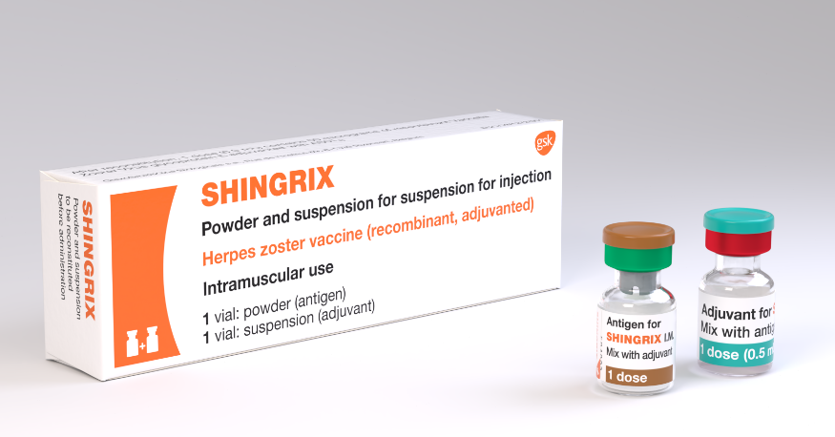
Shingrix® vaccine (1)
Shingrix®
Herpes zoster vaccine
GlaxoSmithKline UK
Shingrix® is a recombinant adjuvanted subunit shingles vaccine
It does not contain live varicella-zoster virus, latex, thiomersal or gelatine.
It contains a single protein glycoprotein E found in the outer shell of the herpes zoster virus, and an adjuvant to enhance the body's immune response to an antigen.
By combining the VZV specific antigen (gE) with an adjuvant system (AS01B), Shingrix® is designed to induce antigen-specific cellular and humoral immune responses in individuals with pre-existing immunity against VZV.
The vial rubber stopper is composed of butyl rubber which does not contain natural rubber latex
Shingrix® is no longer part of the Medicines and Healthcare products Regulatory Agency’s (MHRA) Black Triangle Scheme (▼) .
Notes:
Shingrix® vaccine introduced in 2021 to ensure immunosuppressed individuals, eligible for vaccine under the current programme, develop a similar level of protection to those who are not immunocompromised.

Slide 53
Shingrix® efficacy
Shingrix® vaccine was approved for use in adults 50 years of age or over in the US, Canada and Australia in 2017, and for use in the European Union and Japan in 2018
Shingrix®:
A real-world effectiveness study in 2021 found Shingrix® vaccine effectiveness of 70% and 56.9% for 2 and 1 doses, respectively. Two-dose vaccine effectiveness against post herpetic neuralgia in individuals 65+ years was 76%. The two-dose vaccine effectiveness was not significantly lower for adults 80+ years, for
second doses received at =180 days, or for individuals with autoimmune conditions.
This real world observational study of effectiveness of Shingrix® demonstrates the benefit of completing the 2 dose regime.
Reference: Izurieta H S et al (2021)
In the phase 3 randomized placebo controlled clinical trials of 15,411 participants, vaccine efficacy in the 7,695 immunocompetent adults ≥ 50 years and 6,950 ≥70 years, administered with two doses of Shingrix® 2 months apart was estimated at 97.2% and 91.2% respectively.
Reference: Lal et al (2015)
In a phase 3 clinical trial in autologous haemopoietic stem cell transplant recipients aged 18 years and above who received two doses of Shingrix® 1-2 months apart, robust humoral and cellular responses persisted at 1 year after vaccination.
Reference: Dagnew et al (2019)
Notes:
Izurieta H S et al (2021) Recombinant Zoster Vaccine (Shingrix®): Real-World Effectiveness in the First 2 Years Post-Licensure Recombinant Zoster Vaccine (Shingrix): Real-World Effectiveness in the First 2 Years Post-Licensure | Clinical Infectious Diseases | Oxford Academic (oup.com)
Lal et al (2015) https://pubmed.ncbi.nlm.nih.gov/25916341/
Dagnew et al (2019) https://pubmed.ncbi.nlm.nih.gov/31399377/

Slide 54
Shingrix® vaccine eligibility
Available since September 2021 for individuals 70 to 79 years of age who are clinically contraindicated to receive Zostavax® due to immunocompromised status
From 1 September 2023 Shingrix® vaccine available for:
immunocompromised (severely immunosuppressed) individuals 50 years of age and over who have not received shingles vaccine before (eligibility as defined in the Green Book Shingles Chapter 28a)
immunocompetent individuals from 60 years of age in a phased implementation over a 10 year period starting with those turning ’65’ and ’70’ years of age
immunocompetent individuals 70 to 79 years of age already eligible for the routine immunisation schedule once all stock of Zostavax® has been used up
In the first year from 01 September 2023 to 31 August 2024
- those turning 65 years of age and born on/after 01/09/1958 and
- those turning 70 years of age and born on/after 01/09/1953
Notes:
From 1 September 2023
For the first 5 years, those turning ‘65’ and ‘70’ years of age each year from 1 September until the following 31 August (inclusive) will become eligible for Shingrix® vaccine on their birthday and will remain so until they are 80 years of age.
For the following 5 years, from 1 September 2028, the eligible age will then reduce and those becoming ‘60’ and ‘65’ years of age from 1 September to 31 August (inclusive) each year, will become eligible on their birthday, so that in 10 years’ time, Shingrix® will be offered routinely to all immunocompetent individuals from 60 years of age.
Zostavax® should continue to be offered to immunocompetent individuals from 70 to 79 years of age who were eligible before 01/09/2023 for shingles vaccine until stocks of Zostavax® are exhausted when they will be eligible for Shingrix®.
Immunocompetent individuals who reach their 80th birthday are no longer eligible for a shingles vaccination.

Slide 55
Shingrix® composition
Composition
  After reconstitution 0.5ml contains:
  Varicella Zoster Virus¹ glycoprotein E antigen^{2,3} 50mcgs.
  ¹ Varicella Zoster Virus = VZV
  ² adjuvanted with AS01_{B} containing:
  plant extract Quillaja saponaria Molina, fraction 21 (QS-21) 50 mcgs
  3-O-desacyl-4'-monophosphoryl lipid A (MPL) from Salmonella Minnesota 50 mcgs
  ³ glycoprotein E (gE) produced in Chinese Hamster Ovary cells by recombinant DNA technology.
Excipients
  Powder (gE antigen):
  Sucrose.
  Polysorbate 80 (E 433).
  Sodium dihydrogen phosphate dihydrate (E 339).
  Dipotassium phosphate (E 340).
  Suspension (AS01_{B} Adjuvant System):
  Dioleoyl phosphatidylcholine (E 322).
  Cholesterol.
  Sodium chloride.
  Disodium phosphate anhydrous (E 339).
  Potassium dihydrogen phosphate (E 340).
  Water for injections.
Notes:
https://www.medicines.org.uk/emc/product/12054#EXCIPIENTS and https://www.medicines.org.uk/emc/product/12054#QUALITATIVE AND QUANTITATIVE COMPOSITION

Slide 56
Shingrix® - contraindications
Contraindications to Shingrix®
Systemic allergic reaction (including immediate-onset anaphylaxis) to:
a previous dose of Shingrix® vaccine or
any component (excipient) of Shingrix®
Notes:
https://www.medicines.org.uk/emc/product/12054

Slide 57
Individuals with bleeding disorders: Shingrix®
Shingrix® should be given by intramuscular injection, preferably in the deltoid region of upper arm. Subcutaneous administration is not recommended.
Shingrix® should be given with caution to individuals with thrombocytopenia or any coagulation disorder since bleeding may occur following intramuscular administration to these subjects.
The vaccines must not be given intravascularly.
Reference: Green Book Chapter 28a: Shingles and
UKHSA PGD Shingrix Template (2023)
Notes:
Individuals with bleeding disorders may be vaccinated intramuscularly if, in the opinion of a doctor familiar with the individual’s bleeding risk, vaccines or similar small volume intramuscular injections can be administered with reasonable safety by this route. If the individual receives medication or treatment to reduce bleeding, for example treatment for haemophilia, intramuscular vaccination can be scheduled shortly after such medication or treatment is administered.
Individuals on stable anticoagulation therapy, including individuals on warfarin who are up to date with their scheduled international normalised ratio (INR) testing and whose latest INR was below the upper threshold of their therapeutic range, can receive intramuscular vaccination. A fine needle (equal to 23 gauge or finer calibre such as 25 gauge) should be used for the vaccination, followed by firm pressure applied to the site (without rubbing) for at least 2 minutes.
If in any doubt, consult with the clinician responsible for prescribing or monitoring the individual’s anticoagulant therapy. On occasion the treating clinician may conclude, in discussion with the patient, that the benefit of protection against shingles could outweigh the increased risk of a transient local reaction with intramuscular immunisation.
The individual or carer should be informed about the risk of haematoma from the injection.
UKHSA Shingles vaccination: guidance for healthcare professionals: https://www.gov.uk/government/publications/shingles-vaccination-guidance-for-healthcare-professionals

Slide 58
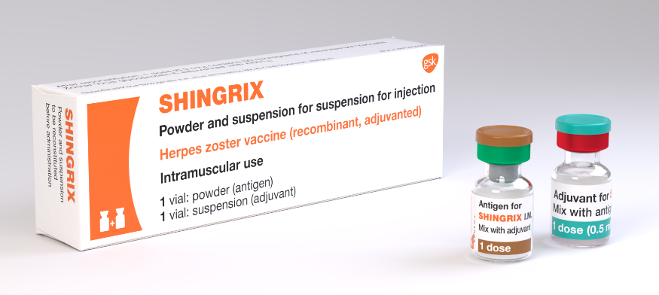
Shingrix® dosage and schedule
After reconstitution Shingrix® should be administered as a 0.5ml dose.
The schedule consists of 2 doses of vaccine with the following interval between doses:
  For immunocompromised (severely immunosuppressed) individuals 8 weeks to 6 months.
  For immunocompetent individuals 6 months to 12 months (it may be offered from 8 weeks after the first dose. For operational reasons a longer dose interval is being used between 6-12 months in England and Wales)
There is no current recommendation for a booster dose (the need for booster doses following 2 primary doses has not yet be determined).
Storage:
Shingrix® should be stored in a refrigerator +2ºC to +8ºC.
Notes:
The second dose can be given 6 months after the first dose but as Shingrix® vaccine is being offered to immunocompromised (severely immunosuppressed) individuals, they should be protected with a full course as soon as possible so the recommendation is to give the 2nd dose of vaccine at 8 weeks to 6 months.
The need for, and the timing of a booster dose, for Shingrix® has not yet been determined therefore no booster is currently recommended.

Slide 59
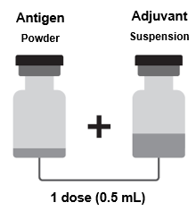
Shingrix® - reconstitution
One vial contains the powder.
One vial contains the suspension (adjuvant).
The powder and the suspension must be reconstituted prior to administration.
The powder and the suspension should be inspected visually for any foreign particulate matter and/or variation of appearance. If either is observed, do not reconstitute the vaccine.
Withdraw the entire contents of the vial containing the suspension into the syringe.
Add the entire contents of the syringe into the vial containing the powder.
Shake gently until the powder is completely dissolved (reconstituted vaccine is an opalescent, colourless to pale brownish liquid).
Withdraw the entire contents of the vial containing the reconstituted vaccine into the syringe.
Change the needle so that you are using a new needle to administer the vaccine.
If any foreign particulate matter and or variation of appearance is observed vaccine should not be administered
after reconstitution, the vaccine should be used promptly
Notes:
Shingrix powder and suspension for suspension for injection, Herpes zoster vaccine (recombinant, adjuvanted) - Summary of Product Characteristics (SmPC) - (emc) (medicines.org.uk)

Slide 60
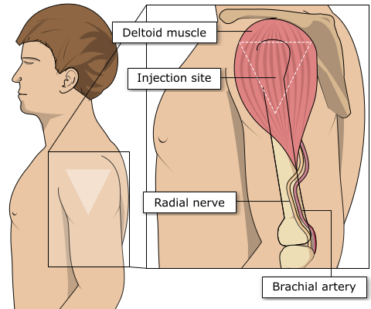
Site of administration
Shingles vaccine should be injected into the deltoid muscle in the upper arm.
Injecting too high into the upper arm might result in a shoulder injury or a frozen shoulder. This leads to pain, weakness and a limited range of motion that can last for months.
Injecting too low or too far to the side of the arm risks injecting into the axillary nerve or the radial nerve.
To avoid shoulder injury, always assess the limb before administering the vaccine to identify the correct site for injection.
.
Image source: The Australian Immunisation Handbook (health.gov.au)
Notes:
Shingles vaccine should preferably be injected into the deltoid muscle in the upper arm (or anterolateral aspect of thigh if not possible to use the deltoid muscle).
Injecting too high into the upper arm might result in the vaccine being deposited in the shoulder capsule rather than the deltoid muscle.
This can cause inflammation that can lead to a shoulder injury or a frozen shoulder leading to pain, weakness and a limited range of motion that can last for months.
Injecting too far to the side of the arm or too low on the arm risks injecting into the axillary nerve or the radial nerve.
This can cause a burning or shooting pain during the procedure and can lead to nerve damage (neuropathy/paralysis).
To avoid shoulder injury, the limb should be assessed before administering the vaccine to identify the correct site for injection.

Slide 61
Shingrix® possible adverse reactions (1)
Most commonly reported (1:10 of people vaccinated)
Pain, redness, swelling at the injection site; headache; gastrointestinal symptoms, (nausea, vomiting) lasting 1 to 3 days, myalgia, fatigue, fever.
Generally lower in those 70 years of age and above.
Less commonly reported (≥1/100 to <1/10)
Injection site pruritus, malaise.
Uncommon (≥1/1,000 to <1/100)
Lymphadenopathy, arthralgia.
Rare (≥1/10,000 to <1/1,000)
Hypersensitivity reactions including rash, urticaria, angioedema (from spontaneous reporting).
Notes:
A full list of side effects can be found in the Shingrix® summary of product characteristics:
https://www.medicines.org.uk/emc/product/12054

Slide 62
Shingrix® possible adverse reactions (2)
Driving and using machines
Shingrix® may have a minor influence on the ability to drive and use machines in the 2- 3 days following vaccination. Fatigue and malaise may occur following administration.
Individuals should be advised that they should not drive or use machines if they are feeling unwell.
Notes:
Some of the effects mentioned in previous slide may temporarily affect the ability to drive or use machines
SmPC reference: Shingrix powder and suspension for suspension for injection, Herpes zoster vaccine (recombinant, adjuvanted) - Summary of Product Characteristics (SmPC) - (emc) (medicines.org.uk) and https://www.medicines.org.uk/emc/product/12054/smpc
PIL reference: Shingrix, INN-Herpes zoster vaccine (recombinant, adjuvanted) (medicines.org.uk) or https://www.medicines.org.uk/emc/files/pil.12054.pdf (27/06/2023)

Slide 63
Shingrix® co-administration
Shingrix® can be given at the same time as inactivated or live vaccines.
This now includes the adjuvanted quadrivalent influenza vaccine (aQIV) Shingles (herpes zoster): the green book, chapter 28a - GOV.UK (www.gov.uk)
  Previously, a 7-day interval was recommended between Shingrix® and aQIV because the potential reactogenicity from two adjuvanted vaccines may reduce tolerability in those being vaccinated.
  Interim data from a US study on co-administration of Shingrix® with aQIV is reassuring – there were no safety concerns when the two vaccines were given together.
  Therefore, an appointment for flu vaccination can be an opportunity to also provide shingles vaccine, although shingles vaccine should be offered all year round, rather than purely as a seasonal programme.
When Shingrix® is given at the same time as the 23-valent pneumococcal polysaccharide vaccine (PPV23), individuals should be advised about possible side effects of fever and shivering.
A recent update to the COVID-19: the green book, chapter 14a - GOV.UK (www.gov.uk) indicates that COVID-19 vaccines can be given at the same time as other vaccines. For the latest advice on COVID-19 vaccines and co-administration refer to COVID-19: the green book, chapter 14a - GOV.UK (www.gov.uk)
For more information on co-administration please refer to the relevant chapters in the Green Book
Notes:
Shingrix® vaccine can be given at the same time as other inactivated or live vaccines. It was previously advised that there should be a 7 day interval between Shingrix® and the adjuvanted quadrivalent influenza vaccine, aQIV. This interval was because there was a concern that there may be potentially be more adverse reactions when these two adjuvanted vaccines are given together. A study looking at co-administration of Shingrix® and the adjuvanted flu vaccine has been carried out in the United States. Interim data from this study showed that there were no safety concerns when the two vaccines were given together. Therefore, if a person attends for flu vaccination and they are also eligible for Shingrix® vaccine, the two can be given together. However, as shingles is a year round programme, it should not be delayed so it can be given with the seasonal flu vaccine.
Shingrix® can also be given with the 23-valent pneumococcal polysaccharide vaccine, PPV23. In studies, when adults aged 50 years and older received PPV23 with their first dose of Shingrix®, the immune response to both vaccines was unaffected but fever and shivering were more commonly reported.

Slide 64
Individuals with a recent history of shingles and post herpetic neuralgia (PHN)
Shingles vaccine is not recommended for treatment of shingles or PHN.
Individuals who have shingles should wait until symptoms have ceased before being considered for shingles immunisation.
Individuals who have two or more episodes of shingles in one year should have immunological investigation prior to vaccination. Clinicians may wish to discuss such cases with local specialist teams.
As PHN can persist for many months or years, if the patient is eligible for shingles vaccine by age and they have no other symptoms, then the recommendation would be to offer the shingles vaccine without any specific interval before offering vaccine.
Natural boosting that occurs following an episode of shingles makes the benefit of offering zoster (Zostavax® or Shingrix®) vaccine immediately following recovery limited.
References and further information refer to the Shingles: Green book Chapter 28a and Shingles vaccination: guidance for healthcare practitioners - GOV.UK (www.gov.uk)
Notes:
Immunisation of individuals who are acutely unwell should be postponed until they have recovered fully. This is to avoid confusing the diagnosis of any acute illness by wrongly attributing any sign or symptoms to the adverse effects of the vaccine.

Slide 65
Transmission of vaccine virus
Transmission of vaccine virus following Zostavax® vaccination may occur rarely between recently vaccinated individuals who develop a varicella-like rash and susceptible contacts.
As a precautionary measure, any person who develops a vesicular rash after receiving Zostavax® should ensure the rash area is kept covered when in contact with a susceptible (chickenpox naïve) person until the rash is dry and crusted. If the person who received the vaccine is themselves immunosuppressed, they should avoid contact with susceptible people until the rash is dry and crusted, due to the higher risk of virus shedding.
Prophylactic acyclovir can be considered in vulnerable patients exposed to a varicella-like rash in a recent vaccinee. These individuals require an urgent assessment*.
If a varicella (widespread) or shingles-like (dermatomal) rash develops post-Zostavax®, a vesicle fluid sample should also be sent for analysis to determine whether the rash is vaccine associated or wild type.
As Shingrix® is a recombinant protein vaccine there are no risks of developing varicella-like rashes following administration of Shingrix®.
Notes:
*Immunosuppressed individuals who develop a varicella rash following inadvertent vaccination should be urgently assessed by a hospital specialist and offered prompt treatment with high dose IV aciclovir given the risks and severity of disseminated zoster.
Post-marketing experience with varicella vaccines suggests that transmission of vaccine virus may occur rarely between those vaccinated who develop a varicella-like rash and susceptible contacts, although there has been no evidence of transmission of vaccine virus between vaccinees and susceptible contacts in the pre-licensure clinical trials of Zostavax®.
As a precautionary measure, any person who develops a vesicular rash after receiving Zostavax® should ensure the rash area is kept covered when in contact with a susceptible (chickenpox naïve) person until the rash is dry and crusted. If the person who received the vaccine is themselves immunosuppressed, they should avoid contact with susceptible people until the rash is dry and crusted, due to the higher risk of virus shedding. Prophylactic aciclovir can be considered in vulnerable patients exposed to a varicella like rash in a recent vaccinee.
Testing of post-vaccination rashes
In the event of a person developing a varicella (widespread) or shingles-like (dermatomal) rash post-Zostavax® or Shingrix®, a vesicle fluid sample should also be sent for analysis to confirm the diagnosis and determine whether the rash is vaccine associated or wild type. This service is available at the Virus Reference Department (VRD) at UKHSA, Colindale.
Transmission of vaccine virus from varicella vaccine recipients without VZV-like rash has not been confirmed. Whilst there remains a theoretical risk, therefore, in those who develop a rash following zoster vaccination of transmitting the attenuated vaccine virus to a susceptible individual, this risk should be weighed against the reduced risk of developing natural shingles and the much higher risk of transmission from the circulating wild type VZV in the community.
Although transmission of the Zostavax® vaccine virus (Oka/Merck strain) has not been reported during clinical trials, any person developing a vesicular rash after receiving Zostavax® should be tested, as per guidance in the Green Book Chapter 28a: Shingles: https://www.gov.uk/government/publications/shingles-herpes-zoster-the-green-book-chapter-28a.
In addition to the precautionary measures outlined above, a vesicle fluid sample should also be sent for analysis to confirm the diagnosis and determine whether the rash is vaccine associated or wild type. This service is available at the UKHSA Virus Reference Department (VRD), Colindale. Please note sampling kits are not supplied by the VRD at UKHSA. Health professionals are requested to obtain vesicle swabs from their local hospital laboratories. Varicella zoster virus referral form and instructions on how to take a vesicle fluid sample are available from GOV.UK.
Contact tracing is not required if an immunocompetent person develops a localised vesicular rash following vaccination.

Slide 66
Patients anticipating immunosuppressive therapy (1)
Before 1 September 2023:
Eligible individuals anticipating immunosuppressive therapy should ideally be assessed for vaccine eligibility before starting treatment that may contraindicate future Zostavax® vaccination.
Individuals are not currently eligible for pre-treatment vaccination with Shingrix® as supply of this vaccine is currently limited and so vaccine supplied via the national programme should not be used for this indication.
Eligible individuals who have not received Zostavax® should receive a single dose of vaccine at the earliest opportunity and at least 14 days before starting immunosuppressive therapy (unless contraindicated), although leaving one month would be preferable if a delay is possible.
From 01 September 2023:
Individuals aged 50 years and older anticipating immunosuppressive therapy
  The risk and severity of shingles is considerably higher amongst immunosuppressed individuals and therefore eligible individuals anticipating immunosuppressive therapy should ideally be assessed for vaccine eligibility before starting treatment.
  If not previously vaccinated, eligible individuals should commence a course of Shingrix® at the earliest opportunity, at least 14 days before starting immunosuppressive therapy, although leaving one month would be preferable if a delay is possible. Green book Shingles Chapter 28a
Notes:
The risk and severity of shingles is considerably higher amongst severely immunosuppressed individuals
Individuals who have received a stem cell transplant have an increased risk of developing herpes zoster which may have severe and debilitating effects
Discussion should take place with the individual patient’s clinical consultant

Slide 67
Patients anticipating immunosuppressive therapy (2)
From 01 September 2023
Individuals aged 18 – 49 years receiving stem cell transplant
  Individuals who have received a stem cell transplant are severely immunosuppressed and as a result have an increased risk of developing herpes zoster which may have severe and debilitating effects.
  This risk is elevated regardless of patient age.
  In recognition of this, it is reasonable to give adult stem cell transplant recipients who are not otherwise eligible two doses of Shingrix® vaccine as part of their overall treatment plan
  Refer to Green Book Chapter 28a Shingles for full details.
This would be a clinical judgement and would need a legal framework to administer. The vaccine would need to be purchased directly from the manufacturer (not ordered through ImmForm).
Notes:
The risk and severity of shingles is considerably higher amongst immunosuppressed individuals
Individuals who have received a stem cell transplant have an increased risk of developing herpes zoster which may have severe and debilitating effects
Discussion should take place with the individual patient’s clinical consultant

Slide 68
Prescription only medication (POM)
Zostavax® and Shingrix® should only be administered using a:
Prescription written manually or electronically by a registered medical practitioner or other authorised prescriber.
Patient specific direction (PSD).
Patient group direction (PGD).
In Wales, there will be a transition period from July 2023, whereby the Welsh Medicines Advice Service (WMAS) will start to lead on the development of PGDs. During this period Public Health Wales (PHW) and the Welsh Medicines Advice Service website will host PHW PGDs information and templates.
UK Health Security Agency (UKHSA) provide updated PGDs (Patient Group Directions) which are available at the Welsh Medicines Advice Service (WMAS). These are template PGD’s that can be amended locally by health boards
In Wales an Advisory Document to supplement the UKHSA Shingles PGD templates will be made available on Patient Group Directions (PGD) - Welsh Medicines Advice Service (wales.nhs.uk)
NB: Local authorisation is required before PGD templates can be used.

Slide 69
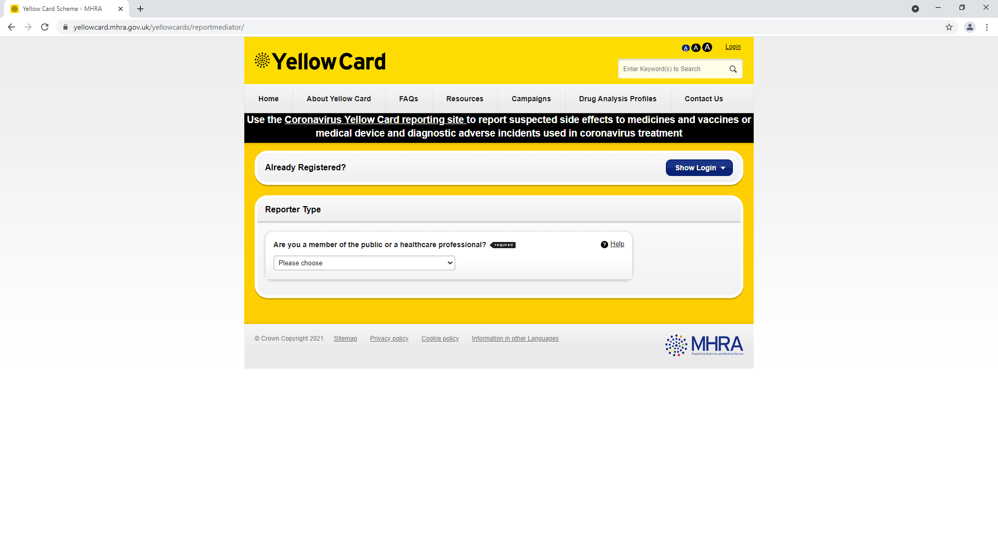
Reporting suspected adverse reactions
    Serious suspected adverse reactions to Zostavax® and Shingrix® should be reported to the Medicines and Healthcare products Regulatory Agency (MHRA) using the Yellow Card reporting scheme.
Yellow Card scheme
Voluntary reporting system for suspected adverse reaction to medicines or vaccines.
Success depends on early, complete and accurate reporting.
Report even if uncertain about whether vaccine caused condition.
Reporting site for the Yellow Card scheme.
See Green Book Chapter 8 for details.
Notes:
Healthcare professionals and patients are encouraged to report suspected adverse reactions to the Medicines and Healthcare products Regulatory Agency (MHRA) using the yellow card reporting scheme.
Yellow Card | Making medicines and medical devices safer (mhra.gov.uk)
https://yellowcard.mhra.gov.uk/

Slide 70
Optimising uptake

Slide 71
How to maximise vaccine uptake (1)
Maximising vaccine uptake supports the aims of the National Immunisation Framework for Wales which aligns to the Well-being of Future Generations (Wales) Act and contributes to A Healthier Wales.
This section is based upon NICE Vaccine uptake in the general population guideline [NG218] recommendations. It is considered good practice to offer the shingles vaccination on a call and recall basis^{1.} The WHC/2023/24 stipulates a requirement for call/recall.
Invitations
Invite eligible individuals for vaccination to book an appointment or attend an open access clinic. From 01 September 2023 it is expected that individuals turning 65 and 70 on/after 01/09/2023 are actively called and recalled².
Ensure all eligible patients are flagged on the system to promote opportunistic vaccination
Use the persons preferred method of communication for invitations where possible
Consider sending the vaccination invitation and any subsequent reminders from a healthcare practitioner or service that is known to the individual
Ensure individuals (or their family or carers, as appropriate) who live in care homes or residential settings or are house bound know how to get home visits for vaccination if they are unable to attend the vaccination clinic or other settings where the vaccination is available
Consider including a shingles leaflet with your invitation. Shingles leaflets will be available to order here: Health Information Resources
Notes:
NICE Vaccine uptake in the general population [NG218] guideline: https://www.nice.org.uk/guidance/ng218
1. Cochrane Database Syst Rev. 2018: Patient reminder and recall interventions to improve immunization rates: https://www.ncbi.nlm.nih.gov/pmc/articles/PMC6491344/
2. WHC/2023/24 https://www.gov.wales/changes-shingles-vaccinations-september-2023-whc2023024

Slide 72
How to maximise vaccine uptake (2)
Reminders:
Identify people who do not respond to invitations or attend clinics or vaccination appointments and send a reminder. Confirm receipt of the reminder
Escalation:
If there is no response from reminders. Consider more direct contact such as a phone call. Explore with them the reasons for their lack of response and try to address any issues they raise
Consider a multidisciplinary approach to address any issues raised, involving other relevant health and social care practitioners
Access issues are often identified as barriers to uptake of vaccination - there are many possible reasons for these, including for example an unknown language issue, literacy ability, sensory loss, additional health condition, difficulties accessing the venue, or lack of social support to attend appointments away from other responsibilities such as caring.
Addressing individual barriers to accessing vaccination can make a difference to individuals being able to access their vaccine appointment.

Slide 73
Additional measures to increase vaccination uptake may include:
Raising awareness within your team about shingles including discussions around potential complications, benefits, eligibility and impact on people’s lives
Raising awareness in your patients about the benefits of the vaccine and eligible groups
Consider the use of resources such as posters and leaflets in waiting rooms, community groups such as local lunch clubs or the library to promote the vaccine. Shingles resources are available to order here: Health Information Resources
Utilise online resources such as your practice webpage or official social media sites to highlight why the vaccine is important, and who is eligible

Slide 74
Accessible information and supported decision making
Try to provide the information, invitation and any subsequent reminders in a format and language appropriate for the person and their family members or carers (as appropriate) Click here for accessible resources for shingles
Ensure the information, invitation and reminders meet the persons communication needs
If someone declines the offer of a vaccination, record this with the reason why if given, and ensure they know how to get a vaccination at a later date if they change their mind.
For additional support with decision making, please refer to Recommendations on supporting decision making in the NICE guideline on decision making and mental capacity
More information is available from the PHW Shingles – information for health professionals' page
Further information on increasing vaccination uptake is available in the NICE guidance for vaccine uptake in the general population and Vaccinations for young children and older people: invites, reminders and escalation of contact
There is an eLearning module available which aims to support staff with having positive conversations about immunisations, the module is called ‘Optimising Vaccine Uptake: Using motivational interviewing for better conversations’ and is available here: eLearning - Public Health Wales (nhs.wales)

Slide 75
Resources

Slide 76
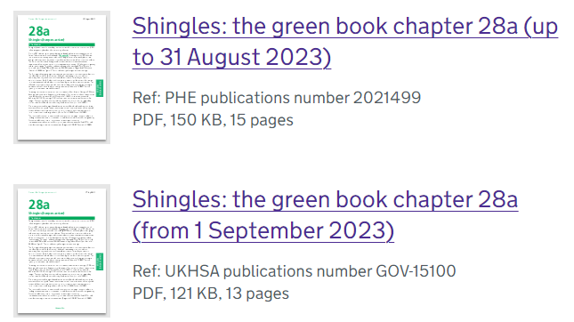
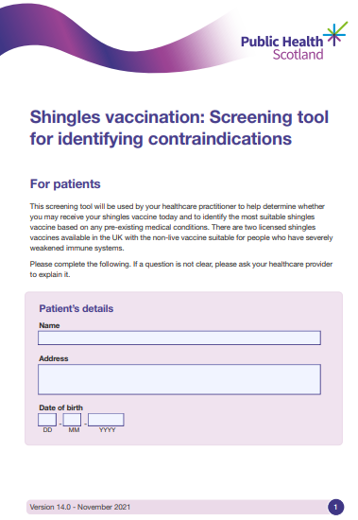
Resources (1)
Immunisation against infectious disease (the Green Book) Shingles (herpes zoster) chapter 28a
There will be 2 Green Book Shingles chapters in use prior to 1 September 2023:
  the current chapter (dated 23 August 2021) which contains information about Zostavax®. This chapter will be removed once Zostavax® is no longer available to order through ImmForm
  the updated chapter (dated 17 July 2023) which includes information about the shingles vaccine programme from 1 September 2023 onwards
Public Health Scotland have developed a Screening Tool for Contraindications for Shingles Vaccine* This tool will be available for download shortly here: https://phw.nhs.wales/topics/immunisation-and-vaccines/vaccine-resources-for-health-and-social-care-professionals/shingles-information-for-health-professionals/#clinical
This can be used by healthcare practitioners to help determine whether an individual may receive a shingles vaccine and to identify the most suitable shingles vaccine to administer based on any pre-existing medical conditions.
A clinical risk assessment should be undertaken to identify individuals who are severely immunosuppressed and the administration of Shingrix® can then be considered.
*This tool does not replace a full clinical assessment.

Slide 77


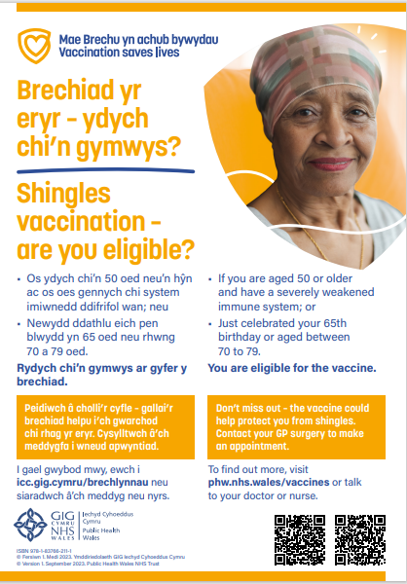
Resources (2)
A shingles leaflet for adults is available to order from the Health Information Resources (HIR) which can be accessed here: https://phw.nhs.wales/services-and-teams/health-information-resources/#!/Imiwneiddio-Immunisation/c/38145364
A shingles poster is available to order from the Health Information Resources (HIR) which can be accessed here: https://phw.nhs.wales/services-and-teams/health-information-resources/#!/Imiwneiddio-Immunisation/c/38145364

Slide 78
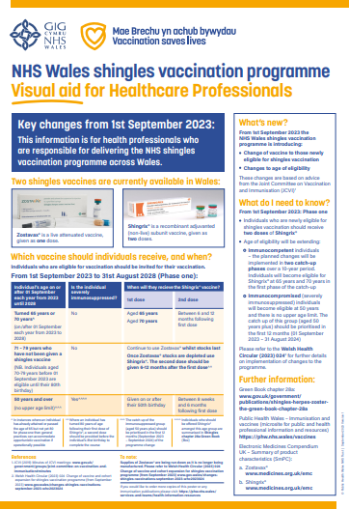
Resources (3)
Shingles ’Frequently Asked Questions’ will be available in due course here: Vaccine Preventable Disease Programme (VPDP) - Home (sharepoint.com)
A shingles healthcare professional visual aid poster will be available on request available to download: Shingles - Information for health professionals - Public Health Wales (nhs.wales)

Slide 79
Resources(4)
Template PGDs and Advisory Document for Wales will be available here: Patient Group Directions (PGDs) and Protocols Landing Page - Public Health Wales (nhs.wales) and Patient Group Directions (PGD) - Welsh Medicines Advice Service (wales.nhs.uk)
Welsh Government Shingles immunisation programme policy: Policy, letters and Welsh Government (sharepoint.com)
Shingles vaccination programme microsite page is available here: Shingles - Information for health professionals - Public Health Wales (nhs.wales)
Shingles (Herpes Zoster): the green book, chapter 28a: https://www.gov.uk/government/publications/shingles-herpes-zoster-the-green-book-chapter-28a
Shingles vaccination: guidance for healthcare practitioners: Shingles vaccination: guidance for healthcare practitioners - GOV.UK (www.gov.uk) or https://www.gov.uk/government/publications/shingles-vaccination-guidance-for-healthcare-professionals

