Slide 1
SCID screening -implications for the neonatal BCG programme
Effective from 1st September 2021

Slide 2
Acknowledgments
These slides have been produced by colleagues in Public Health England (PHE), the content has been reviewed and links to Public Health Wales resources have been added
Lauren Cooper, NHS Newborn Blood Spot Screening Programme, PHE Screening
Liz Robinson, NHS Newborn Blood Spot Screening Programme, PHE Screening
BCG/SCID Project Board
Colleagues in NewBorn Screening Wales
Vaccine Preventable Disease Programme

Slide 3
Aims of this session
By the end of this session, you should have a better understanding of:
The impact of the English evaluation of Screening for Severe Combined Immunodeficiency (SCID) on the BCG neonatal service in Wales

Slide 4

Neonatal BCG immunisation programme
The aim of the BCG Immunisation Programme is to protect those who are at an increased risk from exposure to and developing severe tuberculosis disease and to prevent premature death.
Analysis shows the vaccine to be 70 - 80% effective against the most severe forms of the disease such as TB meningitis and disseminated disease in children
Being updated

Slide 5
BCG eligibility
The Joint Committee on Vaccination and Immunisation (JCVI) recommends that the following groups of neonates be offered BCG vaccination:
all infants (aged 0 to 12 months) living in areas of the UK where the annual incidence of TB is 40/100,000 or greater
all infants (aged 0 to 12 months) with a parent or grandparent who was born in a country where the annual incidence of TB is 40/100,000 or greater
For country information on prevalence visit: https://www.gov.uk/government/publications/tuberculosis-tb-by-country-rates-per-100000-people
Notes:
Mixed service delivery across the country
some at bedside before discharge home
Some discharged home and referred to community BCG clinic

Slide 6
Changes to the BCG programme
1950 - BCG vaccination was first introduced to school age children in the UK
1960s - Selective immunisation of neonates born to new entrants to the UK from countries with high rates of TB was also introduced
2005 – Continued decline in TB incidence in the UK population resulted in school age BCG immunisation stopped. Become a risk-based programme the key part a neonatal programme targeted at those children most at risk of exposure to TB
September 2021 – opportunity to address unwanted variation in BCG delivery and improve uptake across the country, improve national coverage data. Introduction of SCID evaluation and move to BCG immunisation to all eligible babies to at 28 days
Notes:
1950 recommended for secondary school age children. At that time, around 50,000 cases of TB were reported each year in the UK, and cases occurred across most sectors of society. The age at which in the immunisation was recommended represented the most effective use of the vaccine for the epidemiology that prevailed at that time in young working adults
1960, selective immunisation of neonates born to new entrants to the UK from countries with high rates of TB was also introduced. This was due to the concern about the high rates of TB in these populations, and the fact that children born into these communities were at higher risk of infection than the general population

Slide 7
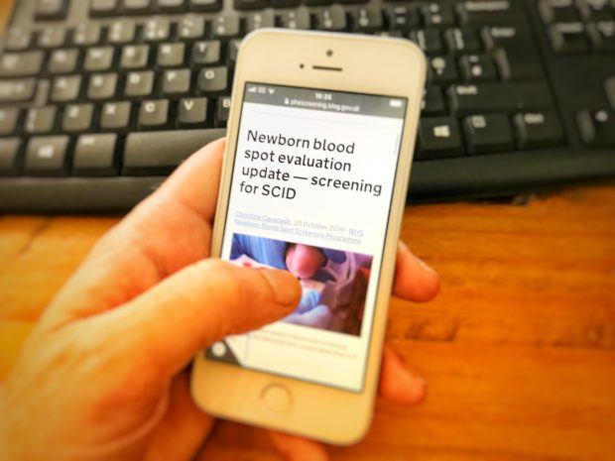
Evaluation of Screening for Severe Combined Immunodeficiency (SCID)

Slide 8
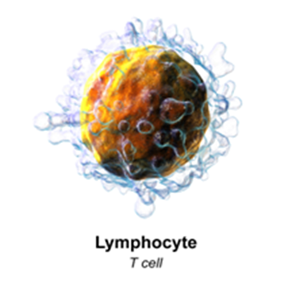

What is SCID?
a group of rare, usually recessively inherited conditions that cause major immune system problems
leads to reduced and malfunctioning T and B lymphocytes, which are the specialist white blood cells made in the bone marrow and the thymus gland to fight infection

Slide 9
Incidence
about 1 in 40,000 babies born in England have SCID- 14 babies per year
currently, about 50% of babies are identified by family history
SCID is more common when parents are related to each other
SCID can happen when there is no family history
the delay in finding the remaining 50% means that they have been exposed to infection for longer before receiving treatment

Slide 10
Impact
from birth, infections that are not serious for most babies can be life-threatening
without screening or family history the average age of diagnosis is approximately six months
if babies with SCID are not treated, they will generally die before they are one year old

Slide 11


What is the SCID Evaluation?
England only is evaluating how screening for SCID works in practice, as part of a national screening programme
Evaluation aims to answer 11 questions & collect robust evidence on the potential benefits and harms
It will be offered as part of the current newborn blood spot (NBS) programme

Slide 12

SCID screening areas
the SCID evaluation will commence on 6 September 2021 in England only and will take place over a 2 year period
the SCID evaluation will cover approximately two-thirds of England
the newborn blood spot (NBS) laboratories taking part are:
- London (Great Ormond Street & South East Thames)
- Manchester
- Birmingham
- Newcastle
- Sheffield
Notes:
There is a need to collect robust evidence on the benefits and harms of SCID screening and to evaluate how screening works in practice. Two thirds of the population in England is an ample size to be able to achieve that.

Slide 13

BCG Immunisation – Change in practice
The SCID screening impacts on the very small number of infants that move into Wales who have been screened in England
Notes:
JCVI has advised that the BCG vaccination is moved “from birth to after SCID screening results are available, as vaccination before testing would not be acceptable
AND
that moving the timing of the BCG vaccination would not intrinsically impact on TB cases in England, and the benefits from SCID screening would outweigh any increase in TB disease

Slide 14
Infants screened in England that move into Wales and are eligible for a BCG vaccine should not be offered a BCG vaccine until :
Staff have checked the record for a negative SCID, SCID not suspected or SCID declined or SCID not offered
Vaccination may be administered earlier than 28 days provided the SCID result is available
In the 6 designated areas SCID will form part of as part of the routine newborn screening test at 5 days, with most results expected within 10 – 12 days.
All live vaccines are contraindicated in babies with a SCID diagnosis – this includes Rotarix vaccine

Slide 15
The bloodspot screening results for babies screened in England should be obtained by contacting the Newborn Screening Administration Failsafe Teams (Wales)
Failsafe Team | Health boards covered | Telephone
South East Wales | Cardiff and Vale, Cwm Taf Morgannwg (except Bridgend) and Aneurin Bevan University Health Boards | 029 2184 3568
Mid and West Wales | Swansea Bay, Cwm Taf Morgannwg (Bridgend) and Hywel Dda University Health Boards and Powys Teaching Health Board | 01792 343364
North Wales | Betsi Cadwaladr University Health Board | 01978 727005
Email - PHW.NBSWFailsafe@wales.nhs.uk

Slide 16
BCG is a live vaccine, so giving this to a baby who has SCID can:
What happens if BCG is given to a baby who has SCID?
cause severe side effects
cause complications for SCID treatment
increase morbidity and mortality rates

Slide 17

Movers In & Movers Out
Child Health Information Service (CHIS) holds records of newborn screening and immunisation uptake and coverage data
Child Health record held within local CHIS follows the baby and family when they move GP or move area
Health visitors contact families who move into Wales to arrange a BCG if eligible
Notes:
CHIS provides a failsafe to ensure that all children, including those not registered with a GP, have access to public health services

Slide 18
Key messages for possible results
SCID screen, suspected
  must not be given BCG vaccine unless the baby’s immunologist or GP subsequently confirms that the baby can receive the BCG immunisation
SCID screen, not suspected – Proceed to give BCG
SCID screen, ‘not offered’ – Proceed to give BCG
Notes:
The parents of any baby that has received a result suggesting SCID may be present will be contacted within 24 working hours of this result becoming available by a specialist immunology team
Babies with screen positive SCID result must not be given BCG vaccine vaccination unless the baby’s immunologist or GP subsequently confirms that the baby can receive the BCG immunisation .
Any baby that has had a positive SCID result or is awaiting the result should not be given rotavirus or any other live vaccine until a negative SCID result is confirmed

Slide 19
Resources
https://www.gov.uk/government/collections/immunisation-against-infectious-disease-the-green-book
PHE_BCG vaccine AJV_slide_set_August_2018_(v1.3)_.pptx | Powered by BoxCEM/CMO/2021/33
SCID Screening Evaluation in England – Implications for Wales, WHC CEM/CMO/2021/33 http://nww.immunisation.wales.nhs.uk/opendoc/541928

