Slide 1
Respiratory syncytial virus (RSV) vaccination of pregnant women for infant protection
Vaccine Preventable Disease Programme
Public Health Wales
Version 3
Last update: 24 March 2025
Notes:
Material contained in this document may be reproduced without prior permission provided it is done so accurately and is not used in a misleading context.
Acknowledgement to Public Health Wales NHS Trust to be stated.
© 2025 Public Health Wales NHS Trust.
Change history:
Version 2:
Slide 7: Added ®to the vaccine names
Slide 8: Added Green Book reference
Slide 11: Amended bullet point 4
Slide 13: Text in second bullet changed to : While most RSV infections usually cause mild illness, babies under one year of age are at the greatest risk of hospitalisation with more severe RSV
Slide 15: Added : A catch-up programme for women past 28 weeks gestation up to discharge from midwifery services, starting from 1 September 2024. This information added to notes section: Pregnant women will remain eligible until discharge from maternity services and should be actively offered vaccination at each opportunity.
Slide 16: Added the word ‘selective’ and made text bold to bullet 3.
Slide 22: Bullets 1 & 2 amended to provide additional clarity on the timing of the programme and the catch up programme
Slide 28: New slide
Slide 32: More detailed information added to this slide and image of vaccine pack
Slide 33: Added first 5 bullet points as additional information
Slide 57: Removed the training slides and prerecorded slide information from this slide and added to new slide 58
Slide 58: New slide
Version 3
Slides 42 -43: New slides outlining the updated advice on vaccine preparation and use of the vial adapter: Abrysvo powder and solvent for solution for injection - Summary of Product Characteristics (SmPC) - (emc) [updated 27 February]

Slide 2
Please note:
This slide set focuses on the RSV vaccination programme of pregnant women for infant protection. There is a separate slide set for the RSV vaccination of older adults. Available to access on the PHW Immunisation training resources and events page

Slide 3
Acknowledgements
These slides were originally produced by UK Heath Security Agency, with permission from colleagues in UKHSA the content of these slides have been adapted for use in NHS Wales by the Vaccine Preventable Disease Programme in Public Health Wales

Slide 4
Learning objectives
By the end of this session, you should be able to:
explain what RSV is and be aware of the UK epidemiology
understand the rationale for the maternal RSV vaccination for infant protection programme
describe how the Abrysvo® RSV vaccine works
state when the RSV vaccine should be offered to pregnant women
describe the process of consent and how this applies when giving vaccines
understand the legal mechanisms by which immunisers can supply and administer Abrysvo® RSV vaccine
describe how to correctly store, prepare and administer Abrysvo® RSV vaccine
communicate key facts in response to questions from pregnant women and direct them to additional sources of information
RSV vaccination of pregnant women programme: training slide set for healthcare practitioners

Slide 5
Pre-requisites to administering RSV vaccines
Before administering the RSV vaccines, you should:
undertake training in the management of anaphylaxis and Basic Life Support (BLS) (adult) as specified by the policy for your local area and are familiar with Resuscitation Council UK (RCUK) guidance on Management of Anaphylaxis in the Vaccination Setting
undertake any additional statutory and mandatory training as required by your employer
undertake theoretical and practical vaccination training and been assessed as competent
be able to describe the process of consent and how this applies when giving vaccines
undertake specific training on the RSV vaccination programme and familiarised yourself with the process for preparation of Abrysvo®
access and familiarise yourself with the following key documents: Green Book RSV Chapter 27a, the UKHSA RSV vaccination of pregnant women for infant protection programme: information for healthcare practitioners guidance and the vaccine product information in the Summary of Product Characteristics (Electronic Medicines Compendium website)
have an appropriate legal framework to supply and administer RSV vaccine in place, for example a patient specific prescription, Patient Specific Direction (PSD) or Patient Group Direction (PGD). Further information will be available here: Patient Group Directions (PGD) - Welsh Medicines Advice Service (wales.nhs.uk)
RSV vaccination of pregnant women programme: training slide set for healthcare practitioners

Slide 6
Key messages
Respiratory syncytial virus (RSV) causes hundreds of thousands of infections across the UK each autumn/winter in the young and the old
RSV accounts for approximately 33,500 hospitalisations annually in children aged under 5 years old, is a leading cause of infant mortality globally, and results in 20 to 30 deaths per year in the UK
RSV vaccines have now been developed which have been rigorously tested for safety and efficacy
Vaccinating a woman in pregnancy enables her to produce RSV antibodies which pass across the placenta to provide the baby with passive protection during the first six months of infancy
A study of RSV vaccination of pregnant women indicated that infants had a 70% reduced risk of severe lower respiratory tract disease caused by the RSV virus
All pregnant women should be offered one RSV vaccine in every pregnancy. This is ideally given in week 28 or soon after, to ensure sufficient time to generate enough antibodies to protect the infant
Those with a role in delivering the RSV vaccine programme need to be knowledgeable, confident and competent in order to promote confidence in the RSV vaccination programme and deliver the vaccine safely
RSV vaccination of pregnant women programme: training slide set for healthcare practitioners

Slide 7
Introduction
In 2010, the Joint Committee on Vaccination and Immunisation (JCVI) recommended a monoclonal antibody programme (palivizumab®) for high-risk infants to protect them against RSV
In 2022 and 2023, a number of RSV products were licensed in the UK for immunisation of infants (nirsevimab®), pregnant women (Abrysvo® vaccine) and older adults (Abrysvo® and Arexvy® vaccines)
Since 2023, the JCVI has been actively reviewing evidence and considering a range of issues including disease epidemiology, vaccine efficacy, vaccine safety and the cost-effectiveness of introducing a routine RSV vaccination programme in the UK. They subsequently recommended that a programme that is cost effective should be developed for both infants and older adults
From 1 September 2024, the RSV vaccine is offered to:
  all pregnant women from 28 weeks' gestation (please see the RSV vaccination of pregnant women for infant protection: Information for healthcare practitioners document for more information on this programme)
  adults turning 75 years old on or after 1 September 2024
  adults already aged 75 to 79 years on 1st September 2024
  RSV vaccine should be offered to eligible individuals throughout the year as this is a year-round programme
RSV vaccination of pregnant women programme: training slide set for healthcare practitioners

Slide 8
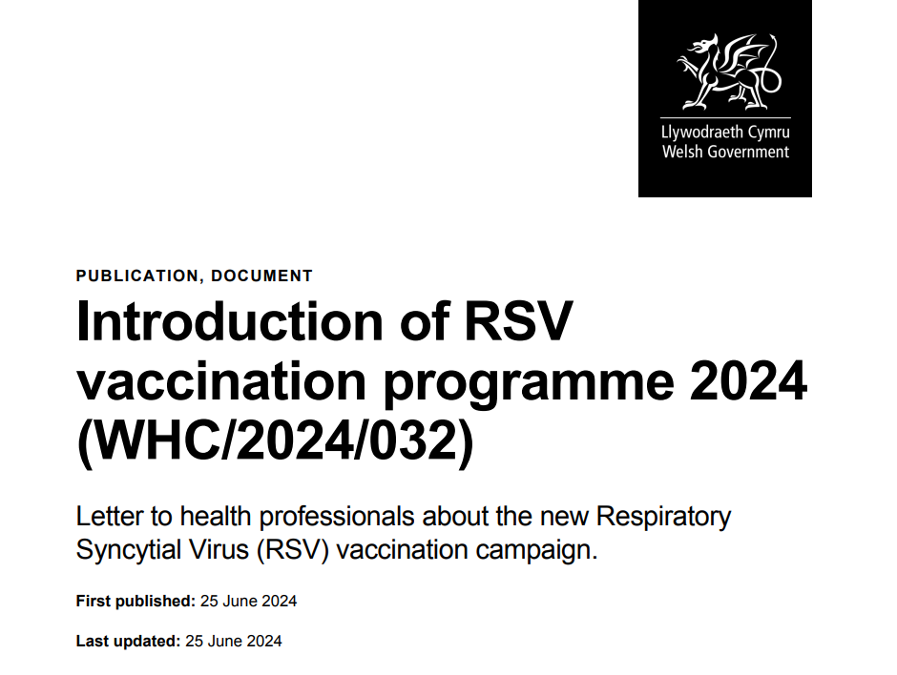
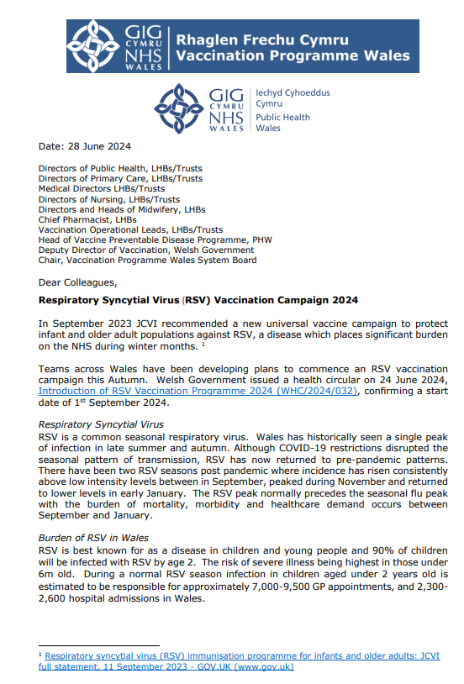
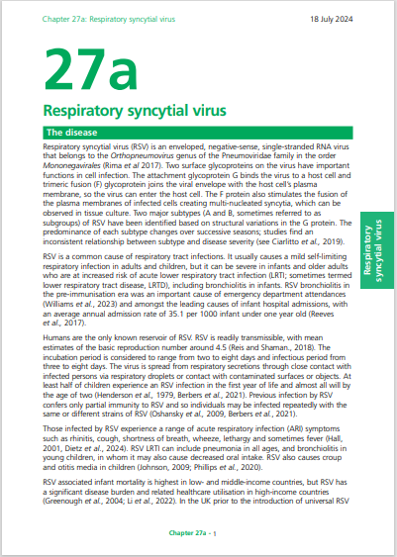
Key publications
Welsh Government issued a health circular on 24 June 2024, Introduction of RSV Vaccination Programme 2024 (WHC/2024/032), confirming a start date of 1st September 2024
Vaccine Programme Wales also issued a letter on the 28 June 2024, Respiratory Syncytial Virus (RSV) Vaccination Campaign 2024, summarising the maternal and adult RSV vaccination programmes, highlighting the vaccine to be used and the resources available from Public Health Wales to support the implementation of the campaign
The Green Book RSV chapter 27a is currently being updated. This provides the national clinical guidance and will be available to view here: Respiratory syncytial virus: the green book, chapter 27a - GOV.UK (www.gov.uk)
RSV vaccination of pregnant women programme: training slide set for healthcare practitioners

Slide 9
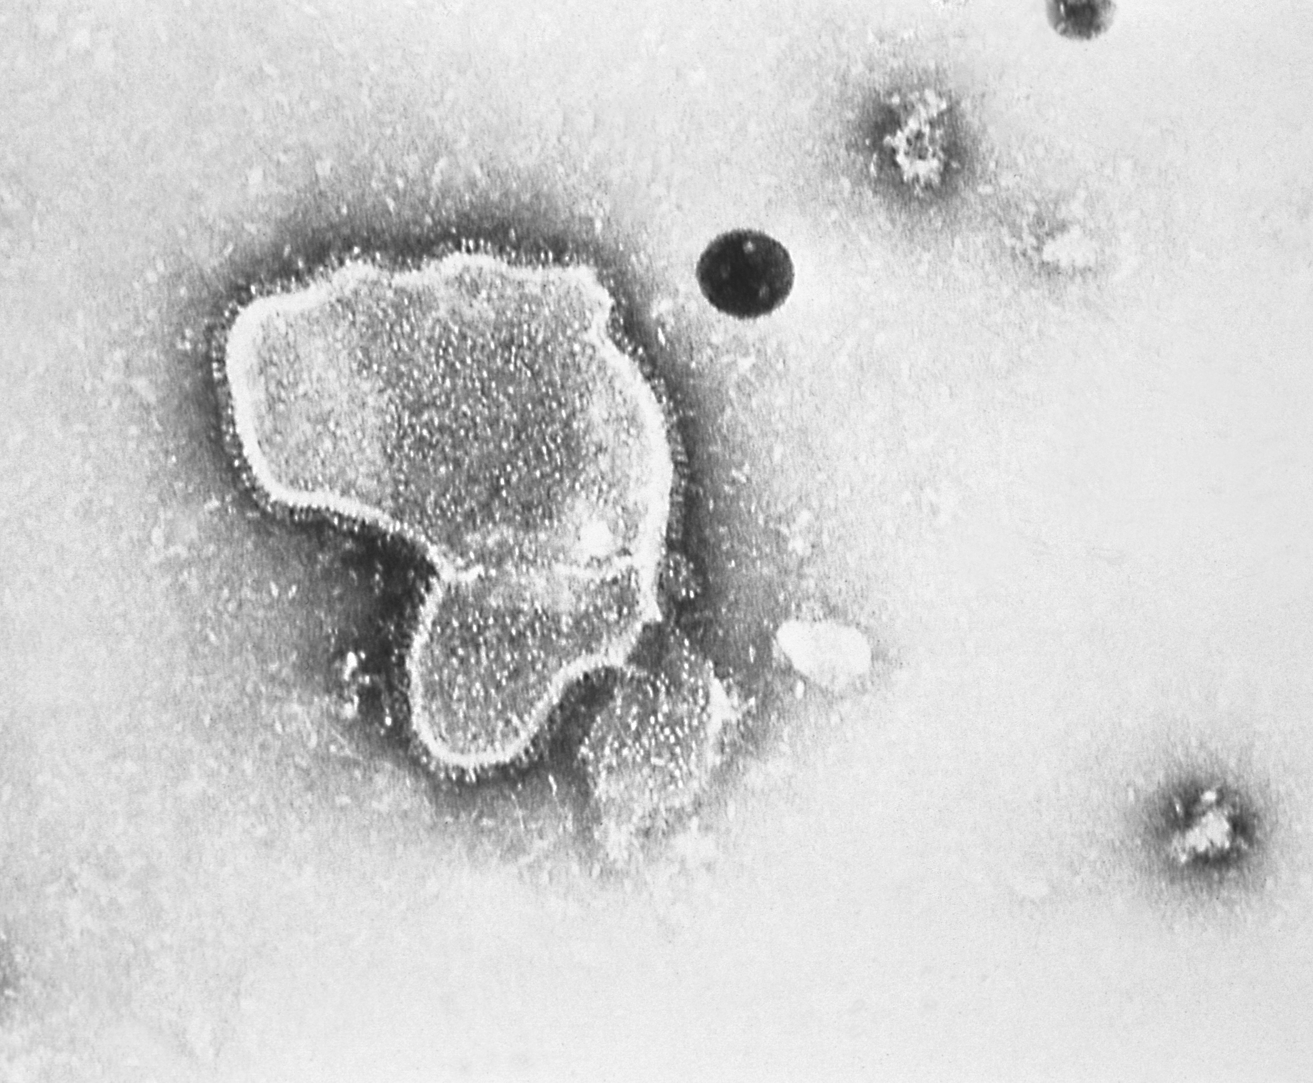
What is RSV?
Respiratory syncytial virus (RSV) is an enveloped, single-stranded RNA virus that belongs to the Orthopneumovirus genus of the Pneumoviridae family
RSV is a common cause of respiratory tract infections
It usually causes a mild self-limiting respiratory infection in adults and children but can be severe in infants and older adults who are at increased risk of acute lower respiratory tract infection
RSV is best known for causing bronchiolitis in infants. The RSV programme could help prevent over 1000 infant hospitalisation a year in Wales. Severe bronchiolitis may lead to intensive care admission and can be fatal
At least half of children experience an RSV infection in the first year of life and almost all will by the age of two (Henderson et al., 1979, Berbers et al., 2021)*
Previous infection by RSV may only confer partial immunity to RSV and so individuals may be infected repeatedly with the same or different strains of RSV
Clinical risk factors for severe RSV infection in infants include prematurity, severe congenital heart disease, chronic lung disease of prematurity and severe combined immunodeficiency
Exposure to environmental tobacco smoke is a risk factor for severe RSV infection in infants
RSV virion highly magnified by transmission electron microscopic
Image courtesy of the CDC
RSV vaccination of pregnant women programme: training slide set for healthcare practitioners
Notes:
*Green Book on Immunisation chapter 27a Respiratory syncyntial virus (RSV) (publishing.service.gov.uk)

Slide 10
Transmission of RSV
RSV is highly communicable, but humans are the only known reservoir
The incubation period (time between infection and appearance of symptoms) varies from 2 to 8 days and the infectious period from 3 to 8 days
The virus is spread from respiratory secretions following close contact with an infected person via respiratory droplets or contact with contaminated surfaces or objects
The virus can survive on surfaces or objects for about 4 to 7 hours

Slide 11
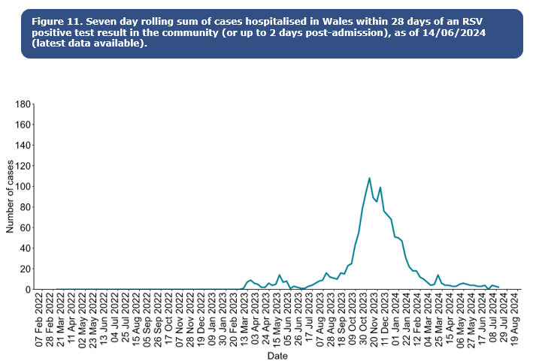
RSV epidemiology
Activity is higher in winter, with RSV season in the UK usually starting from October, peaking in December and declining by March
Whilst the occurrence of the mid-winter peak is often predictable, its size varies from year to year
At least half of children experience an RSV infection in the first year of life and almost all will by the age of two . It frequently reinfects older children and adults
Confirmed case burden is highest in children aged up to 5y. In Wales, there are more than 1,000 babies (<1y) in hospital with RSV annually
It is a leading cause of infant mortality globally, and results in 20 to 30 deaths per year in the UK
For further information on RSV in Wales please go to Public Health Wales Weekly Influenza & Acute Respiratory Infection Surveillance Report 10 (wales.nhs.uk)
RSV vaccination of pregnant women programme: training slide set for healthcare practitioners
Notes:
In recent years, the RSV season has been interrupted by control measures against the COVID-19 pandemic which has resulted in unseasonal RSV activity; this included significant rebound activity in summer 2021 and summer 2022 and a very prolonged period of virus activity in 2022.
RSV is a leading cause of infant mortality globally, resulting in 20 to 30 deaths per year in the UK. RSV-related mortality in low-income countries is considerably higher, and in some analyses is the second commonest cause of death (after malaria) in infancy.

Slide 12
RSV symptoms
For most people, RSV infection causes a mild respiratory illness
RSV can cause a range of symptoms such as rhinitis (runny nose, sneezing or nasal congestion), cough, wheeze, shortness of breath, fever, lethargy and decreased appetite
Symptoms in young children can progress to bronchiolitis (inflammation of the small airways of the lung), and other acute lower respiratory tract infections such as pneumonia, as well as croup and ear infections (otitis media)
Short- or long-term complications may include respiratory complications such as apnoea and hypoxemia, cardiovascular abnormalities, and bacterial infections including pneumonia
Children who have RSV bronchiolitis in early life may be at increased risk of developing asthma later in childhood (it may be that some children are more susceptible to both) and are at increased risk of recurrent wheezing
Those most at risk of developing severe, and occasionally fatal, RSV infection are very young infants born prematurely who have predisposing conditions such as chronic lung disease, congenital heart disease or children who are immunodeficient
RSV vaccination of pregnant women programme: training slide set for healthcare practitioners

Slide 13
High risk groups for RSV
The very young (under 1 year of age) and older adults are at the greatest risk from RSV
While most RSV infections usually cause mild illness, babies under one year of age are at the greatest risk of hospitalisation with more severe RSV
Children born prematurely, who have predisposing conditions such as chronic lung disease, congenital heart disease, children who are immunodeficient and the elderly with chronic disease are at increased risk of developing severe, and occasionally fatal disease
Infants with severe bronchiolitis from RSV may need intensive care and the infection can be fatal
RSV vaccination of pregnant women programme: training slide set for healthcare practitioners

Slide 14
Treatment and prevention
Treatment is aimed at supporting the patient and relieving symptoms
Ribavirin is an antiviral drug licensed for treatment of RSV infection but its effectiveness is not established and there are concerns with toxicity
Transmission can be reduced through standard infection control practices such as respiratory hygiene, hand washing with soap and warm water, and cleaning of surfaces
Ideally, people with colds should avoid close contact with newborn babies, infants born prematurely (before 37 weeks), children under 2 years born with heart or lung conditions, and those with weakened immune systems
Smoking around young children is a risk factor for severe RSV infection
RSV vaccination of pregnant women programme: training slide set for healthcare practitioners
Notes:
Supportive treatment includes nasogastric feeding, IV fluids, low flow or high flow oxygen therapy, breathing support (continuous positive airway pressure (CPAP) or bilevel positive airway pressure (BiPAP)

Slide 15
RSV immunisation
The Joint Committee of Vaccination and Immunisation (JCVI) has reviewed evidence from manufacturers on the efficacy, safety and duration of protection of the newly available products alongside clinical and epidemiological data on the burden of RSV in infants and older adults in the UK
Following advice from JCVI, two RSV immunisation programmes are to start from 1 September 2024. These are:
infant protection programme​
  offered to all pregnant women from 28 weeks' gestation in every pregnancy for infant protection
  A catch-up programme for women past 28 weeks gestation up to discharge from midwifery services, starting from 1 September 2024
  older adults programme​
  adults turning 75 years old on or after 1 September 2024 until their 80th birthday​
  adults already aged 75 to 79 years on 1 September 2024 until their 80th birthday (or until 31 August 2025 if they have their 80th birthday within the first year of the programme)​
  (separate training slide set here and resources available here)​
RSV vaccination of pregnant women programme: training slide set for healthcare practitioners
Notes:
Pregnant women will remain eligible until discharge from maternity services and should be actively offered vaccination at each opportunity. Introduction of RSV Vaccination Programme 2024 (WHC/2024/032),

Slide 16
RSV monoclonal antibody for high-risk infants
It is not possible to vaccinate newborn babies to protect them against RSV during the early months of life – the immature immune system is not able to make a good response. Instead, passive immunisation can be used
An RSV monoclonal antibody passive immunisation programme for eligible high-risk infants has been delivered in secondary care by paediatric services since the JCVI recommended it in 2010
This selective programme will continue, and high-risk infants will remain eligible for monoclonal antibody immunisation in addition to all pregnant women being eligible for RSV vaccination during every pregnancy
High-risk infants and children who meet the eligibility criteria in the high-risk section of the Green Book RSV chapter should be offered a monoclonal antibody immunisation regardless of whether or not their mothers received RSV vaccine in pregnancy
Monoclonal antibody for high-risk infants is a different product to the vaccine offered to pregnant women and older adults
Further information on monoclonal antibodies and the high-risk infant programme can be found in the Green Book RSV chapter
RSV vaccination of pregnant women programme: training slide set for healthcare practitioners

Slide 17
RSV vaccination of pregnant women for infant protection

Slide 18
Aim
The purpose of the RSV vaccination of pregnant women programme is to boost immunity in women during pregnancy so RSV antibodies are passed from mother to baby to passively protect infants in the first months of life
Most women will have had RSV, but infection does not give them good immunity to pass on to their baby in the womb
If the woman is given an RSV vaccine from week 28 of pregnancy, the vaccine will temporarily boost their antibody to high levels
This enables the mother to transfer a high level of RSV antibodies across the placenta to their unborn child which should passively protect the infant against RSV disease until at least 6 months of age
This will be a year-round programme and all women should be offered an RSV vaccine in every pregnancy
Vaccination should be offered from 28 weeks' gestation (ideally in week 28 or soon after), however women may be offered vaccination up until delivery
It is clinically reasonable for women who present in labour and have not received the RSV vaccine during pregnancy to be offered the vaccine up until discharge from maternity services. This will not offer passive protection to the baby through transplacental antibody transfer but may protect the mother from contracting RSV, thus reducing the chance of transmission to the infant, and may help increase levels of antibodies in breast milk. Though neither of these is expected to be as protective a transplacental antibody transfer from vaccination earlier in pregnancy
RSV vaccination of pregnant women programme: training slide set for healthcare practitioners

Slide 19
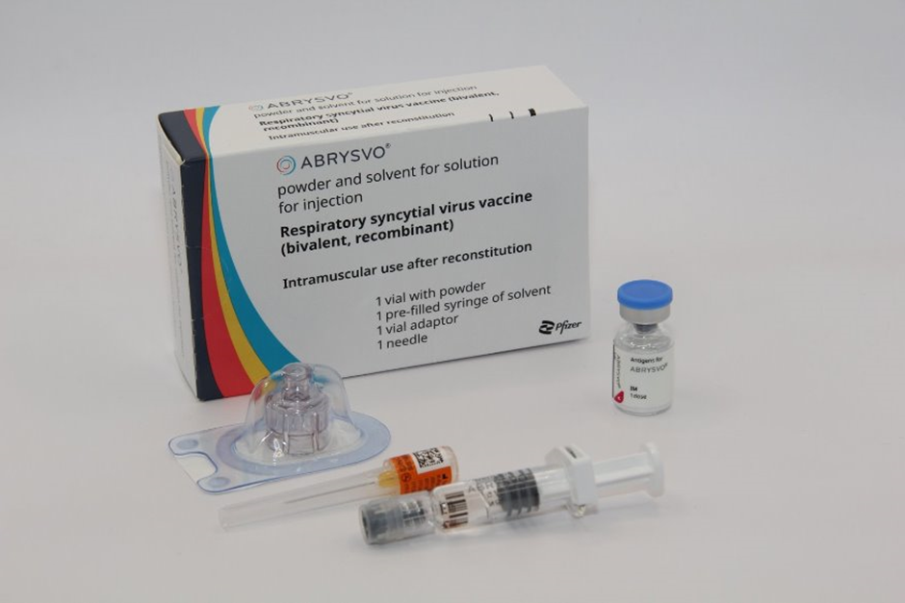
Abrysvo® vaccine: pharmaceutical information
Abrysvo® is the only vaccine licensed for RSV vaccination of pregnant women and is the only vaccine currently available for use within the national programme in the UK
It is a non-live, bivalent recombinant vaccine
Because it does not contain any live organisms, it cannot cause the disease against which it protects and is suitable to be given in pregnancy
A single dose should be administered at week 28 of gestation or soon after
The full volume (0.5 mL) of the reconstituted vaccine should be administered
Infants born to women who have received Abrysvo® can be safely breastfed
Image source: UKHSA
RSV vaccination of pregnant women programme: training slide set for healthcare practitioners

Slide 20
How Abrysvo® vaccine works
The RSV vaccine Abrysvo® is a non-live bivalent recombinant vaccine
Recombinant means a small piece of DNA from the protein of the virus is taken and inserted into a manufactured cell. As these cells grow the protein is made too. This protein is then purified and put into the vaccine which, when introduced into the body via IM injection, activates the immune system
It is referred to as bivalent because Abrysvo® contains versions of two proteins found on the surface of the virus called ‘RSV subgroup A stabilised prefusion F’ and ‘RSV subgroup B stabilised prefusion F’
The vaccine antigen (prefusion F proteins) stimulates the immune system to produce antibodies. When the individual encounters RSV virus, the antibodies neutralise the prefusion F proteins thus preventing the virus particle from fusing with and entering the host’s cells and causing an RSV infection
The vaccine is sometimes called pre-F because it is based on the prefusion form of the fusion (F) protein which the virus uses to invade human cells
RSV vaccination of pregnant women programme: training slide set for healthcare practitioners
Notes:
How RSV causes infection:
any virus particle consists of a protein shell (capsid) inside which is the nucleic acid (DNA or RNA) – the genome or the genetic code for that virus; RSV is an RNA virus
when a virus particle enters the host’s cells it is able to reproduce and release more virus particles which in turn infect other cells – establishing an infection
RSV virus particles use a special type of protein on the surface of the virus called a fusion (F) glycoprotein to pass through the cell membrane
the F proteins does this by fusing the virus cell membrane and the host’s cell membrane together; this allows the virus to move through the host’s cell membrane and enter the cells
the F protein changes shape as it fuses the RSV virus and human cell membranes together: while on the virus surface before infection, the protein is in a “prefusion” form, but as it interacts with the cell membrane it rearranges into an inactive, “postfusion” form
the prefusion form is antigenic – it stimulates an immune response; the immune system is able to recognise and respond to the presence RSV virus particles with prefusion F proteins on their surface by producing antibodies to combat the infection; the postfusion form is not antigenic
there are two subgroups of the prefusion form: A and B
Recombinant vaccine technology
different cells (for example bacteria, yeast, other established laboratory cell culture lines) are used to manufacture the vaccine
a small piece of genetic material (DNA) is taken from the microorganism (virus or bacterium) against which we want to protect and inserted into the manufacturing cells: this results in a “recombinant” version of those cells
the role of these recombinant cells is to help transport the DNA instructions for making the antigen into a host cell
once the recombinant cell enters the host cell line it instructs the host cells to rapidly produce the antigen
this antigen is grown in bulk, collected, purified, and then packaged as recombinant vaccine (the cell line used to manufacture the cells is not in the vaccine)
when the vaccine is injected, the antigen in it triggers the immune system to create antibodies that specifically target that antigen
recombinant vaccines are non-live so they cannot cause disease in the vaccine recipient

Slide 21
How the vaccine works to protect the infant
When a pregnant woman is given RSV vaccine, her immune system recognises the proteins in the vaccine as being foreign and makes antibodies against them
These antibodies pass across the placenta and provide the baby with protection against RSV during their first few months of life
In the trial, Abrysvo® was shown to be effective at preventing lower respiratory tract disease caused by RSV in infants born to vaccinated mothers for at least the first 6 months of life
For the best protection, Abrysvo® is recommended for pregnant women in week 28 or soon after. This gives enough time for the mother to make antibodies and for these to cross the placenta, to help protect the baby, even if born early
RSV vaccine can be offered to pregnant women up until delivery, but this may not offer as high a level of passive protection to the baby
RSV vaccination of pregnant women programme: training slide set for healthcare practitioners

Slide 22
When Abrysvo® should be given
From 1st September 2024:
This is a year-round routine programme will offer vaccination to all pregnant women at 28 weeks gestation, to protect infants. The RSV vaccine will be offered in every pregnancy, to offer protection to each newborn infant
A catch-up programme must be undertaken for women past 28 weeks gestation up to discharge from midwifery services. The vaccine should be offered at or near their next antenatal appointment
Abrysvo® is licensed between week 28 and week 36 gestation but can be given ‘off-label’ up until delivery
Pregnant women will remain eligible until discharge from maternity services and should be actively offered vaccination at each opportunity – This recommendation has been agreed in Wales via the Vaccine Clinical Advisory Group (VCAG) – VPW
Women who have not yet received it should still be vaccinated later in pregnancy:
  vaccination late in pregnancy may not provide optimal protection to the infant as there may be insufficient time for the mother to make a good response and have antibodies to pass across the placenta
  however, data show that most women who gave birth within two weeks of vaccination still passed on protective antibodies to their babies
  late vaccination may also protect the mother from RSV infection and reduce the risk of her becoming a source of infection to their infant, and may help pass on some antibodies through breast milk
Introduction of RSV Vaccination Programme 2024 (WHC/2024/032)
22
RSV vaccination of pregnant women programme: training slide set for healthcare practitioners
22
Notes:
Please note: Abrysvo® is licensed to be given up to 36 weeks gestation (this was based on the gestational ages included in the clinical trials). Pregnant women who have not received the RSV vaccine before 36 weeks remain eligible until delivery, and under the PGD the vaccine can be given off label in these circumstances.

Slide 23
Abrysvo® vaccine effectiveness
Abrysvo® was licensed in the UK in November 2023 following clinical trials which showed it to be safe and effective. It is currently the only RSV vaccine licensed for use in pregnancy
Abrysvo® has been licensed for use as a maternal vaccination in the United States since August 2023. It has also been licensed for use in several European countries as well as Canada, Australia, Argentina and Japan
In trials, Abrysvo® was shown to be 70% effective at preventing severe lower respiratory tract disease caused by RSV in infants born to vaccinated mothers for at least the first 6 months of life (which is the period of time when infants are most vulnerable to severe RSV infection).
Healthcare professionals are asked to report all suspected adverse reactions via the Yellow Card Scheme at: www.mhra.gov.uk/yellowcard​
Notes:
Source: Abrysvo powder and solvent for solution for injection - Summary of Product Characteristics (SmPC) - (emc) (medicines.org.uk)
Source: Bivalent Prefusion F Vaccine in Pregnancy to Prevent RSV Illness in Infants | New England Journal of Medicine (nejm.org)
The Green Book, Chapter 27A (https://www.gov.uk/government/publications/respiratory-syncytial-virus-the-green-book-chapter-27a) contains the following information regarding vaccine effectiveness following maternal vaccination:
Maternal (antenatal) vaccination has been demonstrated to be efficacious against RSV LRTI in infants from birth through 6 months of age (Kampmann et al., 2023). The pivotal phase 3, multi-country, randomised, double-blind, placebo-controlled trial assessed the prevention of RSV LRTI and severe RSV LRTI (co-primary efficacy endpoints) in infants born to pregnant women vaccinated between weeks 24 and 36 of gestation. Vaccine was administered to 3,695 pregnant women with uncomplicated, singleton pregnancies; 3,697 received placebo. In the final analysis, VE against severe RSV LRTI was 82.4% (95%CI: 57.5 to 93.9%) at 90 days and 70.0% (95%CI: 50.6 to 82.5%) at 180 days. VE against RSV LRTI was 57.6% (95%CI: 31.1 to 74.6%) at 90 days and 49.2% (95%CI: 31.4 to 62.8%) at 180 days (Munjal et al., 2024). VE estimates by RSV subtype have overlapping confidence intervals. There is some data showing high levels of antibody transfer to the infant even in infants born within two weeks of immunisation.

Slide 24
Abrysvo® vaccine safety
Abrysvo® was licensed in the UK in November 2023 by the Medicines and Healthcare products Regulatory (MHRA) on the basis of quality, safety and efficacy following clinical trials in over 17,000 adults over the age of 60 and over 4,000 pregnant women
The RSV vaccine is a non-live vaccine (may be referred to as inactivated). It does not contain any live organisms, cannot replicate and therefore cannot cause infection in either the mother or the fetus
Injection site pain, headache and myalgia were the most frequently reported adverse reactions when given to pregnant women in clinical trials
There were slightly more premature births in the vaccine group compared to the unvaccinated group (2.1% in the vaccine group and 1.9% in the placebo group in the month following vaccination), but this was not statistically significant and there was no temporal relationship between vaccination and premature birth. Average birth weight and average gestational age at birth was the same in infants of vaccinated and unvaccinated mothers
As of July 2024, Abrysvo® has been given to more than 100,000 pregnant women in the USA where monitoring has shown a good safety record
24

Slide 25
Abrysvo® contraindications and precautions
Abrysvo® is contraindicated following:
confirmed anaphylactic reaction to a previous dose or to any of the components of the vaccine
Precautions:
immunisation of women who are acutely unwell with fever should be postponed until they have recovered fully to avoid confusing the diagnosis of any acute illness by wrongly attributing any sign or symptoms to the adverse effects of the vaccine
Minor illness without fever or systemic upset are not valid reasons to postpone immunisation
Refer to the Green Book RSV Chapter 27a and Abrysvo® Patient Group Direction (PGD) for full details
RSV vaccination of pregnant women programme: training slide set for healthcare practitioners

Slide 26
Abrysvo® excipients
Abrysvo® contains the following excipients:
Powder vial
trometamol
trometamol hydrochloride
sucrose
mannitol
polysorbate 80
sodium chloride
hydrochloric acid (for pH adjustment)
Solvent
water for injection
  Rarely, people may be allergic to polysorbate 80. However, polysorbate 80 is widely used in medicines and foods, and is present in many medicines including monoclonal antibody preparations:
  some vaccines contain polysorbate 80. It is also commonly used in foods such as ice cream, and other frozen desserts
  women who have tolerated injections that contain polysorbate 80 are likely to tolerate the Abrysvo® vaccine
  There is no animal content in the vaccine.
  Abrysvo® has been certified Halal by The Islamic Food and Nutrition Council of America (IFANCA)
RSV vaccination of pregnant women programme: training slide set for healthcare practitioners

Slide 27
Women with current or previous history of RSV
Although it might be expected that a woman diagnosed with RSV infection during pregnancy would transfer some antibodies to her unborn baby, there is no assurance that the levels would be high enough to sufficiently protect the infant. As high levels of antibodies are made following vaccination, offering vaccine in week 28 of pregnancy or as soon as possible after that should ensure that optimal antibody levels can be passed to the baby
Vaccination of women who may be infected or asymptomatic or incubating RSV infection is unlikely to have a detrimental effect on the illness but women currently experiencing symptoms of RSV disease should not attend for vaccination if they are acutely unwell with a fever
RSV vaccination of pregnant women programme: training slide set for healthcare practitioners

Slide 28
Co-administration of Abrysvo® in pregnancy
Vaccine/ medication given in pregnancy | Can they be administered together?
Abrysvo® and anti-D immunoglobulin | Yes
Abrysvo® and pertussis containing vaccine | Yes* (pertussis is offered from 16 weeks)
Abrysvo® and seasonal influenza vaccine | Yes (Influenza can be given at any stage of pregnancy)
Abrysvo® and seasonal COVID-19 vaccine | Yes (COVID-19 can be given at any stage of pregnancy)
* Co administration of pertussis discussed on the next slide
28

Slide 29
Vaccine co-administration in pregnancy (1)
Pertussis-containing vaccine
Some evidence suggests that coadministration of RSV and pertussis containing vaccines may reduce the response made to pertussis components. The clinical significance of this is unclear and any impact on protection is likely to be small; the key pertussis toxoid component is least affected
Giving the vaccines separately at the usual scheduled times, from 16 weeks' gestation for pertussis (usually given around time of the fetal anomaly scan at 20 weeks) and from 28 weeks' gestation for RSV, will avoid any potential attenuation (weakening) of antibody response to the pertussis containing vaccine
If a woman has not received a pertussis containing vaccine by the time she presents for an RSV vaccine, they can and should both be given at the same appointment to provide timely protection against both infections to the infant and to avoid the risk of the woman not returning for a later appointment
RSV vaccination of pregnant women programme: training slide set for healthcare practitioners

Slide 30
Vaccine co-administration in pregnancy (2)
Where possible, vaccines should be given once a pregnant women becomes eligible. However, there may be times when a pregnant women presents late for vaccination. During influenza and COVID-19 seasonal vaccination campaigns, pregnant women may also become eligible for more than one vaccine at the same time.
Influenza vaccine
Abrysvo® can be given concomitantly with inactivated influenza vaccine to pregnant women
There are no safety or effectiveness concerns around giving Abrysvo® to pregnant teenagers who are due to have or who have recently had a live attenuated influenza vaccine (LAIV) nasal spray
COVID-19 vaccine
pregnant women who are eligible for COVID-19 vaccine during a seasonal vaccination campaign may receive this at the same time as Abrysvo®
RSV vaccination of pregnant women programme: training slide set for healthcare practitioners

Slide 31
Co-administration and anti-D immunoglobulin
The response to Abrysvo® will not be affected by, nor interfere with, anti-D immunoglobulin
The administration of Abrysvo® should not be delayed due to the woman receiving anti-D immunoglobulin (or vice-versa)
Co-administration of vaccines
If more than one injection is administered at the same time, these should be given at a separate sites, preferably in different limbs
If given in the same limb, the injections should be given at least 2.5cm apart. The sites of each injection given should be noted in the woman's health records
RSV vaccination of pregnant women programme: training slide set for healthcare practitioners

Slide 32
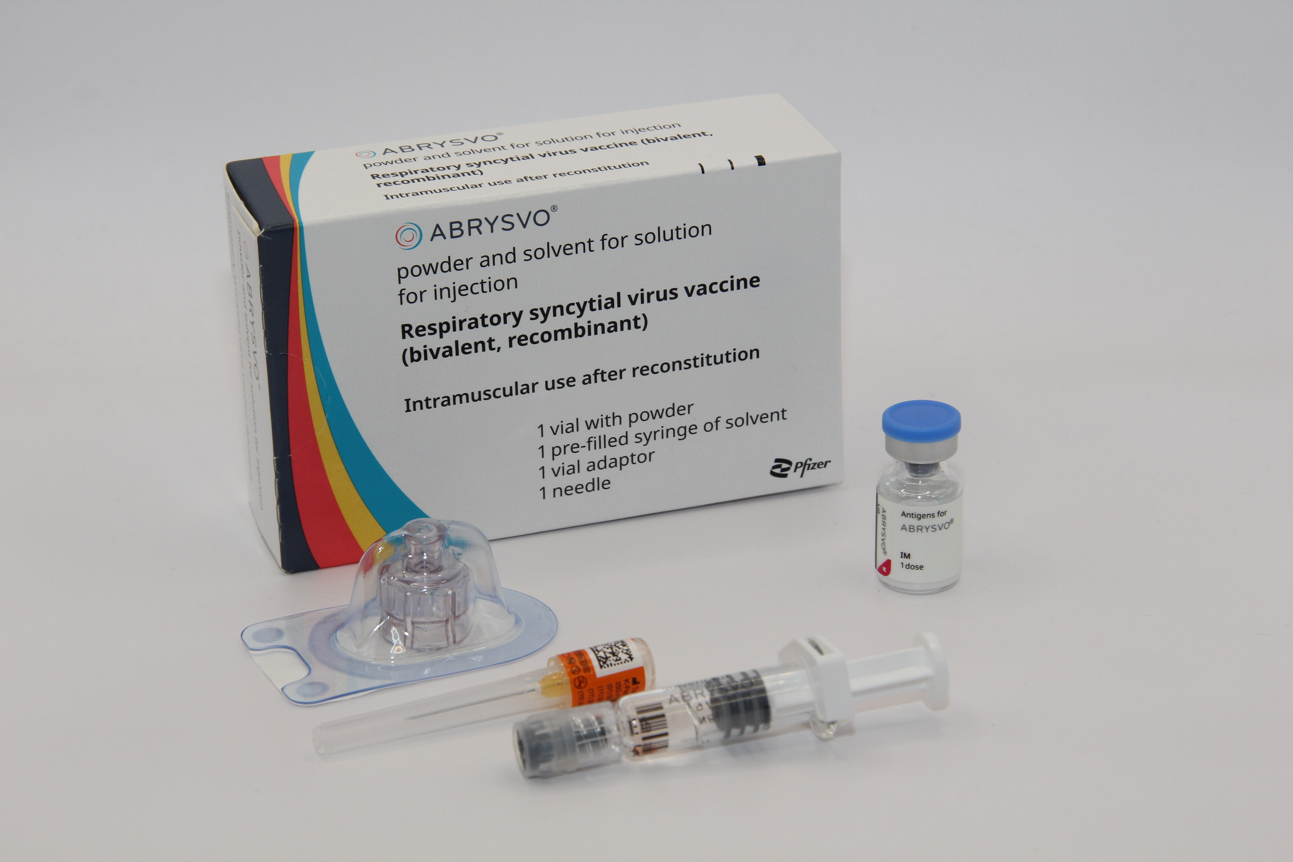
Ordering Considerations
Abrysvo® vaccine
Considerations when ordering Abrysvo®
Vaccines for the national RSV vaccination programmes in Wales should be ordered via ImmForm
Abrysvo® stocks should be monitored by the named staff members to avoid over-ordering or stockpiling.
Current expiry and quantity of Abrysvo® should be checked before ordering.
Only order stock sufficient for two weeks worth of clinics.
One pack contains one vial of vaccine, diluent for reconstitution and patient information leaflet (PIL). Each pack will also contain one 25 G x 25 mm (1") needle.
Ensure the correct Abrysvo® is ordered for the required cohort (Eg maternal vaccine for infant or for older adult protection).
The pack of Abrysvo® vaccine is physically larger than most other vaccines supplied via ImmForm. Each single dose pack measures 73mm x 35mm x 116mm (H x W x D). Please ensure you have enough fridge capacity before placing large orders.
Image source: UKHSA
RSV vaccination of pregnant women programme: training slide set for healthcare practitioners
Notes:
Vaccines required for individuals who are not in the eligible cohort, for example where a clinician has decided that it is clinically appropriate to vaccinate the individual, but they are not within the eligible age cohorts for the national vaccination programme, would require the GP practice to purchase the vaccine directly from the manufacturer and then reclaim the cost of the vaccine

Slide 33
Storage Considerations
Abrysvo® vaccine
Store vaccines in a validated fridge specifically designed for pharmaceutical products. Do not use a domestic fridge
Maintain the temperature between +2 and + 8⁰C. Keep the vaccine fridge secure. It should only be accessible to authorised practice staff. Therefore, keep it locked or in a locked room
Good practice is to have a data logger in the fridge to monitor internal temperatures
Reduce the possibility of accidentally interrupting the electricity supply. For example, install a switchless socket or clearly label the plug with a cautionary notice: ’Do not unplug/switch off’.
Use a large enough fridge to allow enough space around the vaccine packages for air to circulate
Do not freeze. Discard if the carton has been frozen
Vaccines should be ordered, stored and monitored as described in the Green Book Chapter 3 (Storage, distribution and disposal of vaccines).
The advisory document for the ordering, storage and handling of vaccines has been updated, the updated edition will be available to view here
RSV vaccination of pregnant women programme: training slide set for healthcare practitioners
Notes:
Further information on vaccine storage and stability is available in the Summary of Product Characteristics (SPC), the Patient Group Direction and from the manufacturer

Slide 34
Before administering a vaccine
Before administering a vaccine, the woman should be assessed to ensure that:
there are no contraindications to the vaccine being given
they have not experienced any serious reactions to a previous dose or component of the vaccine
they are fully informed about the vaccine to be given and understand the vaccination procedure
they are aware of possible adverse reactions to the vaccine and how to treat them
they have consented to having the vaccine
Immunisers should ensure that:
they have the appropriate knowledge and legal authority to administer the vaccine
the vaccine has been properly stored and prepared for use and they know where and how to administer it
RSV vaccination of pregnant women programme: training slide set for healthcare practitioners

Slide 35
Consent
Before vaccinating, ‘informed’ consent must be obtained
Informed consent is a legal requirement, and the individual's views must be respected
Sufficient evidence-based information must be provided to enable the person to make a balanced and informed decision about their care and treatment
As well as a general explanation of the procedure, there is also a duty to explain the risks inherent in the procedure and the risks inherent in refusing the procedure
Consent can be given verbally, in writing or it can be implied, but however it is given, the person must understand what they are consenting to
If there are any issues or uncertainties with seeking or gaining consent, ask for advice from an experienced colleague rather than abandon the offer of immunisation
Consent is a process and can be withdrawn
RSV vaccination of pregnant women programme: training slide set for healthcare practitioners
Notes:
Before giving a vaccine, immunisers must ensure that they have obtained informed consent from the woman or that a best interest decision has been made if the woman does not have mental capacity at the time of vaccination.
In order to be able to consent to vaccination, the vaccinee should receive an explanation of the treatment and its benefits and risks, either verbally from a clinician, or in the form of a leaflet and letter.
When assessing capacity to consent, the immuniser should be guided by the principles of the Mental Capacity Act (2005). This Act applies to those aged 16 years and over and is designed to protect and empower people who may lack the mental capacity to make their own decisions about their care and treatment.
Consent is a process, not a one-off discussion and must consider 3 factors:
the person giving consent must be appropriately informed: they must have the necessary information in order to make the decision
consent must be voluntary by the woman without undue pressure or coercion
the person consenting must have the capacity to make the decision
.

Slide 36
Informed consent
How much information should you give?
this will be personal to the individual at the time and will depend on their previous knowledge and discussions with others
give people as much information as they need and/or want to make an informed decision
some people will just ‘trust’ what you say while others want lots of information; either is fine
how much each individual needs is up to them, no one is obliged to seek full information
Information to be given includes:
which vaccine is being offered and the disease against which it protects
benefits/risks of immunisation versus risks of the disease​
any possible vaccine reactions and what to do if these occur
Consent is a process, not a one-off discussion and must consider 3 factors:
the person giving consent must be appropriately informed: they must have the necessary information in order to make the decision
consent must be voluntary by the individual without undue pressure or coercion
the person consenting must have the capacity to make the decision
Consent: the green book, chapter 2 - GOV.UK (www.gov.uk)
Mental capacity Act 2005 https://www.legislation.gov.uk/ukpga/2005/9/contents
RSV vaccination of pregnant women programme: training slide set for healthcare practitioners

Slide 37
Legal requirements for the supply and administration of vaccines
The regulation of medicines is defined under the Human Medicines Regulations 2012
All vaccines are classified as Prescription Only Medicines (POMs)
Vaccines are subject to legal restrictions and to give them, there needs to be an appropriate legal framework in place before they can be supplied and/or administered to eligible people
Additionally, any person who supplies and administers a vaccine must have a legal authority to do so
RSV vaccination of pregnant women programme: training slide set for healthcare practitioners

Slide 38
Legal requirements for the supply and administration of vaccines
As vaccines are Prescription Only Medicines (POMs), there must be a legal framework to supply and/or administer the vaccine in place. This can be in the form of a:
written patient specific prescription
Patient Specific Direction (PSD): a written instruction, signed by a doctor, dentist, or non-medical prescriber for medicines to be supplied and/or administered to a named patient after the prescriber has assessed the patient on an individual basis
Patient Group Direction (PGD): allows some registered specified health care professionals to supply and/or administer a POM directly to an individual with an identified clinical condition rather than needing an individual prescription or an instruction from a prescriber. PGDs are often used for the administration of vaccines
RSV vaccination of pregnant women programme: training slide set for healthcare practitioners
Notes:
A PSD is a written instruction, signed by a doctor, dentist, or non-medical prescriber for medicines to be supplied and/or administered to a named patient after the prescriber has assessed the patient on an individual basis. It must include the dose, route and frequency or appliance to be supplied or administered to a named patient.
A PGD provides a legal framework to allow some registered specified health care professionals for the supply and/or administration of a POM directly to a patient with an identified clinical condition rather than needing an individual prescription or an instruction from a prescriber and is often used for vaccines. It sets out the core requisites of those people who can have the medicine under the direction and those who should not. The health care professional working within the PGD is responsible for assessing that the patient fits the criteria set out in the PGD.

Slide 39
Patient Group Directions (PGD)
PGDs set out the core requisites of those people who can have the medicine under the direction (and those who should not).
The document will also include details of any additional training that should have been undertaken, actions to be taken if the patient is excluded or declines the medicine, a description of the medicine(s), route of administration, doses, frequency, reporting of adverse reactions, recording, storage and disposal
The healthcare practitioner working under a PGD is responsible for assessing that the patient fits the criteria set out in the PGD. The healthcare practitioner operating under the PGD may not delegate the role to others
Those using a PGD must ensure that it is authorised by the organisation in which they are operating and signed in section 2 by an appropriate authorising person, relating to the class of person by whom the product is to be supplied, in accordance with the Human Medicines Regulations 2012 (HMR2012)
There are two all Wales PGDs for the RSV programmes. One for older adults and one for the maternal programme and will be available to download for local authorisation and use from PGD webpage​.
Healthcare practitioners who will be using the PGD must be named and authorised before they use it to provide care
RSV vaccination of pregnant women programme: training slide set for healthcare practitioners
Notes:
Please note: Abrysvo® is licensed to be given up to 36 weeks gestation (this was based on the gestational ages included in the clinical trials). Pregnant women who have not received the RSV vaccine before 36 weeks remain eligible until delivery, and under the PGD the vaccine can be given off label in these circumstances.

Slide 40

Pack contents
Each pack of Abrysvo® RSV vaccine contains:
powder for 1 dose in a vial
solvent (water for injection) in a pre-filled glass syringe with a stopper (synthetic chlorobutyl rubber), luer lock adaptor and tip cap (synthetic isoprene/bromobutyl blend rubber)
vial adaptor
25G 25mm needle (suitable alternatives can be used if required)
Image source: UKHSA
Abrysvo powder and solvent for solution for injection - Summary of Product Characteristics (SmPC) - (emc)
RSV vaccination of pregnant women programme: training slide set for healthcare practitioners

Slide 41
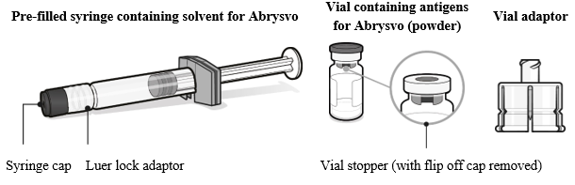
Preparing the Abrysvo® vaccine
Abrysvo® must be reconstituted prior to the administration by adding the entire contents of the pre-filled syringe of solvent to the vial containing the powder using the vial adaptor
The vaccine must only be reconstituted with the solvent provided
Clear instructions on how to prepare the vaccine for administration can be found in the SmPC and in the manufacturer's video. Immunisers are strongly encouraged to watch the video in its entirety before preparing the vaccine for the first time.
Images from Abrysvo® vaccine SPC
RSV vaccination of pregnant women programme: training slide set for healthcare practitioners

Slide 42
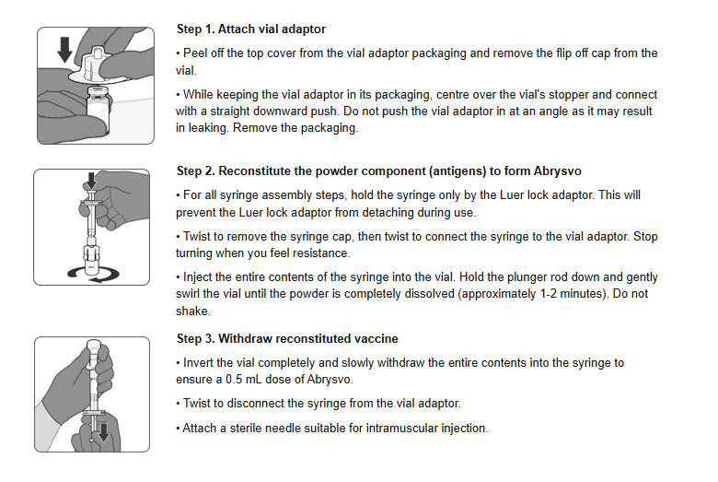
Preparation of Abrysvo® vaccine using a pre-filled syringe of solvent and adding this to the vial containing the powder using the vial adaptor
Image from Abrysvo® vaccine SmPC
42
RSV vaccination of pregnant women programme: training slide set for healthcare practitioners

Slide 43

Preparation for administration
The prepared vaccine is a clear and colourless solution. Visually inspect the vaccine for large particulate matter and discolouration prior to administration
Do not use if large particulate matter or discolouration is found
Disposal
Any unused medicinal product or waste material should be disposed of in accordance with local requirements
*For further information please visit: Respiratory syncytial virus (RSV) programme: information for healthcare professionals - GOV.UK
Image source: UKHSA
Abrysvo powder and solvent for solution for injection - Summary of Product Characteristics (SmPC) - (emc)
43
RSV vaccination of pregnant women programme: training slide set for healthcare practitioners
Notes:
* The UKHSA guidance for healthcare practitioners has a section on what do in the event of reconstitution errors

Slide 44
Vaccine intramuscular administration
Giving vaccine into the muscle:
leads to a better immune response to the vaccine (as the muscle contains the appropriate cells necessary to initiate the immune response)
is less likely to cause local reactions than if the vaccine is given under the skin (subcutaneously)
The needle needs to be long enough to ensure vaccine is injected into the muscle. For this reason, the orange 25 gauge 25mm needle supplied in the Abrysvo® packs should be suitable for administration of the RSV vaccine for most women
In larger women however, a longer length (e.g. 38mm) may be required, and an individual assessment should be made
Abrysvo® should be injected into the deltoid muscle in the upper arm. If there is insufficient muscle mass in the deltoid or a particular reason the deltoid muscle is unsuitable, the vaccine should be given into the vastus lateralis muscle in the anterolateral aspect of the thigh
RSV vaccination of pregnant women programme: training slide set for healthcare practitioners

Slide 45
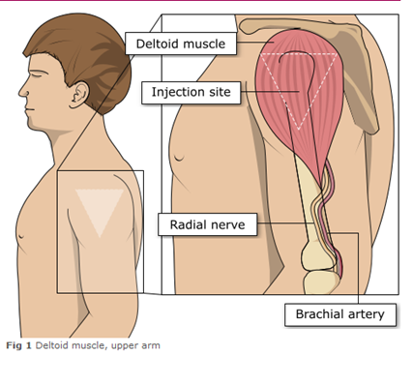
Administering vaccine into the deltoid muscle
It is essential that the correct site and injection technique is used to administer vaccines
Injecting too high into the upper arm might result in a shoulder injury or a frozen shoulder, leading to pain, weakness and a limited range of motion that can last for months
Injecting too low or too far to the side of the arm risks injecting into the axillary nerve or the radial nerve
To avoid shoulder injury, always assess the limb before administering the vaccine to identify the correct site for injection
Image adapted from the Australian Immunisation Handbook
RSV vaccination of pregnant women programme: training slide set for healthcare practitioners

Slide 46
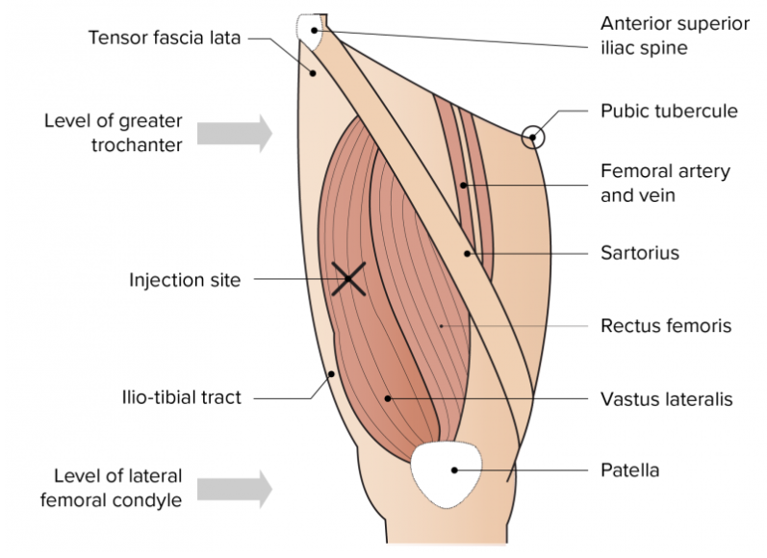
Administering vaccine into the vastus lateralis muscle (anterolateral aspect of the thigh)
Although the deltoid muscle is more commonly used in older children and adults as it is quicker and easier to access, the vastus lateralis muscle in the thigh can be used in these age groups if necessary
Image from the Australian Immunisation Handbook
RSV vaccination of pregnant women programme: training slide set for healthcare practitioners

Slide 47
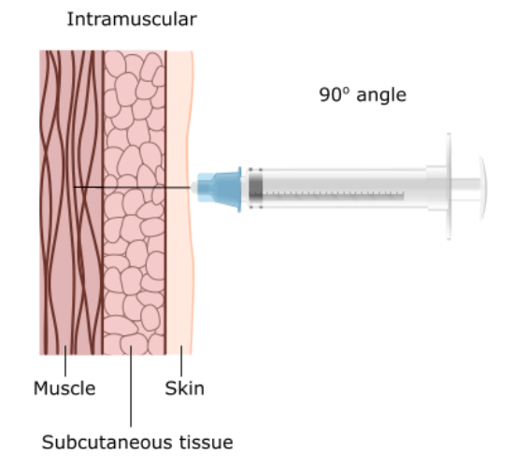
Vaccine administration
Skin does not need to be specially cleaned prior to vaccination. If it is visibly dirty, then water is sufficient to clean it.
Intramuscular process:
identify the correct site for IM injection
stretch the skin at the site
insert the needle at a 90 degrees angle far enough to ensure vaccine is delivered into muscle
depress the plunger
gently remove the needle
apply light pressure using gauze or cotton wool if bleeding occurs
RSV vaccination of pregnant women programme: training slide set for healthcare practitioners
Notes:
https://assets.publishing.service.gov.uk/government/uploads/system/uploads/attachment_data/file/147915/Green-Book-Chapter-4.pdf

Slide 48
Women with bleeding disorders or taking anticoagulation therapy
Women with bleeding disorders may be vaccinated intramuscularly if, in the opinion of a doctor familiar with the woman's bleeding risk, vaccines or similar small volume intramuscular injections can be administered with reasonable safety by this route
If the woman receives medication/ treatment to reduce bleeding, for example treatment for haemophilia, intramuscular vaccination can be scheduled shortly after such medication/ treatment is administered
Women on stable anticoagulation therapy, including women on warfarin who are up-to-date with their scheduled INR testing and whose latest INR is below the upper level of the therapeutic range, can receive intramuscular vaccination. Note that warfarin is not commonly prescribed for anticoagulation in pregnant women and anticoagulation may be through heparin injections
A fine needle (23 or 25 gauge) should be used for the vaccination, followed by firm pressure applied to the site without rubbing for at least 2 minutes
The woman should be informed about the risk of haematoma from the injection
If in any doubt, consult with the clinician responsible for prescribing or monitoring the woman’s anticoagulant therapy
RSV vaccination of pregnant women programme: training slide set for healthcare practitioners

Slide 49
Post-vaccination
Following RSV vaccine administration, women should be observed for any immediate reactions whilst giving them any verbal post vaccination information
Vaccinees should be given a copy of the patient information leaflet for the vaccine that they have received and any other relevant written information
Vaccinees should be given information about possible vaccine reactions, how to treat these, and when and from whom to seek further advice if required
Symptoms post vaccination generally resolve within a few days without treatment, but paracetamol can be taken if necessary to relieve pain or fever
If women are concerned about any symptoms following vaccination, they should be advised to seek advice from their GP or NHS 111
Facilities for management of anaphylaxis should be available at all vaccination sites and staff should have undertaken basic life support and anaphylaxis training
RSV vaccination of pregnant women programme: training slide set for healthcare practitioners

Slide 50
Disposal of consumables
Needles should not be re-sheathed following vaccination under any circumstances because of the risk of sustaining a needlestick injury
The needle and syringe should be disposed of immediately after use in a puncture resistant yellow sharps bin
The yellow sharps bin should be sealed when it is two-thirds full and replaced with a new one
Any blood-stained gauze should be placed in an appropriate bin for healthcare waste
RSV vaccination of pregnant women programme: training slide set for healthcare practitioners

Slide 51
Adverse reactions following vaccination
Some people can feel unwell following an injection and some people may experience an adverse reaction
Pregnant women should be informed of the most frequently reported potential reactions to Abrysvo® which are:
injection site pain (41%)
headache (31%)
myalgia (27%)
(figure in brackets is percentage of recipients who reported reaction in clinical trials)
For pregnant women, the majority of local and systemic reactions are mild in severity and resolve within a few days of onset
RSV vaccination of pregnant women programme: training slide set for healthcare practitioners

Slide 52
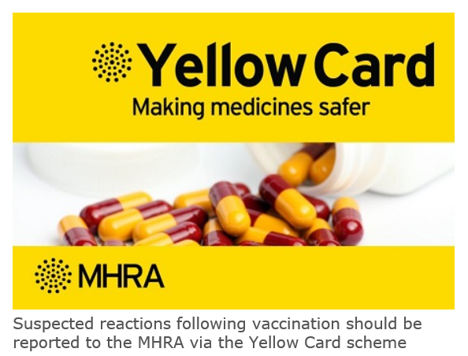
Reporting adverse reactions
Abrysvo® is a newly licensed vaccine in the UK and is subject to additional monitoring under the black triangle labelling scheme by the MHRA. This means that all suspected adverse reactions following administration should be reported to the MHRA using their Yellow CARD reporting scheme at Yellow Card | Making medicines and medical devices safer (mhra.gov.uk).
Vaccines are carefully monitored to ensure they are safe, not causing untoward side effects and are suitable for the immunisation programme
MHRA promotes the collection and investigation of adverse reactions through the Yellow Card scheme which is a voluntary reporting system for suspected adverse reactions
Anyone (vaccine recipients and healthcare practitioners) can make a Yellow Card report, even if they are uncertain as to whether a vaccine caused the condition
RSV vaccination of pregnant women programme: training slide set for healthcare practitioners

Slide 53
Documentation and record keeping
The information in Box 1 must be recorded for all vaccines given to ensure complete and accurate patient vaccination records and to enable extraction of the correct data for programme monitoring.
Box 1. Following vaccination, the following information should be recorded:
vaccine name
product name
batch number
expiry date
dose administered
date immunisation given
route/site used
name and signature of vaccinator
The engaged provider must use the Welsh Immunisation System (WIS) for documenting RSV vaccination.
Including:
consent for vaccination
noting any contraindications
recording immediate adverse events
recording the refrigerator temperature(s) where vaccines are stored, twice daily (start and end of the day) on all working days, as per national guidance
Clinical services may wish to update their own clinical records by entering vaccination on local systems/paper notes.
RSV vaccination of pregnant women programme: training slide set for healthcare practitioners

Slide 54
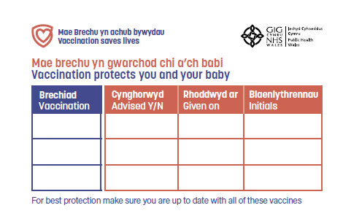
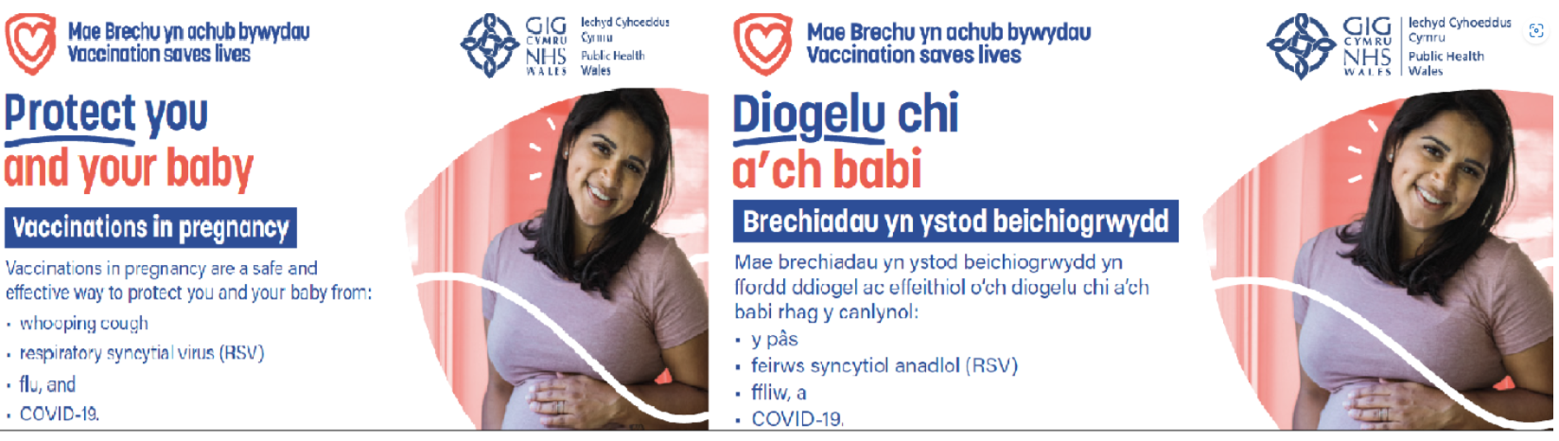
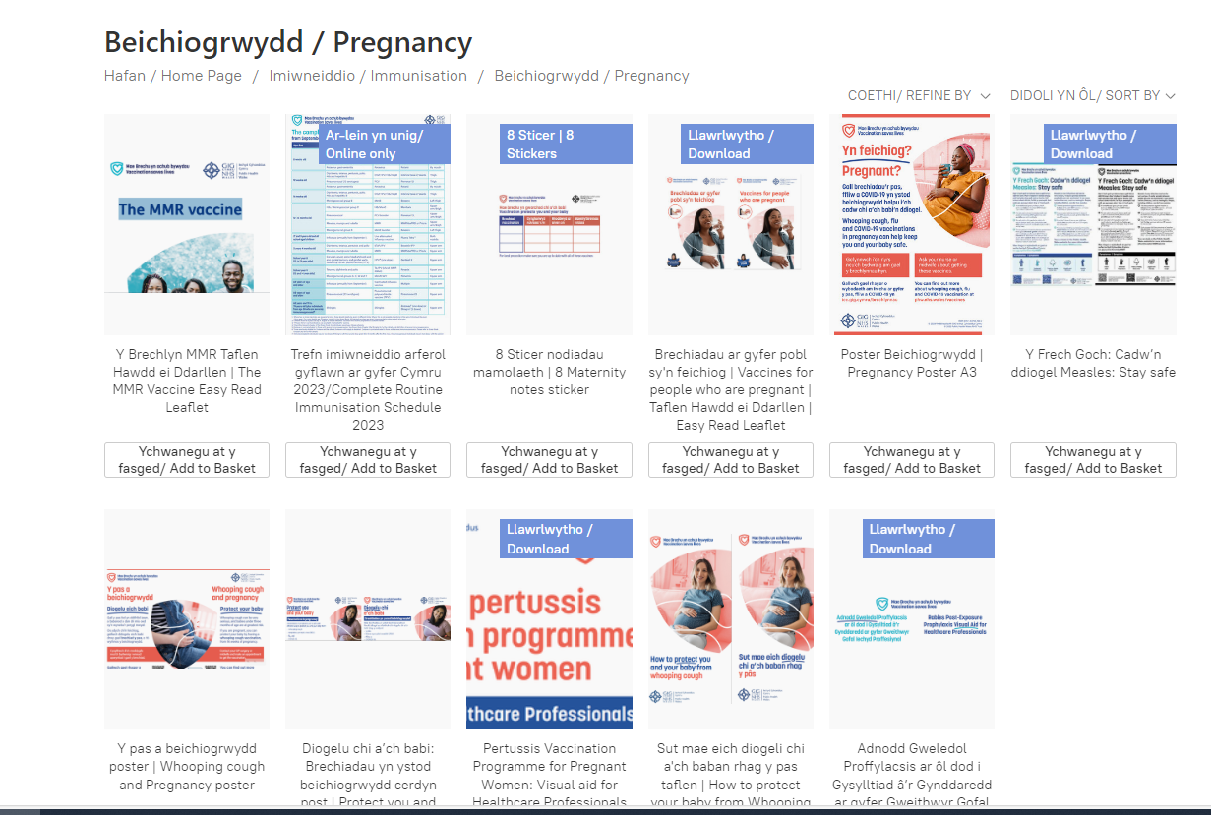
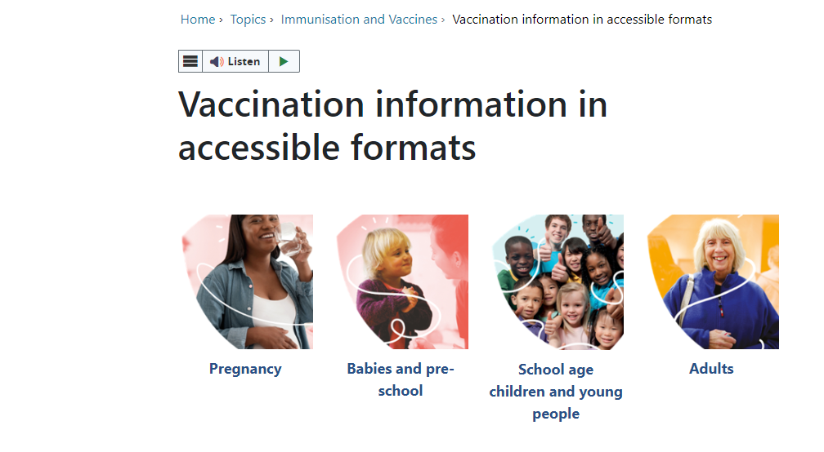
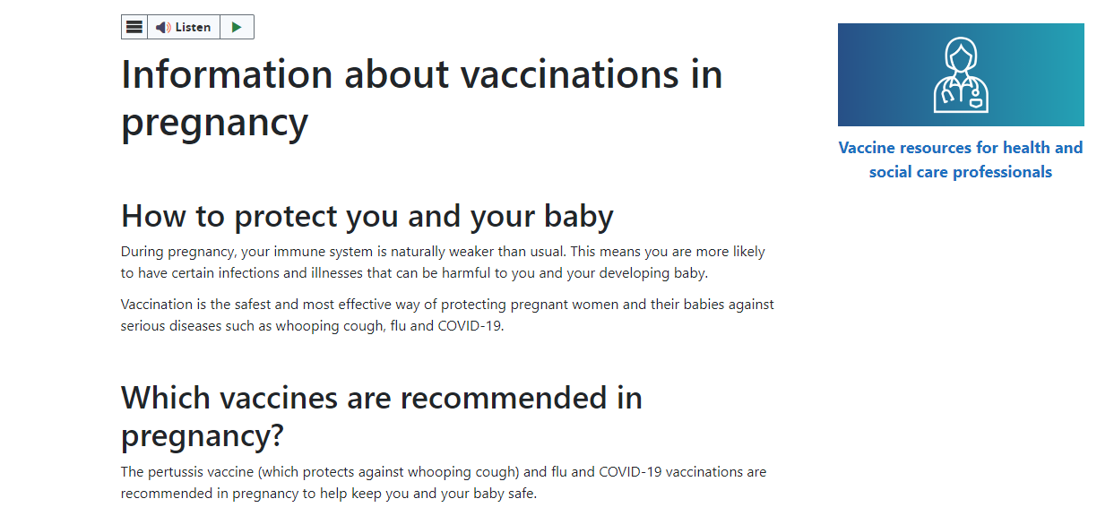
Maternal vaccination resources
All resources are FREE to order with FREE delivery
Pregnancy stickers and postcards are available to order from here:
Beichiogrwydd / Pregnancy (nhs.wales)
A pregnancy poster and booklet with information about all vaccines in pregnancy is available to order here:
Beichiogrwydd / Pregnancy (nhs.wales)
Accessible resources are available from here:
Vaccination information in accessible formats - Public Health Wales (nhs.wales)
Further information on maternal vaccines including RSV is available on our web page here:
Information about vaccinations in pregnancy - Public Health Wales (nhs.wales)
RSV vaccination of pregnant women programme: training slide set for healthcare practitioners

Slide 55
Further information
The Green Book: Immunisation against infectious disease: RSV Green Book Chapter (27a)
Welsh Health Circular: Introduction of RSV vaccination programme 2024 (WHC/2024/032)
UKHSA RSV vaccination of pregnant women for infant protection: information for healthcare practitioners
Marketing authorisation holder’s Summary of product characteristics
Medicines and Healthcare products Regulatory Agency (MHRA): reporting adverse reactions
National Patient Group Direction (PGD): RSV vaccine
Pfizer Abrysvo® vaccine preparation instructional video
NHS website: Bronchiolitis
UKHSA RSV overview: RSV: symptoms, transmission, prevention, treatment
Public Health Wales public webpage: Respiratory syncytial virus (RSV) vaccination information - Public Health Wales (nhs.wales)
For information: A separate training slide set and information for healthcare practitioners document is also available for the RSV vaccination of older adults​
RSV vaccination of pregnant women programme: training slide set for healthcare practitioners

Slide 56
Further resources
These resources are not designed for local training, but as briefing resources to support with awareness raising of the RSV vaccination programme
RSV recorded slides:
1. An Introduction to Respiratory Syncytial Virus (RSV) – Published May 2024
2. Respiratory Syncytial Virus (RSV) - Vaccination Campaign 2024 – Published July 2024
The slides and recordings are available here: Training (sharepoint.com)
RSV Q&A webinar:
VPDP hosted a live Q&A RSV webinar on the 8th of August 2024. The slides and recording are available to view here: Immunisation training resources and events - Public Health Wales (nhs.wales)

Slide 57
Resources: Information for healthcare practitioners guidance
The UKHSA information for healthcare practitioners guidance Respiratory syncytial virus (RSV) programme: information for healthcare professionals - GOV.UK (www.gov.uk) is recommended reading for anyone involved in RSV immunisation
This is a practical document for healthcare practitioners administering or providing advice about RSV vaccination of pregnant women for infant protection. It includes the vaccination programme recommendations, contraindications, precautions and examples of scenarios that staff may experience when immunising
RSV vaccination of pregnant women programme: training slide set for healthcare practitioners

Slide 58
Optimising Vaccine Uptake: Using motivational interviewing for better conversations eLearning
The approach and style of a vaccine conversation can make a real difference in understanding individual hesitancy, addressing barriers, and influencing vaccine uptake
There is an eLearning module available called Optimising Vaccine Uptake: Using motivational interviewing for better conversations which aims to support staff with having positive conversations about immunisations
The module aims to provide health professionals the skills and knowledge required to implement motivational interviewing techniques when having vaccine-related conversations
Further information about the module and how to access it is available here: Immunisation eLearning - Public Health Wales (nhs.wales)
RSV vaccination of pregnant women programme: training slide set for healthcare practitioners

Slide 59
Learning objectives
You should now be able to:
explain what RSV is and be aware of the UK epidemiology
understand the rationale for the maternal RSV vaccination for infant protection programme
describe how the Abrysvo® vaccine works
state when the RSV vaccine should be offered to pregnant women
describe the process of consent and how this applies when giving vaccines
understand the legal mechanisms by which immunisers can supply and administer Abrysvo® RSV vaccine
describe how to correctly store, prepare and administer Abrysvo® RSV vaccine
communicate key facts in response to questions from pregnant women and direct them to additional sources of information
RSV vaccination of pregnant women programme: training slide set for healthcare practitioners

