Slide 1
Q&A webinar outlining the changes to the
childhood immunisation programme and selective neonatal Hep B programme
Vaccine Preventable Disease Programme
Public Health Wales
17 June 2025

Slide 2
Changes to the childhood immunisation programme and selective neonatal Hep B programme
The information contained within this slide set is up to date as of 17 June 2025.
It is important that all immunisers delivering the childhood immunisation programme and/ or those who are providing immunisation advice familiarise themselves with the most up to date clinical evidence and guidance, this can be found in the following key documents:
The Green Book chapters can be found here: Immunisation - GOV.UK
*UKHSA Guidance for Healthcare Professionals: Childhood schedule changes from 1 July 2025: information for healthcare practitioners - GOV.UK
Welsh Health Circular: Changes to routine childhood and selective neonatal hepatitis B vaccinations (WHC/2025/019) | GOV.WALES
Selective neonatal Hepatitis B immunisation pathway (effective 1 July 2025) [HTML] | GOV.WALES
Joint Committee on Vaccination and Immunisation (JCVI) statement on changes to the childhood immunisation schedule - GOV.UK
JCVI statement on a childhood varicella (chickenpox) vaccination programme - GOV.UK,
Minutes from JCVI meeting 5 February 2025, highlighting the PCV & MenB 'switch' Joint Committee on Vaccination and Immunisation - GOV.UK
VPDP webpage is available here: Changes to the childhood immunisation schedule - Information for health professionals - Public Health Wales
2
Notes:
*It’s important to highlight that the advice in relation to Hib/MenC ( Menitorix®) is different to Welsh policy. NHS Wales is deploying a ‘hard stop’ so from 1st July 2025, Hib/MenC (Menitorix®)will no longer be included in the childhood immunisation schedule in Wales. Please refer to Welsh Policy Changes to routine childhood and selective neonatal hepatitis B vaccinations (WHC/2025/019) [HTML] | GOV.WALES for further information.

Slide 3
Acknowledgements
Vaccine Preventable Disease Programme (VPDP), Public Health Wales: Immunisation and Vaccines - Public Health Wales
Vaccine Programme Wales (VPW)
UK Health Security Agency: www.gov.uk/government/topics/public-health

Slide 4
Contents
Section
Aims
Objectives
Organogram
Joint Committee on Vaccination and Immunisation (JCVI)
Proposed changes to the childhood immunisation programme in 2025 & 2026
Epidemiology and Surveillance update
Web pages and resources created/updated for changes to the childhood immunisation schedule
Vaccine Equity & Public Engagement update - Health Protection Public Perceptions Tracker
Summary & resources

Slide 5
Aims of this webinar session:
To provide information for healthcare practitioners involved in advising on and delivering the childhood immunisation programme
To raise awareness of the changes to the childhood immunisation programme and the selective neonatal hepatitis B immunisation programme in Wales
To outline the epidemiology of these diseases and the current vaccine uptake data
To promote vaccine equity in relation to these vaccine preventable diseases
To highlight resources that support these changes

Slide 6
Organogram
Welsh Government
Vaccine Preventable Disease Programme (VPDP)*
Welsh Medicines Advice Service (WMAS)
Digital Health and Care Wales (DHCW)
NHS Wales Shared Services Partnerships (NWSSP)
Vaccine Programme Wales (VPW)
NHS Wales Performance and Improvement
Public Health Wales
Welsh Health Boards
Immunisation teams
This organogram shows the structure of immunisation and vaccination in Wales.
*We are VPDP.

Slide 7
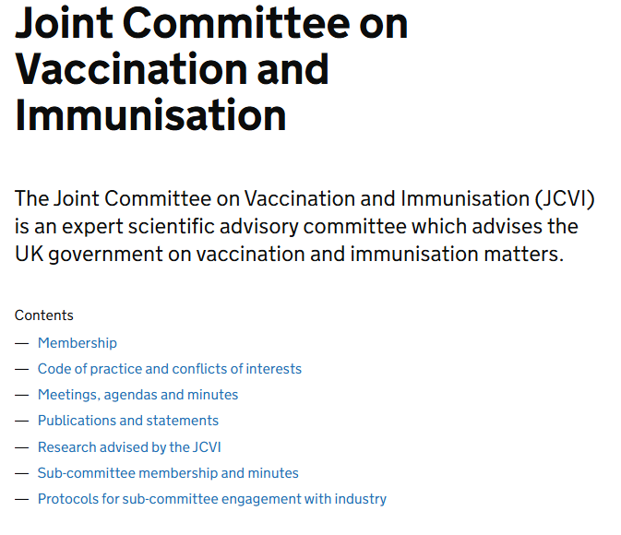
Joint Committee on Vaccination and Immunisation (JCVI)​
The proposed changes are based on advice by the JCVI.
The role of the JCVI​
Independent expert committee advising the UK government on vaccines
Reviews scientific evidence, safety data, cost-effectiveness and public health impact
Ensures vaccine programmes provide the greatest benefit to public health
​
Joint Committee on Vaccination and Immunisation - GOV.UK
8

Slide 8
The JCVI decision making process​
Review disease burden - How serious and widespread is the disease?​
Assess Vaccine Safety & Effectiveness - Evidence from clinical trials and real-world data.​
Consider cost-effectiveness - Is the vaccine a good use of NHS resources?​
Model Public Health Impact - How will the vaccine reduce infections and hospitalisations?​
Consult stakeholders - Input from experts, healthcare professionals and public health bodies.​
Make recommendations ​
Government decision
Welsh Government​​
Health is devolved. Wales aligns with UK guidance for consistency across the UK, unless specific adaptations are needed.
9

Slide 9
Pre-requisites to administering childhood vaccines
Before administering childhood vaccinations, it is recommended that:
*Those new to immunisation should receive comprehensive foundation immunisation training. Both knowledge and clinical competence should be assessed before new immunisers start to give and/or advise the shingles vaccine Immunisation training standards for healthcare practitioner UK Health Security Agency - UKHSA)
Training in the management of anaphylaxis and Basic Life Support is undertaken, as specified by policy for your local area and are familiar with Resuscitation Council UK (RCUK) guidance on Management of Anaphylaxis in the Vaccination Setting
Any additional statutory and mandatory training as required by your employer is completed
An appropriate legal framework to supply and administer childhood vaccines is in place e.g. written prescription, Patient Specific Direction (PSD), Patient Group Direction (PGD). Visit here for further information
Those involved in immunisation and vaccination understand the process of consent and how this applies when giving vaccines. Information on consent can be viewed here: Consent: the green book, chapter 2 - GOV.UK
Immunisers and those giving immunisation advice access and familiarise themselves with the following key documents: All relevant Green Book chapters will be updated: Immunisation against infectious disease - GOV.UK, Information for healthcare practitioners:*Childhood schedule changes from 1 July 2025: information for healthcare practitioners - GOV.UK, Welsh Health Circular: Changes to routine childhood and selective neonatal hepatitis B vaccinations (WHC/2025/019) | GOV.WALES
10
Notes:
*This should be either through a face to face taught course or a blended approach of both e-learning and a face to face taught course. New immunisers should also have a period of supervised practice and support with a registered healthcare practitioner who is experienced, up to date and competent in immunisation.
* It’s important to highlight that the advice in relation to Hib/MeC ( Menitorix) is different to Welsh policy. NHS Wales is deploying a ‘hard stop,’ so from 1 July 2025 Hib/MenC (Menitorix ®) will no longer be included in the childhood immunisation schedule in Wales. Please refer to Welsh Policy for further information: Changes to routine childhood and selective neonatal hepatitis B vaccinations (WHC/2025/019) | GOV.WALES
should always ensure they are accessing the most up to date information and guidance.

Slide 10
Patient Group Directions (PGDs)
All relevant updated UKHSA PGDs will be available at: Patient Group Directions (PGD) - Welsh Medicines Advice Service
The advisory document to be used alongside the new UKHSA DTaP/IPV/Hib/HepB (6 in 1) PGD is available to view here: https://www.wmic.wales.nhs.uk/pgds-templates-advice/#immunisations
This highlights that within Wales the Hib/MenC (Menitorix®) vaccine will no longer be offered after 01 July 2025:
  Children born on or before 30 June 2024 who present for their one-year appointment on or after 01 July 2025, should be offered a fourth dose of DTaP/IPV/Hib/HepB (6 in 1) vaccine alongside the other vaccines scheduled at one year of age (i.e. MenB, PCV13 and first MMR dose).
  Children born on or after 01 July 2024 should be offered a fourth dose of DTaP/IPV/Hib/HepB (6 in 1) vaccine at the new routine 18-month appointment alongside their second MMR dose.

Slide 11
Changes to the childhood immunisation and selective neonatal Hep B programme programme in 2025 & 2026
Juliet Norwood, Specialist Nurse, Immunisation
Vaccine Preventable Disease Programme
Public Health Wales

Slide 12
Key messages
Manufacturing of Hib/MenC (Menitorix) discontinued
Vaccination against MenC in early childhood no longer necessary
Vaccination against Hib in second year of life needs to continue
Additional Hib containing vaccine DTaP/IPV/Hib/HepB (6-in-1) to be given
A new 18-month appointment
Second MMR to be offered earlier
Change of order of vaccines MenB and PCV
Potential addition of varicella to MMR
13
Notes:
Joint Committee on Vaccination and Immunisation (JCVI) statement on changes to the childhood immunisation schedule - GOV.UK

Slide 13
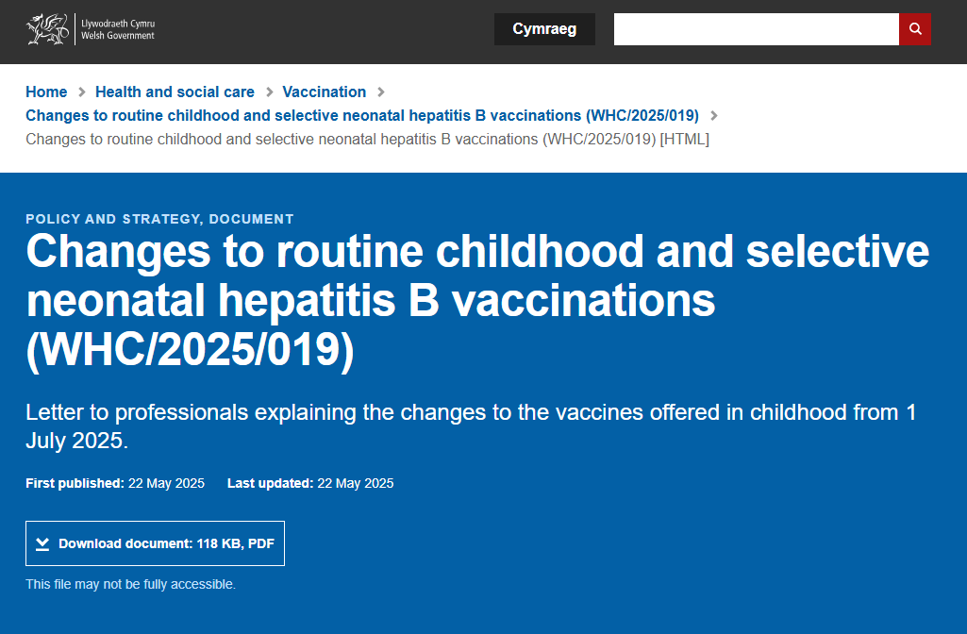
Welsh Health Circular May 2025
Changes to routine childhood and selective neonatal hepatitis B vaccinations (WHC/2025/019) [HTML] | GOV.WALES

Slide 14
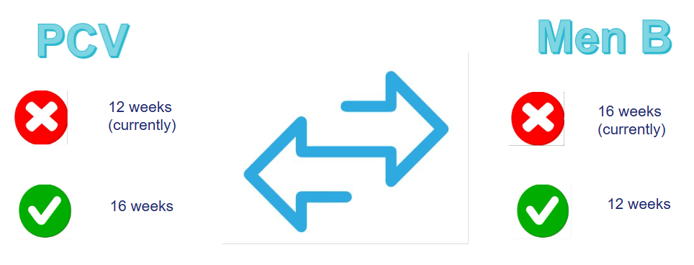
Vaccination changes for first year of life:
PCV and Men B switch
The JCVI reviewed a study comparing data pre and post vaccine implementation of the Men B vaccine in 2016.
  Showed that there has been a continued burden of Men B disease since implementation of the programme
  It showed that the Men B disease burden in infants has shifted from 5-6 months to 1-3 months of age
  Study noted that PCV and Men B may be switched without negative effect
  Switching would maintain the same needle burden across immunisation visits
The Committee therefore agreed that the routine infant immunisation schedule should be amended so that 4CMenB was to be given at 8 and 12 weeks of age, and PCV given at 16 weeks of age.​
  Giving the MenB vaccine earlier would provide earlier immunological protection against invasive Men B disease, without compromising longer term immunological protection​
  This is the first dose of PCV and as infants this age predominantly rely on indirect protection, this may be switched without negative effect
JCVI Minutes 5th February 2025: Joint Committee on Vaccination and Immunisation - GOV.UK

Slide 15
Implementation of PCV/MenB swap
From 1 July 2025
Has the child had their 12-week vaccinations?
No
Vaccinate as per new schedule timings (2nd Men B at 12 weeks and 1st PCV at 16 weeks)
Yes
Already had 12-week PCV before 1 July
Stay on previous schedule and have 2nd MenB vaccine at 16 weeks of age
16

Slide 16

Vaccination changes for second year of life
The manufacturing of Hib/MenC (Menitorix®) vaccine will be discontinued
Commercial decision by the manufacturer (GSK)
This is the only Hib/MenC vaccine available, so changes to the routine infant schedule are necessary
UKHSA estimates that the central stock of Hib/MenC will be depleted by mid-2025 – NHS Wales has a ‘hard stop’ from 1 July 2025
JCVI advised that MenC vaccine is no longer required in the infant vaccination schedule
The success of the Meningococcal C containing vaccine programmes and the decline of invasive Meningococcal C disease subsequently
The excellent current control of Meningococcal disease can be maintained through the MenACWY teenage vaccine programme
JCVI advised that there is still a need for a dose of Hib vaccine during the second year of life
It is important to ensure good uptake of MenACWY

Slide 17

Men C disease and vaccination
The Men C vaccine programme commenced in 1999. This led to a significant reduction of invasive meningococcal disease.
The Men ACWY programme commenced in 2015. This led to further reduction of Men C disease (as well as Men W disease).
COVID-19 social distancing and lockdown measures led to a further decline in spread and detection of invasive meningococcal disease (IMD)
Modelling work has found that indirect protection against MenC disease is sustained because of the teenage MenACWY programme.
Over time it is expected that the teenage MenACWY programme will reduce carriage prevalence of Men C,W and Y to near elimination levels
  Group A has been almost undetectable for many years in the UK
  Carriage prevalence = how many carrying the meningococcal bacteria in their nose and throat.
With the reduction in carriage prevalence of these meningococcal serogroups, it has been predicted that there will be very few IMD cases caused by meningococcus groups A,C,W and Y each year, by the time the Menitorix® is no longer available.
Notes:
Joint Committee on Vaccination and Immunisation (JCVI) statement on changes to the childhood immunisation schedule - GOV.UK (November 2022)

Slide 18

Hib disease and vaccination
Before the Haemophilus influenzae type B (Hib) vaccine was introduced, about 1/600 children developed Hib disease before they were 5
  Most common presentation of invasive Hib disease: meningitis (60%of all cases), epiglottitis (15%), bacteraemia (10%), septic arthritis, pericarditis, cellulitis, pneumonia and osteomyelitis.
  People can carry Hib bacteria in their nose and throat without showing symptoms of the disease. Before introduction of Hib vaccine, 4% pre-school children carried Hib organism.
After the vaccine was introduced, carriage rates fell below level of detection
  Disease incidence has fallen in all age groups. Not just those vaccinated.
However, as immunity following a 3-dose primary course of Hib in infancy does wane, a 4th (booster) dose during the 2nd year of life is needed to continue to prevent transmission in the community and maintain herd immunity

Slide 19

Bringing forward the second dose of MMR
The new 18 months appointment provides an opportunity for the second dose of MMR vaccine to be brought forward from 3 years 4 months to 18 months of age
The main reason for bringing the second dose of MMR forward is to improve coverage and reduce the likelihood of measles outbreaks
In areas of London, where the second dose of MMR was brought forward in response to local measles outbreaks in the 2000s, second dose coverage increased by an average of 3.3%
JCVI considers the likely added benefit of increasing uptake of second MMR further justifies the additional routine immunisation appointment
If the second MMR is not received at 18 months, there is a further opportunity to give it at 3 years and 4 months with the dTaP/IPV (4 in 1) booster vaccine

Slide 20
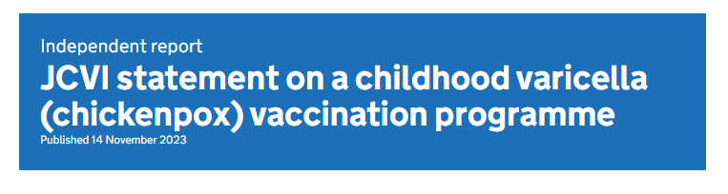
Recommendation of varicella
(chickenpox) vaccination
The JCVI recommends that a universal varicella (chickenpox) programme should be introduced as part of the routine childhood schedule.
They recommend a 2-dose programme at 12 and 18 months using the combined MMRV (measles, mumps, rubella and varicella) vaccine.
A catchup programme is also recommended following implementation of the programme, to prevent a gap in immunity.
If procured, change could be implemented in January 2026.
No policy
21
Notes:
Childhood varicella vaccination programme: JCVI advice, 14 November 2023 - GOV.UK (www.gov.uk)

Slide 21
Summary of changes
From 1st July 2025:
The routine Hib/Men C (Menitorix®) offer to those turning 12 months of age will cease.
Second Men B vaccine moved from 16 weeks to 12 weeks appointment.
First PCV vaccine moved from 12 weeks to 16 weeks appointment.
The monovalent Hep B dose at 1 year in the selective neonatal HepB programme will be removed from the schedule.
From 1st January 2026:
Introduction of an additional (4th dose) of 6-in-1 (DTaP/IPV/Hib/HepB) vaccine at a new routine appointment at 18 months.
Movement of the second MMR dose from 3 years 4 months to the new routine 18-month appointment.

Slide 22
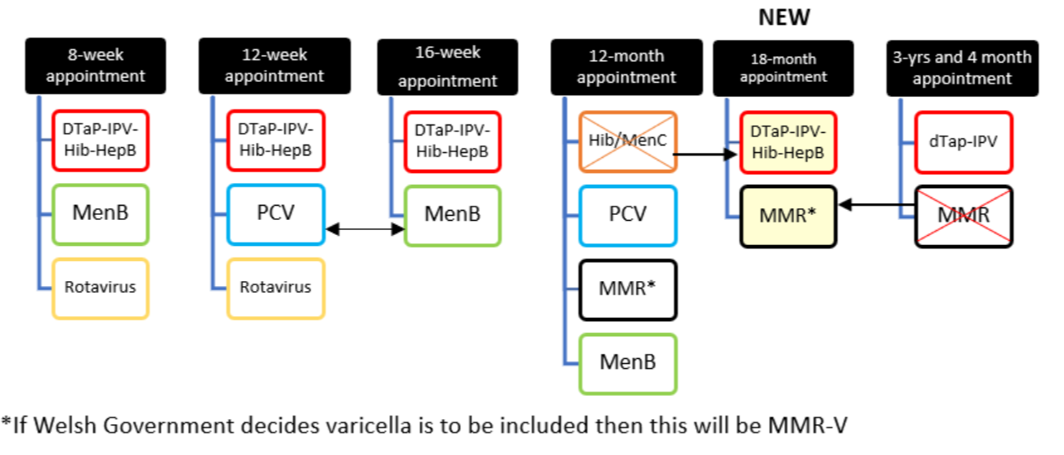
Summary of changes to the routine childhood immunisation schedule

Slide 23


Childhood Vaccination Schedules Algorithm from 1 July 2025
Please follow the algorithm to determine the appropriate vaccination schedule for children on 1 July 2025.
Yet to start vaccination schedule or already had 8-week vaccinations
Already had 12-week vaccinations and due 16-week vaccinations
Already had 16-week
vaccinations and now due 12-month
vaccinations
Already
had 12 to 13-month vaccinations
Start on new schedule:
8 weeks: 6-in-1, MenB, Rotavirus
12 weeks: 6-in-1, MenB, Rotavirus
16 weeks: 6-in-1, PCV
12-13 months: PCV, MMR, MenB
18 months: MMR, 6-in-1
3 years 4 months: 4-in-1
Have had at 12 weeks: 6-in-1, PCV, Rotavirus
Schedule to follow:
16 weeks: 6-in-1, MenB
12-13 months: PCV, MMR, MenB
18 months: MMR, 6-in-1
3 years 4 months: 4-in-1
DOB on or after 1 July 2024
Schedule to follow:
12-13 months: PCV, MMR, MenB
18 months: MMR, 6-in-1
3 years 4 months: 4-in-1
DOB on or before 30 June 2024 - late for 1 year appointment
Schedule to follow:
12-13 months: 6–in-1, PCV, MMR, MenB
18 months: no vaccines
3 years 4 months: 4-in-1, MMR
Schedule to follow:
3 years 4 months: 4-in-1, MMR
DRAFT
Additional information:
For more information about the changes to the childhood immunisation schedule in 2025 and 2026, see: phw.nhs.wales/vaccines/ccs-information-for-health-professionals
Any children with an incomplete history for their age should be managed according to the Vaccination of individuals with uncertain or incomplete immunisation (external site)
The childhood immunisation eligibility calculator (external site) is available to help you understand and plan what vaccines are due and when.
Please note, recommendations in relation to Hib/MenC (Menitorix®) in England is different to Welsh policy. Please consider this when referring to these resources by UKHSA and refer to Welsh Policy for further information: Changes to routine childhood and selective neonatal hepatitis B vaccinations (external site)
Key:
Red text – new schedule
Grey text – no vaccine or appointment
PCV/MenB swap:
If had PCV at 12 weeks, give MenB at 16 weeks.
If MenB given at 12 weeks, give PCV at 16 weeks.

Slide 24

Selective neonatal Hepatitis B programme
For infants eligible for the selective neonatal HepB programme born on or after 1 July 2024 (new pathway):
  Birth: monovalent Hep B
  4 weeks: monovalent Hep B
  One year to 18 months: Test for HepB surface antigen. Testing can be undertaken any time during this period, for example at an opportunistic healthcare attendance or routine appointment. Record the results of the test in the baby’s primary care record
Rationale for change
The addition of a dose of DTaP/IPV/Hib/HepB (6-in-1) vaccine at 18 months from 1 January 2026 replaces the need to receive a dose of monovalent HepB vaccine at one year. It is very important that babies on the selective neonatal HepB schedule receive this 18-month dose
Additional information
Eligible children who turn one year old on or before 30 June 2025 (born on or before 30 June 2024) should continue to be offered a dose of monovalent HepB vaccine (alongside the other vaccines given at this age), on or after their first birthday
Children born on or before 30th June 2025 will continue to follow the current selective neonatal Hep B schedule.
Notes:
Changes to routine childhood and selective neonatal hepatitis B vaccinations (WHC/2025/019) [HTML] | GOV.WALES
Selective neonatal Hepatitis B immunisation pathway (effective 1 July 2025) | GOV.WALES

Slide 25
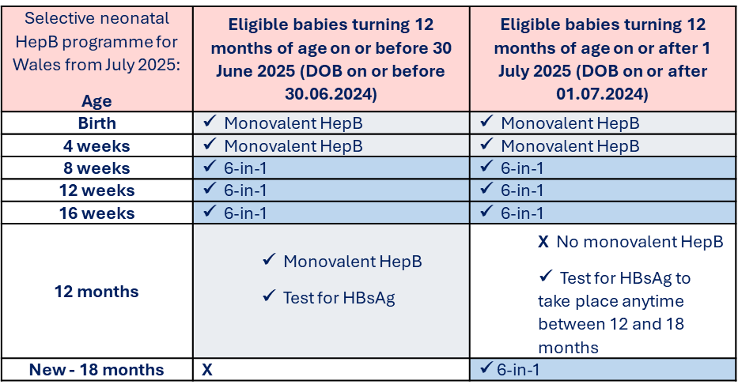
Selective neonatal Hepatitis B programme
This will be affected by the additional 6-in-1 in the new 18-month appointment
For information about this change and a downloadable information sheet go to Hepatitis B (HepB) - Information for health professionals - Public Health Wales

Slide 26
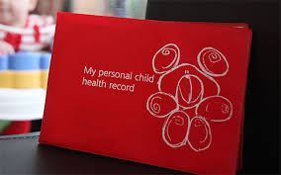
Red Book
A new Red Book will be issued in July 2025. The updated book will reflect the new immunisation schedule
Red Books issued prior to 1st July 2025 will not reflect the 2025 changes and will therefore need to be manually updated
27

Slide 27
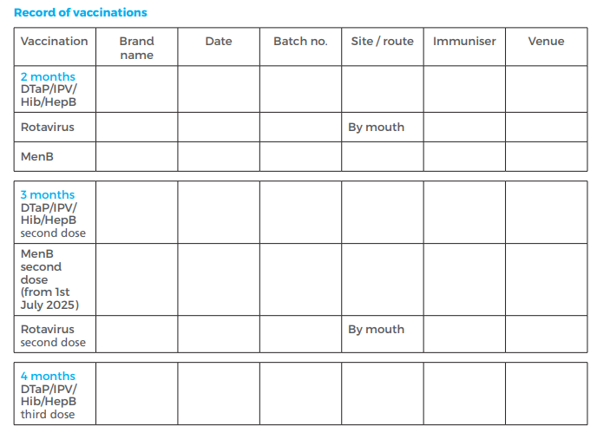
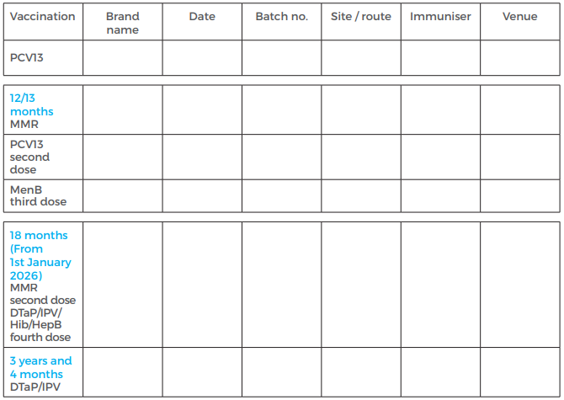
Red Book from 1 July 2025: Draft
28

Slide 28
Temporary delay with NHS IT system (CYPrIS)
Huw Williams – Senior Project Manager
Vaccine Programme Wales
Notes:
Childhood Years Pre –School Immunisation System

Slide 29
Scheduling of appointments
IMPORTANT: Due to an unavoidable delay, the NHS IT system (CYPrIS) used to schedule routine childhood immunisations will not be fully updated in time for the 1 July 2025 changes.
This delay is likely to be ongoing for a few months.
Notification will be given as soon as the IT system has been updated.
It is important that all vaccinators are aware of what they will need to do, until the system is updated.
What does this delay mean?
CYPrIS invitation letters to parents will contain outdated information.
CYPrIS scheduled forms sent to GP practices will contain outdated information, for example appointing PCV at 12 weeks instead of Men B (CYPrIS will automatically correct to appoint PCV at 16 weeks).
CYPrIS will not reflect that after 1 July 2025 any child born before 1 July 2024 attending a 12-month immunisation appointment should receive the 6-in-1 vaccine instead of Hib/MenC.
CYPrIS will be updated on 1 July 2025 to reflect the Hib/MenC hard stop.

Slide 30
Raising awareness about the delay:
VPW and VPDP
A letter outlining the CYPrIS scheduling delay will be sent out from Child Health departments alongside the scheduled forms to GP practices.
The unscheduled form has been updated and shared with health boards.
VPW are working with Child Health Departments in all health boards to ensure they are aware and ready.
VPW are working closely with the immunisation teams in all health boards.
VPDP are ensuring that information about the CYPrIS scheduling delay is outlined in the healthcare professional awareness raising sessions.
  This includes a recorded slide set specifically on the scheduling delay.
Working closely with Immunisation Coordinators in health boards.
VPDP are engaging with health visitors, GPs, paediatricians and other healthcare professionals to inform them of the changes and the scheduling delay.

Slide 31
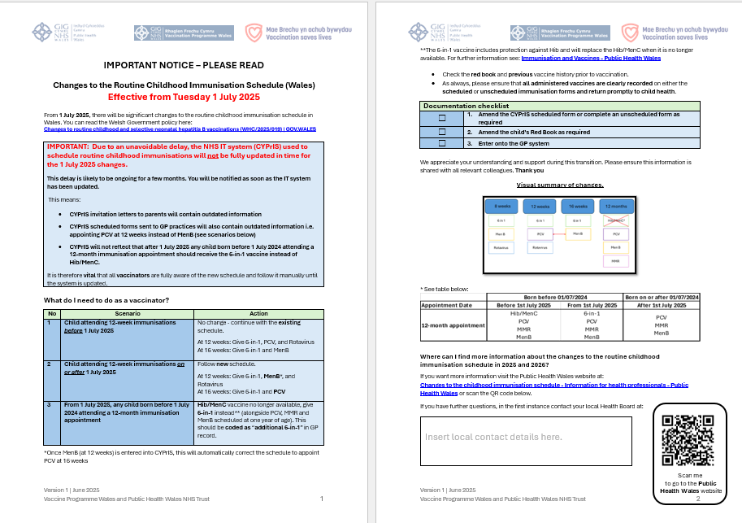
Letter to accompany scheduled form

Slide 32
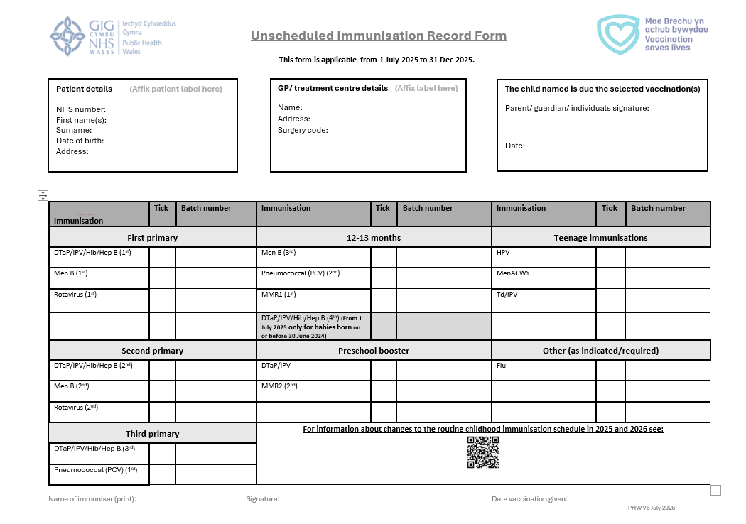
Unscheduled form from 1 July 2025 to 31 Dec 2025: draft

Slide 33
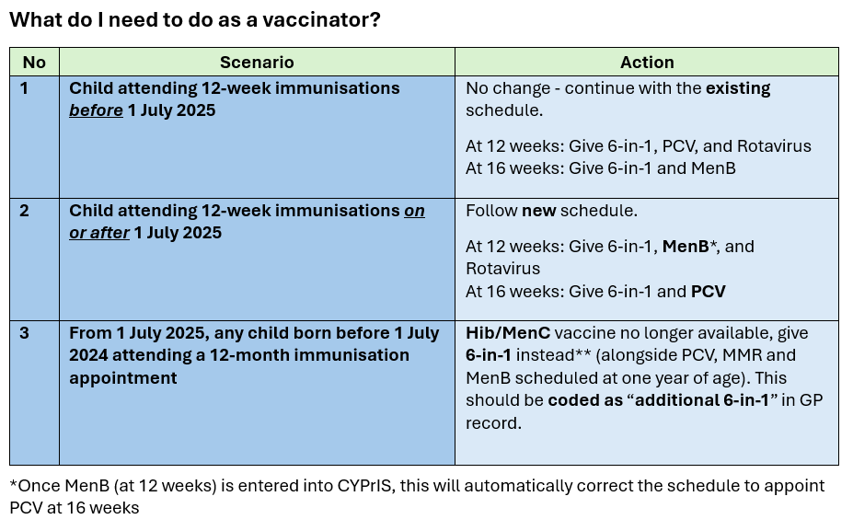
34

Slide 34
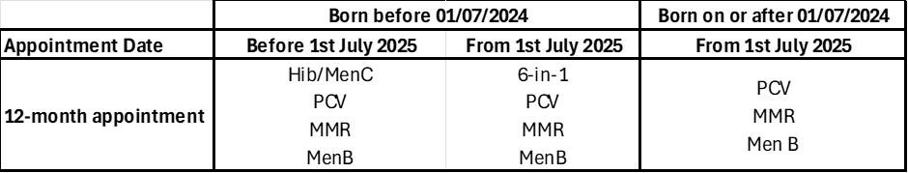
Any child born before 1 July 2024 and attends for their 12-month appointment from 1 July 2025.
The Hib/MenC vaccine will no longer be available from 1 July, and therefore the DTaP/IPV/Hib/ Hep B (6 in 1) vaccine should be given instead.
This cohort of children (circa 1700 across Wales) will not be eligible for an 18-month appointment, due to their date of birth and will therefore require a 4th dose of a Hib containing vaccine at their 12-month appointment.
These children should then be offered their booster dose of dTaP/IPV (4 in 1) vaccine at their 3-year 4-month appointment, along with their second dose of MMR.

Slide 35
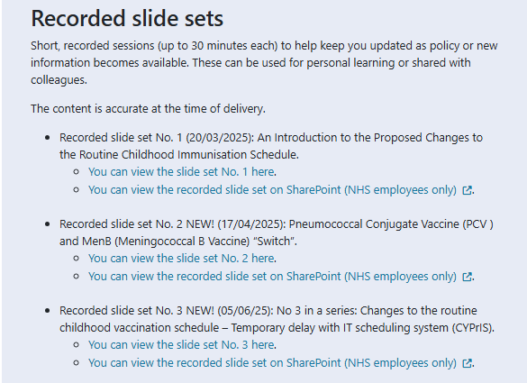
Further Information
For more detailed information on the CYPrIS delay, please refer to recorded slide set No 3. Changes to the routine childhood vaccination schedule – temporary delay with IT scheduling system (CYPrIS) on the VPDP website: Immunisation training resources and events - Public Health Wales.

Slide 36
Epidemiology and Surveillance update
Charlotte McDermott, Senior Epidemiologist
Vaccine Preventable Disease Programme/Communicable Disease Surveillance Centre
Public Health Wales

Slide 37
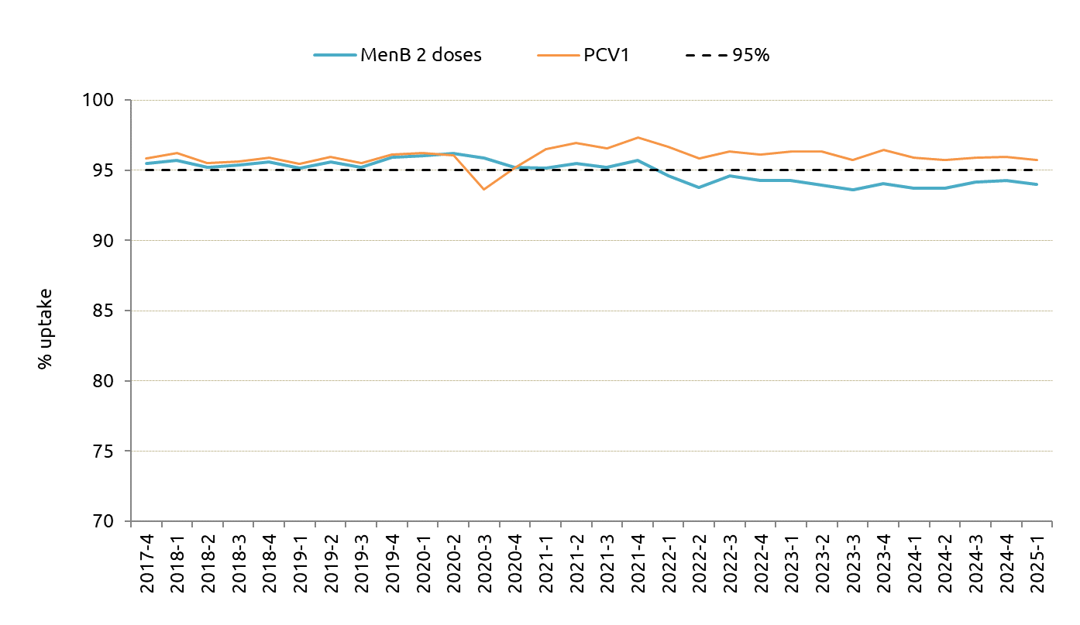
Latest Childhood Immunisation Data: Annual COVER Report 2024/25 PROVISIONAL
Results are for children living in Wales in as at 31/03/2025 and reaching key birthdays during the annual period 01/04/2024 to 31/03/2025.
PCV and Men B Uptake
Uptake of two doses of MenB vaccine, scheduled at 8 weeks and 16 weeks of age, in children reaching their first birthday was 93.8%
Uptake of primary pneumococcal conjugate vaccination (PCV) in children reaching their first birthday was 95.7%
PCV Uptake has remained consistently above 95% since 2021
Since 2022, uptake of two doses of MenB has remained stable and slightly below 95%

Slide 38
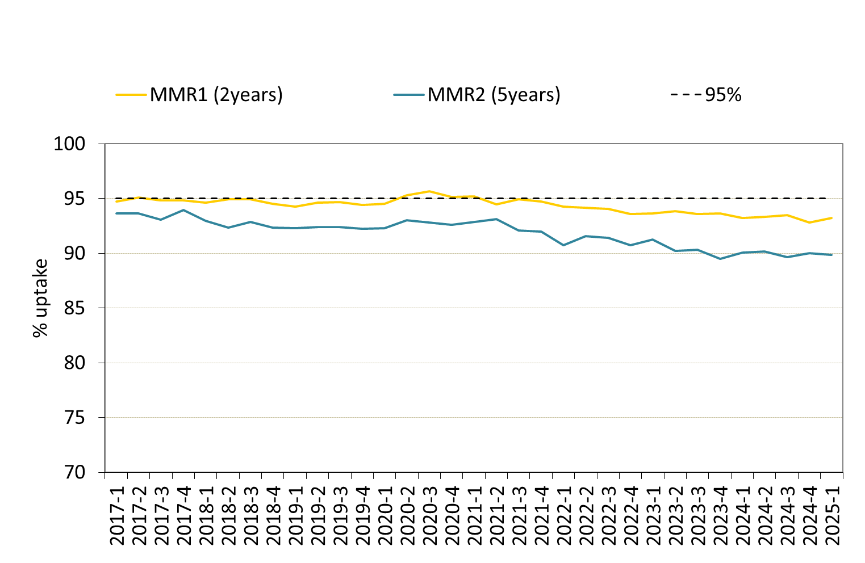
Latest Childhood Immunisation Data: Annual COVER Report 2024/25 PROVISIONAL
Results are for children living in Wales in as at 31/03/2025 and reaching key birthdays during the annual period 01/04/2024 to 31/03/2025.
MMR Uptake
MMR uptake of one dose by two years of age was 93.0%
MMR vaccine uptake of a complete two dose course in children by four years of age was 86.7%. Coverage of one of MMR was 94.7%
MMR uptake of two doses in children at five years of age was 89.5%. Coverage of one dose of MMR was 95.2%

Slide 39
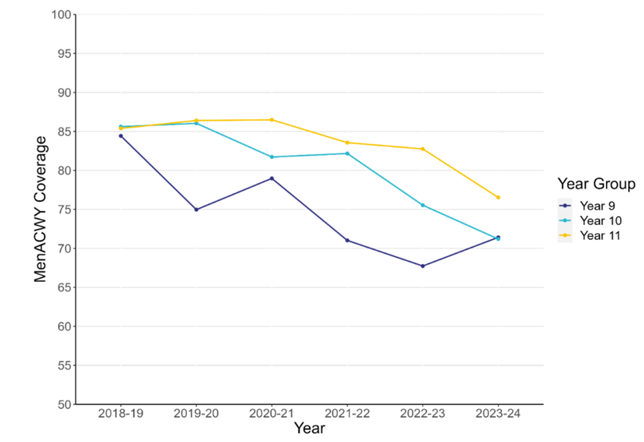
Importance of maintaining high uptake in teenage MenACWY vaccine programme
MenACWY coverage in years 9, 10 and 11 in Wales from 2018-2024.
Since 2021, there has been a declining trend in coverage of teenage immunisations
Indicating an ongoing need for improving catch-up activities in these age groups
Latest data from the Annual COVER Report (PROVISIONAL):
  Coverage of MenACWY vaccine in the 2024/25 School Year 10 group is currently 73.5%. Coverage in the 2024/25 School Year 11 group is currently 71.9%*
*Uptake data are as at end of March for each academic year presented, final uptake figures are likely to be higher for each cohort as vaccination catch-up offers continue throughout the academic year

Slide 40
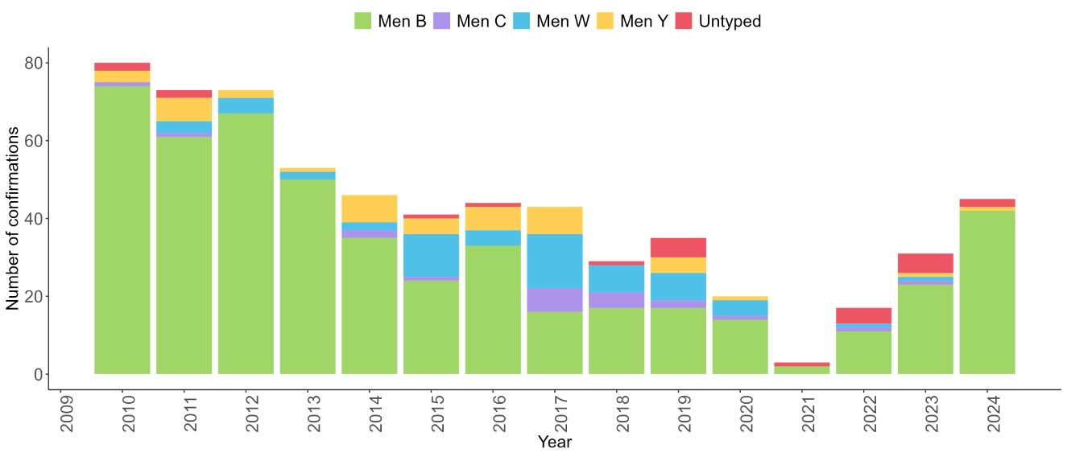
Number of laboratory reports of Neisseria meningitidis by serogroup in Wales 2010-2024

Slide 41
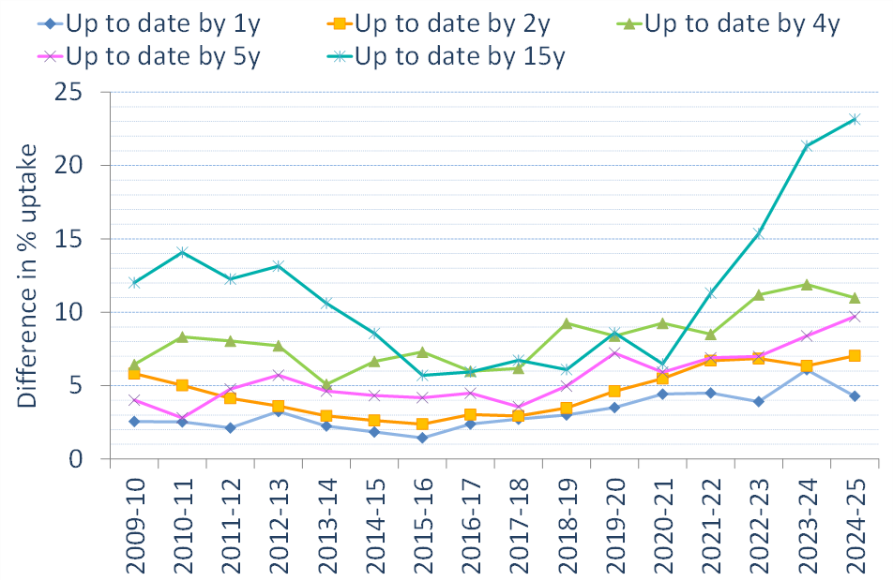
Inequalities in uptake of routine childhood immunisations in Wales 2024-25 PROVISIONAL
Compared to 2023-24, the percentage point gap in uptake of routine immunisations in the most deprived and least deprived areas in Wales have:
Decreased in one-year-olds from 6.1 to 4.3
Increased in two-year-olds from 6.3 to 7.0
Decreased in four-year-olds from 11.9 to 11.0
Increased in five-year-olds from 8.4 to 9.7
Increased in 15-year-olds from 21.3 to 23.2

Slide 42
Surveillance Webpages
Surveillance of Vaccines, Vaccine Preventable Diseases and Respiratory Infections​
COVER - National childhood immunisation uptake data - Public Health Wales​

Slide 43
Vaccine Equity & Public Engagement update
Jasmin Chowdhury, Senior Public Health Practitioner
Vaccine Preventable Disease Programme
Public Health Wales

Slide 44
Vaccine Equity
Impact of changes to childhood vaccination schedules on those living in more deprived areas – existing inequalities in access and uptake
Disparities in access to accurate & timely information may lead to disparities in coverage & increased vulnerability for population groups
Public awareness & education through tailored intervention based on behavioural insights can support vaccine equity

Slide 45

Attitudinal Survey with Parents of 0-5 years old
The aim is to gather insights on:​
Attitudes & perceptions on childhood immunisation​
Explore & understand motivations, barriers & facilitators ​
Identify trusted sources of information, preferred formats & explore interest in co-production
Childhood vaccines: parental attitudes survey 2023 findings
Survey of Parental Attitudes towards Immunisation of Pre-School Children (2021)

Slide 46

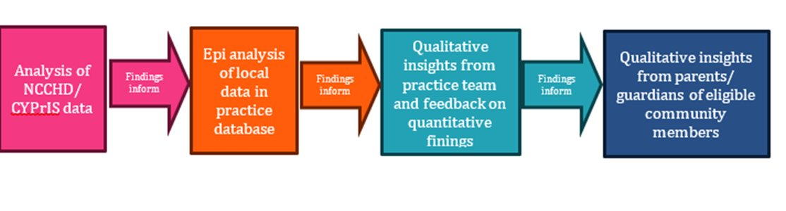
Rapid Service Evaluation Pilot with Deep End Practice
This collaborative piece of work between PHW VPDP, Practice within Deep End Cymru project, is intended to pilot an approach which could be used for future work to explore issues associated with under vaccination in highlighted deprived areas.​
The approach builds on the frameworks recommended in WHO guidance on tailoring immunisation programmes (TIP) (WHO Regional Office for Europe, 2019) and practical guidance on identifying, addressing and tracking inequities in immunisation (WHO Regional Office for Europe, 2023)

Slide 47

Community Vaccine Champions ​ from Ethnic Minority Communities
Working with colleagues from LPHT at Cardiff & Vale to develop a pool of community vaccine champions for pregnancy & pre-school vaccination from ethnic minority communities ​
Roles of vaccine champions:​
Raise awareness of vaccines in local communities​
Gather feedback and insights around vaccination from local communities​
Work with us to co-produce vaccine-related resources​

Slide 48
Health Protection Public Perceptions Tracker
PHW is running a public perceptions tracker to help us understand the Welsh public’s beliefs and attitudes towards health protection issues
The results from the tracker will help future communication strategies and plans
The surveys are a representative sample of 1,000 adults (16+ years old) across Wales, five times a year using an online panel
10 questions per wave
Waves: November 2024, January 2025, March 2025, June 2025 and September 2025
If you are interested in the tracker results, please email phw.vaccines@wales.nhs.uk
49

Slide 49
Web pages and resources created/updated for changes to the childhood immunisation schedule
Emily Chapman, Medical Information Specialist/Writer
Vaccine Preventable Disease Programme
Public Health Wales

Slide 50
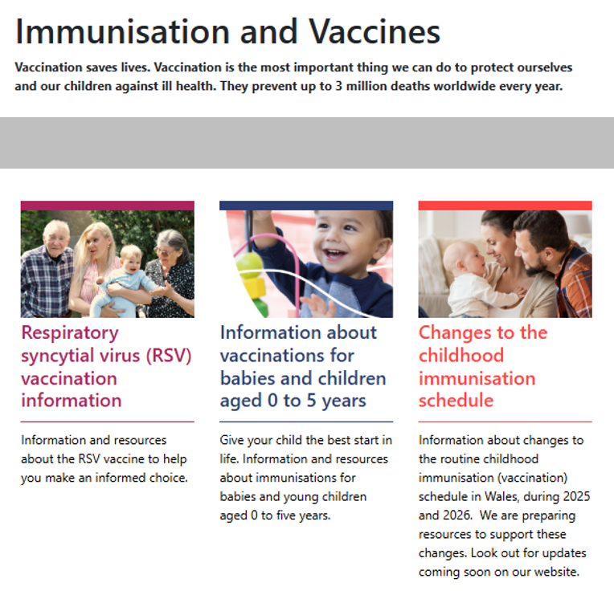
Website pages and resources for CCS
Key pages/connection points for changes to the childhood immunisation schedule (CCS)
Landing pages link to other vaccine web pages and resources
affected by CCS.
Landing pages for CCS:
    Information about vaccinations for babies and
    Children aged 0 to 5 years (preschool landing page)
    Changes to the childhood immunisation schedule
    Changes to the childhood immunisation schedule
    – Information for health professionals
Other key web pages:
  Routine immunisation schedules for Wales
These web pages will be updated as more information and policy becomes available.

Slide 51
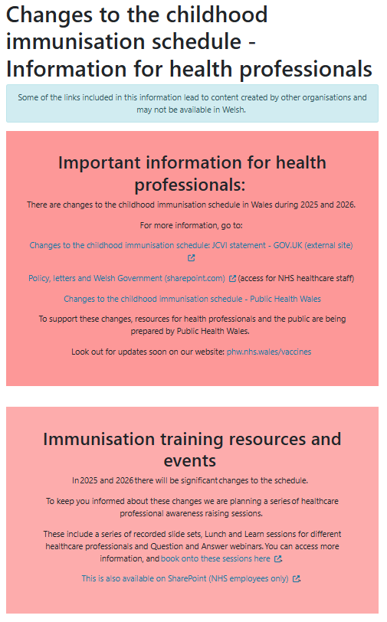
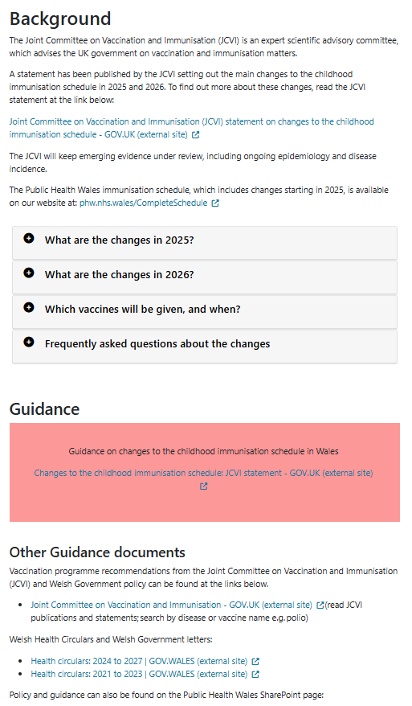
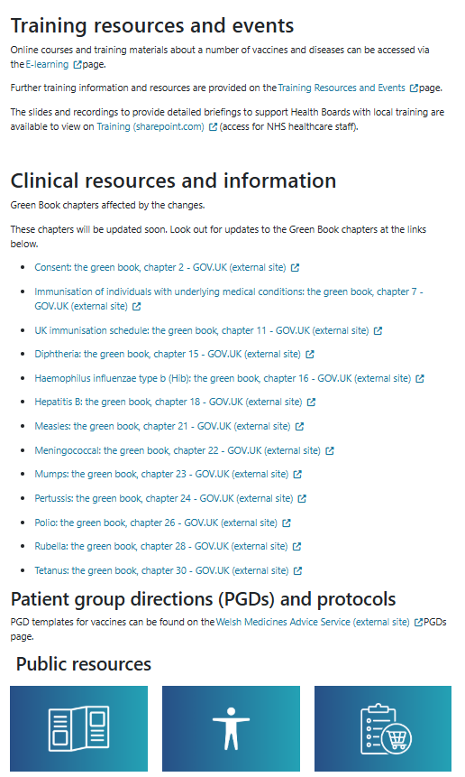
Website pages and resources for CCS

Slide 52
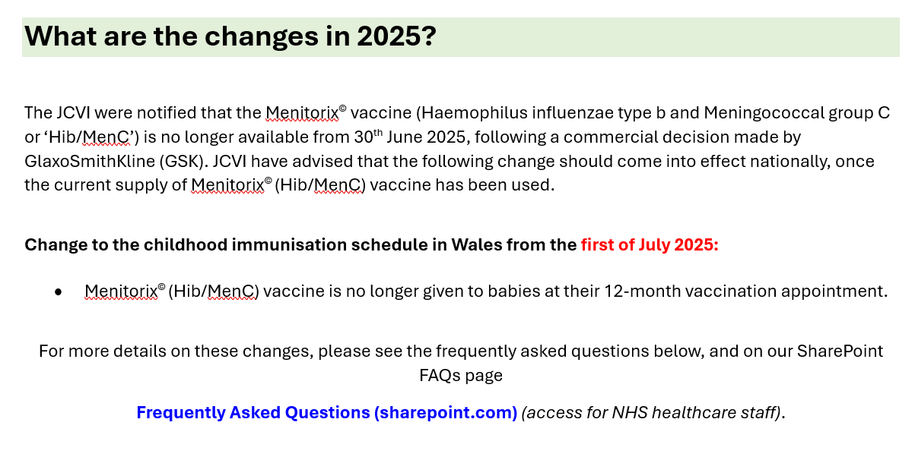
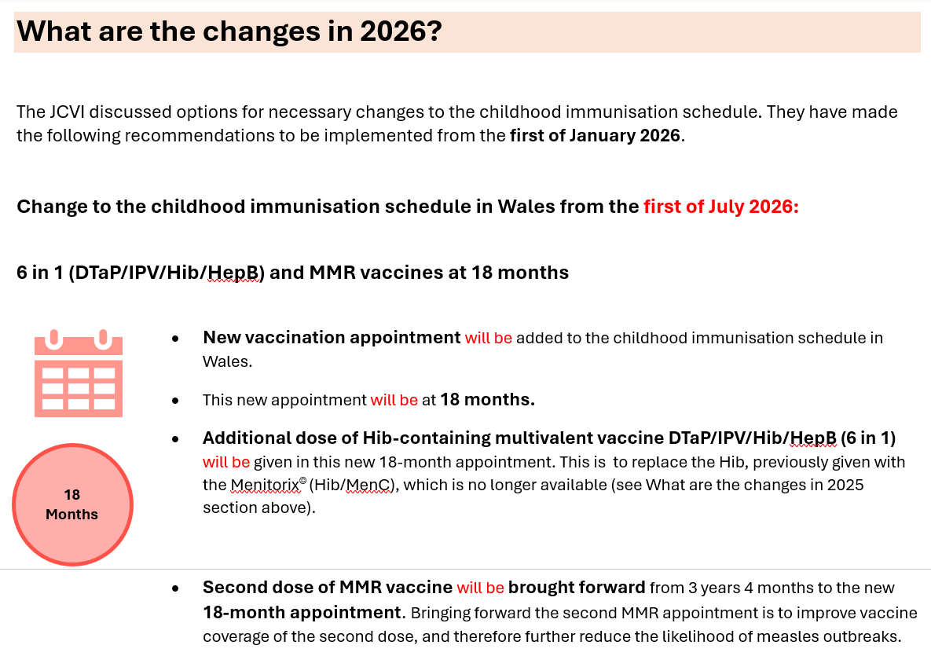
Website pages and resources for CCS
STAGE 1A: Removal of Hib/MenC, MenB/PCV timepoint switch. Implementation Date: 1st July 2025
STAGE 1B: MMR2, 6-in-1 (18-months). Implementation Date: 1st January 2026
Before the implementation of each stage of CCS, health professionals are provided with key clinical information to help them plan at a local level.

Slide 53
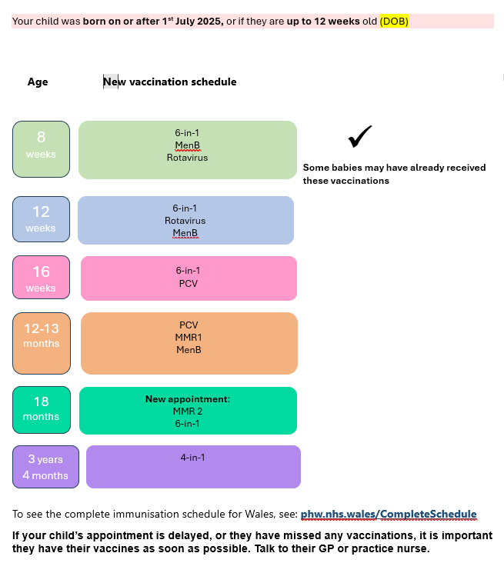
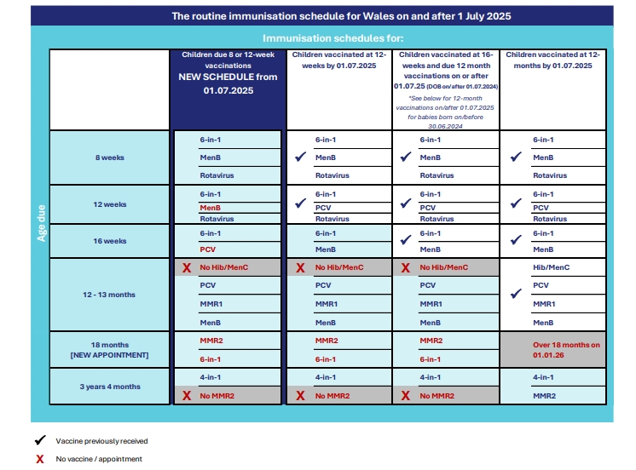
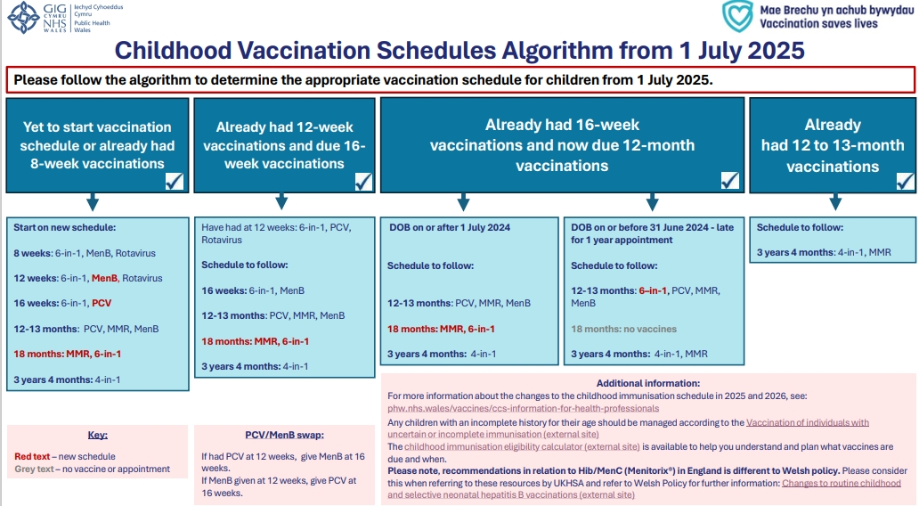
Website pages and resources for CCS
Key information for health professionals
phw.nhs.wales/vaccines/ccs-information-for-health-professionals
Vaccine eligibility tool (visual table on web page – downloadable)
Changes to the selective neonatal Hepatitis B (HepB) vaccination programme information sheet
CCS visual aid
CCS toolkit
Unscheduled immunisation record form for GP practices (to be updated in July 2025, and in January 2026)
Key information for the public
phw.nhs.wales/vaccines/ccs-information-for-public
Eligibility tables (on web page)

Slide 54
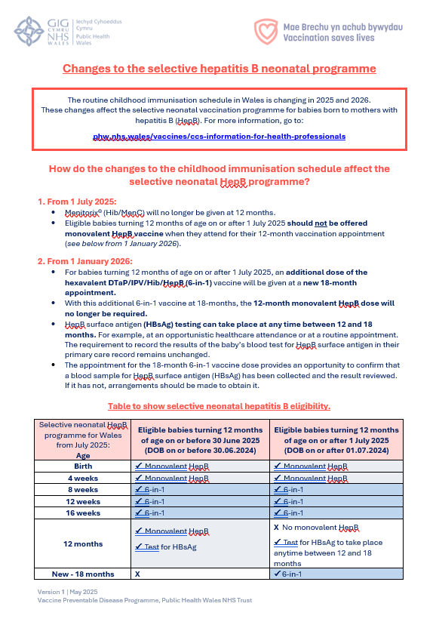
Website pages and resources for CCS
Health professionals resource example:
Changes to the selective neonatal Hepatitis B (HepB) vaccination programme information sheet
This resource will be available for online view, and as a downloadable document from:
  Hepatitis B (HepB) - Information for health professionals - Public Health Wales
Basic information about the selective neonatal HepB programme (including a link to the web page above) will also be provided on:
  Changes to the childhood immunisation schedule - Information for health professionals - Public Health Wales
Current selective neonatal HepB programme | Proposed change
Monovalent at birth, 4 weeks and 12 months Also, Hep B as part of 6-in-1 at 8 weeks, 12 weeks and 16 weeks. | Additional 6-in-1 at 18 months will affect selective HepB. Removal of 12-month monodose, therefore remove. HBsAg test and hexavalent can be given at 18-month appointment.

Slide 55

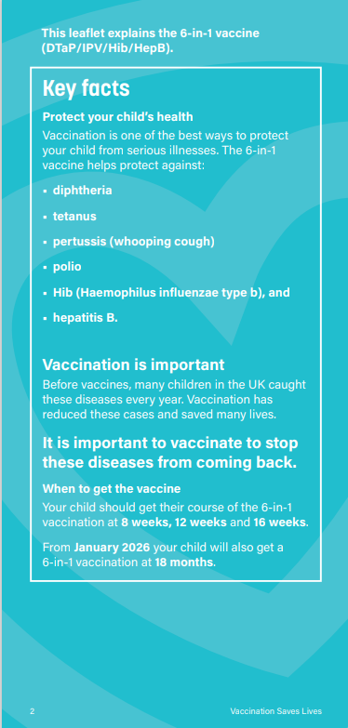
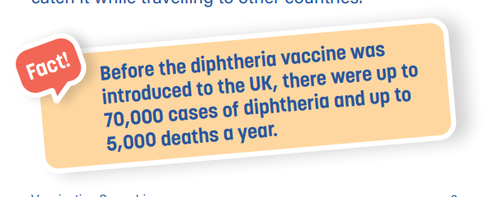
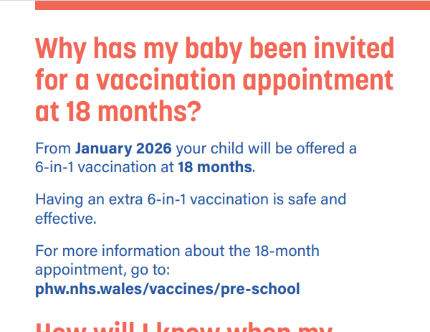
Website pages and resources for CCS
Public resource example: 6-in-1 leaflet
Go live date: 1st January 2026
Information kept brief for the public, with signposting to the public-facing website.
New fact boxes and summary boxes to aid readability.
QR code on the front of the leaflet for accessibility.

Slide 56
Website pages and resources for CCS
Other visual
resources
Reference source: CCS resources and web pages Go Live dates
HCPs and public resources
Resources include:
Toolkits
Visual aids
Information sheets
Forms
Leaflets
Posters
56

Slide 57
Summary & Resources
Influenza
Clare Powell, Specialist Nurse, Immunisation – Training lead
Vaccine Preventable Disease Programme/Communicable Disease Surveillance Centre
Public Health Wales

Slide 58

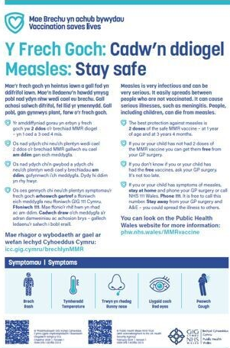
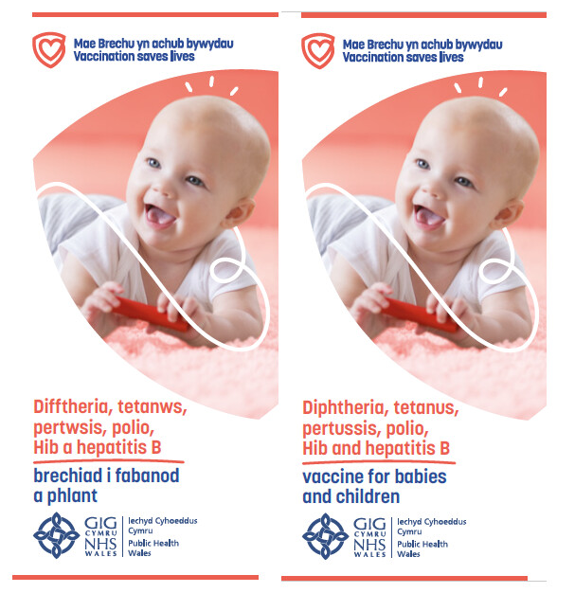
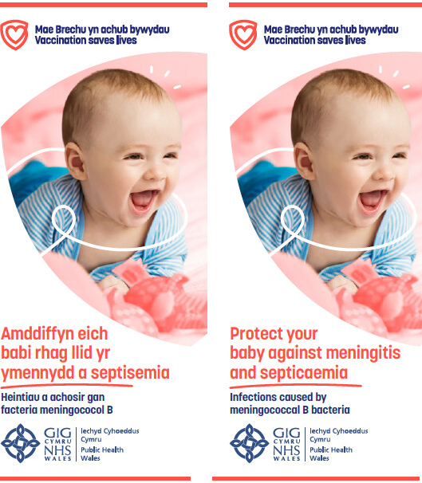
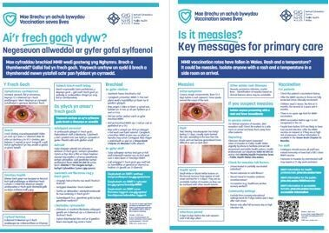
Leaflet ordering: free to order at Health Information Resources - Public Health Wales
Examples of resources
58

Slide 59
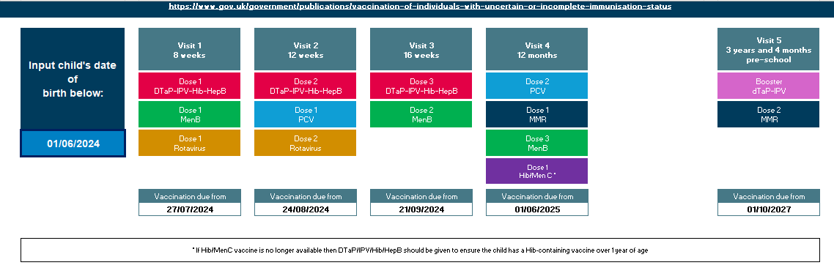
UKHSA - Childhood immunisation eligibility calculator
Childhood immunisation eligibility calculator - Health Publications
This calculator assumes vaccinations are administered in line with the routine UK childhood immunisation schedule. It is intended to support clinicians but does not replace clinical judgement or clinical decision making. If any vaccinations are missed, delayed or incomplete, do not use this calculator and instead refer to the UKHSA algorithm document (caveats for use in Wales on slides 60&62)

Slide 60
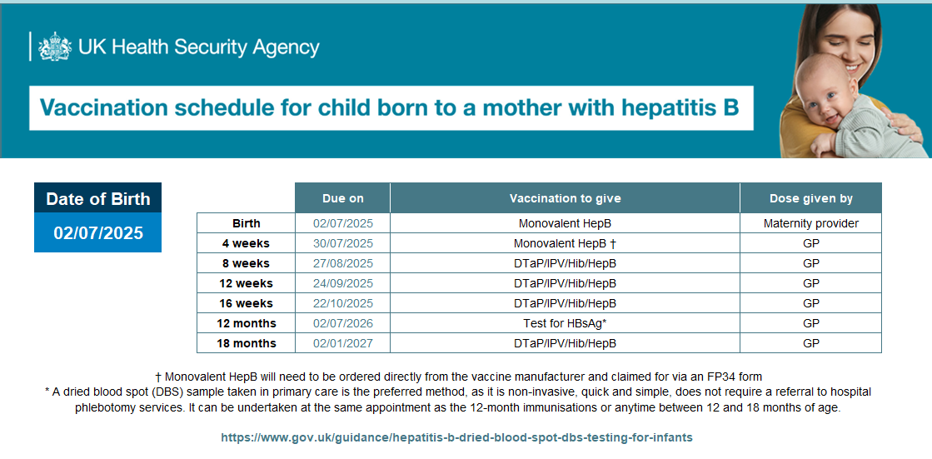
UKHSA - Childhood immunisation eligibility calculator – Hep B
The eligibility calculator can be used in Wales; however, you need to be aware of the differences in terms of:
Ordering – is still directly from the manufacturer
*Dry blood spot testing is not routinely carried out in Wales. A Hep B surface antigen (HBsAg) blood test is generally carried out in Wales by venous sampling
In Wales there are different models of delivery, in terms of who would do the 12 - month blood test and who would administer the monovalent Hep B vaccine at 4 weeks
For a child born to a mother with hepatitis B in Wales, please refer to the following documents:
https://phw.nhs.wales/topics/immunisation-and-vaccines/vaccines-professionals/hepatitis-b-hepb/changes-to-the-selective-neonatal-hepatitis-b-programme/
Changes to routine childhood and selective neonatal hepatitis B vaccinations (WHC/2025/019) | GOV.WALES
Selective neonatal Hepatitis B immunisation pathway (effective 1 July 2025) [HTML] | GOV.WALES
Notes:
* In Wales the HBsAg blood test can be carried out any time between 12-18 months, however as it requires venous sampling this may need a referral to arrange a separate appointment for this to be carried out. The 18 month appointment is a good opportunity to check if the HBsAg blood test has been carried out, if it hasn't then a referral should be made for this to be undertaken.

Slide 61
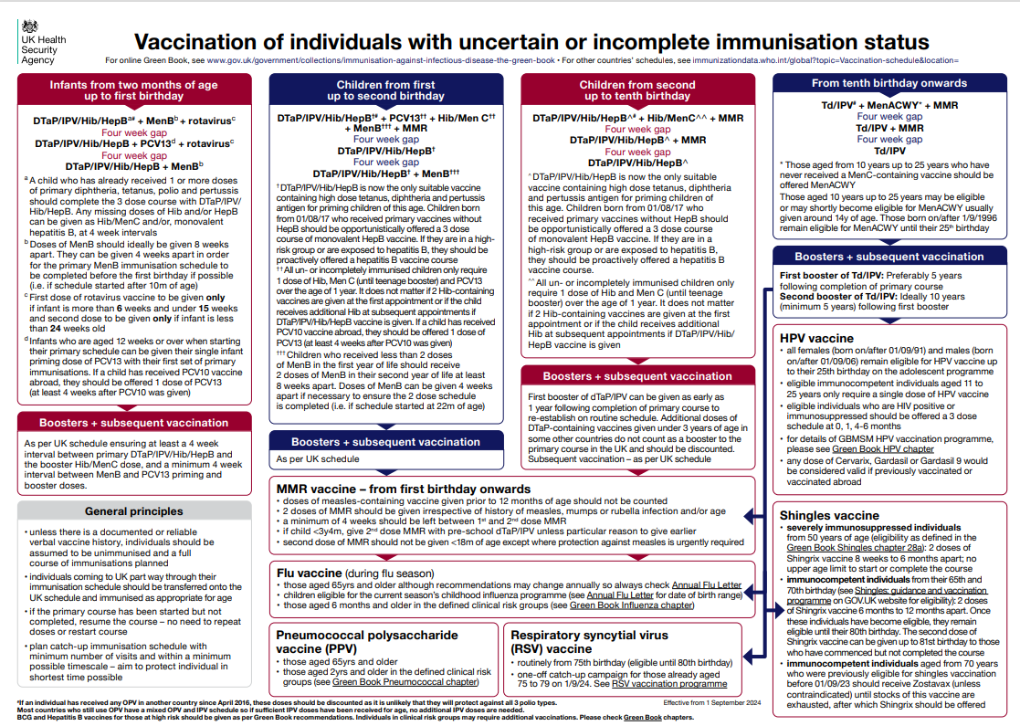
UKHSA algorithm Vaccination of individuals with uncertain or incomplete immunisation status
Vaccination of individuals with uncertain or incomplete immunisation status

Slide 62
Use of UKHSA - Childhood immunisation eligibility calculator and the algorithm for vaccination of individuals with uncertain or incomplete immunisation status in NHS Wales
It’s important to highlight that the recommendations in the eligibility calculator and the UKHSA algorithm for vaccination of individuals with uncertain or incomplete immunisation status, in relation to Hib/MenC (Menitorix®) is different to Welsh policy
Unlike England, NHS Wales is deploying a ‘hard stop’ so from 1July 2025 Hib/MenC (Menitorix ®) will no longer be included in the childhood immunisation schedule in Wales
Please refer to Welsh Policy for further information: Changes to routine childhood and selective neonatal hepatitis B vaccinations (WHC/2025/019) | GOV.WALES

Slide 63
Useful links
Joint Committee on Vaccination and Immunisation (JCVI) statement on changes to the childhood immunisation schedule
Minutes from JCVI meeting 5 February 2025, highlighting the PCV & MenB 'switch' Joint Committee on Vaccination and Immunisation - GOV.UK
Changes to routine childhood and selective neonatal hepatitis B vaccinations (WHC/2025/019) | GOV.WALES
Selective neonatal Hepatitis B immunisation pathway (effective 1 July 2025) [HTML] | GOV.WALES
All relevant Green Book chapters will be updated: Immunisation against infectious disease - GOV.UK
*Childhood schedule changes from 1 July 2025: information for healthcare practitioners - GOV.UK
*Vaccination of individuals with uncertain or incomplete immunisation - GOV.UK
MenACWY programme: information for healthcare professionals - GOV.UK
Pneumococcal vaccination: information for healthcare practitioners - GOV.UK
Patient Group Directions (PGD) - Welsh Medicines Advice Service
Notes:
* It’s important to highlight that the advice in relation to Hib/MeC ( Menitorix) is different to Welsh policy. NHS Wales is deploying a ‘hard stop,’ so from 1 July 2025 Hib/MenC (Menitorix ®) will no longer be included in the childhood immunisation schedule in Wales. Please refer to Welsh Policy for further information: Changes to routine childhood and selective neonatal hepatitis B vaccinations (WHC/2025/019) | GOV.WALES

Slide 64
Contacts
In the first instance, please contact your local vaccine health board contact. They should be able to help you.
Vaccine contacts - Public Health Wales
Contact the Vaccine Preventable Disease Programme at phw.vaccines@wales.nhs.uk
64

Slide 65
Thank you, any questions?
The aim of the changes are to protect children as optimally as possible from vaccine preventable diseases

Slide 66
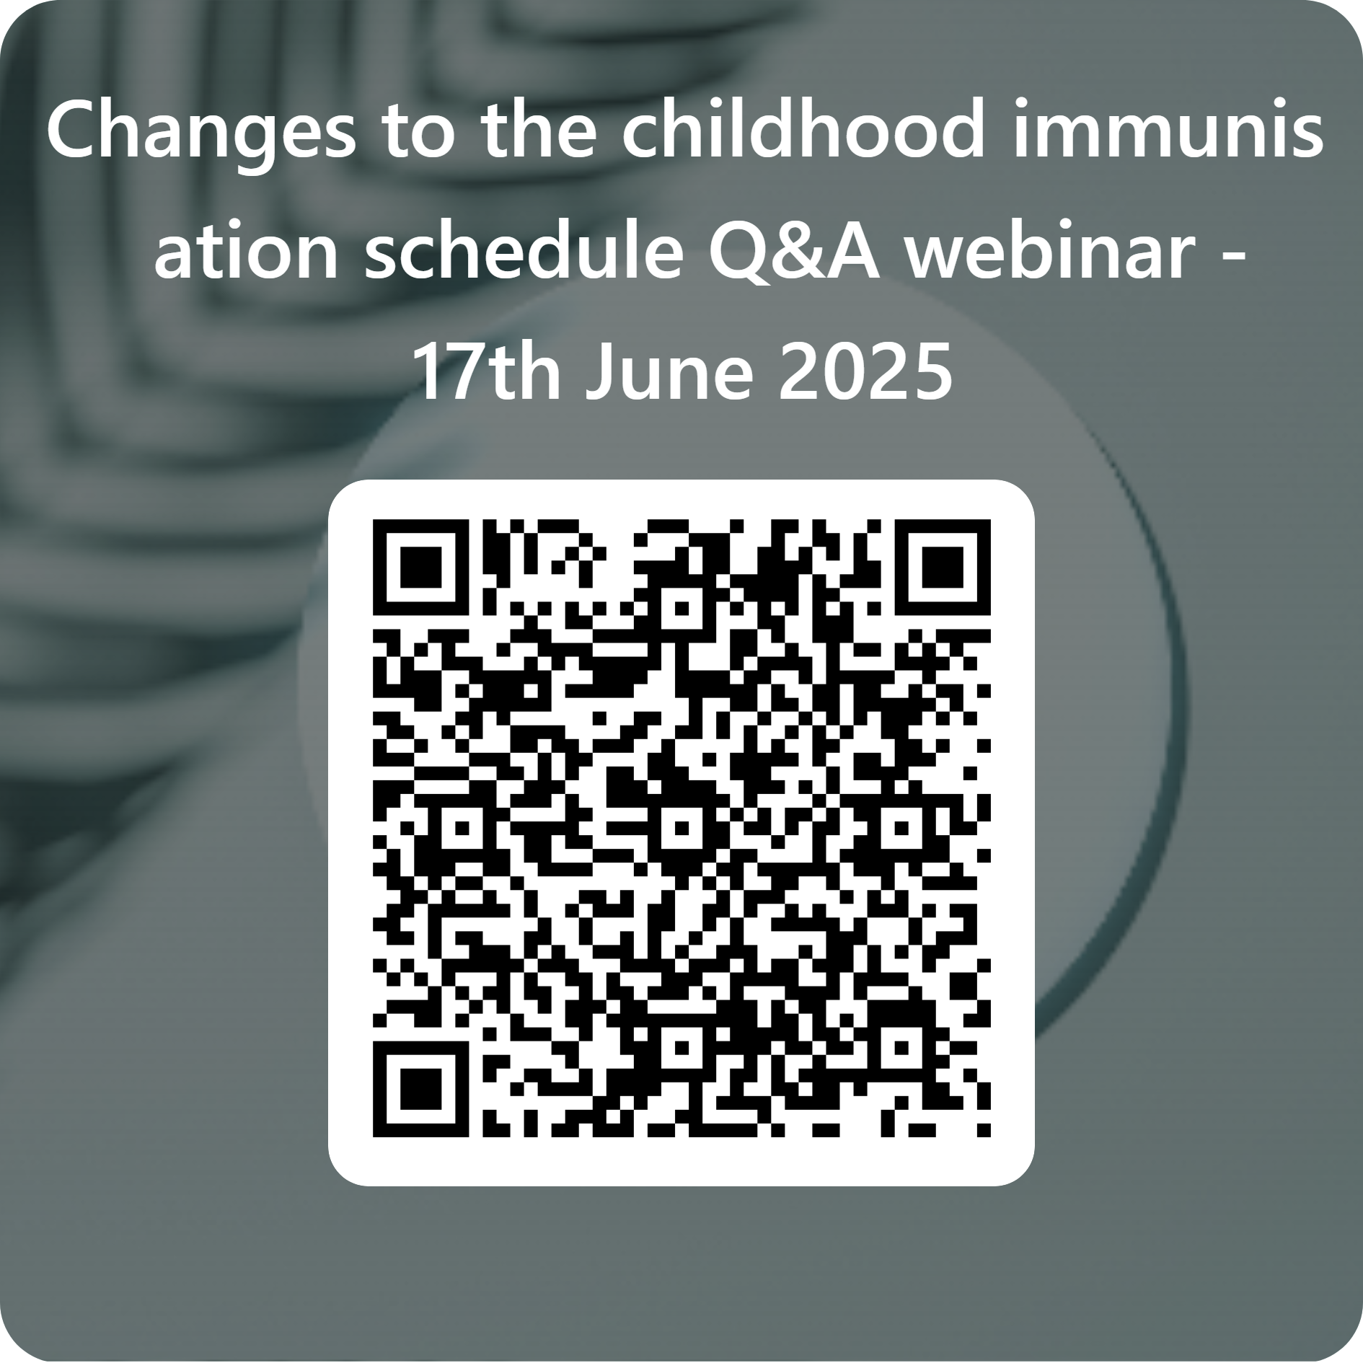
Evaluation
Childhood Schedule Changes Questions and Answers Webinar - Feedback Form

