Slide 1
Meningococcal type B (4CMenB) vaccination
for protection against gonorrhoea
Vaccine Preventable Disease Programme
Public Health Wales
Version 1
Notes:
Material contained in this document may be reproduced without prior permission provided it is done so accurately and is not used in a misleading context.
Acknowledgement to Public Health Wales NHS Trust to be stated.
© 2025 Public Health Wales NHS Trust.

Slide 2
Meningococcal type B (4CMenB) vaccination for protection against gonorrhoea
The information contained within this slide set is up to date as of 19/06/2025.
It is important that all immunisers delivering the 4CMenB vaccination for protection against gonorrhoea programme and/or those who are providing immunisation advice familiarise themselves with the most up to date clinical evidence and guidance, this can be found in the following key documents:
The Green Book Gonorrhoea Chapter: Gonorrhoea: the green book chapter - GOV.UK
UKHSA guidance for healthcare professionals: Will be available here once published
The content of this training slide set is subject to review. This resource will be version controlled. This is version 1, 19/06/2025.
Notes:
This resource is designed to support healthcare practitioners involved in discussing and delivering the routine meningococcal B vaccination for the prevention of gonorrhoea vaccination programme. This resource does not cover the actual administration techniques involved in vaccination. If staff are required to administer vaccinations, they should refer to their line manager for additional training. ​

Slide 3
Acknowledgements
Vaccine Preventable Disease Programme (VPDP), Public Health Wales: Immunisation and Vaccines - Public Health Wales
Public Health Scotland/ NHS Education Scotland NHS Education for Scotland | NES
UK Health Security Agency: Meningococcal B (MenB) vaccination programme for Gonorrhoea - GOV.UK

Slide 4
Contents
Section | Slide number
Aims | 5
Objectives | 6
What is gonorrhoea? | 7
Epidemiology and surveillance | 11
Meningococcal B vaccine for protection against gonorrhoea Routine targeted opportunistic vaccination programme for the prevention of gonorrhoea Efficacy Eligibility Vaccine | 14 18 20 22
Engagement insights | 40
Summary & resources | 44

Slide 5
Aims
To provide information for healthcare practitioners involved in advising on and delivering the meningococcal B for gonorrhoea vaccination programme
To raise awareness of the current epidemiology of gonorrhoea and the impact on individuals deemed high risk
To describe the vaccination programme details including administration of the vaccine, eligibility, recommended dosage and schedule, contraindications, precautions and potential adverse reactions
To raise awareness of the impact of the meningococcal B for Gonorrhoea vaccination programme
To highlight resources that support the meningococcal B for Gonorrhoea vaccination programme

Slide 6
Objectives
After completing this training immunisers will be able to:
Describe the aetiology and epidemiology of gonorrhoea
Understand the rationale and evidence base for the meningococcal type B (4CMenB) vaccination for protection against gonorrhoea programme
Discuss the benefits of vaccination against gonorrhoea
Gain essential knowledge to administer the vaccine safely
Identify relevant resources and additional information in relation to the meningococcal type B vaccination for protection against gonorrhoea programme

Slide 7
What is gonorrhoea?

Slide 8
What is gonorrhoea?
Caused by the bacterium Neisseria gonorrhoeae (N. Gonorrhoeae), also known as the gonococcus
One of the most common bacterial sexually transmitted infections (STIs)
Infects and colonises mucosal surfaces in the urethra, endocervix, rectum, pharynx and conjunctiva
Gonorrhoea is typically treated with antibiotics called cephalosporins, however there is widespread resistance to most medicines used to treat it
The World Health Organization considers Neisseria gonorrhoeae to be a high priority pathogen due to this widespread antimicrobial resistance.
Approximately 82.4 million gonorrhoea diagnosis were reported worldwide in 2020
In 2023 in Wales over 5,000 people were diagnosed with gonorrhoea. Gonorrhoea diagnoses are at a 10-year high with a 27% increase in cases since 2022
Notes:
Gonorrhoea: the green book chapter - GOV.UK
JCVI advice on the use of meningococcal B vaccination for the prevention of gonorrhoea - GOV.UK
Gonorrhoea (Neisseria gonorrhoeae infection) (WHO, 2024)
9789240053779-eng.pdf (WHO, 2022)
publichealthwales.nhs.wales/publications/publications1/sexual-health-trends-in-wales-annual-report-2024/ (PHW, 2024)

Slide 9
Carriage, transmission, and infection
Gonorrhoea can spread through condomless vaginal, oral or anal sex, or mucosal exposure to infected secretions (e.g. genital contact with an infected partner)
Humans are the only known host and reservoir for N. gonorrhoeae
Incubation usually begins 1-10 days following exposure (e.g. after sexual contact with an infected person)
Approximately 90% of infected men and 50% of infected women show symptoms of gonorrhoea
Infection may be asymptomatic, in particular, rectal, pharyngeal, and endocervical infections
Asymptomatic gonorrhoea infection can still be transmitted
Neisseria gonorrhoeae is very effective in evading the human immune response, so natural infection does not induce protective immunity and recurrent infections are common
Gay bisexual and other men who have sex with men (GBMSM) are at significantly higher risk of infection than heterosexuals, accounting for nearly half of all gonorrhoea diagnoses in England in 2022
Notes:
Gonorrhoea: the green book chapter - GOV.UK
Gonorrhoea (Neisseria gonorrhoeae infection)
Clinical features | Diagnosis | Gonorrhoea | CKS | NICE (NICE, 2024)

Slide 10
Clinical presentation and possible complications
Gonorrhoea infection symptoms includes:
dysuria (painful urination)
thick discharge from the vagina or penis which can be green or yellow in colour
rectal bleeding, discharge or pain
lower abdominal pain
intermenstrual bleeding (bleeding between periods)
Complications of untreated gonorrhoea infection includes:​
infertility in men and women​
ectopic pregnancy​
pelvic inflammatory disease ​
infection of the testicles and prostate ​
neonatal conjunctivitis may lead to blindness if left untreated​
systemic infections including disseminated gonococcal infection
Gonococcal infections can also increase the risk of acquiring other sexually transmitted infections, including HIV
Notes:
Symptoms are more likely to occur with penile urethral infections, whereas endocervical, rectal or pharyngeal infections are more likely to be asymptomatic. Typical urogenital symptoms of infection include thick green or yellow discharge from the penis or vagina and pain on urination (Fifer et al., 2020). Left untreated, gonorrhoea can cause complications such as pelvic inflammatory disease (PID), ectopic pregnancy, infertility.
Gonorrhoea: the green book chapter - GOV.UK (2025)
Clinical features | Diagnosis | Gonorrhoea | CKS | NICE (2024)
Gonorrhoea (Neisseria gonorrhoeae infection) (2024)

Slide 11
Epidemiology and surveillance

Slide 12
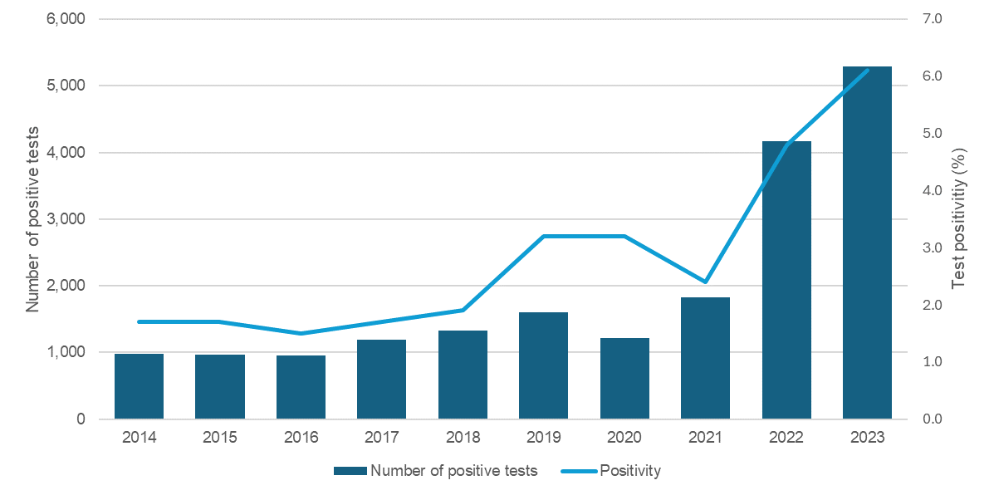
Incidence in Wales
Number of individuals diagnosed with Gonorrhoea and positivity, by year, Wales
Gonorrhoea diagnoses in Wales reached a 10-year high with 5,292 cases in 2023 - a 27% increase from 2022.
Gonorrhoea is the second most frequently diagnosed STI in England, with approximately 80,000 new cases annually.
In 2020 there were an estimated 82.4 million new infections among adults globally.
Source:
Sexual health trends in Wales: Annual report 2024
Notes:
The number of individuals tested for gonorrhoea remained stable from the previous year, with 87,235 individuals being tested in 2023.
Diagnosis at sexual health and postal services has increased since 2021.

Slide 13
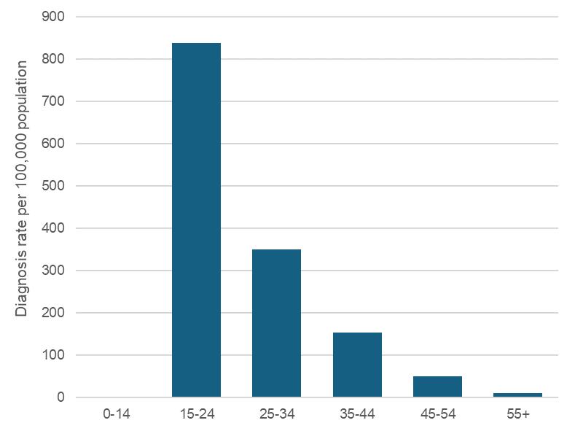
Epidemiology in Wales
During 2023, the diagnosis rate per 100,000 population was 145.9 in females compared to 157.7 in males.
While most diagnoses occur in White populations, Black ethnic groups experience significantly higher rates (283.1 per 100,00000 compared to 132.7 in white ethnic groups).
Gonorrhoea is more frequently detected in gay and bisexual men.
Gonorrhoea reinfections occur most frequently among males, individuals aged 25-34, patients attending Cardiff and Vale University Health Board clinics, and those of White ethnicity.
Gonorrhoea diagnosis rate per 100,000 population, by age group, Wales 2023
Source: Sexual health trends in Wales: Annual report 2024

Slide 14
Routine targeted opportunistic vaccination programme for the prevention of gonorrhoea

Slide 15
JCVI advice on the use of meningococcal B vaccination for the prevention of gonorrhoea (1)
A JCVI announcement on 10 November 2023 on the use of meningococcal B vaccination for the prevention of gonorrhoea advises that:
a targeted programme should be initiated using the 4CMenB vaccine for the prevention of gonorrhoea in those who are at greatest risk of infection
the programme should be offered on an opportunistic basis through specialist sexual health services
real world studies have estimated that the 4CMenB vaccine has between 32.7 to 42% effectiveness against gonorrhoea
vaccination is of benefit as previous infection with gonorrhoea is thought to offer little protection against future infection and reinfection is therefore common although a modest vaccine effectiveness
protection against gonorrhoea isn’t currently a licensed indication for 4CMenB vaccine, this advice is based on off-label use of vaccine
Notes:
Ref: JCVI advice on the use of meningococcal B vaccination for the prevention of gonorrhoea - GOV.UK
Sexual Health Services have vast experience in assessment and identification of those who are at increased risk of infection with bacterial STIs.
Although vaccination would be expected to reduce the chance of becoming infected with gonorrhoea, it would not completely eliminate the possibility. Vaccinated individuals could expect to have some reduction in their own risk of contracting gonorrhoea, however the main benefit of a vaccination programme is expected to be at a community level with a significant reduction in the number of cases overall.

Slide 16
JCVI advice on the use of meningococcal B vaccination for the prevention of gonorrhoea (2)
The JCVI announcement on 10 November 2023 advises that the programme should primarily target GBMSM who are at increased risk of becoming infected.
These risk criteria may include but not be limited to:
  a recent history of gonorrhoea or other bacterial STI diagnosis, individuals should also be offered vaccination after a gonorrhoea diagnosis (whether symptomatic or asymptomatic)
  reporting high-risk sexual behaviours with multiple partners during sexual health screening and assessment
Any offer of vaccination should be based on individual risk assessment by a sexual health clinical professional.
Notes:
Ref: JCVI advice on the use of meningococcal B vaccination for the prevention of gonorrhoea - GOV.UK
While a disproportionate number of gonococcal infections are within GBMSM, this doesn’t cover the entire population at risk. Efforts should be made to ensure that the vaccine is offered to those at similar risk, including but not limited to transgender women and gender-diverse people assigned male at birth. In addition, vaccination should be considered in any other people, irrespective of gender, who may be heterosexual or identify otherwise and who have equivalent markers of increased risk including but not limited to those with a recent history of bacterial STI diagnosis and sex workers.
The JCVI were not aware of any data on the administration of 4CMenB while currently infected with gonorrhoea, and there was some concern that this might lead to the vaccine being ineffective due to the failure to mount a complete immune response to an antigen during an active infection - this is known as anergy.

Slide 17

WHC/2025/021 Introduction of routine vaccination programmes for the prevention of mpox and gonorrhoea
Welsh Government has accepted advice from the Joint Committee on Vaccination and Immunisation (JCVI) to introduce a routine targeted vaccination programme for the prevention of Gonorrhoea for those at highest risk
Gonorrhoea is one of the most common bacterial sexually transmitted infections (STIs), causing significant morbidity, and remains a public health concern globally.
To be offered opportunistically through sexual health services (SHSs) who have experience in assessment and identification of those who are at increased risk of infection with bacterial STIs.
In Wales the 4CMenB vaccine for protection against gonorrhoea will be available routinely for those eligible* through SHSs (WHC/2025/021). Vaccine Programme Wales will advise SHSs when vaccinations can commence, readiness is anticipated to be from July.
Notes:
WHC/2025/021 Introduction of routine vaccination programmes for the prevention of mpox and gonorrhoea (2 June 2025) Introduction of routine vaccinations for mpox and gonorrhoea (WHC/2025/021) | GOV.WALES
JCVI Statement JCVI advice on the use of meningococcal B vaccination for the prevention of gonorrhoea - GOV.UK
*Eligibility covered in slides following

Slide 18
Meningococcal type B (4CMenB) vaccination for protection against gonorrhoea:
Efficacy

Slide 19
Vaccine efficacy
4CMenB is currently licensed for active immunisation of individuals from 2 months of age and older against invasive MenB disease. In 2015, the UK became the first country to implement a publicly funded national immunisation programme offering 4CMenB to infants alongside their routine vaccinations. Within 3 years of the programme, there was a 75% reduction in invasive MenB disease in vaccine-eligible children.
Although their clinical manifestations can be different, N. gonorrhoeae (gonococcus) is very closely related to N. meningitidis (meningococcus) with 80-90% sequence homology and similar virulence factors. This homology gives the potential for cross-protection against Neisseria gonorrhoeae from 4CMenB antigens, including non-specific proteins that form part of the outer membrane vesicles (OMV) component in the vaccine.
Laboratory studies have demonstrated targeting of 4CMenB-induced antibodies against specific gonococcal surface proteins as well as accelerated clearance of genital gonococcal infection in animal models.
Several case-control and cohort studies have reported 30-40% protection against gonorrhoea in people at high risk of gonorrhoea infection who were offered the vaccine for protection against MenB disease. In South Australia, where 4CMenB is routinely offered to adolescents for protection against MenB disease, the two-dose vaccine effectiveness against gonorrhoea in adolescents was estimated to be 34.9% during the first 6–36 months after vaccination, with some evidence of waning protection after this period. A number of randomised controlled trials are currently in progress to prospectively evaluate the effectiveness of 4CMenB against gonorrhoea in populations with a higher risk of infection.
Although not currently licensed for protection against N. gonorrhoeae, 4CMenB could have a significant impact on gonorrhoea disease burden, transmission and antimicrobial use, especially if offered to those at higher risk of infection. This protection against gonorrhoea would be in addition to the prevention of invasive MenB disease in vaccinated individuals.
Notes:
Gonorrhoea: the green book chapter - GOV.UK

Slide 20
Meningococcal type B (4CMenB) vaccination for protection against gonorrhoea:
Eligibility

Slide 21
Eligibility
In Wales the 4CMenB vaccine for protection against gonorrhoea will be available routinely for those eligible through SHSs (WHC/2025/021). Vaccine Programme Wales will advise SHSs when vaccinations can commence, readiness is anticipated to be from July.
The 4CMenB vaccine is recommended for GBMSM considered at higher risk of infection attending a sexual health service, which includes GBMSM who have had:
a bacterial sexually transmitted infection (STI) in the past year or,
five or more sexual partners in the last three months.
Sexual health clinical professionals may perform individual risk assessment and consider the offer of 4CMenB to the small numbers of individuals with an incidence of gonorrhoea approaching that in the eligible GBMSM group defined above; this may include sex workers practicing condomless sex, and others assessed as having a similar incidence as the eligible GBMSM group.
Any offer of vaccination should be based on an individual assessment by a sexual health clinical professional.
Notes:
Gonorrhoea: the green book chapter - GOV.UK

Slide 22
Meningococcal type B (4CMenB) vaccination for protection against gonorrhoea:
Vaccine

Slide 23
Pre-requisites to administering Meningococcal type B (4CMenB) vaccine
Before administering 4CMenB vaccine, it is recommended that:
*Those new to immunisation should receive comprehensive foundation immunisation training Immunisation training standards for healthcare practitioner UK Health Security Agency - UKHSA)
Both knowledge and clinical competence should be assessed before immunisers start to give and/or advise about the 4CMenB vaccine: Immunisation training standards for healthcare practitioner UK Health Security Agency - UKHSA)
Training in the management of anaphylaxis and Basic Life Support is undertaken, as specified by policy for your local area and are familiar with Resuscitation Council UK (RCUK) guidance on Management of Anaphylaxis in the Vaccination Setting
Any additional statutory and mandatory training as required by your employer is completed
An appropriate legal framework to supply and administer 4CMenB vaccine is in place e.g. written prescription, Patient Specific Direction (PSD), Patient Group Direction (PGD) Visit here for Wales PGD template
Those involved in immunisation and vaccination understand the process of consent and how this applies when giving vaccines. Information on consent can be viewed here: Consent: Consent: the green book, chapter 2 - GOV.UK
Immunisers and those giving immunisation advice access and familiarise themselves with the following key documents: Green Book Gonorrhoea Chapter, Vaccination against Gonorrhoea: Information for healthcare practitioners: once published view here and WHC/2025/021 Introduction of routine vaccinations for mpox and gonorrhoea
Notes:
*This should be either through a face to face taught course or a blended approach of both e-learning and a face to face taught course. New immunisers should also have a period of supervised practice and support with a registered healthcare practitioner who is experienced, up to date and competent in immunisation.
Practitioners should always ensure they are accessing the most up to date information and guidance.

Slide 24
4CMenB vaccine (1)
Currently, there are no licensed vaccines specifically for gonorrhoea. However, the JCVI recommends the off-label use of the 4-component meningococcal (4CMenB) vaccine for individuals at highest risk of gonorrhoea.
The 4CMenB vaccine is licensed to help prevent meningococcal B disease in individuals aged 2 months and older and is currently used in the routine childhood programme.
Neisseria gonorrhoeae and Neisseria meningitidis are closely genetically related
Studies have reported 30-40% protection against gonorrhoea in people at high risk when the vaccine is offered for protection against meningococcal B disease.
While the 4CMenB vaccine may reduce the chance of gonorrhoea infection, it does not provide complete protection
The vaccine’s main benefit is thought to be at a community level, contributing to a reduction in overall gonorrhoea cases.
It's important for those at high risk to get vaccinated, even with modest effectiveness, since previous gonorrhoea infection is thought to offer little protection against future infection and reinfection is therefore common.
There is no evidence of the 4CMenB clearing active gonorrhoeal infection. Therefore, infections should be managed according to the British Association for Sexual Health and HIV (BASHH) guidelines
Notes:
Gonorrhoea: the green book chapter - GOV.UK
JCVI advice on the use of meningococcal B vaccination for the prevention of gonorrhoea - GOV.UK

Slide 25
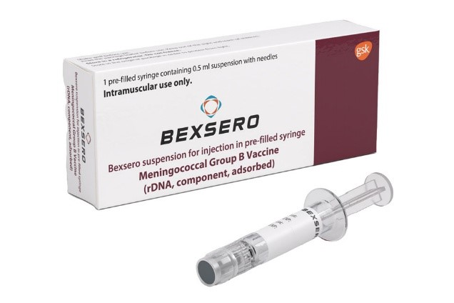
4CMenB - Bexsero®
Full product name: Bexsero®
Meningococcal group B vaccine
Marketed by: GlaxoSmithKline UK
Type of vaccine: Meningococcal group B Vaccine (rDNA, component, adsorbed) [pre-filled syringed]
A multi-component inactivated vaccine made from 3 Neisseria meningitidis proteins produced by recombinant DNA technology (Neisseria meningitidis group B NHBA fusion protein, Neisseria meningitidis group B NadA protein, Neisseria meningitidis group B fHbp fusion protein) and a preparation of Neisseria meningitidis capsular group B outer membrane vesicle (OMV) Neisseria meningitidis group B strain NZ98/254)
*The vial rubber stopper and tip cap are made with synthetic rubber which does not contain natural rubber latex
Image source: UKHSA (2025)
Protection against gonorrhoea is not a licensed use of the 4CMenB vaccine, JCVI advice is based on off-label use.
Notes:
*The tip cap and plunger stopper in Bexsero pre‑filled syringes are made from synthetic rubber, not natural rubber latex. Synthetic rubber does not contain natural latex proteins (the usual allergen), so the syringe components are considered latex‑free. Individuals with latex allergy generally do not need to worry about Bexsero’s tip cap or stopper triggering a reaction.
https://www.medicines.org.uk/emc/product/5168/smpc
Meningococcal B vaccination programme for infants: information for healthcare practitioners - GOV.UK (UKHSA, 2025)
Off-label vaccines: an introductory guide for healthcare professionals - text version - GOV.UK (UKHSA, 2023)

Slide 26
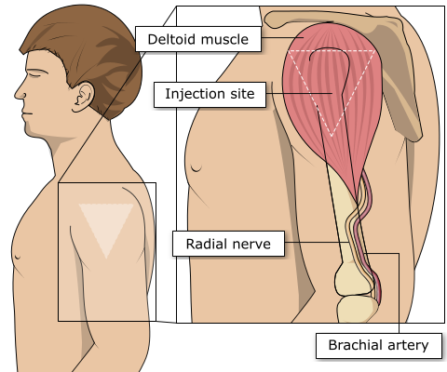
Preparation and administration of Bexsero®
Bexsero comes in a pre-filled syringe (it does not require reconstitution)
Upon storage a fine off-white deposit may be observed in the pre-filled syringe containing the suspension.
Before use, the pre-filled syringe should be well shaken in order to form a homogeneous suspension.
The vaccine should be visually inspected for particulate matter and discoloration prior to administration. In the event of any foreign particulate matter and/or variation of physical aspect being observed, do not administer the vaccine.
If two needles of different lengths are provided in the pack, choose the appropriate needle to ensure an intramuscular administration.
For instructions for the pre-filled syringe refer to SmPC
The vaccine is given intramuscularly preferably into the deltoid:
Select the appropriate needle length to ensure an intramuscular (IM) administration depending on the individuals size and weight (refer to Green Book -Chapter 4 – immunisation procedures)
Administer the entire 0.5ml dose
For individuals with a bleeding disorder, vaccines should be given by deep subcutaneous injection to reduce the risk of bleeding.
Image source: The Australian
Immunisation Handbook (health.gov.au)
Notes:
Healthcare professionals are encouraged to read the Summary of Product Characteristics (SmPC) to ensure accurate reconstitution and delivery of the product.
Bexsero®vaccine should preferably be injected into the deltoid muscle in the upper arm or for subcutaneous injection (refer to Chapter 4 – immunisation procedures).
Injecting too high into the upper arm might result in the vaccine being deposited in the shoulder capsule rather than the deltoid muscle. This can cause inflammation that can lead to a shoulder injury or a frozen shoulder leading to pain, weakness and a limited range of motion that can last for months.
Injecting too far to the side of the arm or too low on the arm risks injecting into the axillary nerve or the radial nerve.
This can cause a burning or shooting pain during the procedure and can lead to nerve damage (neuropathy/paralysis).
To avoid shoulder injury, the limb should be assessed before administering the vaccine to identify the correct site for injection.
The Gonorrhoea Green Book Chapter states that Bexsero® vaccine can be given subcutaneously (refer to relevant Green Book chapters). Gonorrhoea: the green book chapter - GOV.UK, Immunisation procedures: the green book, chapter 4 - GOV.UK
Bexsero® vaccine can be given at same time as other vaccines (refer to slide 30 and relevant Green Book chapters). The vaccines should be given at a separate site, preferably in a different limb. The sites at which each vaccine was given should be noted in the individual’s health records.
Bexsero Meningococcal Group B vaccine for injection in pre-filled syringe - Summary of Product Characteristics (SmPC) - (emc) | 5168

Slide 27
Individuals with bleeding disorders or taking anticoagulation therapy
Individuals with bleeding disorders may be vaccinated intramuscularly if, in the opinion of a doctor familiar with the individual’s bleeding risk, vaccines or similar small volume intramuscular injections can be administered with reasonable safety by this route
If the individual receives medication/ treatment to reduce bleeding, for example treatment for haemophilia, intramuscular vaccination can be scheduled shortly after such medication or treatment is administered
Individuals on stable anticoagulation therapy, including individuals on warfarin who are up-to-date with their scheduled INR testing and whose latest INR is below the upper level of the therapeutic range, can receive intramuscular vaccination
A fine needle (23 or 25 gauge) should be used for the vaccination, followed by firm pressure applied to the site without rubbing for at least 2 minutes
The individual or their carer should be informed about the risk of haematoma from the injection

Slide 28
Vaccine dosage and schedule
A course of two doses [0.5ml].
Minimal interval of 4 weeks after the first dose
There is no maximum time interval limit between the two vaccine doses.
Pragmatically and opportunistically, the second dose can be scheduled for the next clinic attendance, which may be after 3, 6 or 12 months.
There is no need to recommence the primary immunisation schedule even after a prolonged interval between the two doses.
Reinforcing immunisation
There are currently no recommendations for 4CMenB booster doses in eligible adults who have received two doses as part of their primary immunisation.

Slide 29
Previous 4CMenB vaccination in eligible individuals
Eligible individuals with immunosuppression and human immunodeficiency virus (HIV) infection (regardless of CD4 count) should be given meningococcal vaccines in accordance with the advice in the Green Book Gonorrhoea Chapter
Some individuals with human immunodeficiency virus (HIV) infection, asplenia and complement deficiency (including those on complement inhibitors) may already have received two doses of 4CMenB because of their higher risk of meningococcal disease. No further doses are recommended for these individuals.
Eligible individuals who have previously received only one 4CMenB dose (at least 4 weeks ago) can be offered a second dose irrespective of the time interval since the first dose.
Notes:
Gonorrhoea: the green book chapter - GOV.UK
Immunisation of individuals with underlying medical conditions: the green book, chapter 7 - GOV.UK

Slide 30
Contraindications
There are very few individuals who cannot receive meningococcal vaccines. When there is doubt, appropriate advice should be sought from a consultant in sexual health services, immunisation co-ordinator or consultant in health protection, rather than withhold immunisation.
The vaccine should not be given to those who have had:
a confirmed anaphylactic reaction to a previous dose of the vaccine, or
a confirmed anaphylactic reaction to any constituent or excipient of the vaccine
Notes:
Gonorrhoea: the green book chapter - GOV.UK

Slide 31
Precautions
If an individual is acutely unwell, immunisation may be postponed until they have fully recovered to avoid confusing the differential diagnosis of any acute illness by wrongly attributing any signs or symptoms to any possible adverse effects of the vaccine.
Individuals with bleeding disorders (e.g. coagulation or thrombocytopenia) may be vaccinated intramuscularly if, in the opinion of a doctor familiar with the individual’s bleeding risk, vaccines or similar small volume intramuscular injections can be administered with reasonable safety by this route
Pregnancy: Meningococcal vaccines may be given to pregnant women when clinically indicated. There is no evidence of risk from vaccinating pregnant women with inactivated virus or bacterial vaccines or toxoids. In cases where meningococcal immunisation has been inadvertently given in pregnancy, there has been no evidence of harm to the foetus. Any concerns need to be weighed against the maternal risk of gonorrhoea in pregnancy such as spontaneous abortion, premature labour, early rupture of fetal membranes, perinatal mortality and gonococcal conjunctivitis of the new-born
Breast-feeding: There is no evidence of risk from vaccinating women who are breast-feeding with inactivated virus or bacterial vaccines or toxoids.
Notes:
Minor illnesses without fever or systemic upset are not valid reasons to postpone immunisation.
Complications | Background information | Gonorrhoea | CKS | NICE

Slide 32
Possible adverse reactions
For Adolescents (from 11 years of age) and adults:
Driving and using machines: Bexsero® has no or
negligible influence on the ability to drive and use machines.
However, some of the effects mentioned may temporarily
affect the ability to drive or use machines.
For a full list of possible adverse reaction refer to the Bexsero Meningococcal Group B vaccine for injection in pre-filled syringe - Summary of Product Characteristics (SmPC) - (emc) | 5168
For full list of adverse reactions refer to SmPC
Very common (≥ 1/10 of people vaccinated)
Headache
Nausea
Myalgia
Arthralgia
Injection site pain, swelling, induration, erythema
Malaise
Not known (cannot be estimated from the available data)
Lymphadenopathy
Allergic reactions (including anaphylactic reactions)
Syncope or vasovagal responses to injection
Meningeal irritation (signs of meningeal irritation, such as neck stiffness or photophobia, have been sporadically reported shortly after vaccination. These symptoms have been of mild and transient nature)
Rash
Fever
Injection site reactions (including extensive swelling of the vaccinated limb, blisters at or around the injection site and injection site nodule which may persist for more than one month)

Slide 33
Common vaccine product-induced Adverse Event Following Immunisation (AEFI)
Common vaccine-induced AEFIs include:
pain, swelling or redness at the site of injection. These are common after immunisation and should be anticipated
local adverse reactions that generally start within a few hours of administration and are usually mild and self-limiting*.
systemic adverse reactions which include fever, malaise, myalgia, irritability, headache and loss of appetite**.
Notes:
*Although these are often referred to as ‘hypersensitivity reactions’, they are not allergic in origin, but may be either due to high titres of antibody or a direct effect of the vaccine product. The occurrence or severity of such local reactions does not contraindicate further doses of immunisation with the same vaccine or vaccines containing the same antigens.
**The timing of systemic reactions will vary according to the characteristics of the vaccine received, the age of the recipient and the biological response to that vaccine. For example, fever may start within a few hours of tetanus-containing vaccines, but occurs seven to ten days after measles- containing vaccine. The occurrence of such systemic reactions does not contraindicate further doses of the same vaccine or vaccines containing the same .

Slide 34
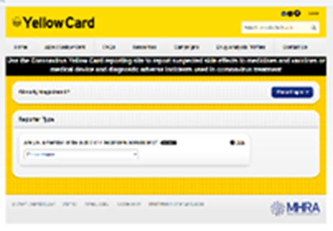
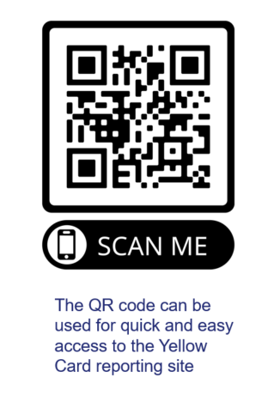
Reporting suspected adverse reactions
Vaccinees should be advised that they can report any adverse reactions or suspected side effects to the MHRA through the online yellow card scheme website or the Yellow Card app
Any suspected side effects following vaccine administration should be reported to the MHRA Yellow Card Scheme.
Anyone can report even if uncertain about whether vaccine caused condition:
  www.mhra.gov.uk/yellowcard or call 0800 731 6789 (9am to 5pm Monday to Friday)
  Green Book Chapter 9 for detailed guidance on reporting vaccine reactions
Notes:
Healthcare professionals and patients are encouraged to report suspected adverse reactions to the Medicines and Healthcare Products Regulatory Agency (MHRA) using the yellow card reporting scheme
Green Book chapter 9: https://www.gov.uk/government/publications/surveillance-and-monitoring-for-vaccine-safety-the-green-book-chapter-9

Slide 35
Co-administration
There are very limited data for co-administration of 4CMenB with other vaccines commonly administered in SHSs. First principles would suggest that any interference between co-administered vaccines with different antigenic content is likely to be limited and any potential interference is most likely to result in a slightly attenuated immune response to one of the vaccines (see Green Book Chapter 11).
4CMenB can therefore be administered before, at the same time as, or after other vaccines currently offered in SHSs (including but not limited to hepatitis A, hepatitis B, human papillomavirus and mpox vaccines) without any restrictions on time intervals between different vaccines.
The vaccines should be given at a separate site, preferably in a separate arm. If more than one vaccine is given in the same limb, they should be at least 2.5cm apart. The site at which each vaccine is given should be noted in the individual’s clinical record.
Vaccinating in a timely manner when an eligible individual is present in the clinic will avoid any delay in protection and reduce the risk of the individual not returning for a later appointment.
The vaccine is also safe for people living with HIV and those taking PrEP.
For more information on co-administration please refer to the relevant chapters in the Green Book
Notes:
Gonorrhoea: the green book chapter - GOV.UK

Slide 36
Vaccine storage and supply
Storage: ​
Bexsero® should be stored in a refrigerator +2ºC to +8ºC. ​
Keep in original packaging​
Protect from light​
Use as soon as possible after removing from fridge​
Effectiveness cannot be guaranteed for vaccines unless the cold chain has been maintained, and vaccine has been monitored as per national recommendations​
Refer to local policy on vaccine storage and handling​
Supply: ​
Supply of Bexsero® is available for hospital sites to order on the ImmForm website for delivery to SHSs. It is only available for those eligible as part of the routine meningococcal B vaccination for the prevention of gonorrhoea vaccination programme. Please ensure you select the right vaccine programme when ordering*.
Notes:
*The name of the vaccine programme as it appears on ImmForm will be shared in due course.
Gonorrhoea: the green book chapter - GOV.UK
Storage, distribution and disposal of vaccines: the green book, chapter 3 - GOV.UK

Slide 37
Legal requirements for the supply and administration of vaccines
The regulation of medicines is defined under the Human Medicines Regulations 2012
All vaccines are classified as Prescription Only Medicines (POMs)
Vaccines are subject to legal restrictions and to give them, there needs to be an appropriate legal framework in place before they can be supplied and/or administered to eligible people
Additionally, any person who supplies and administers a vaccine must have a legal authority to do so

Slide 38
Legal requirements for the supply and administration of vaccines (2)
As vaccines are Prescription Only Medicines (POMs), there must be a legal framework to supply and/or administer the vaccine in place. This can be in the form of a:
  written prescription
  Patient Specific Direction (PSD): a written instruction, signed by a doctor, dentist, or non-medical prescriber for medicines to be supplied and/or administered to a named patient after the prescriber has assessed the patient on an individual basis
  Patient Group Direction (PGD): allows some registered specified health care professionals to supply and/or administer a POM directly to a patient with an identified clinical condition rather than needing an individual prescription or an instruction from a prescriber. PGDs are often used for the administration of vaccines
Notes:
A PSD is a written instruction, signed by a doctor, dentist, or non-medical prescriber for medicines to be supplied and/or administered to a named patient after the prescriber has assessed the patient on an individual basis. It must include the dose, route and frequency or appliance to be supplied or administered to a named patient.
A PGD provides a legal framework to allow some registered specified health care professionals for the supply and/or administration of a POM directly to a patient with an identified clinical condition rather than needing an individual prescription or an instruction from a prescriber and is often used for vaccines. It sets out the core requisites of those people who can have the medicine under the direction and those who should not. The health care professional working within the PGD is responsible for assessing that the patient fits the criteria set out in the PGD.

Slide 39
Patient Group Directions (PGDs)
PGDs set out the core requisites of those people who can have the medicine under the direction and those who should not:
The document will also include details of any additional training that should have been undertaken, actions to be taken if the individual is excluded or declines the medicine, a description of the medicine(s), route of administration, doses, frequency, reporting of adverse reactions, recording, storage and disposal
The Healthcare Practitioner working under a PGD is responsible for assessing that the individual fits the criteria set out in the PGD. The healthcare professional operating under the PGD may not delegate the role to others
Those using a PGD must ensure that it is authorised by the organisation in which they are operating and signed in section 2 by an appropriate authorising person, relating to the class of person by whom the product is to be supplied, in accordance with the Human Medicines Regulations 2012 (HMR2012)
There will be an all Wales PGD for the routine meningococcal B vaccination for the prevention of gonorrhoea programme. The PGD will be available to download for local authorisation and use from PGD webpage
For those that fall outside the inclusion criteria of the PGD another legal framework must be in place prior to vaccinating (Any offer of vaccination should be based on an individual risk assessment by a sexual health clinical professional, a PSD would also require the prescriber to assess the patient on an individual basis)
Healthcare practitioners who will be using the PGD must be named and authorised before they use it to provide care
Notes:
Off-label vaccines: an introductory guide for healthcare professionals - text version - GOV.UK

Slide 40
Engagement

Slide 41
Engagement Insights (1)
In March 2025, a survey was undertaken by the VPDP Engagement Team with health care ( sexual health clinics) and third sector professionals working with Gay, Bisexual, and Men having Sex with Men (GBMSM) population, to gain their insights about the mpox vaccine and other vaccines available to them such as HPV and hepatitis A&B . This survey is part of a wider engagement work with the GBMSM Population. 24 professionals completed the survey and results showed that:
Barriers that may hinder the GBMSM population accepting some vaccines are:
vaccine hesitancy
concerns about side effects and vaccine safety
needle phobia
unaware of the disease risks
difficulty accessing the vaccine
vaccine misinformation
difficulty accessing sexual health clinics in rural areas
wary from "outing" their sexual orientation. Some GBMSM community individuals assume that some vaccines (mpox) are solely for those that are having unprotected anal sex with a large number of individuals

Slide 42
Engagement Insights (2)
Barriers facing health and third sector professionals can be:
Staff shortage in the sexual health services which reduces the time available for health professionals to discuss vaccines queries or introduce different information resources.
Third sector professionals working with the GBMSM population may face language barriers when working with asylum seekers, refugees and immigrants in general.
Based on professionals' insights, GBMSM population information preferences are:
How many injections are required to complete the course,
How long it takes to develop a good level of protection
The duration of immunity and any need for future boosters
Will the injections leave a scar
What are the vaccines side effects
What is the infection rate in the UK

Slide 43
Engagement Insights (3)
GBMSM service users have different preferences when receiving information about the vaccines. For instance, and based on age groups, some of GBMSM service users may not use social media as much
Higher risk GBMSM individuals may benefit more from face-to-face awareness raising
Not all people within this target group have access to online resources
A variety of electronic and physical resources (and interventions) is key to ensure the messages are communicated

Slide 44
Resources

Slide 45


Resources
Public facing
Patient information leaflet – once published will be available here
Public webpage – once published will be available here (select Meningococcal B (MenB) vaccine for protection against gonorrhoea)
Healthcare professional resources:
The following resources are anticipated to be available soon:
Poster
HCP webpage
MenB Visual Aid
Sexual Health Toolkit
SharePoint FAQs
Please visit here and select the Meningococcal (MenB) B vaccine for protection against gonorrhoea from the A-Z menu
Green Book: Gonorrhoea: Gonorrhoea: the green book chapter - GOV.UK
WHC/2025/021 Introduction of routine vaccination programmes for the prevention of mpox and gonorrhoea (2 June 2025) Introduction of routine vaccinations for mpox and gonorrhoea (WHC/2025/021) | GOV.WALES
Welsh Medicines Advice Service (WMAS) PGD - The PGD will be available to download for local authorisation and use from WMAS
UKHSA Information for Healthcare Practitioners: Once published will be available here
SAMPLE

Slide 46
Resources and additional information
9789240053779-eng.pdf (WHO, 2022)
Public Health Scotland slides
Clinical features | Diagnosis | Gonorrhoea | CKS | NICE
JCVI advice on the use of meningococcal B vaccination for the prevention of gonorrhoea - GOV.UK
Gonorrhoea (Neisseria gonorrhoeae infection)

