Slide 1
Meningococcal ACWY
Immunisation programme for adolescents
Vaccine Preventable Disease Programme
Public Health Wales
Version 2
August 2025
Notes:
Material contained in this document may be reproduced without prior permission provided it is done so accurately and is not used in a misleading context.
Acknowledgement to Public Health Wales NHS Trust to be stated.
© 2025 Public Health Wales NHS Trust.
Rationale for resource
This resource is designed to support practitioners and registered healthcare practitioners (including vaccinators) involved in the delivery of the MenACWY vaccination programme in Wales.
This resource does not cover the actual administration techniques involved in vaccination against MenACWY. If staff are required to deliver vaccinations, they should refer to their line manager for alternative training.
Please note: These educational resources continue to be updated as required to support this programme but do not replace the clinical judgement of practitioners. Practitioners should refer to the Green Book (maintained and updated by UK Health Security Agency, formerly Public Health England) when administering the vaccine. Immunisation against infectious diseases: Meningococcal 22: Meningococcal: the green book, chapter 22 - GOV.UK (www.gov.uk)

Slide 2
Version Control
Version | Update | Date
V1 | First version developed. | Dec 24
V2 | The content of this training slide has been updated to reflect the changes to the childhood schedule and the removal of the Hib/MenC vaccine at 12months. Updated information on consent and Gillick competence has been added. It has also been updated to reflect changes in the revised Welsh Government service specification for outstanding immunisations (August 2025). | August 25

Slide 3
Vaccination against Meningococcal A, C, W, Y (MenACWY)
The information contained within this slide set is up to date as of August 2025.
It is important that all immunisers delivering the MenACWY vaccination programme and/or those who are providing immunisation advice familiarise themselves with the most up to date clinical evidence and guidance, this can be found in the following key documents:
Meningococcal: the green book, chapter 22: https://www.gov.uk/government/publications/meningococcal-the-green-book-chapter-22
UKHSA MenACWY programme: information for healthcare professionals: https://www.gov.uk/government/publications/menacwy-programme-information-for-healthcare-professionals
MenACWY vaccination programme website page for healthcare professionals is available here: https://phw.nhs.wales/topics/immunisation-and-vaccines/vaccines-professionals/menacwy/

Slide 4
Acknowledgements
Vaccine Preventable Disease Programme (VPDP), Public Health Wales Immunisation and Vaccines - Public Health Wales
UK Health Security Agency UK Health Security Agency - GOV.UK
Public Health Scotland www.publichealthscotland.scot/
HSC Public Health Agency Northern Ireland https://www.publichealth.hscni.net/

Slide 5
Aims
To provide information for healthcare practitioners involved in advising on and delivering the MenACWY vaccination programme
To raise awareness of invasive meningococcal disease (IMD) epidemiology, and the impact of IMD on infants and adolescents
To describe the vaccination programme details including administration of the vaccine, eligibility, recommended dosage and schedule, contraindications, precautions and potential adverse reactions
To raise awareness of the impact of the MenACWY vaccination programme
To highlight resources that support the MenACWY vaccination programme

Slide 6
Objectives
After completing this training, healthcare professionals will be able to:
Describe the aetiology and epidemiology of invasive meningococcal disease (IMD)
Understand the rationale and evidence base for the MenACWY vaccination programme
Discuss the benefits of vaccination against meningococcal strains A, C, W, Y
Gain essential knowledge to administer the vaccine safely
Identify relevant resources and additional information in relation to the MenACWY vaccination programme

Slide 7
What is invasive meningococcal disease (IMD)?
Meningococcal disease occurs as a result of an invasive bacterial infection caused by Neisseria meningitidis (also known as the meningococcus)
Invasive meningococcal disease (IMD) is rare but serious, resulting in significant mortality and morbidity
Invasive meningococcal disease most commonly presents as either meningitis or septicaemia, or a combination of both
Highest rates of disease are in children under 2 years, particularly infants aged 5 months although disease can occur at any age
Over 95% of cases are sporadic but occasional outbreaks occur, e.g. in families, schools, universities
All suspected cases of invasive meningococcal disease are statutorily notifiable by registered medical practitioners under Health Protection Wales Regulations (2010)
Notes:
Plural: meningococci. The organism is associated with both asymptomatic carriage and invasive disease
Each group has a distinct (i.e. group specific) outer polysaccharide (sugar) capsule
Disease onset is sudden and often dramatic
The overall case fatality rate is ~10% but varies with age, capsular group and clinical presentation and many survivors have long term complications which may include brain damage, deafness, epilepsy, limb/digit loss and cognitive deficit
Less commonly, individuals may present with pneumonia, myocarditis, endocarditis, pericarditis, arthritis, conjunctivitis, urethritis, pharyngitis and cervicitis.
Occasional outbreaks occur e.g. in families, schools, universities: onward transmission from cases to close contacts can rarely result in secondary cases, as well as clusters of infection but fewer than 2% of invasive meningococcal disease (IMD) cases, result from close contact with a primary IMD case.

Slide 8
Meningococcal capsular groups
There are 12 known meningococcal groups, each possessing a distinct outer polysaccharide (sugar) capsule.
The organism is associated with both asymptomatic carriage and invasive disease.
Capsule:
Group specific polysaccharide
12 known capsular groups
A, B, C, W and Y are most common
Cell wall
Outer membrane proteins
Serotype / sero-subtype

Slide 9
Carriage, transmission, infectivity and incubation of IMD
The meningococcal bacteria colonises in the nasopharynx of humans.
Transmission is through person-to-person by spread from respiratory aerosols, droplets or by direct close contact with the respiratory secretions of someone who is carrying the bacteria
Infectivity is relatively low and requires prolonged close contact, for example those living in the same household or through direct contact with nose and respiratory secretions such as intimate ‘wet’ kissing
Incubation period ranges from 2 to 7 days with the onset of disease ranging from severe with overwhelming features to insidious mild prodromal symptoms
Asymptomatic carriage prevalence increases throughout childhood from around 5% in infants to a peak of 24% in 19-year-olds and subsequently decreases in adulthood to around 8%

Slide 10
Risk Factors
Age
  Highest incidence in children under five years, with a peak incidence in those under one year of age. A second peak in incidence is noted in young people aged 15-19 years of age
Season
  Seasonal variation, peak levels in winter, declining to low levels by late summer
Social
  Living in closed or semi – closed communities
Smoking
  Exposure to tobacco smoke increases the risk
Preceding viral infection

Slide 11
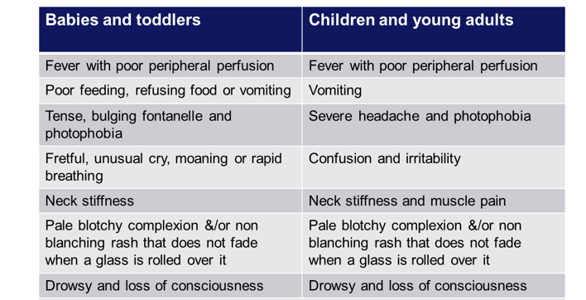
Clinical presentation of IMD
Symptoms can appear in any order, some may not appear at all.
Notes:
Please note that some or all symptoms may appear, in any order, and this list is not exhaustive. Table contents are based on content from the Meningitis Trust http://www.meningitis-trust.org/meningitis-info/signs-and-symptoms/.
Onset of disease varies from fulminant with severe acute and overwhelming features, to insidious with mild prodromal symptoms. Symptoms may be harder to identify in young infants particularly as the onset may be insidious and the signs be non-specific without classical features of meningitis.

Slide 12
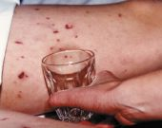
The meningococcal rash
Distinctive red rash can appear anywhere on the body
Formed of tiny ‘pinprick’ blood spots under the skin, also known as petechiae, and appears red in colour. The rash may later develop into purple bruising of the skin
Distinguished from other rashes by pressing a glass tumbler against it:
a meningococcal rash will not fade when a glass tumbler is rolled over it (non-blanching)
A febrile illness and rash that does not fade is a sign of meningococcal septicaemia
The ‘tumbler’ test picture courtesy of Meningitis Research Foundation
http://www.meningitis.org/symptoms
Notes:
A non-blanching rash tends to be a late symptom and should be treated as a medical emergency.
It is important to note the absence of a rash does not preclude meningococcal disease.

Slide 13
Potential complications of IMD
The infection is fatal in 5%-10% of cases, and survivors may develop severe long-term complications
Complications can vary in severity and can either be temporary or permanent. The more severe the disease, the greater the risk of complications
Complications include loss of hearing, loss of vision, loss of memory and/ or concentration, difficulties in co-ordination and balance, epilepsy, cerebral palsy and limb amputations, and may result in death

Slide 14
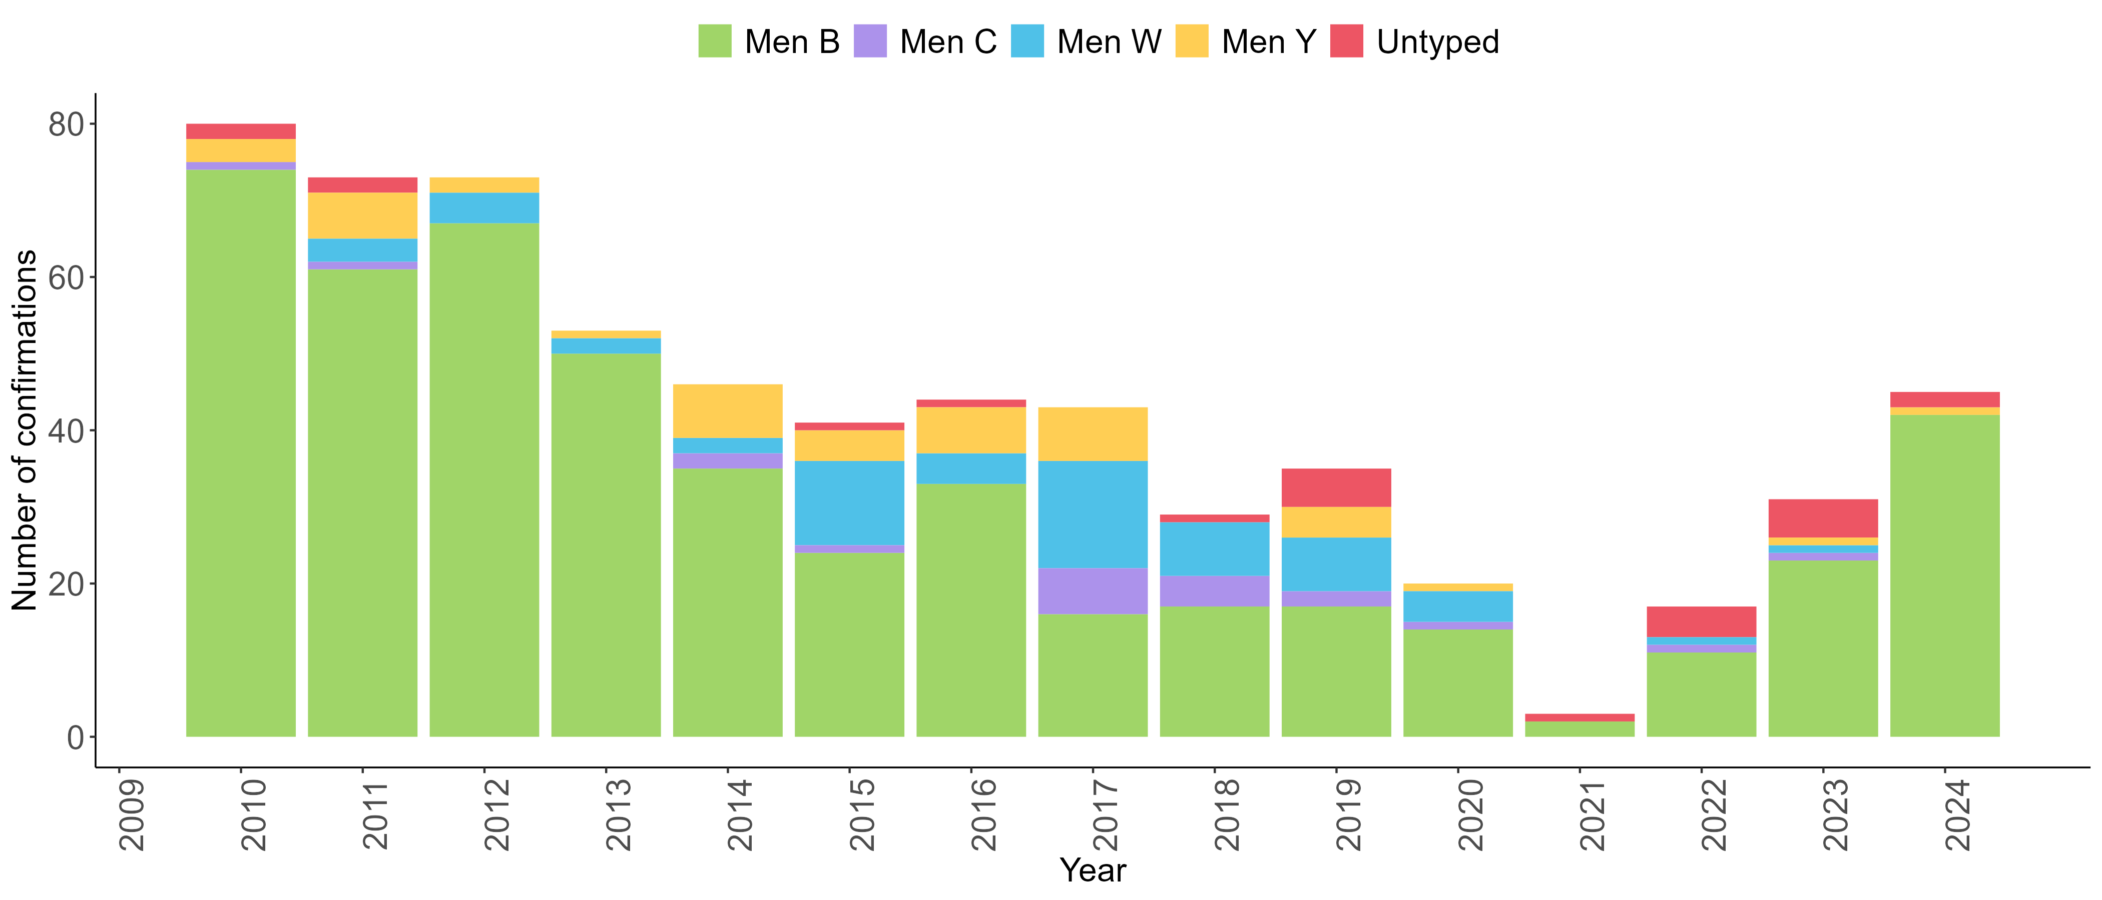
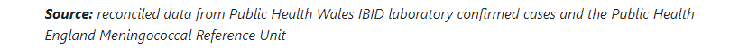
Number of laboratory reports of Neisseria meningitidis by serogroup in Wales 2010-2024

Slide 15
Rationale for the adolescent MenACWY vaccination programme
Adolescents and young adults are at higher risk of getting meningococcal disease, therefore vaccination aims to provide direct protection within this population
Adolescents and young adults are known to be the main carriers of the meningococcal bacteria. Vaccinating a high proportion of those eligible in this age group will reduce onward transmission to susceptible children and adults
JCVI recommended this as the best option to generate population level herd immunity, providing protection across all other age groups, including infants at highest risk
Due to the success of the adolescent MenACWY programme in controlling meningococcal C disease across the population, The Joint Committee on Vaccination and Immunisation (JCVI) no longer recommended a dose of meningococcal C containing vaccine at 12 months
The Hib/MenC dose given at 12 months was removed from the routine childhood vaccination schedule in July 25 (WHC/2025/019)
MenACWY vaccine uptake in the adolescent programme is relied on to provide indirect protection to other age groups. It is important that efforts continue to be made to maintain MenACWY uptake and provide catch-up for individuals that miss vaccination.
Notes:
Teens are at high risk and are known to have high carriage rates. Vaccination for adolescents was therefore expected to rapidly impact on carriage and hence, disease, in all age groups.
WHC available from
JCVI statement re uptake and indirect protection https://www.gov.uk/government/publications/changes-to-the-childhood-immunisation-schedule-jcvi-statement/joint-committee-on-vaccination-and-immunisation-jcvi-statement-on-changes-to-the-childhood-immunisation-schedule

Slide 16
Impact of MenACWY vaccination
MenW cases plateaued within 12 months of the adolescent MenACWY immunisation programme starting, with cases peaking in 2015–16, stabilising in 2016–17, and declining during the next 2 years
MenACWY vaccine effectiveness against disease caused by capsular groups C, W and Y combined was 94% (95%CI 80-99%). Note that MenA cases are very unusual in the UK
The MenACWY immunisation programme has successfully reduced cases of MenW disease across the whole population and now accounts for few cases each year
In England, MenW cases also remained low with 10 cases in 2022 to 2023
In Wales, there was 1 laboratory confirmed case of MenW in 2023
Impact of an adolescent meningococcal ACWY immunisation programme to control a national outbreak of group W meningococcal disease in England: a national surveillance and modelling study - The Lancet Child & Adolescent Health
Notes:
Data: https://www.thelancet.com/journals/lanchi/article/PIIS2352-4642(21)00335-7/fulltext

Slide 17
Eligible groups
The purpose of the MenACWY programme is to actively offer a single dose of MenACWY vaccine to:
All teenagers (including those not attending school*) - this is usually routinely offered at around age 13 or 14 years (in school year 9)
Anyone who has missed their routine vaccination up to their 25th birthday
Individuals at greater risk due to underlying medical conditions including asplenia, splenic dysfunction (including sickle cell and coeliac disease) and complement disorders (including those receiving complement inhibitor therapy)
Notes:
In Wales the MenACWY vaccine is offered at the same time as the TdIPV (3in1, Tetanus Diphtheria and Inactivated Polio booster vaccine) at school based vaccination sessions in school year 9. In Cardiff and Vale UHB only, the MenACWY and TdIPV vaccine is offered in primary care (at 13/14 years of age)
*Children and adults who have outstanding routine immunisations: a national supplementary service specification: Children and adults who have outstanding routine immunisations: national supplementary service specification | GOV.WALES
The immunisation schedule for Wales is available at: Routine immunisation schedules for Wales - Public Health Wales (nhs.wales)

Slide 18
Opportunistic vaccination
Efforts should be made to ensure young people who miss their first opportunity to receive the vaccine in year 9 are offered further opportunities in catch up sessions or subsequent school sessions
Individuals who have left school and remain unvaccinated should be offered vaccination opportunistically – they remain eligible until they turn 25 years of age
Contact with young people/ young adults in school, GP practices and upon entrance to a sixth form, college or university, provides a good opportunity to promote and offer vaccination and raise awareness of the signs and symptoms of the disease
Notes:
The UKHSA publishes specific guidance for higher education settings: Meningitis and septicaemia: prevention and management in higher education institutions. - GOV.UK (www.gov.uk).

Slide 19
MenACWY catch up
The National Supplementary Service Specification for Children and Adults who have Outstanding Routine Immunisations* allows for General Practices to receive payment for MenACWY doses given to children and young people:
From 13 years if the dose of teenage MenACWY has not been received
There is no longer a specific ‘freshers’ dose but university entry is a good opportunity to offer vaccine to anyone who is under 25 years of age and un-immunised. Ideally the dose should be administered at least two weeks before attending university to ensure timely protection.
Note that if an individual’s vaccination history cannot be confirmed before attending university, it is acceptable to offer them a dose of MenACWY vaccine.
*A revised version of this was issued in August 2025 and reflects changes to the childhood programme, including the removal of Hib/MenC at 12months, and lowers the age threshold for the school aged immunisations to reflect the age that they are routinely given. This aims to allow for more opportunities for catch up vaccination in Primary Care. The document can be found here.
Notes:
Children and adults who have outstanding routine immunisations: a national supplementary service specification: Children and adults who have outstanding routine immunisations: national supplementary service specification | GOV.WALES

Slide 20
Pre-requisites to administering MenACWY vaccine
Before administering MenACWY vaccine, it is recommended that:
Those new to immunisation should receive comprehensive foundation immunisation training. Both knowledge and clinical competence should be assessed before new immunisers start to give and/or advise about the Influenza vaccine National Minimum Standards and Core Curriculum for Vaccination Training
Immunisers have received MenACWY vaccine training through attending a taught session and/or eLearning Immunisation eLearning - Public Health Wales (nhs.wales)​
Immunisers have received practical training in MenACWY vaccine preparation and administration (if required)
Training in the management of anaphylaxis and Basic Life Support is undertaken, as specified by policy for your local area and are familiar with Resuscitation Council UK (RCUK) guidance on Management of Anaphylaxis in the Vaccination Setting
Any additional statutory and mandatory training as required by your employer is completed
An appropriate legal framework to supply and administer Influenza vaccine is in place e.g. Written prescription, Patient Specific Direction (PSD), Patient Group Direction (PGD) Home - Welsh Medicines Advice Service
​Those involved in immunisation and vaccination understand the process of consent and how this applies when giving vaccines. Information on consent can be viewed here: Consent: the green book, chapter 2 - GOV.UK
Accessed and familiarised yourself with the following key documents from the UK Health Security Agency: Meningococcal: the green book, chapter 22 - GOV.UK (www.gov.uk), and the MenACWY programme: information for healthcare professionals - GOV.UK (www.gov.uk)
Meningococcal ACWY immunisation programme for adolescents
Notes:
Practitioners should always ensure they are accessing the most up to date information and guidance

Slide 21
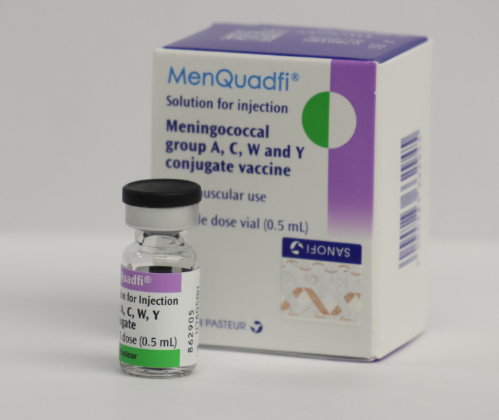
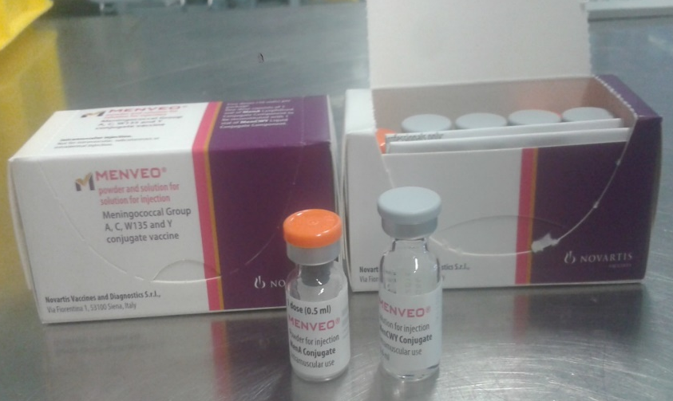
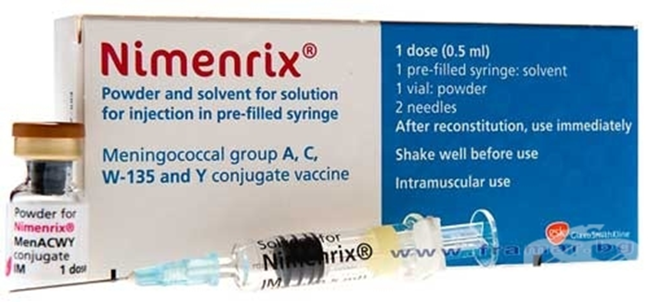
MenACWY vaccines
Three MenACWY conjugate vaccines are currently licensed: Menveo®, Nimenrix® and MenQuadfi®
All vaccines for the routine adolescent programme are centrally supplied through ImmForm
It is important that immunisers familiarise themselves with the specific product information for any vaccine in current use to avoid administration errors
Image courtesy of GSK
Image courtesy of GSK
Image courtesy of Sanofi
Notes:
Not all vaccines may be routinely supplied. Details of all licensed products are included here in case a short-notice substitution of one product for another is required to maintain the programme in the event of manufacturing issues. Supplies of MenQuadfi will commence during the later part of 2024. Welsh Government policy letters advising on supply of MenACWY vaccines are available from Policy, letters and Welsh Government (sharepoint.com)

Slide 22
MenQuadfi®
Full product name: MenQuadfi® solution for injection
Meningococcal groups A, C, W-135 and Y conjugate vaccine
Marketed by Sanofi
Contains: 10 micrograms of each of Neisseria meningitidis groups A, C, W-135 and Y polysaccharides, each conjugated to tetanus toxoid carrier protein per 0.5ml dose
Licensed for use in children from 12 months, adolescents and adults at risk of invasive disease from Neisseria meningitidis A, C, W and Y and can safely be given with other routine adolescent vaccines
Recommended for adolescents (and young adults aged less than 25 years, including those with an unknown or incomplete MenC or MenACWY immunisation history) as part of the routine immunisation programme
This is a black triangle medication which means it is subject to additional monitoring. Healthcare professionals are asked to report any suspected adverse reactions to the MHRA’s Yellow Card scheme (see slide 30 and Green Book, chapter 9)
Meningococcal ACWY immunisation programme for adolescents
22

Slide 23
Preparation and administration of MenQuadfi®
MenQuadfi® solution for injection is a ready-to-use solution that does not require reconstitution
Supplied as a single dose vial
The vaccine should be inspected visually for any particulate matter and/or variation of physical aspect (or discolouration) prior to administration; in the event of either being observed, discard the vaccine
Remove the flip off seal and using a suitable syringe and needle, withdraw 0.5 ml of solution, ensuring no air bubbles are present before injection
Change the needle prior to administration; choose a size suitable for IM administration into the chosen muscle of each individual patient
MenQuadfi® should be administered via intramuscular injection (IM), preferably into the deltoid muscle of the upper arm
*Please note that needles and syringes will need to be ordered separately for MenQuadfi®. Guidance on the choice of needle size can be found in chapter 4 of the Green Book.

Slide 24
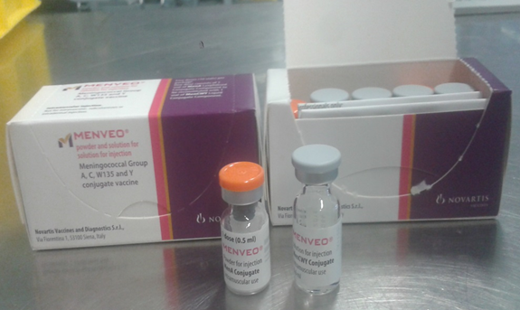
Menveo®
Full product name: Menveo® powder and solution for solution for injection
Meningococcal Group A, C, W-135 and Y conjugate vaccine
Marketed by GlaxoSmithKline
Contains: 10 micrograms of Neisseria meningitidis group A oligosaccharide and 5 micrograms of each of Neisseria meningitidis groups C, W and Y, each conjugated to Corynebacterium diphtheriae CRM197 protein oligosaccharides per 0.5ml dose
Licensed for use in children from 2 years, adolescents and adults at risk of invasive disease from Neisseria meningitidis A, C, W and Y and can safely be given with other routine adolescent vaccines
Recommended for adolescents (and young adults aged less than 25 years, including those with an unknown or incomplete MenC or MenACWY immunisation history) as part of the routine immunisation programme
Image courtesy of GSK

Slide 25
Preparation and administration of Menveo®
The vaccine is supplied in two separate vials – one vial containing Men A (a white to off-white powder) and the second vial containing Men C,W & Y (a colourless, clear solution)
Draw up and inject the entire contents of the vial of Men C, W & Y solution into the vial of MenA powder then invert and vigorously shake the vial
After reconstitution, the solution should be clear, colourless to light yellow and free from visible foreign particles; the vaccine should not be administered where there are variations in physical appearance or signs of foreign particulate are observed after shaking
Withdraw 0.5ml of reconstituted product; it is normal for a small amount of liquid to remain in the vial following withdrawal of the dose
Change the needle prior to administration; choose a size suitable for IM administration into the chosen muscle of each individual patient
Menveo® should be administered via intramuscular injection (IM), preferably into the deltoid muscle of the upper arm
Notes:
The vaccine should be stored between +2°C to +8°C. Both vials should be visually inspected before reconstitution (see SPC Menveo Group A,C,W135 and Y conjugate vaccine - Summary of Product Characteristics (SmPC) - print friendly - (emc) (medicines.org.uk)). After reconstitution, the medicinal product should be used immediately. However, chemical and physical stability after reconstitution have been demonstrated for 8 hours below 25°C.

Slide 26
Nimenrix®
Full product name: Nimenrix® powder and solvent for solution for injection in pre-filled syringe
Meningococcal groups A, C, W-135 and Y conjugate vaccine
Marketed by GlaxoSmithKline
Contains: 5 micrograms of each of Neisseria meningitidis groups A, C, W-135 and Y polysaccharides, each conjugated to tetanus toxoid carrier protein per 0.5ml dose
Licensed for use in children from 12 months, adolescents and adults at risk of invasive disease from Neisseria meningitidis A, C, W and Y and can safely be given with other routine adolescent vaccines
Recommended for adolescents (and young adults aged less than 25 years, including those with an unknown or incomplete MenC or MenACWY immunisation history) as part of the routine immunisation programme
Image courtesy of GSK

Slide 27
Preparation and administration of Nimenrix®
The vaccine is supplied as one vial of (white) powder containing the active components and one pre-filled syringe containing a clear solvent (sodium chloride solution):
Prior to administration the entire contents of the pre-filled syringe should be injected into the vial of powder; the vial should be shaken well to mix the contents - until the powder dissolves, providing one dose (0.5ml)
After reconstitution, the solution should be clear, colourless to light yellow and free from visible foreign particles
The vaccine should not be administered where there are variations in physical appearance or signs of foreign particulate are observed after mixing
Change the needle prior to administration; choose a size suitable for IM administration into the chosen muscle of each individual patient
Nimenrix® should be administered via intramuscular injection (IM), preferably into the deltoid muscle of the upper arm
Notes:
The vaccine should be stored between +2°C to +8°C
After reconstitution, the vaccine should be used immediately. However, stability after reconstitution has been demonstrated for 8 hours below 30°. Discard any reconstituted vaccine not used within 8 hours.

Slide 28
Contraindications
Menveo®, Nimenrix® and MenQuadfi® should not be administered to those who have had:
  a confirmed anaphylaxis to a previous dose of the same vaccine OR
  a confirmed anaphylaxis to any constituent or excipient of the vaccine, including tetanus toxoid (Nimenrix® and MenQuadfi®) or diphtheria toxoid (Menveo®)
There are very few individuals who cannot receive meningococcal vaccines - where there is doubt, appropriate advice should be sought rather than withholding immunisation

Slide 29
Precautions and additional information
Postpone vaccination of any individual suffering from acute severe febrile illness
  note: minor illnesses without fever or systemic upset are not valid reasons to postpone immunisation
Pregnancy and breast-feeding
  meningococcal vaccines may be given to pregnant women when clinically indicated. There is no evidence of risk from vaccinating pregnant women or those who are breastfeeding with inactivated vaccines or toxoids
Immunosuppression and HIV infection
  individuals with immunosuppression and human immunodeficiency virus (HIV) infection (regardless of CD4 count) should be given meningococcal vaccines in accordance with the routine schedule

Slide 30
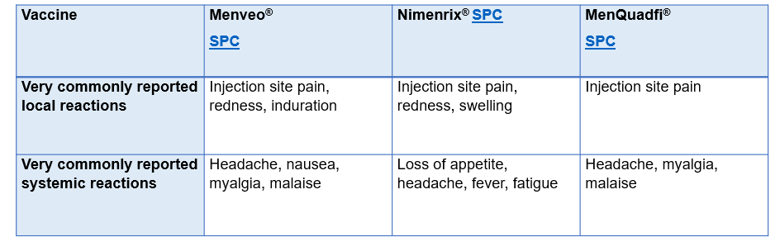
Possible adverse reactions
All three MenACWY conjugate vaccines have excellent side effect profiles; adverse reactions very commonly or commonly reported in the clinical trails were the short-lived, self-resolving type that are expected after vaccination
Only those that were very commonly reported in the clinical trials (by 1 in 10 or more recipients) are listed below; full details of all adverse reactions can be found in the summaries of product characteristics (SPCs), which vaccinators should always consult
Notes:
Menveo® Menveo Group A,C,W135 and Y conjugate vaccine - Summary of Product Characteristics (SmPC) - (emc)
Nimenrix®Nimenrix powder and solvent for solution for injection in pre-filled syringe - Summary of Product Characteristics (SmPC) - (emc)
MenQuadfi® MenQuadfi solution for injection - Summary of Product Characteristics (SmPC) - (emc)

Slide 31

Reporting suspected adverse reactions
  All suspected adverse reactions in children should be reported to the MHRA using the Yellow Card scheme http://mhra.gov.uk/yellowcard
  For vaccines that have been marketed in the UK for two years or more, in adults only serious suspected ADRs should be reported: this includes Menveo® and Nimenrix®
  Vaccines that are newly licensed in the UK, and which are therefore subject to enhanced surveillance and are given ‘black triangle’ status (indicated by an inverted triangle on the product information), all serious and non-serious suspected ADRs should be reported: this includes MenQuadfi®
  Success of the scheme depends on early, complete and accurate reporting; report even if uncertain about whether the vaccine caused the condition
  See chapter 9 of the Green Book for details
Notes:
Healthcare professionals and vaccine recipients (and/or their parent or carer) are encouraged to report suspected adverse reactions to the Medicines and Healthcare products Regulatory Agency (MHRA) using the Yellow Card reporting scheme.
The MHRA additionally monitored the safety of MenACWY vaccine as its use was increased through the adolescent programme. No safety concerns have been raised since this vaccine has been more widely used in adolescents. Safety monitoring is a continuous process.

Slide 32
Dose and scheduling
All licensed MenACWY conjugate vaccines induce very high serum bactericidal antibody titres - i.e. excellent protection after one dose
The need for, and the timing of a booster dose of MenACWY vaccine has not yet been determined and is therefore not currently recommended
It can be administered at any interval before, after or at the same time as all other vaccines, including Flu, HPV, Td/IPV, MMR, and travel vaccines
Those who may have already received a MenC containing vaccine over the age of 10 years should still be offered MenACWY conjugate vaccine to ensure protection against the additional capsular groups A, W and Y
Those who may have already received a MenACWY conjugate vaccine at the age of 10 years or over do not require an additional dose (with the exception of close contacts of a confirmed case of disease caused by Men A, C, W or Y capsular groups, who will be offered a dose of MenACWY conjugate vaccine if they have not received a dose in the preceding 12 months).
Notes:
The local Health Protection Team (HPT) will advise about vaccination of close contacts of any confirmed case of MenACWY infection according to the Guidance for Public Health Management of Meningococcal Disease in the UK: Meningococcal disease: guidance on public health management - GOV.UK (www.gov.uk).

Slide 33
Legal authorisation
MenQuadfi® ,Nimenrix® and Menveo® are prescription only medicines and should therefore only be administered:
  Against a prescription written manually or electronically by a registered medical practitioner or other authorised prescriber
  Against a patient specific direction
  Against a patient group direction
A Meningococcal groups A, C, W and Y (MenACWY) Conjugate Vaccine Patient Group Direction (PGD) template is available on the Welsh Medicines Advice Service website: Patient Group Directions (PGD) - Welsh Medicines Advice Service (wales.nhs.uk) for:
  Individuals eligible for national routine MenACWY programme (including individuals with an incomplete or unknown vaccination history until their 25th birthday)
  Outbreak control and contacts of confirmed cases (under the direction of the local Health Protection Team)
  All three licensed vaccines are included in the PGD template
  NB: Local authorisation is required before PGD templates can be used
Notes:
A separate PGD template is also available for the vaccination of individuals who, due to an underlying medical condition, require doses of MenACWY vaccine that are not included the routine programme. Welsh government PGD templates are available from Patient Group Directions (PGD) - Welsh Medicines Advice Service (wales.nhs.uk)

Slide 34
Consent for vaccination
In the routine school based vaccination programme in Wales, both paper and electronic consent forms are in use
"Parental” consent is the most common method for obtaining consent for vaccination of school age children and young people.
This involves parent/guardian providing their consent for the child or young person to receive the vaccine.
Young people aged 16 and over can consent for themselves, a parent/guardian cannot override that consent.
In some cases, young people under the age of 16 may be able to give consent themselves. This can happen if they are assessed as having sufficient maturity and mental capacity to understand fully what is involved in the proposed procedure, these young people are described as “Gillick competent”.
It is still preferred that parents/guardians are involved in the consent process.
Vaccination cannot take place without the required consent

Slide 35
Self consent and Gillick Competence
Young people under 16 should be made aware they can give their own consent to vaccination if they are assessed to be Gillick competent
If a Gillick-competent young person consents to vaccination, a parent/guardian cannot override that consent.
Where a Gillick competent young person has provided consent, vaccination can proceed despite the disagreement of one or both parents.
A young person may be considered Gillick competent to make one decision but not another, depending on how complex each decision is.
If in the assessment of the young person the health professional giving the immunisation felt the young person was not Gillick competent to consent to vaccination then the consent of someone with parental responsibility is required.
School-aged immunisation services should ensure that they a have a policy in place to support school-aged immunisation teams in assessing Gillick competence. This should include guidance on what action to take when a young person’s vaccination preference is different from that of their parents or guardians
Further information on self consent and Gillick competence in children and young people is available from Chapter 2 Consent Green Book
Notes:
NICE - Vaccinations for school-aged children and young people: invitations, reminders and escalation of contact Young people can give their own consent to vaccination if they are assessed to be Gillick competent

Slide 36
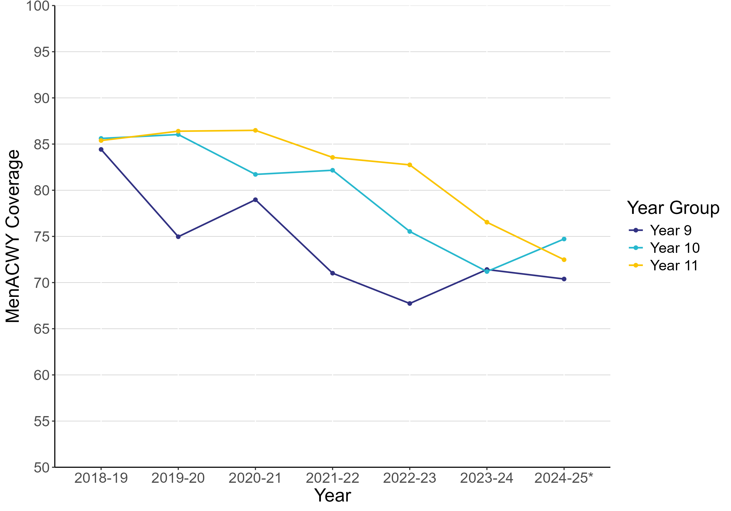
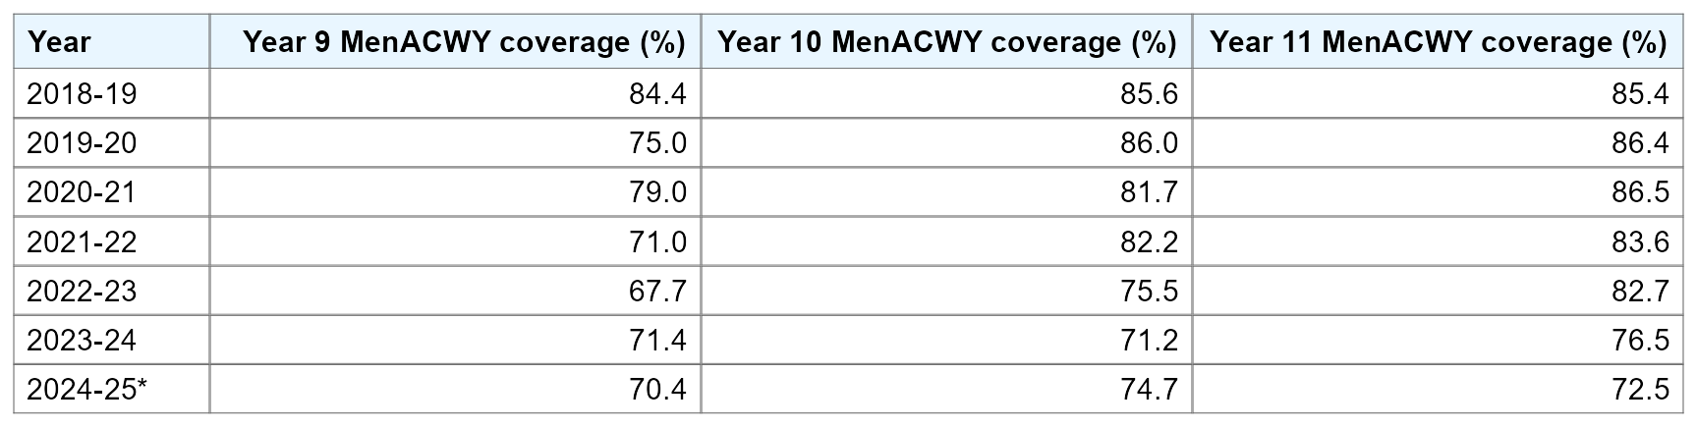
MenACWY coverage for adolescents in Wales, by academic year from 2018-19 to 2024-25*
MenACWY vaccine coverage in 2024-25* increased in year 10 pupils, but decreased in 9 and 11 school year cohorts. This follows an increase in year 9 in 2023-24 and a downward trend in year 11 seen since 2020-21
Coverage as reported at the end of the September to August academic year
*2024-25 coverage as at 30/06/25

Slide 37
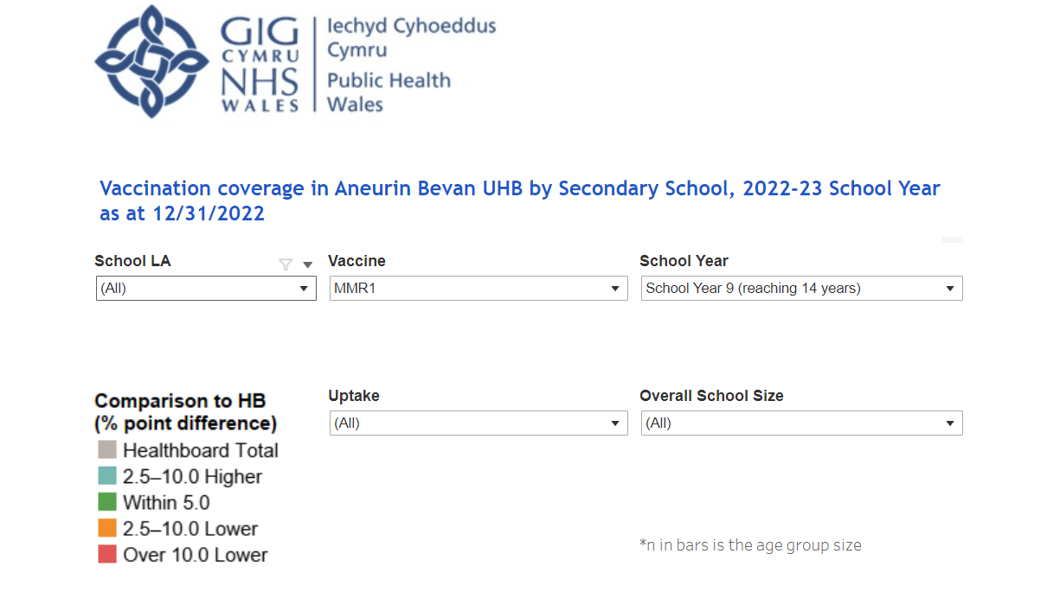
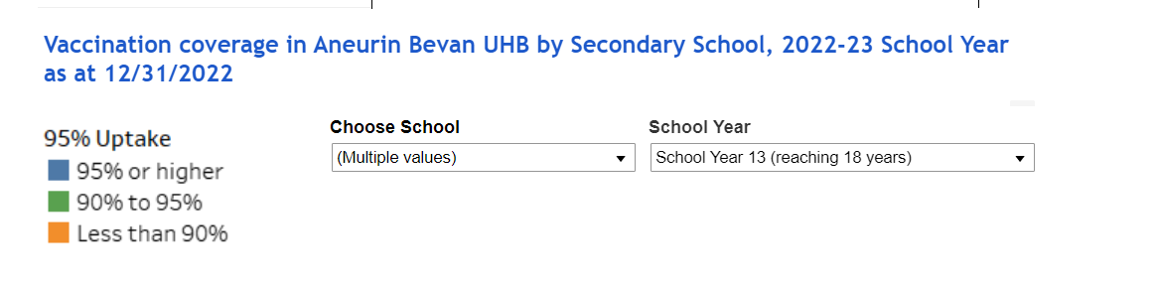
School level data dashboard
In February 2023, school level immunisation data dashboards were made available on SharePoint (NHS intranet only)
The dashboards are health board specific and primary school and secondary school dashboards are separate.
The data is based on the most recent quarterly COVER report
It's an interactive dashboard and can be refined to show:
  specific vaccination uptake by local authority, year group, by vaccine, school size and uptake ranges
  Individual school level uptake by year group
Notes:
See ‘Quarterly dashboards’ under each health board name here: https://nhswales365.sharepoint.com/sites/PHW_VPDPComms/SitePages/Childhood-Immunisation-(COVER).aspx (NHS only)

Slide 38
Young people vaccine information resources insights - survey
Key Survey Findings (2023)
Young people want:
  Vaccine information in school* (seen as trustworthy)
  To know how vaccines work
  To address their psychological needs: autonomy, choice, anxiety
  Audio-visual resource: short, funny, upbeat, bright, colourful
  Resources to be age-appropriate; not too simplified; representative of diversity
Previous PHW surveys suggested young people would prefer audio-visual vaccination resources (BMG 2022)
Co-designed survey for school-aged young people (11-16) - VPDP colleagues, PHW Behavioural Science Unit, PHW Young Ambassadors
361 participants from localities across Wales
Survey undertaken January - February 2023
https://phw.nhs.wales/topics/immunisation-and-vaccines/engagement-insights/
Notes:
BMG (2022) Attitudes towards COVID-19 and Flu Immunisations among Young People and Parents (nhs.wales)
*Note – not all young people attend school, further exploration required for distribution routes to vulnerable young people e.g. outreach workers
phw.nhs.wales/topics/immunisation-and-vaccines/engagement-insights

Slide 39
Information Resource for Young People – Research Findings 2023
To assess vaccine information needs among young people, to inform co-production of resources*
KEY FINDINGS
Attitudes to vaccination are generally positive
Awareness of some vaccine preventable diseases is very low
Parents are most trusted source to discuss vaccination, then medical professionals and teachers
Parental input is key in decision making
Resource content to include: Vaccine information and the disease/illness it protects against, benefits and what the vaccine protects from, who can have it, how delivered, number of doses, reassurances about the pain, and potential side effects
Preference for animation resource with an accompanying leaflet to take home to discuss with parents
Animation should be shown in school, with opportunity for follow up questions – school seen as very trustworthy
High levels of mistrust in social media
Ongoing commissioned work to gather specific insights and co-produce resources on MenACWY and 3 in 1 Teenage Booster (TdIPV) vaccines (Social Change UK 2024)
Notes:
*Research focussed on information needs for the coproduction of HPV vaccine related resources
2 qualitative focus groups, 1 in-depth interview conducted in Welsh Undertaken Sept 2023 Total 16 participants
https://phw.nhs.wales/topics/immunisation-and-vaccines/engagement-insights/phw-hpv-information-resource-research-findings-oct23/
Aims:
What questions, barriers or concerns young people have about the HPV/flu vaccine that should be addressed in the resource.
The content, style, format, and length of an audio-visual resource that would appeal to young people.
If young people would access an audio-visual resource for vaccine information.
How young people would want this information to reach them.
To understand where young people would access a resource, including named platforms.

Slide 40
The role of healthcare professionals
To provide clear, concise and accurate information to young people and parents or carers of those receiving the MenACWY vaccine
To maximise the uptake of the meningococcal ACWY vaccine to provide direct protection to adolescents, and indirect protection within the wider community/population by reducing carriage
To ensure that young people and their parents or carers are fully informed about the importance of protecting against meningococcal disease caused by A, C, W and Y meningococcal strains, and are aware of contraindications and potential side effects of the vaccine
To provide young people with an opportunity to ask questions relating to vaccination e.g. via health education sessions in schools
To continue to be a trusted source of information for young people
Notes:
Based on PHW 2023 Findings from Information Resource for Young People Research Findings https://phw.nhs.wales/topics/immunisation-and-vaccines/engagement-insights/phw-hpv-information-resource-research-findings-oct23/

Slide 41
Summary
Meningococcal disease is caused by invasive infection with the bacterium Neisseria meningitidis also known as the meningococcus
Meningococcal disease is an important clinical and public health problem; it most commonly presents as meningitis or septicaemia and can affect all age groups
Meningococcal bacteria colonise the nasopharynx of humans; asymptomatic carriage prevalence increases throughout childhood, peaks in late teens/ early 20s and subsequently decreases in adulthood
12 capsular groups of meningococcus; in the UK disease is usually caused by groups B, C, W and Y; vaccination has largely eliminated group C disease
MenACWY vaccine was introduced in response to an increase in cases of invasive meningococcal capsular group W (MenW) disease
Offering MenACWY vaccine to adolescents offers them direct protection against capsular groups A, C, W and Y and prevents carriage of these bacteria in this age group, thereby offering protection through herd protection to other age groups
In the autumn of 2024 the programme transitioned to using MenQuadfi ®. For a short period both Nimenrix® and MenQuadfi ® were in use at the same time.
Notes:
Meningococcal C vaccination started in the UK in 1999. A combined Hib/MenC vaccine was later introduced into the infant vaccination programme in 2006. In the summer of 2015, MenACWY vaccination replaced the adolescent MenC vaccine due to an increase in cases of MenW disease. The HibMenC dose delivered in infancy was stopped in July 2025 with the MenACWY adolescent programme expected to provide indirect protection to all age groups.

Slide 42
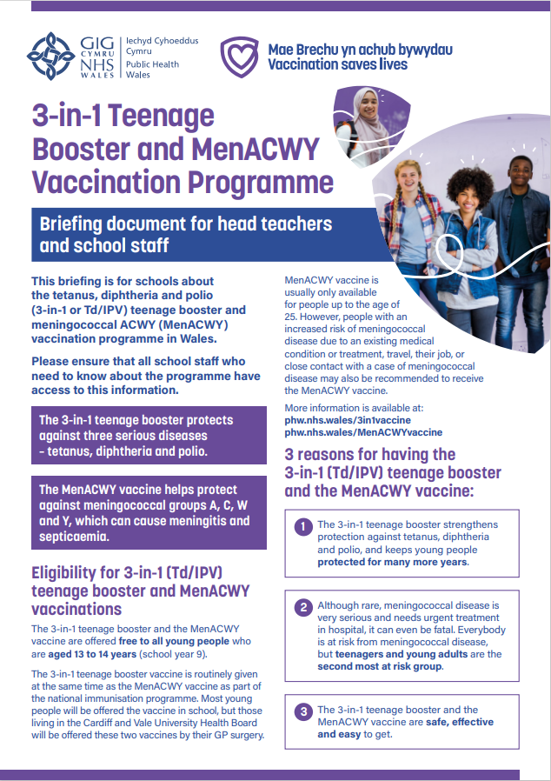

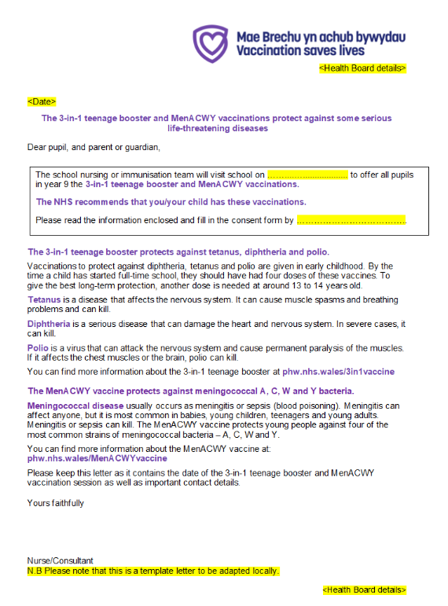

Resources for MenACWY vaccination
Leaflets and posters can be ordered for free from Health Information Resources: Health Information Resources - Public Health Wales (nhs.wales)
MenACWY vaccine – Information for the public: www.phw.nhs.wales/MenACWYvaccine or www.icc.gig.cymru/brechlynMenACWY
MenACWY vaccine - Information for health professionals: MenACWY - Information for health professionals - Public Health Wales (nhs.wales)
Information for schools can be found here: School age children and young people - Public Health Wales
Notes:
The UKHSA publishes specific guidance for higher education settings: Meningitis and septicaemia: prevention and management in higher education institutions. - GOV.UK (www.gov.uk).

Slide 43
Resources and additional information
UKHSA. Immunisation against infectious diseases The Green Book: Meningococcal chapter 22 https://www.gov.uk/government/publications/meningococcal-the-green-book-chapter-22
UKHSA MenACWY programme: information for healthcare professionals. https://www.gov.uk/government/publications/menacwy-programme-information-for-healthcare-professionals
Summary of Product Characteristics:
Nimenrix https://www.medicines.org.uk/emc/product/4118
MenQuadfi https://www.medicines.org.uk/emc/product/12818
Menveo https://www.medicines.org.uk/emc/product/2939/
Meningitis Research Foundation: http://www.meningitis.org/
Meningitis Now. https://www.meningitisnow.org/
NHS 111 Wales: NHS 111 Wales - Health A-Z : Meningitis
WHO Immunization Resource Centre: Vaccines and immunization (who.int)
Optimising Vaccine Uptake: Using motivational interviewing for better conversations eLearning available on ESR and here: https://phw.nhs.wales/topics/immunisation-and-vaccines/immunisation-elearning/
Increase in Endemic Neisseria meningitidis Capsular Group W Sequence Type 11 Complex Associated With Severe Invasive Disease in England and Wales | Clinical Infectious Diseases | Oxford Academic
Notes:
References
1. Ladhani, S. Beebeejaun, K. Lucidarme, J. Campbell, H. Gray, S. Kaczmarkski, E. Ramsay, M.E, Borrow, R. (2015). Increase in Endemic Neisseria meningitidis Capsular Group W Sequence Type 11 Complex Associated With Severe Invasive Disease in England and Wales. Clin Infect Dis. (2015) 60 (4): 578-585. [internet] accessed 15 January 2024. https://cid.oxfordjournals.org/content/60/4/578
2. Public Health England (2015) Health Protection Report: Continuing increase in meningococcal group W (MenW) disease in England. Weekly report. Vol 9. No.7. Published 27 February 2015. [internet]. accessed 15 January 2024. Health Protection Report volume 9 (2015) - GOV.UK (www.gov.uk)
3. Joint Committee on Vaccination and Immunisation (2015). Minutes of the meeting 4 February 2015. [internet] accessed 15 January 2024. https://www.gov.uk/government/groups/joint-committee-on-vaccination-and-immunisation
4. Campbell H and others (2022). Impact of an adolescent meningococcal ACWY immunisation programme to control a national outbreak of group W meningococcal disease in England: a national surveillance and modelling study, England, 2015 to 2016. Lancet Child Adolescent Health: volume 6 issue 2 [internet] accessed 15 January 2024. https://pubmed.ncbi.nlm.nih.gov/34883094/

