Slide 1
Lunch and Learn for Sexual Health Services clinical healthcare professionals
Awareness raising session: Meningococcal type B (4CMenB) vaccination programme for protection against gonorrhoea and the change from a reactive offer of Mpox vaccine to a routine vaccination programme for the prevention of mpox
16 June 2025
Vaccine Preventable Disease Programme
Public Health Wales
Notes:
Material contained in this document may be reproduced without prior permission provided it is done so accurately and is not used in a misleading context.
Acknowledgement to Public Health Wales NHS Trust to be stated.
© 2025 Public Health Wales NHS Trust.

Slide 2
Introduction
Clare Powell
Specialist Nurse – immunisation.
Training lead

Slide 3
Acknowledgements
Vaccine Preventable Disease Programme​ (VPDP)
Joint Committee of Vaccination and Immunisation (JCVI)
Vaccine Programme Wales​ (VPW)
UK Health Security Agency​ (UKHSA)

Slide 4

What will & will not be covered in this session?

Slide 5
Why are we providing a lunch and learn session and what will be covered?
This short session will give a brief overview of the introduction of the new Meningococcal type B (4CMenB) vaccination programme for protection against gonorrhoea, and the change from a reactive offer of Mpox vaccine to a routine vaccination programme for the prevention of mpox.
Opportunity to ask questions relating to your area of work.
What will not be covered?
This is not training. This lunch and learn session is an awareness raising session. Training should be delivered by local health boards.
We will not be covering the more operational aspects of the changes. We will not be discussing the reasons for the recommendations in depth.
For further information on the new programme you can view the JCVI advice, Welsh Health Circular (WHC/2025/021) and the Green Book Gonorrhoea Chapter, VPDP are scoping the possibility of a live Q&A webinar in due course.
Notes:
Immunisation training resources and events - Public Health Wales

Slide 6
Who decides that new programmes or changes are necessary?

Slide 7
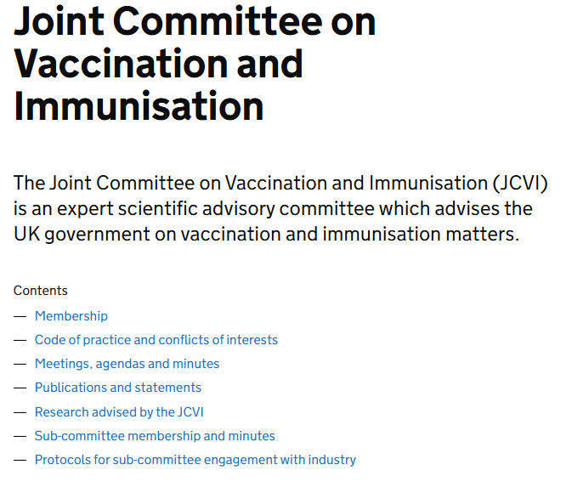
The Joint Committee on Vaccination and Immunisation (JCVI)​
The proposed new programme and change are based on advice by the JCVI.
The role of the JCVI​
Independent expert committee advising the UK government on vaccines Review scientific evidence, safety data, cost-effectiveness and public health impact
Ensures vaccine programmes provide the greatest benefit to public health
Welsh Government
Health is devolved. Wales aligns with UK guidance for consistency across the UK, unless specific adaptations are needed.
​
Joint Committee on Vaccination and Immunisation - GOV.UK
Notes:
In Wales health is devolved

Slide 8
Overview of:
new Meningococcal type B (4CMenB) vaccination programme for protection against gonorrhoea
the change from a reactive offer of Mpox vaccine to a routine vaccination programme for the prevention of mpox and
resources and tools to support SHS clinical healthcare professionals.
Ceriann Howard
Specialist Nurse – Adult vaccinations.

Slide 9
Gonorrhoea epidemiology
Gonorrhoea is a bacterial sexually transmitted infection (STI) caused by the Neisseria gonorrhoeae bacterium
Gonorrhoea causes significant morbidity and remains a public health concern globally
Increased resistance to most antibiotics used to treat gonococcal infection has been reported worldwide, with extensively resistant strains exhibiting resistance to multiple antibiotic classes
The World Health Organization considers Neisseria gonorrhoeae to be a high priority pathogen due to this widespread antimicrobial resistance
Official statistics for STIs in 2022 from the UK Health Security Agency (UKHSA) highlights a rapid rise in gonorrhoea diagnosis in England
The highest diagnoses rates are in gay, bisexual and other Men who have Sex with Men (GBMSM)
Natural infection does not give protection against future infections
JCVI advice on the use of meningococcal B vaccination for the prevention of gonorrhoea - GOV.UK
Notes:
Diagnosis rates for gonorrhoea are consistently disproportionately higher in specific communities including:
those who live in the most deprived areas
people of black Caribbean ethnicity
people born in Central or South America (this measure is used as a proxy for being of Latino, Latina or Latine ethnicity)
young people 15 to 24 years of age and gay, bisexual and other men who have sex with men (GBMSM)
Of these communities the highest diagnoses rates are in GBMSM, however it should be noted that these communities are not mutually exclusive.
As gonorrhoea rates are disproportionally high in certain key communities tied to existing health inequalities, the JCVI support efforts made by the NHS, sexual health services and other organisations involved in outreach and inreach work to ensure equitable access to vaccination in those who are most at risk.

Slide 10
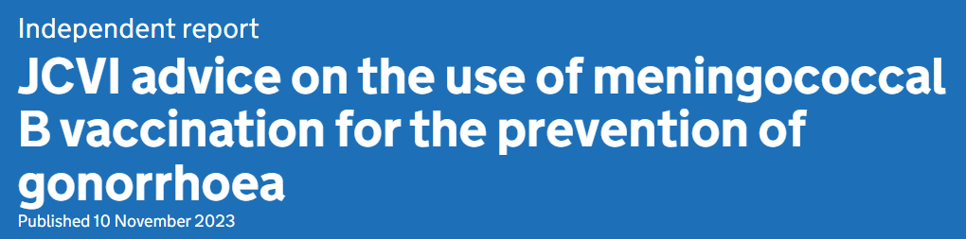
(1)
JCVI advise that:
A targeted programme should be initiated using the 4CMenB vaccine for the prevention of gonorrhoea in those who are at greatest risk of infection
Programme should be offered on an opportunistic basis through specialist sexual health services
Real world studies have estimated that the 4CMenB vaccine has between 32.7 to 42% effectiveness against gonorrhoea*
Vaccination is of benefit as previous infection with gonorrhoea is thought to offer little protection against future infection and reinfection is therefore common although a modest vaccine effectiveness
Notes:
*The recently published Green Book Gonorrhoea chapter states that Several case-control and cohort studies have reported 30-40% protection against gonorrhoea in people at high risk of gonorrhoea infection who were offered the vaccine for protection against MenB disease
Ref: JCVI advice on the use of meningococcal B vaccination for the prevention of gonorrhoea - GOV.UK
Sexual Health Services have vast experience in assessment and identification of those who are at increased risk of infection with bacterial STIs.
Although vaccination would be expected to reduce the chance of becoming infected with gonorrhoea, it would not completely eliminate the possibility. Vaccinated individuals could expect to have some reduction in their own risk of contracting gonorrhoea, however the main benefit of a vaccination programme is expected to be at a community level with a significant reduction in the number of cases overall.

Slide 11
(2)
Protection against gonorrhoea isn’t currently a licensed indication for 4CMenB vaccine, this advice is based on off-label use of vaccine
The programme should primarily target gay, bisexual and other men who have sex with men (GBMSM) who are at increased risk of becoming infected
These risk criteria may include but not be limited to:
a recent history of gonorrhoea or other bacterial STI diagnosis, individuals should also be offered vaccination after a gonorrhoea diagnosis (whether symptomatic or asymptomatic)
reporting high-risk sexual behaviours with multiple partners during sexual health screening and assessment
Any offer of vaccination should be based on individual risk assessment by a sexual health clinical professional.
Notes:
Ref: JCVI advice on the use of meningococcal B vaccination for the prevention of gonorrhoea - GOV.UK
While a disproportionate number of gonococcal infections are within GBMSM, this doesn’t cover the entire population at risk. Efforts should be made to ensure that the vaccine is offered to those at similar risk, including but not limited to transgender women and gender-diverse people assigned male at birth. In addition, vaccination should be considered in any other people, irrespective of gender, who may be heterosexual or identify otherwise and who have equivalent markers of increased risk including but not limited to those with a recent history of bacterial STI diagnosis and sex workers.
The JCVI were not aware of any data on the administration of 4CMenB while currently infected with gonorrhoea, and there was some concern that this might lead to the vaccine being ineffective due to the failure to mount a complete immune response to an antigen during an active infection - this is known as anergy.

Slide 12
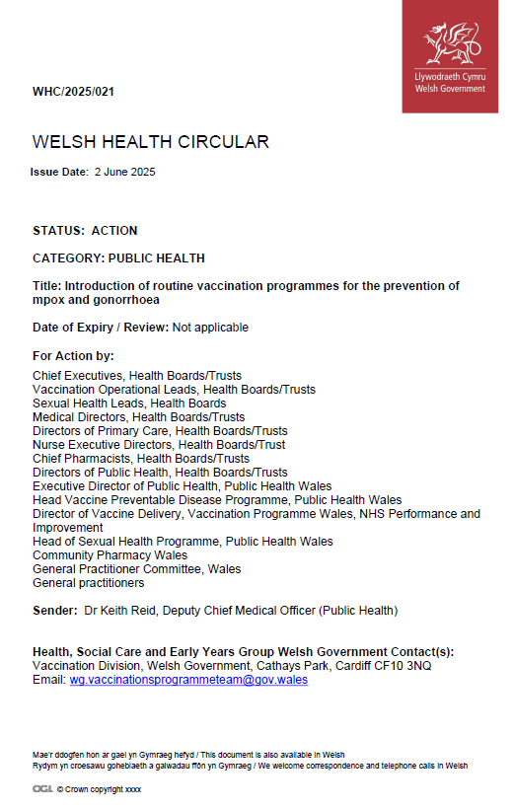
WHC/2025/021 Introduction of routine vaccination programmes for the prevention of mpox and gonorrhoea
Welsh Government has accepted advice from the JCVI to introduce a routine targeted vaccination programme for the prevention of Gonorrhoea for those at highest risk
The programme is to be offered opportunistically through Sexual Health Services (SHS) who have experience in assessment and identification of those who are at increased risk of infection with bacterial sexually transmitted infections (STIs).
Two dose programme*
In Wales the 4CMenB vaccine for protection against gonorrhoea will be available routinely for those eligible* through SHSs (WHC/2025/021). Vaccine Programme Wales will advise SHSs when vaccinations can commence, readiness is anticipated to be from July.
WHC/2025/021 [3 June 2025]
Notes:
*A course of two doses of 4CMenB vaccine (0.5 ml intramuscular/subcutaneous injection) at least 4 weeks apart. There is no maximum time interval limit between the two vaccine doses. Pragmatically and opportunistically, the second dose can be scheduled for the next clinic attendance, which may be after 3, 6 or 12 months. There is no need to recommence the primary immunisation schedule even after a prolonged interval between the two doses.
A UK health economic model indicated that offering 4CMenB to GBMSM at increased risk of gonorrhoea attending sexual health services would be cost-effective, even with a conservative vaccine effectiveness of 31% lasting 18 months after primary vaccination with two doses (Whittles et al., 2022)
**Eligibility covered in next slide
WHC/2025/021 Introduction of routine vaccination programmes for the prevention of mpox and gonorrhoea (2 June 2025) Introduction of routine vaccinations for mpox and gonorrhoea (WHC/2025/021) | GOV.WALES
JCVI Statement JCVI advice on the use of meningococcal B vaccination for the prevention of gonorrhoea - GOV.UK

Slide 13
Eligibility for 4CMenB for protection against gonorrhoea
The 4CMenB vaccine is recommended for GBMSM considered at higher risk of infection attending a sexual health clinic, which is anticipated to include GBMSM who have had:
a bacterial sexually transmitted infection (STI) in the past year
five or more sexual partners in the last three months.
Sexual health clinical professionals may perform individual risk assessment and consider the offer of 4CMenB to the small numbers of individuals with an incidence of gonorrhoea approaching that in the eligible GBMSM group defined above; this may include sex workers practicing condomless sex, and others assessed as having a similar incidence as the eligible GBMSM group.
Any offer of vaccination should be based on an individual assessment by a sexual health clinical professional.
Green Book Gonorrhoea Chapter

Slide 14
Mpox
Change from a reactive offer of mpox vaccine to a routine vaccination programme for the prevention of mpox

Slide 15
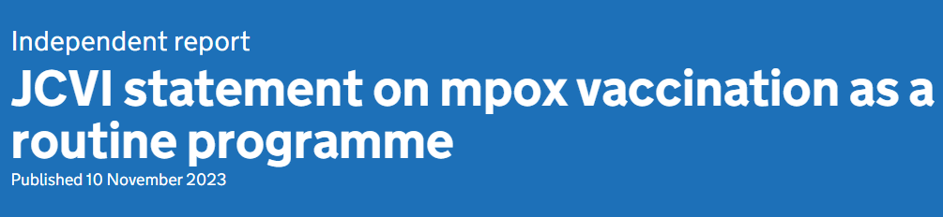
JCVI advise:
An ongoing routine vaccination strategy for protection against mpox should be developed to prevent future outbreaks and protect those at risk of exposure.
Allows vaccines to be offered routinely through sexual health services on an ongoing basis, as opposed to an outbreak response which had caused a significant disruption in sexual health services, impacting on their ability to continue with routine work.
Pre-exposure vaccination should target GBMSM who are at highest risk of exposure to mpox, to be identified via sexual health services using markers of high-risk behaviour.
Efforts should be made to ensure that vaccine is offered equitably to those at equivalent risk including transgender women or gender-diverse people assigned male at birth.
Further information on mpox can be viewed here: Mpox (monkeypox) - Public Health Wales (nhs.wales) (**Website currently being updated**)
Notes:
JCVI statement on mpox vaccination as a routine programme - Published 10 November: https://www.gov.uk/government/publications/mpox-vaccination-programme-jcvi-advice-10-november/jcvi-statement-on-mpox-vaccination-as-a-routine-programme
Guidelines for occupational pre-exposure vaccination in healthcare and laboratory workers can be found in chapter 29 of the Green Book.

Slide 16
WHC/2025/021 Introduction of routine vaccination programmes for the prevention of mpox and gonorrhoea
Welsh Government has accepted advice from the JCVI to introduce a routine vaccination programme against Mpox for those at highest risk
A global outbreak of the disease began in 2022, linked to infections with clade II and a vaccination outbreak response was developed across the UK, using the smallpox vaccine Modified Vaccinia Ankara - Bavarian Nordic (MVA-BN), with this reactive offer continuing in Wales to present day.
Transmission within Wales has mainly been reported within networks of gay, bisexual, and other men who have sex with men (GBMSM) without a documented history of travel to endemic countries, with limited onward transmission outside of sexual networks.
The programme for mpox will be a pre-exposure vaccination primarily offered to GBMSM who are at highest risk of acquiring mpox. GBMSM at highest risk should be identified amongst those who attend sexual health services, using markers of risk to assess eligibility, as per the guidance in the Green Book.
Sexual health services may also vaccinate other individuals who have frequent, close and intimate contact with the GBMSM network at risk of mpox irrespective of their identified gender.
In Wales there will be a routine vaccination programme for the prevention of mpox for those eligible* through sexual health services (WHC/2025/021). Vaccine Programme Wales will advise Sexual Health Clinics when the programme will become routine, readiness is anticipated to be from July.

Slide 17
Eligibility for MVA-BN vaccine
Eligibility for the routine programme will be similar to the 2022 outbreak. GBMSM at highest risk should be identified amongst those who attend sexual health services, using markers of risk to assess eligibility
These risk criteria include:
A recent history of multiple partners
Participating in group sex
Attending sex-on-premises venues
A proxy marker such as a bacterial sexually transmitted infection (STI) within the last year
Other individuals who have frequent close and intimate contact with the GBMSM network at risk of mpox may be vaccinated irrespective of their identified gender. This would include staff who work in GBMSM sex on premises venues, such as saunas, if they are regularly exposed to items (e.g. linen) or surfaces likely to be contaminated with body fluids or skin cells.
Refer to Smallpox and mpox: the green book, chapter 29 and JCVI statement on mpox vaccination as a routine programme - GOV.UK

Slide 18
How can I find out more about the new programmes?
You should read the Green Book Chapters: Gonorrhoea and Smallpox/Mpox
You can read the Welsh Government Welsh Health Circular (WHC/2025/021) June 2025.
You can read the JCVI statements MenB for the prevention of gonorrhoea programme and Mpox vaccination as a routine programme
Our healthcare professional website (including FAQs) once published here.
You can direct your patients to our public website (including FAQs) once updated/published here.
To confidently answer questions by patients about the new and changes to existing programmes, it is important that you understand why they are being implemented.
Notes:
The JCVI statement JCVI advice on the use of meningococcal B vaccination for the prevention of gonorrhoea - GOV.UK
The JCVI Statement JCVI statement on mpox vaccination as a routine programme - GOV.UK
The Welsh Government Welsh Health Circular (WHC/2025/021) June 2025 will be available here: Health circulars: 2024 to 2027 | GOV.WALES
Our healthcare professional website (once published) (including FAQs): A to Z list of vaccinations for health and social care professionals - Public Health Wales
You can direct your patients to our public website (once published) (including FAQs) at: A to Z list of vaccinations - Public Health Wales

Slide 19
What are the timelines?

Slide 20

Timeline
July 2025
Both the
routine targeted vaccination programme for the prevention of Gonorrhoea and
routine vaccination programme against Mpox
Vaccination Programme Wales will advise SHSs nearer to the time, when vaccinations can commence.
Anticipated to be from July 2025
**Awaiting the programme resources and materials, including training slides following recent publication of Green Book Gonorrhoea Chapter and Smallpox/Mpox. Local training should be provided prior to commencing the programme.**

Slide 21
What do these introduction/changes mean to me as a sexual health services clinical healthcare professional?

Slide 22
What do these introduction/changes mean to me as a sexual health services clinical healthcare professional?
An additional vaccine 4CMenB (Bexsero) to the vaccines offered within the current SHS portfolio
The change from reactive offer of Mpox vaccine to a ‘routine vaccination programme for the prevention of mpox’ on an opportunistic basis
Training will be required to ensure you are competent and confident in delivery of 4CMenB (Bexsero) and smallpox/mpox vaccine to eligible individuals*
Continue to make every contact count (MECC)
A new targeted vaccination programme for the prevention of Gonorrhoea on an opportunistic basis
Welsh National PGDs : Mpox available and 4CMenB will be published in due course. PSDs will be required where individuals do not meet the PGD criteria
Notes:
*Annual update training will continue to be required (as per local policy) for the delivery of vaccinations in SHSs

Slide 23
Are there any resources to support me and my patients?

Slide 24
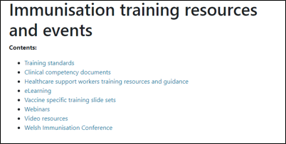
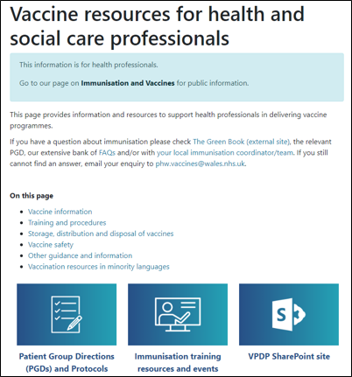
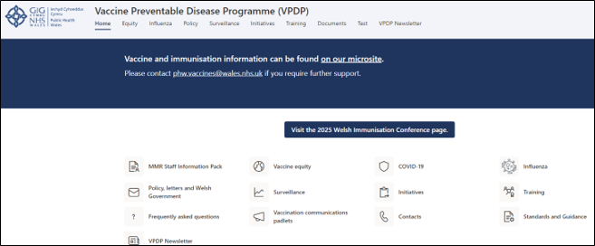
Training resources (1)
Immunisation training resources and events - Public Health Wales
Vaccine resources for health and social care professionals - Public Health Wales
Vaccine Preventable Disease Programme (VPDP) - Home
Notes:
L&L session will be available on SharePoint

Slide 25
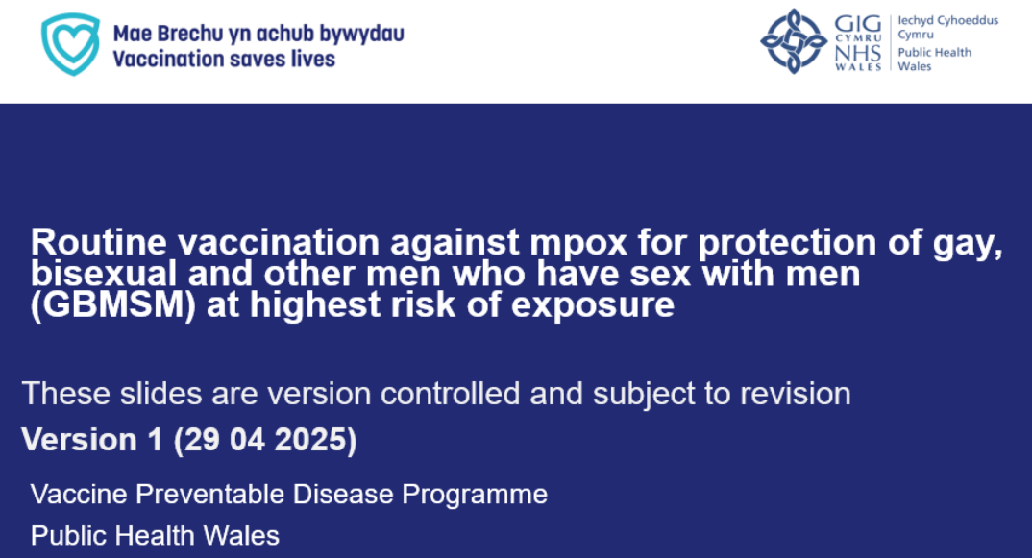
Training resources (2)
Training Slide Sets
The development of slide sets to support training for:
Mpox routine vaccination programme
Routine targeted vaccination programme for the prevention of Gonorrhoea
Immunisation training resources and events - Public Health Wales
Routine targeted vaccination programme for the prevention of gonorrhoea training slides v1.0 are in final development stage awaiting publication of Green Book Chapter

Slide 26

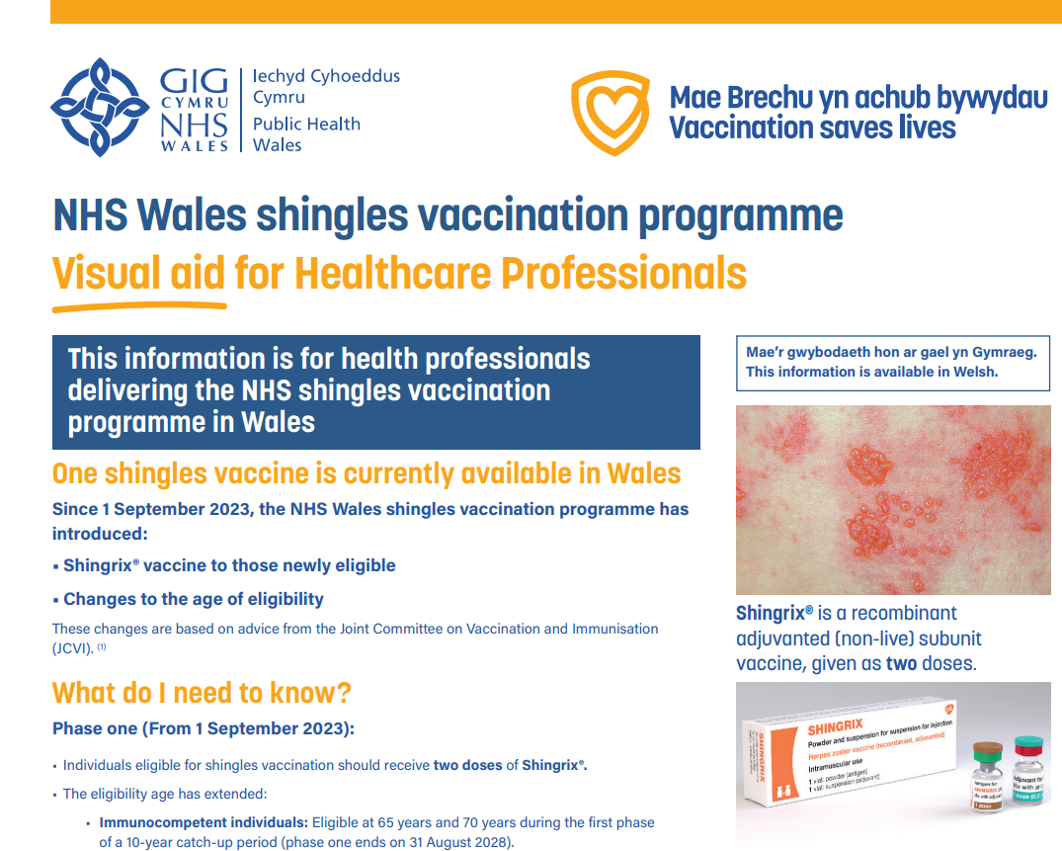



Resources planned to support you:
Bilingual patient information leaflet
Bilingual clinic poster
Visual aid
Resource example
Resource example
Bilingual vaccine record card

Slide 27
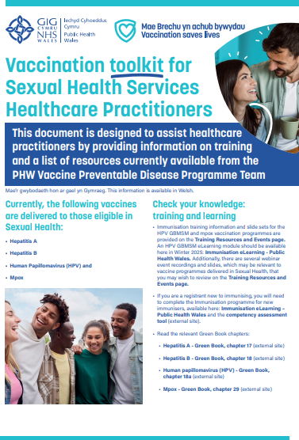
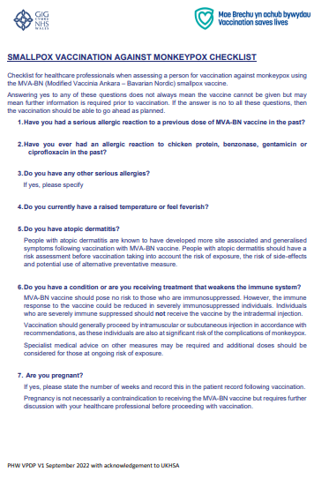
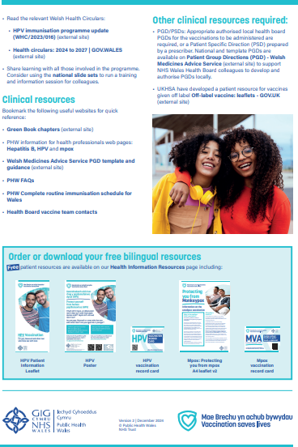
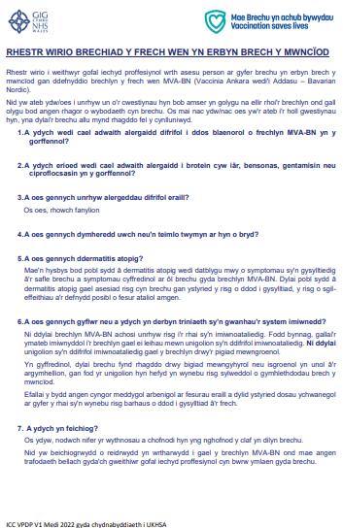
Resources to support you:
Bilingual Sexual Health Toolkit
Bilingual smallpox/mpox vaccination checklist
Currently being updated
Currently being updated

Slide 28
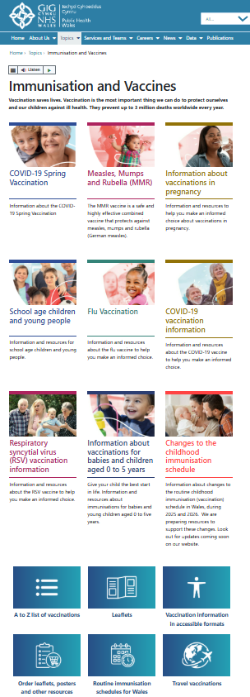
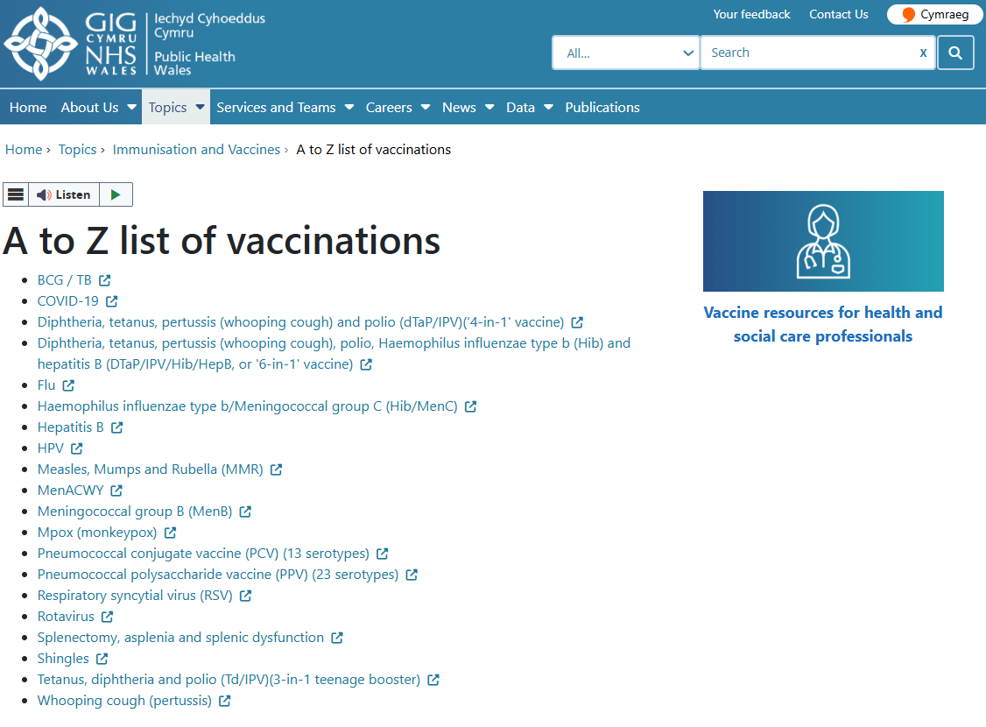
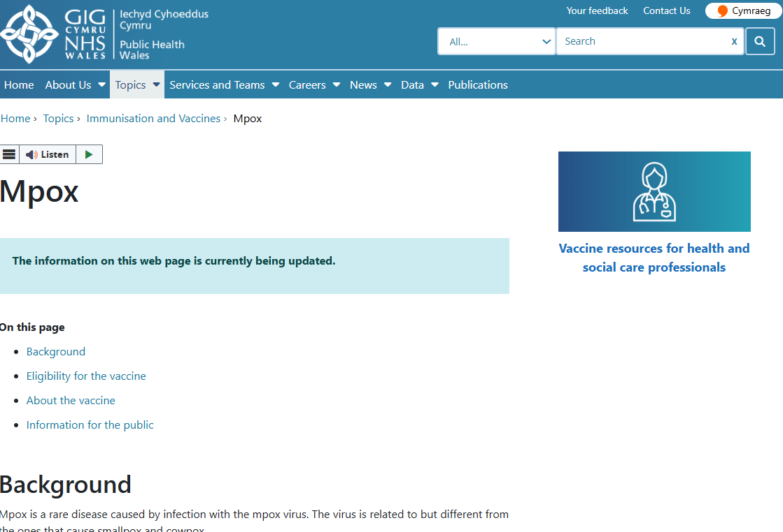
Public Health Wales Website (Public)
Immunisation and Vaccines - Public Health Wales

Slide 29
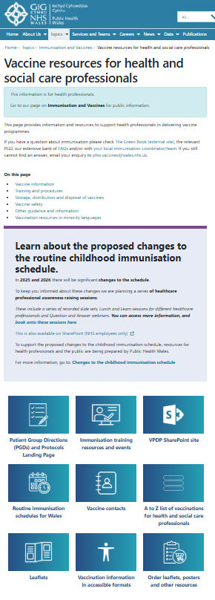
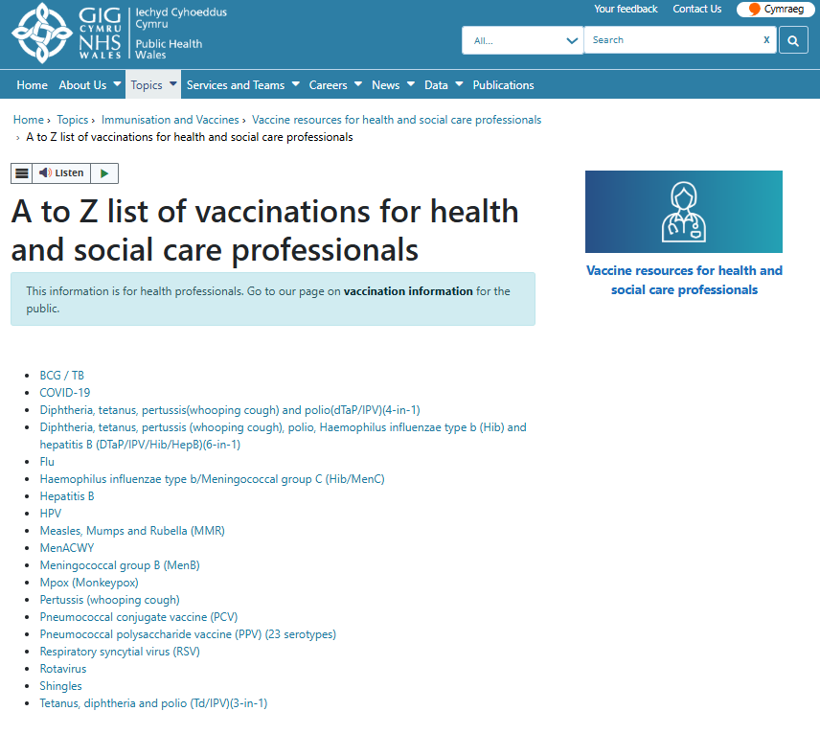
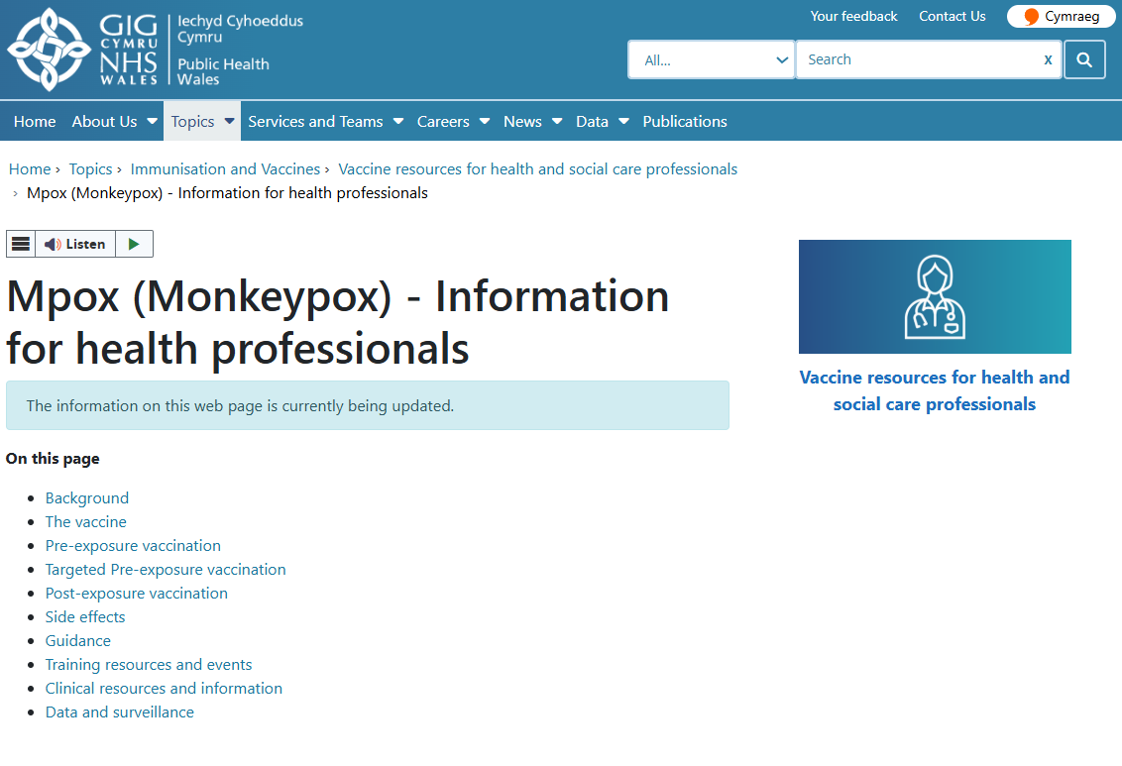
Public Health Wales Website (Healthcare Professional)
Vaccine resources for health and social care professionals - Public Health Wales

Slide 30
Vaccination codes
For mpox and gonorrhoea

Slide 31
Sexual health system codes
All local sexual health systems should have updated vaccination codes for both mpox and gonorrhoea, these are listed below:
MPOX Vaccination Codes | MPOX Vaccination Codes Description
MPVD1 | MPOX Vaccination: 1st Dose
MPVD2 | MPOX Vaccination: 2nd Dose
MPVD3 | MPOX Vaccination: 3rd Dose
MPVDD | MPOX Vaccination Declined
MPVDP | MPOX previously vaccinated (fully)
Gono Vaccination Codes | Gono Vaccination Codes Description
MENBVD1 | 1st dose of MenB vaccination
MENBVD2 | 2nd dose of MenB vaccination
MENBVDD | MenB offered and declined vaccine
MENBVDC | MenB vaccine contraindicated
MENBVDP | MenB previously vaccinated

Slide 32
Who can I contact if I have questions?

Slide 33
Contacts
In the first instance, please contact your local vaccine health board contact. They should be able to help you.
Vaccine contacts - Public Health Wales
Contact the Vaccine Preventable Disease Programme at phw.vaccines@wales.nhs.uk

Slide 34

Further information
Green Book Gonorrhoea Chapter: Gonorrhoea: the green book chapter - GOV.UK
Green Book Smallpox and mpox Chapter 29: Smallpox and mpox: the green book, chapter 29 - GOV.UK
All relevant PGDs will be published/updated: Patient Group Directions (PGD) - Welsh Medicines Advice Service

Slide 35
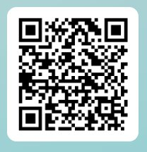
Evaluation
Lunch and Learn Feedback

Slide 36
Over to you. Do you have any questions?

