Slide 1
Human papillomavirus (HPV) vaccination
Universal HPV adolescent immunisation programme
Vaccine Preventable Disease Programme
Public Health Wales
November 2024 Version 2
Notes:
Material contained in this document may be reproduced without prior permission provided it is done so accurately and is not used in a misleading context.
© 2024 Public Health Wales NHS Trust.
Rationale for resource
This resource is designed to support practitioners and registered healthcare practitioners (including vaccinators) involved in the delivery of the HPV vaccination programme in Wales.
This resource does not cover the actual administration techniques involved in vaccination against HPV. If staff are required to deliver vaccinations, they should refer to their line manager for alternative training.
Please note: These educational resources continue to be updated as required to support this programme but do not replace the clinical judgement of practitioners. Practitioners should refer to the Green Book (maintained and updated by UK Health Security Agency) when administering the vaccine. Immunisation against infectious diseases: Human papillomavirus (HPV) 18a: Human papillomavirus (HPV): the green book, chapter 18a - GOV.UK (www.gov.uk)
Version 2 – The content of this training slide set is subject to review, This resource will be version controlled.
This is version 2 November 2024. Version 2 includes amendments to format and content to reflect changes to programme in Wales and improve flow of slides.

Slide 2
Vaccination against Human Papillomavirus (HPV)
The information contained within this slide set is up to date as of November 2024.
It is important that all immunisers delivering the HPV* vaccination programme and/or those who are providing immunisation advice familiarise themselves with the most up to date clinical evidence and guidance, this can be found in the following key documents.
HPV: the green book, chapter 28a: https://www.gov.uk/government/publications/human-papillomavirus-hpv-the-green-book-chapter-18a
UKHSA HPV vaccination: guidance for healthcare professionals: https://www.gov.uk/government/publications/hpv-universal-vaccination-guidance-for-health-professionals
HPV vaccination programme microsite page is available here: https://phw.nhs.wales/topics/immunisation-and-vaccines/vaccine-resources-for-health-and-social-care-professionals/hpv/
The content of this training slide set is subject to review. This resource will be version controlled. This is version 2, November 2024.
Notes:
*Note: For the purpose of this resource Human Papillomavirus will be referred to as HPV and both men who have sex with men (MSM) and gay, bisexual and other men who have sex with men (GBMSM) will be used interchangeably as required in line with reference to related policy.

Slide 3
Acknowledgements
Vaccine Preventable Disease Programme (VPDP), Public Health Wales Immunisation and Vaccines - Public Health Wales
UK Health Security Agency www.gov.uk/government/topics/public-health
Public Health Scotland www.publichealthscotland.scot/

Slide 4
Contents
Section | Slide number
Aims | 5
Objectives | 6
What is human papillomavirus (HPV)? | 7
Disease control | 10
HPV vaccine | 19
Epidemiology | 31
Engagement insights | 41
Summary & resources | 44

Slide 5
Aims
To provide information for healthcare practitioners involved in advising on and delivering the HPV vaccination programme
To raise awareness of the current epidemiology of HPV and the impact on adolescents
To describe the vaccination programme details including administration of the vaccine, eligibility, recommended dosage and schedule, contraindications, precautions and potential adverse reactions
To raise awareness of the impact of the HPV vaccination programme
To highlight resources that support the HPV vaccination programme

Slide 6
Objectives
After completing this resource immunisers will be able to:
Describe the aetiology and epidemiology of HPV
Understand the rationale and evidence base for the HPV vaccination programme
Discuss the benefits of vaccination against HPV
Gain essential knowledge to administer the vaccine safely
Identify relevant resources and additional information in relation to the HPV vaccination programme

Slide 7
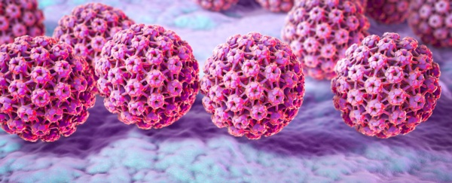
What is human papillomavirus (HPV)?
HPVs are a large group of related viruses. Each virus in the group is given a number, which is called an HPV type
There are over 150 types of HPV
HPV infections are often asymptomatic
Persistent infection with high-risk HPV types such as HPV16 and HPV18 can lead to cancer – most notably cervical cancer in women as well as cancer of the anus, oropharyngeal and the penis
Other types of HPV such as HPV6 and HPV11 cause genital warts and laryngeal papillomas
Image source: PHW 2022
Notes:
Human Papillomavirus Genomics: Past, Present and Future | Human PapillomavirusBench to Bedside | Books Gateway | Karger Publishers

Slide 8
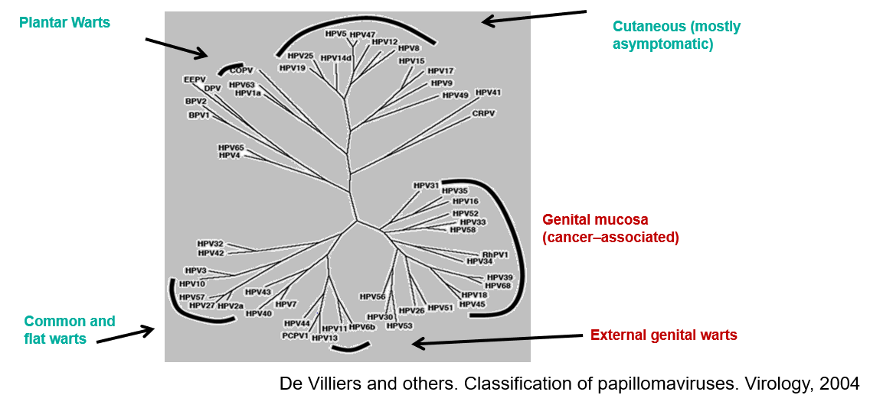
HPV Genotypes

Slide 9
Carriage, transmission, infectivity and incubation of HPV
HPV is spread by skin-to-skin contact including, but not limited to, sexual activity
HPV is a very common virus and around 80% of people will come into contact with the virus at some point in their lives
HPV can resolve spontaneously:
  70% new high-risk infections clear within a year
  90% new infections clear within 2 years
Infection of genital HPV usually occurs after sexual debut and almost 40% of women are infected within two years.
The risk of acquiring HPV infection increases with the number of previous sexual partners, introduction of a new sexual partner, and sexual history of partners
Non-sexual routes of HPV transmission include vertical transmission from mother to newborn baby through contact with a mother’s infected vaginal canal during childbirth
Notes:
It is estimated that around 8 out of 10 people will be infected with HPV at some point in their lives. Most people never know they are infected – HPV infections are typically asymptomatic and most of the time the body clears the infection without it causing any problems. The average length of an infection is around 8 months but for 10% women, infection can last longer than 2 years. It is this group of women who are at increased risk of developing cervical cancer. It usually takes 15–20 years for cervical cancer to develop after HPV infection.
Persistent infection with high risk HPV types can cause abnormal cells to develop which can lead to cancer.
The transmission of genital HPVs are primarily by sexual contact with an infected partner, particularly through sexual intercourse but also by non-penetrative genital contact, including oral sex.

Slide 10
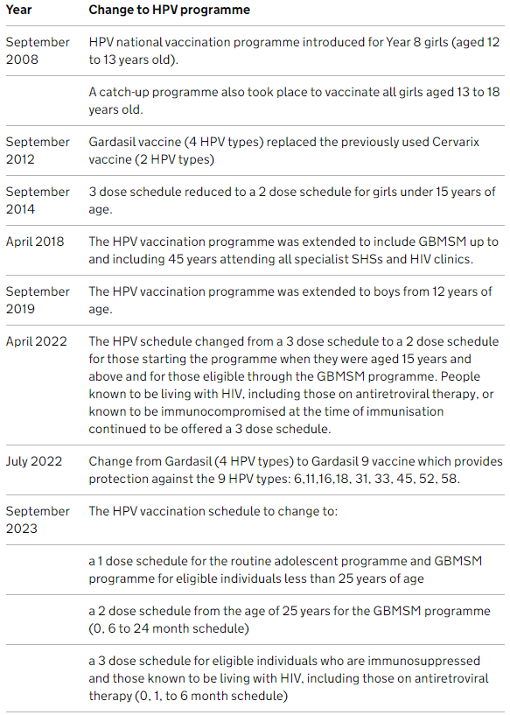
History of the HPV vaccination programme
More than 100 million people have been vaccinated worldwide, in over 113 countries around the world including the USA, Australia, Canada and most of Western Europe
In the UK since the start of the programme in 2008, more than 10 million doses of HPV vaccine have been given
Vaccine coverage has been around 80% in women aged 15 to 24 years in Wales, meaning most have been given the vaccine
In time it is expected that the vaccine will save hundreds of lives every year in the UK
Notes:
Welsh policy is available online from Policy, letters and Welsh Government
COVER - National childhood immunisation uptake data - Public Health Wales (nhs.wales)
HPV Vaccine (Human Papillomavirus Vaccine) | Vaccine Knowledge Project
HPV vaccination: guidance for healthcare practitioners - GOV.UK (www.gov.uk)

Slide 11
One dose routine HPV vaccination programme
In April 2022 Meeting of the Strategic Advisory Group of Experts on Immunisation, review concluded that a single dose HPV vaccine delivers solid protection against HPV to immunocompetent individuals under 25 years of age, that is comparable to a 2-dose schedule
In August 2022, JCVI published a statement on a recommended one-dose schedule for the routine HPV immunisation programme based on:
  Trial and non-trial evidence shows that initial vaccine efficacy from one dose is very high and likely comparable to that from 2 doses
  Long duration of protection already seen is associated with a level of antibody that is steady – it is not biologically likely that the antibody level would suddenly fall in the next few years after being sustained for more than 10 years
  The one-dose antibody level is associated with high efficacy against persistent infection of HPV vaccine types
Notes:
Meeting of the Strategic Advisory Group of Experts on Immunization, April 2022: conclusions and recommendations (who.int)
https://www.who.int/publications/i/item/who-wer9724-261-276
JCVI statement on one-dose HPV routine programme, August 2022: https://www.gov.uk/government/publications/single-dose-of-hpv-vaccine-jcvi-concluding-advice/jcvi-statement-on-a-one-dose-schedule-for-the-routine-hpv-immunisation-programme
JCVI interim statement HPV one dose February 2022: https://www.gov.uk/government/publications/single-dose-of-hpv-vaccine-jcvi-interim-advice

Slide 12
The World Health Organisation (WHO) cancer elimination strategy
The WHO global strategy proposes that the following 90-70-90 targets must be met by 2030 for countries to be on track towards the elimination of cervical cancer in the next century:
  90% of girls fully vaccinated with HPV vaccine by age 15 years
  70% of women are screened with a high-performance test by 35 years of age and 45 years of age
  90% of women identified with cervical disease receive treatment - (90% of women with precancer treated, and 90% of women with invasive cancer managed)
Notes:
Although the global strategy 90% target for vaccine uptake at 15 years is for girls only, the 90% target for Wales also includes boys.
Global strategy to accelerate the elimination of cervical cancer as a public health problem (who.int)
HPV immunisation programme update (WHC/2023/016) | GOV.WALES

Slide 13
HPV vaccination in Wales
In May 2023 Welsh Government issued a Welsh Health Circular (WHC), which:
Instructed the move to one dose of the HPV vaccine in Wales. Since 1 September 2023 doses required by individuals eligible for HPV vaccination are offered as below:
  1-dose schedule for the routine adolescent programme*, those eligible for catch up and GBMSM programme before 25th birthday
  2-dose schedule from the age of 25 in the GBMSM programme
  3-dose schedule for individuals who are immunosuppressed and those known to be HIV-positive
Outlined immunocompetent adolescents and eligible adults (including GBMSM) under 25 years of age who have received 1 dose of HPV vaccine as fully vaccinated. Since 1 September 2023 this group are considered as not needing any additional doses
Included an uptake target of 90% for the adolescent HPV vaccination programme (based on WHO targets), for both boys and girls
Advised that Welsh health boards should focus on strengthening programme delivery
Notes:
*Catch up for the routine adolescent programme is up to the age of 25 for: girls born after 1 September 1991; and boys born on or after 1 September 2006. Therefore, those eligible for catch up in the routine programme will also only require one dose.
Before the change occurred on 1 September 2023 some parents, young people and GBMSM under 25 years of age may have consented to a 2-dose HPV schedule and may have an expectation for offer of two doses to be honoured.
There needs to be ongoing clear communication that the JCVI have advised that the evidence now shows that only 1 dose of HPV vaccine is needed for these groups to give a high level of protection.
HPV immunisation programme update (WHC/2023/016) | GOV.WALES

Slide 14
HPV and cervical cancer
The lifetime risk of cervical cancer in unvaccinated cohorts is 1 in 142
Persistent infection by high-risk HPV types is detectable in more than 99% of all cervical cancers.
High-risk types of HPV can cause changes in the cells of the cervix. These cell changes are called cervical intraepithelial neoplasia (CIN). In some cases cell changes can go back to normal, but sometimes they can get worse and become cervical cancer.
Cervical cancer is the fourth most common cancer in women globally with around 660,000 new cases and around 350,000 deaths in 2022
Notes:
https://www.gov.uk/government/publications/human-papillomavirus-hpv-the-green-book-chapter-18a
https://phw.nhs.wales/services-and-teams/screening/cervical-screening-wales/about-cervical-screening/about-human-papillomavirus-hpv/

Slide 15
Other HPV associated cancers
HPV is also associated with:
  anal and cervical cancers (more than 90%)
  vaginal and vulvar cancers (about 70%)
  oropharyngeal cancers (70%)
  penile cancers (more than 60%)
Cancer Research UK (CRUK) suggests that the proportion of cancer cases linked to HPV is rising and that in Europe:
  73% of oropharyngeal cancer cases are HPV positive
  12% of oral cavity, hypopharynx and larynx cancer cases are HPV positive
  laryngeal squamous cell carcinoma (SCC) risk is 5.4 times higher in people with HPV infection
  the cancer risk for oropharyngeal, tonsil, and base of tongue is higher in people with more past sexual partners, people who started having sex at a younger age, and men who have ever had sexual contact with men
Notes:
In recent years there has been an increase of HPV positive oropharyngeal cancer and it is being seen in younger people aged between 40 and 50 years, who do not smoke. 1 in 55 men and 1 in 108 women will be diagnosed with oral cancer at some point in their life.
www.ncbi.nlm.nih.gov/pmc/articles/PMC4830161/
www.cancerresearchuk.org/about-cancer/causes-of-cancer/infections-eg-hpv-and-cancer/does-hpv-cause-cancer?_ga=2.107067074.1715641418.1562227587-1516946824.1550596213
www.cancerresearchuk.org/health-professional/cancer-statistics/statistics-by-cancer-type/head-and-neck-cancers/risk-factors#ref-10

Slide 16
Eligible groups
The purpose of the HPV vaccination programme is to actively offer vaccination to:
Adolescents aged 12 to 13 years (School Year 8) - eligible girls and boys (eligible boys born on or after 01/09/2006) can continue to be caught up until their 25th birthday
Gay, bisexual, and other men who have sex with men (GBMSM) up to and including 45 years of age attending Specialist Sexual Health Services and/or HIV clinics regardless of risk, sexual behaviour or disease status
Immunocompromised and HIV positive individuals
Individuals with a similar risk profile to that seen in the GBMSM population who may benefit from vaccination, including GBMSM over 45 years of age and transgender individuals, HPV vaccine may be considered on a case-by-case basis*
Notes:
HPV vaccination status on the Children and Young Persons Integrated System (CYPriS) and GP records should be used to ensure eligible individuals who are not up to date are caught up before their 25th birthday
The vaccine is recommended for:
all adolescents aged 12 – 13 years / in school Year 8
GBMSM up to and including 45 years of age, attending Specialist Sexual Health Services and/or HIV clinics, regardless of risk, sexual behaviour or disease status.
Non–eligible individuals requesting vaccine should be assessed on case-by-case basis. Clinicians are able to offer vaccinations outside of the national programme using individual clinical judgement, however in these instances, vaccine should be purchased directly from the manufacturer.
Other individuals with a similar risk profile to that seen in the 16 – 45 year old GBMSM population may also benefit from vaccination.
Clinical FAQs are available here: https://nhswales365.sharepoint.com/sites/PHW_VPDPComms/SitePages/Frequently-asked-questions.aspx (NHS intranet only)
*Can be offered following a clinical assessment of the patient. Vaccines should be purchased from the manufacturer or pharmaceutical wholesaler in this instance.

Slide 17
Immunosuppression and HIV infection
Evidence suggests individuals living with HIV are at increased risk of acquiring HPV and persistent infection, as well as frequent carriage of multiple types of HPV and increased risk of HPV related rapidly progressive malignancies
HPV vaccines are known to be safe and immunogenic for individuals infected with HIV although the immune response and its effectiveness may be less than that observed among those who are not HIV infected
Individuals known to be immunocompromised or who are positive for Human Immunodeficiency Virus (HIV) at the time of vaccination should be offered a 3-dose course of vaccine – please refer to HPV dosage and schedule slides for additional information
Notes:
There is no data on fewer than 3 doses among HIV positive or immunocompromised populations. Therefore a 3-dose schedule should still be offered to individuals who are known to be HIV positive, including those on antiretroviral therapy, or are known to be immunocompromised at the time of immunisation.
Green Book Chapter 18a for details
www.gov.uk/government/publications/human-papillomavirus-hpv-the-green-book-chapter-18a

Slide 18
Pre-requisites to administering HPV vaccine
Before administering HPV vaccine, it is recommended you have:
Undertaken training in the management of anaphylaxis and Basic Life Support as specified by policy for your local area and are familiar with Resuscitation Council UK (RCUK) guidance on Management of Anaphylaxis in the Vaccination Setting
Undertaken any additional statutory and mandatory training as required by your employer
Received HPV vaccine training through attending a taught session if you are a new immuniser a competency assessment is recommended - competency assessment tool: Publications | Royal College of Nursing (rcn.org.uk)
An appropriate legal framework to supply and administer HPV vaccine in place e.g. patient specific prescription, Patient Specific Direction (PSD), Patient Group Direction (PGD)
Described the process of consent and how this applies when giving vaccines
Accessed and familiarised yourself with the following key documents: Human papillomavirus (HPV): the green book, chapter 18a - GOV.UK (www.gov.uk) and the UK Health Security Agency UKHSA HPV vaccination: guidance for healthcare practitioners
Human papillomavirus (HPV) vaccination
18
Notes:
Practitioners should always ensure they are accessing the most up to date information and guidance

Slide 19
HPV Vaccine
Made from the proteins of the outer coat of the virus types
These proteins assemble into small spheres that are called virus-like particles (VLPs) which are very immunogenic and induce high levels of antibody production
VLPs are not infectious and cannot cause HPV-associated cancers or genital warts as they do not contain the virus’s DNA
Upon subsequent exposure to the live virus, the immune system reacts quickly to prevent infection
An adjuvant (aluminium hydroxyphosphate sulfate) is added to increase the immune response made
Clinical trials show very high efficacy and well tolerated:
  over 99% effective at preventing pre-cancerous lesions associated with HPV types 16 and 18. Gardasil 9 offers protection against 5 additional types of HPV (31, 33, 45, 52, 58) which although less common than types 16 and 18, are also considered high-risk
  99% effective at preventing genital warts associated with vaccine types in young women
Notes:
Gardasil vaccine is made from the proteins that make up the outer coat of the virus types. These proteins assemble into small spheres that are called virus-like particles (VLPs). VLPs are not infectious and cannot cause HPV-associated cancers or genital warts as they do not contain the virus’s DNA. VLPs are however very immunogenic, which means that they induce high levels of antibody production by the body.
(Green Book Chapter 18a HPV)
In clinical trials in young women with no previous history of HPV infection, vaccine was 99% effective at preventing pre-cancerous lesions associated with HPV types 16 and 18.
Gardasil is also 99% effective at preventing genital warts associated with vaccine types in young women.
A clinical trial of Gardasil in men indicated that it can prevent anal cell changes caused by persistent infection, and genital warts.
HPV vaccines have not been shown to have an impact on an existing infection or any of the outcomes of an existing HPV infection, such as anogenital warts but may boost immunity and prevent re-infection or reduce reoccurrences in people with previously treated high-grade anal intraepithelial neoplasia.
Swedish KA, Factor SH, Goldstone SE. Prevention of recurrent high-grade analneoplasia with quadrivalent human papillomavirus vaccination of men who have sexwith men: a nonconcurrent cohort study. Clin Infect Dis. 2012;54:891-8.Available at www.ncbi.nlm.nih.gov/pubmed/22291111

Slide 20
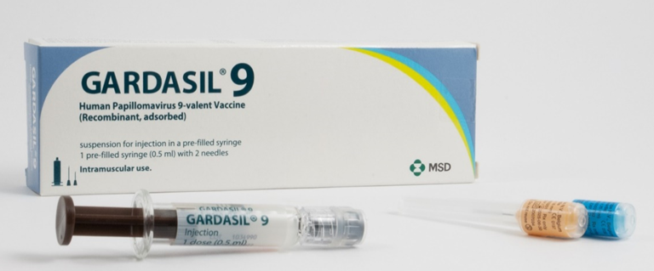
Gardasil ® 9
Full product name: Gardasil ® 9
HPV types 6, 11, 16, 18, 31, 33, 45, 52, 58
Marketed by: MSD
Type of vaccine: Recombinant, adsorbed
Licensed for use in children from 9 years of age, adolescents and adults
Image courtesy of UKHSA
Notes:
Gardasil®9 is the recommended vaccine for the HPV vaccination programme and is the only market authorised 9 valent HPV vaccine in the UK.
Gardasil 9 provides protection against 9 HPV strains: HPV-16 and HPV-18, the two high risk types that can lead to cancer, and HPV-6 and HPV-11, the two types that cause approximately 90 per cent of all anogenital warts in males and females, and HPV 31, 33, 45, 52, 58.
The additional Types 31, 33, 45, 52, 58 although less common than types 16 and 18, are also considered high-risk HPV types.
Gardasil 9 is expected to prevent the majority of cervical, vaginal and vulvar cancers and premalignant lesions, as well as genital warts associated with HPV
The vaccine is approved for use in females and males aged from 9 years of age.
Gardasil 9 SmPC: https://www.medicines.org.uk/emc/product/7330/smpc

Slide 21
Preparation and administration of Gardasil ® 9
Gardasil ® 9 is available for injection in a pre-filled syringe
Shake syringe well before use to form a cloudy white suspension
Discard the vaccine if particulates are present and/or it appears discoloured
Select the appropriate needle length to ensure an intramuscular (IM) administration depending on the patient's size and weight (refer to Green Book -Chapter 4 – immunisation procedures )
Attach the needle by twisting in a clockwise direction until the needle fits securely onto the syringe
Administer the entire 0.5ml dose as per standard protocol, preferably into the deltoid muscle of the arm
The vaccine can be given at the same time as other national schedule vaccines
Notes:
Healthcare professionals are encouraged to read the Summary of Product Characteristics (SmPC) to ensure accurate reconstitution and delivery of the product.
A small air bubble may be visible in the prefilled syringe. This is not harmful and should not be removed prior to administration. This small bolus of air injected following administration of medication clears the needle and prevents a localised reaction from the vaccination. To try to expel it risks accidently expelling some of the vaccine and therefore not giving the patient the full dose.
HPV vaccine can be given at same time as other vaccines. The vaccines should be given at a separate site, preferably in a different limb. The sites at which each vaccine was given should be noted in the individual’s health records.
Human papillomavirus (HPV): the green book, chapter 18a - GOV.UK (www.gov.uk)
Gardasil 9 suspension for injection - Summary of Product Characteristics (SmPC) - (emc) (medicines.org.uk)

Slide 22
Legal authorisation
Gardasil 9 is a prescription only medicines and should only be administered using one of the following:
  prescription written manually or electronically by a registered medical practitioner or other authorised prescriber
  patient specific direction (PSD)
  patient group direction (PGD)
The use of a one-dose schedule of Gardasil® 9 is off-label however, it is in accordance with national recommendations by JCVI and the Green Book, Chapter 18a: HPV
In line with advice from the Medicines & Healthcare products Regulatory Agency (MHRA), where authoritative advice and current practices supports the use of a medicine outside the terms of its license, it is not always necessary to draw attention to this when seeking consent
Notes:
PGD templates: https://phw.nhs.wales/topics/immunisation-and-vaccines/vaccine-resources-for-health-and-social-care-professionals/patient-group-directions-pgds-and-protocols-landing-page/

Slide 23
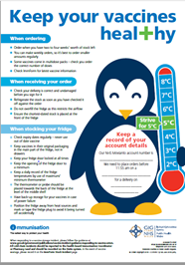
Ordering & Storage of Gardasil ® 9
There are separate order lines for the adolescent and GBMSM HPV programmes on ImmForm
Store between +2 and +8ºC
keep in original packaging
Protect from light
Use as soon as possible after removing from fridge
Effectiveness cannot be guaranteed for vaccines unless the cold chain has been maintained, and vaccine has been monitored as per national recommendations
Refer to local policy on vaccine storage and handling
Notes:
Vaccine is centrally procured for the adolescent and GBMSM HPV vaccination programme. Gardasil9 should be ordered using current processes.
It is recommended that registered healthcare practitioners place small and regular orders rather than over-ordering or stockpiling vaccines.
Gardasil® 9 should be administered as soon as possible after being removed from the refrigerator
Data from stability studies indicate that the Gardasil®9 vaccine components are stable for 96 hours when stored at temperatures from +8°C to +40°C or for 72 hours when stored at temperatures from 0°C to +2°C. At the end of this period Gardasil®9 should be used or discarded. These data are intended to guide healthcare professionals in case of temporary temperature excursion only.
The vaccine should be stored in the original packaging. This makes it easy to identify in the vaccine fridge, provides some protection against fluctuation of temperature and will protect from light.
Vaccines are expensive and it is important to minimise wastage through inappropriate storage.
Further information on the storage and handling of vaccines is included in chapter 3 of the green book.
www.gov.uk/government/publications/storage-distribution-and-disposal-of-vaccines-the-green-book-chapter-3

Slide 24
Vaccine stock management
It is recommended that all providers should:
  review available fridge space to ensure adequate storage capacity before ordering new vaccine
  ensure that there is enough stock for 2 to 4 weeks of use and not over order
  have local protocols in place to reduce vaccine wastage to a minimum and protect vaccines in the event of a cold chain incident
  report any cold chain failures or vaccine wastage in line with local policy and through the ImmForm website on the stock incident page
Small percentage reductions in vaccine wastage have a major impact on the financing of vaccine supplies
Notes:
Effective management of vaccines throughout the supply chain is essential to reduce vaccine wastage and it is recommended that healthcare professionals order only what they need for a 2-4 week period rather than over-ordering or stockpiling vaccines.
Providers should review available fridge space to ensure adequate storage capacity before ordering and the delivery of vaccine.
All providers should have emergency vaccine storage and handling plans which clearly outline the actions to take in the event of out of range temperature excursions or refrigerator break down.
Cold chain failures must be documented and reported through the ImmForm website on the stock incident page.
Green Book Chapter 3: https://www.gov.uk/government/publications/storage-distribution-and-disposal-of-vaccines-the-green-book-chapter-3
ImmForm website: https://portal.immform.phe.gov.uk/Logon.aspx?returnurl=%2f

Slide 25
Contraindications
Gardasil ® 9 should not be administered to those who have had:
  A confirmed anaphylaxis to a previous dose of the vaccine
  A confirmed anaphylaxis to any constituent or excipient of the vaccine
Please note: Yeast allergy is not a contraindication to the HPV vaccine. Gardasil ® 9 is grown in yeast cells, however the final vaccine product does not contain any yeast
Notes:
There are very few individuals who cannot receive HPV vaccines. Where there is doubt, instead of withholding immunisation, appropriate advice should be sought from the local Immunisation Coordinator.
A mild fever or upper respiratory infection (for example cold) itself is not a reason to delay vaccination.
If acutely unwell, the immunisation may be deferred until the individual has recovered – this is to avoid confusing the differential diagnosis of acute illness by wrongly attributing signs or symptoms as adverse effects of the vaccine.
For the composition and full list of excipients of the vaccine, please refer to the manufacturer’s Summary of Product Characteristics (SmPC). Home - electronic medicines compendium (emc)
Please note: These educational resources continue to be updated as required to support this programme but do not replace the clinical judgement of practitioners. Practitioners should refer to the Green Book Chapter when administering the vaccine. Immunisation against infectious diseases: Human papillomavirus (HPV) 18a. https://www.gov.uk/government/publications/human-papillomavirus-hpv-the-green-book-chapter-18a Human papillomavirus (HPV): the green book, chapter 18a - GOV.UK (www.gov.uk)

Slide 26
Precautions and additional information
HPV vaccines can be given at the same time as other vaccines*, please see specific Green book chapter/s for additional advice
Individuals with bleeding disorders may be vaccinated intramuscularly if, in the opinion of a doctor familiar with the individual’s bleeding risk, vaccines or similar small volume intramuscular injections can be administered with reasonable safety by this route
If an individual is acutely unwell, immunisation may be postponed until they have fully recovered to avoid confusing the differential diagnosis of any acute illness by wrongly attributing any signs or symptoms to any possible adverse effects of the vaccine
Notes:
*Where two or more injections need to be administered at the same time, they should be given at separate sites, preferably in a different limb. If more than one injection is to be given in the same limb, they should be administered at least 2.5cm apart. The site at which each injection is given should be noted in the individual’s records Green-Book-Chapter-4.pdf (publishing.service.gov.uk)
Individuals with bleeding disorders may be vaccinated intramuscularly if a doctor familiar with the individual's bleeding risk advises vaccines or similar small volume intramuscular injections can be administered with reasonable safety by this route. If the individual receives medication/treatment to reduce bleeding, for example treatment for haemophilia, intramuscular vaccination can be scheduled shortly after such medication/treatment is administered.
Individuals on stable anticoagulation therapy, including individuals on warfarin who are up to date with their scheduled INR testing and whose latest INR was below the upper threshold of their therapeutic range, can receive intramuscular vaccination. A fine needle (equal to 23 gauge or finer calibre such as 25 gauge) should be used for the vaccination, followed by firm pressure applied to the site (without rubbing) for at least 2 minutes.
If in any doubt, consult with the clinician responsible for prescribing or monitoring the individual’s anticoagulant therapy. See details specific vaccine PGD.

Slide 27
Possible adverse reactions
Possible adverse reactions for Gardasil ® 9 include:
  pain, redness and swelling at the injection site
  headache
  low grade fever
  nausea
  dizziness
These adverse reactions are usually mild or moderate in intensity and short lasting.
Notes:
Gardasil 9 SmPC: https://www.medicines.org.uk/emc/product/7330/smpc

Slide 28
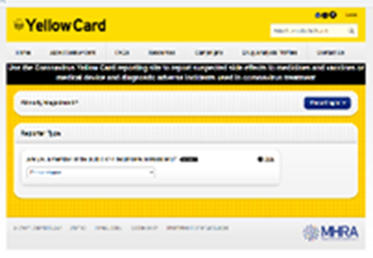
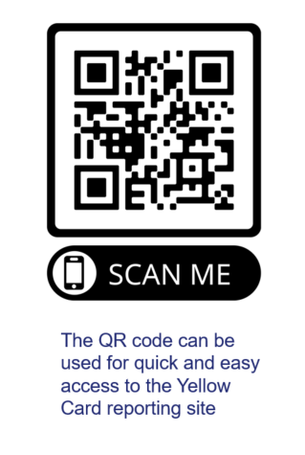
Reporting suspected adverse reactions
Vaccinees should be advised that they can report any adverse reactions or suspected side effects to the MHRA through the online yellow card scheme website or the Yellow Card app
Any suspected side effects following vaccine administration should be reported to the MHRA Yellow Card Scheme.
Anyone can report even if uncertain about whether vaccine caused condition:
  www.mhra.gov.uk/yellowcard or call 0800 731 6789 (9am to 5pm Monday to Friday
  Green Book Chapter 9 for detailed guidance on reporting vaccine reactions
Notes:
Healthcare professionals and patients are encouraged to report suspected adverse reactions to the Medicines and Healthcare Products Regulatory Agency (MHRA) using the yellow card reporting scheme
Green Book chapter 9: https://www.gov.uk/government/publications/surveillance-and-monitoring-for-vaccine-safety-the-green-book-chapter-9

Slide 29
HPV Programme dosage and schedule
From 15 to 24 years of age (unless immunocompromised) | From 25 to 45 years of age (unless immunocompromised) Give at 0 and 6-24 months where possible | From 15 to 45 years of age if HIV+ or have a weakened immune system Give at 0, 1, 4-6 months where possible.
1st dose only required | 1st dose: Initial dose | 1st dose: Initial dose
 | 2nd dose: 6 months* after and within 24 months of initial dose | 2nd dose: 1 month after the initial dose
 |  | 3rd dose: 3 to 5 months** following second dose (All 3 doses within 12 months of initial dose).
Notes:
WHC/2023/016 https://www.gov.wales/hpv-immunisation-programme-update-whc2023016
With regard to any variations, please always consult the latest version of the Green Book chapter online at https://www.gov.uk/government/publications/human-papillomavirus-hpv-the-green-book-chapter-18a Human papillomavirus (HPV): the green book, chapter 18a - GOV.UK (www.gov.uk)
* Whenever possible, immunisations for individuals eligible for the two dose schedule should follow the recommended 0, 6-24 months schedule
For Gardasil 9 the minimum interval between the two doses can be 5 months
Gardasil 9 SmPC
**There is no clinical data on whether the interval between doses two and three can be reduced below three months. Where the second dose is given late and there is a high likelihood that the individual will not return after three months or if, for practical reasons it is not possible to schedule a third dose within this timeframe, then a third dose can be given at least one month after the second dose. This advice applies to all the currently licensed HPV vaccines
For further information see: Human papillomavirus (HPV): the green book, chapter 18a - GOV.UK (www.gov.uk)

Slide 30
HPV vaccine dosage and schedule
Prior infection with one HPV type does not diminish the efficacy of the vaccine against other HPV types included in the vaccine
To get the best protection, it is important the full course of vaccination is received
Booster doses are not currently indicated
Current studies show protection is maintained for at least 10 years although protection is expected to last longer
Long-term follow-up studies are in place to evaluate length of protection and will determine the need for any subsequent boosters
Notes:
No evidence around boosters mentioned in - World Health Organisation: Weekly epidemiological record 16 December 2022 http://apps.who.int/iris/bitstream/handle/10665/365350/WER9750-eng-fre.pdf

Slide 31
Epidemiology: Impact on infection
Evidence from surveillance consistent with:
  very high vaccine effectiveness among those vaccinated
  a substantial herd protection effect with lower HPV 16 and 18 prevalence over time in unvaccinated women.
  studies in the USA and Australia found evidence of indirect protection of unvaccinated females through herd effects (WHO 2022).
  cross-protection – decline in HPV types 31, 33 and 45 in the post-vaccination period
No evidence of non-vaccine type replacement
Similar findings in Scotland, Denmark, Australia and systematic reviews
Notes:
World Health Organisation: Weekly epidemiological record 16 December 2022 http://apps.who.int/iris/bitstream/handle/10665/365350/WER9750-eng-fre.pdf

Slide 32
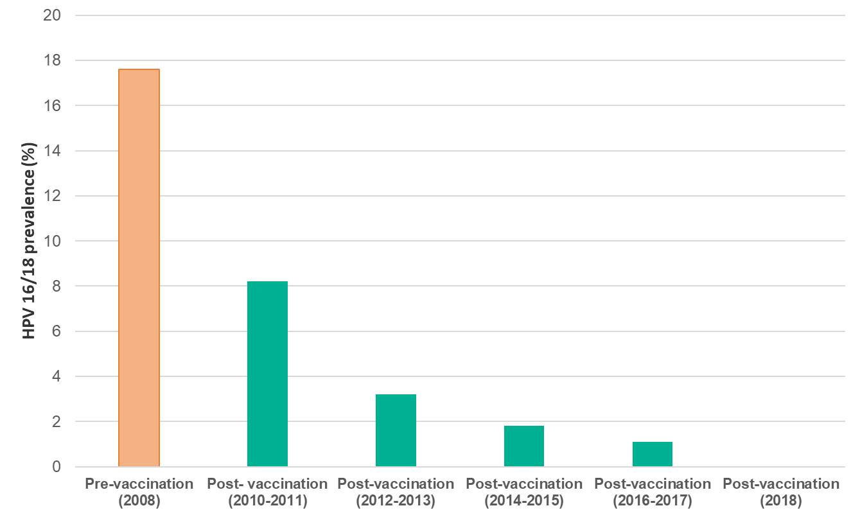
Changes in post-vaccination HPV prevalence in England:
16 to 18 year old females
In studies comparing pre vaccination and post vaccination periods involving more that 60 million individuals, prevalence of HPV16 and HPV18 decreased significantly by 83% among girls aged 13-19 years and by 66% among women aged 20-24 years after 5-8 years of vaccination (WHO 2022).
The prevalence of HPV 16 and/or 18 has decreased within the post-vaccination period from 8.2% in 2010/11 to 1.6% in 2016 (Mesher et al 2018).
In 2018, 10 years after vaccination was introduced, no HPV16/18 infections were detected in 16 to 18 year olds.
Notes:
This figure shows data on HPV 16 AND/OR 18 prevalence in 16-18 year old females, in the post-vaccination period over time, to 2016.
The prevalence of HPV 16 and/or 18 has decreased within the post-vaccination period over time, from 8.2% in 2010 to 1.6% in 2016. These decreases were strongly associated with the increasing estimated vaccination coverage.
World Health Organisation: Weekly epidemiological record 16 December 2022 http://apps.who.int/iris/bitstream/handle/10665/365350/WER9750-eng-fre.pdf
Mesher et al (2018) The Impact of the National HPV Vaccination Programme in England Using the Bivalent HPV Vaccine: Surveillance of Type-Specific HPV in Young Females, 2010-2016. Journal of Infectious Disease. 218 (6), 911-921. https://pubmed.ncbi.nlm.nih.gov/29917082/

Slide 33
Impact on anogenital warts (AGW)
Studies report a number of countries find significant reduction in cases of genital warts following introduction of national HPV vaccination programmes with reductions observed in unvaccinated young men in settings with female- only programmes indicating herd protection (WHO 2022)
Approximately 50,000 new cases of genital warts were diagnosed in sexual health services across England in 2019 (Ratna et al 2021)
  diagnosis rates were highest in young adults under 24
However, the incidence of first episode AGW diagnoses in 15 to 17 year old girls was 84.9% lower in 2021 compared to 2017
  most of whom would have been offered the quadrivalent vaccine (types 6, 11, 16 and 18)
There is also strong evidence of herd protection from the high coverage female programme
In young heterosexual males up to age 24 years there were:
  declines in incidence of AGW similar to same aged females
  the incidence of AGW diagnoses in 15 to 17 year old males was 80% lower in 2021 compared to 2017 (UKHSA 2022)
Notes:
One of the key successes of the programme is that we are seeing strong evidence of herd protection from the high coverage female vaccination programme.
For example, in young heterosexual males up to age 24, we are seeing declines in genital warts incidence that are similar to those seen in same aged females.
World Health Organisation: Weekly epidemiological record 16 December 2022 http://apps.who.int/iris/bitstream/handle/10665/365350/WER9750-eng-fre.pdf
Ratna et al (2021) Sexually transmitted infections and screening for chlamydia in England, 2020. September 2021. Public Health England: London (Referenced in the Green Book Chapter 18a: https://www.gov.uk/government/publications/human-papillomavirus-hpv-the-green-book-chapter-18a)
UK Health Security Agency (UKHSA) (2022). Sexually transmitted infections and screening for chlamydia in
England: 2021 report. Available from: https://www.gov.uk/government/statistics/sexually-transmitted-infections-stis-annual-data-tables/sexually-transmitted-infections-and-screening-for-chlamydia-in-England-2021-report

Slide 34
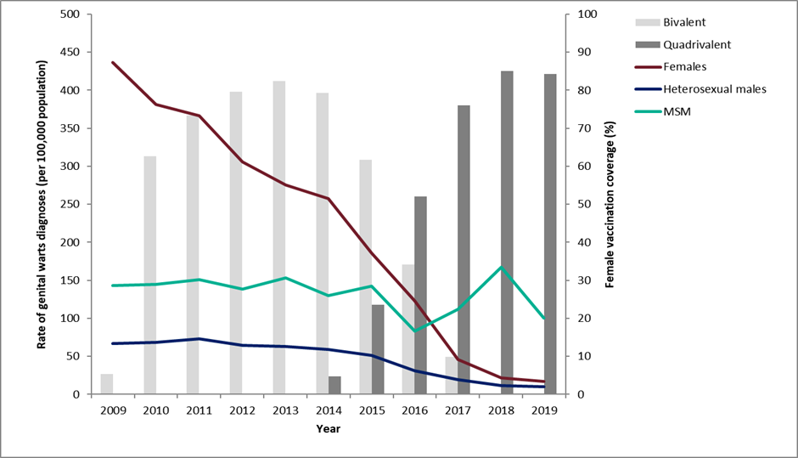
Declines in genital warts diagnoses in England for 15-17 year olds: 2009 to 2020
Notes:
Latest data on declines in GW diagnoses in England.
As reported in latest STI report (https://assets.publishing.service.gov.uk/government/uploads/system/uploads/attachment_data/file/914184/STI_NCSP_report_2019.pdf): In 2019, the rate of genital warts diagnoses among girls aged 15 to 17 years attending SHSs, most of whom would have been offered the quadrivalent HPV vaccine (protecting against HPV types 16,18, 6 and 11) when aged 12 to 13 years old, was 91% lower compared to 2015 (16.9 vs 193.5 per 100,000 population). A decline of 81% (10.0 vs 53.3 per 100,000 population) was seen in same aged heterosexual boys over the same period, suggesting substantial herd protection.

Slide 35
Impact on cervical cancer
In a study published in the Lancet (Falcaro et al 2021), evidence showed that HPV vaccination in England dramatically reduced cervical cancer rates by almost 90% in women in their 20s who were offered vaccine at age 12 to 13.
The HPV immunisation programme has successfully almost eliminated cervical cancer in women born since 1 September 1995
estimates indicate that the HPV vaccination programme has prevented around 450 cervical cancers and 17,200 cases of precancerous conditions over an 11 year period.
Modelling suggests that vaccinated women may only need 3 cervical screens in their lifetime (Landy et al 2018)
Notes:
Falcaro et al (2021) The effects of the national HPV vaccination programme in England, UK, on cervical cancer and grade 3 cervical intraepithelial neoplasia incidence: a register-based observational study. The Lancet, 298; 10316 available at: https://www.thelancet.com/journals/lancet/article/PIIS0140-6736(21)02178-4/fulltext
Landy R, Windridge P, Gillman MS, Sasieni PD. What cervical screening is appropriate for women who have been vaccinated against high risk HPV? A simulation study. Int J Cancer. 2018 Feb 15;142(4):709-718. doi: 10.1002/ijc.31094. Epub 2017 Nov 10. PMID: 29023748; PMCID: PMC5765470. Available at: www.ncbi.nlm.nih.gov/pmc/articles/PMC5765470/

Slide 36
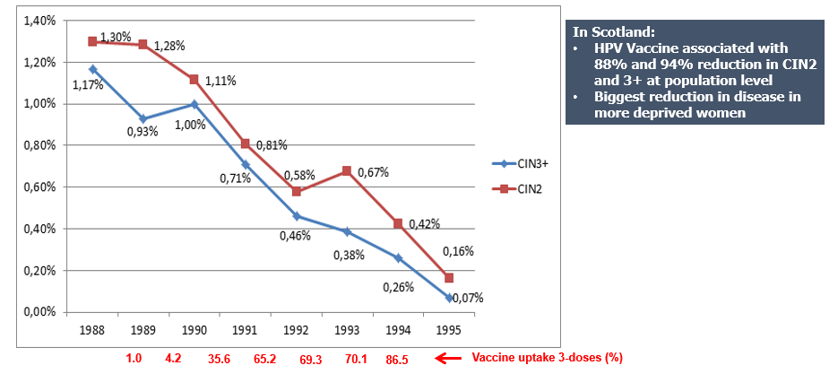
Percentage of 20 year old women diagnosed with CIN 2/CIN 3+ by birth cohort year
Notes:
Pollock KG, Kavanagh K, Potts A et al. Reduction of low- and high-grade cervical abnormalities associated with high uptake of the HPV bivalent vaccine in Scotland. Br J Cancer 2014;111:1824–1830. doi: 10.1038/bjc.2014.479

Slide 37
Dose 1 HPV vaccine coverage by NHS Wales Health Board for the routine female cohort (Year 8) in academic years 2016/17 to 2023/24: Wales
PROVISIONAL
Coverage as reported at the end of the September to August academic year
*Prior to 2018/19, data is given for Cwm Taf University Health Board
**Prior to 2018/19, data is given for Abertawe Bro Morgannwg University Health Board
Notes:
The Coverage of Vaccination Evaluated Rapidly (COVER) reports are available here: https://phw.nhs.wales/topics/immunisation-and-vaccines/cover-national-childhood-immunisation-uptake-data/

Slide 38
Dose 1 HPV vaccine coverage by NHS Wales Health Board for female and male cohorts (Year 8) in academic year 2023/24: Wales
PROVISIONAL
*Coverage as reported at the end of the September to August academic year
Notes:
The Coverage of Vaccination Evaluated Rapidly (COVER) reports are available here: https://phw.nhs.wales/topics/immunisation-and-vaccines/cover-national-childhood-immunisation-uptake-data/

Slide 39
HPV uptake against 90% target
PROVISIONAL
Uptake of HPV vaccine in children reaching 15 years of age between 01/09/23 and 31/08/24 (School Year 10) and resident on 30/09/24:
Boys and Girls
Girls
Notes:
The WHC from May 2023 includes an uptake target for the adolescent HPV vaccination programme: HPV immunisation programme update (WHC/2023/016) | GOV.WALES.(opens in a new tab)
In the WHC the Chief Medical Officer advises that health boards should focus on strengthening programme delivery, striving to achieve 90% uptake by the time individuals reach 15 years of age. This reflects the WHO Global strategy to accelerate the elimination of cervical cancer as a public health problem (who.int).
Although the WHO global strategy 90% target for vaccine uptake at 15 years is for girls only, the 90% target for Wales also includes boys.

Slide 40
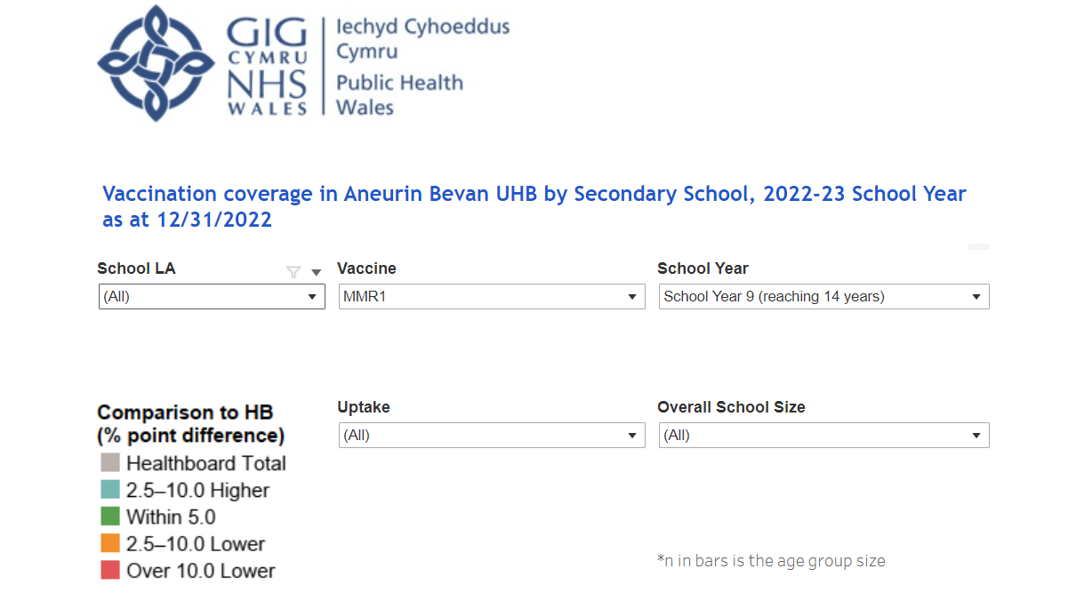
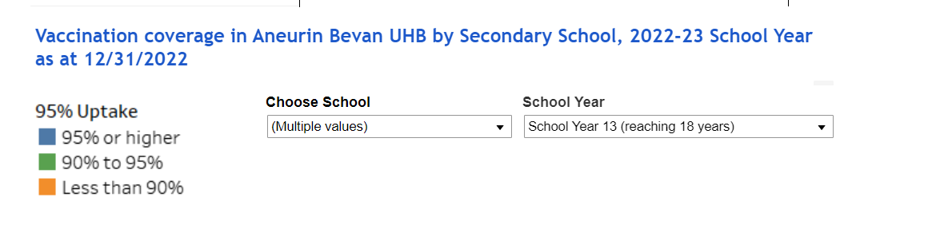
School level data dashboard
In February 2023, school level immunisation data dashboards were made available on SharePoint (NHS intranet only)
The dashboards are health board specific and primary school and secondary school dashboards are separate
The data is based on the most recent quarterly COVER report
It’s an interactive dashboard and can be refined to show:
  specific vaccination uptake by local authority, year group, by vaccine, school size and uptake ranges.
  Individual school level uptake by year group
Notes:
See ‘Quarterly dashboards’ under each health board name here: https://nhswales365.sharepoint.com/sites/PHW_VPDPComms/SitePages/Childhood-Immunisation-(COVER).aspx

Slide 41
Young people vaccine information resources insights - survey
Previous PHW surveys suggested young people would prefer audio-visual vaccination resources (BMG 2022)
Co-designed survey for school-aged young people (11-16) - VPDP colleagues, PHW Behavioural Science Unit, PHW Young Ambassadors
361 participants from localities across Wales
Survey undertaken January - February 2023
Key Survey Findings (2023)
Young people want:
  Vaccine information in school*
  To know how vaccines work
  To address their psychological needs: autonomy, choice, anxiety
  Audio-visual resource: short, funny, upbeat, bright, colourful
  Resources to be age-appropriate; not too simplified; representative of diversity
Notes:
BMG (2022) Attitudes towards COVID-19 and Flu Immunisations among Young People and Parents (nhs.wales)
*Note – not all young people attend school, further exploration required for distribution routes to vulnerable young people e.g. outreach workers
phw.nhs.wales/topics/immunisation-and-vaccines/engagement-insights

Slide 42
HPV Information Resource – Research Findings 2023
To assess vaccine information needs among young people, to inform co-production of resources about the HPV vaccine.
KEY FINDINGS
Attitudes to vaccination are generally positive
Awareness of HPV and the HPV vaccine is very low
Parents are most trusted source to discuss vaccination, then medical professionals and teachers
Parental input is key in decision making
Request for resource content to include: What is HPV, what the HPV vaccine is, the benefits and what it protects from, who can have it, how delivered, number of doses, reassurances about the pain, and potential side effects
Preference for animation resource with an accompanying leaflet to take home to discuss with parents
Animation should be shown in school, with opportunity for follow up questions – school seen as very trustworthy
High levels of mistrust in social media
Notes:
HPV - 2 qualitative focus groups, 1 in-depth interview conducted in Welsh Undertaken Sept 2023 Total 16 participants
Flu – 2 qualitative focus groups
https://phw.nhs.wales/topics/immunisation-and-vaccines/engagement-insights/phw-hpv-information-resource-research-findings-oct23/
Aims:
What questions, barriers or concerns young people have about the HPV/flu vaccine that should be addressed in the resource.
The content, style, format, and length of an audio-visual resource that would appeal to young people.
If young people would access an audio-visual resource for vaccine information.
How young people would want this information to reach them.
To understand where young people would access a resource, including named platforms.

Slide 43

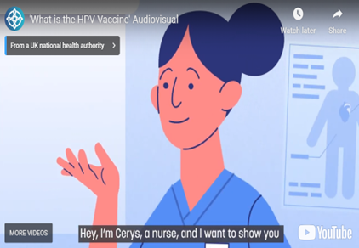
Co-produced resource: HPV animation
  Creative proposal for HPV animation developed based on insights
    To address their psychological needs: autonomy, choice, anxiety
    Audio-visual resource: short, fun, upbeat, bright, colourful, ensure tone reflects importance of vaccination
    Resources to be age-appropriate; not too simplified; representative of diversity
  Young people from focus groups tested animation and gave feedback
  Suggested means for distribution and promotion of resource
  Opportunity to explore vaccine information / education in schools
  Suite of animations for school-age vaccine programmes planned
  Evaluation of resource
What is the HPV Vaccine' Audiovisual (youtube.com)
Notes:
HPV - 2 qualitative focus groups, 1 in-depth interview conducted in Welsh
Flu – 2 qualitative focus groups

Slide 44
Summary
Gardasil ® 9 is the vaccine used in the HPV vaccination programme
HPV vaccination eligibility includes adolescents, GBMSM, immunocompromised and HIV positive individuals, with varying vaccination dosages and schedules
More than 100 million people have been vaccinated worldwide
The Welsh Health Circular (2023) outlines an adolescent vaccination uptake target of 90% for girls and boys
Public Health Wales data collected between 2023-2024 showed a vaccination uptake of 75.6% in Welsh girls and boys reaching 15 years of age
HPV vaccine does not protect against all HPV types so cervical screening is still important and should be carried out according to the local screening programme

Slide 45
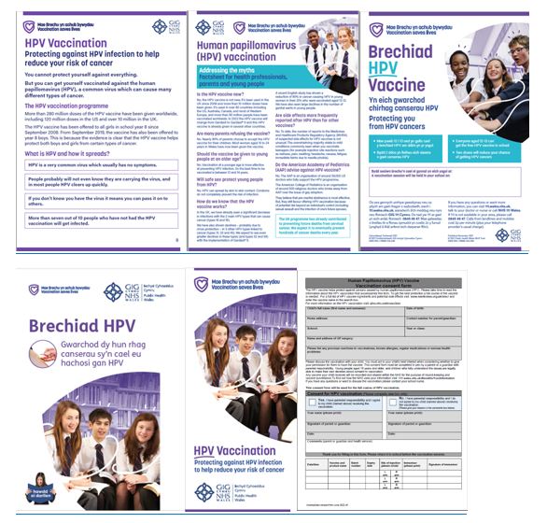
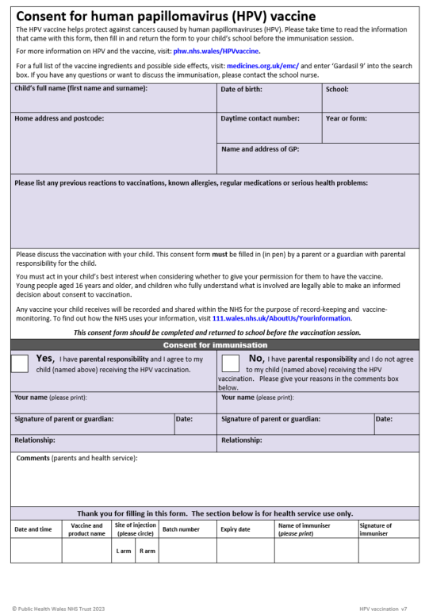
Information materials
A number of public facing resources are already available for the HPV vaccination programme:
Resources can be downloaded from:
  HPV vaccine - Information for health professionals page on the Public Health Wales
  Public Health Wales Asset Library https://phw.brandkitapp.com/
Hard copies of branded resources can be ordered for free from:
  Health Information Resources - Public Health Wales (nhs.wales)
A public information website about HPV is available at:
  www.phw.nhs.wales/HPVvaccine or www.icc.gig.cymru/brechlynnauHPV

Slide 46
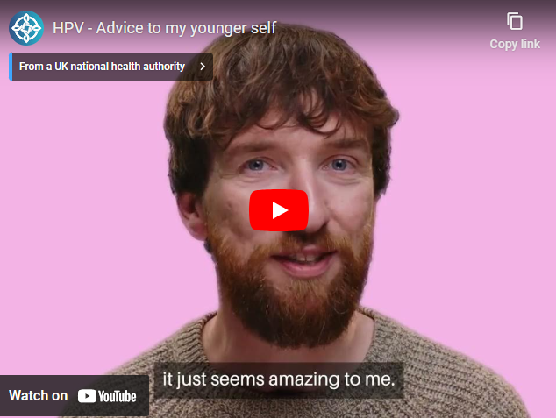
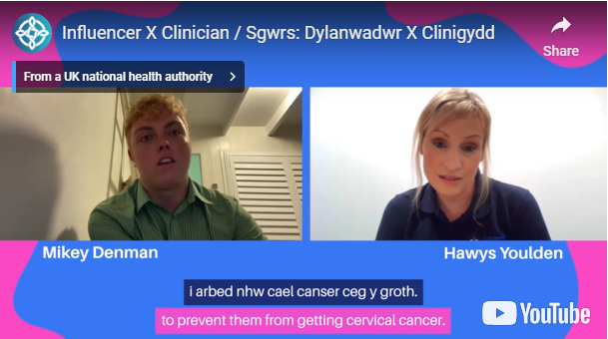
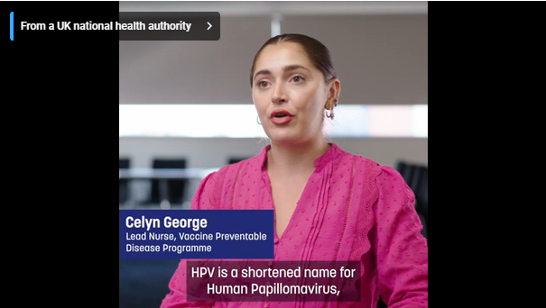
Other resources
https://youtu.be/7cemXEVUawk
https://youtu.be/UJ8kryJIYOI
https://youtu.be/9RyRzslMmjI
Notes:
Online video resources include-
Influencer and Lead Nurse for VPDP chat about the HPV vaccine (Bilingual) https://youtu.be/7cemXEVUawk
Lead nurse answers some common questions about HPV and the vaccine https://youtu.be/UJ8kryJIYOI
Young adults talk about the HPV vaccine and the importance of getting vaccinated https://youtu.be/9RyRzslMmjI
Public Health Wales Asset Library https://phw.brandkitapp.com/
A public information website about HPV is available at www.phw.nhs.wales/HPVvaccine or www.icc.gig.cymru/brechlynnauHPV

Slide 47
Resources and additional information
UKHSA Immunisation against infectious diseases The Green Book: Human papillomavirus (HPV) Chapter18a: www.gov.uk/government/publications/human-papillomavirus-hpv-the-green-book-chapter-18a
HPV guidance for healthcare practitioners: www.gov.uk/government/publications/hpv-universal-vaccination-guidance-for-health-professionals
Summary of Product Characteristics for Gardasil 9: www.medicines.org.uk/emc/product/7330/smpc
JCVI statement on HPV vaccination of men who have sex with men November 2015: www.gov.uk/government/publications/jcvi-statement-on-hpv-vaccination-of-men-who-have-sex-with-men
CEM/CMO/2022/12 Changing to a two-dose NHS Human Papillomavirus (HPV) vaccination schedule for eligible adolescents and adults starting the course after they turn 15 years old, including men who have sex with men (MSM), March 2022: Vaccine Preventable Disease Programme (VPDP) - Changing to a two-dose NHS Human Papillomavirus (HPV) vaccination schedule (2022).pdf - All Documents (sharepoint.com)
WHC/2022/015 Changes to the vaccine for the HPV immunisation programme. June 2022: https://www.gov.wales/changes-vaccine-hpv-immunisation-programme-whc2022015
JCVI statement on a one-dose schedule for the routine HPV immunisation programme August 2022 https://www.gov.uk/government/publications/single-dose-of-hpv-vaccine-jcvi-concluding-advice/jcvi-statement-on-a-one-dose-schedule-for-the-routine-hpv-immunisation-programme
WHC/2022/023 Changes to the vaccine for the HPV immunisation programme, Sept 2022: https://www.gov.wales/changes-vaccine-hpv-immunisation-programme-whc2022023
WHC/2023/016 HPV immunisation programme update, May 2023: https://www.gov.wales/hpv-immunisation-programme-update-whc2023016

Slide 48
Resources and additional information
NHS 111 Wales: NHS 111 Wales - Health A-Z : Human papillomavirus (HPV)
Resources can be ordered from Health Information Resources: phw.nhs.wales/services-and-teams/health-information-resources/
HPV vaccine – Information for the public: phw.nhs.wales/HPVvaccine
HPV vaccine - Information for health professionals: phw.nhs.wales/topics/immunisation-and-vaccines/vaccine-resources-for-health-and-social-care-professionals/hpv/
Cervical Screening Wales: phw.nhs.wales/services-and-teams/cervical-screening-wales/
WHO Immunization Resource Centre: Vaccines and immunization (who.int)
Attitudes towards COVID-19 and Flu Immunisations among Young People and Parents: https://phw.nhs.wales/topics/immunisation-and-vaccines/engagement-insights/attitudes-towards-covid-19-and-flu-immunisations-among-young-people-and-parents-2022-pdf/
PHW HPV Information Resource – Research Findings https://phw.nhs.wales/topics/immunisation-and-vaccines/engagement-insights/phw-hpv-information-resource-research-findings-oct23/
Optimising Vaccine Uptake: Using motivational interviewing for better conversations eLearning available on ESR and here: https://phw.nhs.wales/topics/immunisation-and-vaccines/immunisation-elearning/
Public Health Wales Asset Library - HPV vaccination benefits – Audiovisuals and images Public Health Wales As set Library (brandkitapp.com)

