Slide 1
Current Issues Q&A webinar
Vaccine Preventable Disease Programme
Public Health Wales
30 January 2025
Notes:
Material contained in this document may be reproduced without prior permission provided it is done so accurately and is not used in a misleading context.
Acknowledgement to Public Health Wales NHS Trust to be stated.
© 2025 Public Health Wales NHS Trust.

Slide 2
Acknowledgments
Vaccine Preventable Disease programme
Vaccine Programme Wales
UK Health Security Agency

Slide 3
Aims and objectives
To highlight key policy changes relating to immunisation and vaccination
To provide information on current epidemiology and surveillance of vaccine preventable diseases
To provide information about new vaccination programmes or changes to current programmes
To highlight changes to vaccine products or vaccine supply
To highlight insight findings and co-produced resources developed by the engagement team aiming to improve vaccine equity across Wales
To promote the Public Health Wales microsite and resources
The content of these slides are up to date as of the 30th January 2025

Slide 4
Content
Training context, legal framework and Green book updates
Central procurement of flu vaccine
Epidemiological and surveillance update
  Inequalities in the childhood programmes – annual report findings
  MMR coverage in school aged children – annual report findings
  Importance of maintaining high uptake in the teenage MenACWY vaccine programme
  Pertussis Epidemiology
  RSV uptake: review of the programme so far
  MPox
Vaccination life course updates
  Pregnancy
  Infants and preschool
  School age
  Adults
Engagement team update
Communication team update
Website and resources
Q&A session

Slide 5
Training context and legal framework
Clare Powell - Specialist nurse - training lead
VPDP, PHW

Slide 6
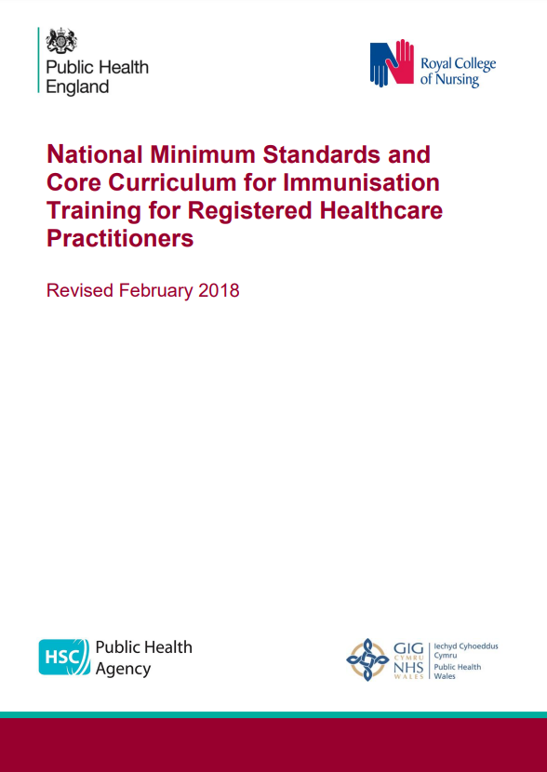
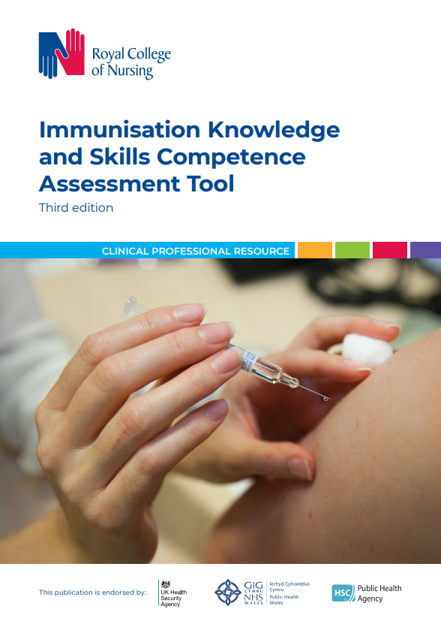
Training context
With the ongoing development of new and improved vaccines and the epidemiology of infectious diseases constantly changing, the need to modify or introduce new vaccine programmes occurs frequently.
It is vital that healthcare professionals involved in immunisation receive solid foundation training in immunisation.
Annual updates should be provided, more frequent updates may be required if substantial changes to programmes or policies are made, or new vaccines are introduced.
www.gov.uk/government/publications/national-minimum-standards-and-core-curriculum-for-immunisation-training-for-registered-healthcare-practitioners
https://www.rcn.org.uk/Professional-Development/publications/immunisation-knowledge-and-skills-competence-assessment-tool-uk-pub-010-074

Slide 7
Legal framework for vaccinations
The Welsh Medicines Advice Service (WMAS) website Home - Welsh Medicines Advice Service (wales.nhs.uk) provides information about Patient Group Directions (PGDs) and their use in clinical practice. Guidance, advisory documents, templates and resources can be accessed via the website
PGD templates are available to support immunisation programmes, with some templates authored by WMAS in collaboration with the Vaccine Clinical Advisory Group (VCAG). Others are authored by UKHSA. All are accessible via the website
There are also links to the relevant National Protocols.
Any queries regarding the clinical content of the PGDs should be addressed to welshmedicines.information@wales.nhs.uk

Slide 8
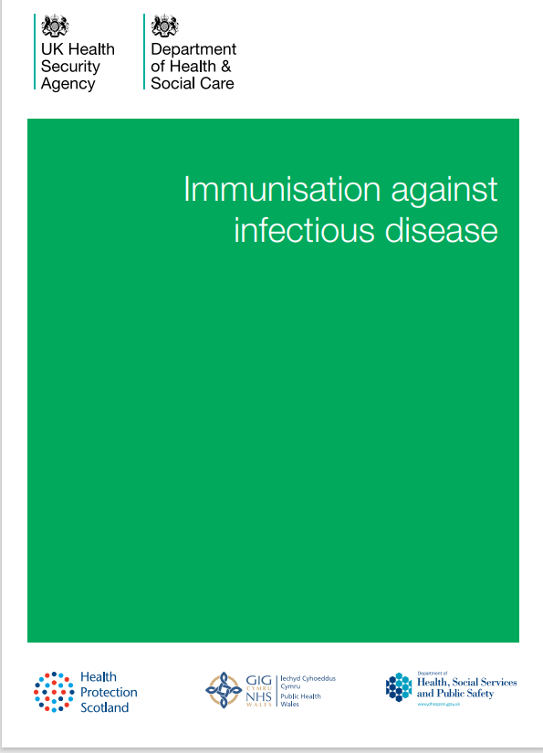
Green book updates
Principles, practices and procedures
Consent: the green book, chapter 2 - GOV.UK [Nov 2024]
Vaccine safety and adverse events following immunisation: the green book, chapter 8 - GOV.UK [Nov 2024]
Diseases, vaccinations and vaccines
Respiratory syncytial virus: the green book, chapter 27a - GOV.UK [Oct 2024]
Smallpox and mpox: the green book, chapter 29 - GOV.UK [Dec 2024]
Varicella: the green book, chapter 34 - GOV.UK [Sep 2024]
Notes:
Consent chapter: Changes to the section on disagreement between parents to clarify the role Gillick competency in such situations.
Vaccine safety and adverse events following immunisation: Extensive re-write of the section on recognition and management of anaphylaxis.
RSV - Links to national immunisation programme letters added, revised in alignment with the 4 national programmes.
Varicella - Updated guidance following the withdrawal of VZIG, including use of iv Varitect CP for Group 1 neonates at highest risk of severe varicella.

Slide 9
Rhys Oats - Vaccine supply and logistics lead
Vaccine programme Wales, NHS Executive
Central Procurement of flu vaccine
(CPoF) 25/26

Slide 10
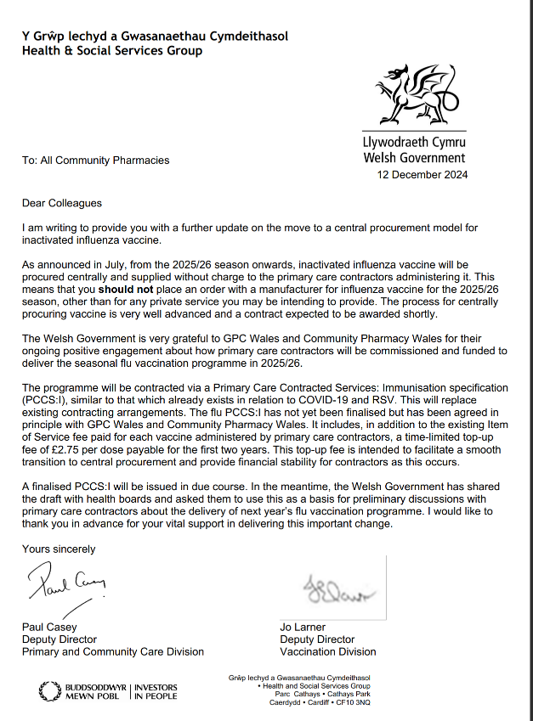
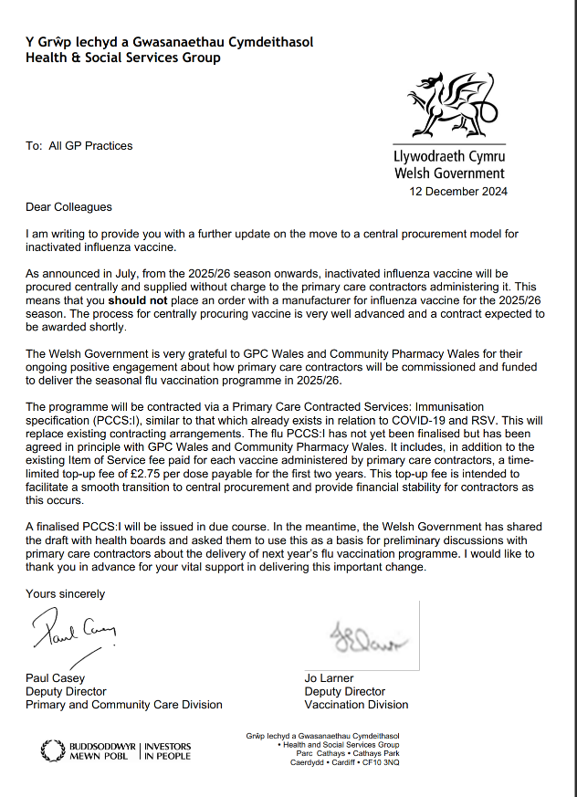
Centralised procurement of flu vaccine
Letter to Pharmacies -– December 2024 ENG/WELSH
Letter to GPs - centralised procurement of flu vaccine – December 2024 ENG/WELSH

Slide 11
Ordering process (1)
NWSSP Procurement will send each health board, WASUT and Velindre order forms
  There will be two order forms sent to each health board
  One will be an order form for Occupational Health (OH) order/s and one will be for Primary Care order/s
  WASUT and Velindre will have one order form
  Order form/s will be in a Microsoft Form template
A ‘Supply, Distribution and Operating’ handbook will be sent to each health board
  The ‘Supply, Distribution and Operating’ handbook will contain all processes and expectations that will be required during the 25/26 Influenza campaign
Health boards will then send out order forms to Primary Care sites that have been commissioned to participate in the Influenza campaign for 25/26 season

Slide 12
Ordering process (2)
  WASUT and Velindre will send their orders directly to NWSSP Procurement. All HBs to follow the below steps
  All health board commissioned sites to then send their orders back to the health board for verification. Date for orders to be sent back to the health board TBC
  Health boards will verify orders that have been received
    Health boards will check and verify all orders received
    Health boards to ensure quantities ordered are sufficient. Health boards will have the ‘Supply, Distribution and Operating handbook’ to reference for this process
  Health boards to then send NWSSP Procurement final order template – date TBC
    Ordering template will be in an Excel format and sent as per Covid vaccine ordering process

Slide 13
Ordering process (3)
  NWSSP to collate and process all orders
    NWSSP will collate and process orders from all health boards inc. OH and Primary Care sites. NWSSP will also collate and process orders from WASUT and Velindre
  NWSSP will then send all orders to the Medicines Unit @ IP5 and Health Courier Service Wales (HCSW)
  Medicines Unit and HCSW will then process all orders and plan the logistics of deliveries
    Medicines Unit and HCSW will plan the delivery frequency and the logistics for all deliveries
  NWSSP Procurement will then send each site participating their delivery date/s
  All deliveries to commence – date TBC

Slide 14
Epidemiological and surveillance update
Charlotte McDermott – Senior epidemiologist – Health Protection, CDSC
Malorie Perry – Advanced epidemiological scientist - Health Protection, CDSC

Slide 15
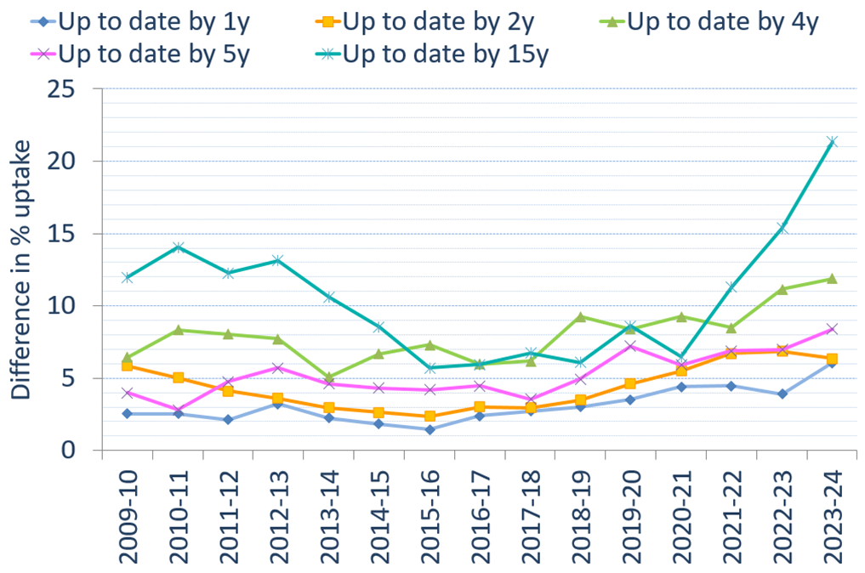
Inequalities in the childhood programmes – annual report findings
Widening inequalities. Largest since 2009-10 for all ages apart from 2-year-olds
Plan to monitor this quarterly going forward

Slide 16
MMR coverage in school aged children
– annual report findings
Of all children reaching their 5th to 16th birthdays during the 2023/24 academic year, National Community Child Health Database records indicated that:
  19,245 (4.4%) had not received any MMR vaccinations
  14,734 (3.4%) had only received one MMR dose
Uptake of MMR in 438,004 children reaching their 5th to 16th birthdays during the 2023/24 academic year in Wales, was 95.6% (418,759 children) for one or more doses and was 92.2% (404,025 children) for a full two dose course
A total of 3,033 MMR1 catch up doses were given in 2023-2024 compared to 1,070 in 2022-2023
A total of 4,237 MMR2 catch up doses were given in 2023-2024 compared to 1,828 in 2022-2023

Slide 17
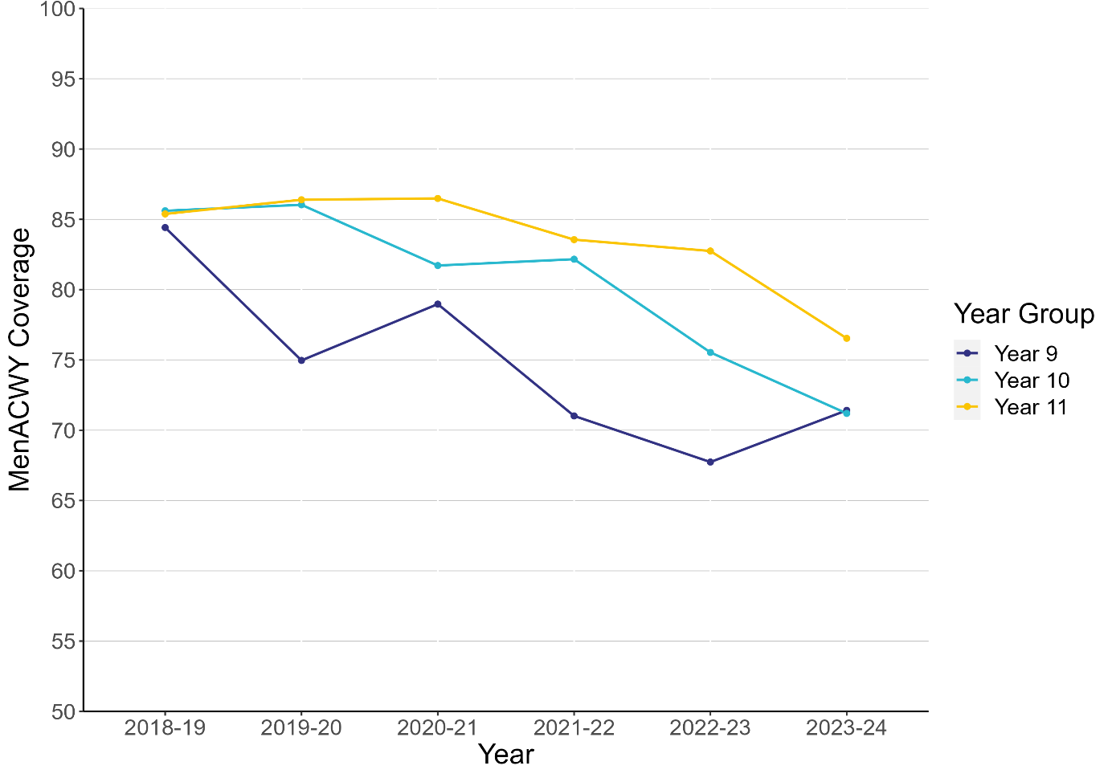
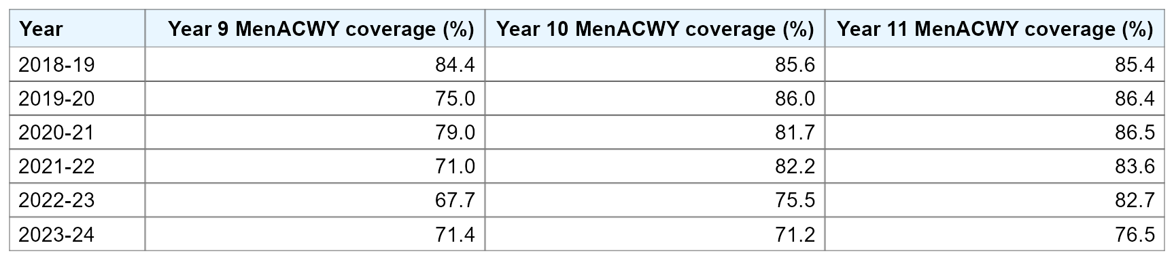
  Importance of maintaining high uptake in the teenage MenACWY vaccine programme
MenACWY coverage in adolescents in Wales for school years 9, 10 and 11 by academic year from 2018-19 to 2023-24.
Notes:
MenACWY and Td/IPV vaccine coverage in 2023-24 increased in year 9 pupils, but continued to decrease in 10 and 11 school year cohorts, following a downward trend seen since 2020-21.

Slide 18
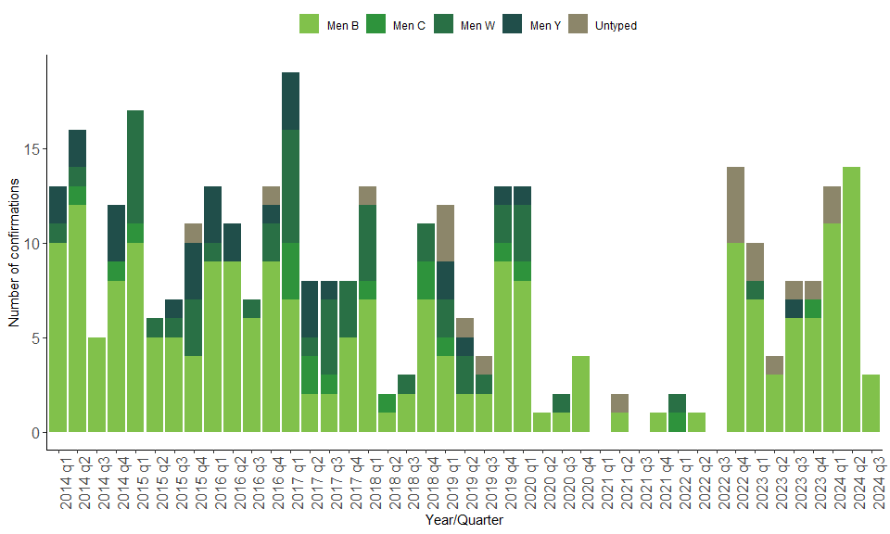
  Importance of maintaining high uptake in the teenage MenACWY vaccine programme
Invasive meningococcal disease cases confirmed by quarter and capsular group: Wales, 2014-2024.

Slide 19
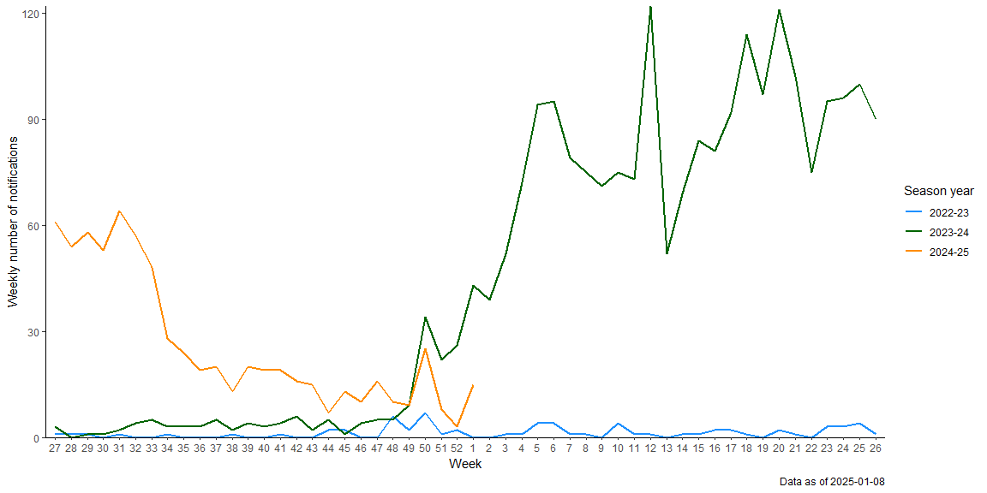
  Pertussis
Weekly notifications of Whooping Cough in Wales, across the 2021-22 to 2024-25 season years

Slide 20
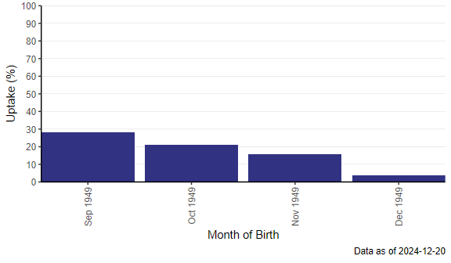
  RSV uptake: review of the programme so far
Routine cohort (Adults reaching 75 years of age after 1st Sep 2024)
28.4% for older adults reaching 75 years of age in September 2024
21.2% for older adults reaching 75 years of age in October 2024
15.8% for older adults reaching 75 years of age in November 2024

Slide 21
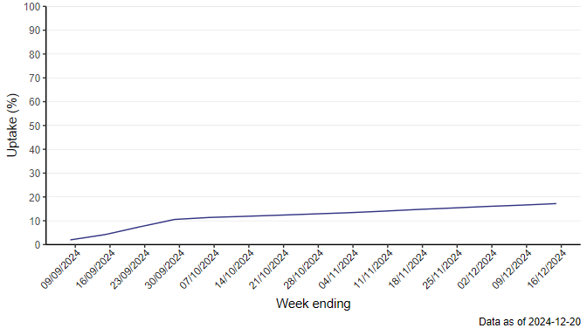
  RSV uptake: review of the programme so far
Catch-up cohort (75 to 79 as at 1st September 2024)
17.5% for older adults aged 75 to 79 as at 01/09/2024
The formal launch of the one-off campaign for those aged 75 to 79 begins in February 2025. There is operational flexibility to start sooner, if there is capacity or if vaccinations is requested by those eligible can be accommodated.

Slide 22
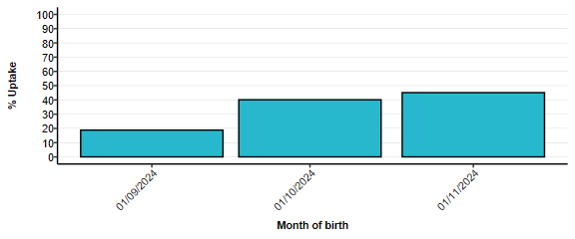
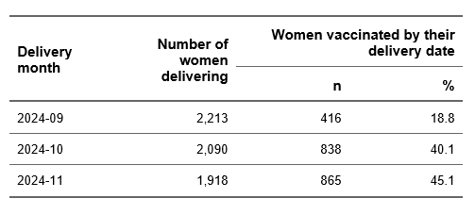
  RSV uptake: review of the programme so far
Coverage of RSV vaccination in pregnant women at the point of delivery

Slide 23
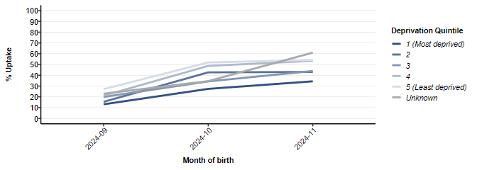
  RSV uptake: review of the programme so far
Coverage of RSV vaccination in pregnant women at the point of delivery
Notes:
Consistent gap between most and least deprived. Also seen for older adults.

Slide 24
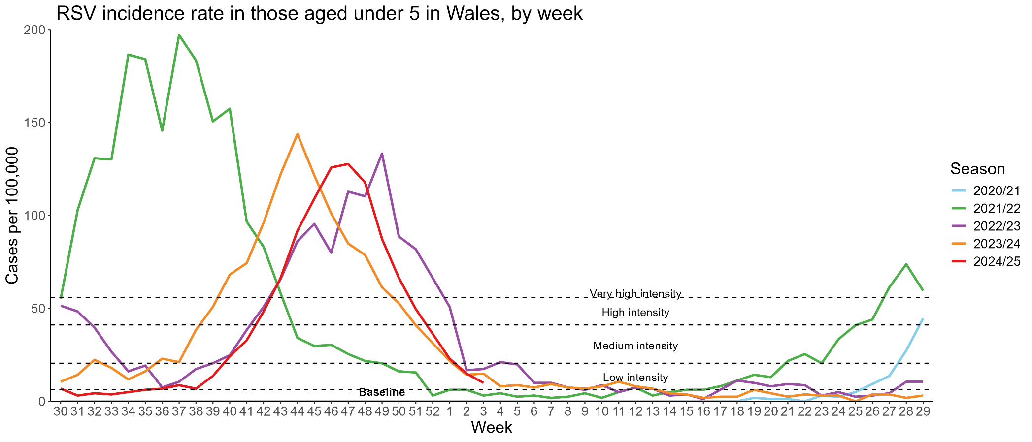
  RSV uptake: review of the programme so far
RSV is currently at low intensity levels.

Slide 25
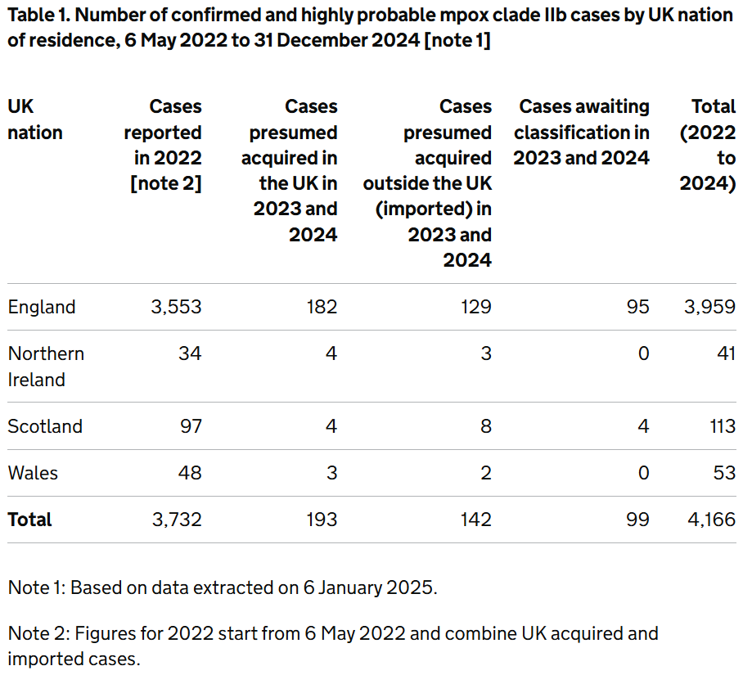
  MPox
Clade IIb – update from UKHSA as at 09/01/2025
Clade Ib – Six cases as at 20/01/2025. 0 in Wales.

Slide 26
Vaccination life course updates

Slide 27
Pregnancy programmes
Hawys Youlden- Lead Nurse Immunisation VPDP, PHW

Slide 28
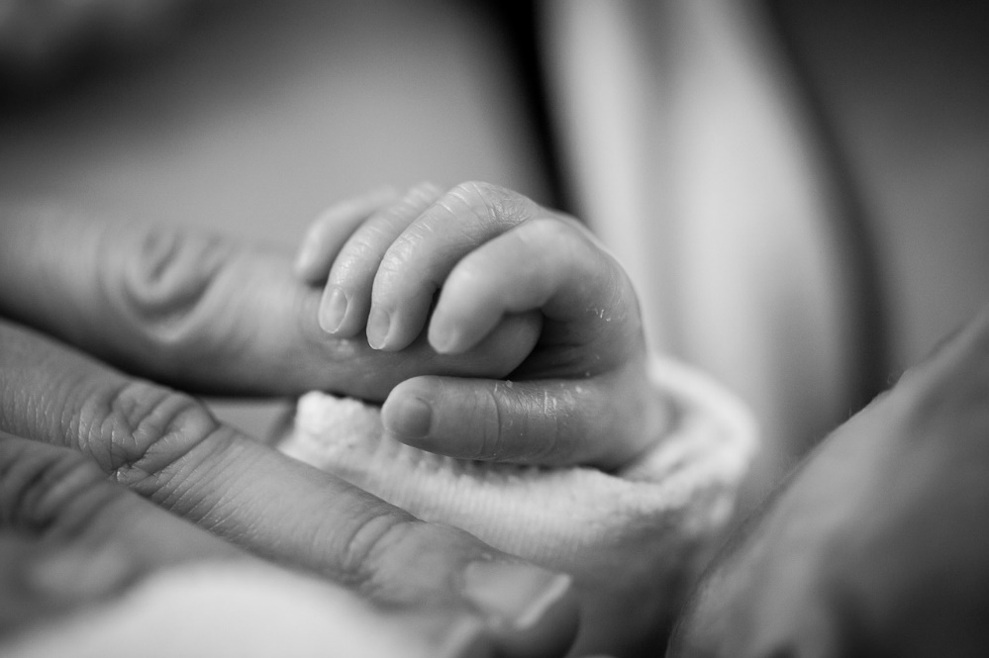
Vaccination in Pregnancy
Vaccination is the safest and most effective way of protecting pregnant women and their babies against serious illnesses such as whooping cough, flu, RSV and COVID-19.
Healthcare workers including midwives are a trusted voice and an important source of information about vaccination in pregnancy. Make every contact count.

Slide 29

Maternal RSV vaccination programme for infant protection
Programme introduced on 1 September 2024
Offer of vaccination to all pregnant women at 28 weeks gestation
Pregnant women will remain eligible until discharge from maternity services.
This will not offer passive protection to the baby through transplacental antibody transfer but may protect the mother from contracting RSV, thus reducing the chance of transmission to the infant, and may help increase levels of antibodies in breast milk. Though neither of these are expected to be as protective as transplacental antibody transfer from vaccination earlier in pregnancy.
Healthcare professional are trusted voices, it is important to ensure we make every contact count to raise awareness of maternal vaccinations
Image source: Public Health Wales

Slide 30
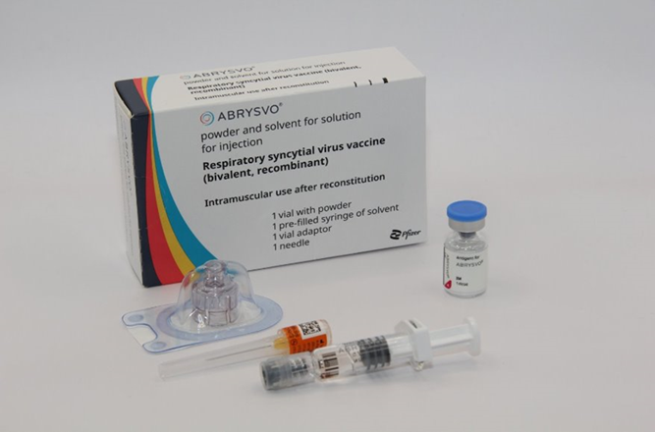
RSV Vaccine- Abrysvo ▼ ®
Vaccination offered year-round.
The offer of maternal vaccination will be available with each pregnancy to protect each infant against RSV
Vaccination discussions are advised throughout a pregnant woman's care, ideally before the vaccination appointment to ensure the pregnant woman is able to make an informed decision
Notes:
Please note: Abrysvo® is licensed to be given up to 36 weeks gestation (this was based on the gestational ages included in the clinical trials). Pregnant women who have not received the RSV vaccine before 36 weeks remain eligible until delivery, and under the PGD the vaccine can be given off label in these circumstances.

Slide 31
Co-administration of Abrysvo▼® vaccine with other vaccines and immunoglobulins in pregnancy
Product | Can be co-administered with RSV vaccine in pregnancy?
Influenza vaccine | Yes
COVID-19 vaccine | Yes
Pertussis-containing vaccine | Yes*
Anti-D immunoglobulin | Yes
*A phase 2 study showed reduced immune response to some pertussis components when a DTaP vaccine was co-administered with an RSV vaccine in non-pregnant women aged 18-49 years¹
The clinical impact of this is unknown, but likely to be small
If the pertussis-containing vaccine is given at the typical time (from 16 weeks) and RSV vaccine at the scheduled time (week 28 onward), there is no chance of a reduced pertussis response
If a woman has not had a pertussis-containing vaccine by the time she is attending for RSV vaccine, give both at once to maximise timely antibody production
Notes:
1 Peterson JT, et al., (2022). J Infect Dis. 225(12):2077-2086. doi: 10.1093/infdis/jiab505.

Slide 32

Influenza infection in pregnancy (1)
Flu is more serious in pregnancy as the immune system is weakened to ensure the pregnancy is successful. Therefore, the pregnant woman is more prone to infections and complications of flu
Influenza presents significant risks to pregnant women and their babies. If a woman catches influenza during pregnancy, she is at increased risk of experiencing severe disease, admission to intensive care and perinatal mortality (Jamieson, 2009; Pierce, 2011)
There were 29 deaths of pregnant women and women up to six weeks postpartum in association with influenza in the UK between 2009 and 2012, representing one in eleven maternal deaths (MBRRACE-UK, 2014). MBRRACE-UK: Mothers and Babies: Reducing Risk through Audits and Confidential Enquiries across the UK | MBRRACE-UK | NPEU (ox.ac.uk)
The risks of flu can be serious to the unborn and new-born babies. It can lead to perinatal mortality, prematurity, smaller neonatal size, lower birth weight (Omer et al., 2011)
Green Book Chapter 19 Influenza (publishing.service.gov.uk)).
Notes:
Women of childbearing age are often exposed to influenza through contact with children. This can lead to greater exposure of pregnant women to flu.
There was one maternal death from influenza in the UK between 2013 and 2015 (MBRRACE UK, 2017) and two maternal deaths between 2016 and 2018 (MBRRACE UK, 2018). This period follows the introduction of maternal vaccination against influenza in 2010 but is mainly due to the low level of influenza activity from 2012 to 2015 compared to 2009 and 2010.

Slide 33

Influenza vaccination in pregnancy (2)
Influenza vaccination in pregnancy
  a) protects the mother
  b) reduces the risk to the unborn child
  c) protects the new-born baby
Influenza vaccination during pregnancy gives passive immunity against influenza to new-borns.
Notes:
Reduces infection
Reduces prematurity, prevents low birth-rate
Prevents the mother being a source of transmission to the new-born child. Provides passive immunity to infants in the first few months following birth

Slide 34

Influenza vaccination in pregnancy (3)
Pregnant women should be offered flu vaccine for each pregnancy (seasonal)
Inactivated influenza vaccines are preferred for women who are pregnant
The flu vaccine offered should be the one which is recommended for the flu season in which they are expected to deliver
Notes:
The ideal time for flu vaccination is before flu starts circulating. However, even after flu is in circulation, vaccine should continue to be offered to those at risk and newly pregnant women. If a woman becomes pregnant after the usual vaccinating period of October to January, it is still worth considering offering the vaccine if flu is still circulating in the community. Women should be offered the vaccine every time they are pregnant as the flu virus constantly mutates and therefore the strains included in the vaccine are reviewed annually.

Slide 35
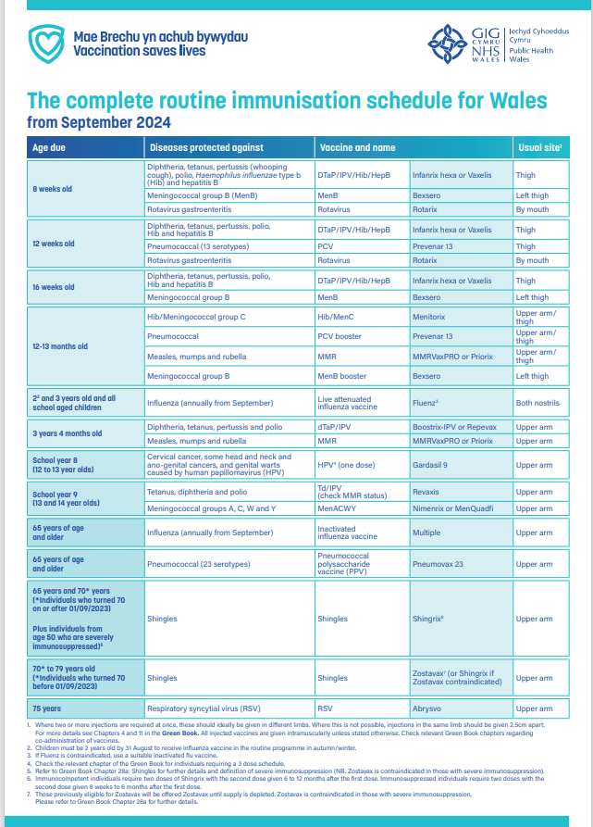
Pertussis Vaccination
Pertussis vaccination is part of the routine childhood schedule
This does not give lifelong immunity.
Immunity from vaccination or previous infection will wane - leaving little or no protection to pass onto the unborn child.
Maternal vaccination: offered between 16 and 32 gestational weeks
Maternal vaccination: may be offered after 32 weeks but this may not offer as high a level of passive protection to the baby
Giving a vaccination from 16 weeks:
Helps protect the baby. Until the babies start receiving their own immunisations.
Helps protect the mother. Reduces the risk of the mother catching pertussis and passing on to the infant.
Green Book Chapter 24 v3_0 (publishing.service.gov.uk).
Notes:
Maternal vaccination should be offered between gestational weeks 16 and 32 to maximise the levels of pertussis antibodies transferred across the placenta, thereby providing passive immunity to the unborn child.
Women may still be immunised after week 32 of pregnancy but this may not offer as high a level of passive protection to the baby. Vaccination late in pregnancy may, however, directly protect the mother against disease and thereby reduce the risk of exposure to her infant. Pertussis vaccine can be offered to pregnant women up until they go into labour, however, this is not the optimal time for immunisation as antibody levels in adults peak about two weeks after vaccination.
The programme has been shown to be very effective at reducing the number of cases in infants, although the levels in older children and adults remains high (waning immunity).
Reference Kroger AT, Atkinson WL and Pickering LK (2013) General immunization practices. In: Plotkin SA, Orenstein WA and Offit PA (eds). Vaccines, 6th edition. Philadelphia: Saunders Elsevier, p 88.

Slide 36
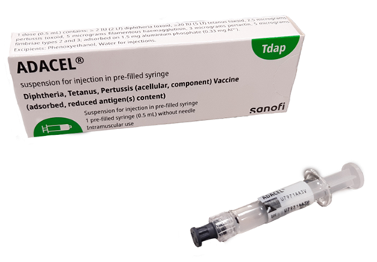
Change of vaccine from July 2024
studies which looked at antibody levels in infants of mothers who had received pertussis-containing vaccines in pregnancy compared to an unvaccinated group showed lower antibody responses to polio in infants born to vaccinated mothers, although all remained above the protective threshold
JCVI review of these studies in October 2022 concluded there should be a preference to use a non-polio (IPV) containing pertussis vaccine in the maternal programme to prevent any blunting of the infant’s own antibody response observed in the studies
since July 2024, ADACEL® has been available for the maternal vaccination programme
ADACEL is a trivalent vaccine containing tetanus, diphtheria and pertussis (Tdap)
the overall priority is to ensure a maternal pertussis vaccination programme remains in place as it continues to save lives
therefore, if Tdap vaccine is not available or is clinically contraindicated (such as for those who have a severe allergy to latex), dTaP/IPV vaccine should be offered. It is imperative to ensure the individual is offered a suitable and available vaccine containing a pertussis antigen, rather than risk them not being immunised against pertussis
Notes:
iMAP2 - Health Research Authority (hra.nhs.uk)
iMAP3- Health Research Authority (hra.nhs.uk)
In October 2022, the JCVI discussed the results from the ‘immunising mothers against pertussis’ (iMAP) studies which looked at the antibody levels of infants of mothers who had received pertussis-containing (the dTaP/IPV vaccines Boostrix-IPV® and REPEVAX®) vaccines in pregnancy compared with an unvaccinated group. These infants were followed up to 40 months when the preschool booster is scheduled and shortly after. Results showed a lower antibody response for the infants born to vaccinated mothers compared to unvaccinated mothers’ responses for polio types 1, 2 and 3 at 13 months, with the polio type 2 response being the most affected. The iMAP3 study polio type 2 results at preschool booster stage showed that pre and post booster antibody levels were lower in the children of vaccinated mothers compared to unvaccinated, however all were above the protective threshold. Although antibody responses were boosted after the pre-school booster, there was still a difference between those with vaccinated and unvaccinated mothers.

Slide 37
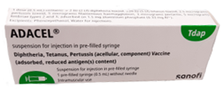

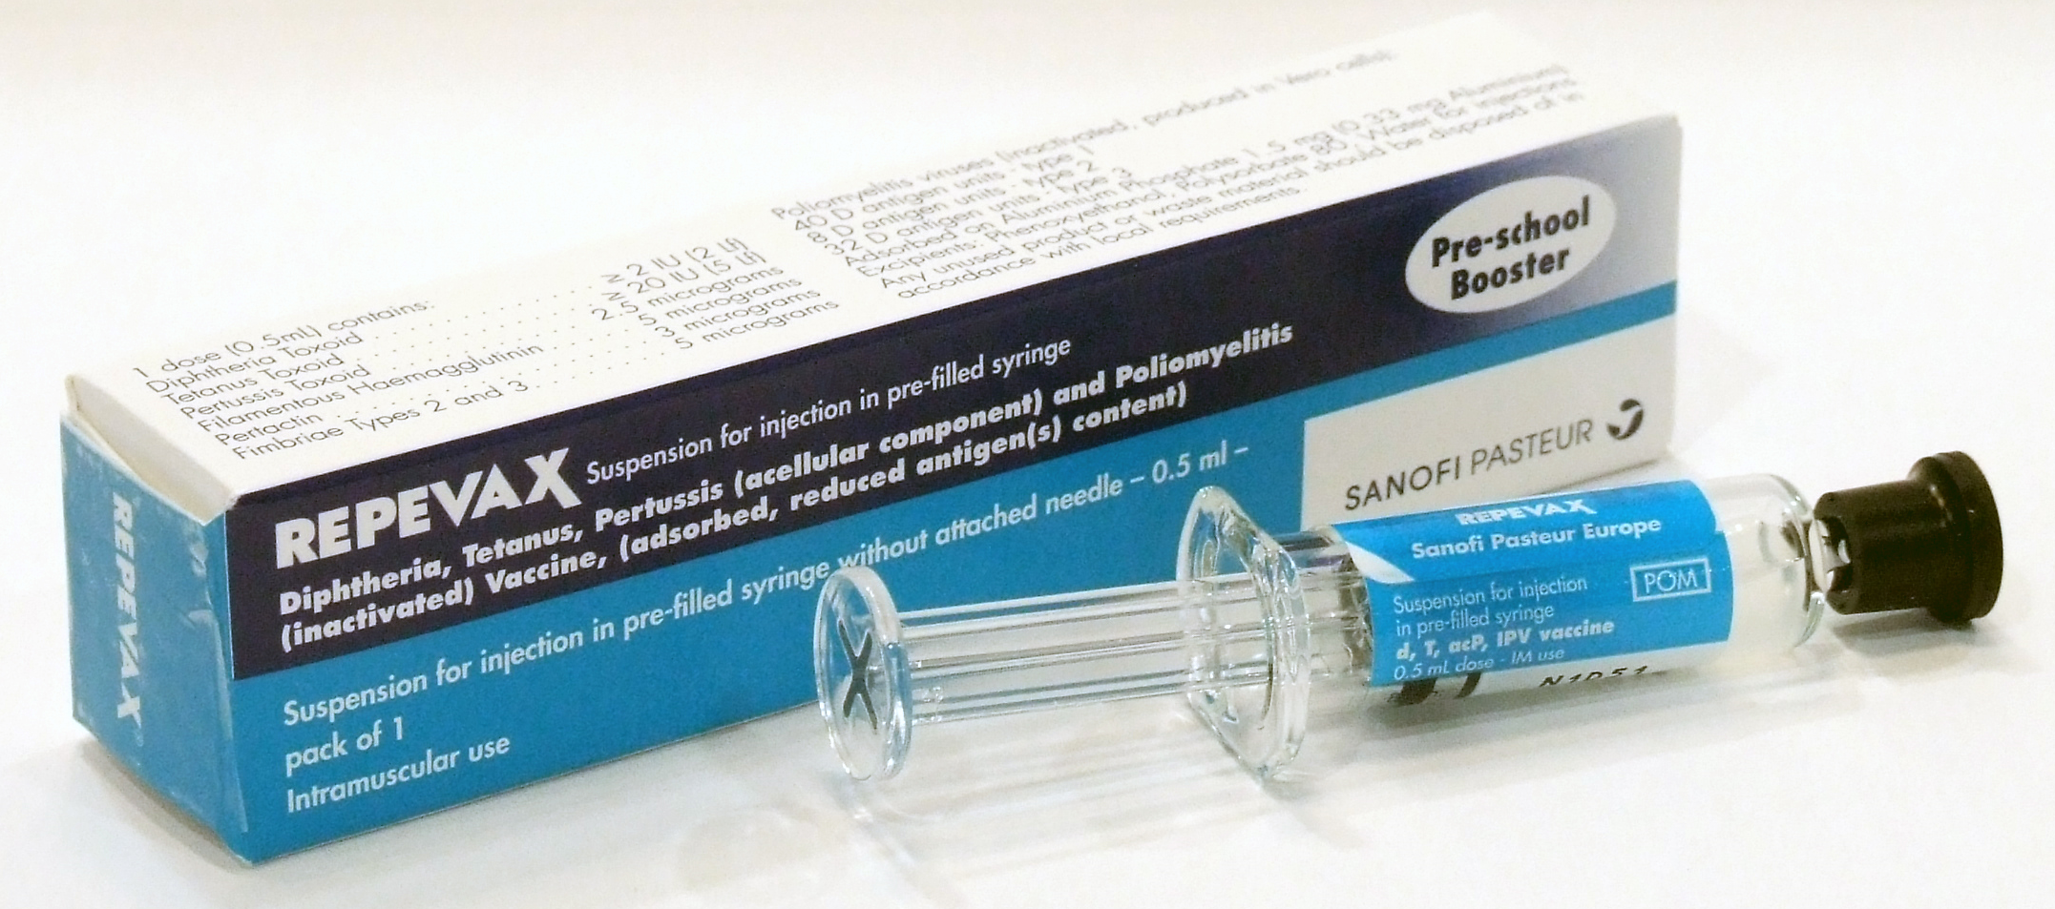
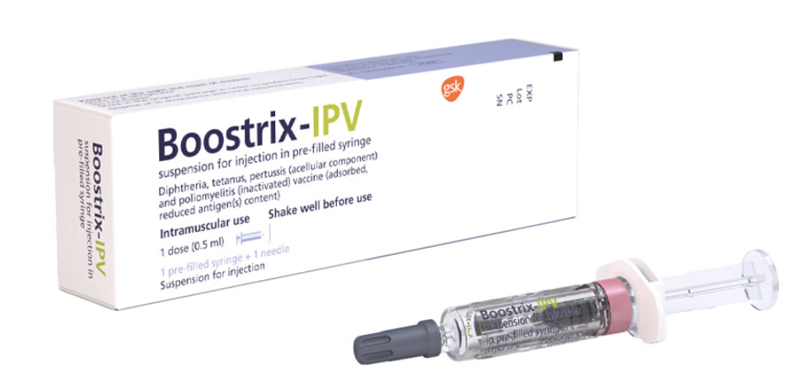
Ensure the right vaccine is given!
ADACEL® (Tdap) is the recommended vaccine for pregnant women from July 2024
REPEVAX® and Boostrix-IPV® vaccines (dTaP/IPV) should only be given to women who cannot receive ADACEL® (for example severe latex allergy) or if ADACEL® is not available and to obtain it would lead to a delay in the pregnant woman being vaccinated
Notes:
Remember: it is imperative to ensure the individual is offered a suitable and available vaccine containing a pertussis-containing antigen, rather than risk them not being immunised against pertussis.

Slide 38
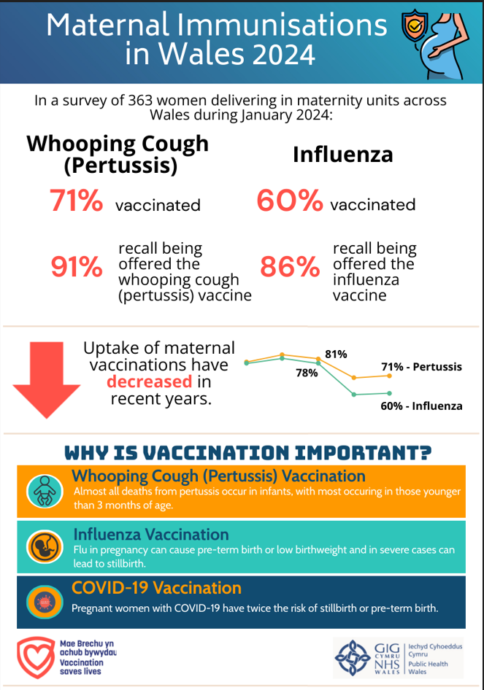
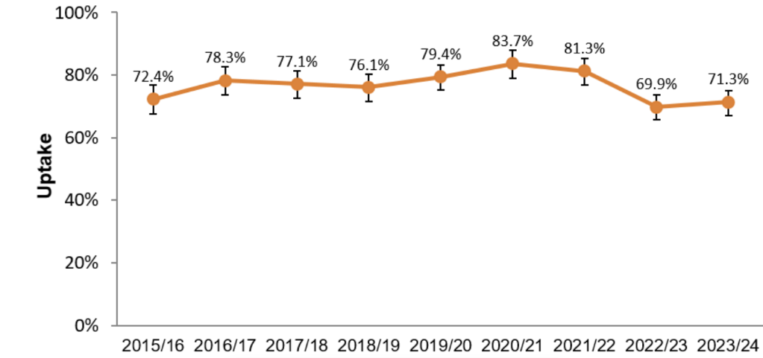
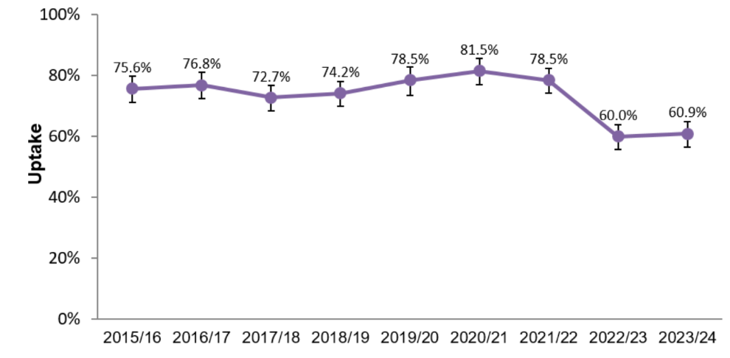
Point of Delivery Survey
A snapshot of maternal immunisation uptake
Carried out in January each year
Denominator is all those women delivering during a 5-day period
All seven health boards in Wales participate
Standard questionnaire asks about offer of vaccinations and receipt of vaccinations
Timeliness of pertussis vaccination is also gathered
Approximately 350-400 women take part in the survey each year
Uptake of pertussis vaccination in pregnant women participating in the 2015/16 to 2023/24 surveys¹
Uptake of influenza vaccination in pregnant women participating in the 2015/16 to 2023/24 surveys¹
¹Bars indicate 95% confidence intervals.
https://nhswales365.sharepoint.com/sites/PHW_VPDPComms/SitePages/Immunisation-uptake-in-pregnancy.aspx
Public Health Wales
38
Notes:
Surveillance: Issues with ascertaining immunisation uptake. Difficulties with ascertaining the denominator - inconsistent recording of pregnancies in GP systems
Pertussis vaccination provided through and recorded in GP systems, however flu vaccinations are provided through a wider range of settings and recording in different systems. No single system consistently records all influenza vaccinations.

Slide 39
Vaccination in pregnancy Jan 2025-
WHAT | WHO | WHEN | WHAT | NOTES
RSV | Pregnant women, every pregnancy | At 28 gestational weeks May be offered after 32 weeks but may not offer as high level of passive protection to baby | Abrysvo | Offer all year-round
Pertussis | Pregnant women, every pregnancy | Between 16 and 32 gestational weeks. May be offered after 32 weeks but may not offer as high level of passive protection to baby. | Combined product: ADACEL Protects against: diphtheria, tetanus, pertussis (acellular). | REPEVAX and Boostrix-IPV can still be used for women with latex allergy
Flu | Pregnant women, every pregnancy | September – March Seasonal | Inactivated influenza vaccinations Offer the flu vaccine recommended for the season | See JCVI and Welsh Health circulars for seasonal eligibility and product.
COVID-19 | Pregnant women following JCVI seasonal advice and eligibility. | September to March Seasonal | COVID-19 vaccination Offer the COVID-19 vaccine recommended for the season | See JCVI and Welsh Health circulars for seasonal eligibility and product.

Slide 40

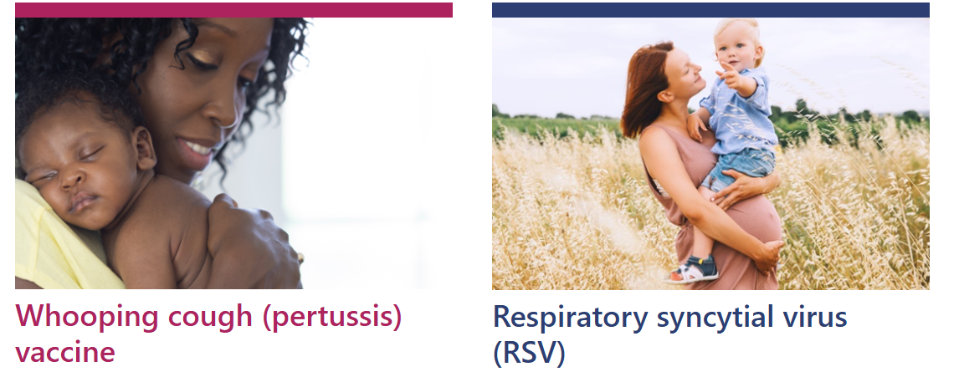

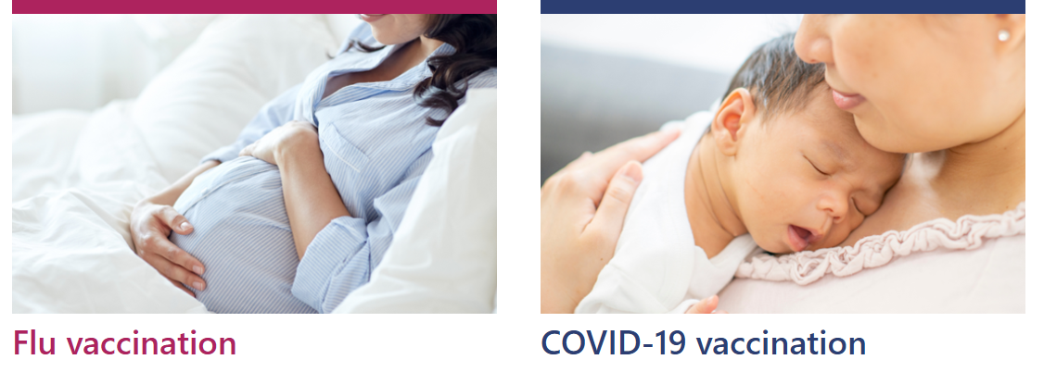

Resources/signposting
Public Health Wales Resources
Pregnancy landing page: Immunisation and Vaccines - Public Health Wales (nhs.wales)
Vaccine information in accessible resources: Information about vaccinations in pregnancy - Public Health Wales (nhs.wales)
Leaflet ordering: Health Information Resources - Public Health Wales (nhs.wales)
Training resources: Immunisation training resources and events - Public Health Wales (nhs.wales)

Slide 41

Maternal vaccines resources
Maternal vaccines resources can be ordered here for FREE: Beichiogrwydd / Pregnancy (nhs.wales)
How to protect you and your baby: a booklet with information about all maternal vaccines
*Also available in accessible formats

Slide 42
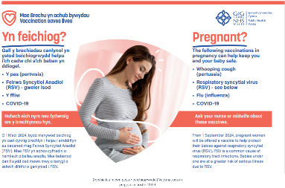

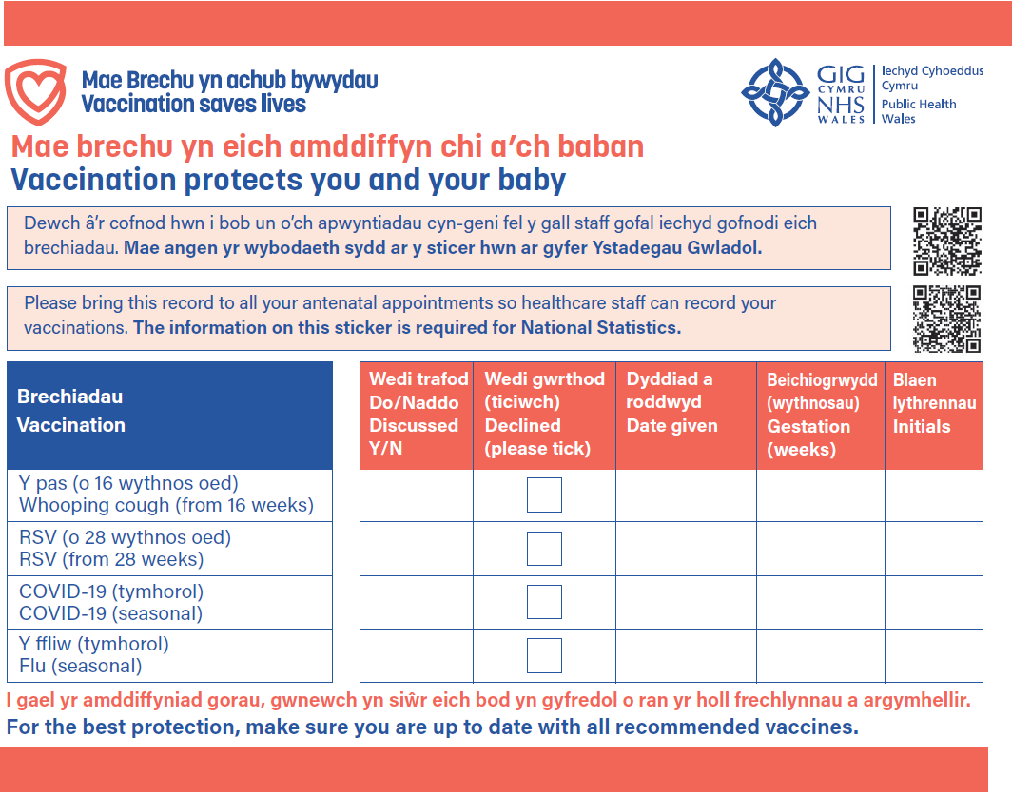
Maternal vaccines resources (2)
A pregnancy vaccines poster: information about all vaccines in pregnancy
Pregnancy sticker: for antenatal records
Pregnancy postcard: a reminder for pregnant women

Slide 43
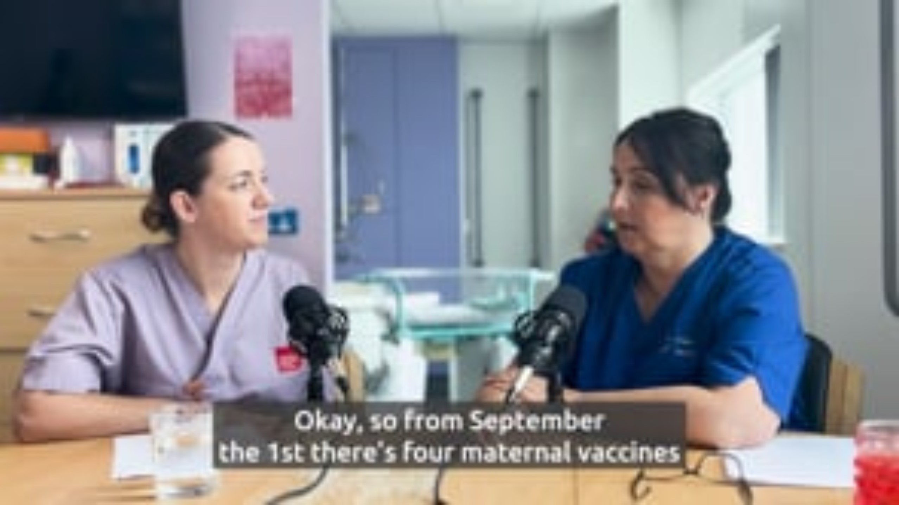
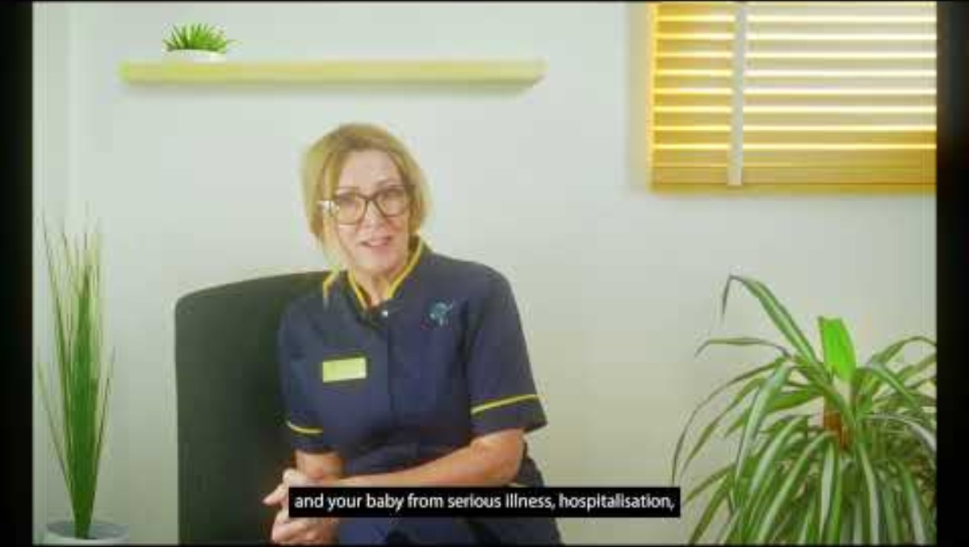
Video resources
These videos discuss all vaccines in pregnancy
Video resource for midwives:
Vaccines in pregnancy: what every midwife needs to know
available in English here, and Welsh here.
Video resource for pregnant women:
Vaccinations in pregnancy; everything you need to know. Available here

Slide 44
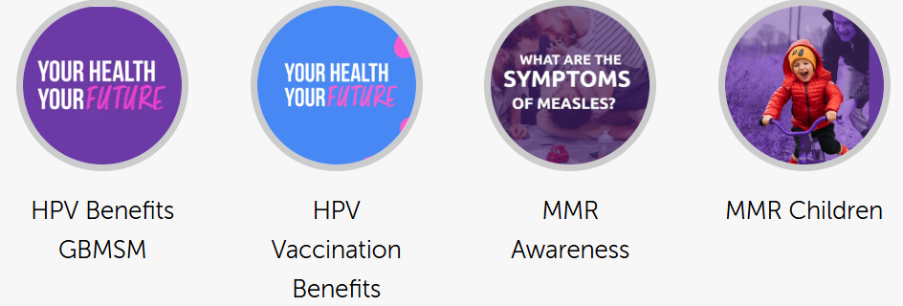

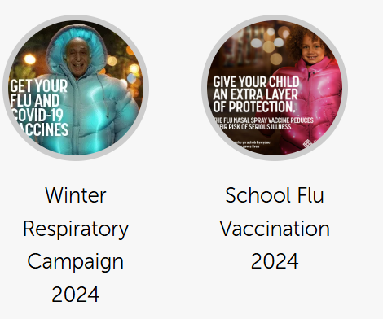
Public Health Wales Asset Library
https://phw.brandkitapp.com/

Slide 45
Infants and preschool programmes
Juliet Norwood - Specialist Nurse Immunisation
VPDP, PHW

Slide 46
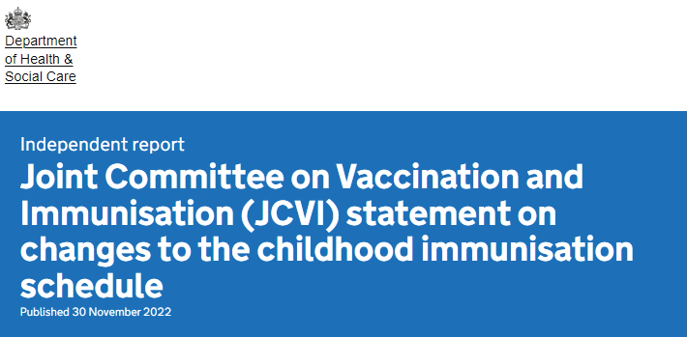
Hib/MenC (Menitorix®) to be discontinued
In November 2022 the JCVI put out a statement following notification that manufacturing of Hib/MenC (Menitorix®) is to be discontinued. This is a commercial decision made by the manufacturer, GlaxoSmithKlein (GSK)
As this is the only Hib/MenC vaccine available, changes to the routine infant schedule are necessary
The UKHSA estimates that the central stock of Hib/MenC (Menitorix ®) will be depleted by mid 2025
Joint Committee on Vaccination and Immunisation (JCVI) statement on changes to the childhood immunisation schedule - GOV.UK
Policy is awaited.

Slide 47
JCVI recommendations
The JCVI recommended the following changes once the current supply of Hib/MenC (Menitorix®) vaccine has been used:
Due to the success of the adolescent MenACWY programme in controlling meningococcal C disease across the population, the JCVI has advised that MenC is no longer required in the childhood schedule
The JCVI advised that there is still a continued need for a dose of Hib vaccine during the second year of life. They advise that a, additional dose of Hib-containing multivalent vaccine (such as the DTaP/IPV/Hib/HepB (6-in-1), which is also given earlier in infancy) should be given at 18 months to replace the Hib. This would be at a new appointment
The second dose of MMR vaccine should be brought forward from 3 years 4 months to 18 months of age, to improve coverage (in the new appointment)
In the meantime, the JCVI will keep emerging evidence under review, including ongoing epidemiology and disease incidence.
Policy is awaited.

Slide 48

Discontinuation of Hib/MenC (Menitorix®): Hib
As Hib/MenC (Menitorix®)is being discontinued, the dose of Hib vaccine at 12 months will no longer be available. Therefore, the JCVI advise:
  There remains a need for a dose of Hib vaccine during the second year of life
  It is recommended that this dose of Hib vaccine be replaced with an additional dose of Hib containing vaccine, such as the hexavalent DTaP/IPV/Hib/HepB (6 in 1)
  It is recommended that this additional dose of DTaP/IPV/Hib/HepB (6 in 1) should be given at 18 months
  This would be at a new 18-month appointment
  Having the new 18-month appointment provides an opportunity for the second dose of MMR (MMR2) to be brought forward from 3 years 4 months to 18-months
Note: an additional DTaP/IPV/Hib/HepB (6 in 1) vaccine at 18 months will have implications for the selective Hepatitis B programme. Await policy on this

Slide 49

Timing of the replacement Hib dose
The JCVI considered many factors in relation to the timing of the Hib-containing vaccine
  The overarching aim of the Hib programme is to attain herd immunity in the population
  Due to the success of the current Hib immunisation programme there is minimal Hib disease currently circulating in the UK
  Modelling shows that Hib transmission is primarily driven by children aged 2-4 years old, therefore vaccination at any time before then should prevent transmission
  Giving the Hib-containing vaccine at 18 month allows space and flexibility to consider the best schedule for future programmes
  *A dose of a multivalent Hib-containing vaccine at 18 months mitigates blunting from maternal programmes
  Having an immunisation visit prior to school entry provides an additional opportunity for any children who may have missed previous vaccine doses to catch up with their routine immunisations
Recommended additional dose of Hib containing vaccine DTaP/IPV/Hib/HepB (6 in 1) at 18 months
Notes:
*Unpublished evidence from the National Vaccine Evaluation Consortium study suggests high maternal pertussis, tetanus and diphtheria antibody levels, whilst providing good protection against these infections, may reduce the infant’s response to IPV when measured at 12 months

Slide 50

Bringing forward second MMR
The JCVI have proposed bringing forward the second MMR from 3 years 4 months to the new 18-month appointment
The main reason for bringing the MMR forward is to improve coverage and reduce the likelihood of measles outbreaks
In areas of London where the second dose of MMR was brought forward in response to local measles outbreaks in the 2000’s, coverage of the second dose of MMR vaccine increased by an average of 3.3% Impact of an accelerated measles-mumps-rubella (MMR) vaccine schedule on vaccine coverage: An ecological study among London children, 2012–2018 - ScienceDirect.
The JCVI considers that the likely added benefit of increasing coverage for the second MMR further justifies the additional routine immunisation appointment at 18 months

Slide 51
Timeline for the changes. Please note that these are planning assumptions, and subject to change.
Mid 2025 (TBC)
  cessation of the Hib/MenC (Menitorix®) dose at 12 months: around mid-2025
Six months after:
  Introduction of additional dose of Hib-containing multivalent vaccine (such as the DTaP/IPV/Hib/HepB (6 in 1) which is also given in infancy) at age 18 months
  bringing forward the second dose of measles, mumps and rubella (MMR2) from 3 years 4 months to 18 months of age
Policy is awaited.

Slide 52
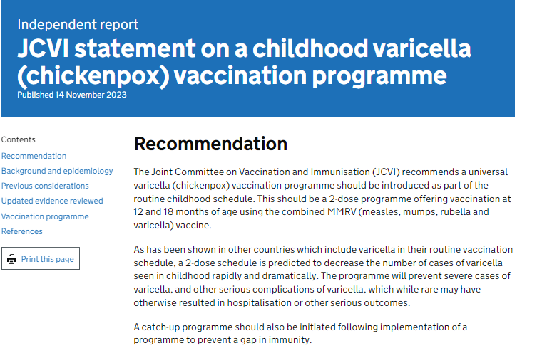
Varicella (Chickenpox) vaccination programme
14th November 2023 JCVI statement.
Recommending a universal varicella programme as part of the routine childhood schedule
2-dose schedule at 12 and 18 months
Using combined MMRV (measles, mumps, rubella and varicella) vaccine
With a catch-up programme, to prevent a gap in immunity
Aim of programme would be to prevent severe cases of varicella and other serious complications of varicella
JCVI statement on a childhood varicella (chickenpox) vaccination programme - GOV.UK
Varicella vaccination is included in the routine vaccine schedules of several countries, including the USA, Canada, Australia and Germany. This is either as a single dose or 2-dose strategy.
Policy is awaited.

Slide 53
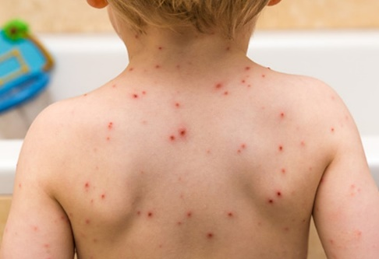
Complications of varicella and the burden of disease
Complications of varicella infection
Some children will go on to develop complications from varicella including bacterial infection of skin lesions (including group A streptococcus) and in rare cases, encephalitis, pneumonitis and stroke. These complications can result in hospitalisation and very rarely may result in death
Varicella is often more serious in very young infants (under 4 weeks) and adults, in particular in pregnancy when it may cause complications in both the mother and the foetus, and in adults who are immunosuppressed
Burden of varicella
A study was carried out by the University of Bristol to better capture the impact on quality of life for children hospitalised with varicella. The study highlighted that the true extent of hospitalisations caused by varicella is underestimated through routine data sources due to errors in coding
Hospitalisations are frequently due to secondary complications of varicella infection including cellulitis, invasive group A streptococcal infection or childhood stroke, and therefore are not always recorded as a hospital admission related to varicella
The study suggested that there may be other secondary complications from varicella infection which are not currently well understood or captured
Marlow R, Roderick M, Oliver J and others. Epidemiology of hospitalisations due to chickenpox and quality of life lost in community and hospital settings: protocol for a prospective cohort study across 2 countries. BMJ Open (2023), volume 13, e068611

Slide 54

Varicella catchup programme
The JCVI discussed the potential for a catch-up vaccination programme. Most countries following the implementation of a routine programme have offered some form of catch up
Analysis of the cost-effectiveness of potential catch-up vaccination scenarios are underway
Initial findings suggest that a universal catch-up vaccination programme using a single dose of vaccine is likely to be cost-effective for children aged up to and including 5 years
Further work is needed to understand whether a targeted catch-up programme could be cost-effective for children aged 6 to 11 years
Policy is awaited.

Slide 55
Summary of potential changes to routine childhood schedule
AGE | CURRENT | PROPOSED
12-13 months | Hib/MenC PCV MMR MenB | X PCV MMR (V) MenB
18 months. New appointment |  | Additional 6-in-1 MMR (V)
2-3 years (and every school year annually from September) | Flu | Flu
3 years 4 months | 4-in-1 MMR | 4-in-1 X
For routine immunisation schedules for Wales see: Routine immunisation schedules for Wales - Public Health Wales

Slide 56

Influenza
Under 5 eligibility: 2 & 3 year olds and all school aged children (annually from September). Children in a risk group risk group for influenza, from six months of age. As outlined in Green book chapter 19 Influenza.
COVID-19
JCVI statement published [14 November 2024]
Eligibility: infants and children aged 6 months and over who are immunosuppressed (as defined in the ‘immunosuppression’ sections of tables 3 or 4 in the COVID-19 Green Book: Chapter 14a)

Slide 57
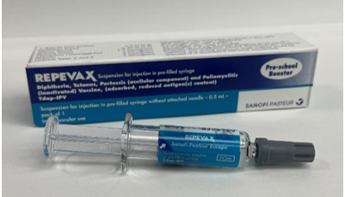
Spring 2025: change of vaccine for 3-year 4-month diphtheria, tetanus, acellular pertussis and polio (dTaP/IPV)
Changing from Boostrix-IPV® to REPEVAX®
The vaccines are clinically equivalent
For children 3 years and 4 months and to children up to 10 years of age who have not received it
Continue to order and administer Boostrix-IPV® until availability on ImmForm and local stockholdings deplete
Single dose pack. Pack does not contain needle for administration. Needles and syringes should be obtained locally
Order no more than 2 weeks of stock
Details about the pre-school booster dTaP/IPV vaccination programme is published in the Green Book Green Book Chapter 24 - Pertussis
Further details about REPEVAX® vaccine can be found here – REPEVAX - Summary of Product Characteristics (SmPC) - (emc)

Slide 58
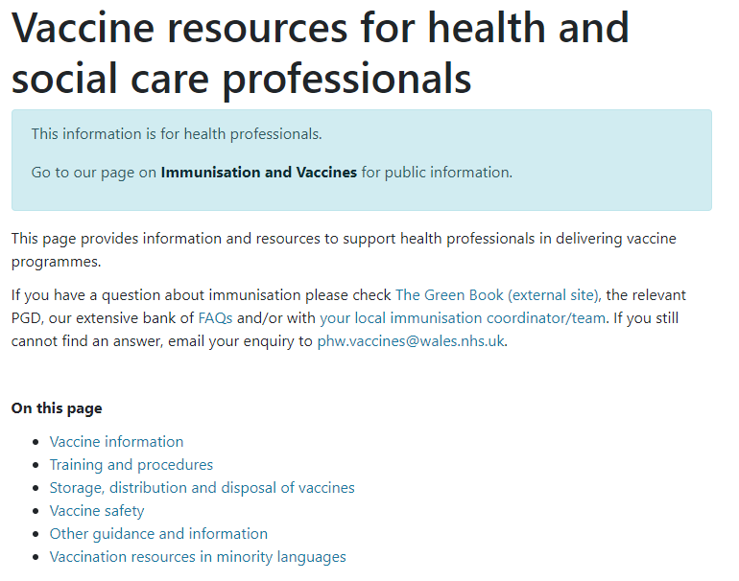
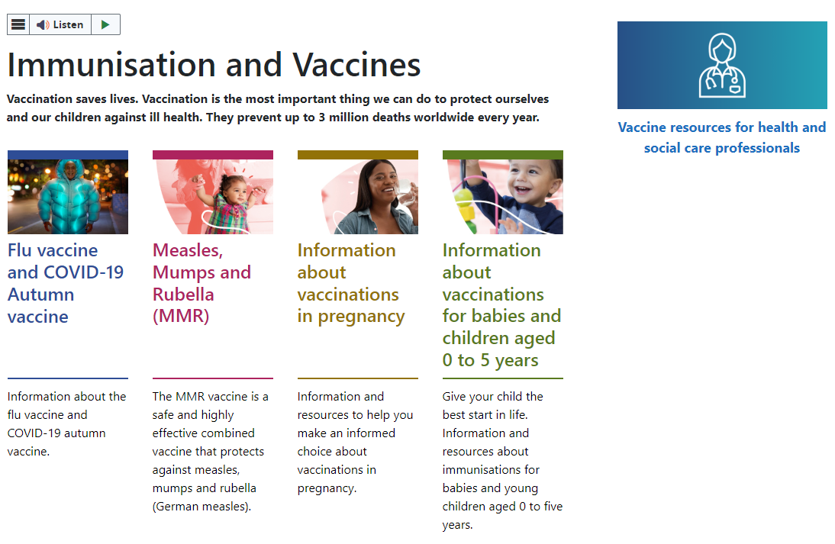
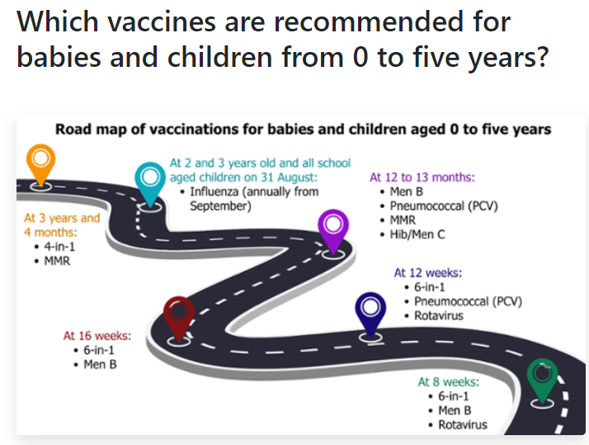
Signposting
Vaccine resources for health and social care professionals - Public Health Wales
Immunisation and Vaccines - Public Health Wales
Information about vaccinations for babies and children aged 0 to 5 years - Public Health Wales

Slide 59
School age programmes
Leony Hiscocks - Specialist Nurse Immunisation
VPDP, PHW

Slide 60
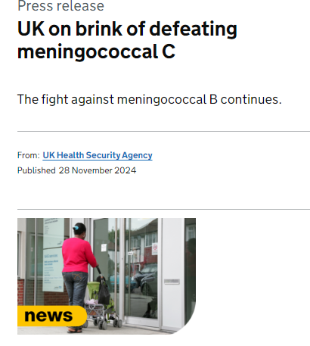
Group C meningococcal vaccine
Modelling work reviewed by the JCVI in June 2022 found that indirect protection against MenC in infants is sustained because of the teenage MenACWY programme
Over time the teenage vaccine programme is expected to reduce carriage prevalence of groups C, W and Y to near elimination levels (group A carriage has already been almost undetectable for many years in the UK)
It is therefore predicted that by the time Menitorix Hib/MenC vaccine is no longer available there would be very few invasive meningococcal disease (IMD) cases caused by meningococcus groups A, C, W and Y each year, and therefore very few cases which could be prevented by a MenC-containing vaccine in infancy
It is therefore essential that high uptake of MenACWY and good surveillance of meningococcal infection and IMD is maintained to monitor the impact of the vaccination programme and expected overall decline in disease
UK on brink of defeating meningococcal C - GOV.UK
Notes:
Highlighted text box, concern from stakeholders

Slide 61
What the changes mean for the school age vaccination programmes
“Due to the success of the adolescent MenACWY programme in controlling meningococcal C disease across the population, a dose of meningococcal C containing vaccine is no longer recommended at 12 months” Joint Committee on Vaccination and Immunisation (JCVI) statement on changes to the childhood immunisation schedule - GOV.UK
From mid 2025 (subject to WG policy) MenACWY vaccine will be the only routine MenC dose in the Routine Immunisation Schedule for Wales
The JCVI noted concerns about MenACWY vaccine uptake in the teenage programme where this is relied on to provide indirect protection. Modelling showed that where the uptake substantially dropped indirect protection was still maintained, however it will be important that efforts continue to be made for vaccine catch-up for any cohort that missed vaccination.
Notes:
Highlighted text box, concern from stakeholders

Slide 62
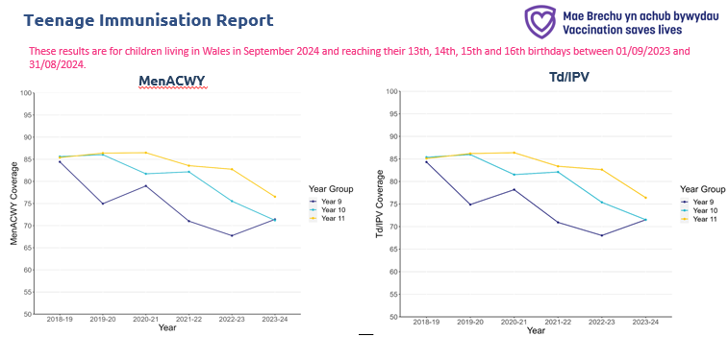
Vaccine Uptake
Notes:
Picture very similar for HPV – Boys??
MenACWY and Td/IPV vaccine coverage in 2023-24 increased in year 9 pupils, but continued to decrease in 10 and 11 school year cohorts, following a downward trend seen since 2020-21.
Engagement to speak later on the ongoing insight work underway with a plan to develop supporting resources for these vaccines

Slide 63
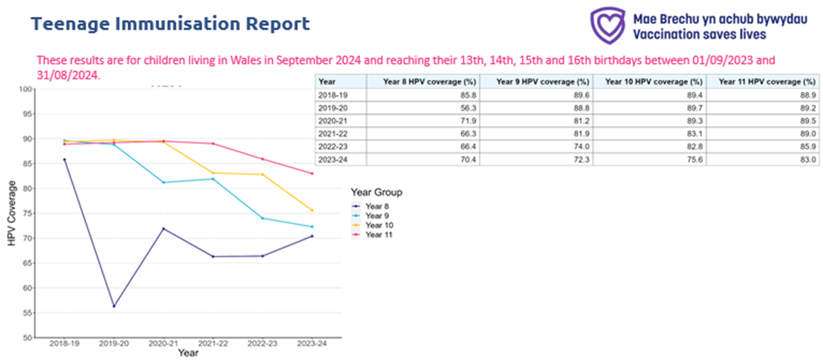
Vaccine Uptake
Notes:
Picture very similar for HPV – Boys seeing 6% difference between boys and girls
HPV coverage across Wales increased in year 8 pupils (+4 percentage points). There was a decline in year 9 and year 10 children of 1.7 and 7.2 percentage points respectively from the previous year.

Slide 64
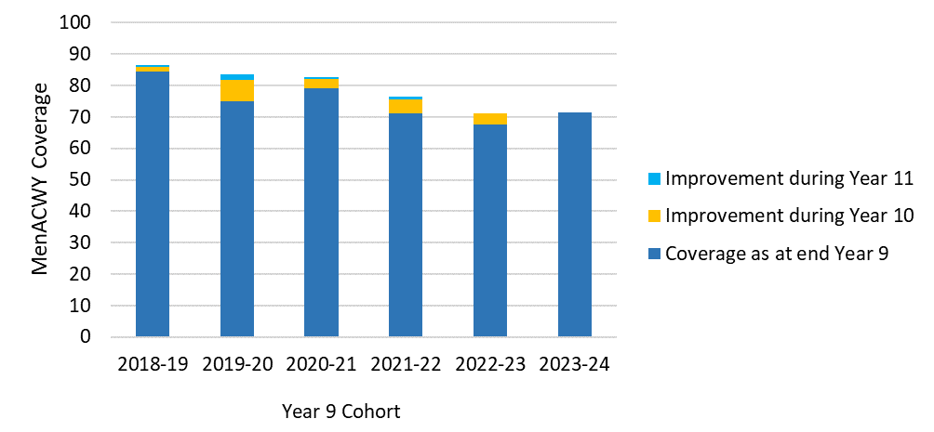
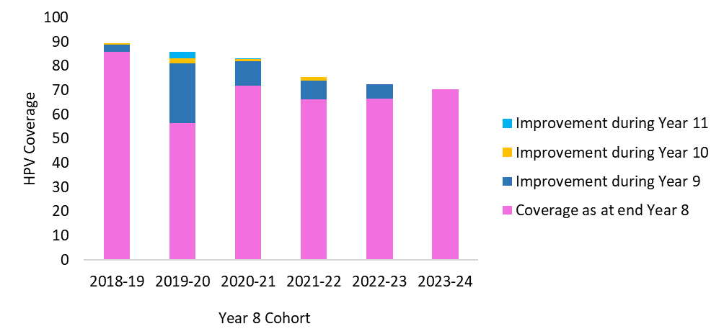
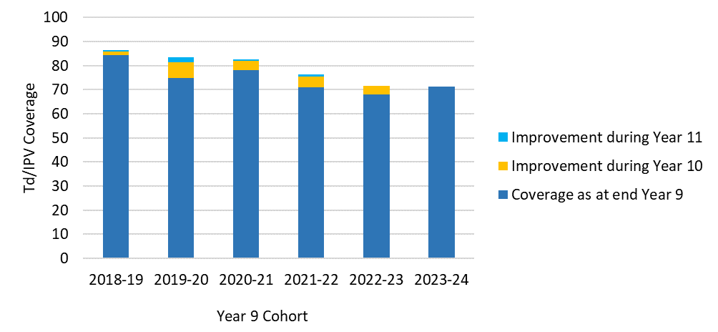
Importance of Catch-up Vaccinations
MenACWY and TdIPV coverage in a year cohort from academic year 2018-19 to 2023-24.
HPV coverage in a year cohort from academic year 2018-19 to 2023-24.
Notes:
Note reduction to one dose HPV potentially resulting in less opportunities for catch up vaccination
Promote offer of outstanding immunisations alongside any routine imms given and the importance of offering other opportunities in school or other settings.

Slide 65
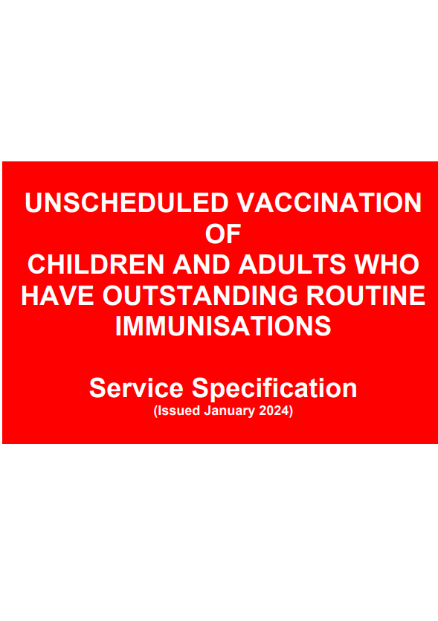
Primary care - catch up
Young people remain eligible for vaccination in primary care
  MMR – No upper age limit
  TdIPV – No upper age limit
  HPV – up to 25 years*
  MenACWY – up to 25 years
Vaccinations given to those individuals up to and including 18 years old should be reported to the health board local child health office within 7 days of the vaccine being administered
Notes:
HPV - under 25 years old (females born after 01/09/1991 and males born after 01/09/2006) unless patient has already commenced course by that age, in which case the course should be completed.

Slide 66
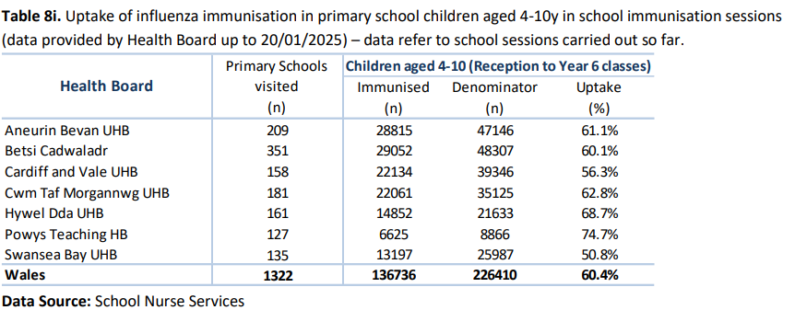

School Age Flu Programme
Final LAIV batch will be expiring on 3rd March this year
Stock will not be delivered with less than 14 days before expiry.
The last ordering date will be at cut off (11.55am) on Thursday 13th February with final deliveries on Monday 17th February.

Slide 67

MenACWY Vaccine Switch to MenQuadfi®
This is a straight vaccine brand switch, following a competitive tender. The vaccines are clinically equivalent.
Ordering opened on ImmForm for MenQuadfi® November 2024
Ordering for both Nimenrix® and MenQuadfi® remains open until Nimenrix® exhausted (some stock of Nimenrix already in circulation may not expire until early 2025)
MenQuadfi® is a black triangle drug ▼ and is supplied in 0.5-mL single-dose vials as a ready-to-use solution that does not require reconstitution.
Needles and syringes should be obtained locally.
Training materials, PGDs and resources updated to include MenQuadfi®

Slide 68









Resources
School age children and young people - Public Health Wales
Notes:
Available from our web pages and
Highlight and encourage use of resources

Slide 69
Adult programmes
Ceriann Howard – Specialist Nurse Immunisation
VPDP, PHW

Slide 70

Respiratory Syncytial Virus (RSV)
Routine vaccination programme for older adults and eligibility
Introduction of RSV vaccination programme 2024 (WHC/2024/032)
The aim of the programme is to reduce the incidence and severity of RSV disease, and hospitalisation because of RSV disease, in eligible older adults.
Routine (year-round) programme commenced 1 September 2024
Older adult eligibility:
  individuals become eligible on their 75th birthday and remain eligible until aged 79 years and 364 days (that is, up until and including the day before their 80th birthday)
  individuals who were born on or after 1 September 1949
Individuals should be invited within 12 weeks of their 75th birthday
Image source: PHW
Notes:
The GB Respiratory syncytial virus: the green book, chapter 27a - GOV.UK (www.gov.uk) guidance says:
Clinically it is preferable to vaccinate as soon as possible after individuals become eligible, so they are protected at the earliest opportunity:
for those turning 75 years of age between March and October each year, the vaccine should ideally be given by the end of October before RSV activity increases and
soon after turning 75 if their birthday falls during the RSV season (November to February)

Slide 71

RSV catch-up campaign
FORMAL LAUNCH: February 2025
A one-off (12 month) catch-up campaign for individuals aged 75 - 79 (DOB between 2 September 1944 and 1 September 1949 [inclusive])
ˆ Those turning 80 years of age between 2 September 2024 and 31 August 2025 will remain eligible up to and including 31 August 2025 (for the first year of the programme).
ˆˆ There was operational flexibility to start from 1 September 2024, if there was capacity or vaccination was requested by eligible individuals and could be accommodated.
Ref: Introduction of RSV vaccination programme 2024 (WHC/2024/032)
Notes:
*Individuals who are aged 79 years on 1 September will have their 80th birthday within the first year after the catch-up campaign commences (date of birth range 2 September 1944 to 31 August 1945 inclusive) but they remain eligible up until and including 31 August 2025 to ensure that they have sufficient opportunity to be vaccinated
*Other eligible individuals (date of birth range 1 September 1945 to 31 August 1949) are eligible until and including the day before their 80th birthday
*The formal launch of the one-off campaign for those aged 75 to 79 begins in February 2025. The one-off campaign will run for 12 months from the start of the programme, therefore starting from 1 September 2024 and concluding by 31 August 2025.

Slide 72

Preparing the Abrysvo▼® vaccine
Abrysvo▼® vaccine must be reconstituted prior to administration by adding the entire contents of the pre-filled syringe of solvent to the vial containing the powder using the vial adaptor
The vaccine must be reconstituted only with the solvent provided as directed in SmPC
Clear instructions on how to prepare the vaccine for administration can be found in the SmPC and the manufacturer's video. Immunisers are strongly encouraged to watch the video in its entirety before preparing the vaccine for the first time
More detailed information about the preparation, reconstitution and administration of Abrysvo▼® vaccine can be found in the RSV training slides which are available to view here: Immunisation training resources and events - Public Health Wales (nhs.wales)
Image from Abrysvo ▼ ® vaccine SPC

Slide 73

RSV and co-administration:
®
ˆˆˆ Giving Abrysvo▼® with the seasonal influenza vaccine may reduce the immune response to both the RSV and influenza (H3N2) components, which may increase the risk of severe respiratory disease in older adults. Additionally, co-administering the COVID-19 vaccine may diminish the immune response to the RSV vaccine. However, if it is thought that the individual is unlikely to return for their influenza or COVID-19 vaccine, they can be given at the same time.
Notes:
It is therefore recommended that RSV vaccine is not routinely scheduled to be given to an older adult at the same appointment or on the same day as an influenza or COVID-19. No specific interval is required between administering the vaccines. If it is thought that the individual is unlikely to return for a second appointment or immediate protection is necessary, Abrysvo® can be administered at the same time as influenza and/or COVID-19 vaccination. Reactogenicity for co-administered vaccines is expected to be consistent with the prof

Slide 74



RSV public resources
Resources are available to order for free on Health Information Resources website
(Note: please contact phw.vaccines@wales.nhs.uk if you wish to place a large order
Patient information leaflet
Bilingual digital version available on PHW vaccines website:
  English website page (English presents first on the leaflet)
  Welsh website page (Welsh presents first on the leaflet)
Poster

Slide 75






RSV healthcare professional resources
Resources are available to order for free on Health Information Resources website
Or download from the RSV HCP webpage
RSV Toolkit CYM/ENG
RSV Template invite
letter CYM/ENG
RSV Visual Aid CYM/ENG

Slide 76

Influenza programme
Change to the influenza vaccination programme 2024 to 2025 (WHC/2024/046) [04 December 2024]
Uptake of flu vaccine is sub-optimal
Concerning as flu is circulating
Health boards should now support Primary Care services, through partnership working, with targeted flu ‘mop up’ to maximise uptake in all adult groups, particularly those in a clinical risk group
A weekly summary of administered vaccinations must be provided by HBs to the registered GPs of vaccinated individuals (to enable updates to the patient record using an appropriate code)
HBs will be expected to record vaccine administration using WIS
Every effort should be made to check an individual’s previous vaccination history prior to vaccine administration

Slide 77

COVID-19 Spring 2025
JCVI statement published [14 November 2024]
Eligiblity:
JCVI advises that the following groups should be offered COVID-19 vaccination in Spring 2025:
  adults aged 75 years and over*
  residents in a care home for older adults
  individuals aged 6 months and over who are immunosuppressed (as defined in the ‘immunosuppression’ sections of tables 3 or 4 in the COVID-19 Green Book: Chapter 14a)
Timing:
COVID-19 vaccine should usually be offered no earlier than around 6 months after the last vaccine dose, although operational flexibility around the timing of vaccination in relation to the last vaccine dose is considered appropriate (with a minimum interval of 3 months between doses). Refer to COVID-19 Green Book: Chapter 14a
Notes:
JCVI advise as COVID-19 becomes an endemic disease, and with a move towards standard assessment of cost-effectiveness, the focus of the programme is shifting towards targeted vaccination of the oldest adults and individuals who are immunosuppressed.
*Adult eligibility
Adult eligibility should be based on the willingness-to-pay approach that is subject to procurement and delivery at a cost-effective price. The advice for universal vaccination from age 75 years is an example. JCVI has no role in the procurement or delivery of COVID-19 vaccines or any other vaccine.
The exact price paid for vaccines used in future programmes will be dependent on the procurement process run by the UK Health Security Agency (UKHSA) and these commercially confidential prices will not be made available to JCVI. The deployment costs of the programme per person are also variable, with the minimum cost being the relevant item of service fee (for example £10.04). Given these variables, the actual size of a cost-effective programme may be slightly smaller or larger than this advice specifies. DHSC should aim to deliver a programme which is cost-effective, as determined by the latest modelling results from the University of Warwick and based on the price of the vaccine and the cost of delivery.
Ref: JCVI statement on COVID-19 vaccination in 2025 and spring 2026 - GOV.UK

Slide 78

COVID-19 Spring
WHC COVID-19 spring vaccination programme 2025 (WHC/2024/047) [19 December 2024]
Campaign programme: 01/04/2025 – 30 June 2025*
Health boards are expected to continue to:
  maximise vaccine uptake
  minimise vaccine waste
  retain their focus on reaching the most vulnerable
  understand and address inequity by ensuring access for all eligible people
  invite all eligible
  ensure uptake levels are maintained or improved across all cohorts
  75 years + and resident in an adult care home achieve 75% uptake target
Training slides will be available here
Patient information leaflet will be available here
COVID-19 vaccine record card is available to order here
Notes:
* There will be some limited flexibility into July, for those who are unable to receive a vaccination within the main programme window, due to illness.

Slide 79







Flu and COVID-19 public resources
Bilingual digital version available on PHW vaccines website:
  English website page (English presents first on the leaflet)
  Welsh website page (Welsh presents first on the leaflet)
Resources are available to order for free on Health Information Resources website (Note: please contact phw.vaccines@wales.nhs.uk if you wish to place a large order)
The following accessible versions are available here (ENG/WEL):
  Large Print
  Easy Read
  BSL
  Audio

Slide 80



Flu healthcare professional resources:
Frequently asked questions for health professionals. Available here
PHW Management chart for influenza (flu) vaccination in egg allergic individual (June 2024). Available here
NHS Wales recommended flu vaccines (PHW 2024/25 Influenza season). Available here

Slide 81
Shingles vaccination update
In Wales, the Vaccine Clinical Advisory Group (VCAG) and Welsh Government have agreed that if following a clinical assessment, a severely immunosuppressed* individual would benefit from revaccination then they can be offered a course of Shingrix (2 doses of Shingrix vaccine at a minimum interval of 8 weeks apart) on a permissive approach based on opportunistic clinical identification. There is no reason to leave any interval after previous Zostavax vaccine for these individuals.
The Welsh Health Circular: Change of vaccine and cohort expansion for shingles vaccination programme (from September 2023) (WHC/2023/024) was updated to reflect this on 02 January 2025.
The use of stock from ImmForm is permitted in these cases as the individuals being offered would be severely immunosuppressed. A Patient Group Directive (PGD) cannot be used in these cases and an alternate legal framework for administration will be required e.g. Patient Specific Directive (PSD) or prescription. The practice would be reimbursed for administering the course of Shingrix under the Statement of Financial Entitlements (SFE).
The UKHSA Shingles vaccination: guidance for healthcare practitioners resource provides further information here
FAQ ‘Can individuals who have had the Zostavax vaccine routinely (between 70-79years) but who have since become severely immunosuppressed* be re-vaccinated with two doses of Shingrix?’ is available here Frequently asked questions
Notes:
*For definition of severely immunosuppressed refer to Box Green Book: Shingles Chapter 28a

Slide 82



Shingles public resources
A shingles leaflet for adults is available to order from the Health Information Resources (HIR) which can be accessed here: https://phw.nhs.wales/services-and-teams/health-information-resources/#!/Imiwneiddio-Immunisation/c/38145364
A shingles poster is available to order from the Health Information Resources (HIR) which can be accessed here: https://phw.nhs.wales/services-and-teams/health-information-resources/#!/Imiwneiddio-Immunisation/c/38145364

Slide 83


Shingles Healthcare Professional Resources (1)
Shingles ’Frequently Asked Questions’ are available here:
An updated shingles healthcare professional visual aid is available to download in ENG/CYM here
An updated shingles immunisation programme toolkit for Healthcare Practitioners is available to download in ENG/CYM here

Slide 84




Shingles Healthcare Professionals Resources (2)
A template invitation letter is available to download here in English and Welsh
Template with date for appointment
Template with no date for appointment

Slide 85

Mpox (1)
JCVI statement published [10 November 2023] which advises an ongoing routine vaccination strategy for protection against mpox should be developed to prevent future outbreaks and protect those at risk of exposure
Eligibility:
Gay, bisexual and men who have sex with men (GBMSM) at highest risk. Risk criteria include:
    a recent history of multiple partners
    participating in group sex
    attending sex-on-premises venues
    a proxy marker such as a bacterial STI within the last year
Individuals at equivalent risk (e.g. transgender women, gender-diverse people assigned male at birth)
Image source: https://northeastlondon.icb.nhs.uk/health-advice/advice-about-mpox/
Notes:
Eligible individuals would be identified by sexual health services

Slide 86


Mpox (2)
Outbreak response vaccination continues (2022)
Awaiting policy for routine programme
Recent update to Green Book Chapter 29: Smallpox and mpox
Training slides will be available here
Patient information leaflet will be available here
Updated consent form will be available here
Mpox record card will be available to order here
Sexual health toolkit is available to download here

Slide 87
MenB for gonorrhoea (1)
JCVI statement published [10 November 2023] which advises a targeted programme using the 4CMenB vaccine (2 doses) for the prevention of gonorrhoea in those who are at greatest risk of infection
Eligibility:
  GBMSM who are at increased risk. Criteria includes but not limited to:
    a recent history of gonorrhoea or other bacterial STI diagnosis, individuals should also be offered vaccination after a gonorrhoea diagnosis (whether symptomatic or asymptomatic)
    reporting high-risk sexual behaviours with multiple partners during sexual health screening and assessment
  Individuals at similar risk (including but not limited to transgender women, gender-diverse people assigned male at birth)
  Vaccination should be considered for those who have equivalent markers of increased risk including but not limited to those with a recent history of bacterial STI diagnosis and sex workers
Notes:
Opportunistic offer through sexual health services

Slide 88

MenB for gonorrhoea (2)
Awaiting policy
Awaiting publication of Green Book chapter
Training slides will be made available here
Patient information leaflet will be available here
Sexual health toolkit available to download here

Slide 89
Engagement team update
Sonia Khoury- Service Development and User Engagement Senior Practitioner
VPDP, PHW

Slide 90

Purpose of the VPDP Engagement:
Focuses on gathering insights to enhance designing and providing tailored interventions and promote vaccine equity across various vaccination programs and population groups. This purpose ensures that vaccination efforts are inclusive, effective, and equitable while addressing the unique needs of diverse populations ( Public Health Wales, 2025).

Slide 91

VPDP Engagement Key Responsibilities:
Establishing/enhancing advocacy partnership, Third Sector, Community groups, Governmental bodies. etc
Facilitating tailored interventions
Addressing uptake inequities
Collecting insights and analysing data to identify the unique needs of different population groups.
“keep sharing, keep having #VaccineConversations”.
British Society for Immunology,
Vaccine Engagement Day, 2024

Slide 92

Engagement insights - Public Health Wales
Our work is life course based
Such as :

Slide 93



School aged public engagement:
Co-Production
Purpose: To gather behavioural insights relating to the knowledge, attitudes, experiences, and preferences of children and young people, to create better tailored vaccine resources.*
Previous co-produced resources (2023/2024): :
What is the HPV vaccine? Video animation and comic: HPV vaccine - Public Health Wales
What is the Flu vaccine? Video animation and comic: About the vaccine - Public Health Wales
Co-produced resources in development (involving 13–14-year-olds):
What is the MenACWY vaccine?
What is the 3-in-1 booster (Td/IPV) vaccine?
*Full suite of school-aged vaccine animations/resources anticipated by end of April 2025.

Slide 94
School aged public engagement:
Behavioural insights summary
Previous insights from HPV / Flu focus groups, with Children & Young people CYP 11-16 years old (2023/2024):
Parents/guardians have a key role in vaccine related decision-making
Information to include: how the vaccine is given, the benefits, the consequences of not getting vaccinated, potential side-effects and reassurances about pain
Resources that address their psychological needs: autonomy, choice, anxiety
Resources to be shown in schools
Audio-visual resources: short, funny, upbeat, colourful, age appropriate, and representative of diversity
Snapshot of recent insights from MenACWY / 3 in 1 booster focus groups, with CYP 13–14 years old:
Key motivators include understanding the consequences of not getting vaccinated, and reassurance on vaccine safety.
Barriers can include insufficient information, doubts about vaccine reliability, concerns about side effects, ​fear of needles and anticipated pain.
Information from personal experiences and in-person reassurance are highly valued.
Young people prefer a mix of messengers, including peers, family, and medical professionals. ​
*Anticipate the MenACWY / 3 in 1 booster insights report will be available to share with completed co-produced resources by end of April 2025.

Slide 95
School aged public engagement:
What do we need to include in our resources? Recommendations from the MenACWY/3 in 1 report (2024/25)
  Education– include information on side effects, and statistics of uptake among young people
  Coercion - highlight negative consequences of not receiving vaccination
  Modelling – use personal stories and anecdotal evidence
  Incentivisation – highlight personal responsibility for one’s own health and the broader impact on others' health.
  Persuasion – using an engaging question, or visually appealing hook, and bright, energetic music
*Anticipate the MenACWY / 3 in 1 booster insights report will be available to share with completed co-produced resources by end of April 2025.

Slide 96
Communication team update
Jodie Philips - Communications Manager
Health Protection and VPDP
Ishani Sen - Communications officer
Health Protection and VPDP

Slide 97
RSV vaccine- Implementation
Timings: Two bursts of activity August & January. Campaign included media relations, paid digital ads, radio adverts, stakeholder engagement
Press release – Pregnant midwife case study
Primary care toolkits shared with HBs - Canva amendable assets, GP screens video content - fact file video, peer to peer midwife video (script in collaboration with midwives), midwife to patient video
Paid for campaign (July-October) included: Radio advertising, digital audio ads – podcasts, broadcast video on demand (BVOD) Ad pause, meta-ads, YouTube and TikTok, programmatic digital ads
Influencer content - 2 pregnant women
Organic social media – older adults and pregnant women
Stakeholder comms – Health boards, Welsh Government (WG), midwifes, primary care, pregnancy and older people stakeholders (eg: Older People's Commissioner for Wales & Age Cymru
The second phase of the paid for communications campaign is currently ongoing (Jan-Feb) which includes meta (Facebook and Instagram)and digital ads, BVOD and digital radio

Slide 98







Example campaign images – RSV vaccine
98

Slide 99
Winter Respiratory vaccine campaign Implementation
Integrated communications campaign encompassing a range of communication channels, as outlined below. Campaign period: October-December
Press releases – launch focus clinically at-risk, WG follow up on uptake, Beat Winter Viruses
Amendable assets for Health boards - Canva amendable assets,
Organic social media – Facts in 30, side effects, why vaccines are important etc
Paid for campaign: Radio advertising, digital audio ads, broadcast video on demand (BVOD) ad pause, Meta ads, YouTube and Tiktok, programmatic digital ads
Advertorials in print media
Influencers – parents and pregnancy, clinically at risk, health and social care
Partnership content – Now in a Minute and Grangetown hub video
Collaborative content – Healthcare workers video with the Health boards
Stakeholder comms – health boards, welsh govt.,primary care, parent groups, pregnancy, older people (eg: Age Cymru), clinically at risk (eg: asthma and lung uk), housing orgs, ethnic minority orgs, etc

Slide 100








Example campaign images
100

Slide 101

Media coverage
Launch on Tuesday 1 October. Focused on clinically vulnerable and their risks of not being vaccinated – Case study - 26-year-old who was hospitalised with flu.
Coverage across BBC Wales TV and Online, Radio Wales, ITV Wales, Wales Online, Radio Cymru, S4C’s Newyddion and Nation.Cymru
Other media activity
13 December – Reminding public to practice healthy behaviours. Coverage in Wrexham.com, Daily Post, Capital Radio, Radio Cymru, Heart FM, and others.
31 December – Healthy and Happy new year message. Coverage in BBC Radio Wales, Radio Cymru, S4C, Wales Online, the Daily Post (North Wales), Deeside.com, and others.
Round of media interviews with Dr Giri Shankar talking about vaccine uptake, 2 January - coverage in BBC Radio Wales, BBC Online, Newyddion, Capital, Heart FM and others and interviews on 8 January with ITV Wales

Slide 102


Website and resources
Immunisation and Vaccines - Public Health Wales
Leaflets - Public Health Wales
102

Slide 103


Welsh Immunisation Conference
Poster presentations
Posters are an important part of the Welsh Immunisation Conference helping to share immunisation initiatives and good practice from across Wales.
E-posters will be displayed on screens at the conference and attendees will have the opportunity to view throughout the day and to vote for their favourite two posters.
Winners will be announced and presented with their prize and a photo opportunity shortly before the conference closes.
Closing date for nominations 7th March 2025
Welsh Immunisation Conference - Public Health Wales
Thursday 1st May 2025 – Liberty stadium Swansea (now known as Swansea.com Stadium)

Slide 104
Q&A session

