Slide 1
Changes to the routine childhood immunisation programme in 2025 and 2026
Vaccine Preventable Disease Programme
Public Health Wales
V1
4 June 2025
Notes:
Material contained in this document may be reproduced without prior permission provided it is done so accurately and is not used in a misleading context.
Acknowledgement to Public Health Wales NHS Trust to be stated.
© 2025 Public Health Wales NHS Trust.

Slide 2
Changes to the childhood immunisation programme
The information contained within this slide set is up to date as of 04/06/25.
It is important that all immunisers delivering the childhood immunisation programme and/ or those who are providing immunisation advice familiarise themselves with the most up to date clinical evidence and guidance, this can be found in the following key documents:
All relevant Green Book chapters, PGDs and existing resources will be updated
Welsh Health Circular: Changes to routine childhood and selective neonatal hepatitis B vaccinations (WHC/2025/019) [HTML] | GOV.WALES
Joint Committee on Vaccination and Immunisation: Joint Committee on Vaccination and Immunisation (JCVI) statement on changes to the childhood immunisation schedule
JCVI Minutes 5th February 2025 Joint Committee on Vaccination and Immunisation - GOV.UK
VPDP webpage is available here: Changes to the childhood immunisation schedule - Information for health professionals - Public Health Wales
The content of this training slide set is subject to review. This resource will be version controlled. This is version 1. Trainers should select the slides required depending on the background and experience of the vaccinators they are training and according to the role they will have in delivering the childhood vaccination programme.
2

Slide 3
Acknowledgements
These slides were originally produced by UK Heath Security Agency (UKHSA). With permission from colleagues in UKHSA the content of these slides have been adapted for use in NHS Wales by the Vaccine Preventable Disease Programme in Public Health Wales.
UK Health Security Agency: www.gov.uk/government/topics/public-health
Vaccine Preventable Disease Programme (VPDP), Public Health Wales: Immunisation and Vaccines - Public Health Wales

Slide 4
Contents
Aims
Objectives
Background and overview of the changes to the childhood immunisation schedule: first year of life
Background and overview of the changes to the childhood immunisation schedule: second year of life
Selective Hepatitis B infants programme eligibility
Summary & resources
4

Slide 5
Aims
To provide information for healthcare practitioners involved in advising on and delivering the childhood immunisation programme
To raise awareness of the changes to the childhood immunisation programme
To outline the proposed changes to the childhood immunisation programme; what, when and why
To highlight resources that support the changes to the childhood immunisation programme
5

Slide 6
Objectives
Following this training slide set, immunisers will be able to:
Describe the changes to the childhood immunisation programme
Understand the rationale and evidence base for the changes to the childhood immunisation programme
Describe the benefits of the changes to the childhood immunisation programme
Identify relevant resources and additional information in relation to the childhood immunisation programme
6

Slide 7
Key messages
Manufacturing of Hib/MenC (Menitorix) discontinued
Vaccination against MenC in early childhood no longer necessary
Vaccination against Hib in second year of life needs to continue
A new 18-month appointment will be introduced
Second MMR to be moved from 3 years 4 months to the new 18-month appointment
Change of order of vaccines MenB and PCV
Additional Hib containing vaccine (DTaP/IPV/Hib/HepB (6 in 1) to be given at the new 18-month appointment
Notes:
Joint Committee on Vaccination and Immunisation (JCVI) statement on changes to the childhood immunisation schedule - GOV.UK

Slide 8
Background and overview of the changes to the vaccination schedule:
first year of life

Slide 9

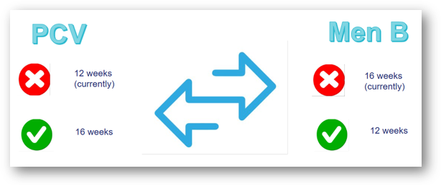
Changes for infants less than 12 months old
The order of the PCV​ and MenB vaccines will be changed
Infants this age predominantly rely on indirect protection from PCV; therefore, this vaccine can be switched with MenB without negative effect.​
Giving the MenB vaccine earlier would provide earlier immunological protection against invasive MenB disease, without compromising longer term immunological protection.
Notes:
Health circulars: 2024 to 2027 | GOV.WALES
JCVI Minutes 5th February 2025 Joint Committee on Vaccination and Immunisation - GOV.UK

Slide 10

Rationale for the changes to the infant schedule
Meningococcal serogroup B is responsible for the majority of UK invasive meningococcal disease (IMD) cases
Following introduction of the routine MenB vaccination programme, peak age of infection has shifted from 5 to 6 months to 1 to 3 months of age
A substantial proportion of cases were occurring before infants gained protection from their second dose of vaccine given at 16 weeks
The change in epidemiology of IMD means it would be beneficial to move the second dose of MenB vaccine to 12 weeks of age to provide earlier protection
Moving the PCV dose to 16 weeks avoids increasing the number of injections at the second vaccination appointment at 12 weeks
Young children will be protected by very high levels of herd immunity against the pneumococcal vaccine serotypes until they receive their dose of PCV13 at 16 weeks
Although previously an 8-week interval between doses of MenB vaccine was recommended, evidence from a recent study showed a good response was made when the 2 doses were given 4 weeks apart

Slide 11
Implementation of PCV/MenB swap
From 1 July 2025
Has the child had their 12-week vaccinations?
No
Vaccinate as per new schedule timings (2nd Men B at 12 weeks and 1st PCV at 16 weeks)
Yes
Already had 12-week PCV before 1 July
Stay on previous schedule and have 2nd Men B vaccine at 16 weeks of age

Slide 12
Background and overview of the changes to the vaccination schedule:
second year of life

Slide 13

Changes for second year of life vaccines
The manufacturing of Hib/MenC (Menitorix®) vaccine has been discontinued
Commercial decision by the manufacturer (GSK)
This is the only Hib/MenC vaccine available, so changes to the routine infant schedule are necessary
UKHSA estimates that the central stock of Hib/MenC will be depleted by mid-2025
JCVI advised that MenC vaccine is no longer required in the childhood schedule
The success of the Meningococcal C containing vaccine programmes and the decline of invasive Meningococcal C disease subsequently
The excellent current control of Meningococcal disease can be maintained through the MenACWY teenage vaccine programme
JCVI advised that there is still a need for a dose of Hib vaccine during the second year of life

Slide 14
Men C disease and vaccination
The Men C vaccine programme commenced in 1999. This led to a significant reduction of invasive meningococcal disease
The Men ACWY programme commenced in 2015. This led to further reduction of Men C disease (as well as Men W disease)
Covid-19 social distancing and lockdown measures led to a further decline in spread and detection of invasive meningococcal disease (IMD)
Modelling work has found that indirect protection against MenC disease is sustained because of the teenage MenACWY programme
Over time it is expected that the teenage MenACWY programme will reduce carriage prevalence of Men C,W and Y to near elimination levels
  Group A has been almost undetectable for many years in the UK
  Carriage prevalence = how many carrying the meningococcal bacteria in their nose and throat
With the reduction in carriage prevalence of these meningococcal serogroups, it has been predicted that there will be very few IMD cases caused by meningococcus groups A,C,W and Y each year, by the time the Menitorix® is no longer available
Notes:
Joint Committee on Vaccination and Immunisation (JCVI) statement on changes to the childhood immunisation schedule - GOV.UK (November 2022)

Slide 15

Hib disease and vaccination
Before the Haemophilus influenzae type B (Hib) vaccine was introduced, about 1/600 children developed Hib disease before they were 5
Most common presentation of invasive Hib disease: meningitis (60%of all cases), epiglottitis (15%), bacteraemia (10%), septic arthritis, pericarditis, cellulitis, pneumonia and osteomyelitis
People can carry Hib bacteria in their nose and throat without showing symptoms of the disease. Before introduction of Hib vaccine, 4% pre-school children carried Hib organism
After the vaccine was introduced, carriage rates fell below level of detection. Disease incidence has fallen in all age groups. Not just those vaccinated
However, as immunity following a 3-dose primary course of Hib in infancy does wane, a 4th (booster) dose during the 2nd year of life is needed to continue to prevent transmission in the community and maintain herd immunity
Modelling shows that Hib transmission is primarily driven by children aged 2 to 4 years, therefore vaccination at any time before then should prevent transmission
A dose of a multivalent Hib-containing vaccine at 18 months will also boost the child’s protection against other infections such as pertussis and polio

Slide 16

Moving the second dose of MMR
The new 18 months appointment provides an opportunity for the second dose of MMR vaccine to be brought forward from 3 years 4 months to 18 months of age
The main reason for bringing the second dose of MMR forward is to improve coverage and reduce the likelihood of measles outbreaks
In areas of London, where the second dose of MMR was brought forward in response to local measles outbreaks in the 2000s, second dose coverage increased by an average of 3.3% (Lacy et al., 2022)
JCVI considers the likely added benefit of increasing uptake of second MMR further justifies the additional routine immunisation appointment
If the second MMR is not received at 18 months, there is a further opportunity to give it at 3 years and 4 months with the dTaP/IPV (4 in 1) booster vaccine
Notes:
*Lacy J and others (2022). ‘Impact of an accelerated measles-mumps-rubella (MMR) vaccine scheduled on vaccine coverage: an ecological study among London children, 2012-2018’ Vaccine: volume 40, issue 3, pages 444 to 449

Slide 17
Infants eligible for the selective Hepatitis B vaccination programme

Slide 18
Selective HepB neonatal programme for babies born to
HepB positive mothers
Children born on or after 1 July 2024 who are on the selective hepatitis B vaccination programme will no longer be offered a monovalent vaccine at 12 months of age as they will now receive a further dose of hepatitis B vaccine as part of the DTaP/IPV/Hib/HepB vaccine (6 in 1) being offered at 18 months
It is important that these children receive Hep B surface antigen (HBsAg) testing between 12 months and 18 months
Children born on or before 30 June 2024 who are on the selective hepatitis B vaccination programme should continue to be offered a dose of monovalent hepatitis B vaccine with their other one-year vaccinations (Hib/MenC, MenB, MMR and PCV13) as per the previous schedule
After 1st July 2025 Hib/MenC is no longer available, the additional dose of the DTaP/IPV/Hib/HepB vaccine (6 in1) vaccine at 18 months replaces the need for a dose of monovalent HepB vaccine at 12 months
This age cohort should continue to be tested for infection from 12 months of age

Slide 19
Selective HepB neonatal programme for babies born to
HepB positive mothers
The additional dose of the DTaP/IPV/Hib/HepB (6 in1) vaccine at 18 months replaces the need for a dose of monovalent HepB vaccine at 12 months
It is very important that babies on the selective neonatal HepB schedule receive this 18-month dose
Testing for HepB surface antigen (HBsAg):
Can be undertaken any time between 12 and 18 months of age, e.g., at an opportunistic healthcare attendance or at a routine appointment
The requirement to record the results of the baby’s blood test for HepB surface antigen (HBsAg) in their primary care record remains unchanged
19

Slide 20
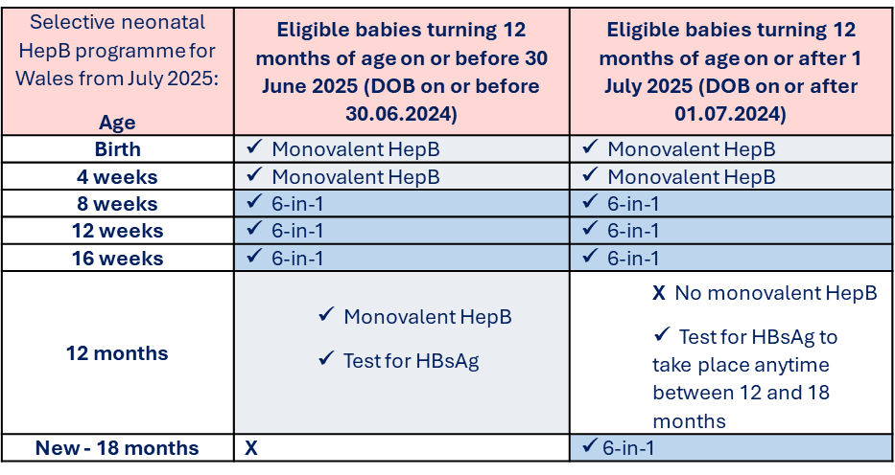
Selective HepB neonatal programme for babies born to
HepB positive mothers
More information about this change and a downloadable information sheet is in preparation and will be available at Hepatitis B (HepB) - Information for health professionals - Public Health Wales
20

Slide 21
Summary & Resources
Influenza

Slide 22
Summary of changes
From 1st July 2025:
The routine Hib/Men C (Menitorix®) offer to those turning 12 months of age will cease.
Second Men B vaccine moved from 16 weeks to 12 weeks appointment.
First PCV vaccine moved from 12 weeks to 16 weeks appointment.
The monovalent Hep B dose at 1 year in the selective neonatal HepB programme will be removed from the schedule.
From 1st January 2026:
Introduction of an additional (4th dose) of DTaP/IPV/Hib/HepB vaccine (6 in1) at a new routine appointment at 18 months.
Movement of the second MMR dose from 3 years 4 months to the new routine 18-month appointment.
22

Slide 23
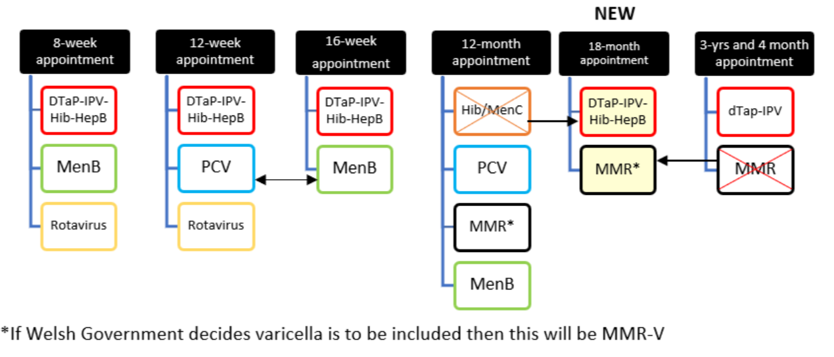
Summary of changes to routine childhood schedule

Slide 24
Implementing the changes: timeline and eligibility
Children who have their first birthday on or after 1 July 2025 (DOB on/after 01/07/24):
Should be offered first MMR, second PCV13 and third MenB at their one-year-of-age vaccination appointment but will not be offered Hib/MenC (Menitorix®)
Should be offered a DTaP/IPV/Hib/HepB (6 in1) booster dose at a new 18-month routine vaccination appointment (starting from 1 January 2026)
Should be offered their second dose of MMR at the new 18-month appointment
Should be offered DTaP/IPV (4 in 1) booster vaccine at 3 years 4 months of age

Slide 25
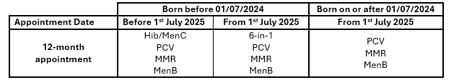
Implementing the changes: timeline and eligibility
Children who turned one year of age on or before 30 June 2025 (DOB on/before 30/06/24):
  Should be offered Hib/MenC (Menitorix®) at their one-year-of-age vaccination appointment as per the previous schedule, along with their first MMR, second PCV13 and third MenB
  After 1 July 2025 there will be no Hib/MenC (Menitorix®) available. If children born on or before the 30th June 2024 present for their 12-month appointment after 1 July, they will be offered DTaP/IPV/HepB (6 in 1) instead, alongside PCV, MMR and MenB scheduled at one year of age
Should be offered their booster dose of dTaP/IPV (4 in 1) vaccine at 3 years 4 months, along with their second dose of MMR

Slide 26
General information
There are no new vaccine products in the amended schedule – the DTaP/IPV/Hib/HepB (6 in 1) vaccine administered at age 18 months is the same vaccine that is given at 8, 12, and 16 weeks of age
DTaP/IPV/Hib/HepB (6 in 1) vaccines for the 18-month appointment should be ordered via ImmForm
Monovalent Hepatitis B vaccine for children on the selective HepB pathway should be ordered directly from the manufacturer
All PGD's will be updated and available at Patient Group Directions (PGD) - Welsh Medicines Advice Service

Slide 27
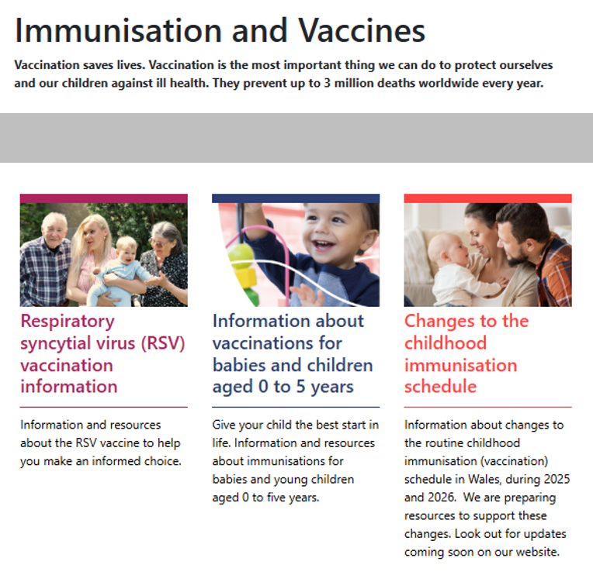
Website pages and resources for CCS
Key pages/connection points for changes to the childhood immunisation schedule (CCS)
Landing pages link to other vaccine web pages and resources
affected by CCS.
Landing pages for CCS:
    Information about vaccinations for babies and
    Children aged 0 to 5 years (preschool landing page)
    Changes to the childhood immunisation schedule
    Changes to the childhood immunisation schedule
    – Information for health professionals
Other key web pages:
  Routine immunisation schedules for Wales
These web pages will be updated as more information and policy becomes available.
27

Slide 28
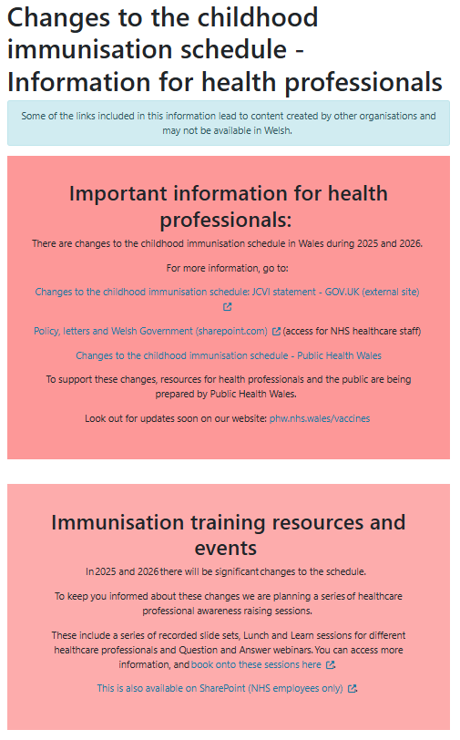
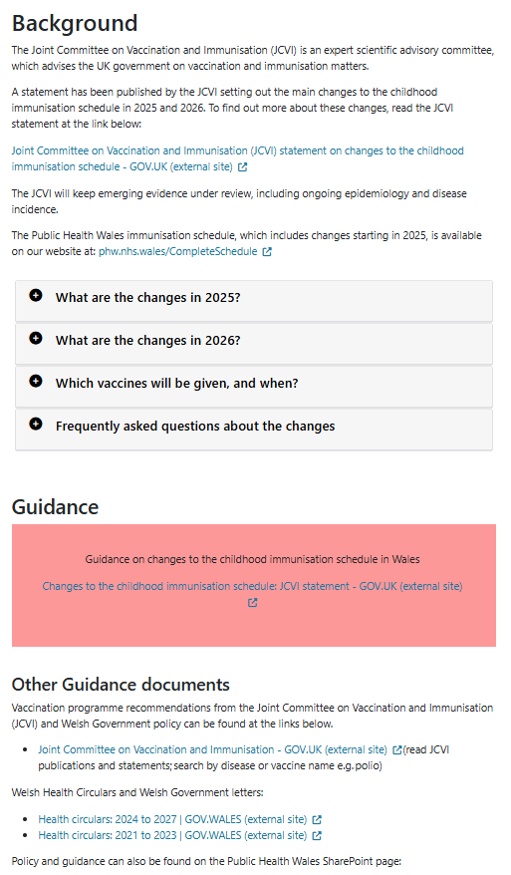
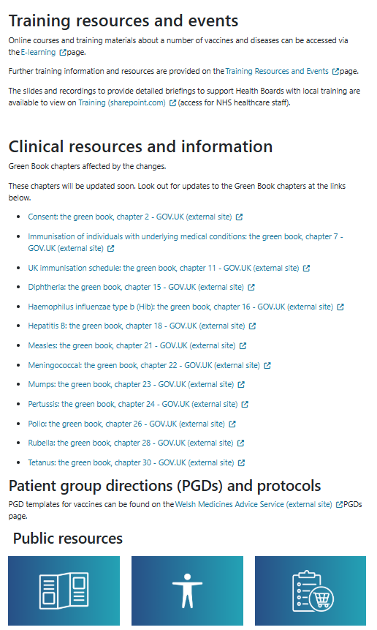
Website pages and resources for CCS
28

Slide 29
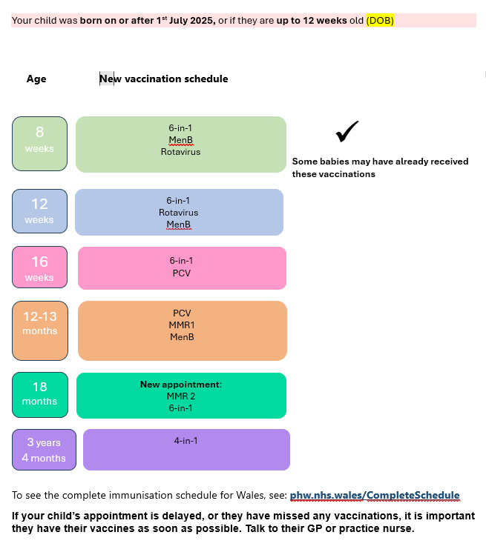
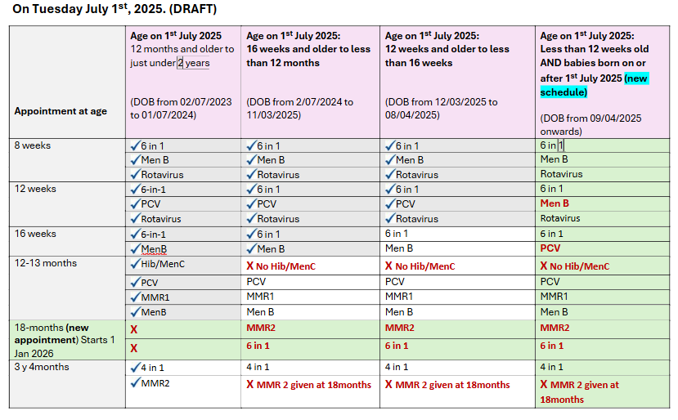
Website pages and resources for CCS
Key information for health professionals
phw.nhs.wales/vaccines/ccs-information-for-health-professionals
Vaccine eligibility tool (visual table on web page – downloadable)
Changes to the selective neonatal Hepatitis B (HepB) vaccination programme information sheet
CCS visual aid
CCS toolkit
Unscheduled immunisation record form for GP practices (to be updated in July 2025, and in January 2026)
Key information for the public
phw.nhs.wales/vaccines/ccs-information-for-public
Eligibility tables (on web page)
29

Slide 30
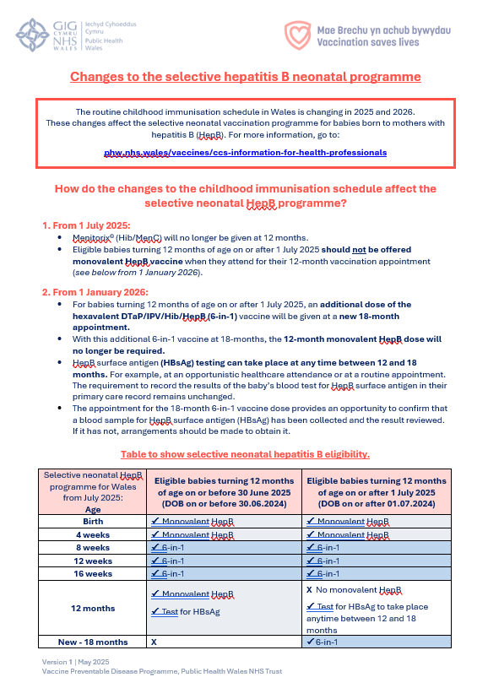
Website pages and resources for CCS
Health professionals resource example:
Changes to the selective neonatal Hepatitis B (HepB) vaccination programme information sheet
This resource will be available for online view, and as a downloadable document from:
  Hepatitis B (HepB) - Information for health professionals - Public Health Wales
Basic information about the selective neonatal HepB programme (including a link to the web page above) will also be provided on:
  Changes to the childhood immunisation schedule - Information for health professionals - Public Health Wales
Current selective neonatal HepB programme | Proposed change
Monovalent at birth, 4 weeks and 12 months Also, Hep B as part of 6-in-1 at 8 weeks, 12 weeks and 16 weeks. | Additional 6-in-1 at 18 months will affect selective HepB. Removal of 12-month monodose, therefore remove. HBsAg test and hexavalent can be given at 18-month appointment.
30

Slide 31

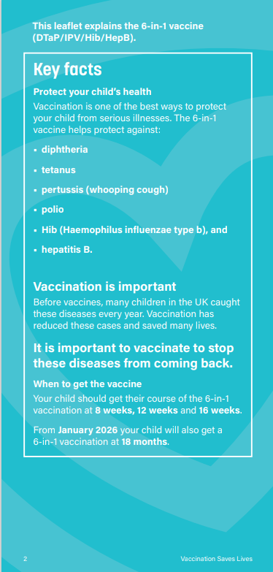
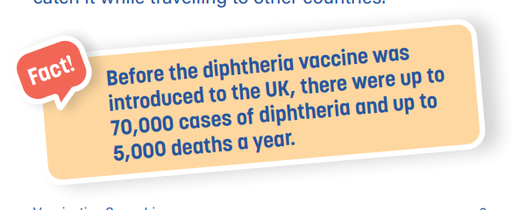
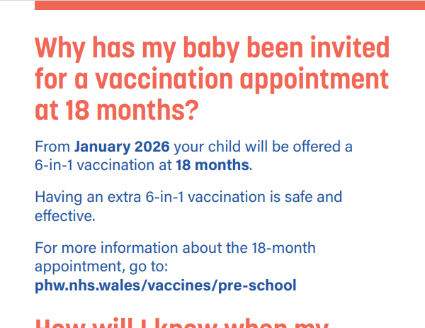
Website pages and resources for CCS
Public resource example: 6-in-1 leaflet
Go live date: 1st January 2026
Information kept brief for the public, with signposting to the public-facing website.
New fact boxes and summary boxes to aid readability.
QR code on the front of the leaflet for accessibility.
31

Slide 32
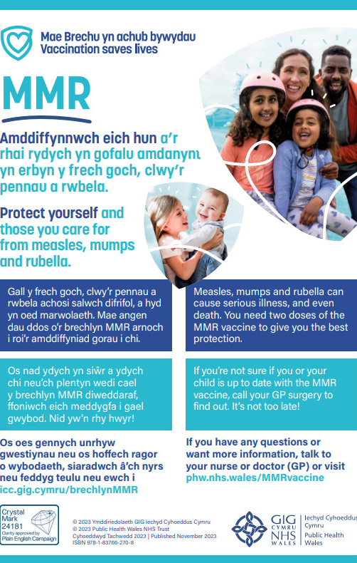
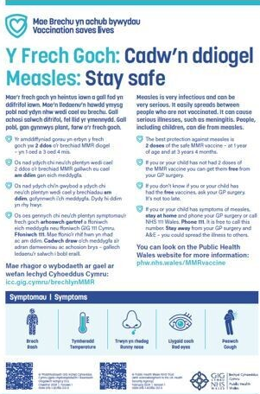
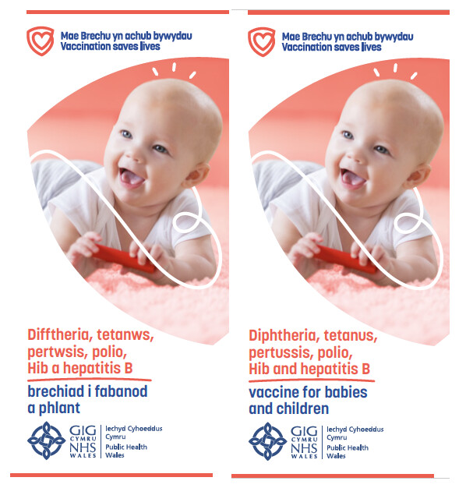
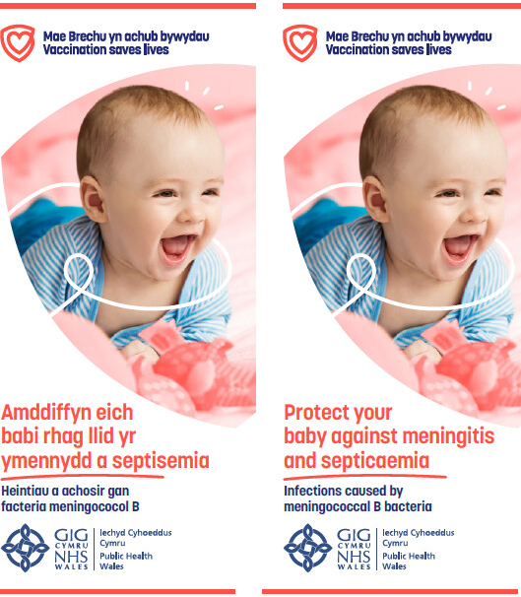
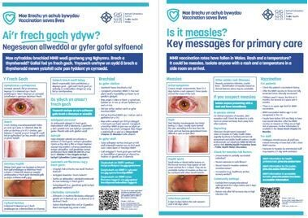
Leaflet ordering: free to order at Health Information Resources - Public Health Wales
32

Slide 33
Useful links
Joint Committee on Vaccination and Immunisation (JCVI) statement on changes to the childhood immunisation schedule
JCVI Minutes 5th February 2025 Joint Committee on Vaccination and Immunisation - GOV.UK
Changes to routine childhood and selective neonatal hepatitis B vaccinations (WHC/2025/019) | GOV.WALES
All relevant Green Book chapters will be updated: Immunisation against infectious disease - GOV.UK
*Childhood schedule changes from 1 July 2025: information for healthcare practitioners - GOV.UK
MenACWY programme: information for healthcare professionals - GOV.UK
Pneumococcal vaccination: information for healthcare practitioners - GOV.UK
*Vaccination of individuals with uncertain or incomplete immunisation - GOV.UK
Patient Group Directions (PGD) - Welsh Medicines Advice Service
Notes:
* It’s important to highlight that the advice in relation to Hib/MeC ( Menitorix) is different to Welsh policy. NHS Wales is deploying a ‘hard stop,’ so from 1 July 2025 Hib/MenC (Menitorix ®) will no longer be included in the childhood immunisation schedule in Wales. Please refer to Welsh Policy for further information: Changes to routine childhood and selective neonatal hepatitis B vaccinations (WHC/2025/019) | GOV.WALES

Slide 34
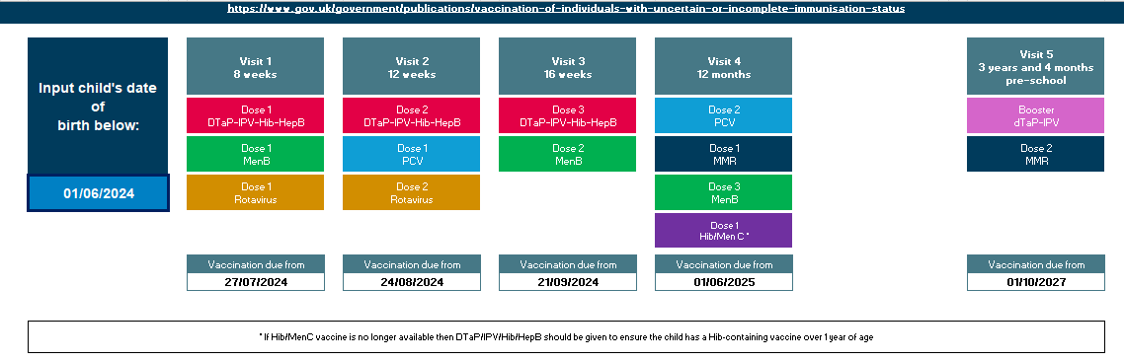
*UKHSA - Childhood immunisation eligibility calculator
Childhood immunisation eligibility calculator - Health Publications
*It’s important to highlight that the recommendations in the eligibility calculator in relation to Hib/MenC (Menitorix®) is different to Welsh policy. NHS Wales is deploying a ‘hard stop,’ so from 1July 2025 Hib/MenC (Menitorix ®) will no longer be included in the childhood immunisation schedule in Wales. Please refer to Welsh Policy for further information: Changes to routine childhood and selective neonatal hepatitis B vaccinations (WHC/2025/019) | GOV.WALES

Slide 35
Contacts
In the first instance, please contact your local vaccine health board contact. They should be able to help you.
Vaccine contacts - Public Health Wales
Contact the Vaccine Preventable Disease Programme at phw.vaccines@wales.nhs.uk
35

