Slide 1
Proposed changes to the routine childhood immunisation programme:
Pneumococcal Conjugate Vaccine and Meningococcal B vaccine “switch”
Recorded slide set (2nd in series)
17 April 2025
Vaccine Preventable Disease Programme
Public Health Wales

Slide 2
Acknowledgements
UK Health Security Agency​
Vaccine Preventable Disease Programme​
Vaccine Programme Wales​

Slide 3
Aim of this resource​
The aim of this recorded slide set is to provide healthcare professionals with an introduction and overview of the proposed changes to the routine childhood immunisation schedule in 2025/2026.​
​
This is the second in a series of recorded slide sets in relation to the changes. ​
See slide set no. 1 for more information about the proposed changes to the routine childhood immunisation schedule. The slides are available here: https://publichealthwales.nhs.wales/topics/immunisation-and-vaccines/vaccines-professionals/immunisation-training-resources-and-events/changes-to-childood-schedule-slideset/. The recording is available on SharePoint (NHS employees only) here: https://nhswales365.sharepoint.com/sites/PHW_VPDPComms/SitePages/Training.aspx
​
Further slide sets in this series will be published as more information about the changes becomes available. These will be made available here: Immunisation training resources and events - Public Health Wales​
​
As these are recorded slides they can be viewed in many clinical settings, including lunch and learn sessions and independent CPD. ​
​
The proposed changes are dependent on policy approval. ​
​
The information within these slides is up to date as of the 17th April 2025

Slide 4
Proposed changes to routine childhood schedule
Juliet Norwood, Specialist Nurse,
Vaccine Preventable Disease Programme,
Public Health Wales.

Slide 5
Summary of proposed changes - JCVI recommendations:
The JCVI recommended the following changes once the current supply of Hib/MenC (Menitorix®) vaccine has been used:​
due to the success of the adolescent MenACWY programme in controlling meningococcal C disease across the population, the JCVI has advised that a dose of meningococcal C (MenC) containing vaccine is no longer required in the childhood schedule.​
the JCVI advised that there is still a continued need for a dose of Hib vaccine during the second year of life. They advise that an additional dose of Hib-containing multivalent vaccine (such as the 6-in-1 DTaP/IPV/Hib/HepB, which is also given earlier in infancy) should be given at 18-months to replace the Hib.
this 18-month appointment would be a new appointment.​
the second dose of MMR vaccine should be brought forward from 3 years 4 months to 18 months of age, to improve coverage (in the new appointment).​
In the meantime, the JCVI will keep emerging evidence under review, including ongoing epidemiology and disease incidence.​
Joint Committee on Vaccination and Immunisation (JCVI) statement on changes to the childhood immunisation schedule - GOV.UK
Policy is awaited.

Slide 6



Proposed Pneumococcal Conjugate vaccine (PCV) and Meningococcal B vaccine (MenB) switch
Men B
PCV
12 weeks (currently)
12 weeks
16 weeks (currently)
16 weeks
Policy is awaited.

Slide 7

Pneumococcal conjugate vaccine (PCV)
Helps protect against pneumococcal disease.
Pneumococcal disease is caused by the bacterium Streptococcus pneumoniae.
Pneumococcal disease is a respiratory infection, often presenting as pneumonia or acute otitis media, which can become invasive bacteraemia or rarely meningitis.
The PCV was added to the routine childhood immunisation schedule in 2006.
It has been routinely given at 8, 12 weeks of age and 12-13 months.
The UK PCV immunisation programme has successfully achieved high levels of protection from the 13 pneumococcal serotypes contained in the vaccine.
Public webpage: Pneumococcal conjugate vaccine (PCV) Pneumococcal (13 serotypes) - Public Health Wales
HCP webpage: Pneumococcal polysaccharide vaccine (PPV) (23 serotypes) - Information for health professionals - Public Health Wales
Order free leaflets here: health information resources - Search

Slide 8

Meningococcal B vaccine
There are 12 known groups of meningococcal bacteria (Neisseria meningitidis).
Meningococcal group B (MenB) is responsible for about 9 in every 10 meningococcal infections in the UK.
In 2015 a four-component meningococcal B (4CMenB) protein vaccine was introduced.
It has been routinely given to infants at 8, 16 weeks and 12-13 months of age, as part of the routine childhood vaccination programme.
The MenB vaccine is effective against serious infections caused by meningococcal group B bacteria. The vaccine may also protect against infection by capsular groups other than group B.
Public webpage: Meningococcal group B (MenB) - Public Health Wales
HCP webpage: Meningococcal group B (MenB) - Information for health professionals - Public Health Wales
Order free leaflets here: health information resources - Search

Slide 9
Reasons for earlier scheduling of MenB: evidence
Findings from the LION MenB study assessing the serogroup B meningococcal vaccination schedule were presented to JCVI. The study highlighted that in the first year of life the peaks of serogroup B meningococcal disease occurred at 12 weeks of age.
The study compared a primary 4CMenB vaccination schedule of 8 weeks and 12 weeks with the current schedule of 8 weeks and 16 weeks with PCV13 given at 16 weeks to provide the same number of injections at each visit for both schedules.
The JCVI looked at evidence from the LION MenB study which looked at whether giving the 2nd dose of 4CMenB earlier may prevent some cases of Men B disease, without loss of longer-term protection. Study noted that PCV and Men B may be switched without negative effect. Switching would maintain the same needle burden across immunisation visits.
A presentation on the LION MenB study noted a continued burden of meningococcal B disease post implementation of the vaccination programme in 2016. When comparing data pre and post vaccine implementation, it was shown that the disease burden in infants has shifted from 5-6 months to 1-3 months of age (*Mensah AA, et al, 2023).
This showed that there may be some benefit in moving the second dose of 4CMenB vaccine earlier to prevent some of the remaining cases of invasive meningococcal disease in infants who had not yet received their full primary course.
JCVI Minutes 5th February 2025 Joint Committee on Vaccination and Immunisation - GOV.UK.
Notes:
*Mensah AA, Campbell H, Clark SA, Ribeiro S, Lucidarme J, Bai X, Borrow R, Ladhani SN. Outcomes of meningococcal serogroup B disease in children after implementation of routine infant 4CMenB vaccination in England: an active,
prospective, national surveillance study. Lancet Child Adolesc Health. 2023 Mar;7(3):190-198. doi: 10.1016/S2352-4642(22)00379-0. Epub 2023 Jan 31. PMID: 36736341 Outcomes of meningococcal serogroup B disease in children after implementation of routine infant 4CMenB vaccination in England: an active, prospective, national surveillance study - PubMed

Slide 10
JCVI Minutes: 5th February 2025
“The Committee agreed that the data were reassuring that vaccinating infants against meningococcal B at 8 + 12 weeks (compared with the current schedule of 8 + 16 weeks) would provide earlier immunological protection against vaccine-preventable serogroup B invasive meningococcal disease without compromising longer term immunological protection.”
“An updated schedule of 8 + 12 weeks had the potential for an improved safety profile and to prevent a small but potentially significant number of cases occurring prior to completion of the primary course”.
“To maintain the same needle burden across immunisation visits, it was proposed that the pneumococcal conjugate vaccine (PCV, currently given at 12 weeks of age) would therefore need to be given four weeks later at 16 weeks of age.
This is the first dose of PCV and as infants this age predominantly rely on indirect protection, this may be switched without negative effect.”
JCVI Minutes 5th February 2025: Joint Committee on Vaccination and Immunisation - GOV.UK
The Committee therefore agreed that the routine infant immunisation schedule should be amended so that 4CMenB was to be given at 8 and 12 weeks of age, and PCV given at 16 weeks of age.​

Slide 11
Summary of potential changes to routine childhood schedule
Age​ ​ | Current schedule​ | Proposed schedule​
8 weeks​ | 6 in 1​ | 6 in 1​
 | Men B​ | Men B​
 | Rotavirus​ | Rotavirus​
12 weeks​ | 6 in 1​ | 6 in 1​
 | PCV​ | Men B ​
 | Rotavirus​ | Rotavirus​
16 weeks​ | 6 in 1​ | 6 in 1​
 | Men B​ | PCV​
12-13 months​ | Hib/MenC​ | Discontinues mid 2025​
 | PCV​ | PCV​
 | MMR1​ | MMR1​
 | Men B​ | MenB​
18 months (new appointment)​ Beginning 2026 | ​ | MMR2 Moved from 3 years 4 months beginning 2026​
 | ​ | 6 in 1 Additional. Beginning 2026​
3 y 4 months​ | 4 in 1​ | 4 in 1​
 | MMR2​ | Move to 18-months beginning 2026​
Policy is awaited.

Slide 12
Healthcare professional awareness raising in relation to proposed changes to childhood schedule
Recorded Slide sets:
A series of short, recorded sessions up to 30 minutes long, to keep staff up to date about the changes, as policy or new information becomes available.
The slides can be viewed here: Immunisation training resources and events - Public Health Wales
The recording is available on SharePoint (NHS employees only): Training
Lunch and learn sessions for different HCPs
Brief summary of the proposed changes, followed by time to ask questions. 30-minute sessions.
Live sessions via Teams.
Practice nurses: May 21st 12:30 - 13:00.
Midwives: May 27th 12:30 - 13:00.
Paediatricians and GPs: June 4th 12:30 - 13:00.
Health visitors: June 11th 12:30 - 13:00.
Q&A Webinars.
Detailed sessions about the changes. Aimed at all healthcare professionals who support in the delivery of the childhood immunisation schedule or in delivering messages around childhood vaccination.
These will be live sessions via Teams.
Planned: 17th June 2025 (12:00 – 13:30) and 4th December 2025 (to be confirmed).
Information about these sessions, and about how to book is available here: Immunisation training resources and events - Public Health Wales

Slide 13
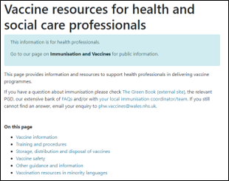
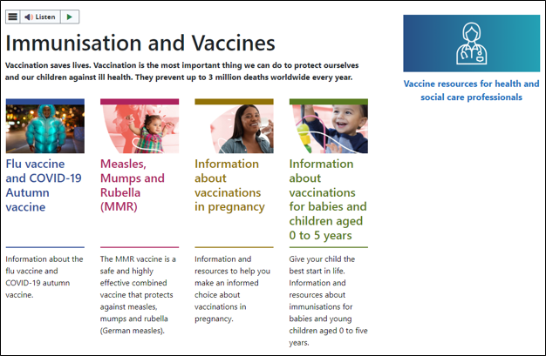
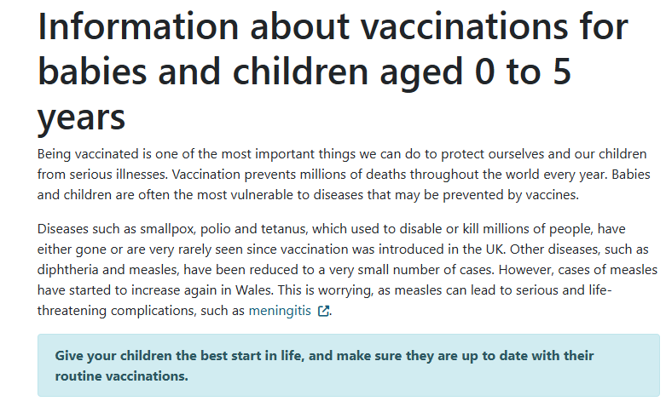
Signposting: to be updated to reflect the changes
Vaccine resources for health and social care professionals - Public Health Wales
In preparation. Proposed changes to the childhood vaccination schedule page for HCP
Immunisation and Vaccines - Public Health Wales
In preparation. Proposed changes to the childhood vaccination schedule public page.
Information about vaccinations for babies and children aged 0 to 5 years - Public Health Wales

Slide 14
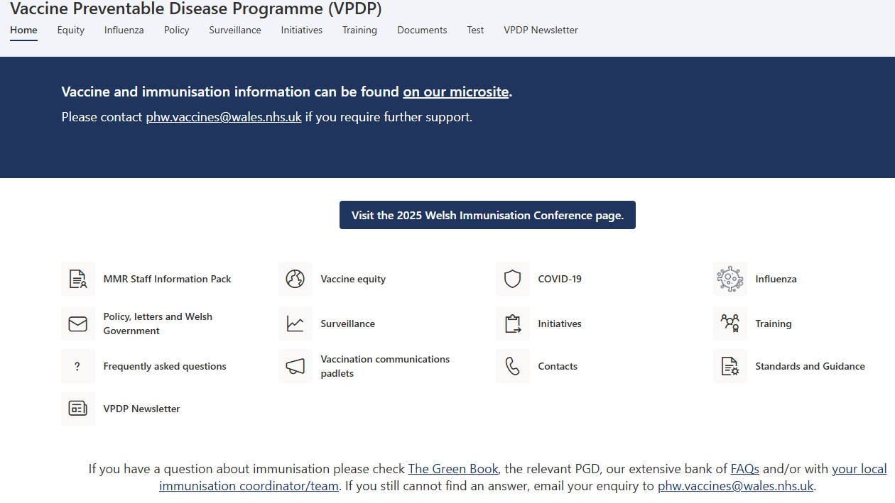
SharePoint page: NHS employees
Vaccine Preventable Disease Programme (VPDP) - Home

Slide 15
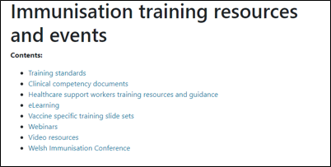
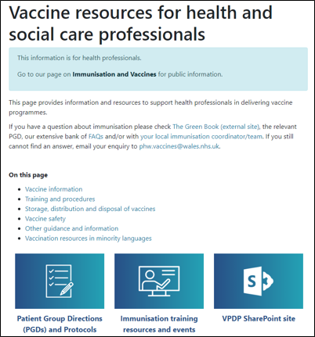
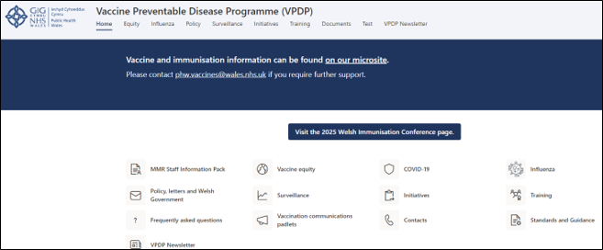
Training resources
Immunisation training resources and events - Public Health Wales
Vaccine resources for health and social care professionals - Public Health Wales

Slide 16
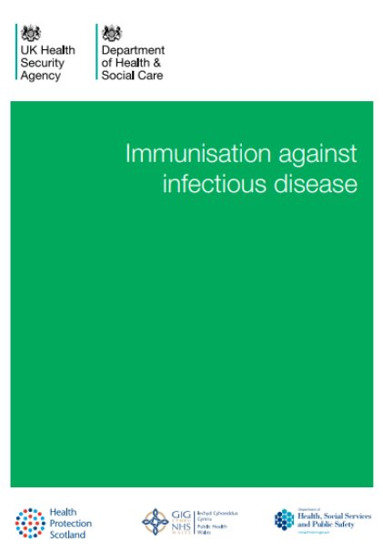
Planned resources
There will be a full range of resources and guidance for healthcare professionals, parents and carers. ​
All relevant Green Book chapters, PGDs and existing resources will be updated.
Immunisation against infectious disease - GOV.UK
Patient Group Directions (PGD) - Welsh Medicines Advice Service

Slide 17
Epidemiology and Surveillance
Charlotte McDermott – Senior Epidemiologist – Health Protection - CDSC

Slide 18
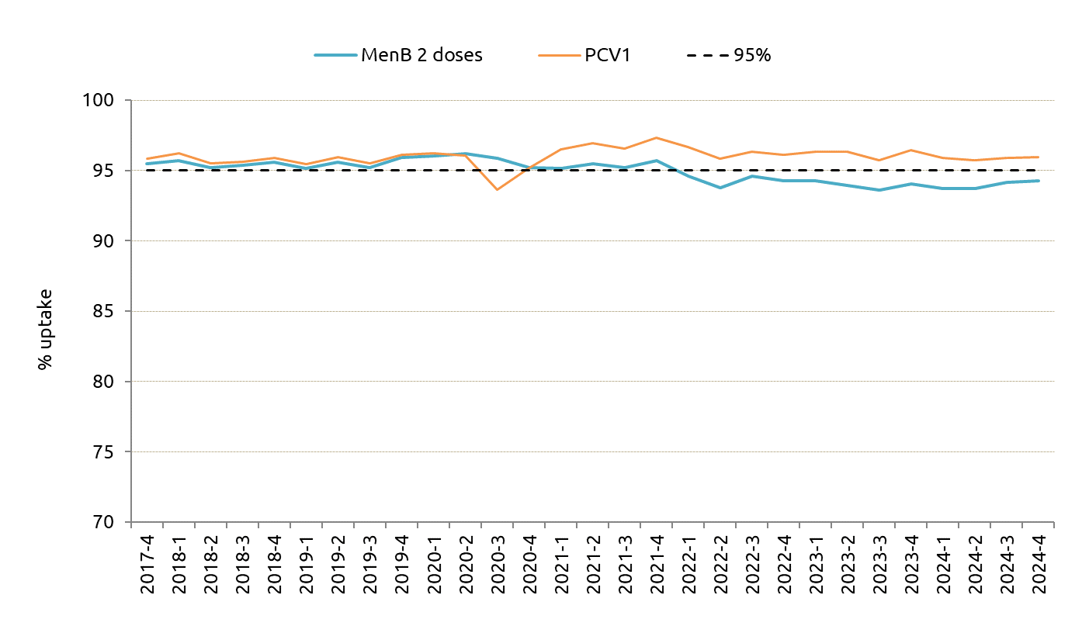
Quarterly COVER Report: Oct-Dec 2024
Results are for children living in Wales in December 2024 and reaching their first birthday during the quarter 01/10/2024 to 31/12/2024.
Uptake of two doses of MenB vaccine, scheduled at 8 weeks and 16 weeks of age, in children reaching their first birthday was 94.3%.
Uptake of primary pneumococcal conjugate vaccination (PCV) in children reaching their first birthday was 95.9%.
PCV Uptake has remained consistently above 95% since 2021.
Since 2022, uptake of two doses of MenB has remained stable and slightly below 95%.
Percentage uptake of two doses of MenB and primary PCV in children reaching their first birthday in Wales, quarter 4 2017 to quarter 4 2024

Slide 19
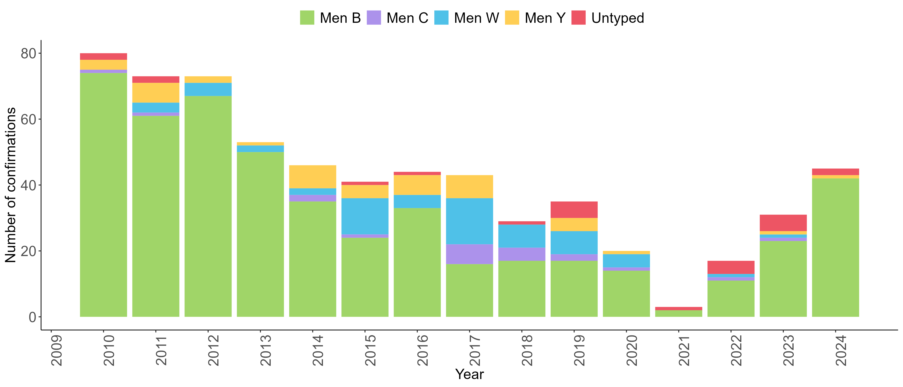
Number of laboratory reports of Neisseria meningitidis by serogroup in Wales 2010-2024

Slide 20
Surveillance Webpages
Surveillance of Vaccines, Vaccine Preventable Diseases and Respiratory Infections​
COVER - National childhood immunisation uptake data - Public Health Wales​

Slide 21
Public Engagement and Vaccine Equity
Jasmin Chowdhury – Service Development and User Engagement Senior Practitioner, Vaccine Preventable Disease Programme

Slide 22

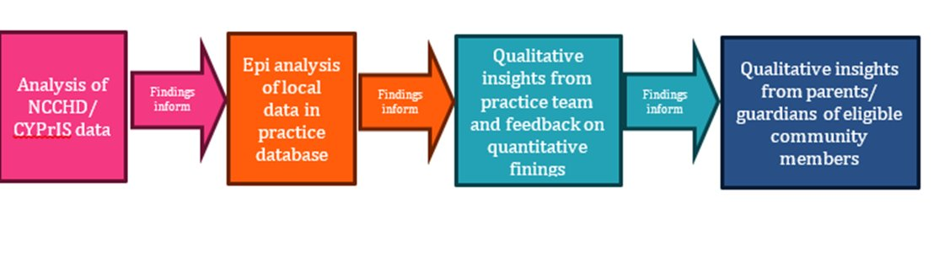

Public Engagement Workstreams: Brief Overview More detailed update shared here: https://publichealthwales.nhs.wales/topics/immunisation-and-vaccines/vaccines-professionals/immunisation-training-resources-and-events/changes-to-childood-schedule-slideset/.
Attitudinal survey to gather insights on:​
Attitudes & perceptions on childhood immunisation​
Explore & understand motivations, barriers & facilitators ​
Identify trusted sources of information, preferred formats & explore interest in co-production
A collaborative study between PHW VPDP, Bellevue Practice within Deep End Cymru project, is intended to pilot an approach which could be used for future work to explore issues associated with under vaccination in areas high socioeconomic deprivation
Working with colleagues from LPHT at Cardiff & Vale to develop a pool of community vaccine champions for pregnancy & pre-school vaccination from ethnic minority communities

Slide 23

phw.vaccines@wales.nhs.uk

Slide 24

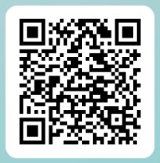
We value your feedback! Please take a few moments to complete the evaluation – this will ensure future sessions are meeting service needs.
Potential changes to the routine childhood immunisation programme - Feedback Form

