Slide 1

The Target
Audience

Slide 2
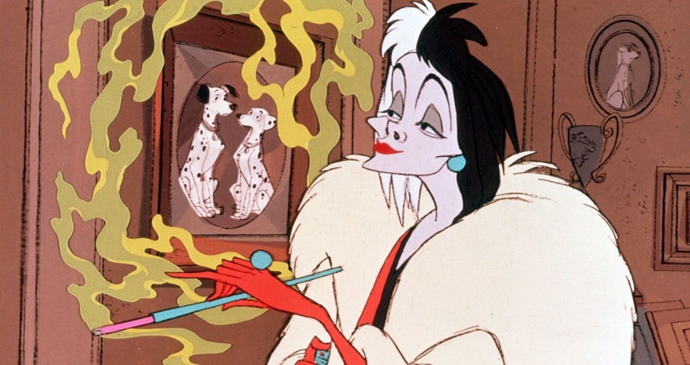
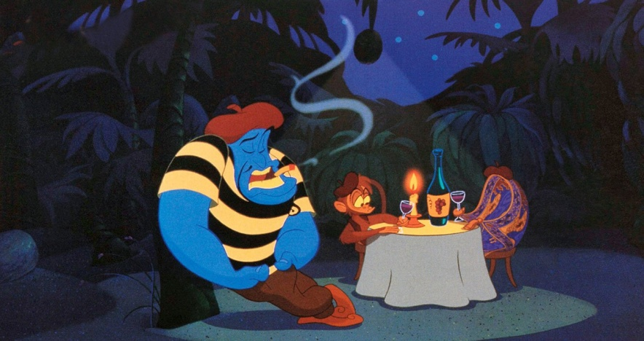
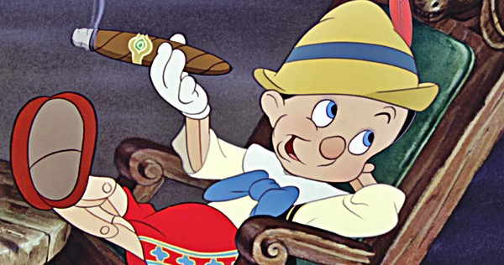
A bit of background...
It is against the law for tobacco companies to advertise cigarettes in the UK. However, this has not always been the case...
Does anyone remember seeing smoking in Disney films when they were younger?
101 Dalmatians
Aladdin
Pinocchio

Slide 3
Why ban tobacco advertising?
Smoking is the leading cause of preventable death in the UK
78% of young people across the world report regular exposure to some form of tobacco advertising or promotion (WHO, 2013)
Young people are in a position where they can be influenced by celebrities, television and other forms of media
Seeing tobacco advertising makes it seem like the normal thing to do. In Wales smoking has been banned from indoor spaces and in some outdoor places to de-normalise smoking and allow children to grow up in a smoke free environment

Slide 4
Other techniques...
Whilst advertising smoking on television and billboards has been banned it is a bit more difficult to monitor tobacco advertising in other media.
Until a few years ago actors and film companies accepted payments to smoke and use particular cigarette brands in their films.
This is a bit more difficult with media such as music videos. Music videos that are made in the UK are not able to portray smoking however this law does not apply to other countries. Therefore, videos made in America are able to glamorise smoking by showing celebrities using cigarettes and these are shown on television and accessed on YouTube and other websites.
Here are some examples:

Slide 5
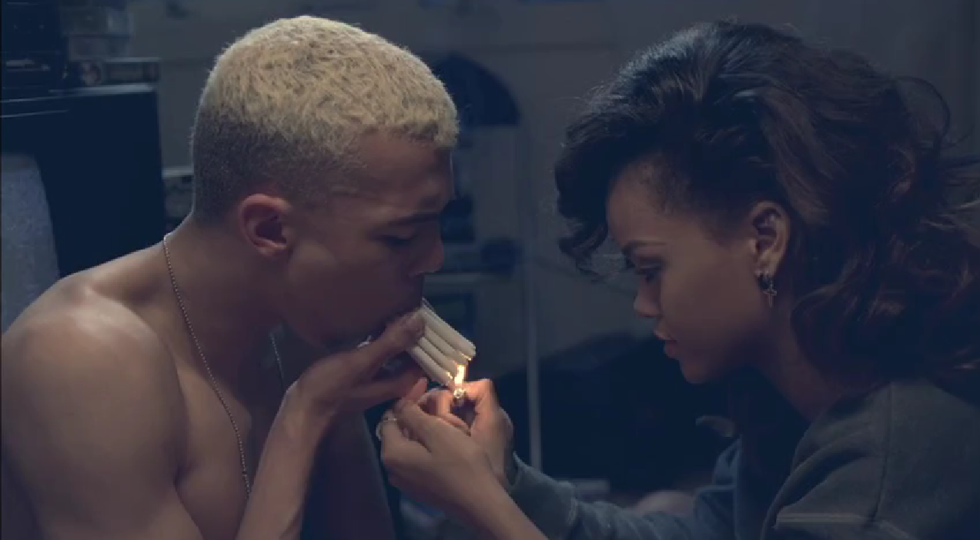
Rihanna featuring Calvin Harris – We Found Love Music Video

Slide 6
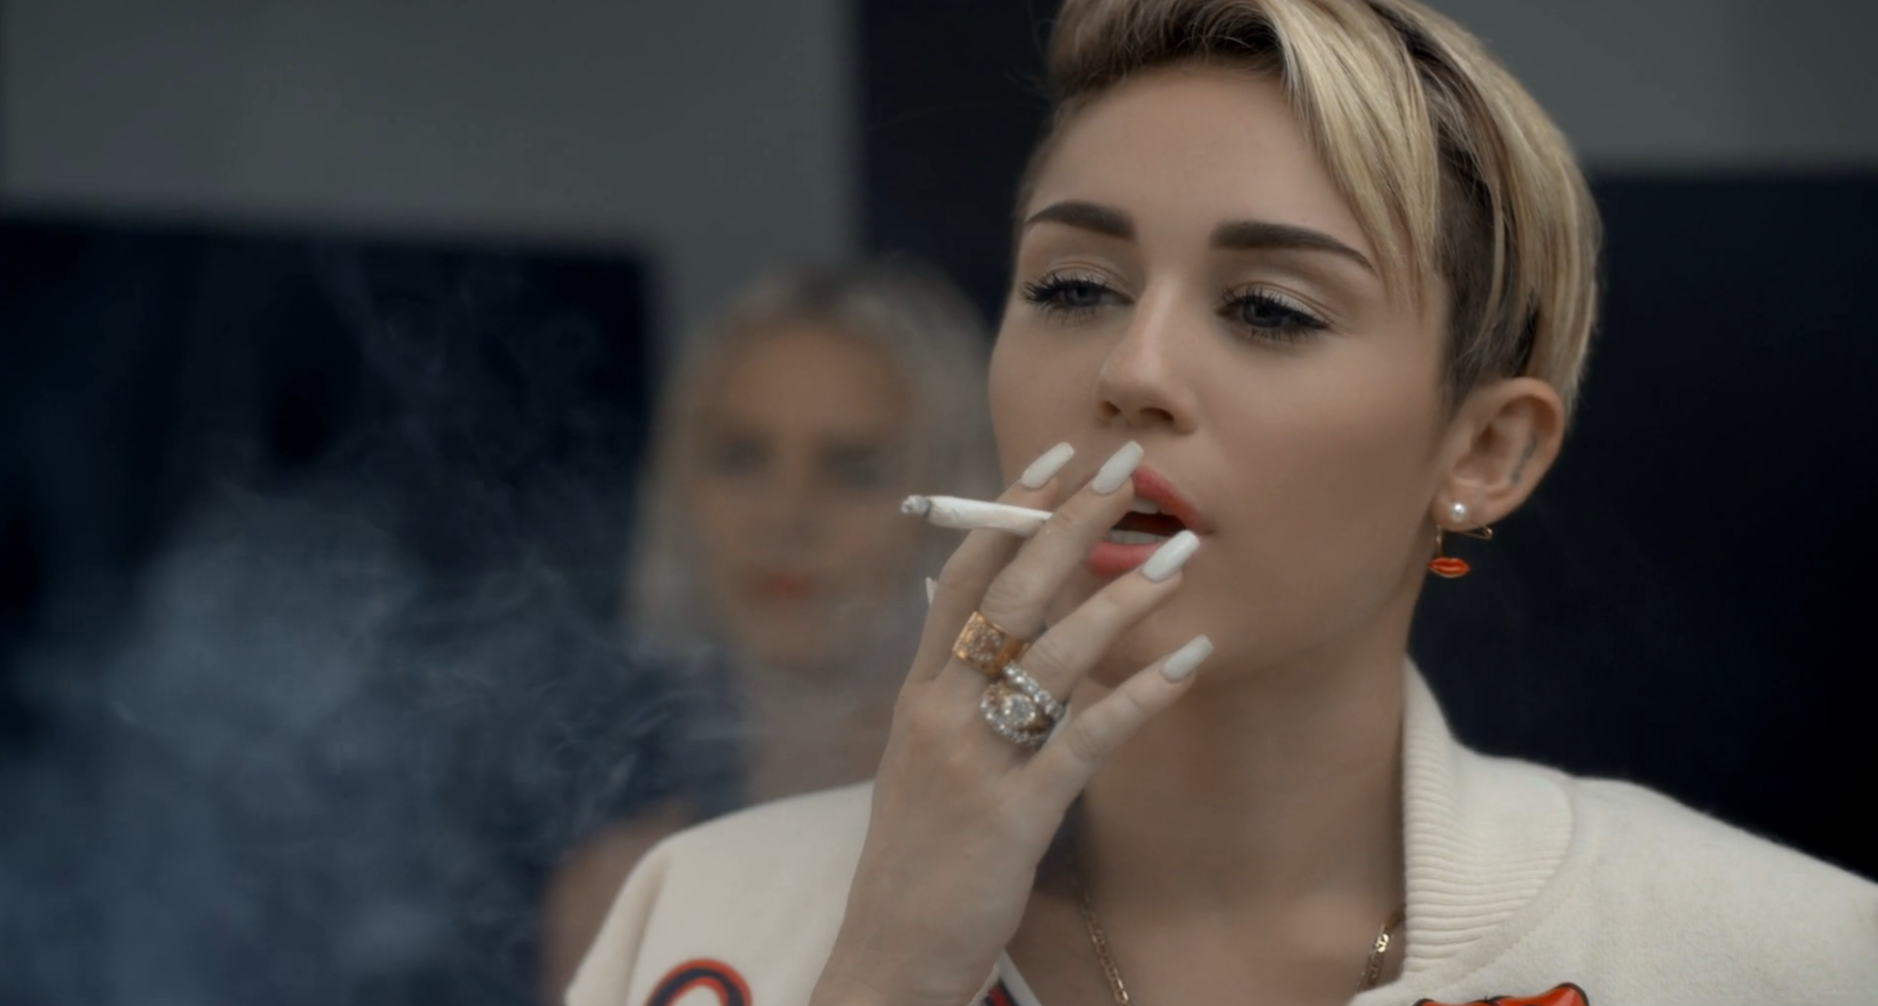
Mike WiLL Made-It featuring Miley Cyrus, Wiz Khalifa, Juicy J – 23 Music Video

Slide 7

G-Easy – Been On Music Video

Slide 8
Questions for discussion...
Have you ever bought something because of the way it was advertised?
How old are the majority of people who watch music videos?
Do you think young people could be influenced by this?
Do you think the cigarette companies are making money from this?
Do you think this is a form of advertising?
Do you think this should be allowed?

