Slide 1
Child Measurement Programme for Wales report 2016/17
Public Health Wales Observatory
April 2018

Slide 2
Using these slides
These maps accompany the Child Measurement Programme for Wales Report 2016/17.
These maps are a resource to demonstrate examples of findings from the Child Measurement Programme for Wales Report 2016/17.
The presentation can be used as a whole or as individual slides.
© 2018 Public Health Wales NHS Trust
Material contained in this document may be reproduced under the terms of the Open Government Licence (OGL)
www.nationalarchives.gov.uk/doc/open-government-licence/version/3/
provided it is done so accurately and is not used in a misleading context. Acknowledgement to Public Health Wales NHS Trust to be stated. Copyright in the typographical arrangement, design and layout belongs to Public Health Wales NHS Trust.
Child Measurement Programme for Wales 2016/17

Slide 3
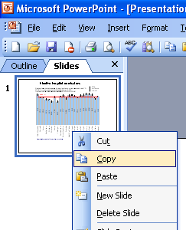
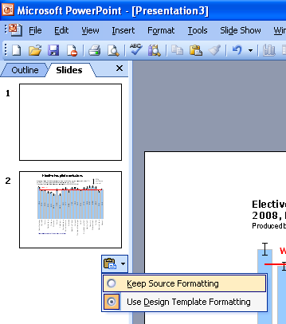
Instructions to copy a slide
To copy a slide for use in a presentation:
1. Right-click on the slide you wish to copy from the list on the left-hand side (the ‘slides’ tab) when in normal view and select ‘Copy’ from the list.
Go to your presentation and right-click where you want the copied slide to appear in the ‘slides’ tab and select ‘paste’ from the list.
On being pasted into your presentation a small clipboard icon with a black arrow will appear near the bottom right-hand corner of the newly pasted slide. Click on the arrow to show the drop-down menu and select “Keep Source Formatting” from the list. The slide will then appear as seen in the original presentation.
Child Measurement Programme for Wales 2016/17

Slide 4
Index
Slide 5: Wales, Overweight or obese
Slide 6: Wales, Obese
Slide 7: Betsi Cadwaladr UHB, Obese
Slide 8: Powys THB, Obese
Slide 9: Hywel Dda UHB, Obese
Slide 10: ABM UHB, Obese
Slide 11: Cardiff and Vale UHB, Obese
Slide 12: Cwm Taf UHB, Obese
Slide 13: Aneurin Bevan UHB, Obese
Slide 14: Further information
Child Measurement Programme for Wales 2016/17

Slide 5
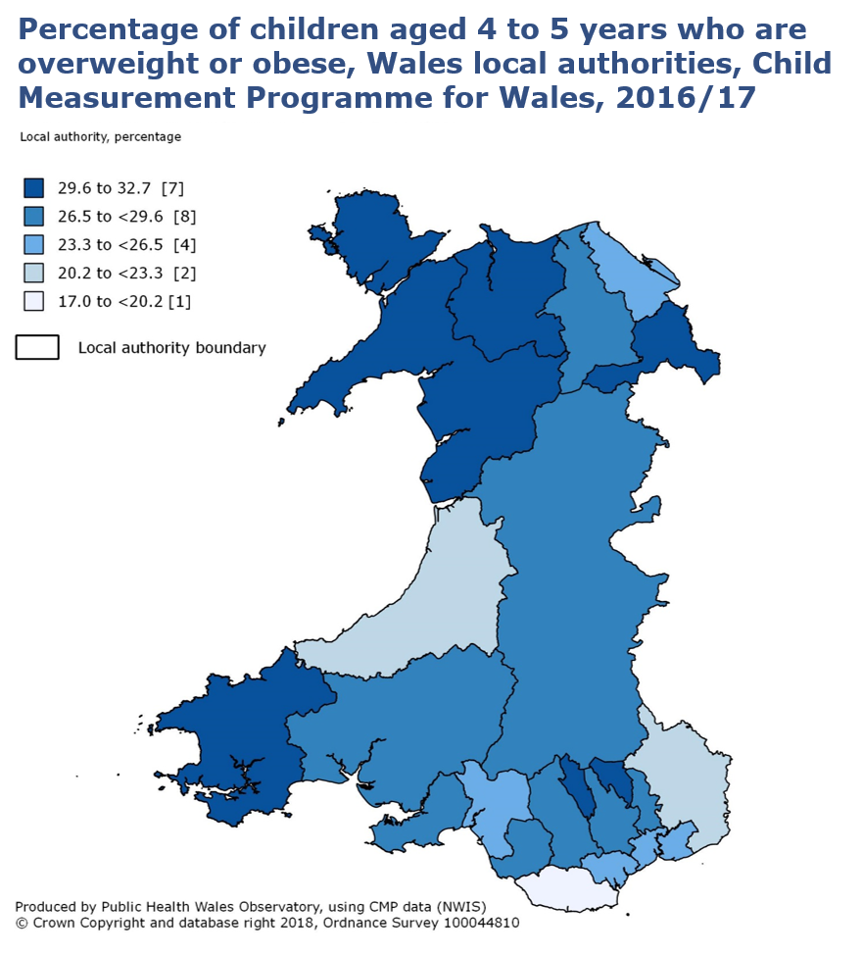
Child Measurement Programme for Wales 2016/17

Slide 6
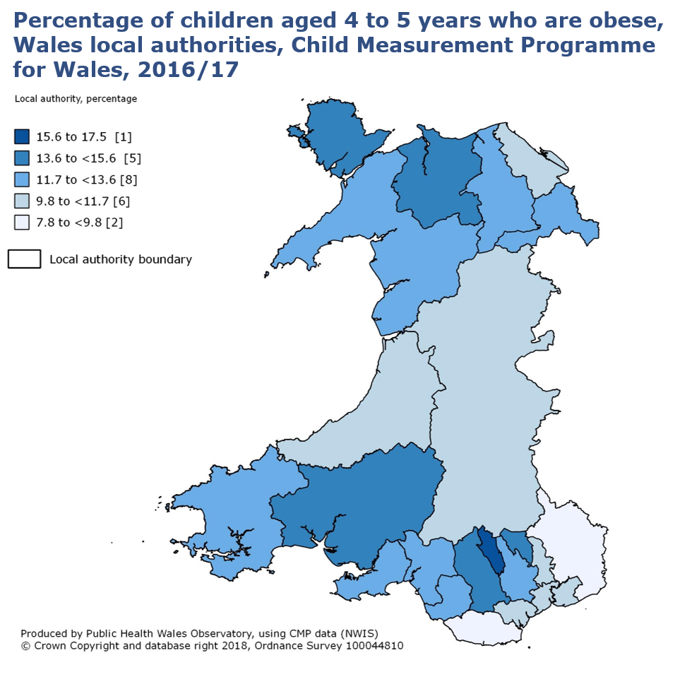
Child Measurement Programme for Wales 2016/17

Slide 7
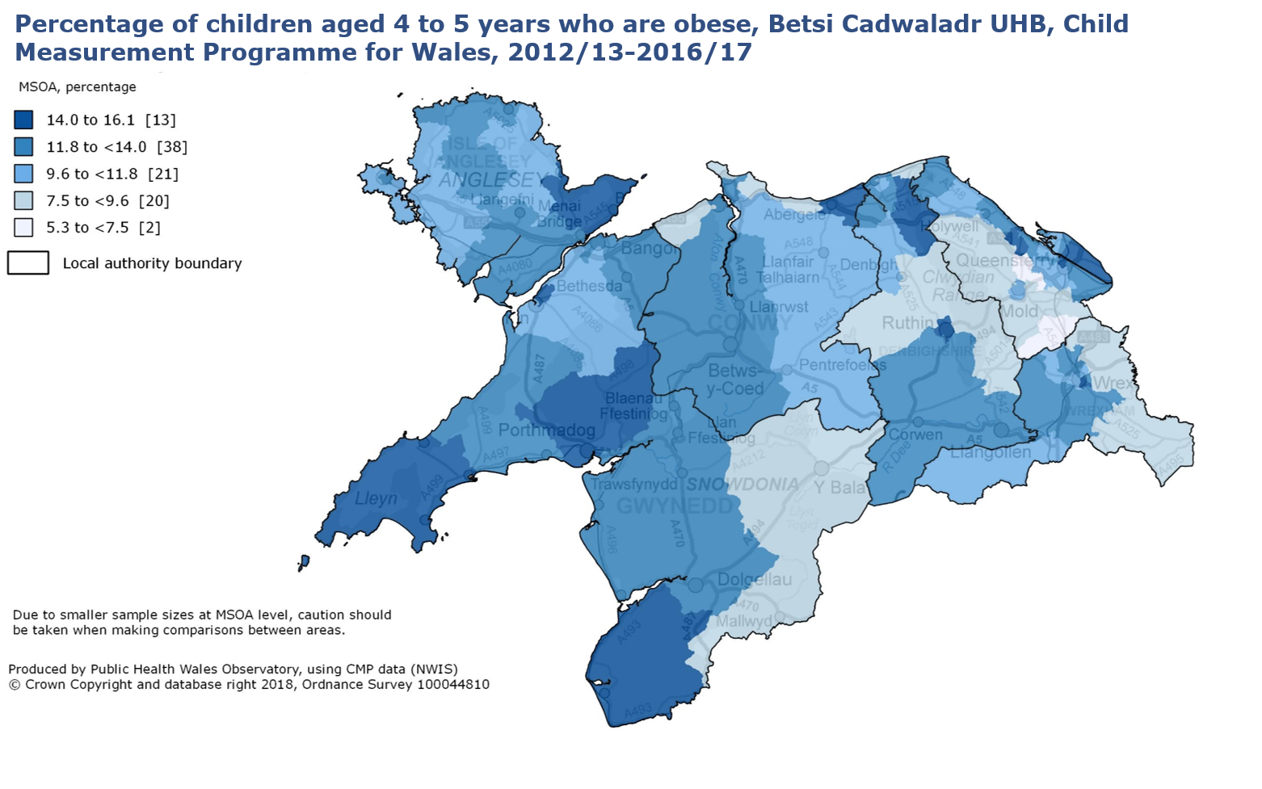
Child Measurement Programme for Wales 2016/17

Slide 8
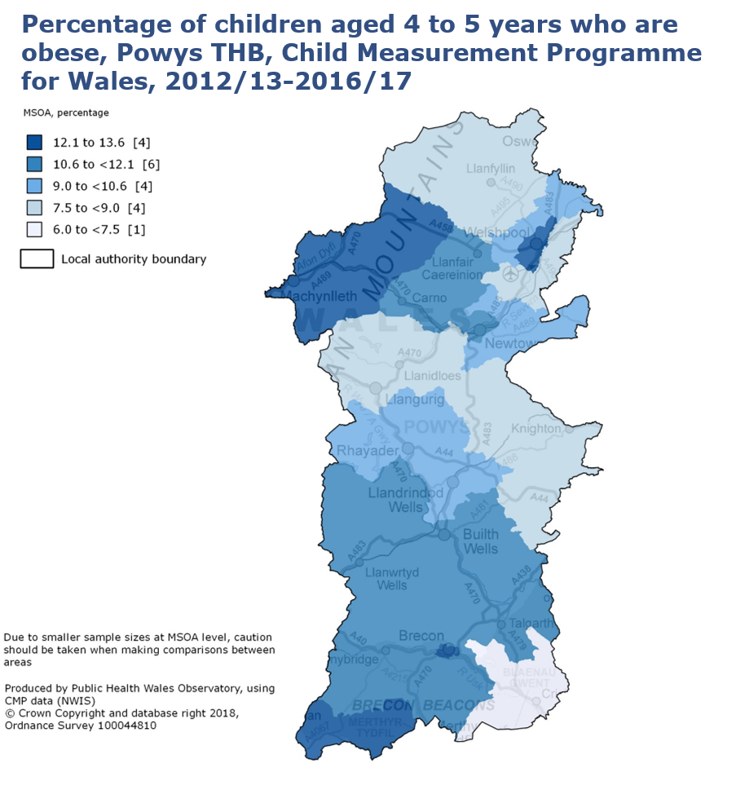
Child Measurement Programme for Wales 2016/17

Slide 9
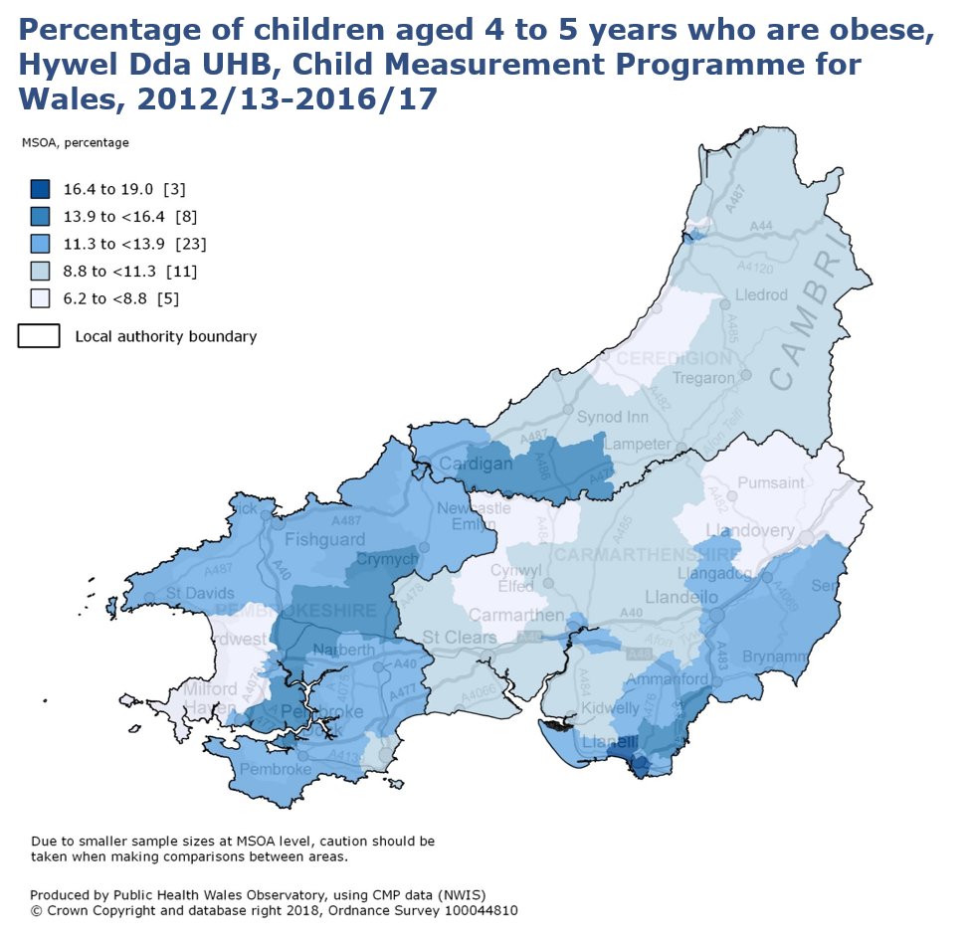
Child Measurement Programme for Wales 2016/17

Slide 10
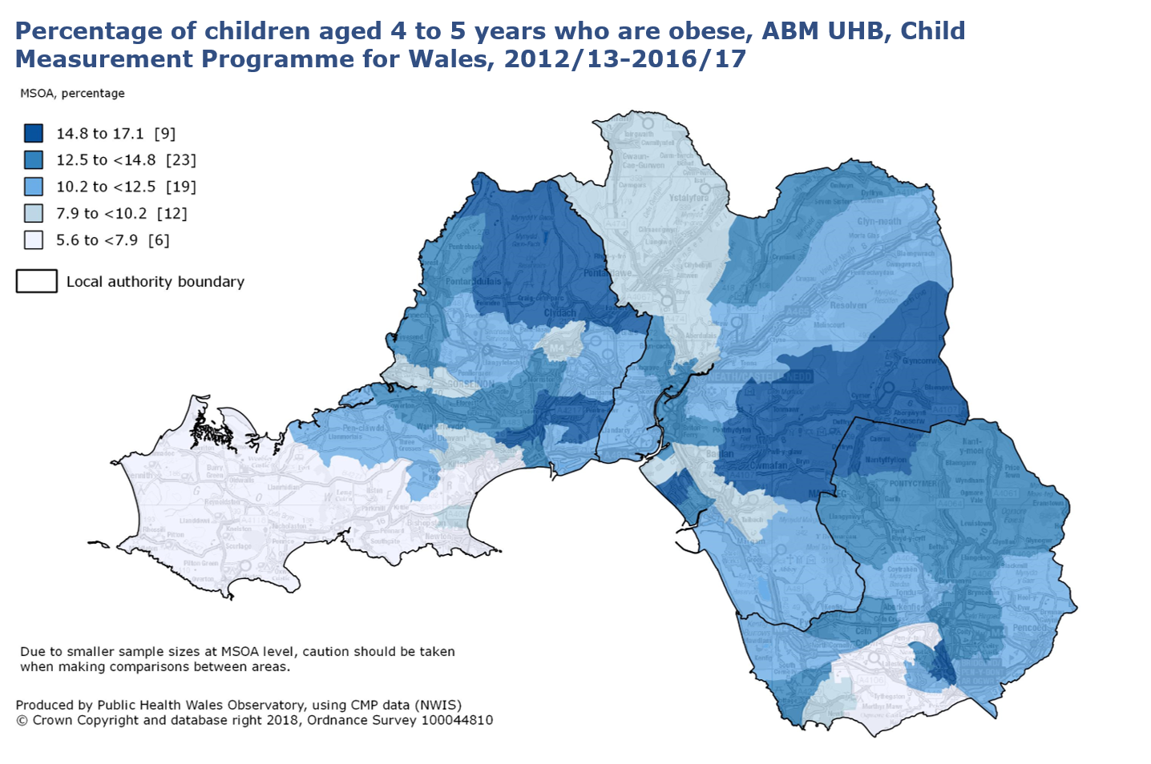
Child Measurement Programme for Wales 2016/17

Slide 11
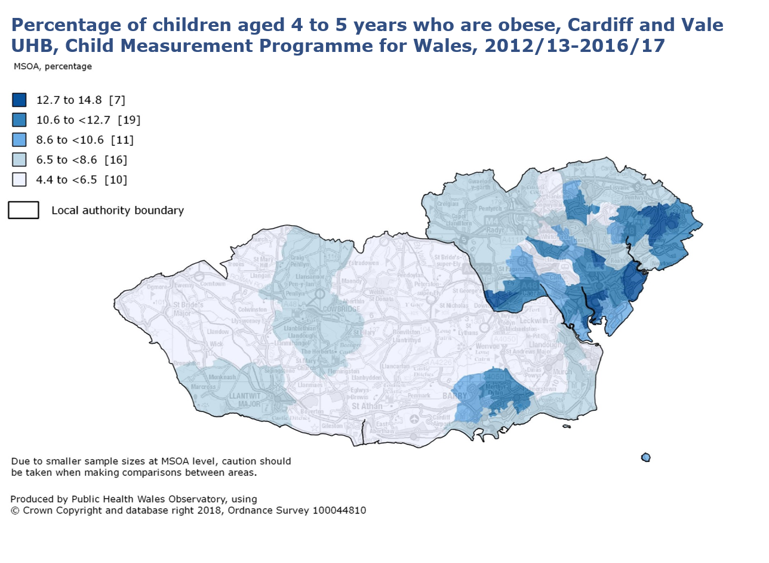
Child Measurement Programme for Wales 2016/17

Slide 12
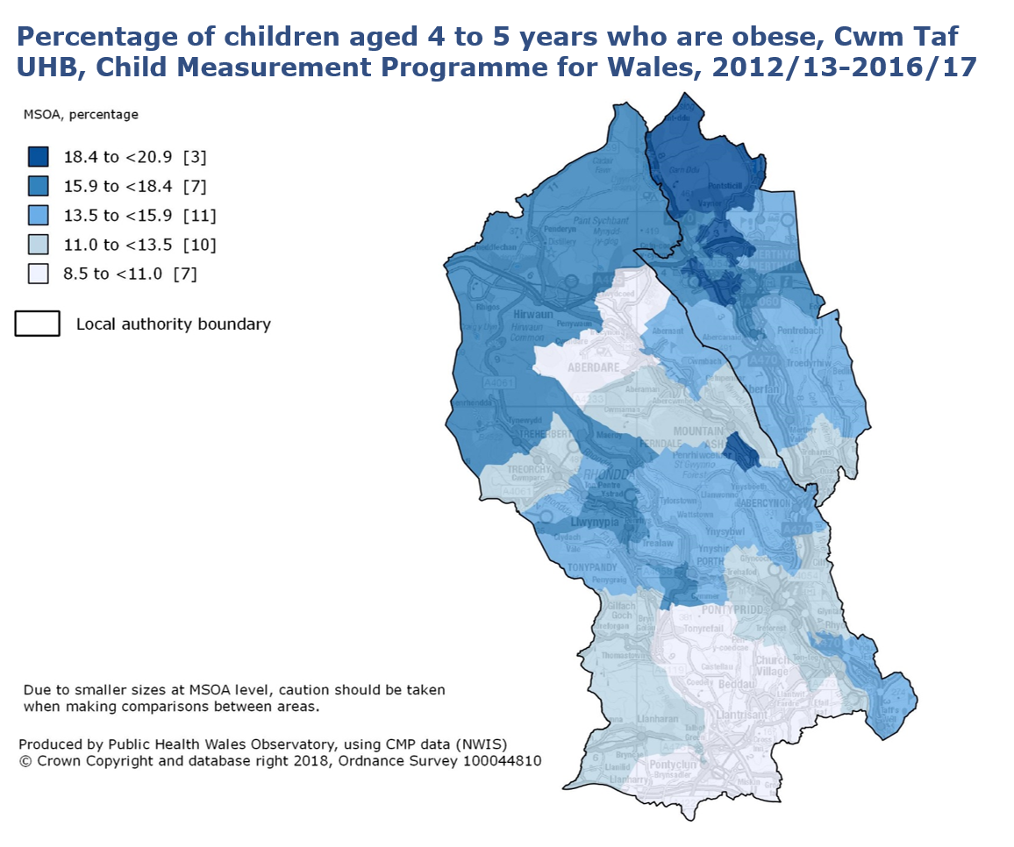
Child Measurement Programme for Wales 2016/17

Slide 13
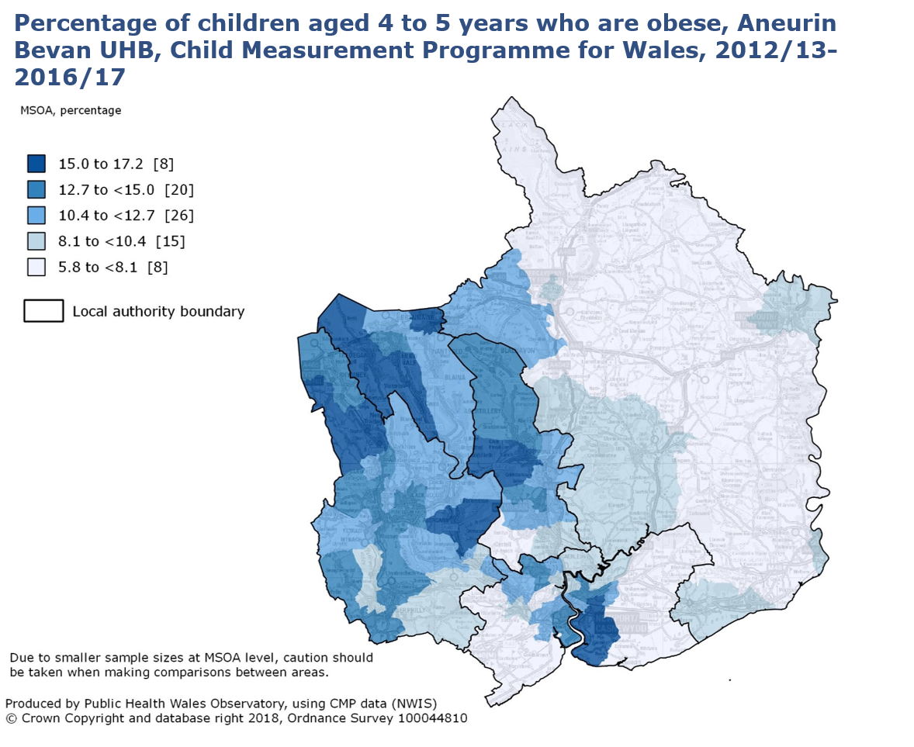
Child Measurement Programme for Wales 2016/17

Slide 14
Further information
This file is part of the Child Measurement Programme 2016/17 release. A report, additional data files and a ‘Technical summary’ are available at: http://www.wales.nhs.uk/sitesplus/888/page/67795
Child Measurement Programme for Wales Web: www.publichealthwales.org/childmeasurement Email: childmeasurementprogramme@wales.nhs.uk
Child Measurement Programme for Wales 2016/17

