Slide 1







Mouth Cancer Action Month
1st November to 30th November
Mouth cancer is twice as common in men
Mouth cancer is more common in deprived areas of Wales
To see more statistics on cancer in Wales scan the QR code
Mouth cancer is more common in people over 50
Each year there are over 350 new cases of mouth cancer
<29
0.6%
30 - 49
10.3%
50 - 69
54.9%
70 - 89
32.2%
>90
2.1%
#MouthCancerActionMonth
0%
20%
40%
60%

Slide 2




Mouth Cancer Action Month
1st November to 30th November
Early diagnosis is key to improve survival
Actions for Health Boards and health professionals:
Improve public and healthcare professional awareness of mouth cancer
Advise people to see a dentist for regular check-ups even if they do not have any teeth
Ensure urgent referral pathways exist and promote programmes to address inequalities in mouth cancer
Provide effective brief interventions to people at risk

Slide 3







Mouth Cancer Action Month
1st November to 30th November
90% of mouth cancers are linked to lifestyle factors
For help with quitting smoking scan the QR code
Quit smoking or chewing tobacco
Maintain a healthy diet
Drink less alcohol
Practice safe sex and ensure you are immunised from HPV
Check your mouth monthly
Use SPF on lips
#MouthCancerActionMonth

Slide 4

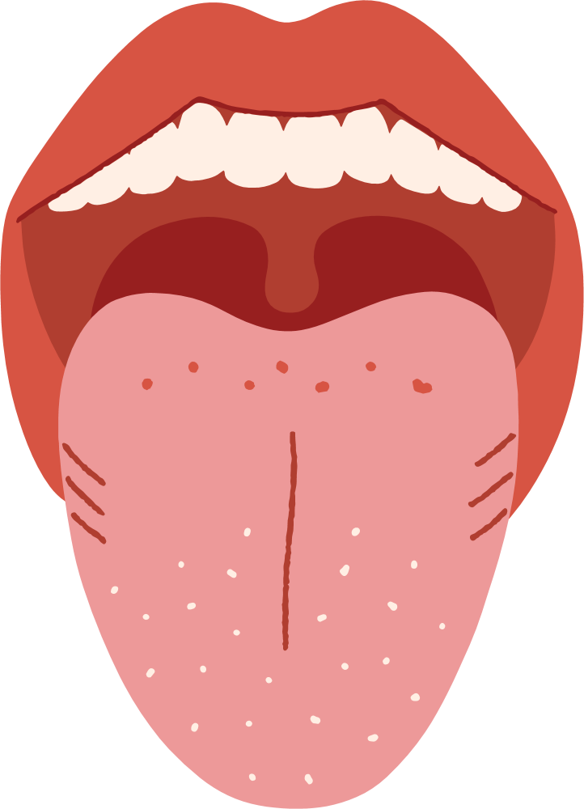

Mouth Cancer Action Month
1st November to 30th November
Symptoms to look out for
Learn how to do a mouth cancer check at home
Ulcers lasting more than 3 weeks
Red or white patches
Pain or difficulty swallowing
Unexplained lumps
Unexplained numbness
#MouthCancerActionMonth

