Slide 1





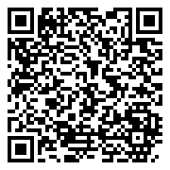

Mouth Cancer Action Month
1st November to 30th November
Mouth cancer is twice as common in men
Each year there are over 300 new cases of mouth cancer
To see more statistics on cancer in Wales scan the QR code
Mouth cancer is more common in people over 50
The number of new cases of mouth cancer has been increasing each year since 2002
<29
0.6%
30 - 49
10.3%
50 - 69
54.9%
70 - 89
32.2%
>90
2.1%
#MouthCancerActionMonth
0%
20%
40%
60%

Slide 2




Mouth Cancer Action Month
1st November to 30th November
Early diagnosis is key to improve survival
Actions for healthboards and health professionals:
Improve public and healthcare professional awareness of mouth cancer
Advise people to see a dentist for regular check-ups even if they do not have any teeth
Provide effective brief interventions to people at risk
Ensure an urgent mouth cancer referral pathway exists

Slide 3



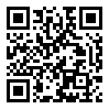



Mouth Cancer Action Month
1st November to 30th November
90% of mouth cancers are linked to lifestyle factors
For help with quitting smoking scan the QR code
Drink less alcohol
Quit smoking or chewing tobacco
Maintain a healthy diet
Use SPF on lips
Practice safe sex to reduce risk of HPV
Check your mouth monthly
#MouthCancerActionMonth

Slide 4

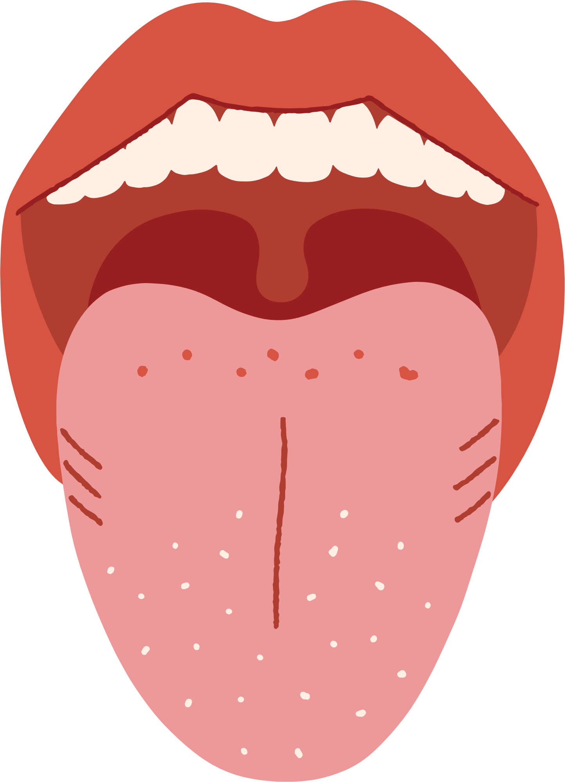
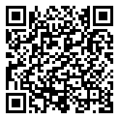
Mouth Cancer Action Month
1st November to 30th November
Symptoms to look out for
Learn how to do a mouth cancer check at home
Ulcers lasting more than 3 weeks
Red or white patches
Pain or difficulty swallowing
Unexplained lumps
Unexplained numbness
#MouthCancerActionMonth

