Slide 1

We Care Network
Key Achievements 2023
Hosted 5 bi-monthly network meetings, on Teams and hybrid with in person options – this is the frequency our network members told us worked best for them
Arranged sessions on Laughter Yoga, Lasting Power of Attorney, a joint event with Enfys Network (supporting LGQBT+ Carers) – more planned following a recent survey of members
Continued membership for PHW with Employers For Carers and shared the benefits associated with membership
Raised more than £700 on the Alzheimer’s Society Memory Walk in Bute Park
Arranged lunch and learn sessions for managers of carers
Welcomed the appointment of our new Exec Sponsor, Paul Veysey
WHIWB has been transformational for lots of our colleagues who are carers, and our network members have welcomed its introduction
We Care Network presentation to Board November 2023

Slide 2
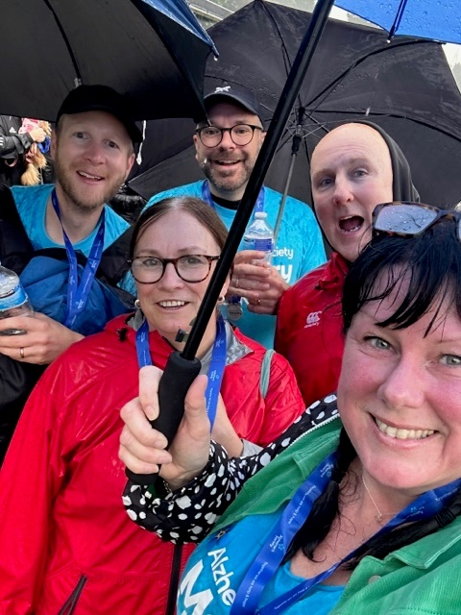
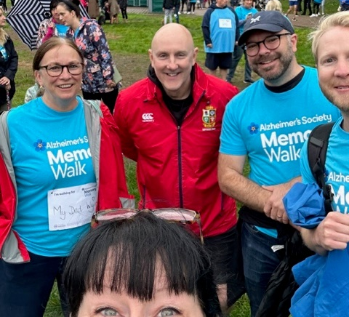
We Care Network
Key Achievements
Memory Walk before
……..and after!
We Care Network presentation to Board November 2023

Slide 3
Plan for 2024
Creation and approval of a PHW Carers Policy
Further bi-monthly network meetings, including ones with Jan and Tracey
A session on Will Writing/Trusts – open to all staff
Wellbeing/mindfulness session/events and ;
Further manager lunch and learns
Events to celebrate different elements of caring during Carers Week June 2024
We Care Network presentation to Board November 2023

Slide 4
How We Add Value
Contributing to policy workshops, and encouraging carers in the organisation to help shape these
Signposting to useful information and resources for colleagues with a Caring responsibility
Supporting working Carers across the organisation, being there for one another
Raising Awareness of the issues that working carers face
Our ask – Continued support to adopt the Carers’ Policy and promotion of the Workplace Passport for staff, dedicated resource for communications, to ensure that the wonderful work of the networks is showcased and shared with all colleagues
We Care Network presentation to Board November 2023

