Slide 1
Wales Public Health Rapid Overview Dashboard Screenshots

Slide 2
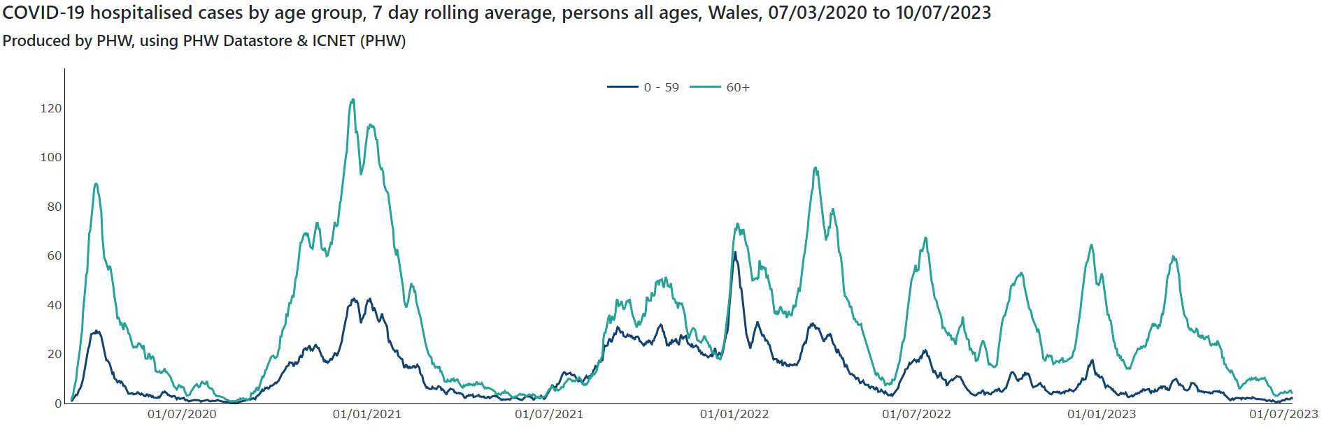
Communicable disease

Slide 3
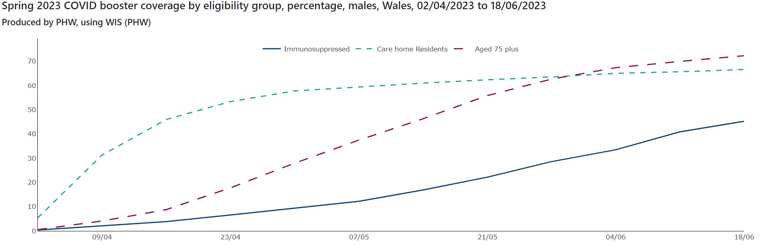
Communicable disease

Slide 4
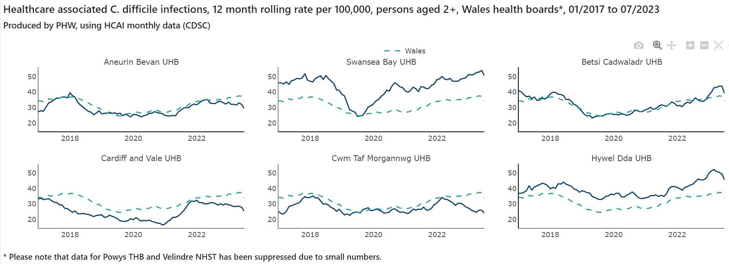
Communicable disease

Slide 5
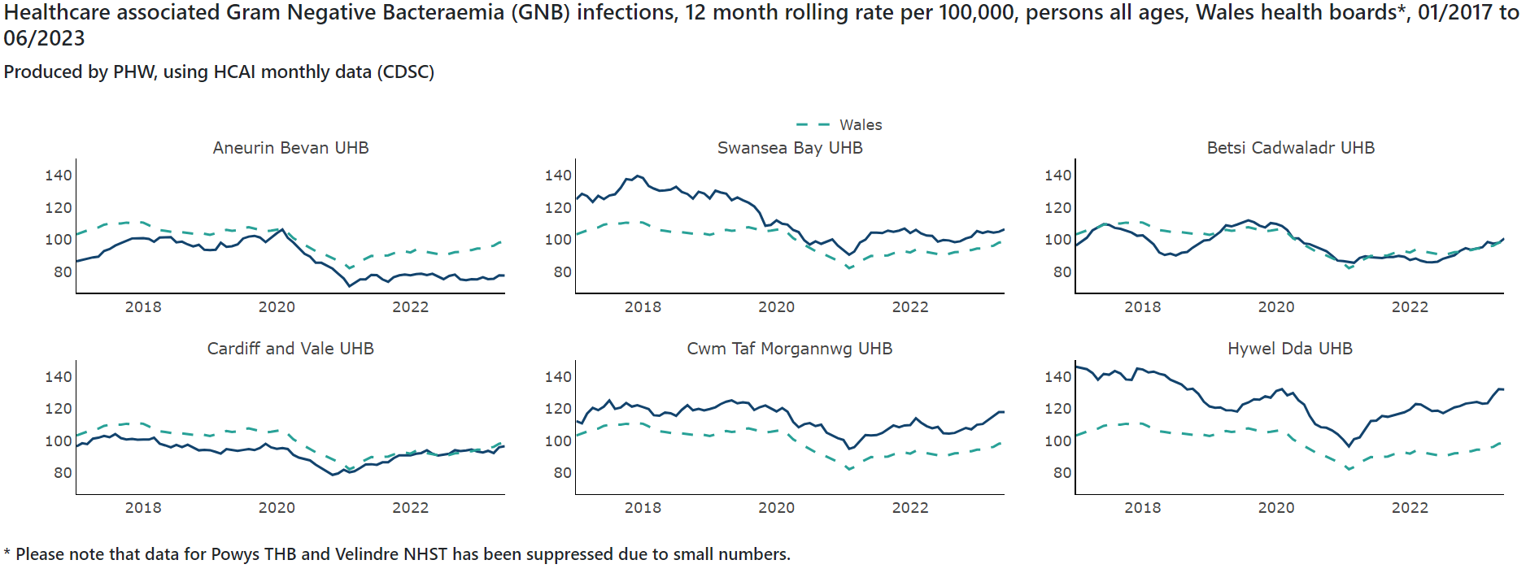
Communicable disease

Slide 6
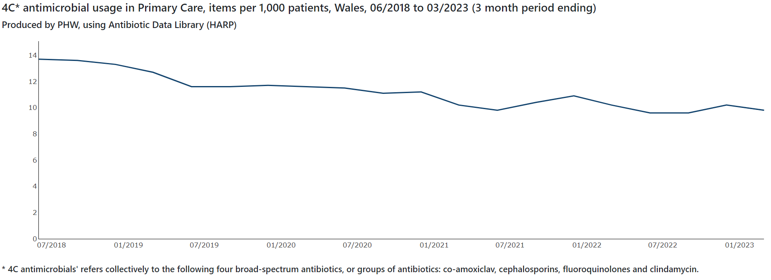
Communicable disease

Slide 7
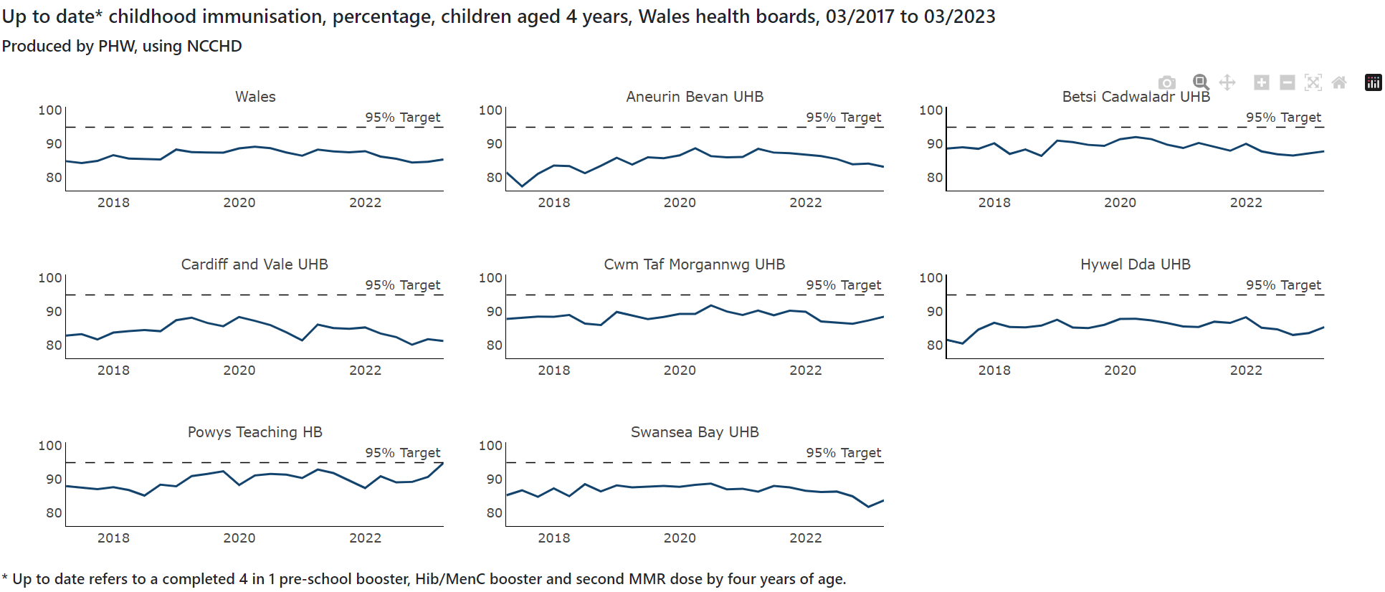
Communicable disease

Slide 8
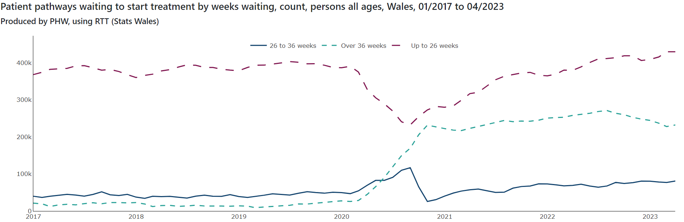
System Ability to Respond

Slide 9
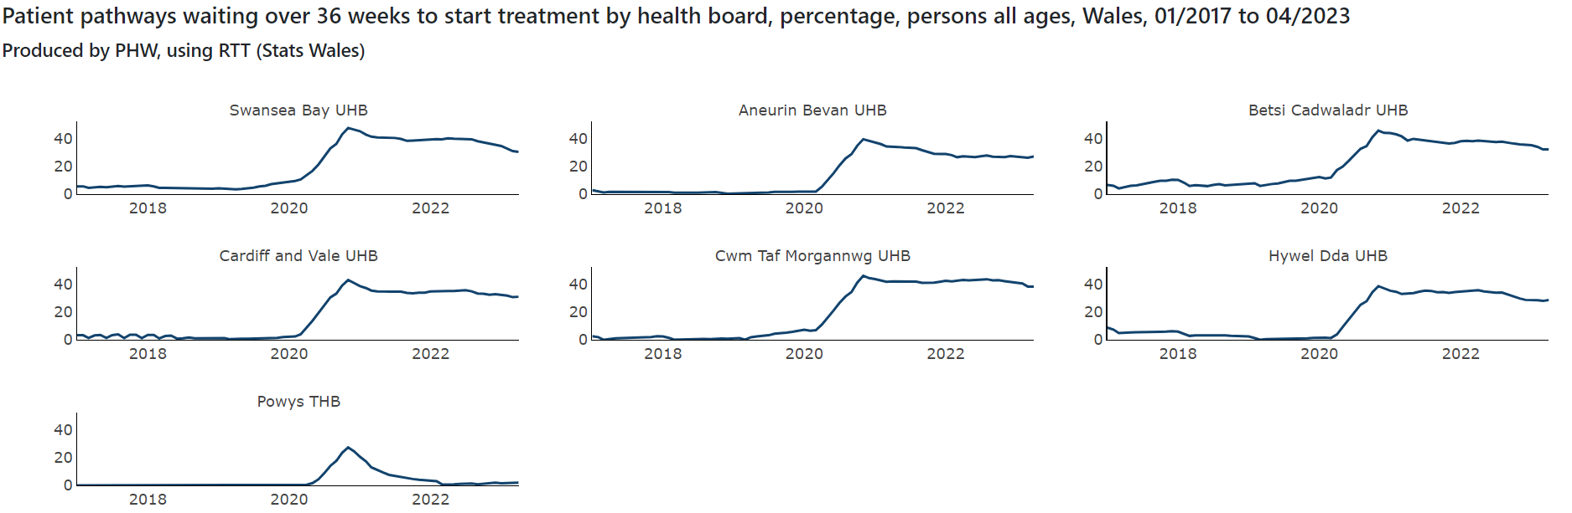
System Ability to Respond

Slide 10
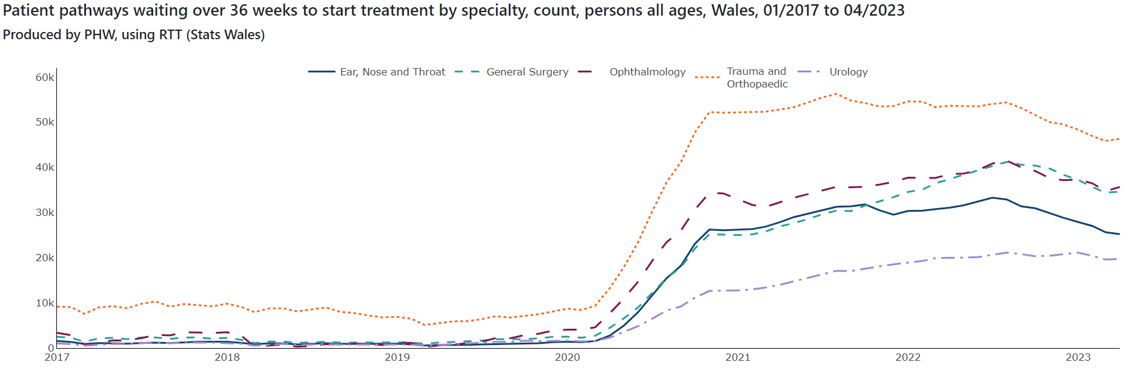
System Ability to Respond

Slide 11
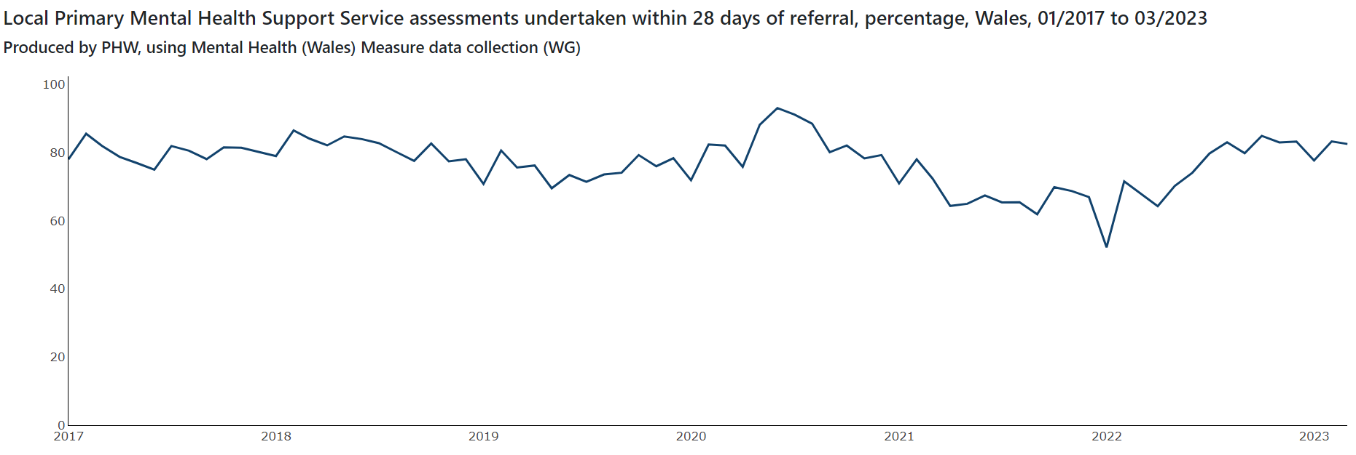
System Ability to Respond

Slide 12
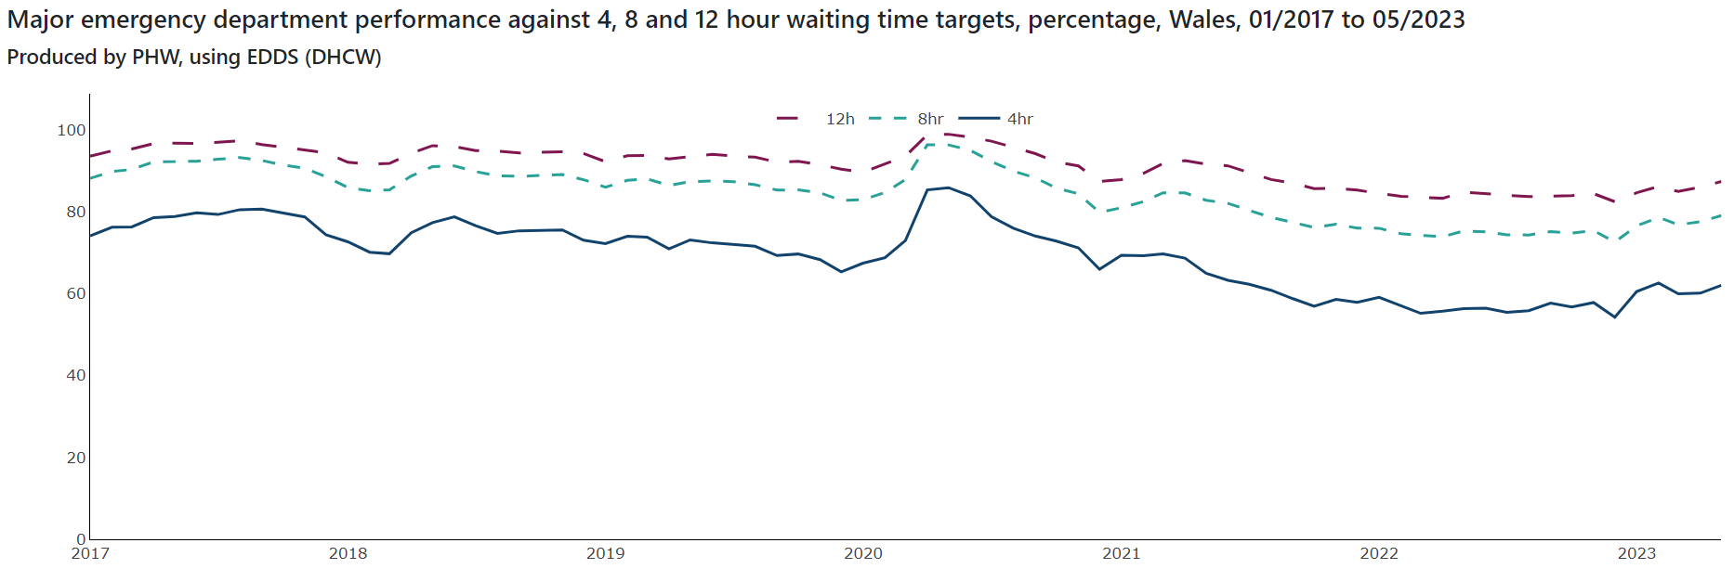
System Ability to Respond

Slide 13
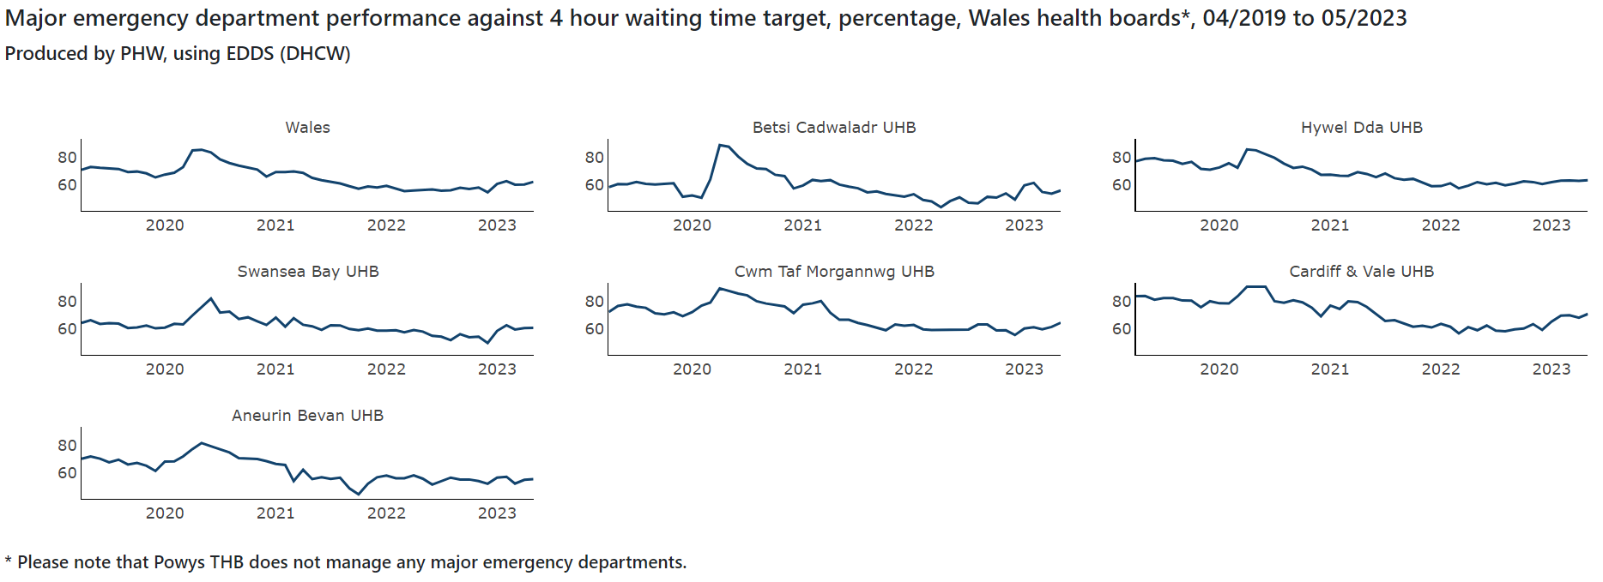
System Ability to Respond

Slide 14
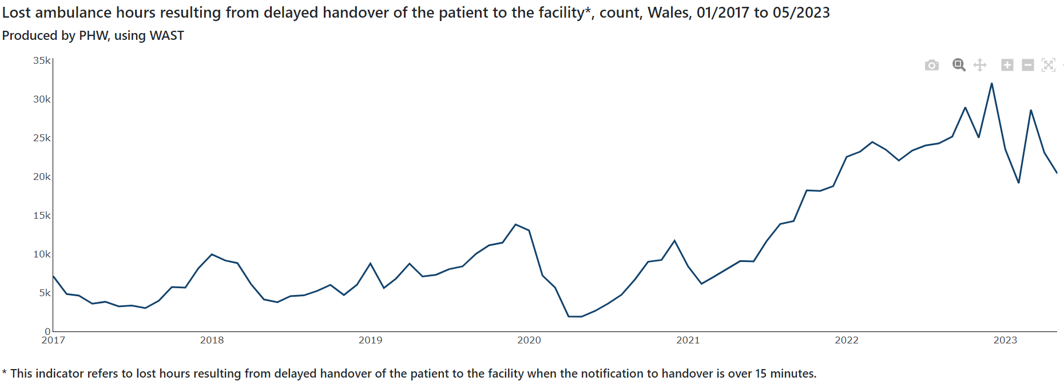
System Ability to Respond

Slide 15
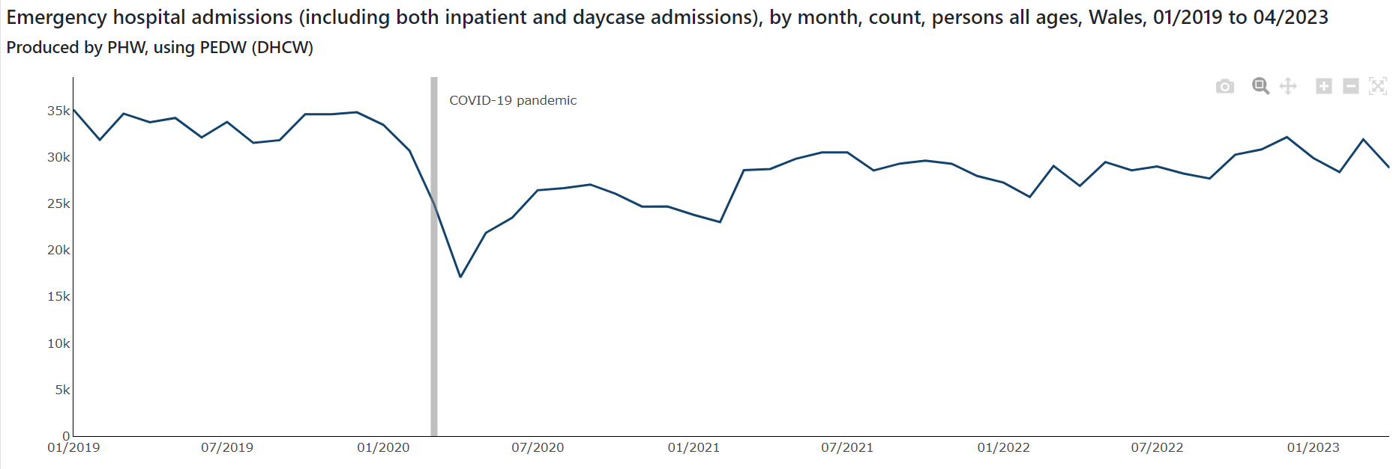
System Ability to Respond

Slide 16
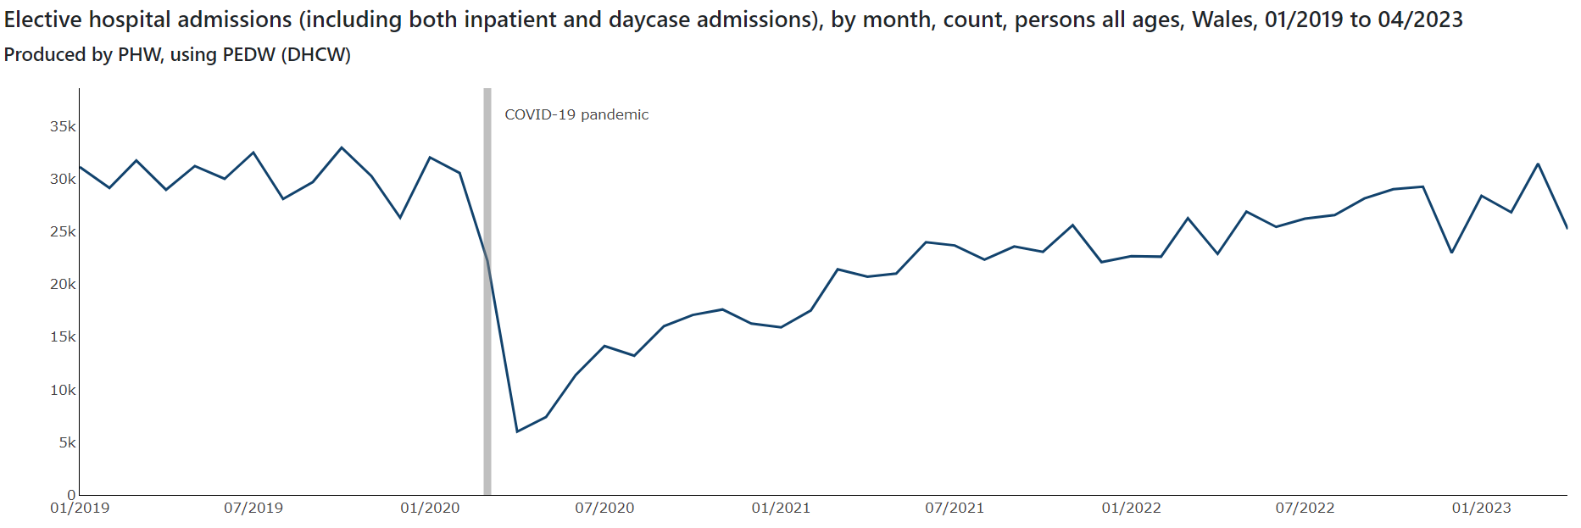
System Ability to Respond

Slide 17
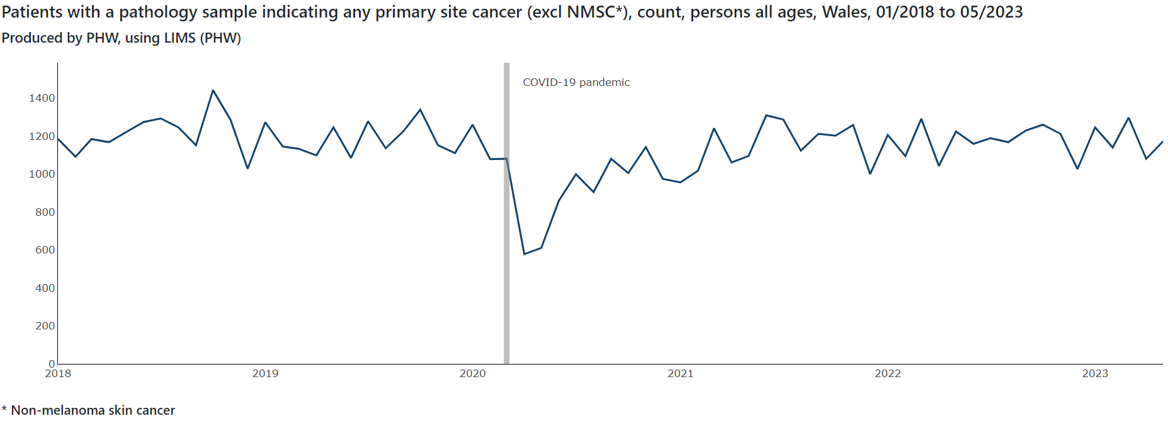
System Ability to Respond

Slide 18
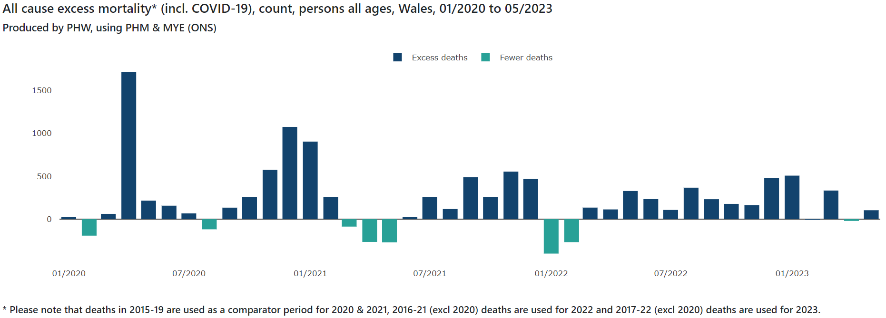
Excess mortality

Slide 19
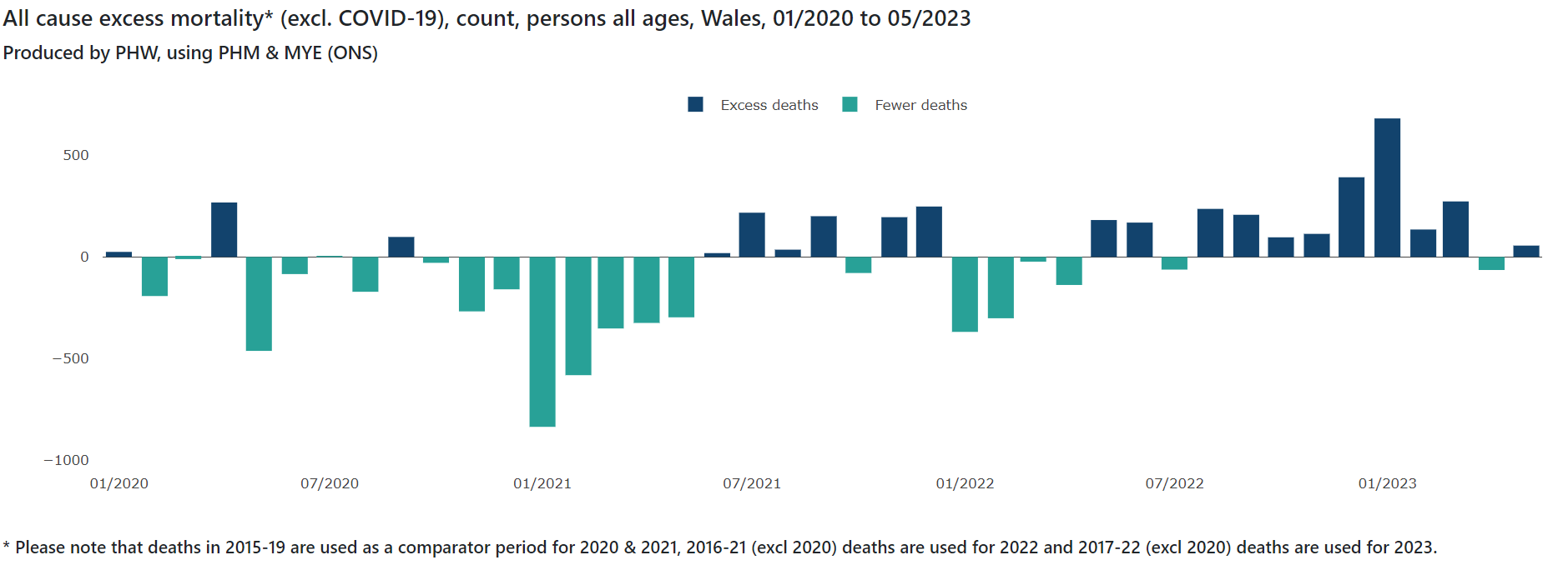
Excess mortality

Slide 20
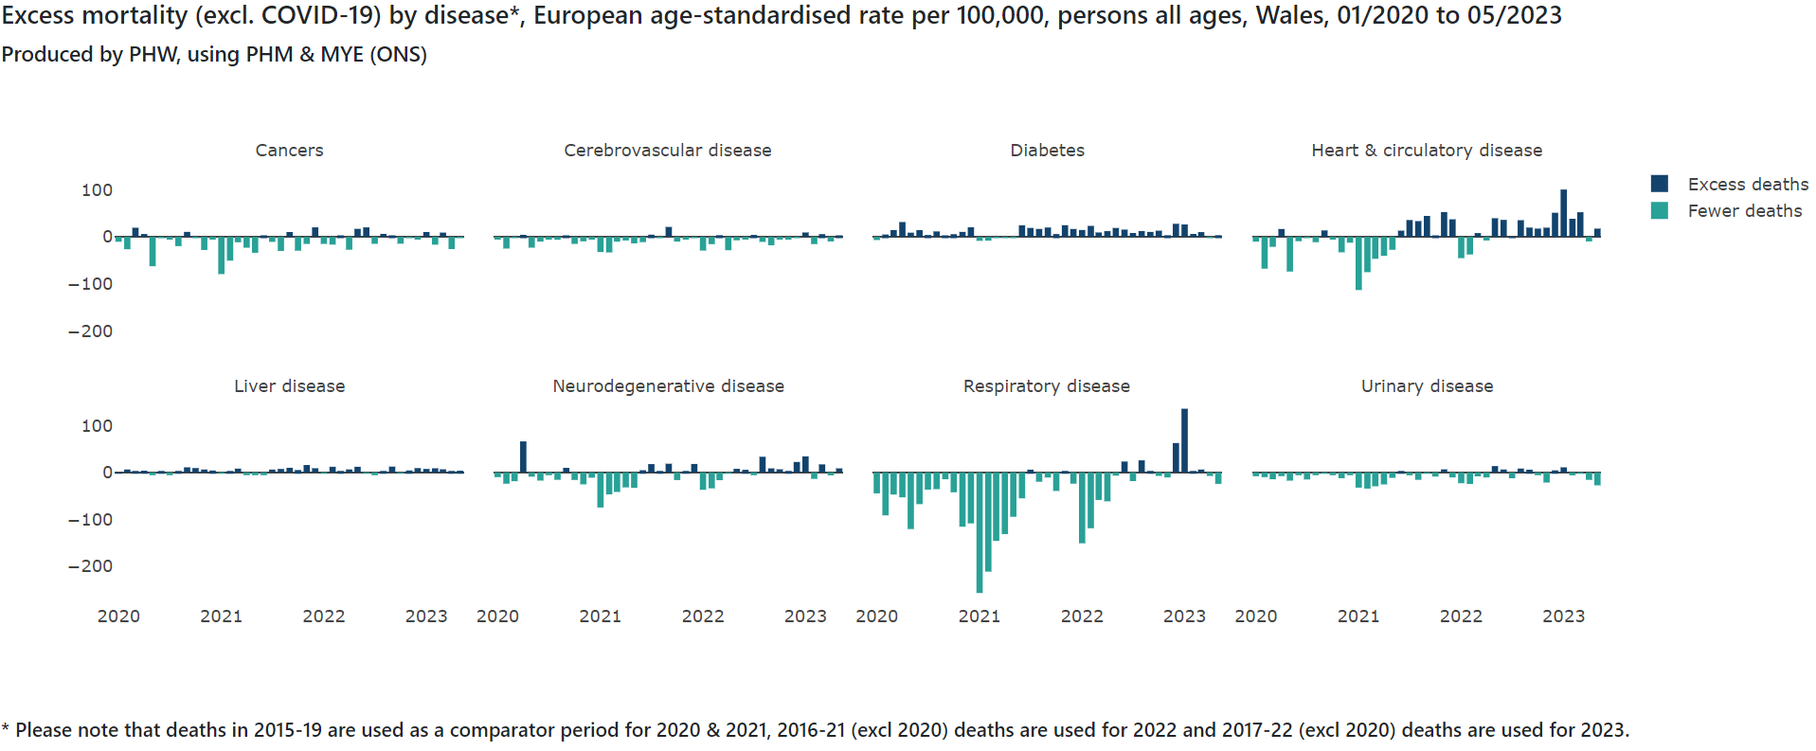
Excess mortality

Slide 21
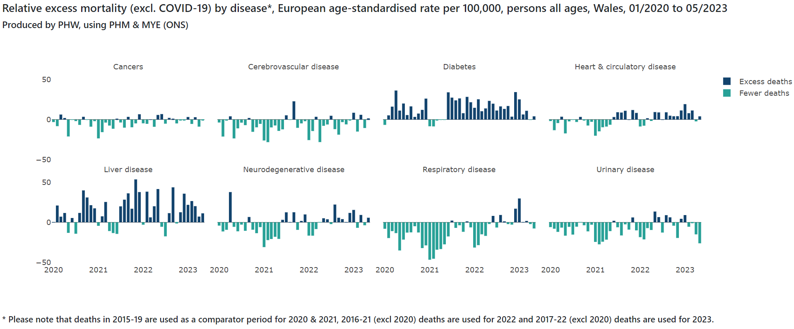
Excess mortality

Slide 22
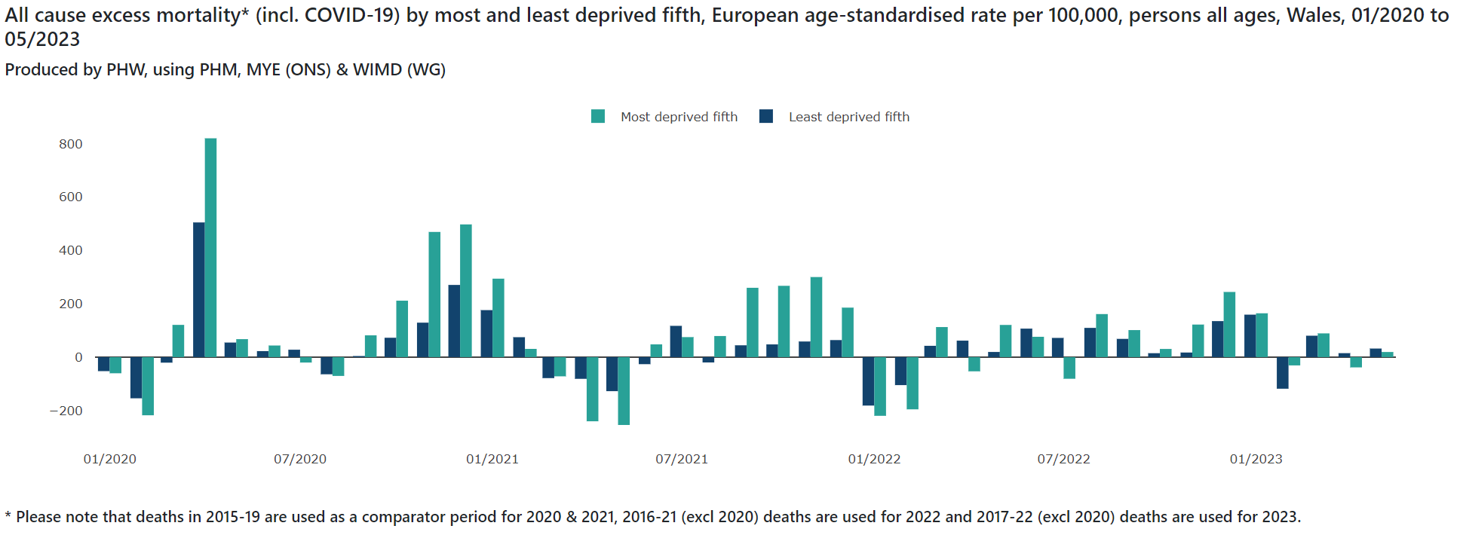
Excess mortality

Slide 23
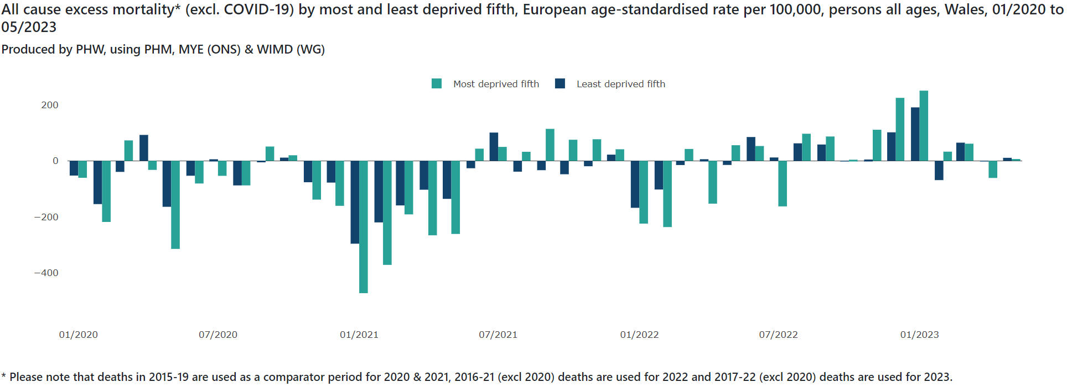
Excess mortality

Slide 24
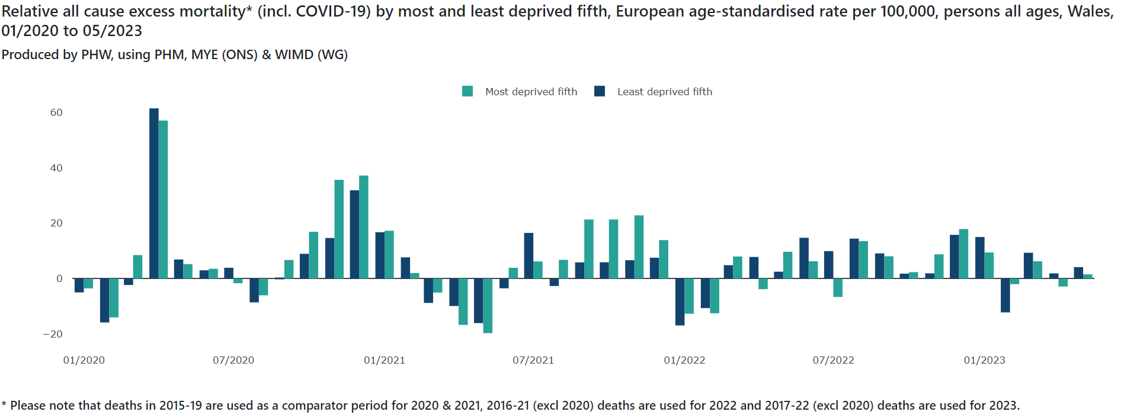
Excess mortality

Slide 25
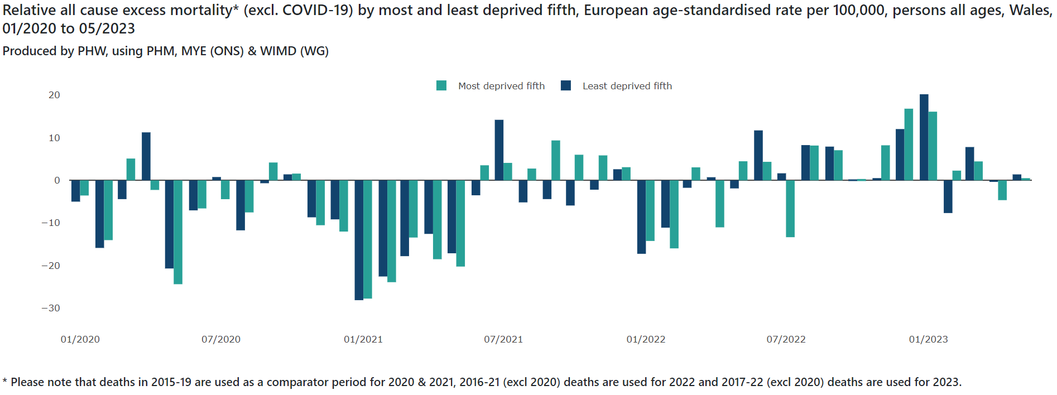
Excess mortality

Slide 26
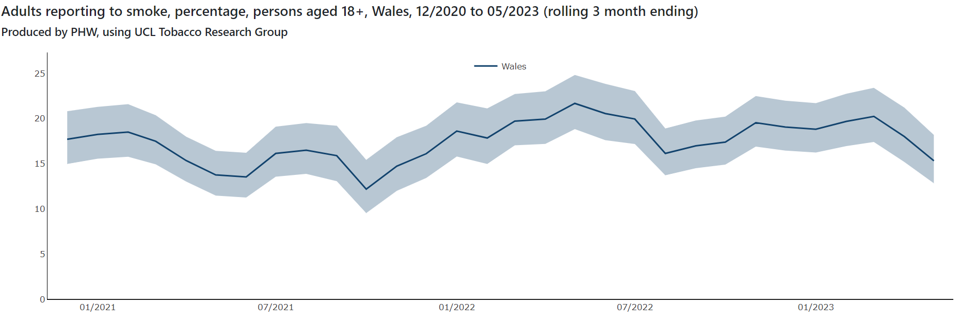
Healthy Behaviours and Wellbeing

Slide 27
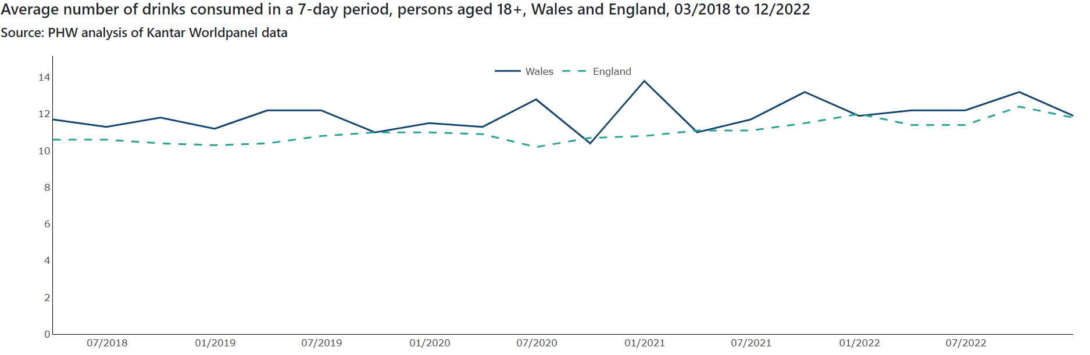
Healthy Behaviours and Wellbeing

Slide 28
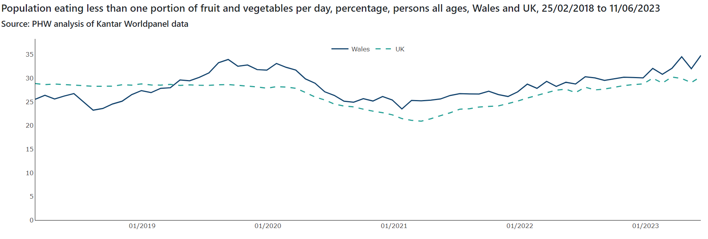
Healthy Behaviours and Wellbeing

Slide 29
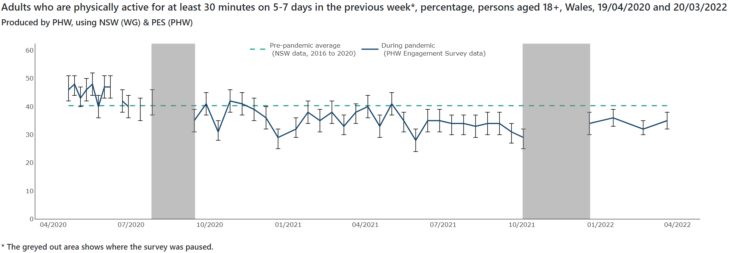
Healthy Behaviours and Wellbeing

Slide 30
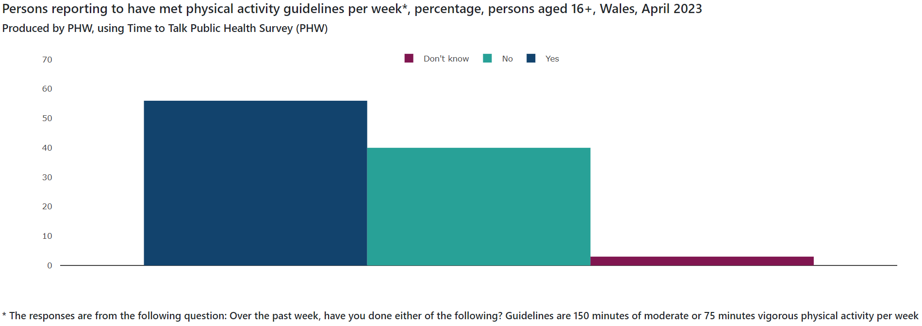
Healthy Behaviours and Wellbeing

Slide 31
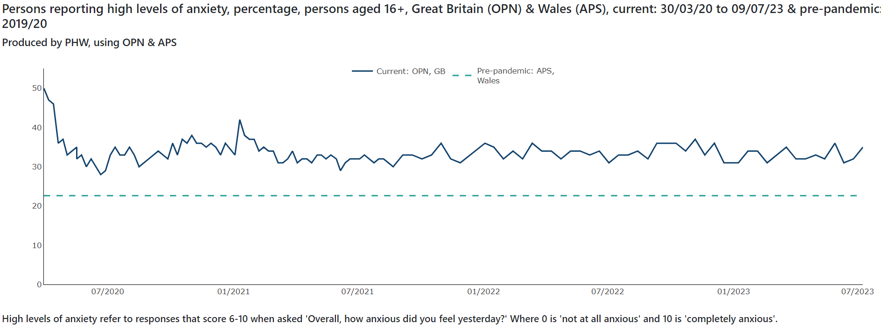
Healthy Behaviours and Wellbeing

Slide 32
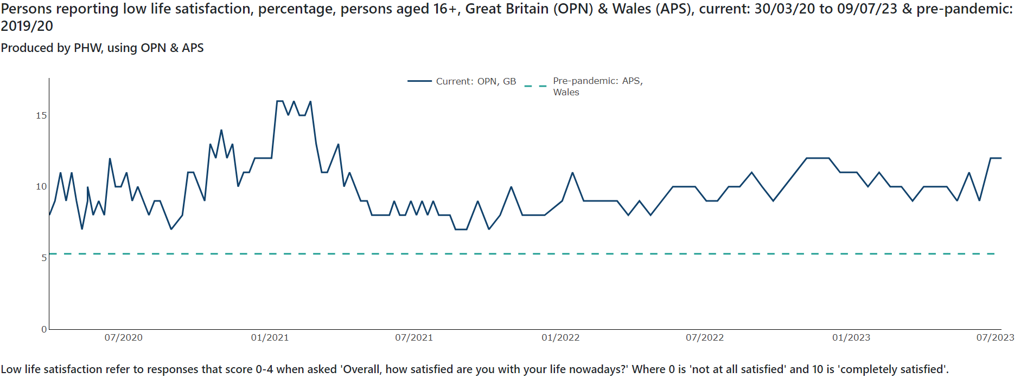
Healthy Behaviours and Wellbeing

Slide 33
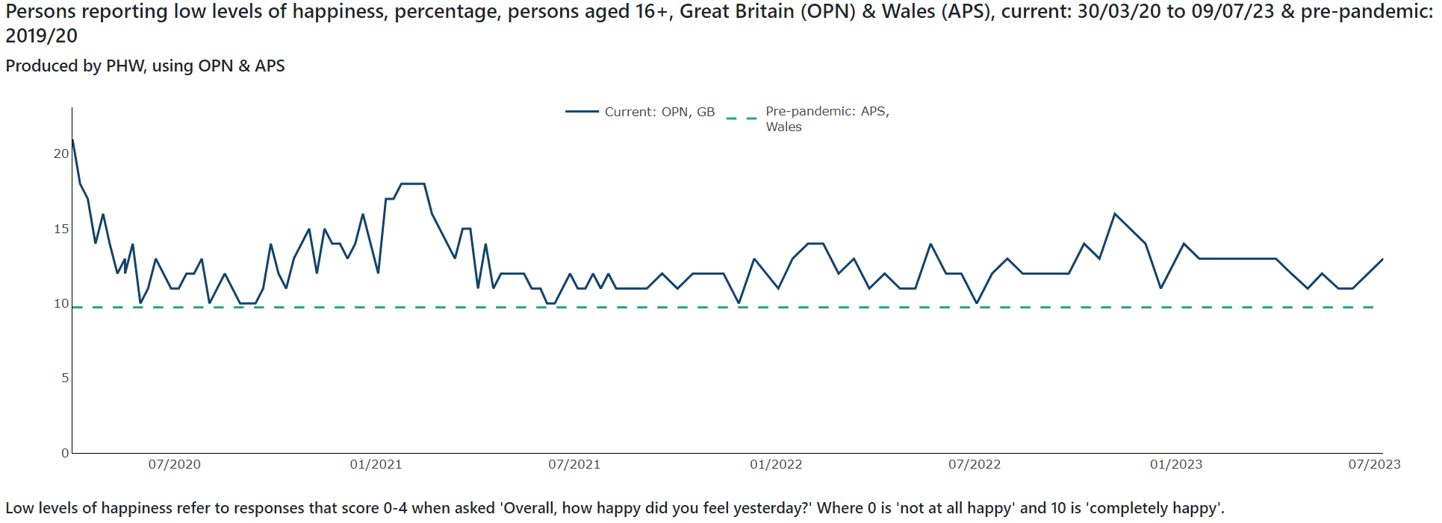
Healthy Behaviours and Wellbeing

Slide 34
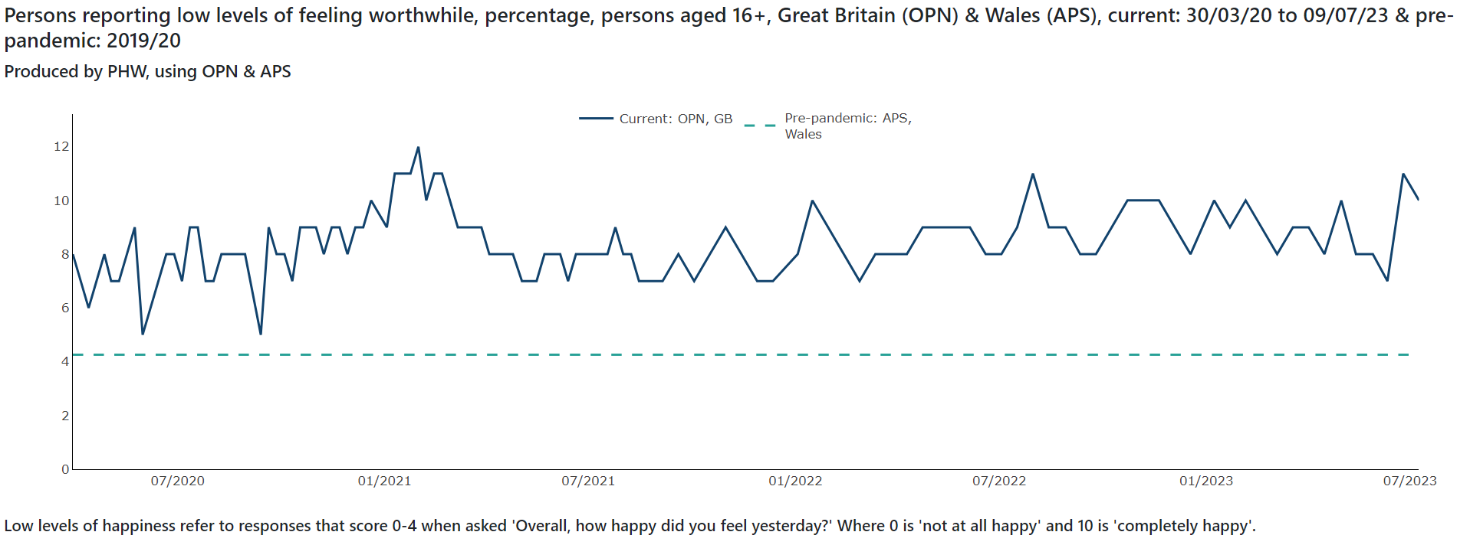
Healthy Behaviours and Wellbeing

Slide 35
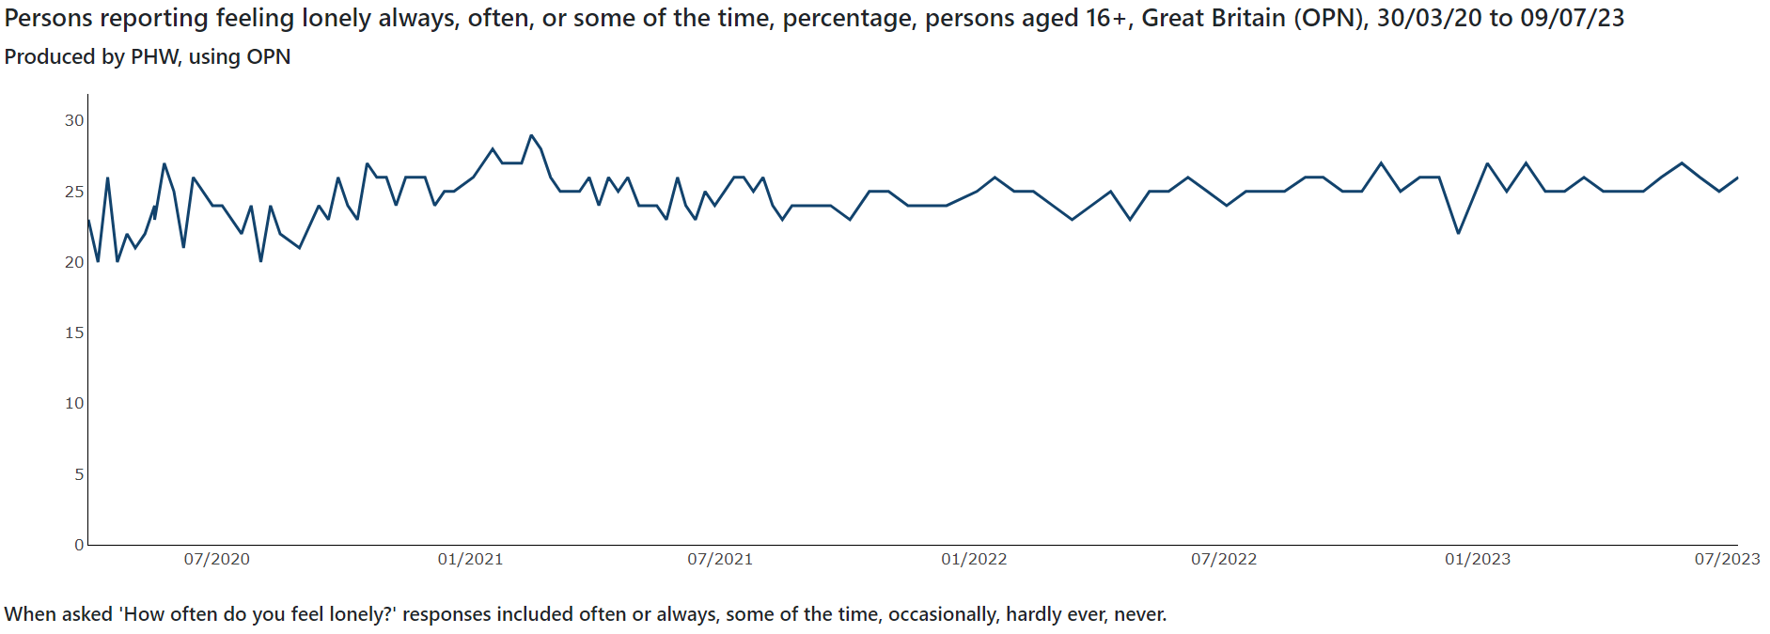
Healthy Behaviours and Wellbeing

Slide 36
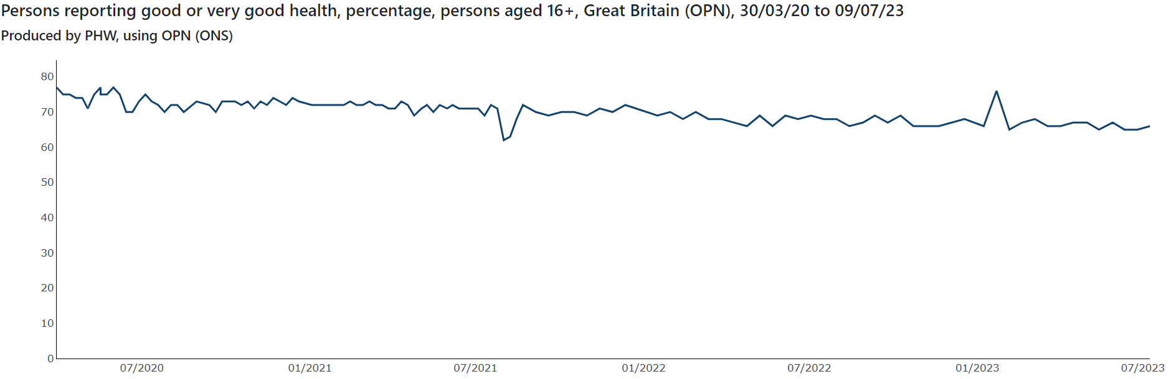
Healthy Behaviours and Wellbeing

Slide 37
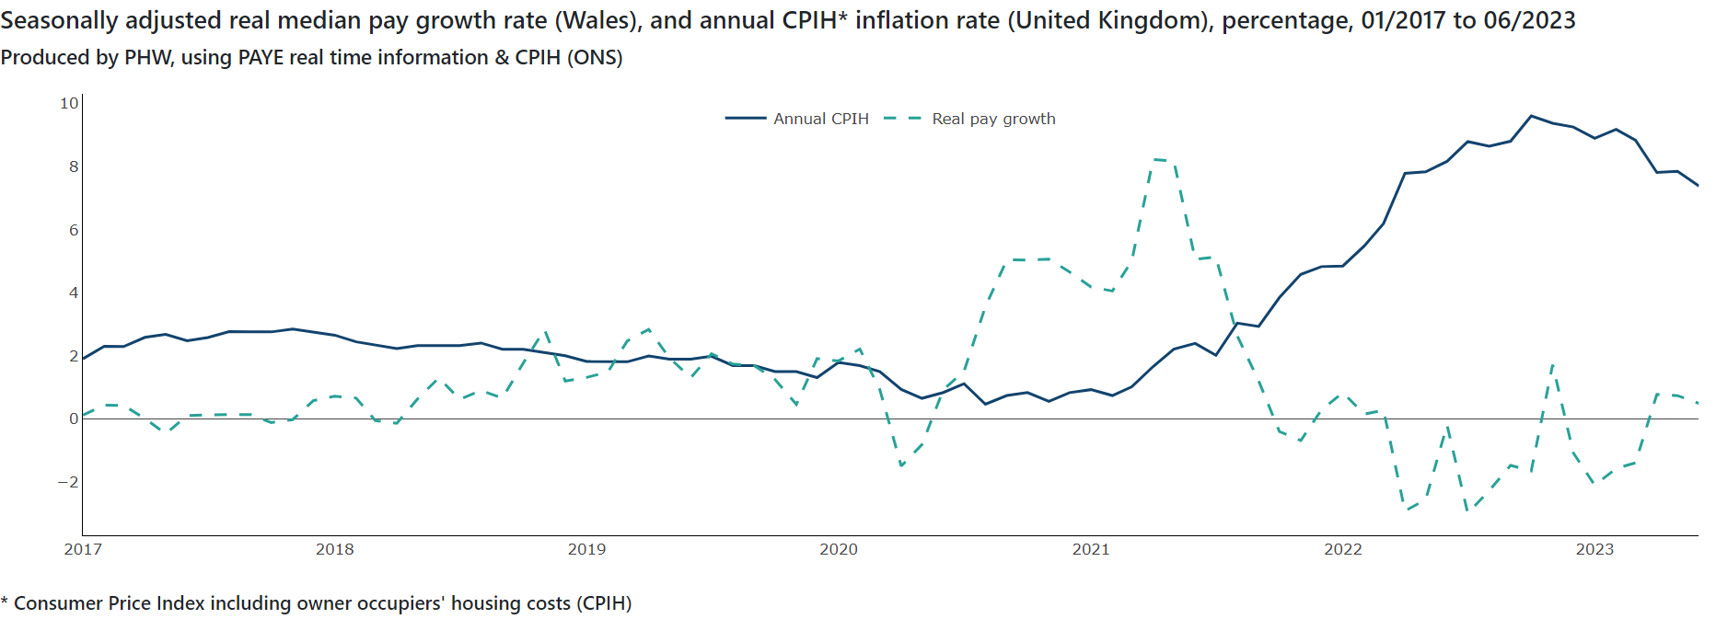
Wider Determinants

Slide 38
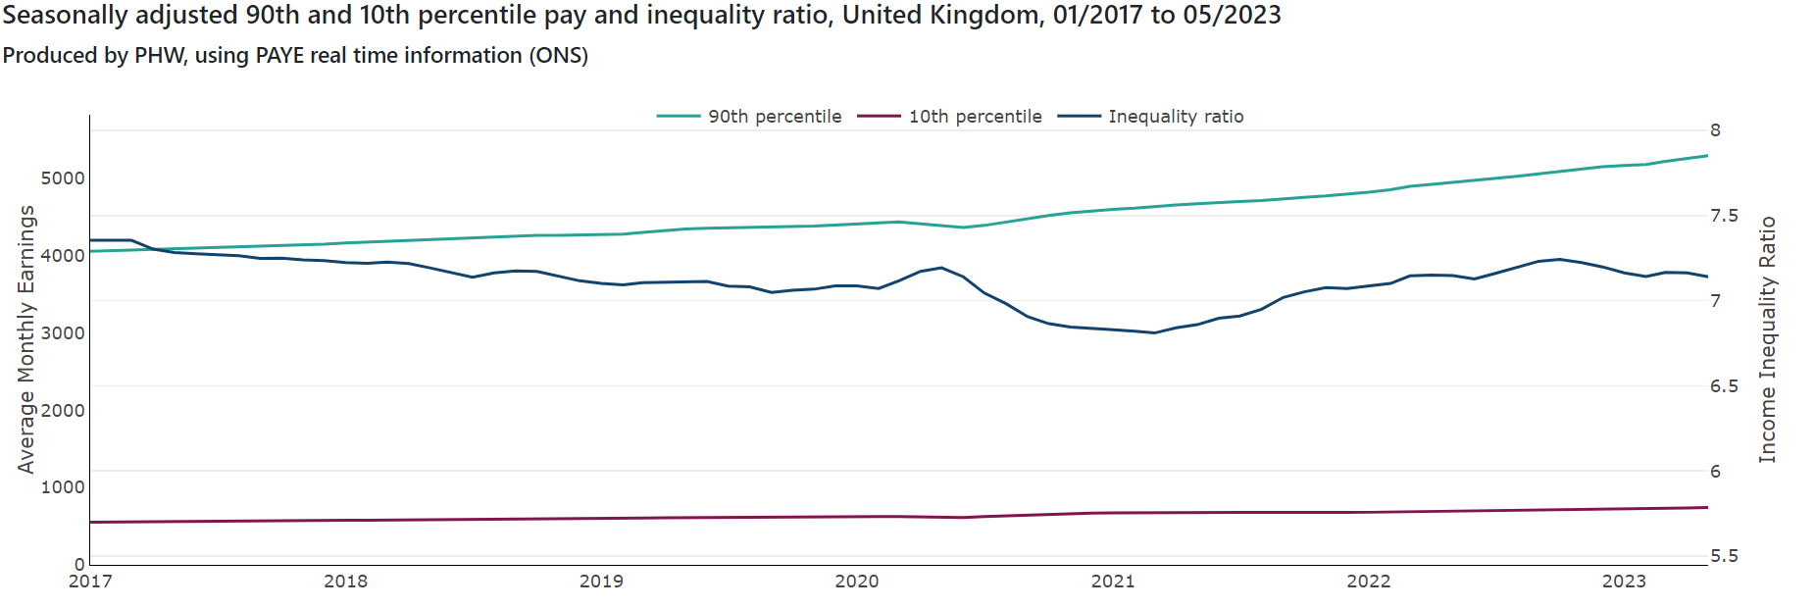
Wider Determinants

Slide 39
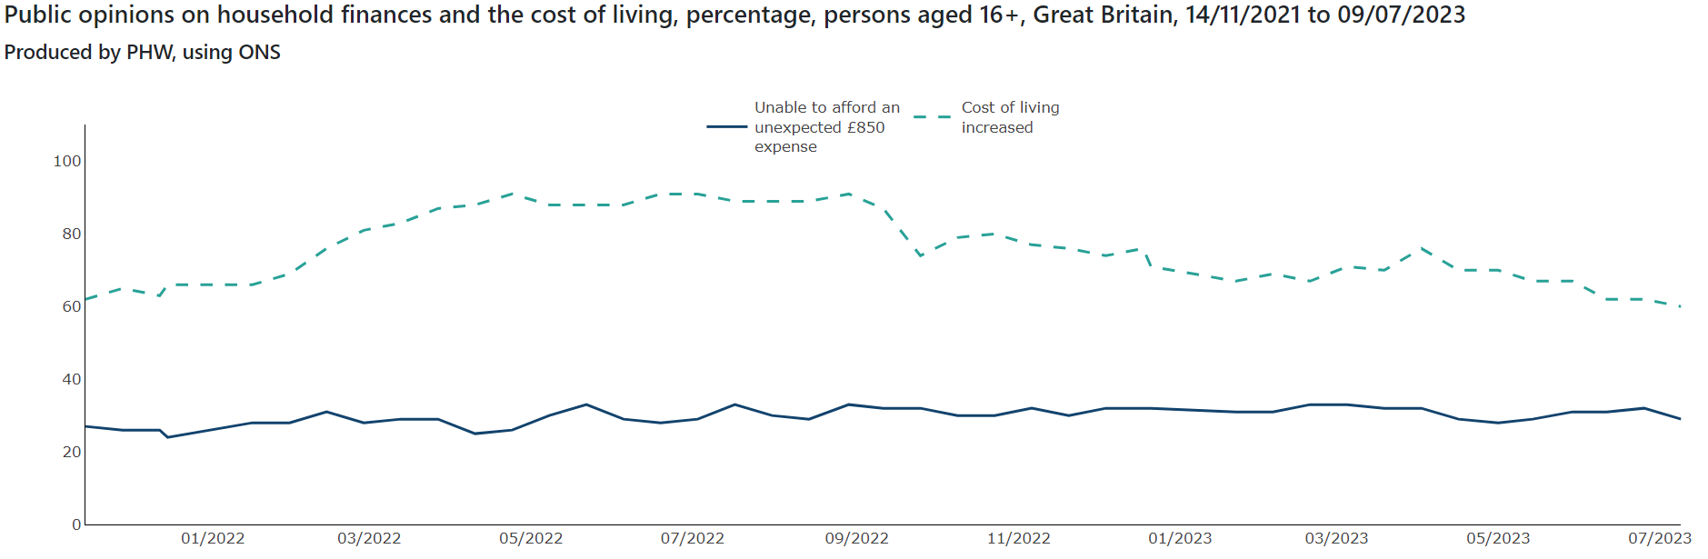
Wider Determinants

Slide 40
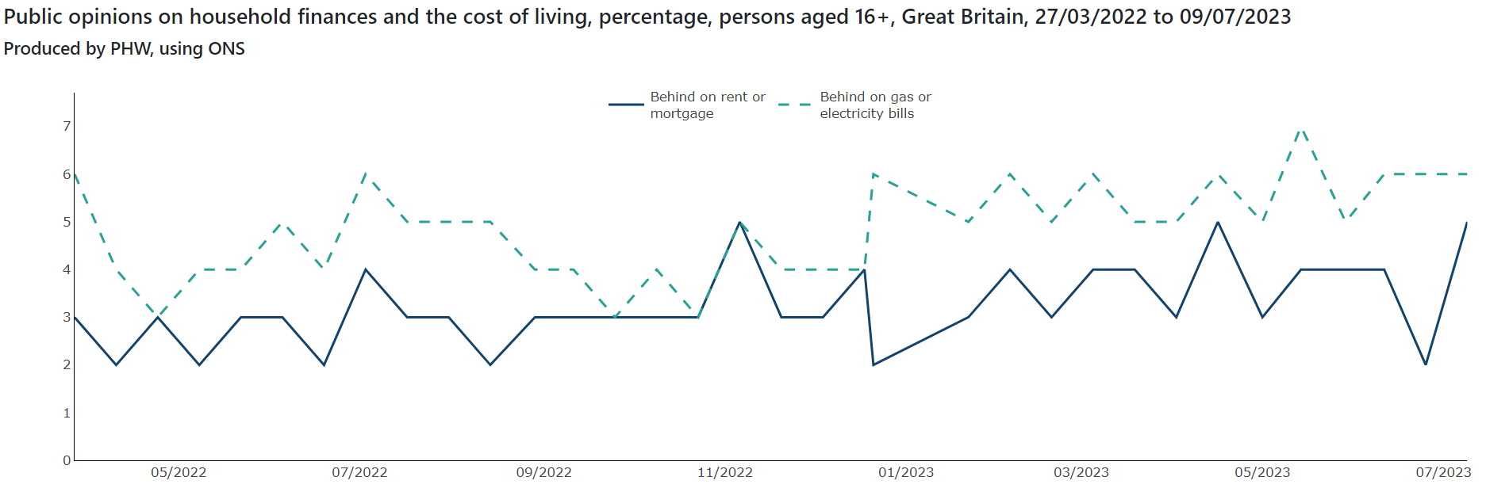
Wider Determinants

Slide 41
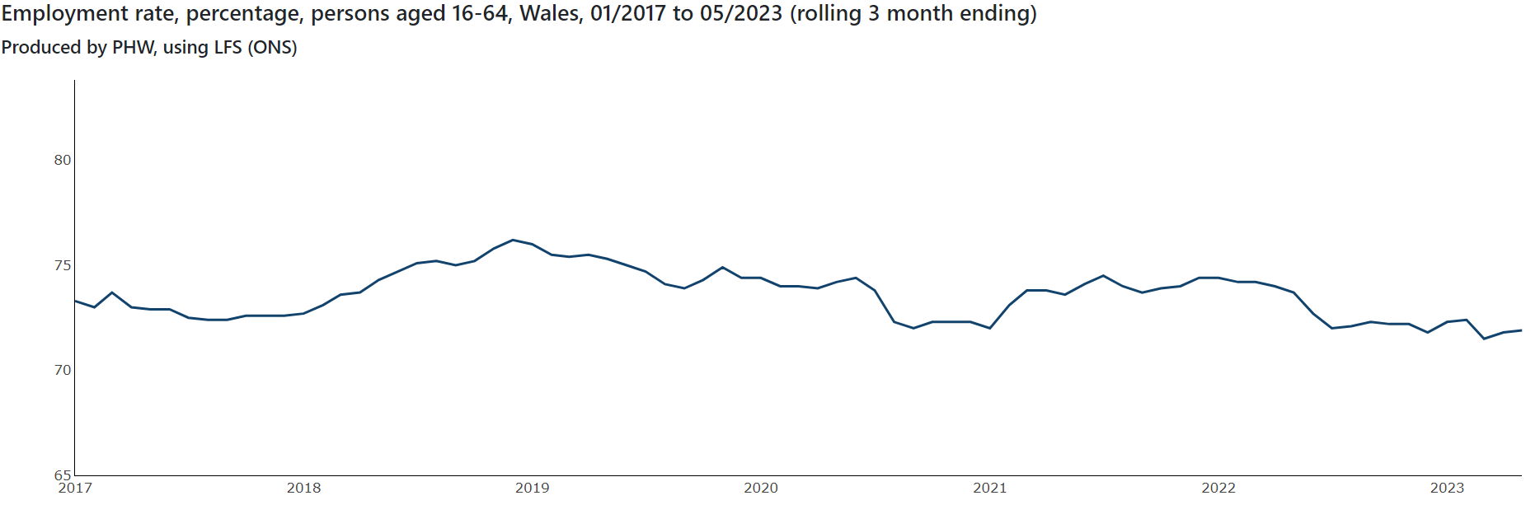
Wider Determinants

Slide 42
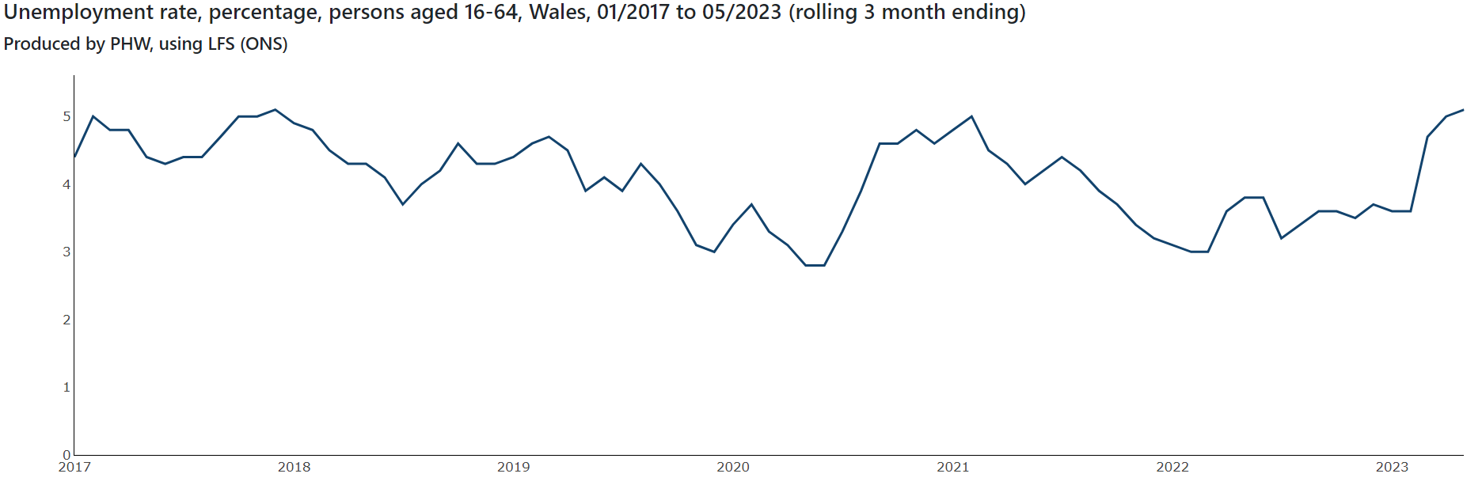
Wider Determinants

Slide 43
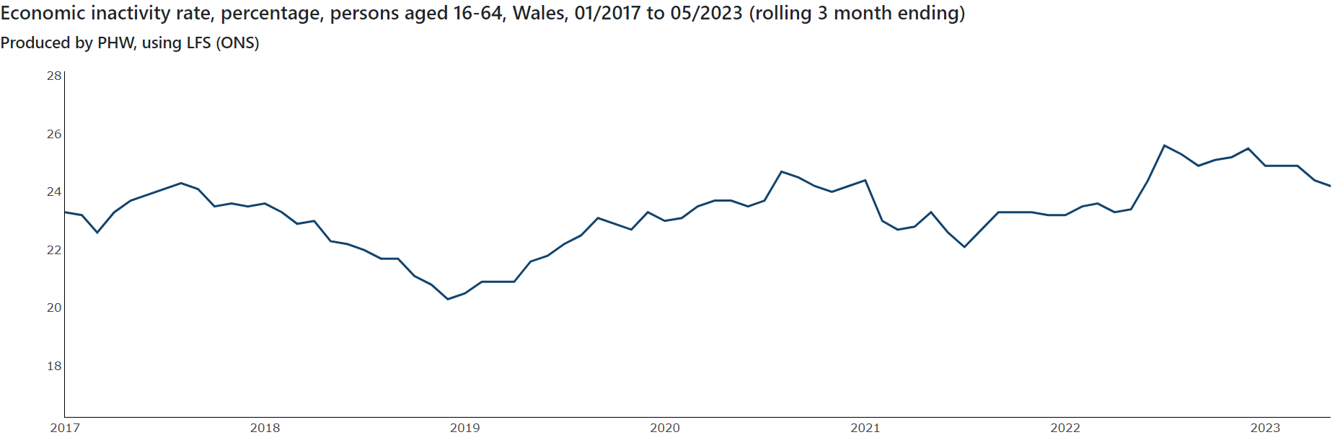
Wider Determinants

Slide 44
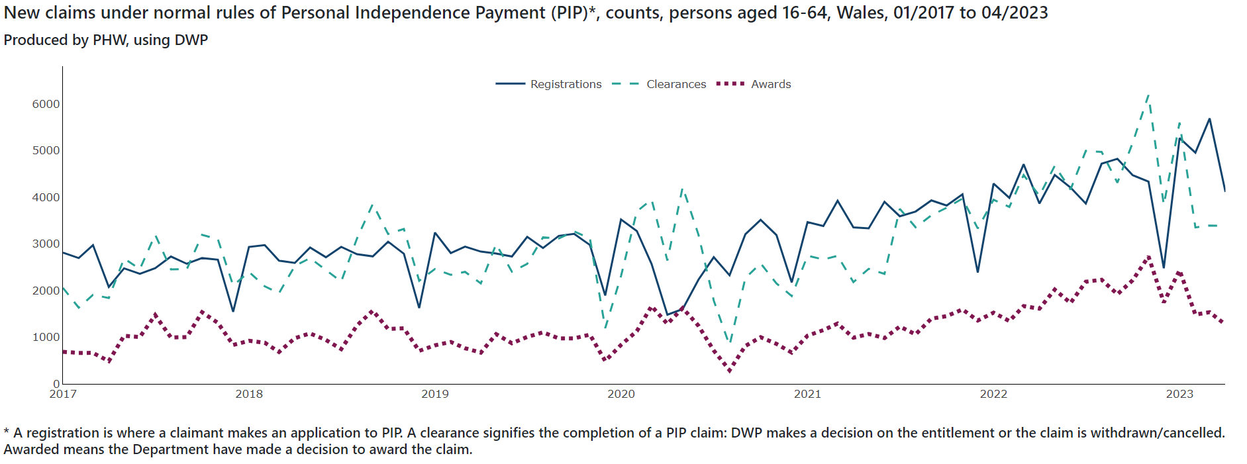
Wider Determinants

