Slide 1

Ymlaen
Rhwydwaith Y Gymraeg
Welsh Language Network
Jordan Everitt, Gruffydd Weston

Slide 2
Welsh Language Network
Our Mission
At Ymlaen, we are trying to bring people together to increase the use of the Welsh language within Public Health Wales.
Discuss how the organisation could best support staff to use their Welsh skills at work.
Progress initiatives to develop PHW’s bilingual culture and highlight instances of where the language is not being treated fairly.
Give a stronger voice and visibility to the language within the organisation.
Bring staff together from across the organisation, creating stronger links between teams, locations and directorates.
Model how Welsh-medium meetings can be held, to the benefit of all.
Public Health Wales
2

Slide 3
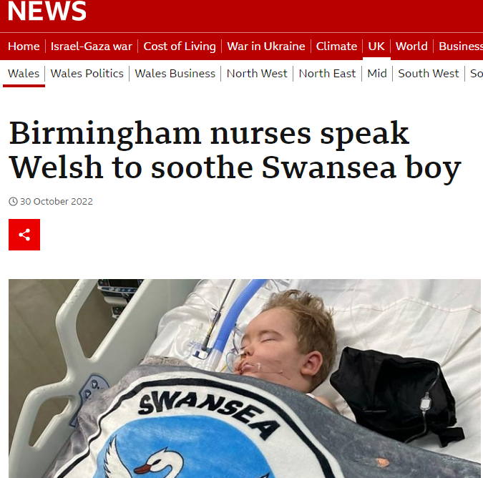
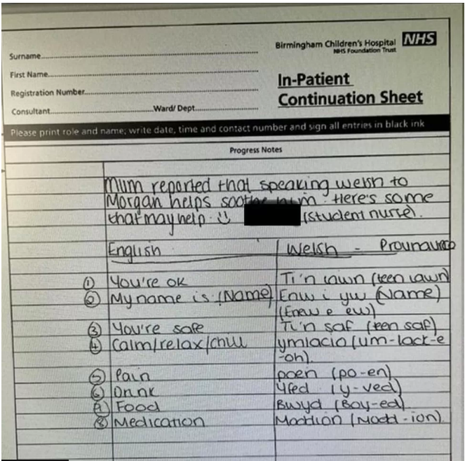
Importance of language in healthcare
Morgan’s Story
It’s impossible to forget the story of Morgan Ridler from Swansea who was being treated in Birmingham for Cancer.
Because his first language was Welsh and it was how he spoke to his family, the nurses at the Hospital did their best to learn basic phrases so that he would feel at home, despite being many hours from his home in Swansea.
Cysga’n dawel Morgan

Slide 4
What we achieved in 2023
Set up the organisation’s network for all things Welsh language – open to all
Welcomed our exec sponsor, Fu-Meng Khaw
Held our opening event to mark Dydd Gŵyl Dewi (St Davids Day)
Grown to 81 members, spread across the entire organisation
Held three Ymlaen Network meetings to expand staff’s Welsh language networks and discuss want members want from the network – we are community-led
Celebrated ‘Diwrnod Shwmae’
Christmas catch up & Welsh language commissioner visit
Public Health Wales
4

Slide 5
Our aims for 2024
Establish a sub-network focused on learners
Think about how bilingualism can become more integrated and natural, for example we will stop using interpreters and try and run all sessions bilingually
We will be celebrating Welsh Language Week during the run up to Dydd Gŵyl Dewi, on Friday March 1st.
We have some fun events planned including a “taste of Wales” video with staff, and we’ll be putting a piece together highlighting historical, unsung Welsh people from the field of public health and medicine.
Public Health Wales
5

Slide 6
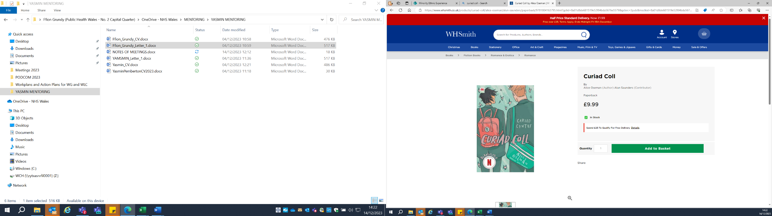
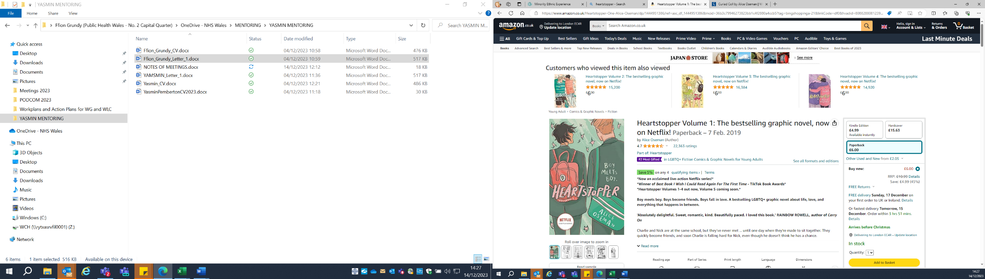
Guest speakers
Alun Saunders
Along with the Enfys network, we have arranged for Alun Saunders to give a talk in February. Alun translated the Heartbreaker series into Welsh, it’s mainly about the lives of young LGBT people in Britain. He also wrote the sitcom, Jam, for S4C, and is a drag artist, ‘cornie off’.
He will be discussing his experiences living and working in Wales, why he translated the series to Welsh, and why the language and culture matters to him.
Future Generations Commissioner
We hope to arrange for the Future Generations Commissioner (or someone from the Future Generations team) to give a talk to PHW staff about the importance of, and role language and culture in a vibrant, future Wales.

Slide 7
Requests
Be supportive and lead by example. Help us normalise the language and embed a culture which embraces Welsh language and culture. Use bilingual signage at all our premises, use Welsh greetings and phrases like bore da, prynhawn da, diolch, croeso, use Welsh language versions of celebration days, e.g. Dydd Gŵyl Dewi, Pasg Hapus etc.
Promote our meetings and events, and attend 2 meetings a year, one guest speaker event and one networking event. This way we hope you can share in our learning and hear directly from staff what’s working well and what we can do better.
Encourage staff and colleagues to improve their Welsh language skills, whether that be to level 1, 2 or above. Signpost to- and promote learning opportunities.
Mostly, enjoy the language, help us ensure that using Welsh is seen as a benefit, something to celebrate, rather than an obstacle!

Slide 8
Gweithio gyda'n gilydd i greu Cymru iachach
Working together for a healthier Wales
Notes:
8

