Slide 1



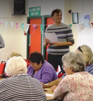
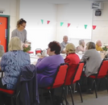
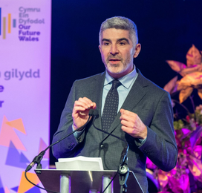
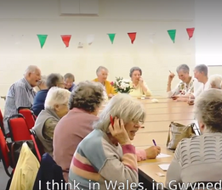
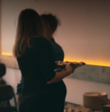
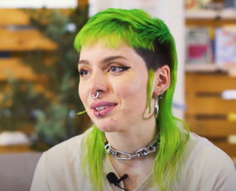
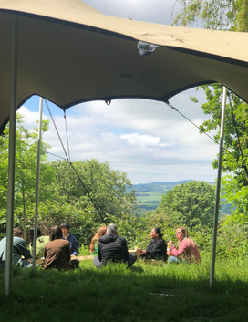
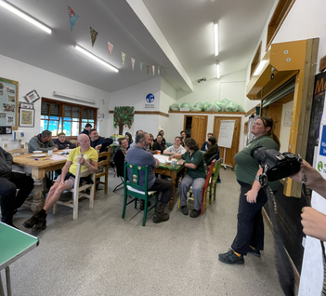
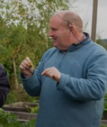
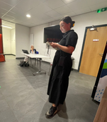
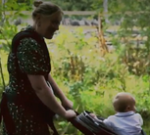
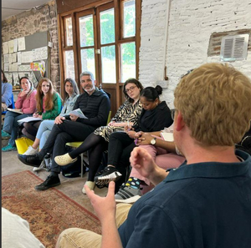
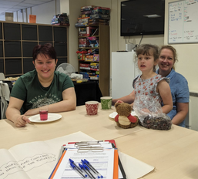
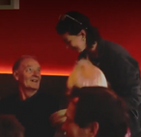
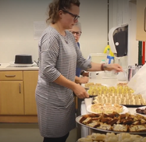
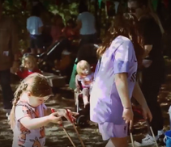
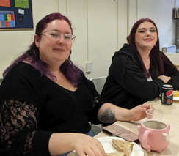
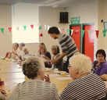
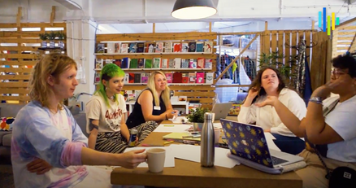
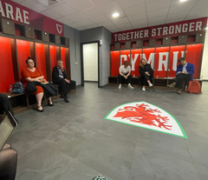
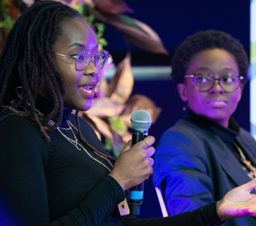
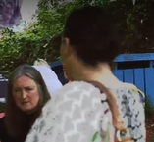
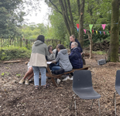
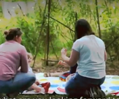
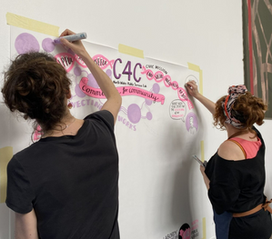
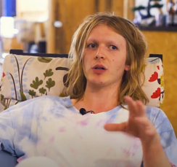
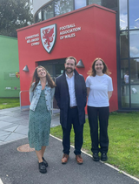
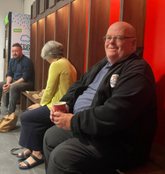
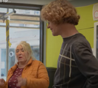
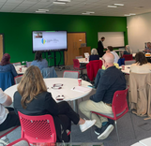
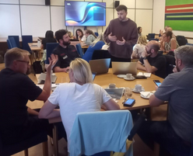
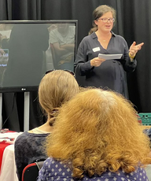
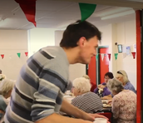
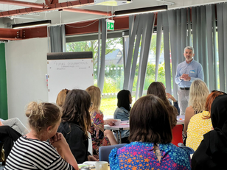
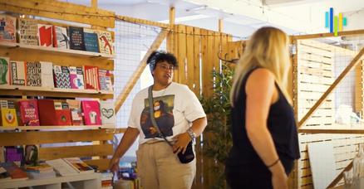
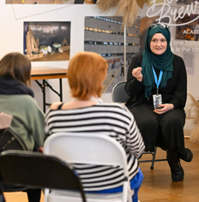

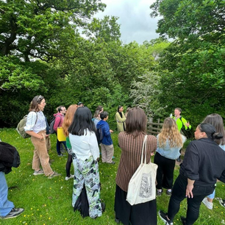
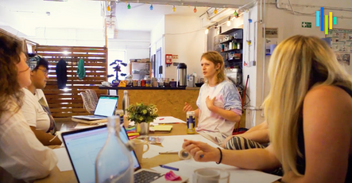
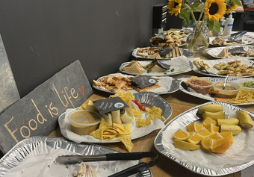
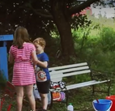
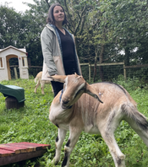
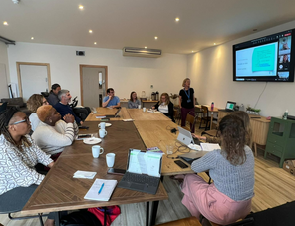
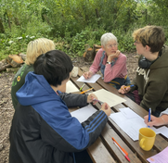
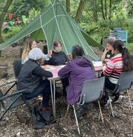
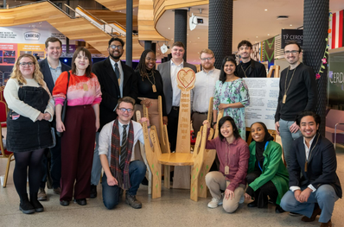
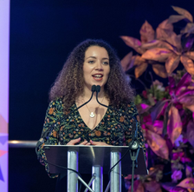
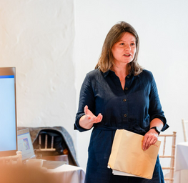
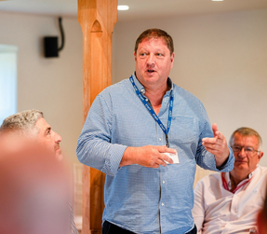
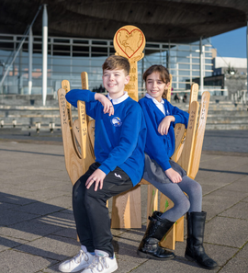


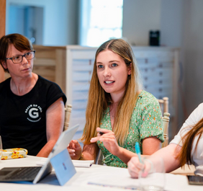
























CymruCan
cymrucan
Cymru Can
The strategy for the Future Generations Commissioner for Wales 2023- 2030
Strategaeth 2023-2030 ar gyfer Swyddfa Comisiynydd Cenedlaethau’r Dyfodol Cymru

Slide 2




CymruCan
cymrucan
5 cenhadaeth 5 missions
Culture & Welsh
Health & Well-being
Implementation and Impact is our core mission that encompasses our role to ensure the Well-being of Future Generations Act is applied effectively and with ambition. Under that sit 4 missions which correspond with the 4 dimensions of well-being in the Well-being of Future Generations Act.
language
Implementation and Impact
Cultural dimension
Social dimension
Sustainable development
Climate and Nature
A Well-being Economy
Environmental dimension
Economic dimension

Slide 3

Ein cenadaethau Our Missions
CymruCan
cymrucan
To facilitate a transformation in the way we keep people healthy, with a greater focus on prevention and the long term. As a result, public bodies are working together to tackle the root causes of ill health and addressing health inequalities.
To reinforce the positive impact of cultural well-being. As a result, public bodies are making the urgent changes needed to promote culture and creativity, enhance the fabric of communities and promote multi-culturalism and the Welsh language.
Culture & Welsh
Health & Well-being
language
Implementation and Impact
To ensure the Well-being of Future Generations Act is applied effectively and with ambition in a way that improves the lives of the people of Wales now and in the future.
To ensure all Welsh public bodies achieve their net zero and nature positive goals by 2030. As a result, public bodies are leading action on climate change including adaptation, in a way that reduces inequalities and maximises the benefits to people and communities across Wales.
Climate and Nature
A Well-being Economy
To help transition Wales to an economy that puts people and planet first. As a result, governments at all levels, communities and business are making this happen.

Slide 4
CymruCan
Pam y cenadaethau hyn?
Why these missions?
cymrucan
  Health is central to our well-being
  Levels of preventable illness and health inequalities remain high
  With projected growth in demand for our health and social care services, financial cost is becoming increasingly unsustainable
  Public bodies often find cultural well-being difficult to understand
  Increasing funding challenges put culture and leisure services under threat
  Well-being plans and objectives are not doing enough to ensure cultural well-being outcomes are supported
Culture & Welsh
Health & Well-being
language
Implementation and Impact
  The Act and its ambition need to be implemented more effectively and with urgency
  There is a gap between aspiration and delivery
  The legislation needs to live to its full potential
  Tangible progress in this area is currently insufficient. We risk not meeting our targets
  Without change in our approach, climate change will cause more destruction and loss
  1 in 6 species in Wales, and 1 in 3 mammals is facing extinction without intervention.
Climate and Nature
A Well-being Economy
  Our economy is not yet delivering for all of the well-being goals
  The cost-of-living crisis is widening economic inequality in Wales
  Poverty is increasing
  Our economy uses natural resources at a faster rate than we can replenish them

Slide 5






CymruCan
cymrucan
Meysydd Ffocws Areas of Focus
Culture and Welsh language
The food we eat is a part of Welsh culture and identity, our food system helps protect the heartlands and promotes the Welsh language
Implementation and Impact
The learning from this work helps public bodies implement the Act better in other areas as well
Implementation and Impact
Digitalisation and AI can help public services become more efficient and support innovation
Culture and Welsh language
The implications of digitalisation and AI on the cultural sector need to be carefully considered to ensure no adverse impacts
Health and Well-being
Healthier diets helping to prevent illness and promote well-being
Health and Well-being
AI can improve the capacity of our health system
Food
AI & digital
Climate and Nature
Sustainable food system that does not contribute to climate change and enhances biodiversity
A Well-being Economy
Developing skills in this are can help Wales become a leader in this space to model a compassionate, well-being society to increase the potential for AI to be a force for good.
A Well-being Economy
Local supply chains that help to support cohesive communities and a well-being economy
Climate and Nature
AI has a huge potential to help us address the climate emergency

Slide 6




CymruCan
cymrucan
Iechyd a Llesiant Health and Well-being
Mission
We will make it our mission to facilitate a transformation in the way we keep people healthy, with a greater focus on prevention and the long term. As a result, public bodies are working together to tackle the root causes of ill health and address health inequalities.
Need
Progress towards a Healthier Wales is too slow.
Preventable illnesses are on the rise and inequalities in health outcomes are high in many communities.
The future burden on health and social care is unsustainable without moving to a more preventative system.
Activity
Outcomes
Impact
Wales is reducing the incidence of preventable diseases, comparing well to other UK nations.
Health inequalities have decreased, and healthy life expectancy is increasing.
People’s experience of our health services will be better with joined up health and care plans.
Across Cymru we have created environments for good that promote well-being - not cause illness.
Equip all public bodies to understand their role in preventing ill health and to apply long-term and preventative approaches.
Convene public bodies, community groups and others to facilitate learning exchanges on the health agenda.
Share good practice examples and advocate for those people doing good things.
Ensure organisations outside the NHS use their levers to improve health and well-being, in areas like housing, education, and land use planning.
Work with others to better understand the implications of future trends and the potential of future solutions.
The social model of health is understood and is the focus of well-being objectives.
There is a shift in budgets and planning towards prevention in Welsh Government and public bodies.
More collaboration and integration are happening between the NHS, social care, and other relevant organisations, for example sharing data, budgets, plans and campaigns.
A more diverse range of people are involved in co-producing services.
28
*This page gives an overview of the way we’ll work, and an indication of the types of activity we'll undertake
29

