Slide 1






Quality Governance Performance Report

Slide 2
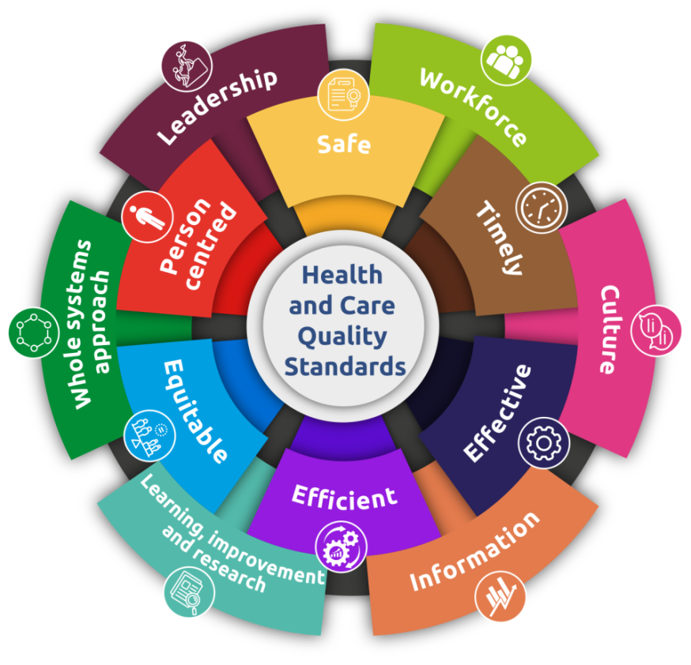
Introduction
The Quality Governance report is a quarterly report provided to the Quality safety & Improvement Committee to review and take assurance on clinical quality and safety through the provision of data and summary highlights from Public Health Wales’s assurance groups. It covers the following areas:
Putting things Right
Compliments
Safety Alerts and Notices
Clinical Audit
Corporate Safeguarding
Corporate Infection Prevention & Control

Slide 3
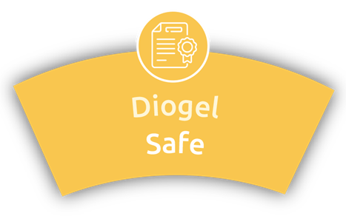
Putting Things Right (PTR) Section
Key Points:
There were 0 National Reportable Incidents or Early Warning Reports in Quarter 4
471 incidents were reported this quarter
Of these, 2 were initially reported as moderate harm in Microbiology with 1 subsequently downgraded following investigation . The remaining incident was reported externally as a RIDDOR. This was due to a manual handling injury for a member of staff. The other incident was in health protection and remains under investigation at present
‘Failure to follow protocol/SOP’ remains the highest reported sub-category however, it should be noted that this type of incident has reduced from 71 incidents in Q3 to 40 reported in this Quarter
83 incidents have an open status currently with 8 being open for more than 120 days.
Overall Incident closure rates are improving with a noticeable improvement in February 2024, for Cervical Screening Wales.
Public Health Wales

Slide 4

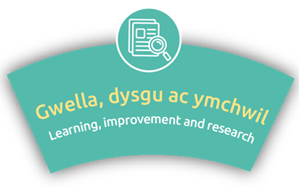
Patient /Service user Experience (PTR) cont.
Complaints
45 Early resolution complaints were received in Q4 an increase of 24 compared to the previous quarter.
33 were resolved within 2 days . Concerns related to access to services, appointments, communication and staff attitude
5 Formal complaints received this quarter and 100% acknowledged within 5 days . Common themes recorded include attitude and behaviours.
Compliments
145 compliments received this quarter - with the common theme being beyond the level of expected care
Highest Responses received by Screening Division
Most popular method of leaving compliment is the website
Safety Notices
3 out of the 61 received this quarter were applicable to PHW
Main theme of alerts was medicines shortages
Public Health Wales

Slide 5

Safeguarding
Safeguarding Concerns
10 Safeguarding incidents reported this quarter
Higher number of concerns reported in Screening and Health Protection as the largest Directorate with the most public contact.
Highest reported category - mental health concerns
Training Compliance
Adult Level 1 safeguarding training at 92%
Child Level 1 safeguarding training at 90%
Violence against women, domestic Abuse and Sexual Violence 90%
Safety Notices
Risk 1541 - DBS (Disclosure and Barring Service) checks for established staff and the risk they may pose to vulnerable people . Now on the corporate risk register .
DBS audit completed and is now a key area for improvement work .
Public Health Wales

Slide 6

Infection Prevention and Control
IP&C Incidents
18 incidents – all deemed low or no harm apart from 2 which remain under investigation
3 incidents were for contact with needles /sharps of which 1 remains under investigation. Of these only 1 was a true contact with blood or body fluids.
IPC Risks and Issues
Decontamination practice and compliance against standards within some screening services ( BTW and BSW) . Sites include Glan Clwyd endoscopy unit reprocessing facilities, & air change and ventilation within Breast Test Wales clinic environments.
Compliance with new decontamination requirements for of breast ultrasound probes compounded by the ventilation issues.
Compliance with IPC Environmental Auditing at some screening sites due to staffing shortages.
Training Compliance
Compliance for the IPC Level 1 & 2 has improved
Level 1 compliance is at 89.5% and for Level 2, 80% however both remain below performance target
Public Health Wales

Slide 7
Gweithio gyda'n gilydd i greu Cymru iachach
Working together for a healthier Wales

