Slide 1





Duty of Quality and Clinical Governance Framework updates
May 24

Slide 2
Purpose
To provide the Quality, Safety and Improvement Committee with an update on the implementation of the Clinical Governance Framework and progress of the Quality Oversight Group (QuOG).

Slide 3
CG Framework and Quality Oversight Group (QuOG)
CG Framework Approved
October 2023
CG Framework Published
October 2023
Formation of Quality Oversight Group – Working Group
December 2023
Quality Standards Development
January – February 2024
Annual Quality Report Development/ Data Collection/ Triangulation/ Production
February –
April 2024
Annual Quality Report Approval and Publication
May 24
Quality Standards Socialisation
April – June 2024
Aim for Organisational Quality Oversight Group to be Operational
July 2024
All Sub-Groups Reporting to Organisational Quality Oversight Group to be Operational
December 2024
IMTP Deliverable amended to include DoQ/ Quality Standards – encompassing CG Framework
IMTP Deliverable Organisational Oversight Group to be functional September 2024
IMTP Deliverable sub-groups to be functional
Public Health Wales
xxxxxxxxxxxxx

Slide 4
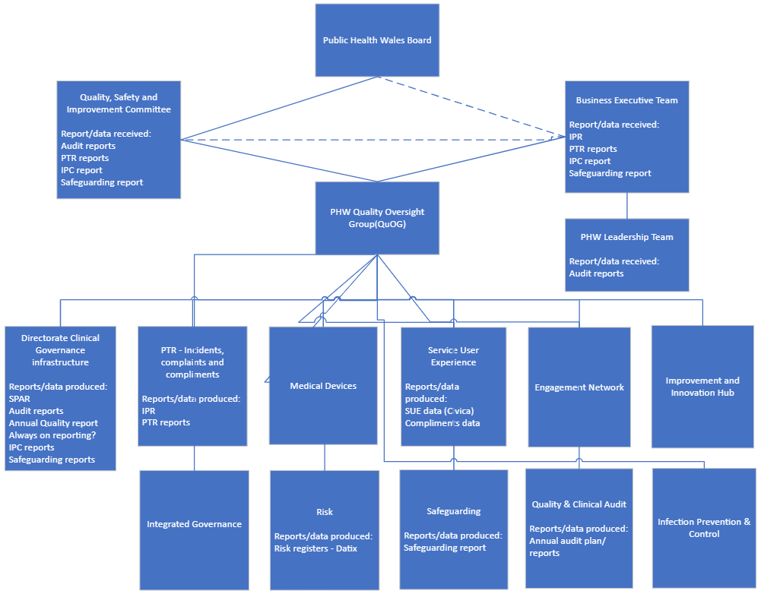
Key
---- Groups in Place
---- Reports to QSIC
---- Currently Missing
---- Team
Shared Learning (name to be determined) Group
Medicines Management
Public Health Wales
Quality Oversight Grp

Slide 5








Role of the QuOG in Support of QSIC and Organisation
To QSIC
Assurance:
Person Centred Approach
Safety
Safeguarding
Evidence based
Clinically effective
Meeting standards
Advise:
Adoption of key indicators
Always on reporting
Annual Quality Report
Support/ Ensure:
Clear, consistent strategic direction
Strong leadership
Transparent lines of accountability
Provide:
Leadership
Direction
Commitment
Demonstrate:
Quality Improvement
Learning
Exploit opportunities
Share:
Good practice
Learning
Impact
Identify & Review:
Risk
Issues
Receive Assurance:
Logged
Managed
Mitigated
QSIC
QuOG
Organisation
Oversee:
Key performance indicators
Demonstrating Improvements in:
Safety
Effectiveness
Service User Experience
Facilitate Data & Information
Timely
Valid
Accurate
Complete
Identify Learning:
Patient safety incidents
Complaints
Claims
Public Health Wales
xxxxxxxxxxxxx

Slide 6
Duty of Quality – Deliverables 2024/25
Deliverable | Delivery Date
Evidenced all strategic decisions and commissioning and hosting arrangement are made through a quality lens (rolled over from Q4 2023/24) | Sept 2024
Utilised the Duty of Quality Standards to operationalise and embed the Clinical Governance Framework within clinical public health services, demonstrating the Standards comply with legislative requirements | Dec 2024
Aligned the quality infrastructure to the Quality Standards to enable all strategic decision-making and reporting arrangements meet the Duty of Quality | Mar 2025
Designed and implemented a bespoke offer of enhanced quality management training by the Improvement and Innovation Hub to accompany the mandatory Duty of Quality training for all staff linked to Quality as an Organisational Strategy | Dec 2024
Developed an agreed methodology for Quality Impact Assessments (QIA) to ensure that there is a consistent approach across the organisation to assess the impact on quality of any proposed changes to service provision, and policy change | Sept 2024
Evaluate the introduction of Quality Impact Assessment (QIA) methodology | Mar 2025

Slide 7
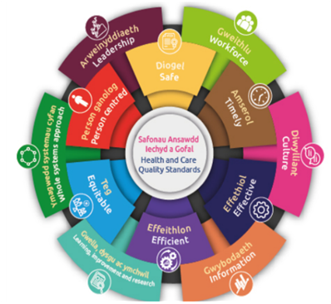

Duty of Quality – Annual Quality Report
The Duty of Quality outlines 12 Health and Care Quality Standards that describe what good quality care looks like
Annual Quality Report 2023/24:
Captures Quality across PHW under the 12 standards
Quality Improvement and Learning
Forward look to 2024/25
Purpose of this Annual Quality Report:
Illustrate how we comply with the 12 standards
Look back at what has been achieved in relation to the quality of our services
Learn how we can do better and look forward to the coming year
Annual Quality Report 2024/25:
Iterative process throughout the year
Aligned to the Quality Oversight Group
Builds upon the ‘Always on’ reporting

Slide 8
Recommendation
This Quality, Safety and Improvement Committee is asked to take assurance on the update of the implementation of the Clinical Governance Framework and the progress of the Quality Oversight Group (QuOG).

Slide 9
Gweithio gyda'n gilydd i greu Cymru iachach
Working together for a healthier Wales

