Slide 1





Clinical Governance Framework DRAFT QSIC Update
Rhiannon Beaumont-Wood/ Angela Cook
Meng Khaw
Wayne Jepson
Paula Mitchell
18/07/23

Slide 2

Why do we need a Clinical
Governance Framework?
Cinical Governance - Why?
Political
Health policy
Impact of organisational change
Public
Rising expectation
Demographic changes
Reduced confidence
Increased patient dependency
Access to information
Professional
Technology advances
Rising complaints
Notes:
Term clinical governance became prominent following the publication of New Labour’s White Paper on health, the New NHS Modern and Dependable (DoH 1997) where the government set out its agenda of modernising the NHS by focusing on quality improvements. Placing a duty and expectation on local health and care providers organisations, as well as individuals to provide clinical excellence
Multiple factors contributed to the development of clinical governance agenda and can be console - dated into 3 main drivers – political, public and professional.

Slide 3
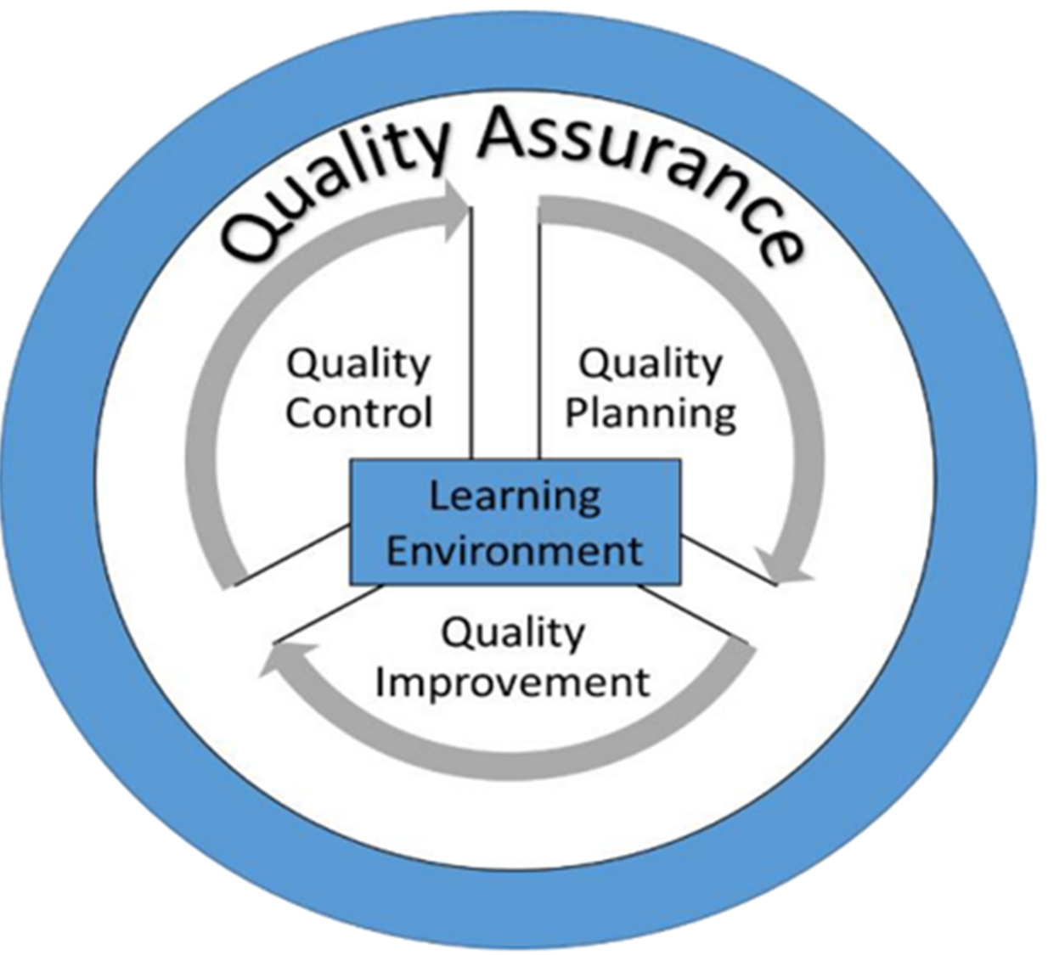
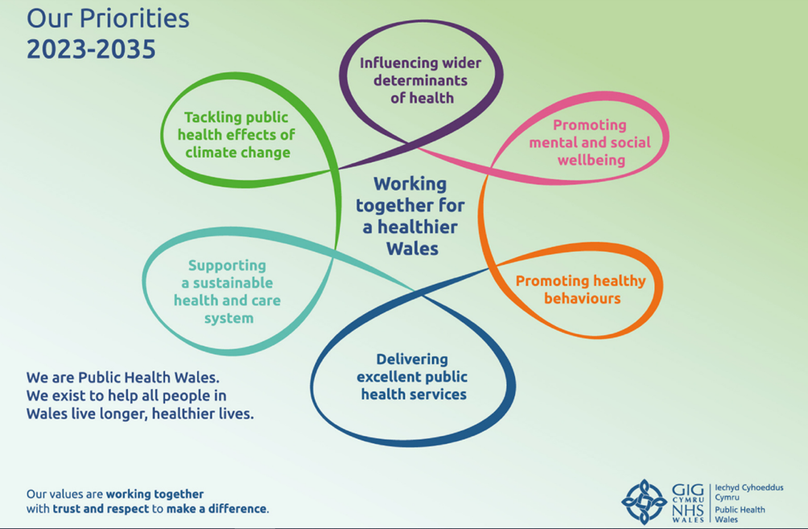
Quality Management System/ Quality as an Organisational Strategy
Notes:
To achieve our strategic priorities, the organisation has adopted quality as an organisational strategy; effectively a quality management system.

Slide 4

Work to date
Initial Engagement/ gap analysis
2 x workshops
            QNAHPs
  HPSS
  Knowledge
  Invited
  Performance and Planning
  Health and Well Being
Further Engagement
Microbiology
Screening
Health Protection
Knowledge
Invited – Health and Well being
Notes:
To achieve our strategic priorities, the organisation has adopted quality as an organisational strategy; effectively a quality management system.

Slide 5
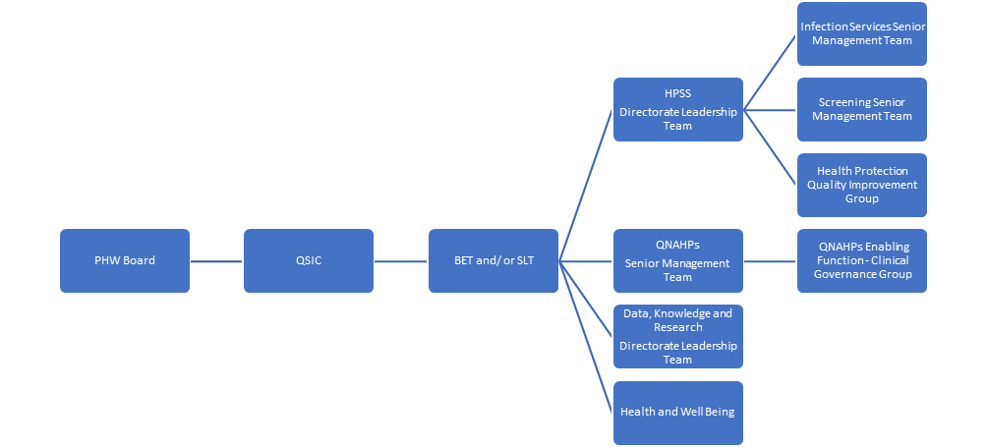
Current Organisational Structures

Slide 6


Definitions
Clinical Governance
“Clinical Governance is the system through which NHS organisations are accountable for continuously improving the quality of their services and safeguarding high standards of care by creating an environment in which clinical excellence will flourish ”. *
*DoH 2011
Clinical Service in PHW
“Services where the primary focus is concerned with the prevention, investigation and treatment of ill-health at an individual or population level, where the intended benefit is to achieve better health and well-being”.

Slide 7
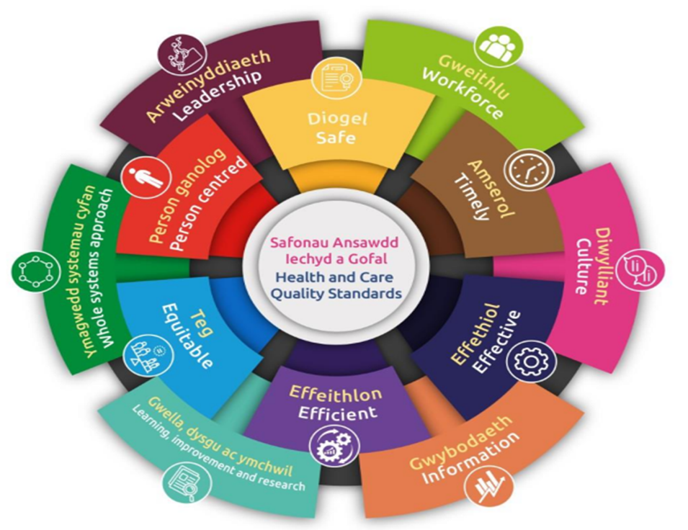
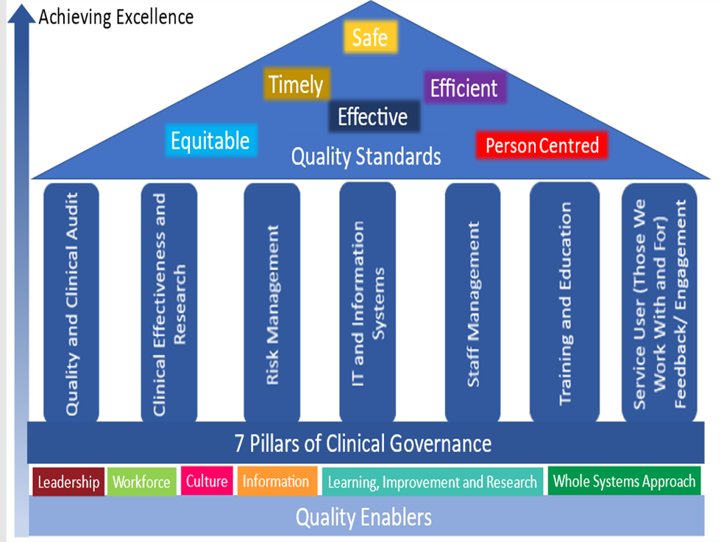
Duty of Quality and Clinical Governance
Notes:
Quality Statements:
PHW Has adapted the Quality Statements for STEEEP to meet the needs of the organisation.
The Quality enablers has remained the same.
Figure on the right is a visual representation of how PHW envisions the quality enablers/ STEEEP/ Clinical governance framework will ensure we meet the needs of the DoQ and DoC

Slide 8

Quality Reporting Requirements
Awaiting further information on requirements but expected to include the following:
    Always on Reporting – incidents/ complaints/ compliance with mandatory requirements/ experience and feedback
Annual Report
Notes:
To achieve our strategic priorities, the organisation has adopted quality as an organisational strategy; effectively a quality management system.

Slide 9
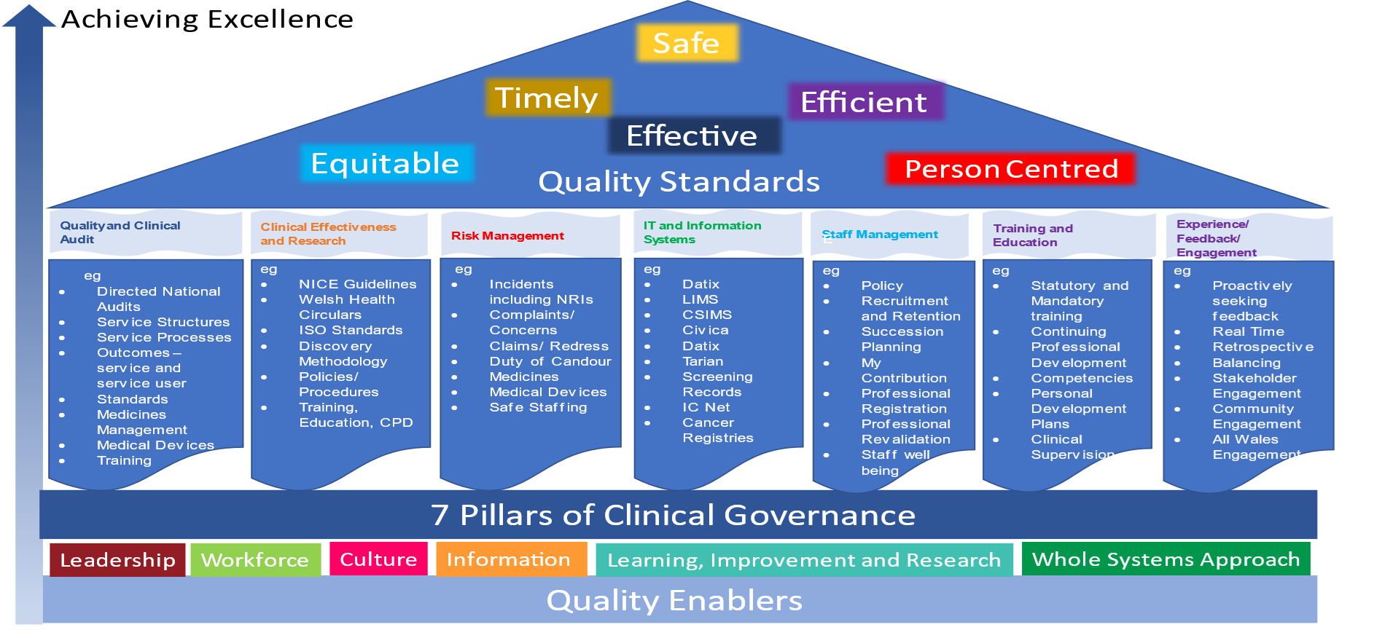
How will we know we’re accountable?

Slide 10

Key Questions
Do our current reporting and monitoring structures meet the needs of clinical governance?
How would this feed into Quality Reporting for QSIC?

Slide 11

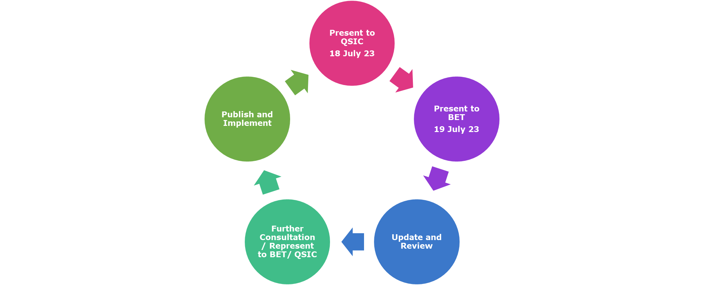
Next Steps

Slide 12
Gweithio gyda'n gilydd i greu Cymru iachach
Working together for a healthier Wales

