Slide 1
Internal Influenza Vaccination Campaign 2022-2023
End of Year Report
Angela Cook Assistant Director of Quality, Nursing and Allied Health Professionals

Slide 2
Purpose of this paper
To receive an annual Staff Influenza Vaccination Summary Report detailing the final position and identified learning to inform this years 23/24 delivery plan
Description
This Paper summarises the activity and performance for the 2022/23 annual staff Flu Delivery programme.
It provides assurance that systems and processes are in place to maximise the uptake of the Influenza ( Flu ) vaccination for Public Health Wales Staff
Recommendation
The committee is asked to note that vaccine uptake for PHW at the end of the Influenza staff vaccination campaign was 51.6% for all staff compared to 46.2% in 2021/22
Consider the areas of learning identified and suggested improvements to inform the 23/24 Campaign
Receive Assurance that the annual Flu Delivery plan was successfully delivered

Slide 3
Introduction
An annual Influenza (Flu) vaccination is recommended for all health and social care staff with direct patient/client contact. It is a World Health Organization (WHO) priority and actively encouraged as part of the annual flu programme in Wales
The Welsh Government published a Winter respiratory vaccination strategy for autumn and winter 2022 to 2023 to maximise the uptake of the Flu vaccination
No Welsh Government 'target' was set for flu vaccine uptake, but there was an 'ambition' to achieve 80% flu vaccine uptake in frontline staff ( CMO WHC/2022/010)
The Annual Influenza Delivery plan was approved by BET on 18th July and presented to Quality Safety & Improvement Committee (QSIC ) for assurance in August 2022
The Influenza vaccine was offered to all Public Health Wales employees during the 2022/23 campaign

Slide 4
The 2022/23 Flu Plan
A Mixed Model Approach which included :
Vaccination Clinics/bespoke delivery with internal peer vaccinators
The Use of Welsh Ambulance Service Occupational Health Service
Health Board Occupational Health Depts where Service Level Agreements (SLA’s) existed
Attendance at 2 staff conferences
Flu Vouchers for use in community pharmacy’s

Slide 5
Promoting and Communicating with staff
A Communications Plans and regular messaging via the intranet and email
An online booking system-Matrix, CQ2, BTW Llandudno & Mold, Madden Park , Rhos House
Offered Community Pharmacy Flu Vouchers
Role modelling to reinforce the importance of protecting against the flu virus
Personal and professional responsibility to protect ourselves, family, work colleagues and others from contracting flu- A staff member Blog
Request to staff to Self Report community vaccination via Microsoft Forms on the intranet
Intranet
Regular updates
Online booking system
Flu Delivery Meetings
Weekly
Key stakeholders from across organisation
Messaging
Exec Lead
Use of a dedicated email address for vaccination enquiries
Targeted Comms

Slide 6
Challenges to the internal flu uptake in Public Health Wales Uptake
Cost of Living crisis and impact on travel to PHW sites and limitations of PHW clinic Venues
Small dedicated number of registered health professionals available as peer vaccinator to support Internal campaign
Vaccine hesitancy and Vaccine fatigue amongst staff
Data collection – multiple data entry systems ( WIS, GP systems, Community Pharmacist, HB OH systems
and access to data for people living outside of Wales)
Staff working remotely throughout Wales and visiting offices less
Community pharmacy vouchers purchased ( 150) with just under 50% uptake
Cold Chain compliance and vaccine Storage and transportation
Availability of peer vaccinators due to workload demands
All Wales Organisation with multiple sites
Limited Administrative Support

Slide 7
End of Flu Season Summary
Positives
An improved Position on previous year and 3rd position in the ‘leader’ board for all Trusts & HB’s for frontline staff and 4th of all staff
Good representation of key stakeholders POD, Microbiology, Health and Safety, Screening , Informatics QNAHPs at the Flu delivery group meetings which provided governance across the campaign and collaborative working
Mixed model of delivery-vaccination clinics at main PHW sites and community pharmacy vouchers reaching ( especially for remote working staff).
Use of the online booking system for appointments
Dedicated email address to improve staff response
Increased use of Welsh Immunisation System (WIS) which electronically uploads details of the individuals influenza vaccine record in conjunction with paper forms
The creation and use of a self reporting form
Revision of governance arrangements and cold chain procedure
Flu Training and Competency Assessment to provide assurance

Slide 8
End of Campaign Learning
1 No Surprises incident reported relating to vaccine storage and staff vaccinations- actions identified and implemented
3 Incidents reported via datix relating to the vaccine storage – as above
The need to strengthen internal training offer to support vaccine fridge monitoring by non registered healthcare professional staff
Fridge temperature recording and monitoring and escalation
Development of a fridge checking competency for all staff
Increase in the number of Flu champions and advocates and peer vaccinators required
Data Capture
Addressing Vaccine Hesitancy

Slide 9
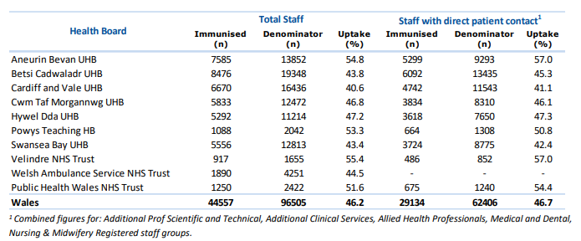
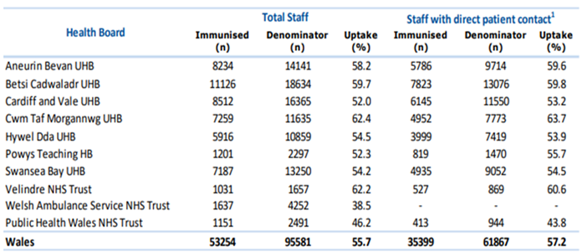
End of Year Staff Flu Vaccine Uptake Position compared to previous year
PHW Final Uptake Result : All Staff 51.6% and Front Line Staff 54.4%
Improved Position of 5.4% for all staff and 10.6% for Front line staff
2022/23 Flu Vaccination Results
PHW position 4th for all staff (51.6%)
PHW position 3rd for Front line staff (54.4%)
2021/22 Flu Vaccination Results
PHW position 9th (46.2%)
PHW position Front line Staff 9th
(43.8%)

Slide 10

Engaging with staff to understand and improve Flu Vaccination Uptake
An online questionnaire has been developed and currently active on Civica
A Focus group approach is being developed using a behavioural science approach to understand vaccine hesitancy within directorates with low uptake reported
Engaged with Staff Network chairs to develop and produce staff stories and video to support this Autumn’s Flu Campaign ‘People like Me’
This

Slide 11
Future delivery and Recommendations
Provide a well publicised offer launching influenza campaign September 2023
Maximise New Service Level Agreements
Increased clinic capacity between October and December 2023 utilising WAST sites and mobile units through a new SLA in addition to PHW sites
Recruit more Health Care Professionals as Peer vaccinators and Flu champions targeting directorates with a reported lower uptake in May/June 2023
Ensure Peer vaccinators training compliant by September 2023 and Patient Group Directive signed and vaccinator competencies assessed
Work closely with the communications team to develop a comprehensive communication plan and promotional materials
Continue to work with Digital colleagues to improve Data capture and reporting
Increased Administrative support in Q3 to support data imputting and timely enquiry management

