Slide 1
Strategic BET: Our Approach to Engagement
Presented by Rebecca Fogarty and Wayne Jepson
20 July 2022
Notes:
Introduce format of session

Slide 2
What is ‘Our Approach to Engagement’?
Background
Overarching approach for equitable, effective public engagement, ensuring the voice of the people we work with and for is at the heart of what we do and how we do it.
Covers 4 main types of engagement:
  Public Information & General Consultation
  User Feedback
  Coproduction
  Community Empowerment
Strategic alignment
Long-term Strategy refresh
People Strategy
Quality
Knowledge
Our Approach to Engagement

Slide 3
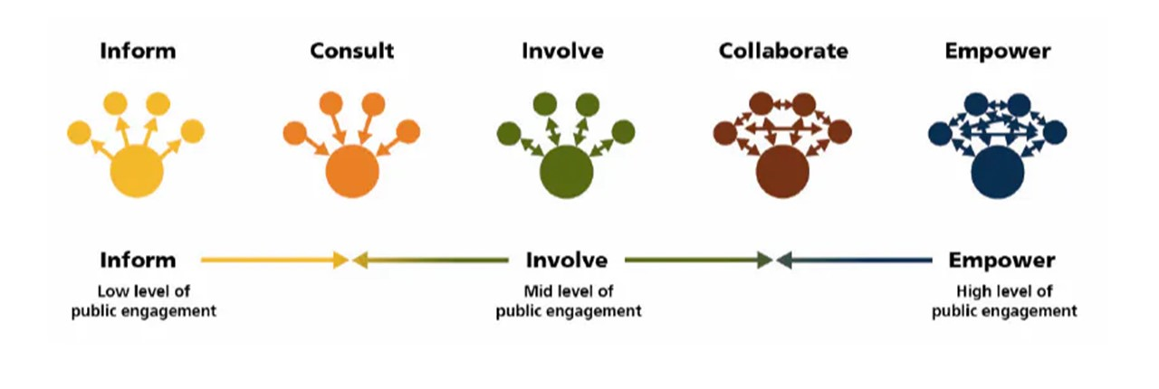
Spectrum of Public Engagement
Notes:
Assess organisation and you’d find us on the Involve
Not always appropriate to move towards the right, but that’s the general direction of movement
Not appropriate to increase level of public engagement e.g. when:
A decision needs to be taken very quickly e.g. emergency response
A decision has already been made and cannot be changed
A high level of technical knowledge is required (although where possible we should try to share the evidence base to inform public engagement)

Slide 4
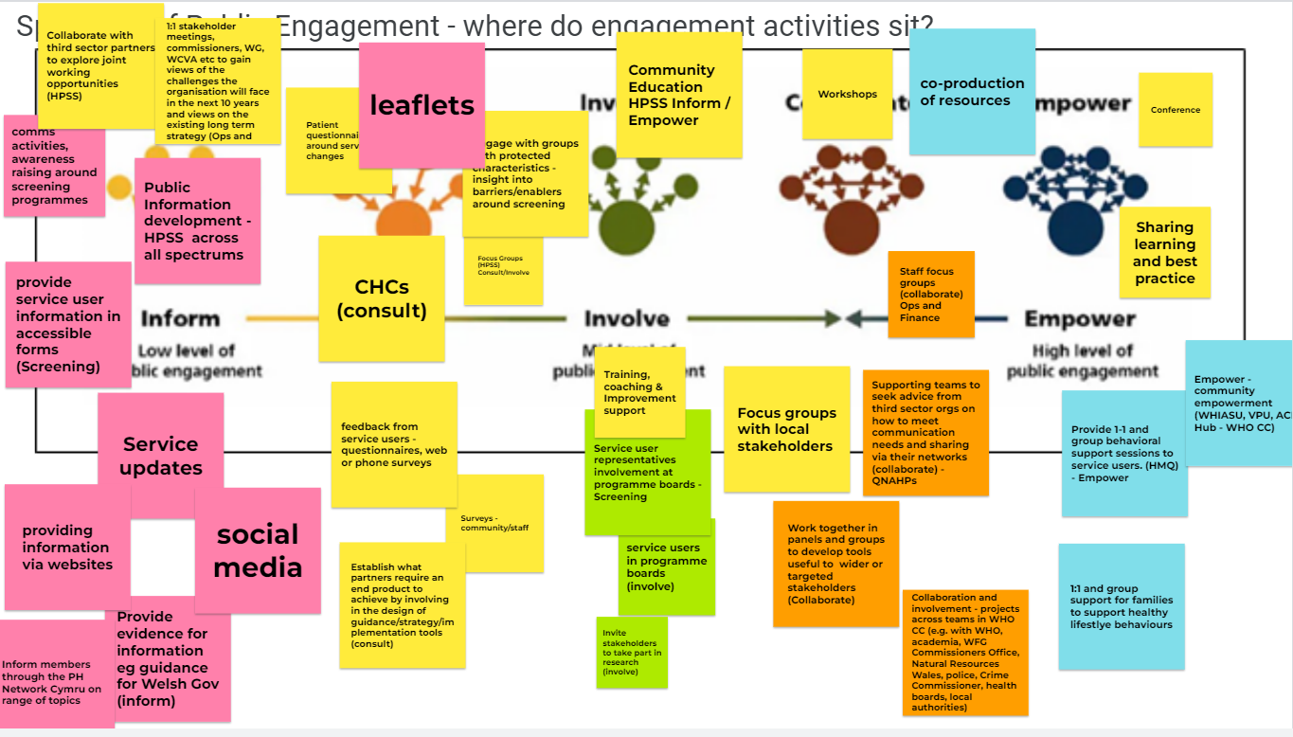
Notes:
Feedback from colleagues across the organisation, representing all directorates
Examples at ‘inform’ level are quite straightforward and obvious
At consult level we have an interesting example: ‘establish what partners require an end product to achieve’; otherwise, standard user feedback type stuff
Involve, we had user representation on programme boards or in research programmes.
Beyond that it gets a bit murky, with one or two good examples, but little that is clearly in the Collaboration/Empowerment space as we don’t always know what the impact of the engagement activity is

Slide 5

An organisational culture that values public engagement, recognises its benefits for the business, and strives for excellent experience. Driven by visible commitment and systems-level leadership at all levels of the organisation.
Progress against drivers
Workforce Commitment
All staff workshop in March, plus follow-up workshop with Communications team. Feedback has been incorporated into plans for the rest of the year.
Successful presentation at ‘Ask Tracey’ leading to a number of follow-up requests for support from the enabling function from across the organisation.
Our Approach to Engagement

Slide 6

The workshop
Workshop was held on 3rd March 2022 (follow up with Communications team on 5th April 2022)
Over 30 attendees representative of a broad slice of the organisation
Participants generated over 50 potential solutions to the barriers they identified
The common solutions have been incorporated into plans for the rest of the year
Our Approach to Engagement
Notes:
Purpose was raise awareness of ‘Our Approach to Engagement’
Begin to create credibility for the Quality, Engagement & Collaboration team and promote our offer
Identify engagement activities currently used
Identification of barriers to engagement
Generation of solutions, ideas innovation and support required
Five overlapping themes​
Purpose/prioritisation​
Skills & Capacity​
Culture, values and relationships​
Co-ordination & Planning​
Resources & Time​
Key barriers:
- Perception that the priorities of the organisation may not align with the priorities of the public and worry that engagement will lead to expectations that cannot be fulfilled.
- Unclear who in the organisation is leading on what, and what engagement is taking place in other parts of the organisation. The Engagement & Experience Network will in part resolve this but there remains the issue of lack of visibility of different parts of the organisation.
Lack of straightforward mechanism to engage with the public e.g. stakeholder reference panel for the whole organisation. This would need to be carefully thought through to ensure it doesn’t become stagnant and remains truly reflective of the Welsh population
- Insufficient understanding of the time required to build trust and enable meaningful engagement
Difficulties in getting agreement for budget, including over longer timespans than one year, with particular pressure in Q4 to ‘spend’ but not necessarily ‘invest’ in effective, sustained engagement. One participant reported that a request for budget to facilitate engagement activity was perceived as an ‘unnecessary cost’ at SMT level.
The key message is that people are ‘unsure’ – unsure if they’re supported or even allowed to weave engagement into their work, unsure if it’s part of their role, unsure if they have the skills to do it well, unsure if it will make a difference, unsure who they can reach particularly in underserved communities, unsure who else is trying to reach those communities

Slide 7
Solutions
Common themes
Visibility and leadership
Valuing engagement and recognising its impact on our outcomes
Collaboration and utilising our assets better
Celebrating what is done well
Our Approach to Engagement

Slide 8
An organisational culture that values public engagement, recognises its benefits for the business, and strives for excellent experience. Driven by visible commitment and systems-level leadership at all levels of the organisation.
What next?
Workforce Commitment
Build a compelling narrative that reaches a range of staff through various formats, of the importance and impact of engagement on the experience of those who come into contact with our services, programmes and functions, with case studies from across the organisation and externally
Use internal communication to demonstrate the value and impact of engagement:
Regularly share good practice with a ‘human’ face plus the outcomes
Senior/executive staff leading by example - taking time to engage with stigmatised groups e.g. traveller communities
Make the links between engagement and tangible change clear to the people we work with and for
Our Approach to Engagement
Notes:
Repurposing of QNAHPs complete – next step is to improve how we communicate what we do and how to get in touch with us

Slide 9
Robust governance and reporting of engagement and experience activity across the organisation to capture and have a greater understanding of those who are impacted by what we do
Progress against drivers
Monitoring & Evaluation
New Engagement & Experience Network launched on 11th July
Draft procedure for producing accessible and inclusive public information currently being consulted on with Communications and Public Health Services
Maximise potential of Engagement & Experience Network to improve capability and capacity across organisation
Connecting staff to learn from each other:
Introducing new starters to people who do similar roles in other teams to share knowledge and understanding
A forum for idea sharing
Identified need to support staff to be able to meet language and communication needs, reflecting organisational minimum standards
Our Approach to Engagement

Slide 10
Enhanced engagement skills and capacity in key teams across the organisation
What next?
Skills & Capability
Providing training opportunities, reflecting priorities of experienced staff, which emphasises both the values and specific skills needed for meaningful public engagement, including:
Opportunities to speak with people from a range of underserved communities about their lived experience
Showcasing good practice examples
Helping staff to understand the role they play as health professionals and the effect of giving power to communities, recognising that empowerment is health-promoting in its own right
Ways to remind teams of the organisation’s core purpose and what we can do to support engagement
Collaboratively design and develop an organisational approach to capacity and capability building for skills in engagement and feedback analysis to inform planning and improvement
Our Approach to Engagement

Slide 11
Coordinated approach to stakeholder engagement across Public Health Wales to facilitate:
High quality engagement
Avoiding ‘engagement fatigue’
Excellent reputation for effective and empowering engagement that leads to improvements in service user/consumer experience
What next?
Relationship Building
Using gathered intelligence to develop corporate resource (e.g. central stakeholder database) to facilitate shared relationships with external stakeholders and to identify and fill gaps so that we reach all sectors of the Welsh population.
Advocate for investment in a Customer Relationship Management System (CRM) to deliver an organisation-wide, easily accessible stakeholder list with key internal contacts listed too
Develop a stakeholder reference group in PHW
Our Approach to Engagement

Slide 12
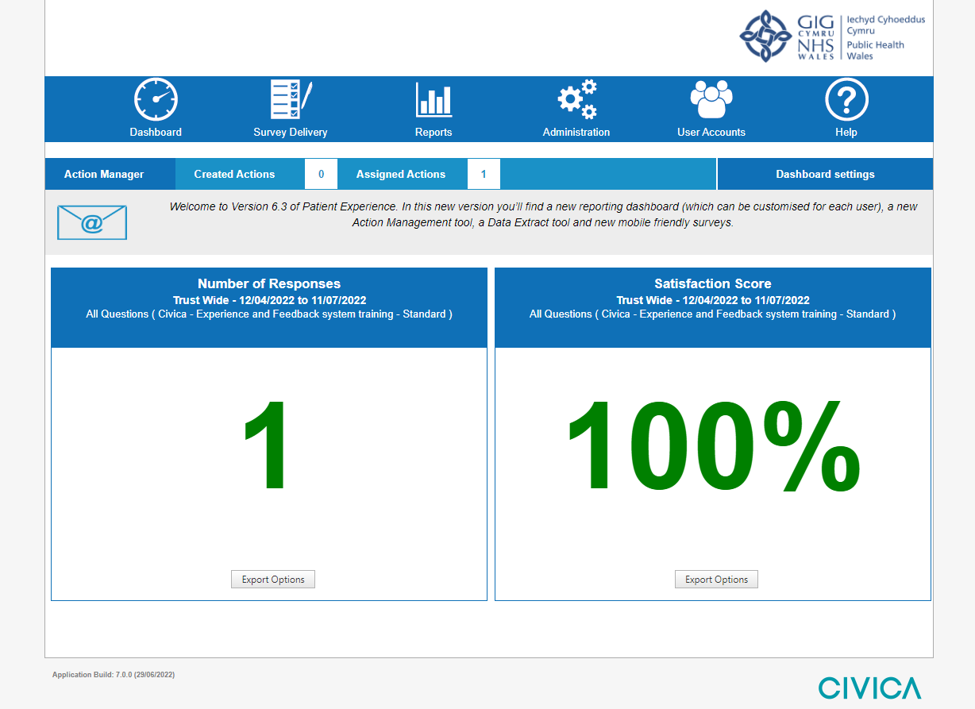
Systems and infrastructure in place to enhance capture of views and experiences of our service users and the public, allowing improved analysis to plan approaches to service and programme delivery
Progress against drivers
Tools and Resources
Civica Implementation Project complete
System live, 142 users registered
Training of 110+ staff across People & OD, WHO CC, Knowledge, Screening and Health Protection
Further sessions planned for the future with more staff from these teams, and Improvement Cymru
Agile and personas work
Our Approach to Engagement

Slide 13


Experience
Turning feedback into real-time insights
July 2022
}

Slide 14
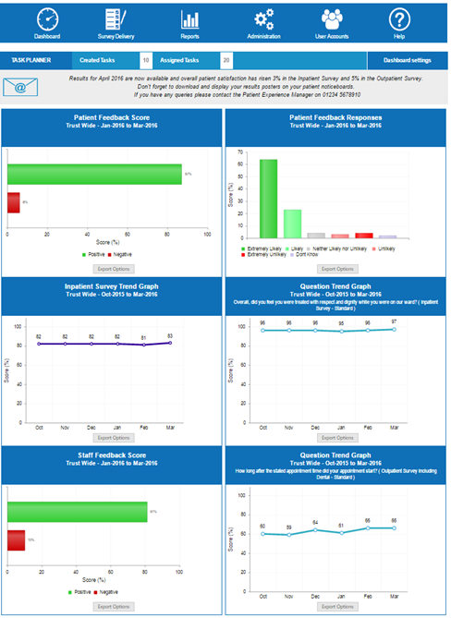
EXPERIENCE - Overview
Experience and Engagement insights platform
Cloud: accessible 24/7/365 through web-browser
Multi-channel survey data collection
Scalable platform with unlimited questionnaires, all touch points a learning opportunity
Real-time reporting
Smart text analytics: emotions, themes, sentiments
Unlimited user accounts – roles based access
Workflow tools: Action management, Comment flagging, Event-driven alerts, Push reporting
Built in partnership with our customers

Slide 15
Data Hierarchy
Public Health Wales
Screening Division
Bowel
Diabetic Eye
Improvement Cymru
Ad Hoc
DESW (North)
Mid Wales
DESW (South West)
All data collected against a hierarchy – e.g. Directorate, Division, Service Group, Service Team, etc.
Feedback can be collected for both people PHW works with and for
Reports can be run against any part of the hierarchy
Hierarchy can be updated as required
Data can be tracked over time (e.g. if tier moves, data is tracked against new location)
Survey links contain hierarchy information (no need to ask patient “Where do you seen?”)

Slide 16
Reporting – Snapshot Dashboard
Real-time dashboard
Showing key metrics across 6 tiles
Dashboard view can be customised to individual users:
  Type of tile (question scores, Satisfaction scores, trends, etc.)
  Which parts of the hierarchy to include results from
  Which surveys and questions to include
  Date range (from - to), e.g. last 3 months
  Position on the dashboard

Slide 17
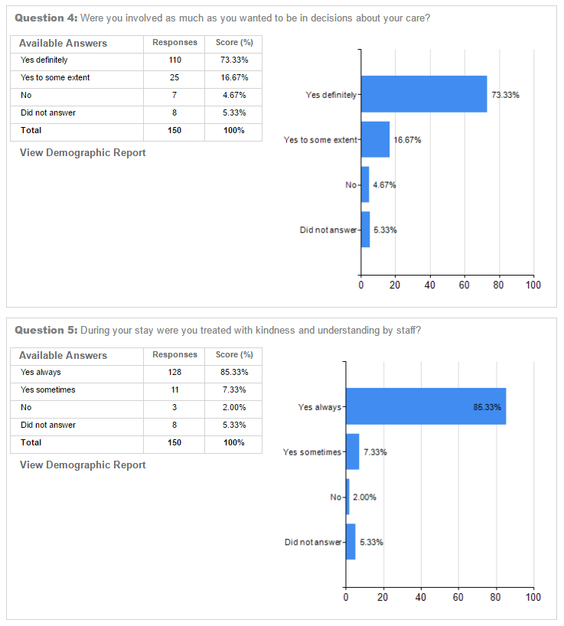
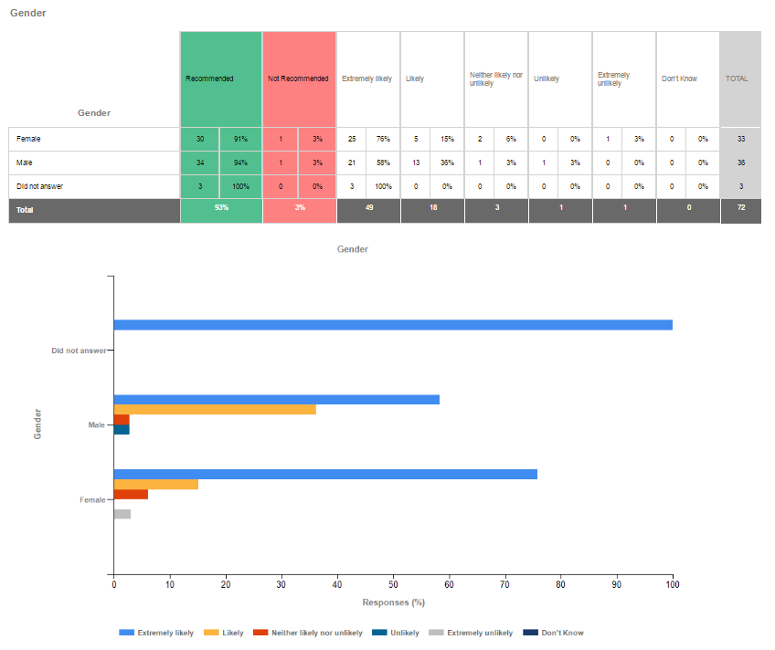
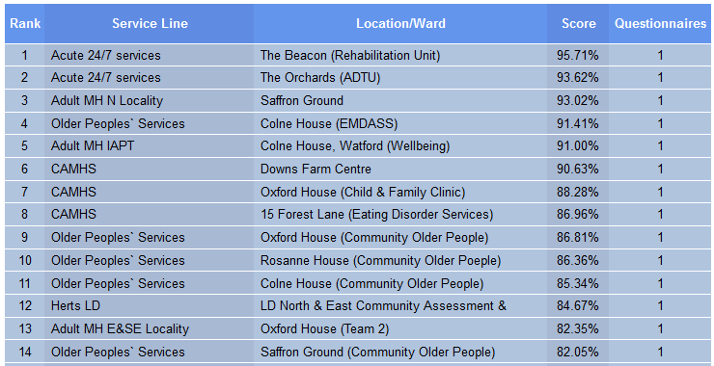
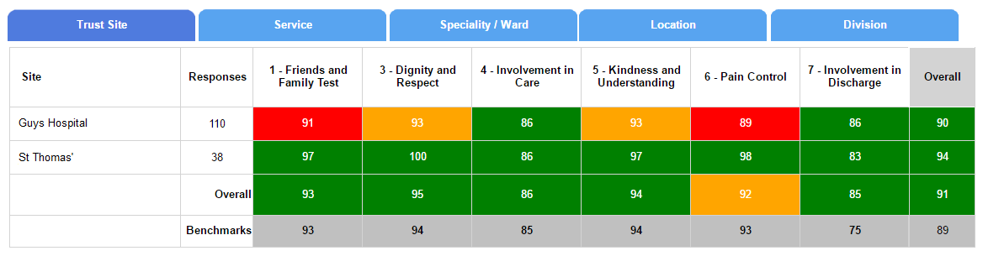
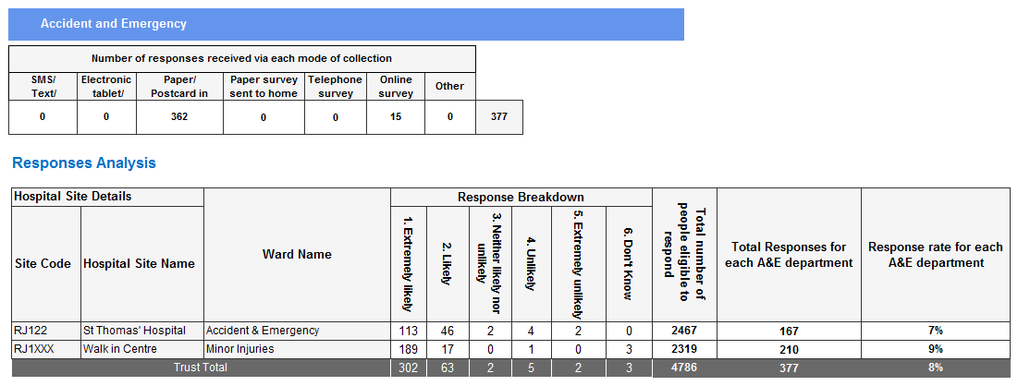
Reporting Suite
Wide set of SSRS reports available
Can create additional reports bespoke to your needs
Survey Analysis
Demographics analysis
League tables
Heat Maps
Statutory
17

Slide 18
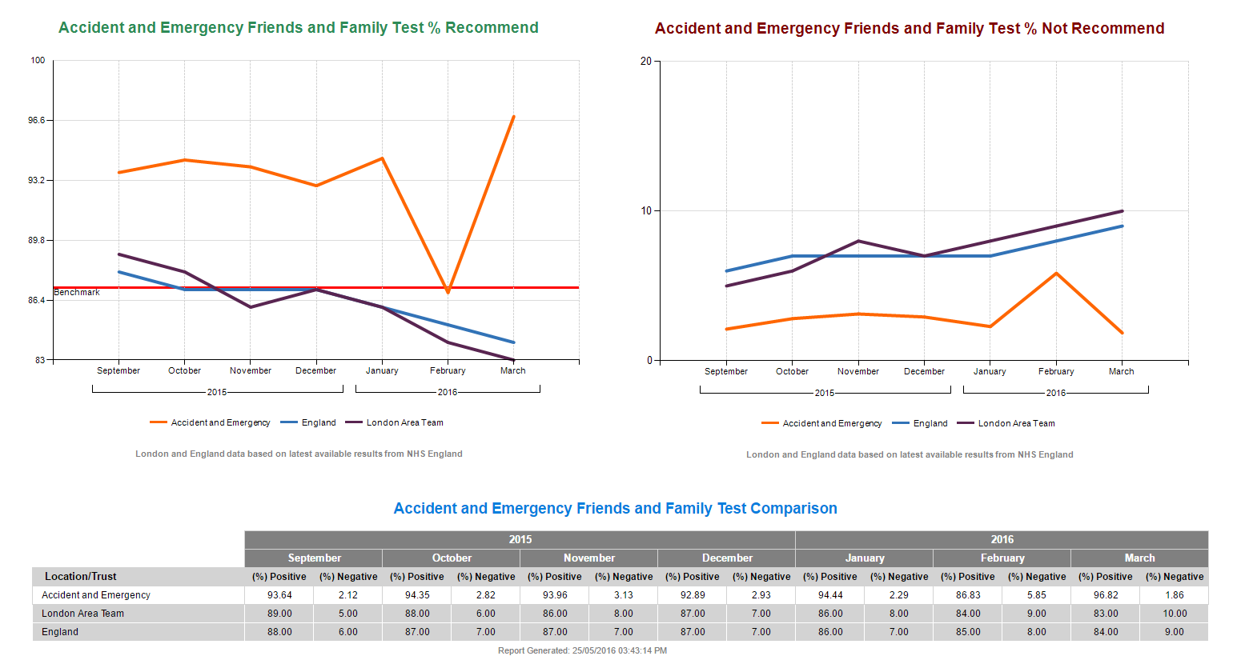
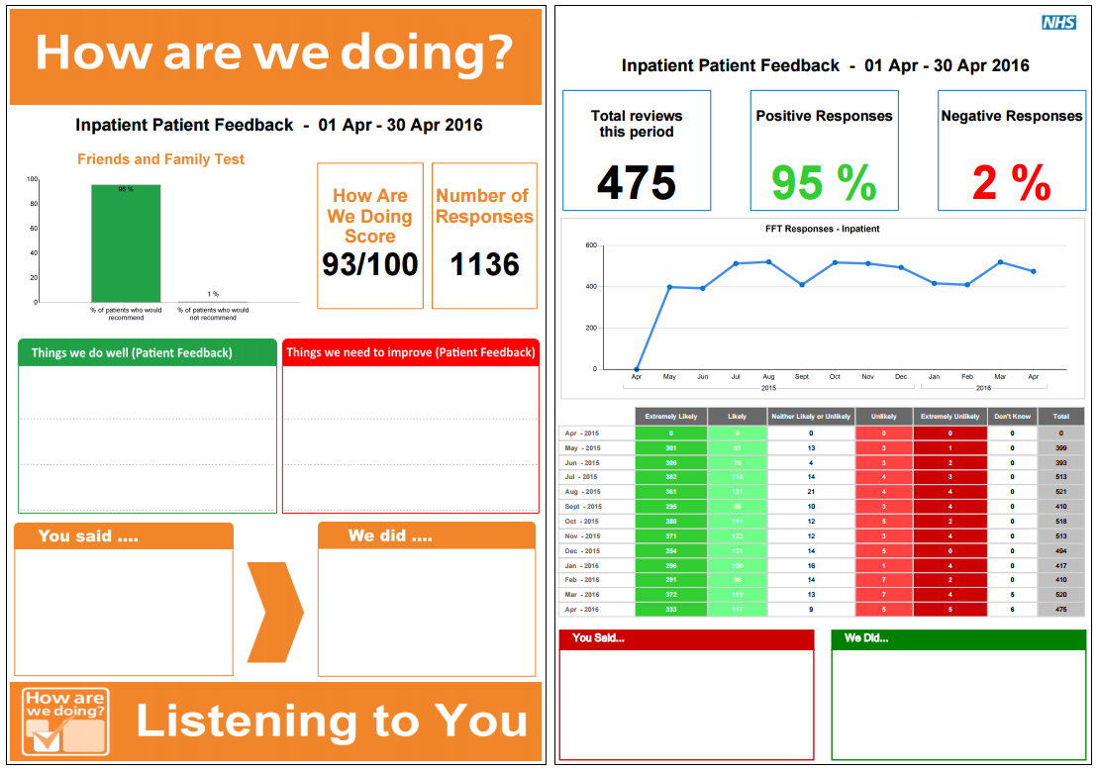
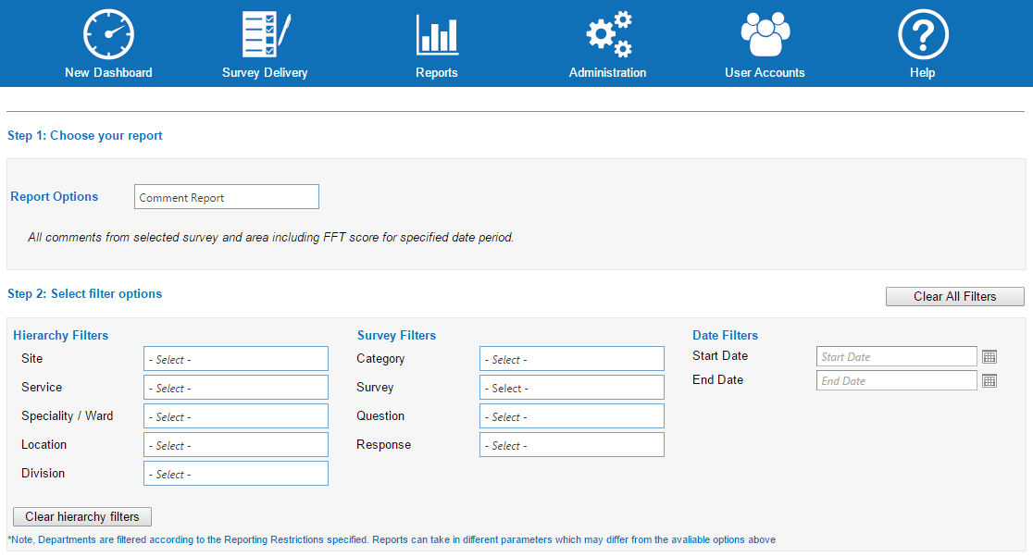





Reporting Suite
Further example reports; can create additional reports bespoke to customer
Trend and benchmarking
‘You said, We did’ feedback posters, focusing on lessons learnt
All reports filterable & exportable (XLS, PDF, PPT, DOC, CSV, JPG)

Slide 19
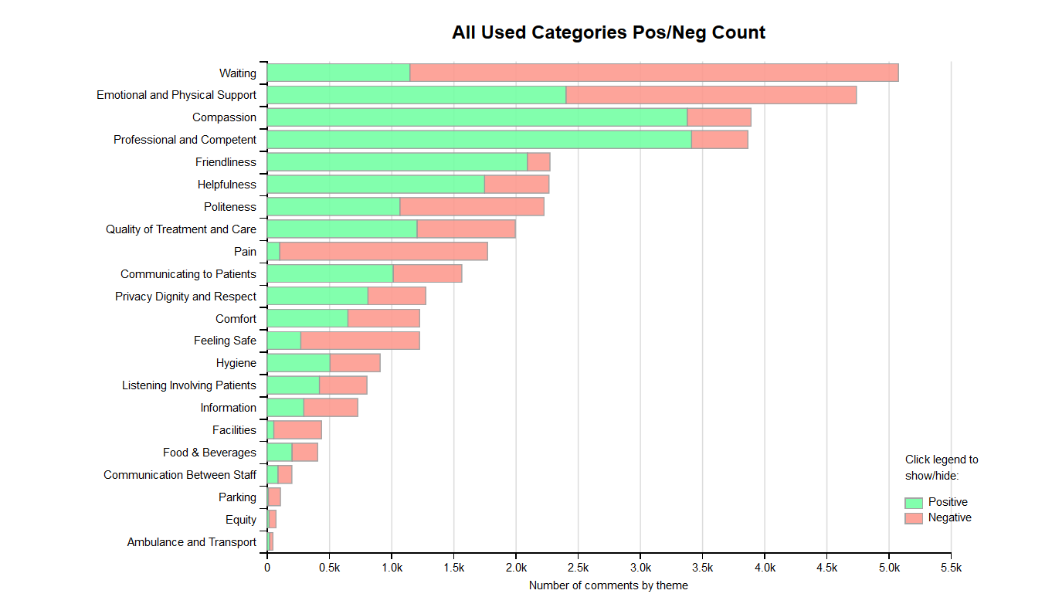
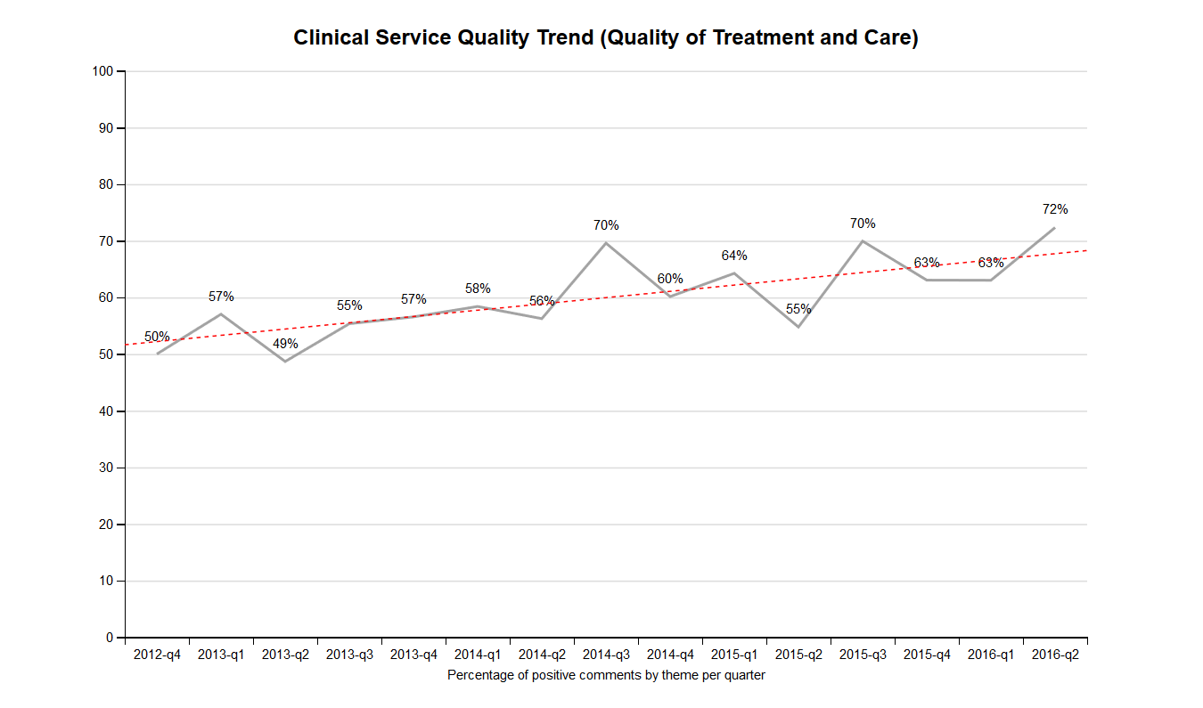
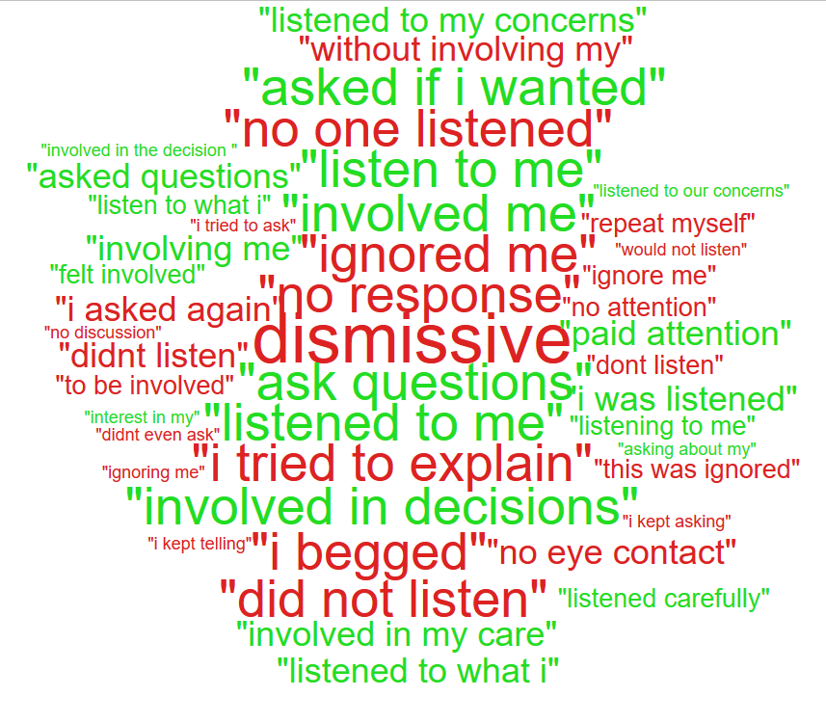

Smart text analytics – organisation-wide improvement
Quantitative data helps you understand ‘what’, but only qualitative data helps you understand ‘why’
Emotion analytics
22 experience themes
Positive and negative sentiment analysis
Trend analysis
In-context word clouds (by theme or emotion)
Analysis by staff groups
Interactive dashboard
Drill down to verbatim comments

Slide 20
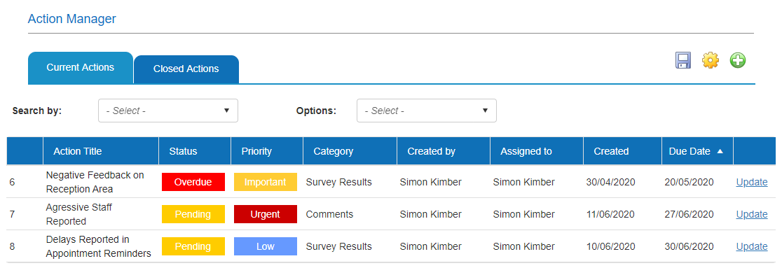
Workflow tools to drive usage and improvements
Action manager
  Assign actions to other system users
  Track and record when completed
  Add notes
Push reporting
  Schedule reports to be sent via email to system users
  Daily, weekly, monthly, quarterly, annually
Event driven email alerts, e.g.
  Survey completed
  Negative feedback
Comment flagging
  Explicit language, legal terms, personal identifiers, Covid terms, safeguarding, etc.
  Comments are quarantined before released to reports

Slide 21
Further information
To speak further about Civica’s experience platform please contact Simon Kimber at simon.Kimber@civica.co.uk

Slide 22
Systems and infrastructure in place to enhance capture of views and experiences of our service users and the public, allowing improved analysis to plan approaches to service and programme delivery
What next?
Tools and Resources
Develop tools and resources for a best practice approach to engagement and informed by internal engagement with staff to identify learning and knowledge needs
Create resources to facilitate engagement for teams, such as:
Best practice guides for each level of the spectrum of public engagement
Lists of digital tools and technology that are available
Public-facing resource that sets out what PHW is, what we do and key facts
Resources/ support for adapting communication depending on the needs of different audiences
List of key considerations to ensure high quality engagement
Our Approach to Engagement

Slide 23
Questions considered at Strategic Business Executive Team
For discussion
What’s the benefit of engaging? Who do we want to engage with?
What are the opportunities available to us to move us to where we want to be on the spectrum?
What do you see as the role of the Executive in implementing these solutions?
How do we make decisions about the allocation of resources for engagement?
How can we align monitoring and evaluation of engagement with other performance measures?
How do we tilt the balance from emphasis on stakeholder engagement towards service user/end user engagement?
Our Approach to Engagement

Slide 24
Key discussion points from Strategic Business Executive Team session
Need to be deliberate and purposeful, to ensure we’re engaging with the right people at the right time
Innovation and evaluation
Engagement is an organisational responsibility – everybody’s business
Opportunity to look at how we might re-allocate resources to integrate engagement better into how we deliver our objectives
Possibility to bring together expertise and capability in an Engagement Hub model
Harnessing what is working well
Incorporation into the planning process
Our Approach to Engagement

