Slide 1
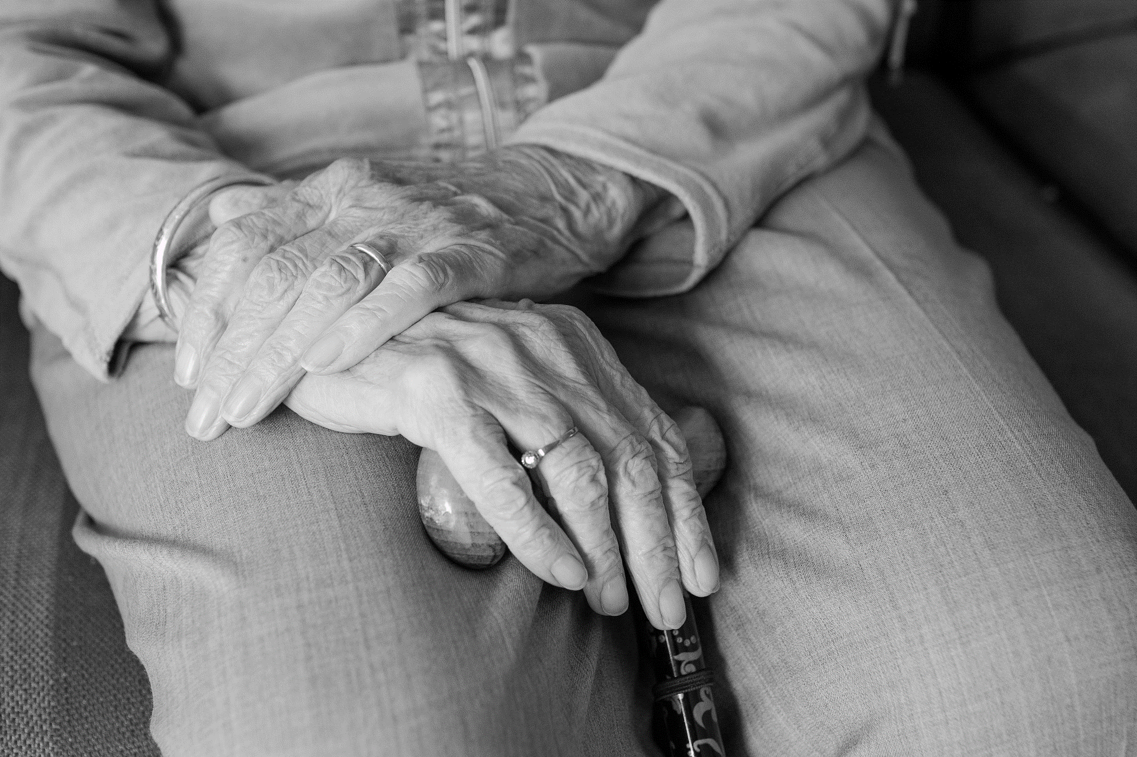



Public Health Wales Safeguarding Annual Report 2021-2022

Slide 2
Chapter | Contents | Page
1 | Introduction | 3
2 | Governance arrangements | 4
3 | Safeguarding People | 5
4 | Reports to Local Authorities | 6
5 | Supporting Staff with Safeguarding Responsibilities | 7
6 | Continuous Improvement in Safeguarding | 8
7 | Safeguarding in Relation to Safe Recruitment and Retention Practices | 9
8 | Partnership Working | 10
9 | Key Performance Indicators | 11
10 | The Right Way Matrix/ Public Health Wales Safeguarding Policy | 12
11 | Summary of 2021/2022 | 13
12 | Improvements for 2022-2023 | 14
Safeguarding Annual Report 2021-2022 Page 1 of 14

Slide 3
Introduction
Welcome to the 2021-2022 Annual Safeguarding Report. This report demonstrates our ongoing organisational commitment to safeguarding.
We have outlined our quality assurance processes regarding our statutory duty to safeguard children and vulnerable adults throughout the report. The report demonstrates the changes and progress made in the management of our safeguarding arrangements.
The aim of this annual report is to provide assurance that Public Health Wales (PHW) is fulfilling legislative requirements in relation to key pieces of legislation as identified below and assess against best practice standards i.e. Safeguarding Maturity Matrix during the period 2021-2022.
Social Services and Well-being (Wales) Act (2014) (SSWBA)
Violence against women and domestic abuse (2015) (VAWDASV)
Well-being of Future Generations (Wales) Act 2015
The Annual Report is also underpinned by Health and Care Standard 2.7 Safe Care: Safeguarding Children and Safeguarding Adults at Risk. Health services promote and protect the welfare and safety of children and adults who become vulnerable or at risk at any time (Health and Care Standards Wales 2015). Public Health Wales recognises safeguarding is fundamental to the quality and safety of services and functions we provide.
Safeguarding Annual Report 2021-2022 Page 2 of 14

Slide 4
Governance Arrangements
Cross Organisational Safeguarding Group
Business Executive Team
Quality Safety and Improvement Committee
Board
The Business Executive Team (BET) is supported by the cross organisational Safeguarding Group chaired by the Executive Director for Quality, Nursing and Allied Health Professionals to monitor organisational arrangements and progress in relation to the corporate safeguarding agenda. The Quality, Safety and Improvement Committee (QSIC) is the main Board Committee (on behalf of the Board) to oversee and take assurance on Safeguarding arrangements within Public Health Wales and is chaired by the Vice Chair of Public Health Wales. Both BET and QSIC monitor progress and receive key elements of assurance through the Safeguarding Maturity Matrix annual improvement plan.
Section 27 part 3 of the Children’s Act (2004) states that:
An NHS trust to which section 25 applies must—
(a)appoint an executive director, to be known as the trust’s “lead executive director for children and young people’s services”, for the purposes of the trust’s functions under that section; and
(b)designate one of the trust’s non-executive directors as its
“lead non-executive director for children and young people’s services”
to have the discharge of those functions as his special care
The Executive Director of Quality, Nursing and AHP’s fulfils the role
identified at a) and a Non Executive Director has been identified for
b).
Safeguarding Annual Report 2021-2022 Page 3 of 14

Slide 5
Safeguarding People
To comply with the following pieces of legislation, Public Health Wales has in place Safeguarding arrangements to access advice and support: Mainly provided by the Named Professional for Safeguarding
This requirement is outlined in specific sections of the relevant legislation namely:
Social Services and Well Being (Wales) Act Part 7 - S130 duty for relevant partners to a report child at risk; there should be a single point of contact in each organisation; and policies and procedures in place to ensure we discharge both S164, duty to co-operate and provide information and
Part 7- S128 the duty to report an ‘adult at risk
Children Act 2004- Section 28(2) places a duty on NHS Wales to make arrangements for ensuring that their functions are discharged having regard to the need to safeguard and promote the welfare of children, which includes
Between 1st April 2021-31st March 2022
46 incidents were referred to the Named Lead for Safeguarding for advice.
These incidents related to:
Service user 35
Employees of PHW 6
Research Advice 5
Safeguarding Annual Report 2021-2022 Page 4 of 14

Slide 6
Reports to Local Authorities
When a safeguarding concern has been identified staff follow the Public Health Wales and multiagenacy Wales Safeguarding Procedures, making a referral to the relevant Local Authority accordingly. These concerns are captured on the Datix system and categorised as safeguarding by the referring staff.
A total of 16 Safeguarding Reports were made to Local Authorities across Wales between April 2021 to March 31st 2022. This is an increase of three from the previous annual year. The graph demonstrates the number of reports month by month. three referrals were made for Child Protection Concerns, 10 referrals were made to the LA for adult at risk concerns, three reports were made for assessment of adult care and support needs.
Safeguarding Annual Report 2021-2022 Page 5 of 14

Slide 7
Key performance indicators for Safeguarding
Key Performance Indicator | Target | Compliance 2019-2020 | Compliance 2020-2021 | Compliance 2021-2022 | Compliance change
Referrals made to local authority (where appropriate) Within 24hrs of incident | 24 hr target | 100% | 100% | 100%
Level 1 Safeguarding Children Training | 95% | 88% | 85% | 83.95%
Level 2 Safeguarding Children Training | 95% | 82% | 78% | 69.98%
Level 1 Safeguarding Adult Training | 95% | 88% | 86% | 85.60%
Level 2 Safeguarding Adult Training | 95% | 79% | 86% | 78.03%
Group 1 Domestic Abuse Training | 95% | 87% | 87% | 82.74%
Group 2 Domestic Abuse Training | 95% | 38% | 54% | 76.4%
Group 6 Domestic Abuse Training | 95% | 0% | 0% | 0%
Disclosure and Barring Service | 100% | 100% | 100% | 99.2%
Safeguarding Annual Report 2021-2022 Page 10 of 14

Slide 8

Safeguarding Maturity Matrix assessment
The NHS Wales Safeguarding Maturity Matrix (SMM) was adopted in 2018. This tool supports Health Boards and Trusts in Wales to measure the effectiveness of Safeguarding using self assessment, identifying strengths and areas for future focus and improvement
The NHS Safeguarding Maturity Matrix is underpinned by the Health and Care Standards, Wales Future Generations Act 5 Ways of Working and 7 Well-Being goals and the 4 Principles of Prudent Healthcare. From this, 5 standards were developed with indicators for each of the standards, as highlighted below
Each area of the matrix is supported by a number of example indicators which should be considered in order to decide which score fits with the position of the organisation for the reporting period. An improvement plan is then developed and submitted to the NHS Wales Safeguarding Network in September 2021, to collaboratively record the overall themes from NHS Wales improvement plans followed by a peer review process to identify organisational annual improvement plans.
Public Health Wales SMM assessment scores.
Standards | Maturity Score 2019-2020 | Maturity Score 2020-2021 | Maturity Score 2021-2022
1) Governance and Rights based approach | 4 | 4 | 4
2) Safe Care | 4 | 4 | 4
3) ACE Informed | 4 | 3 | 3
4) Learning Organisation | 3 | 4 | 4
5) Multi agency working | 4 | 3 | 3
Public Health Wales’s Maturity Matrix Score for 2021-2022 was 19 out of 25. A robust improvement plan will have a positive impact on the maturity score in the next year.
Safeguarding Annual Report 2021-2022 Page 7 of 14

Slide 9

Supporting Staff with Safeguarding Responsibilities
Formal Group Safeguarding Supervision was prioritised for key areas working directly with people who use our services, in particular the Newborn Hearing Screening team as roles needed to adapt in response to the Pandemic. This was provided either face to face or virtually for Newborn Screeners across all regions in Wales, following the All Wales Safeguarding Supervision Guidance.
Collaboration with the Live Fear Free helpline has continued, who were able to provide 24 hour support to staff, providing them with a way to share information for any domestic abuse concerns
A “message from Rhiannon” the lead Executive was delivered via the Intranet during Wales’ National Safeguarding Week
The Public Health Wales Safeguarding Ambassadors Group continued to meet with the Named Professional for Safeguarding, the purpose of this role is to strengthen safeguarding supporting arrangements across the organisation.
Supporting information for staff is available in a variety of formats such as training sessions, supervision sessions and on the Safeguarding Intranet Pages.
The Named Professional for Safeguarding is accessible for advice and support Monday to Friday 9am to 5pm and appropriate cover as necessary.
Safeguarding Annual Report 2021-2022 Page 6 of 14

Slide 10

Safe Recruitment and Retention Practices
Public Health Wales has a duty to safeguard all vulnerable people and promote their welfare through safe recruitment, selection and retention procedures.
DBS compliance is monitored on a quarterly basis by People/ Workforce/HR and the Named Lead for Safeguarding, this is reported through to the safeguarding Group for further monitoring.
During 2021/22 Public Health Wales was 99.2% compliant in ensuring all new starters and job moves had the correct (Disclosure and Barring Service) DBS check, where needed, prior to commencement of employment.
We have networked with the Regional Outreach Adviser for Wales for the Disclosure and Barring Service who presented at the Safeguarding Group Meeting. This has resulted in opportunities to improve and strengthen PHW’s recruiting managers understanding around DBS with a number of training sessions being offered.
DBS Compliance 2021-2022
Total number of new starters/staff movements
772
Enhanced DBS and Adult and Children Barred List
Checks
Required = 46
Undertaken = 46
Enhanced DBS Checks and Adult Barred List
Required = 40
Undertaken = 40
Enhanced DBS Checks and Children Barred List
Required = 9
Undertaken = 9
Standard DBS Checks
Required = 42
Undertaken = 42
Safeguarding Annual Report 2021-2022 Page 8 of 14

Slide 11

Partnership working
The Social Services and Wellbeing (Wales) Act 2014 places a duty on Public Health Wales to engage with Regional Safeguarding Children and Adult Boards.
Public Health Wales is committed to partnership working and will participate in safeguarding processes for investigating and learning where an issue has arisen in the context of services or functions provided by the organisation. Due to the national context of Public Health Wales the organisation has written to the Regional Safeguarding Boards and proposed being a corresponding member for the operational matters relating to Safeguarding Board business and attendance for specific agenda items and to provide the annual report for assurance.
Designated Safeguarding Professionals from Public Health Wales also attend regional safeguarding Boards to provide independent health advice in relation to safeguarding.
Other examples of partnership working also includes:
The NHS Wales Safeguarding Network and its subgroups
Public Health Wales continues to maintain links with all Local Authorities across Wales
Children’s and Older Persons Commissioners Office
Live Fear Free Helpline
Safeguarding Annual Report 2021-2022 Page 9 of 14

Slide 12
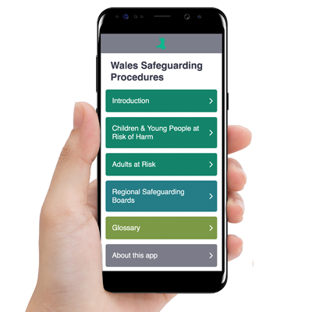
The Right Way Matrix
Work has been progressed with an organisational benchmarking exercise against the Children’s Commissioner “The Right Way Matrix” which is based in the five principles and taken from “ The Right Way” guide. Engagement throughout the organisation has been positive and the findings are being analysed and collated. The organisational position will be used to engage the Young Ambassadors in developing an approach that will ensure that Children's Rights are embedded within Public Health Wales and considered in decision making at every level and when working with children
PHW Safeguarding Policy & Procedures
PHW Safeguarding Policy and Procedures has been reviewed in line with the Wales Safeguarding Procedures published in 2019
Readily available on PHW intranet
Disseminated communication across PHW
Encouraged staff to download the app
Utilised the app as a tool for safeguarding training
Disseminated communication within Safeguarding Ambassadors Group and in Safeguarding Supervision
Safeguarding Annual Report 2021-2022 Page 12 of 14

Slide 13
Further improvements being made
Work has commenced to incorporate KPI measures into the organisational Performance and Assurance Dash Board.
The Welsh Government target for Statutory mandatory training is 85% and Public Health Wales has set targets of 95 %
All training compliance is captured on the Electronic Staff Record and is regularly reported and is subject to monitoring.
There has been a decrease in the compliance with Level 1, Level 2 Safeguarding Children and Adult training and Group1 VAWDASV. All these modules are delivered electronically via ESR. It is reported that this may be due to staff vacancies. Directorates are advised to ensure staff are briefed in relation to their requirements to comply with training. A change in the training policy for the next annual year advises that 100% mandatory training will need to be adhered to for pay progression within pay scales. This should have a positive impact on compliance with an anticipated increase in the next Annual Report.
An increase in the compliance with Group 2 VAWDASV training has been noted. The named Lead for Safeguarding has been able to have a direct impact on the improved compliance as it is delivered virtually and gaps for specific directorates have been identified and specifically targeted.
The Group 6 is a series of short films that are aimed at Public Service Leaders. It has been identified Nationally that the reporting of the compliance with this training is a challenge. As a result WG have developed a platform where the videos can be accessed. A paper outlining this was written and presented at Safeguarding Group Meeting and disseminated to the Board.
The Group 6 is a series of short films that are aimed at Public Service Leaders. It has been identified Nationally that the reporting of the compliance with this training is a challenge. As a result WG have developed a platform where the voddeos can be accessed. A paper outlining this was written and presented at Safeguarding Group Meeting and disseminated to the Board.
Safeguarding Annual Report 2021-2022 Page 11 of 14

Slide 14
Summary of Key Achievements for 2021/2022
Bi monthly Safeguarding Ambassador Meetings were established with the newly appointed Named Lead for Safeguarding, a TEAMS channel was created to share a wealth of Safeguarding information, including Safeguarding Network Bulletins, training opportunities and legislative updates. Feedback has been gained through the development Microsoft Forms so that meetings can be improved and shaped by the Safeguarding Ambassadors professional needs
Work has commenced on completing The Right Way: A Children’s Rights for submission to The Children’s Commissioner for Wales. Directorates within PHW will be supported to complete the matrix and consideration will be a made to engage the Young Ambassadors in this piece of work
The VAWDASV Group 2 Training compliance has improved following the development of a virtual delivery platform
Working in collaboration with screening a bespoke training package has been developed and delivered to ensure members of the public accessing screening services who lack capacity have best interest decisions made. The consent form 4s (consent form for those lacking capacity) has been implemented in AAA screening, with the aim of implementing in all screening services using a quality improvement methodology.
Safeguarding Annual Report 2021-2022 Page 13 of 14

Slide 15
2022-2023 Safeguarding Maturity Matrix Improvements
Improvement 1 | To continue with Quality Improvement project relating to MCA/ consent with aim of presenting evidence of good practice to the Safeguarding Network in 2022/2023
Improvement 2 | The Named Lead for Safeguarding will work collaboratively with the Communication Team with participation from the Safeguarding Ambassadors in further developing and shaping a safeguarding intranet page to better meet the needs of staff
Improvement 3 | To improve safeguarding training including strengthening awareness raising of ACE’s through greater utilisation of tools and information from the ACE hub to and increase awareness, understanding and compliance across all relevant areas of safeguarding training.
Improvement 4 | To continue to progress with The Right Way: A Children’s Rights Approach, engaging the organisation and The Young Ambassadors in a piece of work that ensures that Children’s Rights are embedded within the organisation
Improvement 5 | To further strengthen PHW’s understanding around safe recruitment and DBS by maintaining the professional relationship with Regional Outreach Advisor for DBS. The Regional Outreach Advisor will deliver a range of training sessions to recruiting managers strengthening their understanding around requirement s for DBS . An audit group have been identified and will develop an audit tool to review the requirements for DBS associated with roles within PHW Identify effective opportunities to engage further with Regional Safeguarding Boards potentially through the national Business leads meeting with Welsh Government.
Safeguarding Annual Report 2021-2022 Page 14 of 14

