Slide 1
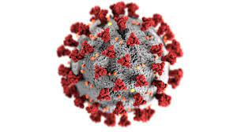
Infection Prevention and Control
Annual Report
(Corporate)
1 April 2021 - 31 March 2022

Slide 2
Chapter | Contents | Slide
 | Introduction | 3
 | Key Achievements | 4
 | The Code of Practice for the Prevention and Control of Healthcare associated Infections 2014 | 5
Standard 1 | Appropriate Organisational structures and management systems for Infection Prevention and Control must be in place | 6
Standard 2 | The physical environment should be maintained and cleaned to a standard that facilitates IPC and minimises the risk of infection. | 7 & 8
Standard 3 | Suitable and Accurate information on infections must be made available to service users their visitors and the public | 9
Standard 5 | All staff employed to provide care in all settings are fully engaged in the process of IP&C. | 10 & 11
Standard 7 | Policies on IPC must be in place and made readily accessible to all staff | 12
Standard 8 | So far as is reasonably practicable, staff are free of and is protected from exposure to infections that can be acquired or transmitted at work | 13
Standard 9 | All staff are suitably trained and educated in IPC associated with the provision of healthcare. | 14
 | Next Steps. Priorities for 2022-23 | 15
Infection Prevention and Control Annual Report 2021-2022

Slide 3
Introduction
In striving for excellence, Public Health Wales aims to have arrangements in place and to provide services that are safe and comply with best practice standards, for the benefit of those service users who need to access them.
Infection prevention and control is an integral part of services and functions provided to protect our staff and public. Public Health Wales is committed to ensuring that robust infection prevention and control systems and processes are operating within the organisation.
The organisation has a responsibility to comply Code of Practice for the Prevention and Control of Healthcare Associated Infections 2014 (the ‘Code’). A requirement of the Code is for the Board to receive an annual report on Infection Prevention and Control. The annual report seeks to provide the Board and relevant Board Committees with assurance that the organisation is meeting its statutory requirements in relation to the management of infection prevention and control.
This report covers the period from 1 April 2021 to 31st March 2022 including key achievements for this period and priorities for 2022/23.
As with all organisations within the NHS, the COVID 19 pandemic has impacted on the routine work of the Lead Nurse for infection prevention and control.
Infection Prevention and Control Annual Report 2021-2022

Slide 4
Key achievements
Delivery and offering of Covid-19 vaccine in the initial phases of the vaccine delivery programme and flu vaccine to staff within Pubic Health Wales
Working in partnership with the health and safety team and Directorates/Divisions ensuring the workplace is COVID safe for staff to work in and return to, this includes risk assessments and audits.
Engagement of screening programme leads in the IPC audit process and the purchase of hand hygiene kits to provide validation
Continuous review and implementation of Welsh Government guidance issued through the pandemic to ensure organisational compliance
Establishment of a structured response to audits received form Shared Services in relation to Bowel Screening Wales
Infection Prevention and Control Annual Report 2021-2022

Slide 5
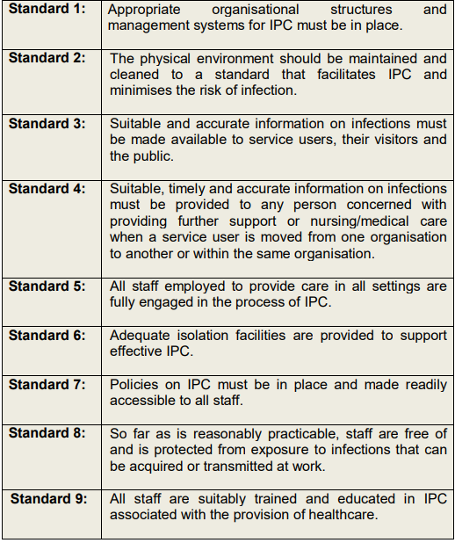
The Code of Practice for the Prevention and Control of Healthcare associated Infections 2014
The Code applies to all NHS healthcare organisations (Health Boards and Trusts) in Wales and to all services provided in both primary and secondary care.
For those organisations that do not provide in-patient services, the relevant sections of the Code apply.
Standards 3, 4 and 6 are not relevant for Public Health Wales and will not be reported on
Infection Prevention and Control Annual Report 2021-2022

Slide 6
Standard 1
Appropriate Organisational structures and management systems for Infection Prevention and Control must be in place
The Executive Director of Quality, Nursing and Allied Health Professionals provides the Executive lead role for organisational arrangements for Infection Prevention and Control, and specialist knowledge provided by the Lead Nurse for corporate Infection Prevention and Control
The IPC group meets quarterly and there are representatives from Screening, Microbiology, Healthcare Associated Infection; Antimicrobial Resistance and Prescribing Team (HARP), Health Protection, Health and Safety and facilities
Exception reports and assurance are made to the Business Executive Team and the Quality, Safety and Improvement Committee on compliance with the ‘Code’. Policies and procedures relating to infection prevention and control have been reviewed and updated
The Lead Nurse IP&C is notified of all incidents entered on Datix with an IPC implication. Each incident is investigated by the appropriate team with assistance from IP&C lead nurse. Themes and trends in incidents are also identified to inform service improvement
Infection Prevention and Control Annual Report 2021-2022

Slide 7

Standard 2
The physical environment should be maintained and cleaned to a standard that facilitates IP&C and minimises the risk of infection.
Decontamination
Public Health Wales is represented at the All Wales Strategic Decontamination Group.
Public Health Wales receives the validation reports for decontamination of endoscopes within Health Boards
Commenced meetings with shared services and Bowel Screening Wales to discuss validation audit reports and ensure assurance for commissioned services
Environmental cleanliness
Environmental cleanliness audits undertaken on a quarterly basis by the screening teams. With good compliance.
Where premises are used by screening programmes that are owned by Health Boards, validation audits were completed by the screening programs
Hand Hygiene Audits.
Hand Hygiene audits are performed monthly by screening teams with good compliance.
Ongoing discussion with Screening and Lead Nurses IP&C around modernising the audit process by using an electronic tool.
Purchase of hand hygiene kits by the screening teams for training and validation purposes
Infection Prevention and Control Annual Report 2021-2022

Slide 8
Standard 2 Continued
Health and Safety
The Lead Nurse for IP&C has been working collaboratively with the Health and Safety team ensuring:
Workplace Covid-19 risk assessments undertaken across the Estate and findings and recommendations actioned through Health and Safety Group and presented at the infection prevention and control group
Increased monitoring across the Estate to ensure compliance with Covid-19 regulations
The appropriate use of LFD test kits for front facing staff as per Welsh Government advice and working with the communications team to ensure Covid-19 messages and updates are accessible to staff
The Identified themes and trends in Datix incidents and provide any mitigation required in collaboration with services
Suspected Covid-19 nosocomial or outbreaks that have occurred within the organisation have been reported via Datix and investigated accordingly but this has not been a significant issues
Water sampling/monitoring and risk assessment are conducted across the organisation
Infection Prevention and Control Annual Report 2021-2022

Slide 9
Standard 3
Along with the invitation letter, an insert specific to Covid was sent to service users. This was to inform them about what to expect at their appointment and included information about precautions that our staff were taking as well as changes to the way our venues are set up. The insert also included information about what the service user needed to do including wearing a mask and not to attend when symptomatic or testing positive.
Triage calls were performed prior to appointments in some programmes which were also used to explain to participants the IPC measures in place. Where triage calls were not in place a conversation was had with the service user on arrival.
Screening included images of people wearing PPE in our public facing literature where possible, so people the images gave a more realistic representation of what is currently happening
Social media posts including information on “things we are doing to keep you safe” to further inform members of the public about IPC measures
Infection Prevention and Control Annual Report 2021-2022

Slide 10
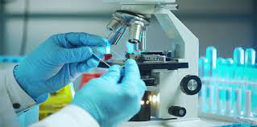
Standard 5
All staff employed to provide care in all settings are fully engaged
in the process of IP&C (Microbiology)
During 2021-22 all Microbiology laboratories underwent an annual internal audit inspection. Conducted by PHW Deputy H&S manager.
Comprehensive audits are carried out which include aspects of infection, prevention and control, (including) daily cleaning schedule compliance, maintenance and cleaning of equipment, PPE compliance, and health and safety induction, understanding of needle stick inoculation procedure, eye wash location/expiry, autoclave inspection and registering understanding of key documents such as the health and safety policy and the spillage and disinfection policy.
Audits completed show a decrease in the overall number of non compliances. However an increase in non compliance in sharps was noted as well as an increase in datix incidents of needle stick/ needle stick like injury. Review of this increase is underway to inform necessary improvements.
CL3 Sealability testing- Swansea site failed in February 2022. Resulting in redirection of high risk service for 6 weeks to facilitate remedial work. Remedial work was completed, proof of efficacy study completed on 25/04/22 and service resumed.
Efficacy tests for each laboratory have been commissioned for proof of concept in the case of an uncontrolled spillage.
All laboratories have completed internal 6 monthly laboratory audits and office audits. Some non-compliance issues noted in relation to audit schedule and action plans produced and monitored bi monthly.
A working group is due to be formed to progress the replacement of the aged Containment Level 3 Class I cabinets at UHW. Awaiting costing for the project. Replacement aimed to be completed within the next financial year.
Infection Prevention and Control Annual Report 2021-2022

Slide 11
Standard 5 continued
All staff who provide direct services are fully engaged
in the process of IP&C
Staff within screening continued to be compliant with IP&C standards and Welsh Government guidance. This included the evolving COVID-19 guidance
The lead nurse for IP&C continued to attend quarterly IP&C screening leads meetings to address any pertinent concerns to ensure compliance and high standards
Staff have been regularly updated of any changes in IP&C and have been supported with any implementation issues
Infection Prevention and Control Annual Report 2021-2022

Slide 12
Standard 7
Policies on IPC must be in place and made readily accessible to all staff
Public Health Wales uses the electronic National Infection Prevention and Control Manual to ensure staff have access to consistent, current and standardised policies
There is a rolling programme in place to review policies and procedures that require updating
Core policies available on Public Health Wales intranet site for staff to access
During 2021-2022 the cold chain and decontamination procedures were reviewed and are currently going through the consultation and approval process
Infection Prevention and Control Annual Report 2021-2022

Slide 13
Standard 8
So far as is reasonably practicable, staff are free of and protected from exposure to infections that can be acquired or transmitted at work
Influenza campaign was delivered via mixed model approach using an in-house vaccination team consisting of peer vaccinators and bank immunisers
Microbiology staff were able to access the influenza vaccine through the occupational health departments based at their health board via service level agreements. For routine vaccinations for microbiology staff there have been some challenges gaining confirmation of staff vaccination status. Work is ongoing with occupational health departments.
An increase in needle stick injuries was noted in November/ December 2021 further analysis is ongoing with microbiology and Quality, Nursing and AHP Directorate to work through any improvements that need to be made to mitigate risks.
Organisaitonal compliance with the Infection prevention and control guidance for seasonal respiratory infections in health and care settings (including SARS-CoV-2) for winter 2021 to 2022 and the use of FRSM type 11R for staff who work in settings where direct services are delivered. Mitigation for Covid-19 across PHW estate such as social distancing, use of face masks, signage for flows through buildings and the appropriate use of LFDs were in place and regularly reviewed.
Infection Prevention and Control Annual Report 2021-2022

Slide 14

Standard 9
All staff are suitably trained and educated in IPC associated with the provision of healthcare
Infection prevention and control e-modules were available to all staff for both level 1 and level 2.
The Welsh Government target for e learning compliance is 85%, with an internal target of 95%.
Aseptic Non Touch Technique (ANTT) is mandatory which is required to be completed by clinical staff within Breast Test Wales (BTW) who perform invasive procedures. There are two parts to the ANTT competency- theory and the practical assessment. The practical assessment is required to be carried out by a trained ANTT assessor. There are currently no ANTT assessors within BTW.
The lead nurse for IPC has attended the ANTT steering group and ANTT assessor courses will be available for staff from BTW to attend in May 2022. This will improve compliance in line with the organisational expectation.
Completion of IPC e-learning is encouraged, yet staffing issues due to COVID-19 sickness has impacted the ability for staff to dedicate to complete
 | 2020/2021 | 2021/2022
IPC Level 1 | 86.9% | 89.25%
IPC Level 2 | 76.36% | 74.76%
Aseptic Non touch technique (ANTT) | 78.72% | 76.29%
Infection Prevention and Control Annual Report 2021-2022

Slide 15
Next Steps and Priorities for 2022-2023
Continue the co-ordination and delivery of the internal staff flu programme to protect staff and service users
Lead and coordinate in the infection prevention and control audit delivery programme whilst modernising the process. Share point forms and excel spreadsheets to be utilised in the first instance.
Provide on-going advice to Public Health Wales staff especially those providing direct services and liaising with HARP team as required for additional expert advice.
Facilitate implementation of Aseptic Non Touch technique (ANTT) practice and assessment within Breast Test Wales. ANTT assessor workshops planned for May 2022.
Promote opportunities for staff to attend IP&C courses to gain knowledge and skills that will benefit personal development and support the organisation by improving overall compliance.
To finalise the cold chain procedure, decontamination procedure and IP&C policy by June 2022
To ensure all nosocomial transmission is reported accurately to allow for investigation
Infection Prevention and Control Annual Report 2021-2022

