Slide 1
Internal Influenza Vaccination Campaign 2021-2022
End of Year Report
Rebecca Bicknell
Lead Nurse for Infection Prevention and Control (Corporate)

Slide 2
Contents
 | Slide Number
Introduction | 3
Epidemiological summary | 4
Communicating with staff | 5
Model for the Internal Flu Vaccination Campaign- What did we do? | 6
Challenges to the internal flu uptake in Public Health Wales Uptake | 7
End of Flu Season Position | 8
Engaging with staff to understand their views on the delivery of the internal flu vaccine campaign | 9
Future delivery and Recommendations | 10

Slide 3
Introduction
Influenza (flu) vaccine is one of the most effective, safe methods to help prevent influenza infection, thus reducing pressure on health and care settings as it lowers the incidence of that disease in a given population
No Welsh Government 'target' was set for flu vaccine uptake, but there was an 'ambition' to achieve 80% flu vaccine uptake in frontline NHS Wales staff and social care workers
The influenza vaccine was offered to all Public Health Wales employees during the 2021/2022 campaign
Initially the Astra Zeneca COVID-19 vaccine was offered by Public Health Wales to staff, but the programme was later discontinued as access via the Mass Vaccination sites became more logistically prudent

Slide 4
Epidemiological summary
The 2021/2022 influenza season in Wales was shorter in comparison to pre COVID 19 pandemic seasons, due to the protective measures used to prevent COVID 19 transmission
At the start of February 2022 the influenza season had not officially been declared, though there was some indication of circulating influenza-like illness (ILI) within the community
There were low numbers of cases of influenza being detected in hospitals, despite a high number of tests being conducted (Likely to be linked to combined COVID19 respiratory virus testing)
Low number of outbreaks reported in closed settings
Flu AH3, AH1 and B Victoria have been detected so far, with the predominance of AH3 and B Victoria
There had been an increase in the uptake of flu vaccine in the aged 65 and over group in Wales this year, but there have been decreases in the other groups compared to the same point last year.

Slide 5
Communicating with staff
What did we do?
How did we do it?
Reassured staff of steps taken to ensure the process is safe. Use of an online booking system-Matrix, CQ2, Preswylfa
Engaged with staff, to help them understand the importance of protecting themselves against the flu virus, motivate them to take action
Personal and professional responsibility to protect ourselves, family, work colleagues and others from contracting flu
Annual vaccination is safe and effective for best protection.
Intranet
Regular updates
News stories
On line booking system
Video's
Flu Delivery Meetings
Weekly
Key stakeholders from across organisation
Messaging
Exec Lead
Use of a dedicated email address for vaccination enquiries

Slide 6
Model for the delivery of the Internal of staff Flu Vaccination Campaign
Vaccines were delivered at three main sites by the staff vaccination team (Preswylfa, Mold, Matrix House Swansea, CQ2 Cardiff.)
Occupational Health Service Level Agreement in place with health boards to deliver vaccine to microbiology staff (peer vaccinator in team for Cardiff and Vale laboratory as no SLA)
Trained Peer vaccinators held clinics and vaccinated their colleagues within the work place (not comprehensive due to limited number of peer vaccinators)
Responded to requests for bespoke clinics held in PHW Sites i.e. NHS Collaborative (as far as possible)
Offered Flu Vouchers for use in pharmacy’s for staff- which was well advertised on the intranet
Used Welsh Immunisation System for recording flu vaccination thus reducing paper consent
Use of a dedicated email address and admin support to enable speedy response to enquiries

Slide 7
Challenges to the internal flu uptake in Public Health Wales Uptake
The final reporting position for staff flu uptake was 46.2% for all staff and 43.8% for frontline staff for the flu season 2021-22
Personnel
Staff working remotely from home were unable, concerned about their safety or potentially unwilling to travel to a main site
Limited number of registered health professionals available as peer vaccinators or bank staff to support Internal campaign due to ongoing workforce pressures with COVID-19 and recovery
Anecdotal evidence by managers of “Vaccine fatigue” due to booster COVID19 as a barrier to uptake
Logistic
Community pharmacy vouchers offered but not all pharmacies carried stock of influenza vaccination leading to staff enquiring to multiple pharmacies. Confusion noted around vouchers (previously only over 65s eligible). Concerns fed back to National Influenza Action Group (NIAG)
Requirement for 2 registrants due to less staff overall in the building for the safe delivery of the Covid 19 Vaccination programme, made rota coverage more challenging, for the flu campaign where this is not routinely required
Lack of the one system approach by the Health Boards across Wales (to record vaccine uptake) lead to inaccurate reporting figures from those vaccinated
Ensuring cold chain compliance with the flu vaccine

Slide 8
End of Flu Season reflections
Positives
Good representation of key stakeholders POD, Health and Safety, VPDP, QNAHP at the Flu delivery group meetings which provided governance across the campaign
Mixed model of delivery-vaccination clinics at main PHW sites and community pharmacy vouchers.
Use of the online booking system for appointments
Dedicated winter vaccinations email address to improve staff response
Dedicated admin support for campaign
Use of Welsh Immunisation System (WIS) which electronically uploads details of the individuals influenza vaccine record in conjunction with paper forms
Development of a cold chain procedure awaiting approval-
Training and audit to document compliance and provide assurance
Negatives
Uptake was 46.2% for all staff and 43.8% for frontline staff
Only a small number of peer vaccinators available

Slide 9
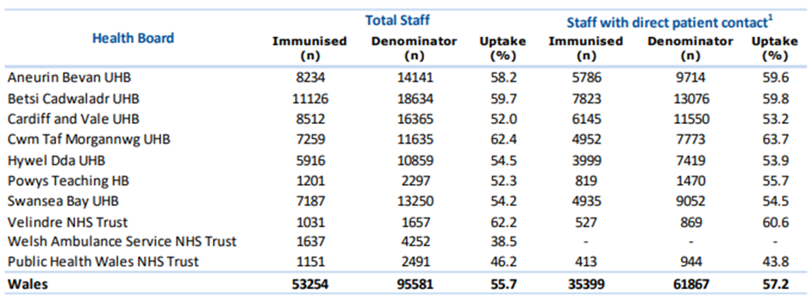
Staff Uptake Influenza Vaccine
Influenza vaccine uptake for all staff in PHW was 46.2% and 43.8% within front line staff for 2021-22. When compared with other Health Boards and Trusts at Figure 1, the uptake of influenza vaccine across the NHS was low for 2021-22 season

Slide 10
Engaging with staff to understand their views on the delivery of the internal flu vaccine campaign
An online questionnaire was developed with advice from VDPD and published on the intranet to elicit a cross section of views regarding the delivery of the internal flu campaign. This will inform the delivery of the 2022-23 campaign
Only 173 (7.2 %) responses were returned from a workforce of over 2,400 employees and of these:
76% stated they would prefer to receive the vaccine at a Public Health Wales site which indicated sessions needed to be run within Public Health Wales locations for 2022-23
19% stated they didn’t know about the flu vaccine despite a well publicised internal communicated plan
10% of respondents' who normally receive the flu vaccine but didn’t for the 2021-22 season found issues with using the flu voucher a barrier to vaccination this was due to pharmacy stock or confusion surrounding the voucher being accepted.
Of the 173 staff who responded | Findings
43% | Staff respondents were working from home
87% | Had received the flu vaccine
76% | Would prefer to receive vaccine at PHW site
76% | Found easy access to information regarding flu vaccine
19% | Stated they didn't know about flu vaccine

Slide 11
Future delivery and recommendations
Provide a well publicised mobile road show launching simultaneously internal influenza campaign September 2022 across key sites Preswylfa, CQ2 and Matrix
Identify more Health Care Professionals as Peer vaccinators and Flu champions May/June 2022 and ensure training compliant by September 2022, allowing in team vaccination - Basic Life Support (May and June), Flu E-learning, Anaphylaxis, Patient Group Directive signed and vaccinator competencies assessed
Requirement for one Registered HCP plus one other person (trained support worker)
Work closely with the communications team to develop a comprehensive communication plan
Provide incentives for teams and vaccinators who have achieved high rates of uptake as suggested by VPDP. This could be in the format of ‘vaccinator of the month’ and published via the communications team on the intranet site.

