Slide 1

Duty of Candour Implementation Update February 2023
Purpose of the Presentation :
The Committee has regular updates for assurance programmed into the work plan on Health and Social Care (Quality and Engagement) (Wales) Act (2020).
Description :
This update is to provide assurance on the progress made and the preparedness for the implementation of the Act, which is due for implementation from 1 April 2023.
An update on the Duty of Candour was last presented to the Committee in October 2022, this update details progress made since then.
This directly links with the Risk 207 on the Corporate Risk Register (‘There is a risk that Public Health Wales will fail to meet the requirements of The Health and Social Care (Quality and Engagement) (Wales) Act (2020)’)
Recommendation
Consider the information provided
Receive Assurance

Slide 2
Duty of Candour Implementation Update January 2023
What is Duty of Candour
Progress to Date
Implementation Plan Update
Governance
Potential Risks
Next Steps

Slide 3
Duty of Candour
Overview
Duty of Candour is being introduced in April 2023 as part of the Health & Social Care (Quality and Engagement) (Wales) Act 2020.
The overall purpose of Duty of Candour is to ensure as an NHS Wales organisation we are open, honest and supportive when there has been an unintended or unexpected incident which has resulted or could have resulted in an adverse outcome for a service user
This includes telling the person affected that an unintended or unexpected incident has occurred; apologising; offering and involving them to understand what happened
Builds on Putting Things Right (PTR) principles

Slide 4

Work completed and Ongoing
PHW Submission to WG consultation response
WG Self Assessment submission
Representation at DOC & Quality Executive Implementation Board and Network
Contribution to the WRP Network & Subgroup
DOC internal implementation group (QNAHPS)
Project/Implementation plan and monitoring
Internal Engagement sessions

Slide 5
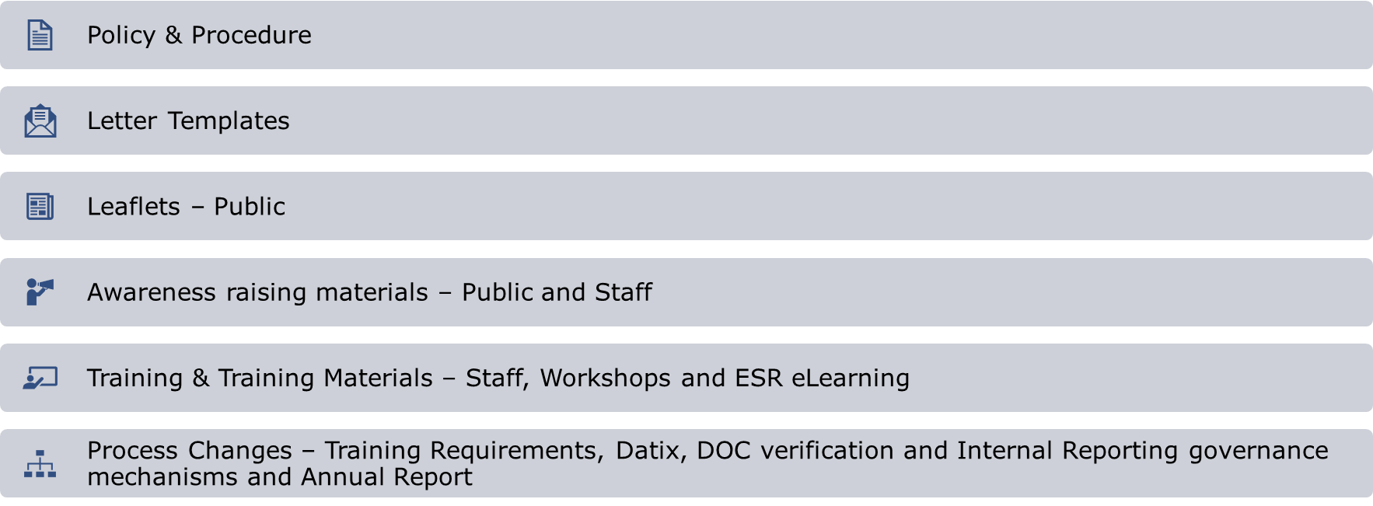


Key Areas of Activity

Slide 6

Engagement Activity
Workshops held with Screening Divisions - BTW, New Born Hearing , Blood Spot, AAA and DESW
Further workshops arranged for CSW
Scheduling in progress for Microbiology and Health Protection and the remaining Directorates
Bespoke sessions on the application of DOC for these areas

Slide 7
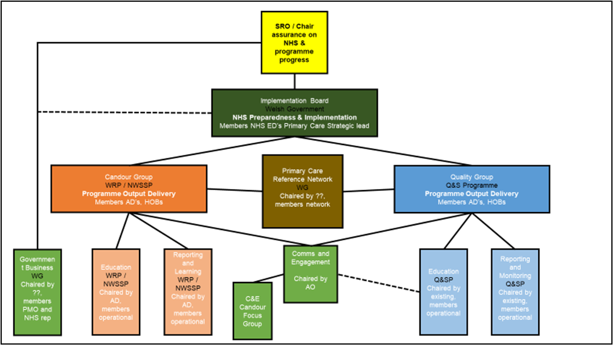
Reporting Structures Internal and External
Monthly Highlight /Progress Reporting to Welsh Government Duty of Quality & Candour Implementation Board
PTR team oversight and operational management & monitoring
DOC will be incorporated into PTR reporting structures within PHW- BET/QSIC etc
Will Inform internal audit and Quality Improvement activity
Initial Annual Report submission due to Welsh Government- March 2024

Slide 8
Potential Risks & Concerns
Risks or Concerns | Mitigation
Workforce: DOC knowledge and skills | Awareness raising though a communications plan Bespoke workshops Newsletter WG Materials including leaflets, awareness video, ESR eLearning module PHW bespoke level 2 in house training
Workforce Demand: staff may not be able to meet the extra workload required by DOC investigations and follow up in person meetings | Local Service monitoring of demand and capacity and impact on performance Risk Register with monitoring /review
Impact of front line service delivery from the additional DOC requirements | AS Above

Slide 9
Potential Risks & Concerns cont.
Risks or Concerns | Mitigation
Workload pressures may contribute to DOC breaches or DOC backlogs | Local Service monitoring of demand and capacity and impact on performance PTR team oversight and monitoring of incidents and performance
BTW- concerns regarding the impact on the interval cancer audits backlog | Local Monitoring, and management of workforce and audits
Increased costs initially but anticipated improvements for learning from DOC | PTR oversight and monitoring

Slide 10
Next steps
Board – Vice Chair Finalised & Board Session planned
Further Engagement Workshops
Launch internal Tier 2 training
Launch of ESR module once available
Strengthening of Lessons Learnt cascade
Publication of Policy & Procedure
Duty of Candour reporting and monitoring

