Slide 1
Health and Well-being Directorate
Angela Jones – Acting Director, Health and Well-being
15th February 2022

Slide 2
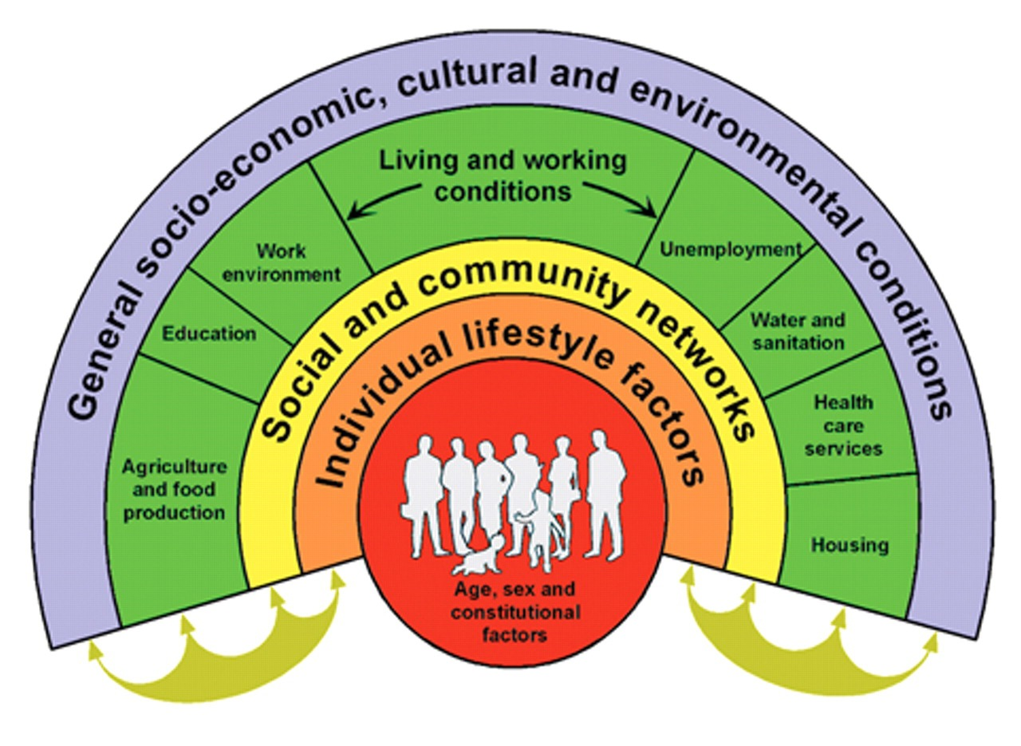
Wider Determinants of Health and Well-being
Dahlgren and Whitehead
Health and Well-being Directorate

Slide 3
Health and Well-Being Directorate structure – current
Angela Jones
Acting HWB Director
Vacant
Deputy Director, Health and Well Being
Zoe Wallace
Director of Primary Care
Dr Julie Bishop
Director of Health Improvement
Tim Hooper
Head of Planning and Business Support (1)
Wider Determinants of Health Unit
(Cons: Ciaran Humphreys)
Wider Determinants
Public Health Network Cymru
Primary Care Division
Primary Care Hub (Cons: Sian Evans 2x new CsPH)
Primary Care Prevention (Cons: Amrita Jesurasa)
Dental (Cons: Anup Karki, Mary Wilson, Paul Brocklehurst}
Business Support (David Titley)
Health Improvement Division
Tobacco (2x new CsPH)
Obesity and Nutrition (Cons: Ilona Johnson)
Physical Activity (Cons: Paul Pilkington)
Mental Well-Being (Cons: Emily van de Venter)
Alcohol and Substance Misuse (Cons: Kerry Bailey)
Settings (Educational, Work, NHS (Cons: Mary-Ann Mc-Kibben)
Pre-schools (Cons: Mary-Ann Mc-Kibben)
Early Years (Cons: Amy McNaughton)
Behaviour Change and Public Information (Hd: Vacant)
Programme/ Business Management (Sarah Morrison)
People Management (Claire Peglar)
Business Support teams embedded within Divisions and within LPHTs
All Local Public Health Team staff and resources transferring to Local Health Boards on 30/9/22

Slide 4
Impact of Covid-19 Pandemic
Health and Well-being response
Most programmes were paused from March 2020 as lockdown prevented delivery and staff were redeployed
Help me quit was maintained online and telephone support
Gradual restart of services as staff released from redeployment
Review of programmes and change in delivery for some
Many vacancies, sickness absence

Slide 5
Resources
Staff and budgets
Budget £15 m
  Core budget
  Core grant budgets, grants out - WNHSS, HSPSS, NERS
  Grants drawn in then out to system – WSAMEWB, C&F pilot
  Grants drawn down based on expenditure – PEY, Obesity, CAMHS, WNHSS (central), HWW, Pre-diabetes
Staff 159 WTE

Slide 6
Wider Determinants of Health and Well-being
Key workstreams
Influence how work and education can improve health and equity
  Delivering Fair work for health, well-being and equity, guide, resources developed by and expert panel with wider engagement.
  Educational attainment – causal system map, policy gaps and opportunities
Strengthen capability of public health system to influence the wider determinants of health:
  Health Foundation to support systems working in Public Services Boards in Wales
  Public Health Network Cymru: 2,700 members, 12 webinars, 3,000 YouTube views: Mental well-being and Greener Primary Care.
  Building a Healthier Wales partnership: Free primary school meals, Early years and childcare offer, income maximisation pilot, cost of living

Slide 7
Primary Care: transformation of primary and community care
Programmes of Work
Key National Programmes
Strategic Programme for Primary Care (PH input and collaboration)
Embedding the Primary Care Model for Wales
Greener Primary Care Wales
Others
Public Health advice and support to key partner organisations
Public Health expertise to national strategic committees and groups
Supporting evidence & data driven primary care through monitoring/ evaluation
System leadership and joint working btw PH(W) and PC for popn health
Providing Once for Wales guidance, tools and resources
Building capability and capacity of the primary care workforce

Slide 8

Public health contribution to primary care transformation
IMTP SO 1.5
Joint working btw PH(W) and PC for popn health
Primary Care Interests Group: Forum for coordinating interests in PC space for PCD, PHW central teams & LPHTs; info exchange; identify once-for-Wales actions
Primary Care Leads Network: Peer support focus for Hub & LPHT colleagues; air & mitigate challenges of local capacity & capability to enhance cluster working
Cluster Development Support Officer Network: Forum with HB PC teams who work directly with cluster – cluster support through PH lens / advocating PH principles
INTERNAL/
PH SYSTEM
PARTNERS

Slide 9
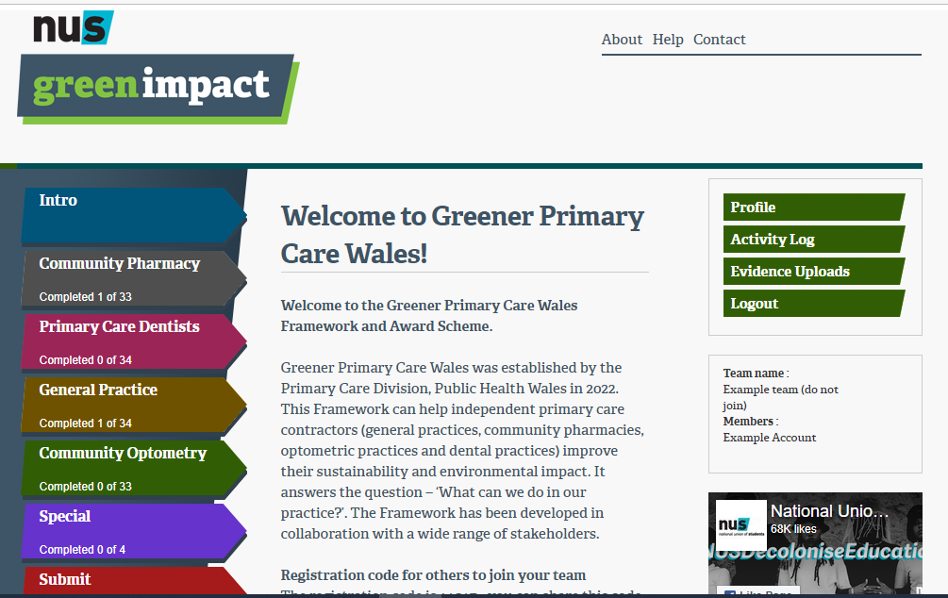

Example of national programme contributing to primary care action
Framework and award scheme for 4 primary care contractors
Approx. 50 climate change mitigating actions
Supported by WG policy, professional bodies & contractual bodies
Expert group Chaired by Kate Eden
Pilot Jan – March 2022 – 140 practices expressing interest
Launch W/C 6 June 2022 – Ministerial support (HSS and Climate Change) plus WBfG Commissioner, 100+ practices registered,
Bevan Exemplar
Greener Primary Care

Slide 10
Primary Care Prevention
Programmes of work
Key National Programmes
Obesity Prevention – All Wales Weight Management Programme
Diabetes Prevention work – National Diabetes Prevention Programme
Social Prescribing (join up with Policy, WDs of Health and M+EWB in Health Improvement)
Others
Public Health advice and support to key partner organisations
Role of NHS in improvement programmes such as Anchor Institutions, Inverse Care Law, Pre-Diabetes and Social Prescribing

Slide 11
Primary Care - Dental Public Health
Programmes of work
Key National Programmes
General Dental Services Reform Programme
Oral Health Improvement - Designed to Smile, Gwen am byth
Oral Health Intelligence - Dental Epidemiology Programme
Others
Dental Public Health advice and support to key partner organisations
Specialty Training in Dental Public Health
R&D and outputs in collaboration with Academia

Slide 12
Dental Public Health: Systems leadership and expertise in improving oral health and reducing health inequalities working across organisations and systems in Wales.
NHS Wales
Public Health Wales
Welsh Government
Health Education And Improvement Wales
Local Authorities, and others
We provide strategic advice and support to improve oral health and enable innovation working across a range of organisations and systems
Professional organisations, committees, regulatory bodies
Universities in Wales
Key partnerships and networks locally, regionally, nationally and beyond
Leadership for oral health spanning the three pillars of public health:
Underpinned by dental and public health expertise and activities:
Health Improvement
Healthcare Public Health
Health Protection
Health Intelligence
Workforce Development
Academia
Including
Education and Research
Advocating and supporting to reduction of inequalities and improving value of health care systems
Knowledge management to inform dental policy, oral health programmes and services improvement
Leading oral health improvement across populations and systems
Ensuring health protection in dental settings
Supporting strategic planning and development of workforce
Contributing to dental education and research priorities in oral health
V11
02.12.20

Slide 13
Health Improvement
Healthy Behaviours
Reducing the harm from tobacco systems leadership and delivery
  Cessation – Help Me Quit in hospitals, maternity, community, 18-24 year olds, nicotine additions service feasibility.
  Prevention and demormalisation – smoke free legislation,
Substance use prevention
Nutrition:
  early years nutrition, 10 steps, breastfeeding, Healthy Start Scheme and school food
  Obesity: Children and families pilot, Whole Systems Approach HWHW, Minimum data set, L1 digital offer, legislation support
Physical activity – active school travel, hands up survey
Behaviour Change and Public Information

Slide 14
Health Improvement
System Leadership of National Programmes
First 1000 Days Programme
Welsh Network of Health Schools Schemes - transformtaion
Whole School Approach to Emotional and Mental Well-being
Launch of Primary School Health Research Network
Curriculum and professional learning – H+WB, RSE
Population approach to protecting and improving mental well-being: “HAPUS” and CAMHS in reach in schools
Healthy Working Wales

Slide 15
Health Improvement
NHS Settings
National Exercise Referral Programme (NERS)
  Completion of service review
  Procurement of patient management system
  Took on operational management, new team
Making Every Contact Count (MECC)
  Re-established National MECC Leads
  Collation of National Data MECC L1 E Learning 2017–2022
  Development of Healthy weight E-Learning modules L1 and L2
  National evaluation framework
  Curriculum development with HEIW

Slide 16
Health Improvement
Direct delivery of Programmes
Help Me Quit (HMQ) – online, telephone support and data collation
Just B: tobacco prevention targeted in schools based on SHRN findings
Healthy Working Wales: revised programme to attract more SMEs

Slide 17
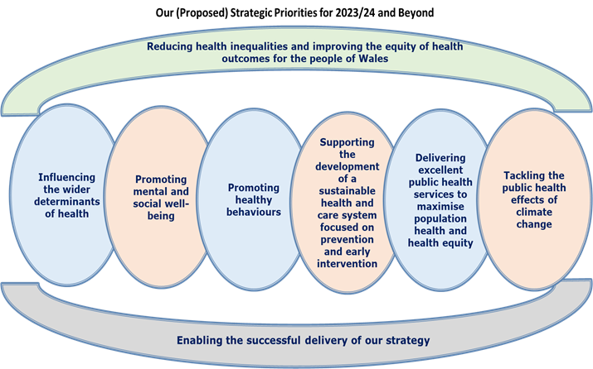
Risks - development
Key Risks (including any related risks on the CRR and SRR)
There is a risk that population health improvement programmes will not deliver effective health improvement caused by pressures across the public health system resulting in greater inequalities in population health outcomes.
There is a risk that we do not support the NHS through a population health focus on prevention and early intervention resulting in further inequity of access and outcomes.
Context of Long- Term Strategy review

Slide 18
Areas that the Committee may wish to explore further?
2023/24 Committee work plan
Strategic risks for Public Health Wales and our systems leadership role for the population of Wales
Mitigating factors to drive excellence in service delivery and systems leadership
  Development of MOU2
  Systems leadership training and development
  Aligned academic public health
  Delivering excellent population health programmes
Developing our Healthcare Public Health role.
Delivering the Long-term Strategy

