Slide 1
Clinical Governance Framework Update
Wayne Jepson
Paula Mitchell
Rhiannon Beaumont-Wood, Executive Sponsor
Date: 5th December 2022

Slide 2
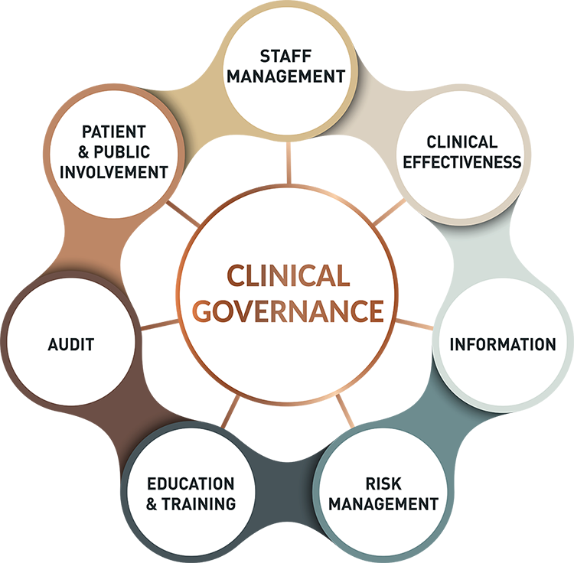
What is Clinical Governance?
A system by which health and care (service) providers can continuously monitor and improve the quality of their services and safeguarding high standards of care (services).
It brings together different strands of quality improvement including service user/client feedback, effective leadership, evidence-based practice, education and training, audit and managing risk.
https://cqc-compliance.com/clinical-governance/
Notes:
Clinical Effectiveness and Research – Care should be evidence based and designed to deliver the best outcome for the patient/client.
Information and IT – Data needs to be secure, up to date and accurate, and used effectively to measure quality of the services.
Risk Management – Systems should be in place to understand, monitor and minimise risk to safeguard patients and staff.
Education and Training – Staff need appropriate training and support available to maintain their competency and to develop new skills, so they are continuously up to date.
Audit – The audit process is to ensure that clinical practice is continuously monitored and that deficiencies in care delivery are remedied. For PHW this is known as Quality and Clinical Audit, annual plan in place.
Patient and Public Involvement – Involvement and feedback from both the patient/client and the public is used to develop and improve services and the quality of the experience of the care delivered.
Staff Management – The safe and appropriate recruitment and management of staff.

Slide 3
Why is Clinical Governance Important to PHW?
Align with QOS / Refresh of Long Term Strategy
Emerging Theme of Delivering Excellence
Underpinning framework to promote quality and clinical excellence
Address our risks on the strategic and corporate risk register
https://cqc-compliance.com/clinical-governance/

Slide 4
Current Position
Clinical Governance arrangements in PHW
  NHS Wales Governance e-Manual/ Health and Care Standards
  Local Arrangements Divisional/ Directorates; for example:
    Microbiology – UKAS Accreditation
    Screening – SPAR Reporting
Building on existing structures
Identified as a deliverable in Intermediate Medium Term Plan Action (IMTP) 2022/23
Recognition this needs to be done collaboratively
Notes:
Rhiannon
Currently CG Framework in PHW, which is the missing component to delivering excellent services which will help with systems mapping for QOS
We need to develop a framework which is suitable for our needs but can also be translated across to the new Quality Reporting Framework that is due to come into place on 1 Apr 23 as part of the new Duty of Quality – this quality reporting framework is currently in development with workstreams across WG and NHS Bodies. The QRF reporting will be aligned with STEEEP.
Health and Care Standards are being replaced,
We need to be open and transparent across PHW to meet the needs of the Duty of Candour which is also due to come into place on 1 Apr 23, learn from when things go wrong, share the learning across the organisation
Lots of good practice already going on across PHW in relation to CG for example UKAS accreditation for microbiology, screening service programmes assurance groups, HP Divisional Quality/ Safety/ Improvement Group

Slide 5
Steps to Date
Scoping and horizon scanning
Review of best practice across the UK including National Institute of Clinical Excellence and Care Quality Commission, other Health Boards and Trusts across NHS Wales
Interim scoping across the organisation commenced to understand any gaps against the 7 pillars of Clinical Governance prioritising key clinical areas
Formulation of draft gap analysis and improvement matrix
Workshop1: 2 November 22
Notes:
Rhiannon
Currently no CG Framework in PHW, which is the missing component to delivering excellent services which will help with systems mapping for QOS
We need to develop a framework which is suitable for our needs but can also be translated across to the new Quality Reporting Framework that is due to come into place on 1 Apr 23 as part of the new Duty of Quality – this quality reporting framework is currently in development with workstreams across WG and NHS Bodies. The QRF reporting will be aligned with STEEEP.
Health and Care Standards are being replaced,
We need to be open and transparent across PHW to meet the needs of the Duty of Candour which is also due to come into place on 1 Apr 23, learn from when things go wrong, share the learning across the organisation
Lots of good practice already going on across PHW in relation to CG for example UKAS accreditation for microbiology, screening service programmes assurance groups, HP Divisional Quality/ Safety/ Improvement Group

Slide 6
Workshop 1: 2 Nov 22
AIM: To progress the development of Clinical Governance Standards for the Public Health Wales Clinical Governance Framework, which can support the delivery of excellent services.
PURPOSE:
To agree proposed Standards
Identify Key Lines of Enquiry (KLOE)
Highlight Evidence to support Standards/ Key Lines of Enquiry
How We Share Learning
Identify Gaps
Agree Next Steps

Slide 7
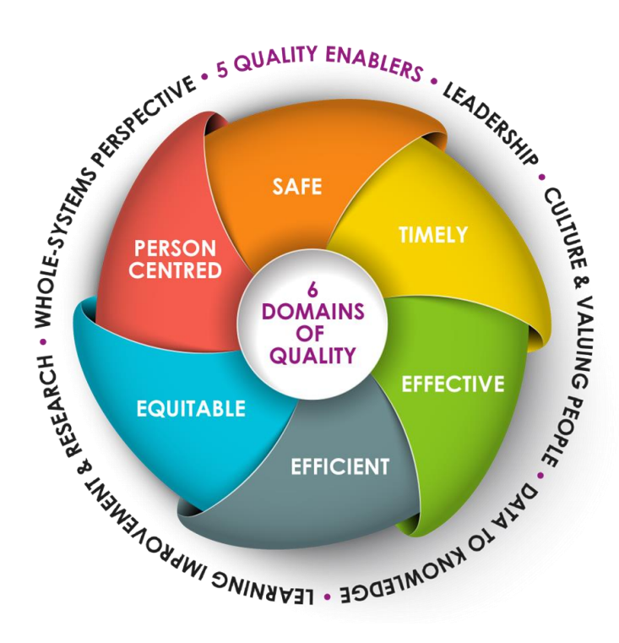
Duty of Quality 2023
Proposed Clinical Governance
Framework Standards
6 Quality Standards
Underpinned by:
5 Quality Enablers
*Draft “The Duty of Quality Guidance 2023 and Quality Standards 2023” released 25 Oct 22 for Consultation

Slide 8
Standards & Key Lines of Enquiry – Workshop 1 Outcomes
Participants agreed to:
Use Duty of Quality 6 Quality Standards
Reviewed STEEEP definitions from Duty of Quality
    Safe
    Timely
    Effective
    Efficient
    Equitable
    Person Centred
Review Key Lines of Enquiry – develop version suitable for PHW
Omissions highlighted and additional KLOE added

Slide 9
Providing Evidence – Key Themes Identified
National Evidence
Standard Operating Policies and Procedures
Standards
Incident Management and Reviews
Complaints/ Concerns/ Compliments
Audit
Service User Experience/ Civica
Clinical Notes/ Handovers
Professional Registration and Revalidation
Continual Professional Development/ Professional Development Records/ My Contribution

Slide 10
Sharing Learning – Key Themes Identified
Audit
Case Reviews
Case Studies
Incidents Themes and Trends
Complaints Themes and Trends
Professional Forums and Meetings
Newsletters
Experience and Engagement Group
How do we Share Learning Wider than Directorates?
How do we Share Learning Wider than PHW?

Slide 11
Addressing Gaps – Key Themes Identified
Digital Platforms
  IT Systems
  Always on Reporting
  Automated Reporting
Incident Review Panels/ Reviews
Workforce Strategy
Succession Planning
Clinical Governance Framework development aligning with STEEEP
Governance of outputs – sign off arrangements/oversight

Slide 12
Next Steps
Theme Workshop
Define “Clinical Services” – do we need a wider audience?
Once defined, engage with wider organisation to identify where “clinical services” are and invite to further workshops
Further workshop to develop Driver Diagram
Develop Draft Framework based on STEEEP
Re-phrase IMTP action and timelines to be reviewed

