Slide 1
Quality and Clinical Audit
Deep Dive
Presented by: Jessica Taylor, Quality and Clinical Audit Officer
December 2022

Slide 2
Content
1. Background
3. Key improvement aims
Clinical governance and improvement
Annual audit plan
Governance
Strategy and QOS
Audit Wales
Our 4 main aims
What we have done so far
Where we are going next
2. Drivers
4. Audit case studies
Quality and Improvement Strategy
Quality as an Organisational Strategy
Integrated Governance Model
Audit Wales report
Quality and Clinical Audit Deep Dive

Slide 3
Background
Clinical governance and improvement
Annual audit plan
Governance
Quality and Improvement Strategy and Quality as an Organisational Strategy
Quality, Safety and Improvement Committee and Audit, Assurance and Governance Committee feedback
Audit Wales
Quality and Clinical Audit Deep Dive
1
Notes:
The programme is comprised of quality and clinical audits.
Quality and clinical audit aims to improve quality and provide assurance by measuring existing practice against evidence-based standards. Essentially we use audit to assess how we are performing against known best practice.
Clinical Audit is one of the seven pillars of clinical governance. It is therefore vital we have a robust clinical audit programme that can provide assurance, sustain and improve standards, and improve the quality of our clinical services and functions within PHW
Audit overall is a useful improvement tool by demonstrating to us where things are going well and should be celebrated, and where things are going not so well and improvements can be made. Therefore quality audits can assess the quality of our programmes, functions and services by measuring the management, processes and outcomes of these against evidence-based standards
Each financial year an annual Quality and Clinical audit plan is compiled in collaboration with teams across the organisation.
It is comprised of National/externally driven audits in response to a statutory duty to participate in relevant national quality and clinical audits. These audits are undertaken and reported to external bodies. These include UK wide audits, such as the Association of Breast Surgery audit BTW contribute to, and Welsh audits such as that All Wales Audiology Audit that Newborn hearing screening contribute to.
Our programme of local audits are identified by programmes and divisions. These are reported internally and comprise of audits of quality and clinical / public health practice undertaken within Public Health Wales, and where appropriate should reflect nationally agreed best practice standards.
Governance for the audit programme includes:
Quality, Safety and Improvement Committee seeks assurance on the overall plan, it’s fitness for purpose and it’s delivery. QSIC also seeks detail on the outcomes and improvements made as a result of quality & clinical audit.
Internal Audit provide assurance on the Quality and Clinical Audit Plan as part of a specific internal audit.
Quarterly updates are provided to the Quality Nursing and AHPs directorate clinical governance group, to update on progress on the audit plan and demonstrate outcomes and improvements. This allows triangulation of this information with other information streams
Audit contributes to the governance of programmes, services and functions by providing assurance of quality and safety, benchmarking against national standards, prioritising specific local concerns and driving improvements
Quality as an Organisational Strategy includes several important aspects of which audit supports the primary focus to improve. Audit supports planning improvement activity and the redesign of systems or processes or work based on the results. It along with other methodologies is part of a system to obtain information providing measurement and feedback into the system to inform planning for improvement ultimately leading to improved quality
Audit supports many of our long term strategic aims through providing evidence and assurance our programmes, services and functions are delivering excellence and performing to best practice standards. The strategy refresh offers an opportunity to promote the use of audit to support how we will deliver our strategic objectives
In 2021 Audit Wales reviewed quality governance arrangements in PHW, which included a review of the quality and clinical audit programme. This review made recommendations for the audit programme to improve the flows of assurance around quality and safety and the oversight and tracking of the audit programme.
Duty of Quality guidance is out for consultation at the moment, and the quality reporting framework is still in development. Will be a key driver in how we report audit as a quality measure, and an opportunity to promote the use of audit as an assurance and evidence mechanism for quality.
Our organisational approach has been improving iteratively year on year which I will outline in these slides, as well as demonstrate further continuous improvements we are planning.

Slide 4
Audit Wales Report: Drivers for change
Central oversight of quality and totality
Central repository of audits
Risks, key themes and actions implemented
Develop risk-based approach
Collate themes arising from the programme and share with QSIC
Central system to track and report progress of actions
Quality and Clinical Audit Deep Dive
2
Notes:
Audit Wales report:
Require better central oversight on the quality and totality of the quality & clinical audit programme.
No clear picture of how well the programme links to quality and safety risks, key themes arising from the programme, or whether actions to address recommendations have been implemented.
Recommendations:
a. Creating a central repository to store and share all quality and clinical audits
b. Developing a system to track and report progress of implementing the recommendations of audit to QSIC.
c. Developing a process to link the annual audit plan more clearly to operational, corporate, and strategic risk registers to demonstrate that audits are mapped to key quality and safety risks.
d. Collating themes arising from the audit programme and share these with QSIC. Future audit plans should provide assurance that themes are being investigated.

Slide 5
Key Improvement Aims
Quality assurance of a robust audit process
Learning from audits
Risk-based approach
Increased directorate coverage
Quality and Clinical Audit Deep Dive
3
Notes:
Recommendations:
1. Developing a system to track and report progress of implementing the recommendations of audit to QSIC.
This forms part of a robust audit process. We want to ensure all elements of the audit process are completed and we have quality assurance of this.
Two related recommendations:
2. Creating a central repository to store and share all quality and clinical audits
3. Collating themes arising from the audit programme and share these with QSIC. Future audit plans should provide assurance that themes are being investigated.
- We need to improve the analysis we do on the outcomes and improvements that arise from audit, and how this links to other information streams. This analysis contributes to the assurance we provide QSIC and, as relevant, to the Audit and Assurance Committee. We also need to be sharing insights from audits across the organisation.
4. Developing a process to link the annual audit plan more clearly to operational, corporate, and strategic risk registers to demonstrate that audits are mapped to key quality and safety risks.
- We need to ensure that linking audits to risk registers needs to be more than a tick box exercise, but instead a risk-based approach should be used throughout the quality and clinical audit programme so that resources are used more effectively and prioritised based on risk.

Slide 6
Key Improvement Aims
Quality assurance of a robust audit process
What we’ve done
Introduced standardised audit report template in Apr 22
Developed an action log system to track and report progress implementing the recommendations of audit
Updated organisational Procedure to make process clearer
Where we’re going
Expand audit training offer to staff to increase capability in completing good quality audits
Digitalisation of audit process to make it more robust, user-friendly and improve reporting and data analysis. Improved oversight and reporting via dashboard
National agenda for core audits
Quality and Clinical Audit Deep Dive
4
Notes:
What we’ve done
New standardised report template ensures all aspects of a quality audit are included and reported on
Action log implemented to keep a central overview of recommendations and ensure actions are implemented
Where we’re going
Training
Currently undertaking course on Training Skills. Piloted introductory training sessions with DESW staff
Next year: develop an intro to audit training that is available to all staff. Explore training materials e.g. videos, e-learning to make training accessible and sustainable. Involvement in audit supports CPD, which is a key component of clinical governance, and we want to really promote the value of being involved in audit to staff.
Digital
Long term solution = digital software/cloud-based platform. Benefits = built in quality assurance thus making process more robust. Better reporting, action tracking and data analysis to theme results and evidence compliance and improvement. More user-friendly audit process, avoid duplication and waste, audits can be more mobile e.g. IPC audits.
Opportunities e.g. NHS Wales info sharing.
Constraint: business case/investment needed, building capacity and capability to use.
Next 6 months: scope options, engage with org to build spec (what adds value)
In the interim we want to maximise what we can do with audit reporting and oversight with the resources we have available to us. Real-time dashboard to improve the oversight of audits and enhance audit reporting. Explore possibilities for automating audit reporting – constraint: too much change. Utilise scoping exercise for digital platform to ensure any changes add value.
Core audits: national agenda looking at clinical audit undertaken across HBs and Trusts where they are standardising key audit questions in audits such as hand washing, bare below the elbow, PPE, clinical documentation. Task and Finish group set –up and they have just agreed the first set of core questions for hand washing and PPE, and bare below the elbow. This will mean an organisational change for PHW, as there will be guidelines on how often they should be reported. This will allow for benchmarking across organisations.

Slide 7
Key Improvement Aims
What we’ve done
Developed a one-page overview template to share key audit findings
Utilise Directorate intranet pages as an interim repository for sharing audit results
Developed thematic analysis of audit results in 2021-22 year-end report
Where we’re going
Scope options for long term repository and options to proactively share audit learning
Continue to develop thematic analysis and further data analysis of audit results. Triangulating audit findings with other data streams
Consider how we can present Audit activity in Microbiology in the organisational plan
Learning from audit
Quality and Clinical Audit Deep Dive
5
Notes:
What we’ve done
When sharing the results of audits to the wider organisation, this needs to be done in a way that people can quickly access the information that is relevant to them and will add value to their own work. To facilitate this, we have developed a one-page overview template, so the main findings, improvements and recommendations from audits can be shared easily. Will demonstrate poster at end. The QNAHPs directorate intranet pages on SharePoint are going to be used as an interim repository for these.
Developed thematic analysis, which themed audits around the type of audit, Health and Care Standards, and the IHI 6 domains of quality.
Where we’re going
Long term repository: Liaised with I&I Hub – advised that the Hub is unable to support sharing audit results at this time due to capacity and an central focus on innovation and improvement. Will look to scope options for a repository. Risk: ‘too many clicks’ to get to the content, too many places where learning may be shared
Repository is only part of the solution, as we need to make people aware of what is there and how sharing learning from audits adds value. Explore options to proactively share this information. Opportunities: Promoted Clinical Audit Awareness Week in June 2022 with uptake across the organisation of national webinars– in 2023, opportunity to share PHW audit case studies and learning. New ways of sharing information e.g. Yammer. New quality reporting framework as part of the Duty of Quality is an opportunity to consider how we report and share information.
As mentioned on the previous slide, our plans to enhance reporting with a dashboard would also provide opportunities to improve how we share information and good practice. We are looking to develop the thematic analysis that is produced at the end of the year and triangulate this with other data streams to provide greater detail on the outcomes and improvements made from audit and how this links to other trends e.g. putting things right. Further to this, we are aware of quality and clinical audits taking place in the organisation, such as IP&C audits and vertical and horizontal audits undertaken in Microbiology as part of their UKAS assessment, and currently receive a synopsis of this audit activity for our year-end report. Going forward, we will look at ways of capturing greater information about these areas of audit that can contribute to our overall assurance and thematic analysis of quality and clinical audit.
These improvements will ultimately feed into the Quality as an Organisational Strategy system, as a key mechanism for providing measurement and feedback into the system to inform planning for improvement and ultimately leading to improved quality.

Slide 8
Key Improvement Aims
What we’ve done
Introduced prioritisation system for audit in Apr 22
Initial scoping exercise to determine if quality and clinical audits are linked to risk registers
Liaised with Risk Team to ensure risk-based approach to audit is developed in tandem with the Risk Management Development Plan
Where we’re going
Continue matrix working with Risk Team
Align with Internal Audit’s risk based approach to identify opportunities for quality and clinical audit
Continue to promote prioritisation of audits based on risk, strategic aims and national priorities
Risk-based approach
Quality and Clinical Audit Deep Dive
6
Notes:
Prioritisation system: encourage staff to use risk to guide prioritisation of audits using information such as complaints, incidents, procedural changes etc. to assess the priority for each audit
Matrix working with Risk Team to link quality and clinical audit to the organisational approach to risk
Internal audit: may be opportunities to recommend Q&C audits for risks not audited in the Internal Audit annual plan
Continue to promote a prioritisation system that prioritises audits based on local, corporate and strategic risks, as well as organisational strategic aims and national priorities such as NICE and national audits. This again links to our triangulation with other data streams and to QOS, as we can use information obtained from audit results in conjunction with other data streams to help us understand where key risks lie and inform improvement work and the redesign of systems, processes or work.

Slide 9
Key Improvement Aims
What we’ve done
Utilised Health and Care Standards report 2021-22 to identify audit projects
Exploring information sharing solutions with Health Boards for Microbiology audits
Worked closely with the Board Business unit to align other audit activity with the Quality/Clinical audit plan
Increased directorate coverage
Quality and Clinical Audit Deep Dive
7
Notes:
H&CS – 2 x WHO CC audits added to the audit plan. Not identified as audit, but upon discussion deemed the projects to fit the criteria for audit. Initial discussion with some Micro staff indicates audits are being registered with the HB, and not in the PHW Q&C audit plan. Need to remove reporting duplication. Liaising with HBs to uncover how information can be shared easily.
We have identified that there are areas of reporting duplication in Microbiology for clinical audits, whereby teams are reporting audits to the HB audit team, but then not necessarily reporting them to ourselves. To remove this reporting duplication which we anticipate is a barrier to teams reporting to us, we have begun conversations with HBs, to explore how we can easily share information.

Slide 10
Key Improvement Aims
Year | No. of Q&C audits in plan at start of year
2018-19 | 14
2019-20 | 21
2020-21 | 21
2021-22 | 31
2022-23 | 40
Increased directorate coverage
Quality and Clinical Audit Deep Dive
8

Slide 11
Key Improvement Aims
What we’ve done
Utilised Health and Care Standards report 2021-22 to identify audit projects
Exploring information sharing solutions with Health Boards for Microbiology audits
Worked closely with the Board Business unit to align other audit activity with the Quality/Clinical audit plan
Where we’re going
Where we’re going
Align to the Quality and Engagement Act in relation to Quality standards
Work with Engagement & Collaboration team to develop an engagement plan for 2023-24
Identify opportunities through ongoing engagement with Internal Audit
Increased directorate coverage
Quality and Clinical Audit Deep Dive
9
Notes:
Plan to engage with teams across the organisation to uncover if there is audit taking place, and highlight the benefits and value of undertaking audit.
The H&CS are changing as part of the Duty of Quality, and we will consider the reporting requirements once these are published. This again is an opportunity to promote the use of audit to measure and demonstrate quality and as well as make improvements.
As the Internal Audit plan is developed for 2023-24, there may be opportunities for quality and clinical audit

Slide 12
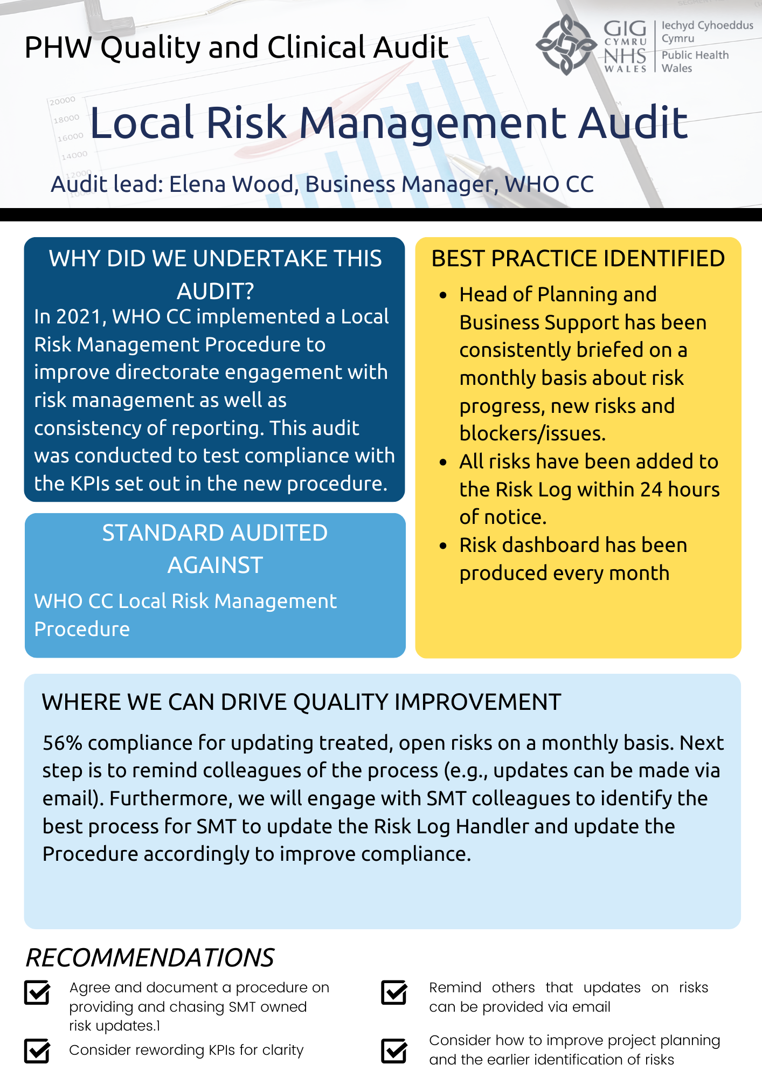
Quality and Clinical Audit
Deep Dive
10

Slide 13
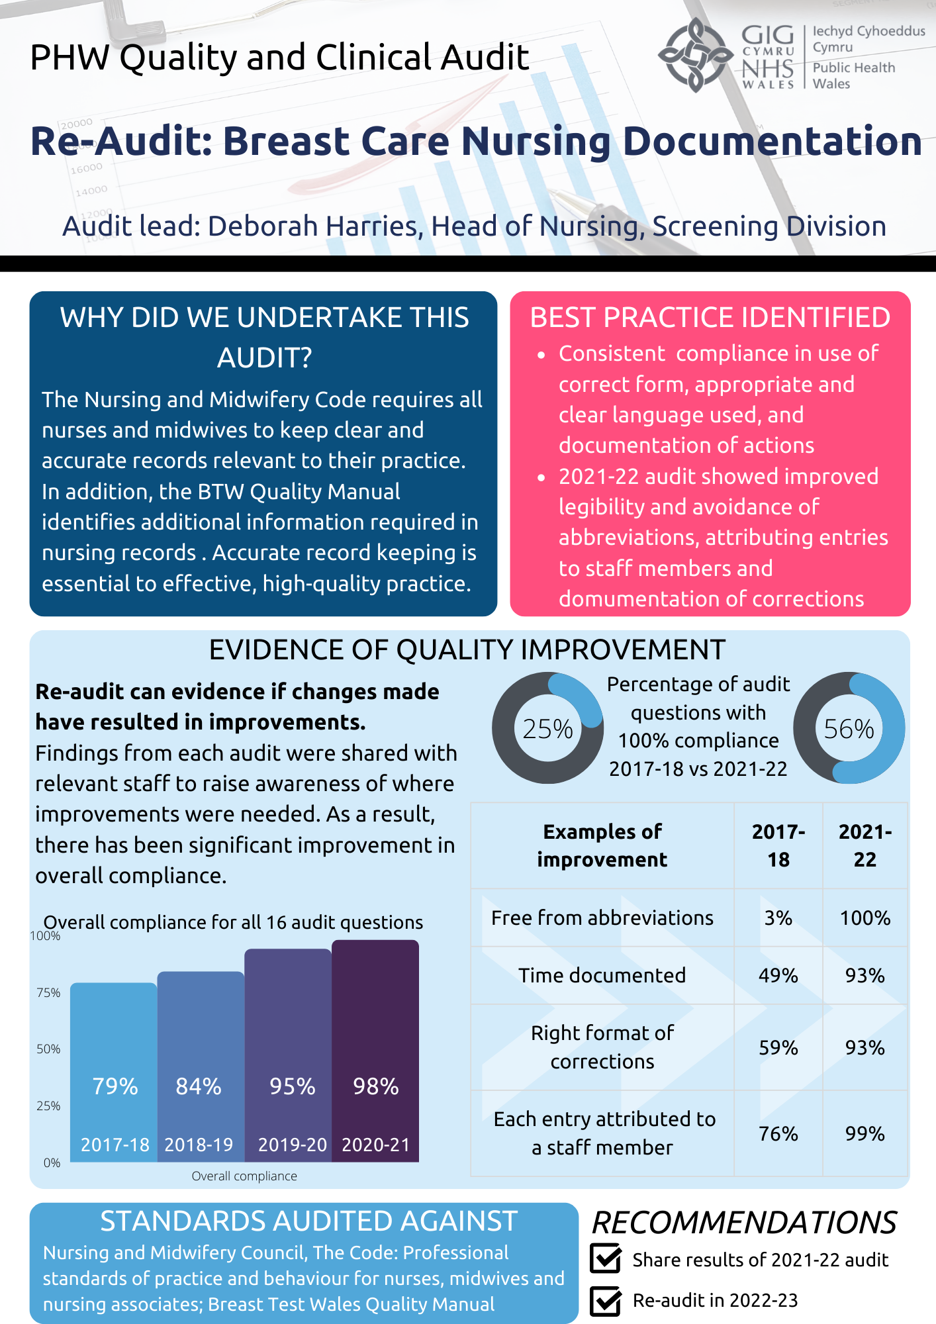
Quality and Clinical Audit
Deep Dive
11

