Slide 1
Infection prevention and Control Annual report 1 April 2019 -31 March 2020

Slide 2
Chapter | Contents | Page
 | Introduction | 2
Standard 1 | Appropriate Organisational structures and management systems for Infection Prevention and Control must be in place | 3
Standard 2 | The physical environment should be maintained and cleaned to a standard that facilitates IPC and minimises the risk of infection. | 4
Standard 5 | All staff employed to provide care in all settings are fully engaged in the process of IP&C. | 5
Standard 7 | Policies on IPC must be in place and made readily accessible to all staff | 6
Standard 8 | So far as is reasonably practicable, staff are free of and is protected from exposure to infections that can be acquired or transmitted at work | 7
Standard 9 | All staff are suitably trained and educated in IPC associated with the provision of healthcare. | 8
 | Priorities for 2020-2021 | 9

Slide 3
Introduction
In striving for excellence, Public Health Wales aims to have arrangements in place and to provide services which are safe and comply with best practice standards, for the benefit of those service users who need to access them.
Infection prevention and control is an integral part of services and functions provided and Public Health Wales is committed to ensuring that robust infection prevention and control systems and processes are operating within the organisation.
Our aim is to ensure that all steps are taken to prevent and minimise the spread of potential infection.

Slide 4
Standard 1
Appropriate Organisational structures and management systems for Infection Prevention and Control must be in place
On behalf of the Chief Executive Officer the Executive Director of Quality, Nursing and Allied Health Professionals provides the Executive lead role for organisational arrangements for Infection Prevention and Control, supported by the Assistant Director for Quality and Nursing and specialist knowledge provided by the Lead Nurse for IP&C.
The IP&C work plan is monitored by the IP&C cross organisational group, with exception reporting to the Business Executive Team and assurance reported to the Quality, Safety and Improvement Committee on compliance with the ‘Code’.
Policies and procedures relating to infection prevention and control have been reviewed and updated.
IPC incidents are reported on our Datix incident reporting system and reviewed at the IP&C Group.
Chief Executive Officer
Executive Director of Quality, Nursing and Allied Health Professionals.
Assistant Director of Quality, Nursing and Allied Health Professionals
Infection prevention and Control Lead Nurse

Slide 5
Standard 2
The physical environment should be maintained and cleaned to a standard that facilitates IPC and minimises the risk of infection.
Environmental cleanliness
Environmental cleanliness audits undertaken on a quarterly basis.
Where premises used by screening programmes are owned by Health Boards, validation audits were completed by the screening programs.
Escalation process developed to establish the suitability and cleanliness of the premises provided by the Health Boards
Decontamination:
The lead Nurse for Infection prevention and control represented Public Health Wales at the all Wales strategic decontamination Group.
Public health wales has been involved in gaining assurance for the effective decontamination of endoscopes for Public Health Wales Bowels Screening program. Annual validation reports continued during 2019-2020.
Water safety:
A rolling programme of water risk assessments established to assess water systems to safeguard against Legionella.
Inspection assessments undertaken at all premises (n= 14) where Public Health Wales staff are based and for which Public Health Wales has a statutory responsibility.

Slide 6
Standard 5:
All staff employed to provide care in all settings are fully engaged in the process of IP&C.
During 2019-2020 Microbiology laboratories underwent an annual audit inspection
The audit inspected aspects of infection, prevention and control, (including) daily cleaning schedule compliance, maintenance and cleaning of equipment, PPE compliance, and health and safety induction, understanding of needle stick inoculation procedure, eye wash location/expiry, autoclave inspection and registering understanding of key documents such as the health and safety policy and the spillage and disinfection policy.
All laboratories completed the internal 6 monthly laboratory audits and office audits.
Sealability testing completed by an external contractor with all laboratories passing.
Contingency plans to address reliability and access to autoclaves (containment level 3 room) put in place to respond to the possibility of site specific issues

Slide 7
Standard 7 :
Policies on IPC must be in place and made readily accessible to all staff
Public Health Wales use the electronic National Infection Prevention and Control Manual to ensure staff have access to consistent, current and standardised policies.
Rolling programme in place to review policies and procedures that are out of date. Core policies available on Public Health Wales intranet site for staff to access

Slide 8
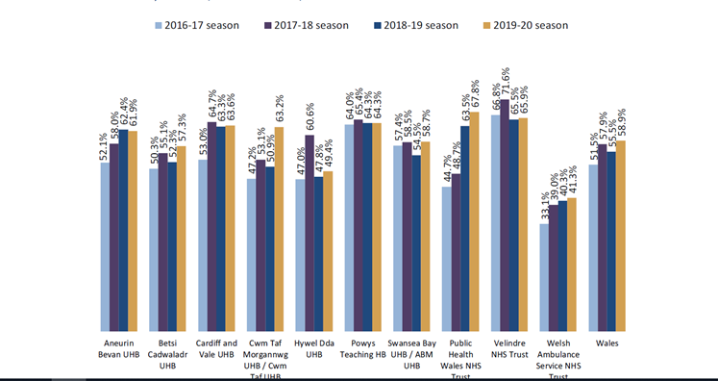
Standard 8:
So far as is reasonably practicable, staff are free of and protected from exposure to infections that can be acquired or transmitted at work
Influenza campaign was delivered via mixed model approach of using an in-house vaccination team which consisted of peer vaccinators and bank immunisers
Microbiology staff were able to access the vaccine through the occupational health department within the health board they are based
Public Health Wales had the best uptake of the vaccine within Wales, uptake of influenza vaccination in staff with direct patient contact exceeded the Welsh Government target of 60% and had the best uptake within recent years building on the improvement of every year

Slide 9
Standard 9:
All staff are suitably trained and educated in IPC associated with the provision of healthcare
Infection prevention and control e-modules were available to all staff for both level 1 and level 2. The Welsh Government target for e learning compliance is 85%, however, the Public Health Wales internal target is 95%. For the reporting period there was an increase in level 2 compliance and a decrease in level 1.
Aseptic Non touch technique (ANTT) is mandatory which is required to be completed by Breast Test Wales by all staff within screening who perform invasive procedures. There has been an increase in compliance.
 | 2018-2019 | 2019-2020
IPC Level 1 | 94.35 % | 82.4%
IPC Level 2 | 65.7 % | 79.26%
Aseptic Non touch technique (ANTT) | 67% | 75%

Slide 10
Next Steps
Priorities for 2020-2021.
Develop KPIs for inclusion in the organisation’s dashboard.
Continue the co-ordination and delivery of the internal staff flu programme to protect staff and achieve an uptake target of 75% for front line staff overall 70% uptake for the organisation.
Provide on-going advice to Public health wales staff especially front facing staff in relation to COVID 19 precautions
.
lead and coordinate in the infection prevention and control audit delivery programme.
Ensure all infection prevention and control policies/procedures/guidelines are current and relevant. To update the outbreak management policy and exposure injury policy.
Facilitate implementation of Aseptic Non Touch technique (ANTT) practice and assessment within Breast Test Wales.

