Slide 1
Mental Health
Knowledge, Research and Information Committee
5th March 2024
Jim McManus, National Director, HWB
Emily Van de Wenter, Mental Health and Communities Team. HWB
Alisha Davies, Head of Research and Development, Knowledge Directorate

Slide 2
Content
Section
1. Introduction - Jim
2. Research and Intelligence -Alisha
3. Health and Wellbeing – Emily/Jim
4. Conclusions - Jim

Slide 3
The PHW Role?
Prevention Pathway and Mental Wellbeing
Time
Primary Prevention
Secondary Prevention
Tertiary Prevention
Wider Determinants
The role of income, employment, housing, education, community infrastructure and wider environments
Psycho-social Determinants
Mental Wellbeing
(e.g. emotional literacy; self esteem; social relationships; resilience, trauma and discrimination), it’s determinants and influences on positive health behaviours and health outcomes
Commercial and Behavioural Determinants
Role of physical activity, sleep, diet alcohol and substance misuse, smoking, social media and commercial determinants
Early Detection and intervention
Action to address poor mental wellbeing and key risk factors - MECC, Social Prescribing, early intervention initiatives in MH services
Treatment and Care
Services & support for mental health conditions
Role for wellbeing interventions in tertiary prevention & supporting recovery
Health Equity

Slide 4
Understand and describe the issue – prevalence and size of the problem
What do we have in place
What are we developing
What do we need to develop
National Survey for Wales (WEMWBS)
Wellbeing of Future Generations Act National Indicators (Mental wellbeing, loneliness, Sense of Community)
School Health Research Network (SWEMWBS, SDQ, School Connectedness)
Increasing understanding of inequalities in mental and social wellbeing and barriers and facilitators to engagement with wellbeing-promoting activities (research with the Centre for Health Activity and Wellbeing Research)
National HIW work on children identified as having a mental health need and how they are supported
Mental health and wellbeing data profile for Wales
Single overview of the Mental Health of the Population of Wales across the Lifecourse
Clear data on the span from thriving to very unwell
A single shared system architecture of who does what

Slide 5





Section 2:
Children and Young People’s mental health and well-being programme
Professor Alisha Davies, Dr Annette Evans, Dr Catherine Foster, Dr Melda Lois Griffiths, Enfys Preece, Dr Giles Greene, Ashley Akbari, Professor Ann John
Notes:
Hello my name is Annette Evans, I’m a principal statistician in the R & E Division in PHW
Today I’m going to talk about…. (title)
And the consists of… Prof Alisha Davies… Prof Ann John (currently working at PHW and bringing her expertise on MH to the programme).

Slide 6
Section 2:
Children and Young People’s mental health and well-being programme
Professor Alisha Davies, Dr Annette Evans, Dr Catherine Foster, Dr Melda Lois Griffiths, Enfys Preece, Dr Giles Greene, Ashley Akbari, Professor Ann John
Notes:
Hello my name is Annette Evans, I’m a principal statistician in the R & E Division in PHW
Today I’m going to talk about…. (title)
And the consists of… Prof Alisha Davies… Prof Ann John (currently working at PHW and bringing her expertise on MH to the programme).

Slide 7

The mental health and well-being programme
3 research projects about children and young people in Wales age 11-24 years
exploring the lived experience of seeking and accessing support for mental well-being, mental health problems or crisis
investigating associations between population well-being and mental health diagnoses
understanding crisis presentation and routes to care
SAIL data linkage project Qualitative project in partnership SAIL data linkage project
health, care, ONS census and with the third sector health, care, ONS census and education data sets SHRN* data sets
* School Health Research Network survey
Public Health Wales
We exist to help all people in Wales live longer, healthier lives

Slide 8
Mental health crisis

Slide 9
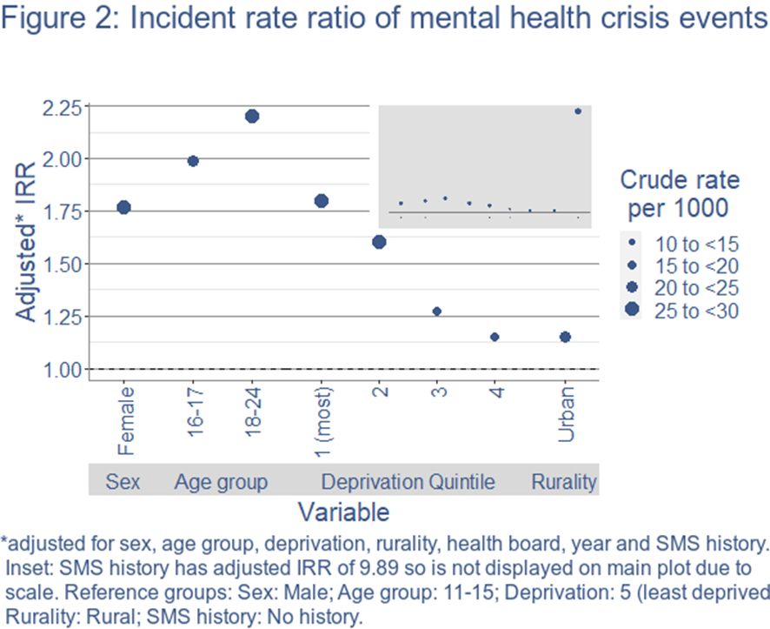
1. Understanding crisis presentation and routes to care
Building from a previous PHW project by the National Data Laboratory Wales
Children and young people's mental health: exploring presentation of 11-24 year olds in mental health crisis through linked routine health care data in Wales, 2016-2020
Mental health crisis event = presentation of mental health symptoms or associated behaviours requiring immediate treatment/care in an acute care service.
Over 51,000 events were found across ambulance attendances, A&E and emergency hospital admissions.
The largest risk factor for having a MH crisis event was previous history of referral or assessment within SMS, with an incidence rate ratio of 9.89 compared to those without a SMS history.
Risk of mental health crisis events was also associated with:
  being female
  older age groups of children and young people
  living in areas of higher deprivation
  living in an urban area.
Grimm F et al. Briefing: Improving children and young people’s mental health services. UK: Network Data Laboratory; 2022.
NDL Wales. The Networked Data Lab Wales: Children and Young People’s Mental Health Methodology. Wales: PHW Research and Evaluation Division; 2022.
Public Health Wales
We exist to help all people in Wales live longer, healthier lives
Notes:
Rates per 1,000 PYAR Stark contrast for socioeconomic inequalities:
If you would like to hear more the NDL can present their findings, these are just the highlights.

Slide 10
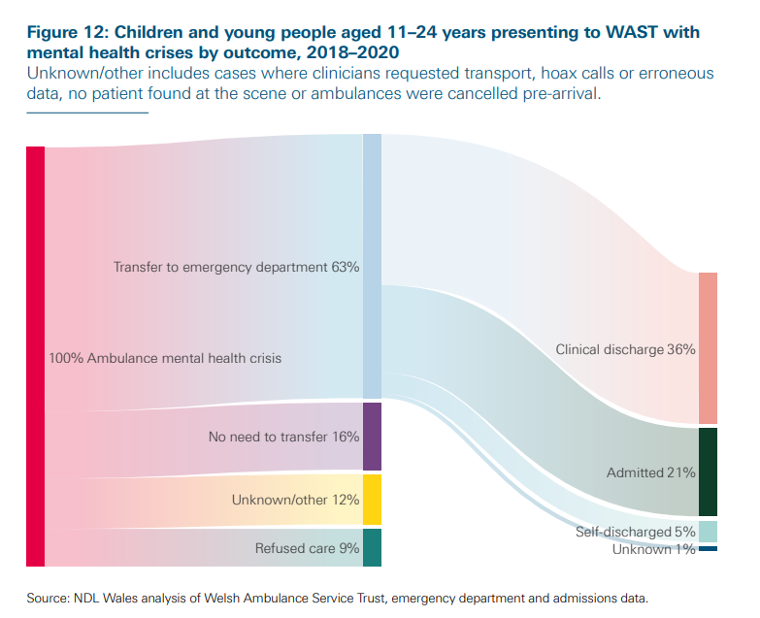
1. Understanding crisis presentation and routes to care
Building from a previous PHW project by the National Data Laboratory Wales
There were over 4,000 ambulance call outs related to mental health crisis between 2018-2020.^{1,2}
Of these:
  63% were transferred to the Emergency Department.
  21% went on to be admitted to hospital.
Impact:
WAST have since implemented new MH liaison posts in ambulance call centres.
Plans for this were in place before the work this with the NDL. However, people with specific experience of working with children and young people in crisis were recruited as a direct result of this work.
Grimm F et al. Briefing: Improving children and young people’s mental health services. UK: Network Data Laboratory; 2022.
NDL Wales. The Networked Data Lab Wales: Children and Young People’s Mental Health Methodology. Wales: PHW Research and Evaluation Division; 2022.
Public Health Wales
We exist to help all people in Wales live longer, healthier lives
Notes:
Sankey-Diagrams ‘a specific type of flow diagram, in which the width of the arrows is shown proportionally to the flow quantity’.
Uses a sub-section of cohort who presented to WAST in MH crisis.

Slide 11
1. Understanding crisis presentation and routes to care
Dr Annette Evans, Dr Lois Griffiths
What touchpoints with health and social care services do children and young people aged 11-24 years have ahead of mental health crisis?
Touchpoints
Investigation will also consider:
History of mental health diagnoses
Learning difficulties, special educational needs (SEN) at school or Additional learning needs (ALN) from 2021
Potential neurodiversity
NHS 111 press 2 services (urgent mental health services)
Potential inequalities
Household composition in the months prior to crisis (living alone or with family)
Deprivation (eligible for free school meals), ethnicity, Welsh speakers, urban or rural living, demographics (intersectionality)
Potential impact
Insight into characteristics of individuals who present to different services
Better understanding of those who have no touchpoints with services
Hospital admission, outpatients, emergency department
Receiving care and support
GP consultations & referrals
Substance misuse services
Public Health Wales
We exist to help all people in Wales live longer, healthier lives
Notes:
What happens to CYP in the years prior to MH crisis. Receiving care and support from the LA.

Slide 12
Together for mental health
- wellbeing focus

Slide 13
Wellbeing on a specific group – unpaid carers
A previous project in PHW
Used data collected in the 2016/17 National Survey of Wales (NSW), which was the most recently available national survey to collect self-reported information on both caring status and mental wellbeing.
Mental wellbeing was measured in the NSW using the self-reported Warwick Edinburgh Mental Well-being Scale (WEMWBS)
Overall, mental wellbeing decreased as the number of hours caring (caring intensity) increased.
Female carers were likely to provide higher intensity care than males, and were more likely to experience negative impacts of caring on self-reported mental wellbeing.
In the oldest age group (65+ years), those who provided high intensity care reported poorer mental wellbeing compared to those providing low intensity care.
Whereas, amongst the youngest unpaid carers (16 - 44 years) the impact on mental wellbeing was worse for those providing moderate intensity care, compared to low intensity care.
Unpaid carers who were not in employment and those with low level of education reported significantly lower mental wellbeing compared to unpaid carers in employment or with a high level of education.

Slide 14
2. Understanding associations between mental wellbeing and mental health
Predictors
Predictors
RQ3
Well-being
(SWEMWBS)
Mental health
(SDQ)
RQ1. Are there groups of young people with scores indicating poor wellbeing and/or mental distress who are not present in health data, when other groups with similar scores are?​
Association
RQ2
RQ2. Is there a correlation between self-reported wellbeing and mental distress scores?
RQ1
RQ1
RQ3. What level of overlap is observed between predictors of well-being and mental distress?
Predictors:
Age, sex, ALN, WIMD, ethnicity etc.
Primary, secondary and emergency care
Public Health Wales
We exist to help all people in Wales live longer, healthier lives
Notes:
3. Comparison with previous studies (Rees 2018; Patalay 2016; Lereya 2022)
Need for better data differentiating wellbeing and mental health, and greater understanding that initiatives aimed at improving wellbeing will not necessarily reduce mental health need and vice versa
RQ1. Goes beyond previous work by linking self-reported wellbeing (SWEMWBS) and mental distress (SDQ, sMFQ) by associating with healthcare use
RQ2. Studies using Millennium Cohort Study and survey data (Patalay, 2016; Lereya 2022) suggest there is some correlation (r=0.2-0.48) between mental wellbeing and mental health
RQ3. There are also individual predictors (family income and cognitive ability predict mental health only)
This study goes from the School Health Research Network (SHRN) survey to electronic health and education records

Slide 15
2. What are we hoping to achieve?
Wider Aims
Shape services that are fit for purpose – avoid implementation of wellbeing initiatives to those experiencing mental distress/illness
Family affluence/deprivation is associated with mental health and wellbeing inequalities, but what are inequalities in access to health care evident?
Use of linked data analysis to identify clusters of young people most likely to require healthcare for mental illness symptoms, i.e., of those who have low wellbeing scores and high mental distress scores – who will require healthcare intervention?
Public Health Wales
We exist to help all people in Wales live longer, healthier lives
Notes:
Beyond the obvious – deprivation, poor relationships with family, substance misuse

Slide 16
Seeking and accessing support
- qualitative project

Slide 17

3. Exploring the lived experience of seeking and accessing support
Dr Melda Lois Griffiths, Dr Diana Bright, Enfys Preece & Hannah Spacey
What are the key characteristics of 18-25 year olds' perspectives and experiences of seeking and/or accessing mental health support across various settings in Wales?
Aims to explore:
Barriers and facilitators to accessing support
Helpful and less helpful characteristics of the support accessed
Motivations for choosing certain sources of support
Experiences of transitions across or within services
Awareness of support options, and how this is developed
Young people's suggestions for improvement
Methods:
~50 minute semi-structured interviews with 20 young people
Primarily recruited via the third sector, educational settings & social media
Sampling framework developed to achieve representation across ages, genders, deprivation quintiles, urban/rural settings, types of support sought and across individuals that accessed / did not access the support sought.
Target numbers for representation from priority groups - members of BAME communities, individuals that identify as LGBTQ+, and Welsh speakers.
Public Health Wales
We exist to help all people in Wales live longer, healthier lives
Notes:
Data linkage can only tell us about individuals that are known to health services - what about those that are lost to the system or seeking help elsewhere? This third component was designed to inform and complement the linked data components of the programme & explore young people (18-25)’s experiences of seeking and/or receiving mental health support across diverse settings in Wales.
Potential for impact: Hearing about lived experiences will enhance our understanding of what's behind the numbers, highlighting key areas where barriers to accessing services are introduced, and potential solutions. Particularly as young people are asked at the end of the interview to offer their suggestions for improvement. Project team have met with Welsh Gov's Children and Young People working group of the disability rights taskforce to share findings and discuss how they can be applied. Similar engagement could be arranged for groups focused on the study's other target groups.
Aims (slide)
Methods (slide)
Analysis:
Analysis underway, with early themes including:
Individuals coming back to services with worsened mental health after failing to access the support needed prior, or after negative experiences with services causing hesitancy in approaching them again
Lack of leniency and understanding of complex needs when young people miss appointments with services. Recommend text reminders etc.
Siloed working and inconsistent follow up processes mean people are left without the support needed and lack of clarity on next steps.
Importance of offering support in different ways – face to face sessions not accessible to everyone but in the same vein, remote sessions are problematic for others (e.g. those in abusive homes). Text based services work for some but not all.
Issues with accessibility for neruodivergent / disabled individuals (accessing support would be easier if adjustments were made that were suited to their needs; problems of being referred to services without disabled access etc).
LGBTQ+ individuals facing lack of awareness and sensitivity to their unique experiences, and sometimes report feeling unable to be their authentic selves in sessions as a result.
(Note. Exclusion criteria include individuals that are not able to complete interview in English or Welsh; sought mental health support more than 5 years ago; undergoing an acute mental health crisis requiring urgent help (e.g. feeling extremely anxious and having panic attacks or flashbacks; feeling suicidal, self-harming; episode of hypomania or mania or psychosis); not able to understand the specific circumstances and details of the research being proposed to be able to provide consent)

Slide 18
Involving young people in our research
Interpretation of findings and co-design of outputs – Enfys Preece
We will conduct a rapid review on best practice for co-production both with young people and in mental health to inform our strategy.
Qualitative Project: use co-analysis with young people to finalize themes from our initial codes; and co-produce an output targeted towards young people
Mental health crisis project: involve young people at data analysis stage.
Mental health well-being project: Engagement throughout analysis, interpretation and dissemination stage. Co-design of outputs
Public Health Wales
We exist to help all people in Wales live longer, healthier lives
Notes:
It can be for the whole project or stages of the project.
PPIE – Patient and public involvement and engagement
Stakeholder advisory group - Multiple sectors to consider for children and young people’s mental health
The programme is in the process of establishing an advisory group for the work containing members from sectors such as:
Welsh Government, CAMHS / AMHS, Emergency Services, GP, Social services/social care, Education, Academia, Third sector mental health organisations

Slide 19
Section 3:
Health and Wellbeing Directorate Action and Cross-System Programmes
Emily van de Wenter and Team
Notes:
Hello my name is Annette Evans, I’m a principal statistician in the R & E Division in PHW
Today I’m going to talk about…. (title)
And the consists of… Prof Alisha Davies… Prof Ann John (currently working at PHW and bringing her expertise on MH to the programme).

Slide 20
The PHW Role?
Prevention Pathway and Mental Wellbeing
Time
Primary Prevention
Secondary Prevention
Tertiary Prevention
Wider Determinants
The role of income, employment, housing, education, community infrastructure and wider environments
Psycho-social Determinants
Mental Wellbeing
(e.g. emotional literacy; self esteem; social relationships; resilience, trauma and discrimination), it’s determinants and influences on positive health behaviours and health outcomes
Commercial and Behavioural Determinants
Role of physical activity, sleep, diet alcohol and substance misuse, smoking, social media and commercial determinants
Early Detection and intervention
Action to address poor mental wellbeing and key risk factors - MECC, Social Prescribing, early intervention initiatives in MH services
Treatment and Care
Services & support for mental health conditions
Role for wellbeing interventions in tertiary prevention & supporting recovery
Health Equity

Slide 21
Understand and describe the issue – prevalence and size of the problem
What do we have in place
What are we developing
What do we need to develop
National Survey for Wales (WEMWBS)
Wellbeing of Future Generations Act National Indicators (Mental wellbeing, loneliness, Sense of Community)
School Health Research Network (SWEMWBS, SDQ, School Connectedness)
Increasing understanding of inequalities in mental and social wellbeing and barriers and facilitators to engagement with wellbeing-promoting activities (research with the Centre for Health Activity and Wellbeing Research)
National HIW work on children identified as having a mental health need and how they are supported
Mental health and wellbeing data profile for Wales
Single overview of the Mental Health of the Population of Wales across the Lifecourse
Clear data on the span from thriving to very unwell
A single shared system architecture of who does what

Slide 22
Mental wellbeing in Wales
What do we know? – Children and Young People
School Health Research Network Survey
Mean wellbeing scores for young people aged 11-16 show declining mental wellbeing and life satisfaction
Mean SWEMWBS scores: 2019/20: mean=24, 2021/22: mean=23
  Lowest among those self-identifying as “neither boy or girl” (mean = 18 in 2021/22)
Life satisfaction:
  85% scored 6 or over in 2017/18, 78% 2021/22.
  Higher in boys (85%) than girls (74%)
  Lowest in young people self-identifying as neither boy or girl (43%)
  Mental wellbeing and life satisfaction decline with increasing age and lower family affluence
Adults

Slide 23
Mental wellbeing in Wales
What do we know? - Adults
National Survey for Wales – declining mental wellbeing
Mean WEMWBS: 52 in 2018/19 to 48.2 in 2022/23
  Lower in adults aged 16-24yr (47), people in “bad/very bad” health (39), and people who are lonely (39)
Population surveys (June 2023) - “Value-action” gap
69% (TTPH survey) / 58% (Wales Omnibus) of people strongly agree it’s important to take action for mental wellbeing
43% (TTPH Survey) / 31% (Wales Omnibus) strongly agree they know what actions to take
  lowest in 16-24yr olds (19%), DE social grade (24%) and Welsh speakers (27%) (Wales Omnibus)
31% strongly agree they are able to find the time to do the things that matter for their mental wellbeing
14% (TTPH survey) / 21% (Wales Omnibus) report taking no action for their mental wellbeing
  highest in males >45yrs (34%) and The Valleys (26%)
Sources: Time to talk PH (TTPH) survey Wales Omnibus survey (both June 2023)

Slide 24
Understand the evidence base for action
What do we have in place
What are we developing
What do we need to develop
What Works Toolkit – collection of evidence summaries for school level interventions and approaches to improve mental wellbeing
Evidence-based content for the Hapus website
Expanding interventions and approaches within the What Works Toolkit
Evidence reviews on psychological and emotional components of mental wellbeing
Opportunities for research funding and learning with Hapus partners
Increase understanding of the determinants of increasing distress in children and young people

Slide 25
Delivery at Scale; Monitoring and Evaluation
What do we have in place
What are we developing
What do we need to develop
Continuous improvement tool for schools
Monitoring dashboard for implementation of WSAEMWB
Realist process evaluation on the implementation of Whole School Approaches to Emotional and Mental Wellbeing (WSAEMWB)
Evaluation framework for the Hapus Strategic Partnership
Evaluation framework for the Hapus National Conversation
Population dashboard for mental health and wellbeing

Slide 26
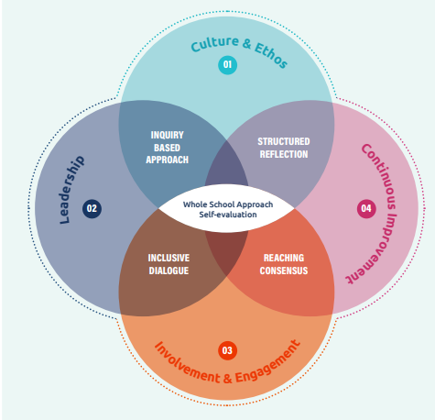
Supporting the system to out evidence-based approaches into practice
Whole school approaches to emotional and mental wellbeing
Plan
Study
Act
Do
National evaluation and improvement action
  Realist process evaluation approach for evaluating roll-out of whole-school approaches to emotional and mental wellbeing
  ADEPT course for school-facing workforce to build knowledge, skills and confidence in supporting schools to use data and evidence
School level evaluation and improvement action
  Guidance, self-evaluation tool, learning reports & evidence summaries
Plan
Study
Act
Do

Slide 27
Supporting the system to out evidence-based approaches into practice
Hapus – protecting and promoting mental wellbeing
Evaluation and improvement action
  R&E division leading formative evaluation of 1) the national conversation and 2) Hapus Strategic Partnership
  PHW commissioned research on barriers and facilitators to engaging with wellbeing-promoting activities and assets, to be used to inform future partnership action
  Supporting partners to evaluate wellbeing outcomes
  Collaboration with academics to share knowledge across the partnership
  Cross-organistional bids for research funding which address shared priorities

Slide 28
Section 4:
Conclusions
Jim McManus
Notes:
Hello my name is Annette Evans, I’m a principal statistician in the R & E Division in PHW
Today I’m going to talk about…. (title)
And the consists of… Prof Alisha Davies… Prof Ann John (currently working at PHW and bringing her expertise on MH to the programme).

Slide 29
Support the development of policy and strategy to address the determinants
What do we have in place
What are we developing
What do we need to develop
Draft Mental Health and Wellbeing Strategy (consultation launched 20th February 2024)
Working with Welsh Government to shape the delivery plan for the MH&WB strategy
Cross organisational public health approaches
Single overview of the Mental Health of the Population of Wales across the Lifecourse
Clear data on the span from thriving to very unwell

Slide 30






Being clear about our offer across the lifecourse and how we monitor it?
Life Stage | Prenatal/ pregnancy | Early Childhood | School Age | Transition to Adulthood | Adulthood | Ageing
What is the PHW Role?
What gaps are there?

Slide 31
Diolch

