Slide 1

AI in health and care in Wales
KRIC December 2022
Louisa Nolan, PHW, Head of Data Science
This Photo by Unknown Author is licensed under CC BY-SA-NC

Slide 2

Purpose
Provided to the KRIC Committee for information, to present the findings of the review that has taken place into AI health and care in in Wales
Seek comment and input on the next steps for Public Health Wales.

Slide 3
Commissioned by the Chairs of PHW, DHCW, HEIW
The goals of the review were to:
  understand what AI has been implemented / is being tested / has been tried in health in Wales
  review exemplars of AI in health outside Wales
  understand the opportunities and barriers to the further adoption of AI in health in Wales
  make recommendations for the future of AI in healthcare in Wales

Slide 4
Types of AI
Text
Visual
Analytical
Interactive
Internet of things
Speech-to-text
Classification / coding
Find similar topics
Augmented reality
Images / video-to-data
Wearables
Robots
Prediction
Risk analysis
Classification
Sensors
Chatbots
Smart personal assistants
Artificial intelligence is:
  the simulation of human intelligence processes by machines, especially computer systems
It can:
  speed up operations
  improve operational quality
  improve decision-making
  save money

Slide 5
Where are we now?

Slide 6
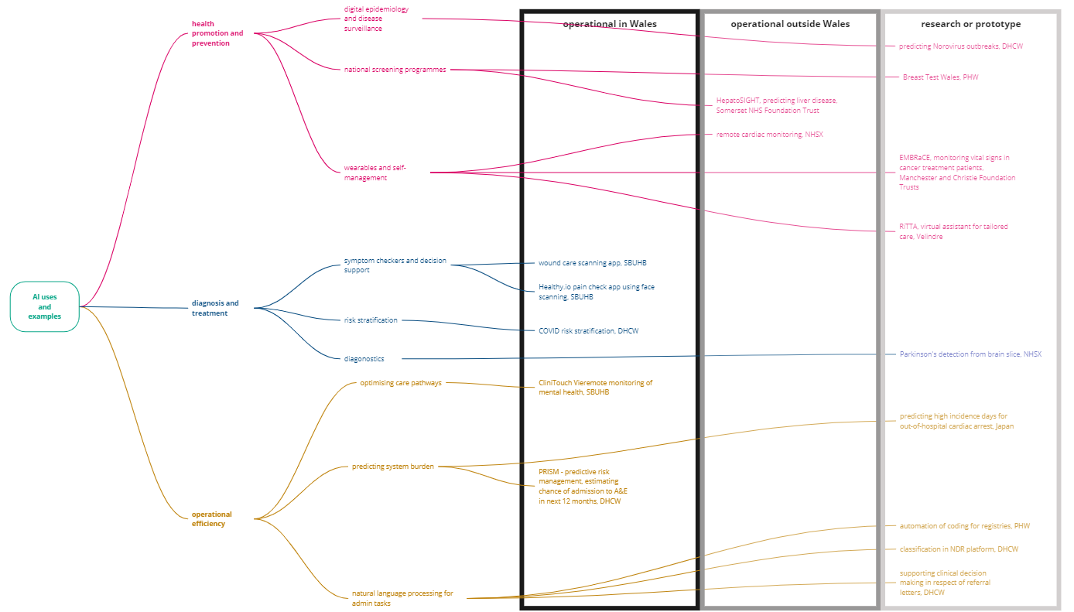
What can AI do in health and care?
Case studies

Slide 7
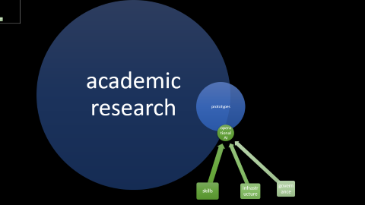
academic research
prototypes
operational AI
skills
infrastructure
governance

Slide 8
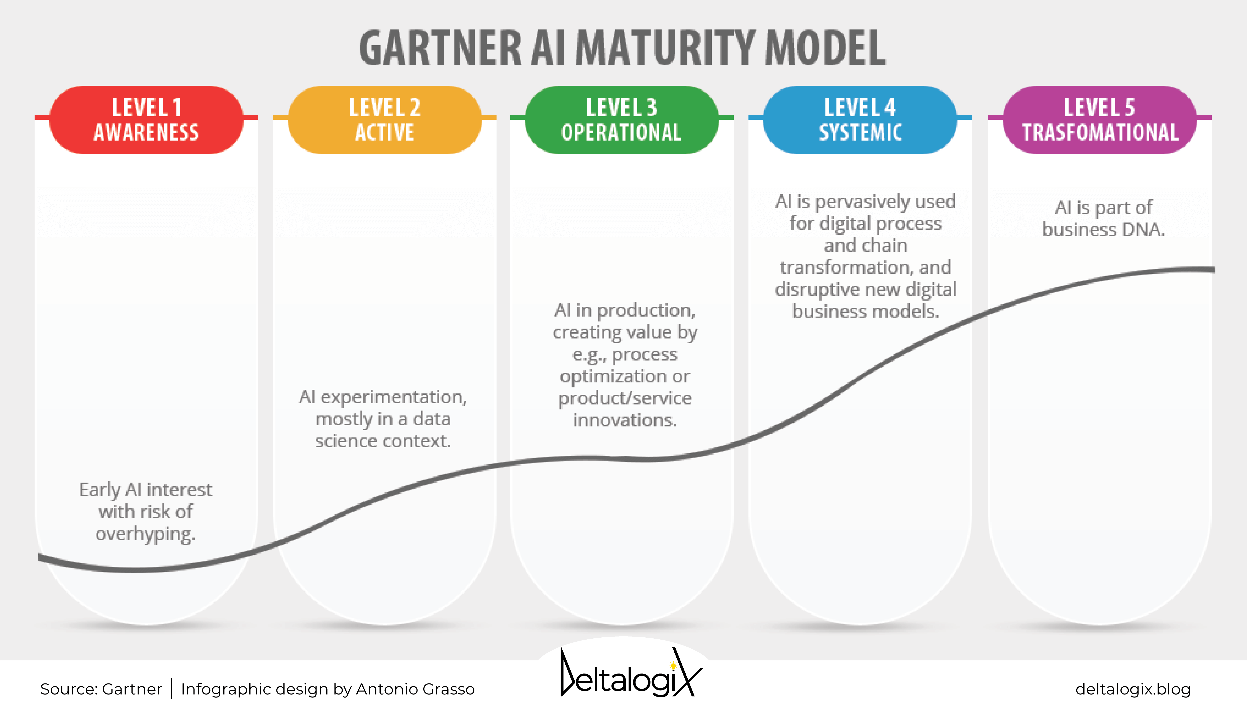
AI maturity in health and care in Wales
We are here

Slide 9
What are the barriers to increasing AI maturity?
What can be done to address them?
What more could be done to address them?

Slide 10
What are the barriers to AI adoption?
Lack of skills to identify, evaluate and implement solutions
  Digital and AI procurement
  User research, service design, digital product delivery etc (Digital, data and technology professions, DDAT)
  AI, digital and data literacy, especially in senior leaders and decision-makers
Digital and data maturity still a work in progress
  Legacy, often proprietary systems
  Lack of interoperability, and of consistent data and digital standards and governance
  Lack of access to primary care data, except in research environment
There is a gap between research and prototyping, and implementation into operation
  Many research and prototype projects, far fewer translate into operation
  The skills required to operationalise products are different from the skills required for research and prototyping
  Research platforms are not suitable for operational deployment
  Regulation is behind the technology, and legal accountability for clinical devices using AI is uncertain, leading to uncertainty around corporate risk
Lack of an AI strategy for health and care in Wales
  No strategic case for AI made
  No roadmap

Slide 11
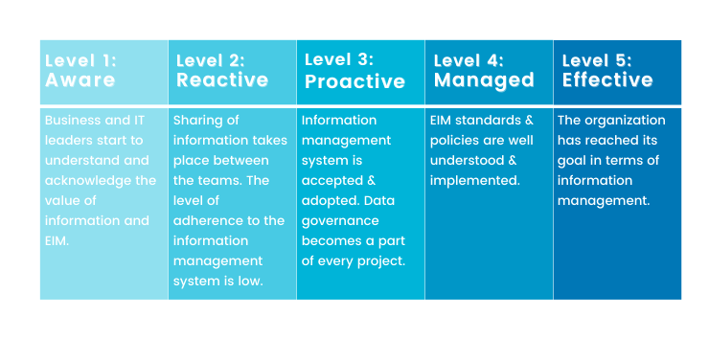
Gartner data maturity model
We are here

Slide 12
What is already being done to address these barriers?
Lack of skills to identify, evaluate and implement solutions
  DDAT professions and skills mapping to NHS bands by DHCW will enable recruitment and retention of much-needed DDAT skills
  WG funded degree-level software engineering apprenticeship & ONS data science graduate programme are available & there is some take-up e.g. PHW
  A review of the health informatics apprenticeship by HEIW is underway
  There is growing strength in digital leadership
Digital and data maturity still a work in progress
  National Data Resource platform and associated work programme, including data discovery is designed to address many of the issues
There is a gap between research and prototyping, and implementation into operation
  There is a growing set of examples of successful implementation of AI solutions across the UK and more widely to draw from
  The NDR platform will facilitate both research and operations
  A growing set of organisations in Wales to support AI adoption for example, the Life Sciences Hub, Tec Cymru, Centre for Digital Public Services, Health Technology Wales
  There has been significant work on ethics and consent, including WAST’s work with the ICO ‘s AI specialist team
  Many AI use cases, including all those currently deployed, are not defined as clinical devices, but are operational, or support human-in-the-loop decision-making, avoiding the issue of lack of regulation for clinical devices, and falling within current corporate risk appetites
Lack of an AI strategy for health and care in Wales
  Welsh Government, DHCW, PHW and the Welsh Institute for Digital Information have begun collaboration on a strategic vision and recommendations for AI in Wales, aligning with the Digital Health and Social Care Strategy refresh

Slide 13
What else could be done to address these barriers?
Lack of skills to identify, evaluate and implement solutions
  Seek to embed digital and data literacy across all NHS Wales professions, and as an expectation for leaders
  Create professional standards, competency frameworks and career pathways for the DDAT professions in NHS Wales – including user researcher and service design, which are critical to successful implementation
  Consider creating an AI in health and care seminar series or conference, to facilitate knowledge sharing and innovation across and beyond Wales
Digital and data maturity still a work in progress
  Create strong AI, data and digital standards, governance, and supporting training, to ensure good practice and regulatory understanding which facilitates technological innovation and trust. This should be owned by the NHS Exec
  Take a strategic approach to accessing primary care data, led by NHS Exec, and backed up by robust data governance

Slide 14
What else could be done to address these barriers?
There is a gap between research and prototyping, and implementation into operation
  Ensure that clinical staff are involved in development from the start. Strong user engagement is the key to successful implementation
  Map out the support already available from the various digital organisations, and create a roadmap for those considering implementing AI, for each step of identifying opportunities, developing and implementing AI
  Systematically promote funding opportunities, and the outcomes from the awards, including AI in Health and Care Awards (£250 million over 4 years), TriTech’s technology challenge (£80,000). AI in health and care award winners have been implemented in 1 Trust in Wales, 6 in Scotland and 20% of NHS Trusts in England
  Assess the feasibility of extending the services of the Multi-Agency Advisory Service for Artificial Intelligence (MAAS) into Wales, They have developed a valuable resource collating guidance including guidance on regulations, for adopters and producers of AI in health and care, and have an important role to play in addressing challenges around corporate risk appetite
  Seek opportunities to champion the need for better regulation of AI clinical devices. This is likely to be a lengthy process.
  Focus on bringing in AI solutions already tested and in use elsewhere, through collaborative development with end users
Lack of an AI strategy for health and care in Wales
  Incorporate these findings into the visions and recommendation for AI in Wales
  Ensure a robust economic case is made, demonstrating potential for invest to save, operationally and through improved health outcomes
  Build evaluation into the strategy, so that benefits are measurable

Slide 15
Next steps

Slide 16
Next steps
Set out the requirements for an AI strategy, based on this review
  complete by end 2022
  present to Minister
Work with:
  Welsh Government (Digital Strategy, Innovation, Social Care)
  Wales Institute of Digital Information (commissioned by DCHW to explore this topic)
  wider stakeholders
Incorporate into WG plans on AI strategy / roadmap for Wales

Slide 17
Questions
What other examples are there of AI in health and care?
What other challenges do we face?
What would help to facilitate an increased use of AI to improve quality and operations in health and care?

Slide 18
Annexes

Slide 19
Annex A: Who is involved?
Welsh Government
Public Health Wales
Digital Health and Care Wales, and the National Data Resource
Health Boards
Health Education and Improvement Wales
Digital Health Ecosystem Wales
Tec Cymru
Health Technology Wales
Wales Data Nation Accelerator
National Clinical Framework and D2K
Life Sciences Hub, and the AI Special Interest Group
The Multi-Agency Advice Service
Alan Turing Institute
Welsh academia including the SAIL Databank
AI in Health and Care Awards
NHSX
Private sector including Palantir
Government Digital Service
Spread and Scale Academy
Bevan Commission
Centre for Digital Public Services
Respiratory Innovation Wales
Wales Institute of Digital Information

Slide 20
Annex B: examples of AI in health and care
Case studies – note that this is not a census of all activity, in Wales or more widely
  predicting Norovirus outbreaks, DHCW
  Breast Test Wales, PHW
  HepatoSIGHT, predicting liver disease, Somerset NHS Foundation Trust
  remote cardiac monitoring, NHSX
  EMBRaCE, monitoring vital signs in cancer treatment patients, Manchester and Christie Foundation Trusts
  RiTTA, virtual assistant for tailored care, Velindre
  wound care scanning app, SBUHB
  Healthy.io, pain check app using face scanning, SBUHB
  COVID risk stratification, DHCW
  Parkinson's detection from brain slice, NHSX
  CliniTouch Vie, remote monitoring of mental health, SBUHB
  predicting high incidence days for out-of-hospital cardiac arrest, Japan
  PRISM - predictive risk management, estimating chance of admission to A&E in next 12 months, DHCW
  automation of coding for registries, PHW
  classification in NDR platform, DHCW
  supporting clinical decision making in respect of referral letters, DHCW
Reviews and awards for AI in health and care
  Digital and AI technologies for cancer care: current examples, Moondance Cancer Initiative, Gregory, March 2022
  Tritech competition winners set to drive innovations in health and social care | Digital Health Wales
  AI in health and care award - 79 innovations with £90 million, Swansea University on the evaluation advisory group. The AI Award is part of the £250 million NHS AI Lab aimed at improving the health and lives of patients.
  Public Health Wales Screening Division, opportunities for AI, 2019
  NHSX AI Skunkworks programmes – 5 case studies

