Slide 1
Towards a Public Health Wales Research & Evaluation Strategy
Iain Bell
21st September 2022

Slide 2
“Why value / do research?”
Core function of public health​
Evaluate and conduct research is a defined function of Public health Wales outlined in legislation ​
Core function of IANPHI "Public health Institute” - and highlighted in IANPHI review of PHW 2019(?)​
“Evaluation and analysis of health status; Public health research”​
Learning and developing organisation – research => better care, better recruitment and retention, Transforming public health ​
Eg here with focus on “health care” settings NIHR; or Academy of Med Sciences (innovation report Jan 2020)

Slide 3
To support the development of the strategy we have
Undertaken a research mapping exercise across Public Health Wales​
Undertaken user research with users of our data and evidence products​
Undertaken research priorities questionnaires with stakeholders​
Reviewed/reflected on 2019/25 PHW R&E Strategy ​
We will, in future, assess the academic public health research landscape but this is not in scope just now

Slide 4
Research mapping

Slide 5

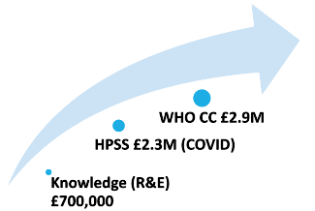
RESEARCH SPEND 2016-2021​
INTERNAL SPEND ~£750,000
(hard to discern exact amount)
EXTERNAL INCOME ~£6 Million

Slide 6
RESEARCH ACTIVITY BY DIRECTORATE 2016-2021
HPSS, WHO CC & KNOWLEDGE (R&E) MOST ACTIVE
WHO CC and R&E have formed service/academic models and collaborations with welsh universities – Bangor and Swansea, and others
WHO CC well funded to deliver programme of work - service evaluation/ literature review type ‘research’ and funding streams outside of health (police force funding streams etc)
R&E collaborating in the population health/inequalities system arena – Health Foundation (NDL etc)/ NCPHWR
HPSS – Handful of researchers bringing in larger pots – Chris Williams/Josie Smith/Tom Connor/ Lim Jones/ Rachel Chalmers

Slide 7
Conclusions
Our research activity mirrors the profile of the researcher
There’s no visible map between PHW priorities and our research
We are very diverse and our work covers the remit of many of the research: ESCR, MRC, BBSRC, STRC, NERC, Innovate UK and to a lesser extent AHRC
We will never be a research funder but:
  Should we fund more ourselves?
  We need to influence the funders to fund our priority areas?
  Fit-for-purpose governance beyond just HCRW/MRC work

Slide 8
User research

Slide 9
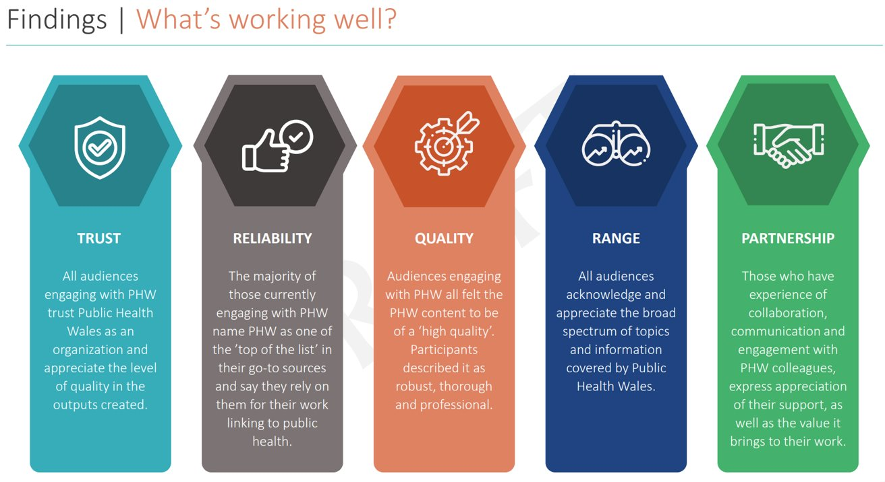

Slide 10
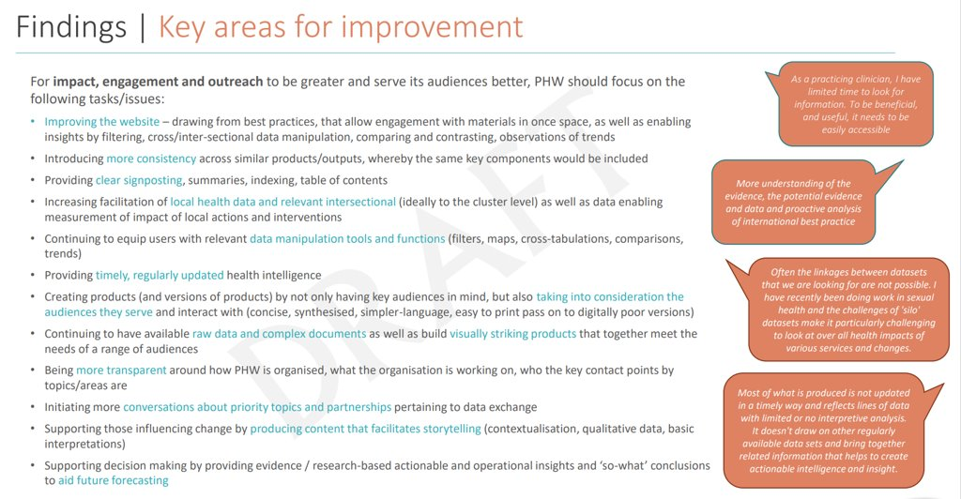

Slide 11
User priorities

Slide 12
Key findings​
Unclear how all our work fits together​
Alignment with Government priorities​
Equality and protected characteristics are vital​
A greater focus on evaluation, impact and service delivery – the “how?” and “why?” change achieved or not​

Slide 13
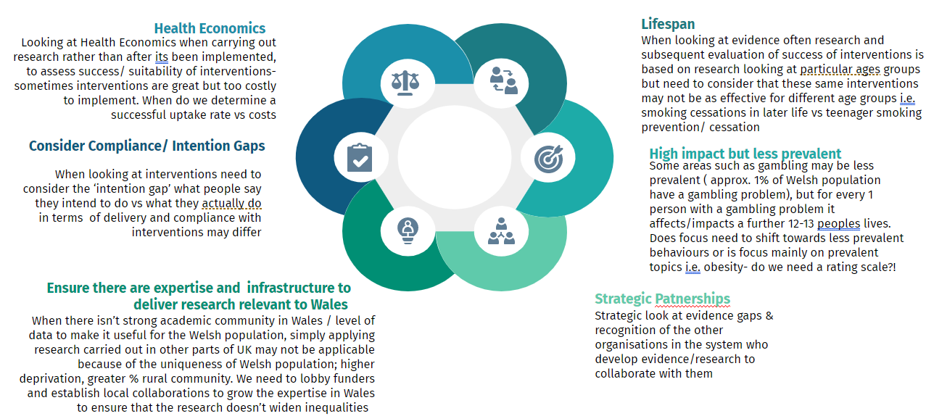
Considerations for research strategy​

Slide 14
So what might this mean for our strategy

Slide 15
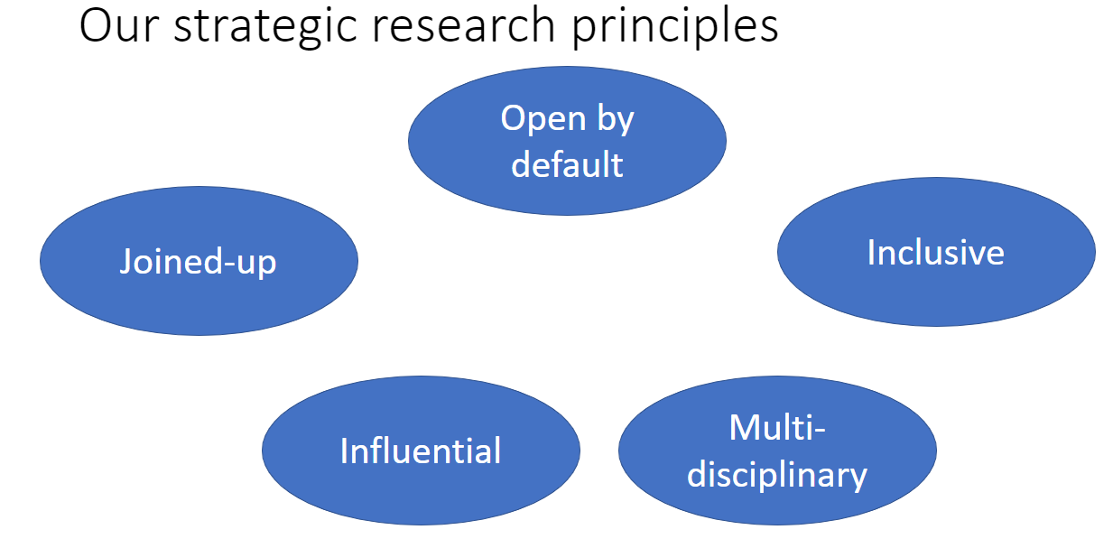

Slide 16
Open by default​
Open about our priorities​
Develop and share areas of research interest within and external to PHW​
Publish outputs targeted to user needs​
Be clear about what we are leading/supporting ourselves​
Open with the public about what we are doing​
Open about our methods, ​
Open data or TREs​
Open source​
Replicability​
Open on non-findings

Slide 17
Inclusive
Co-design with communities when working with them​
Ensure we capture and are representative of all areas of society​
Capture equalities information systematically to enable evaluation​
Work with communities to reach out and include those whose trust we don’t have

Slide 18
Multi-disciplinary
Celebrate the breadth of our agenda from microbiology and pathogen genomics to panel surveys and everything in between​
Pull together the skills we need and the diverse expertise across PHW and externally where there are gaps​
Statistical design​
Subject matter expertise​
Bioinformatics​
Evaluation methods​
Economics​
Questionnaire design​
And much, much more​
Integrated model of R&E development and delivery which achieves joint success

Slide 19
Joined-up
Common standards for PHW products​
A coherent and comprehensive package of research​
Partnering with others to deliver​
Academics​
Local Health Boards​
Third sector​
Local Authorities

Slide 20
Influential
Influencing funders to address evidence gaps/R&E needs for pop health ​
A stronger focus on “what works” for who in the population and why ​
Be clear on actions and what could be done to improve things​
Support effective operational delivery​
Concrete and implementable conclusions and findings​
Identify audience and deliver products that maximise impact for that audience

Slide 21
Implications
Need further work on our priorities​
Research governance will need to be strengthened​
Integrated with corporate, finance (eg grant management), legal, information, data governance….ethics? ​
Data infrastructure/TRE to enable access to data for research(when appropriate)​
Enabling model/approach to support multi-dis teams R&E inc external partners (ie hon contracts, partnerships, staffing models)​
Need to develop an influencing network on funders​
A fundamental culture shift from behind closed door research to an open-by-default policy​
Developing blog space with Comms for this​
Effective links to public involvement/co-production ​

Slide 22
Next steps
Further discussion amongst executives on priority areas​
Discuss with research teams for input​
Iterate and develop in line with long-term strategy​
Discuss with stakeholders

